Slide 1
ECEN 460 Power System Operation and Control
Lecture 2: Introduction, Power Grid History
Prof. Tom Overbye
Dept. of Electrical and Computer Engineering
Texas A&M University
overbye@tamu.edu

Slide 2
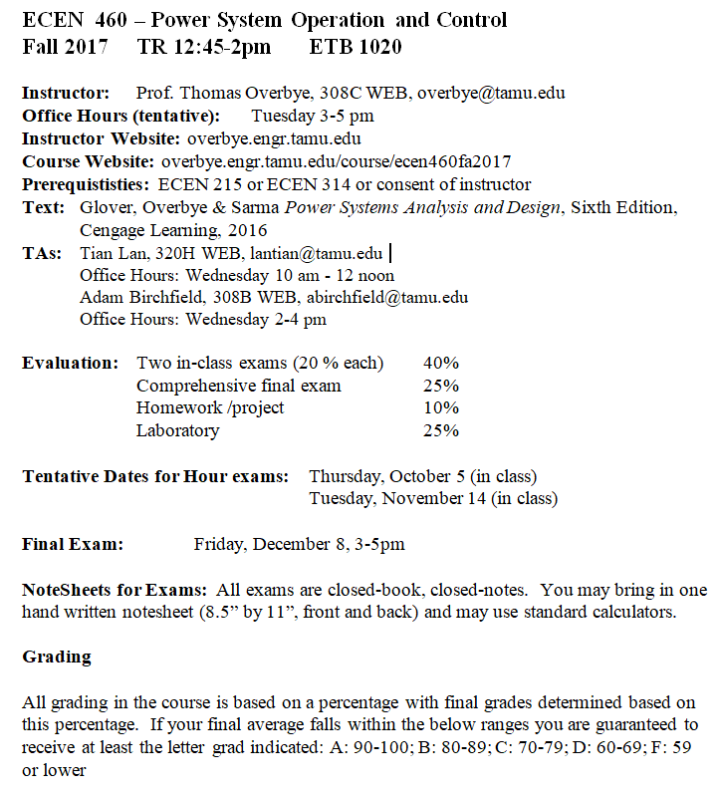
Syllabus
Slides will be posted before each lecture on the website

Slide 3
Course Topics
Introduction and review of phasors & three phase
Transmission line and transformer modeling
Models for generators, and loads
Power flow analysis and control
Economic system operation/restructuring
Power system stability
Distribution systems
Emerging topics

Slide 4
Announcements
Please read Chapters 1, 2
HW 1 is 2.9, 22, 28, 43, 48; due Thursday 9/14
Regular problems (not multiple choice)
Labs will start next week (Sept 11)

Slide 5
About Me
Professional
Received BSEE, MSEE, and Ph.D. all from University of Wisconsin at Madison (83, 88, 91)
Worked for eight years as engineer for an electric utility (Madison Gas & Electric)
Was at UIUC from 1991 to 2016, doing teaching and doing research in the area of electric power systems
Joined TAMU in January 2017
Developed commercial power system analysis package, known now as PowerWorld Simulator. This package has been sold to about 600 different corporate entities worldwide
DOE investigator for 8/14/2003 blackout

Slide 6
Research Group, Fall 2017

Slide 7
About Prof. Tom Overbye
Nonprofessional
Married to Jo
Have three children
Tim age 22
Hannah age 20
Amanda age 18
We’ve homeschooled our kids all the way through, with Tim now in his last year at UIUC in ME and Hannah in her third year in psychology, and Amanda is just now starting at Belmont
Attend Grace Bible Church in College Station

Slide 8
About TA Adam Birchfield
From Easley, South Carolina, USA
Education:
Ph.D. (in progress), Texas A&M University
M.S., University of Illinois at Urbana-Champaign
B. of E.E., Auburn University
Research Interests: Power system simulation and analysis, including transient stability, system planning, and visualization.
Adviser: Prof. Tom Overbye
A more familiar setting
Family: dad, mother,
brother, two sisters
Thanksgiving 2016

Slide 9
About TA Tian Lan
From Wuhan, Hubei, China
Office: Wisenbaker 320H
Education:
Ph.D. (in progress), Texas A&M University (2013-now)
B.E., Huazhong University of Science and Technology (2009-2013)
Teaching experience:
TA for ECEN 460 (2014 fall, 2015 fall, 2016 fall)
TA for ECEN 459 (2014 spring)
Research Interests: Power system stability, renewable integration, smart grid, optimization.
Adviser: Prof. Garng M. Huang

Slide 10
About Grader Yuqi Zhou
MSEE student at Texas A&M
Research interests include power system state estimation and cyber-security in smart grid
Likes playing basketball and tennis
Office: 053G WERC
Email address: zhouyuqi@tamu.edu

Slide 11
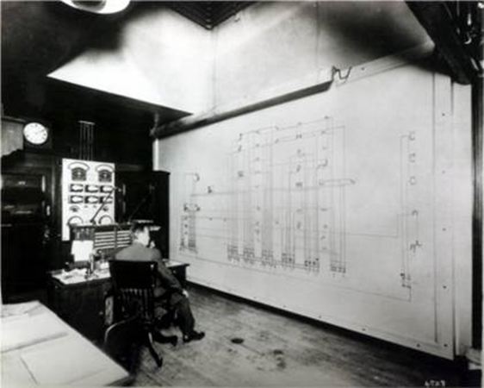
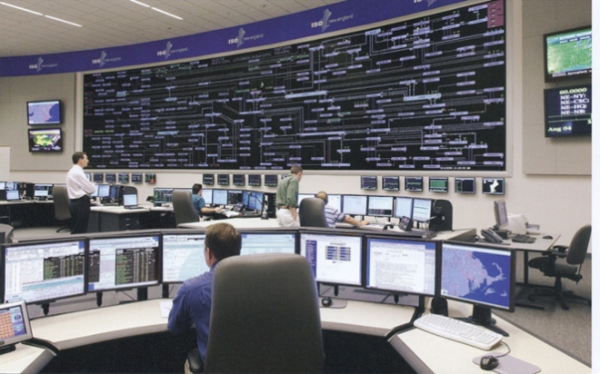
ECEN 460 Motivation: A Vision for an Long-Term Sustainable Electric Future
In 2000 the US National Academy of Engineering (NAE) named Electrification (the vast networks of electricity that power the developed world) as the top engineering technology of the 20th century
Beating automobiles (2), airplanes (3), water (4), electronics (5)
Electricity has changed the world!
For the 21th century the winner could be “Development of a sustainable and resilient electric infrastructure for the entire world”

Slide 12
Power System Examples
Electric utility: can range from quite small, such as an island, to one covering half the continent
there are four major interconnected ac power systems in North American, each operating at 60 Hz ac; 50 Hz is used in some other countries.
Microgrids can power smaller areas (like a campus) and can be optionally connected to the main grid
Airplanes and Spaceships: reduction in weight is primary consideration; frequency is 400 Hz.
Ships and submarines
Automobiles: dc 12 V standard; 360-376 V for electric
Battery operated portable systems

Slide 13
North America Interconnections

Slide 14
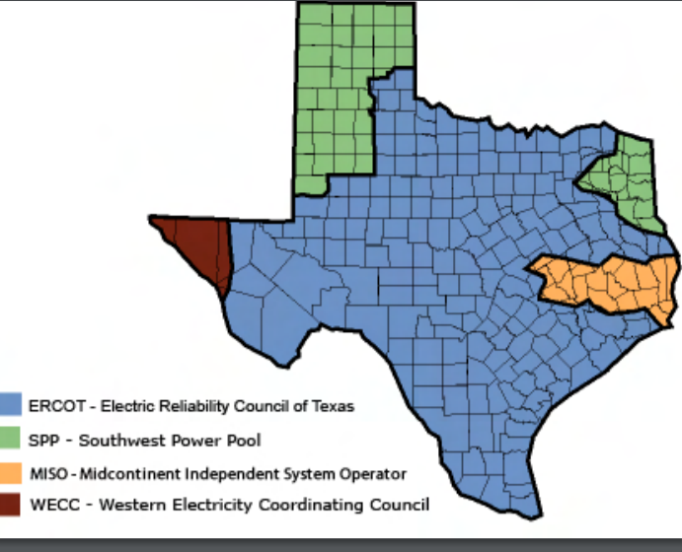
Electric Interconnections in Texas
Source: www.puc.texas.gov/industry/maps/maps/ERCOT.pdf

Slide 15
Electric Systems in Energy Context
Class focuses on electric power systems, but we first need to put the electric system in context of the total energy delivery system
Electricity is used primarily as a means for energy transportation
Use other sources of energy to create it, and it is usually converted into another form of energy when used
About 40% of US energy is transported in electric form
Concerns about need to reduce CO2 emissions and fossil fuel depletion are becoming main drivers for change in world energy infrastructure

Slide 16
Looking at the 2015 Energy Pie: Where the USA Got Its Energy
About 40% of our energy is consumed in the form of electricity, a percentage that is gradually increasing. The vast majority on the non-fossil fuel energy is electric!
In 2015 we got about 1.9% of our energy from wind and 0.6% from solar (PV and solar thermal), 0.2% from geothermal
About 81% Fossil Fuels (86% in 1990 and 2000)
Total of 97.5 Quad; 1 Quad = 293 billion kWh (actual), 1 Quad = 98 billion kWh (used, taking into account efficiency)
Source: EIA Monthly Energy Review, July 2016

Slide 17
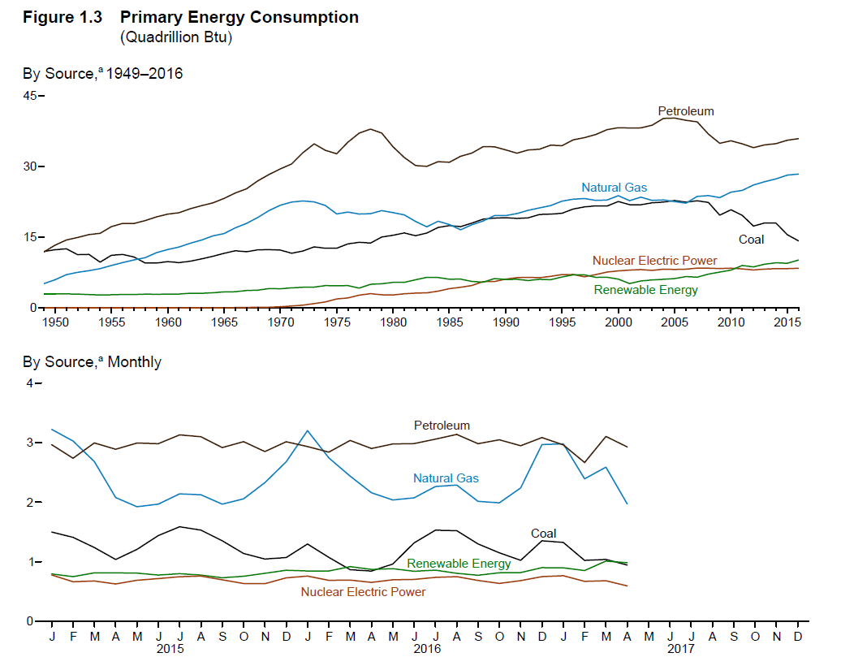
US Historical Energy Usage
Source: EIA Monthly Energy Review, July 2017

Slide 18
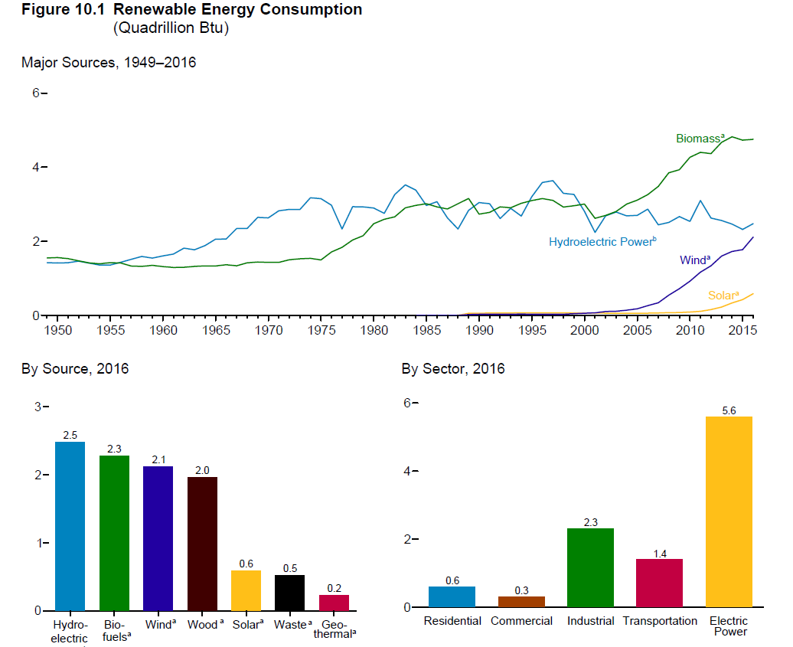
Renewable Energy Consumption
Source: EIA Monthly Energy Review, July 2017

Slide 19
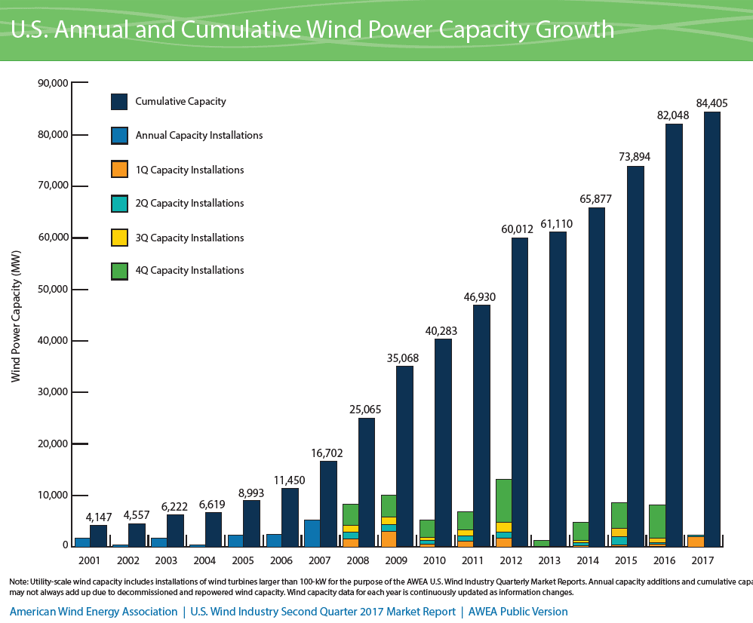
Growth in US Wind Power Capacity
Source: AWEA Wind Power Outlook 2 Qtr, 2017

Slide 20
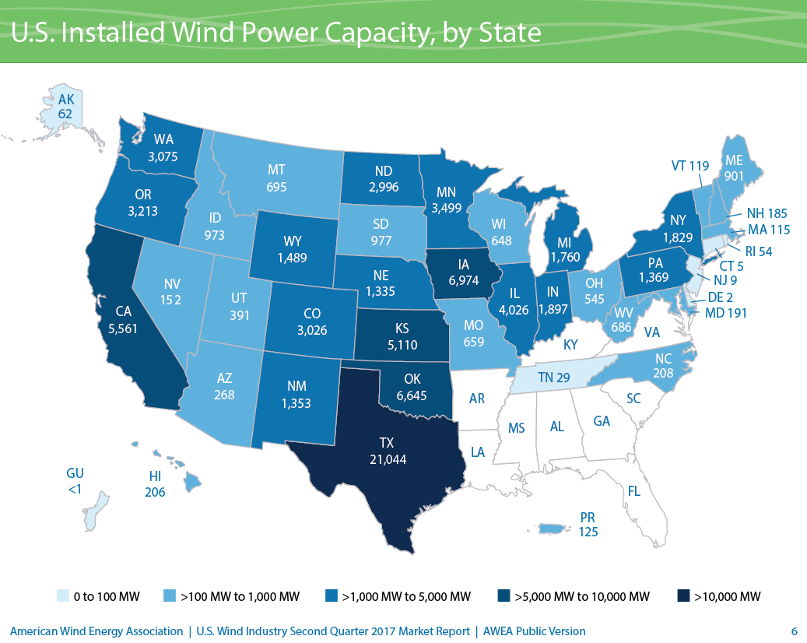
Wind Capacity Installations by State
Texas is number one!
Source: AWEA Wind Power Outlook 2 Qtr, 2017

Slide 21
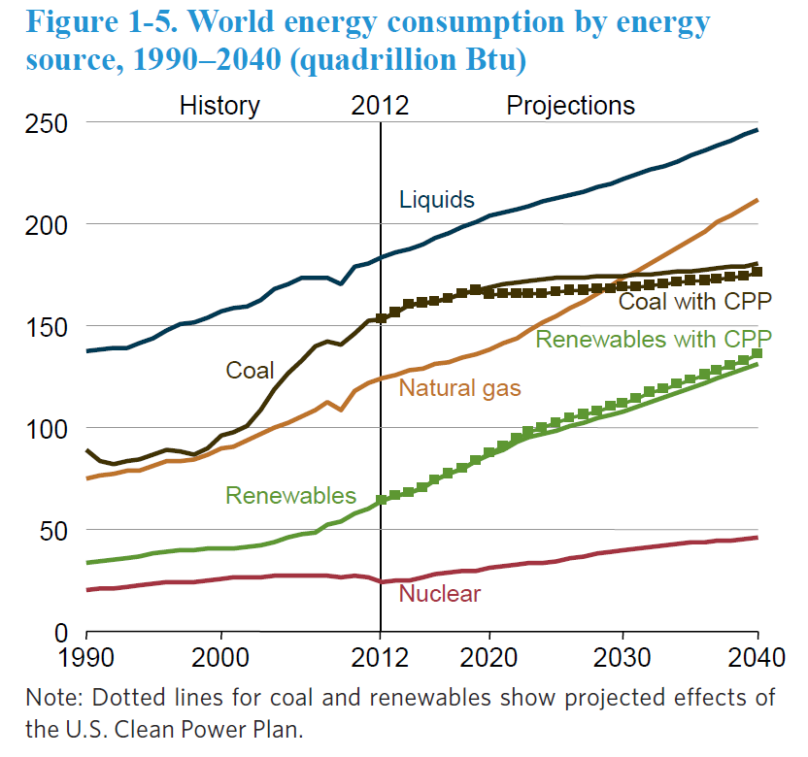
The World
Source: EIA, International Energy Outlook 2016

Slide 22
Energy Economics
Electric generating technologies involve a tradeoff between fixed costs (costs to build them) and operating costs
Nuclear and solar high fixed costs, but low operating costs (though cost of solar has decreased substantially recently)
Natural gas/oil have low fixed costs but can have higher operating costs (dependent upon fuel prices)
Coal, wind, hydro are in between
Also the units capacity factor is important to determining ultimate cost of electricity

Slide 23
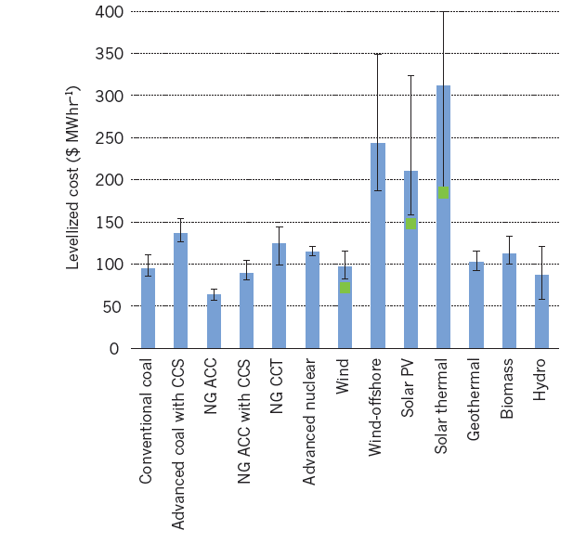
Ball park Energy Costs
Energy costs depend upon the capacity factor for the generator. The capacity factor is the ratio of the electricity actually produced, divided by its maximum potential output. It is usually expressed on an annual basis.
Source: Steve Chu and Arun Majumdar, “Opportunities and challenges for a sustainable energy future,” Nature, August 2012, Figure 6

Slide 24
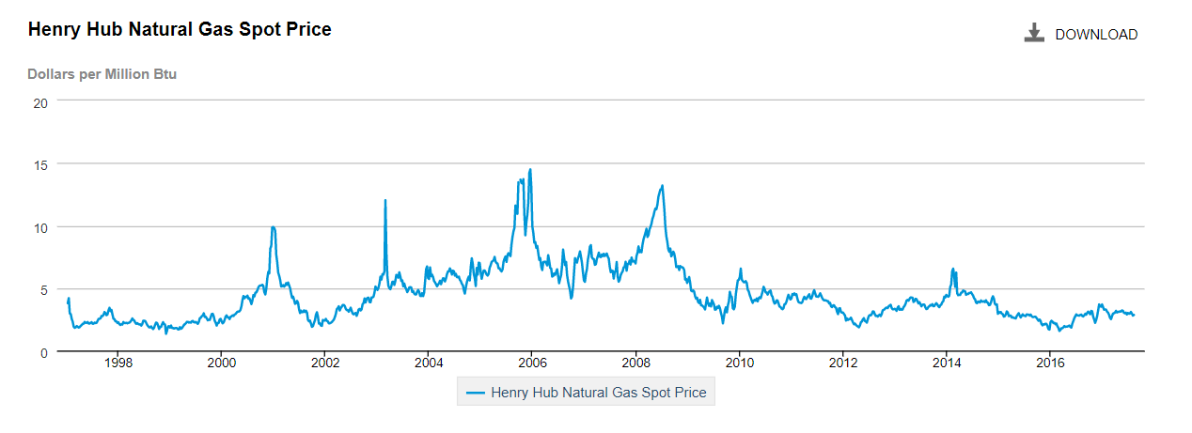
Natural Gas Prices 1997 to 2017
Marginal cost for natural gas fired electricity price
in $/MWh is about 7-10 times gas price
Source: http://www.eia.gov/dnav/ng/hist/rngwhhdW.htm

Slide 25
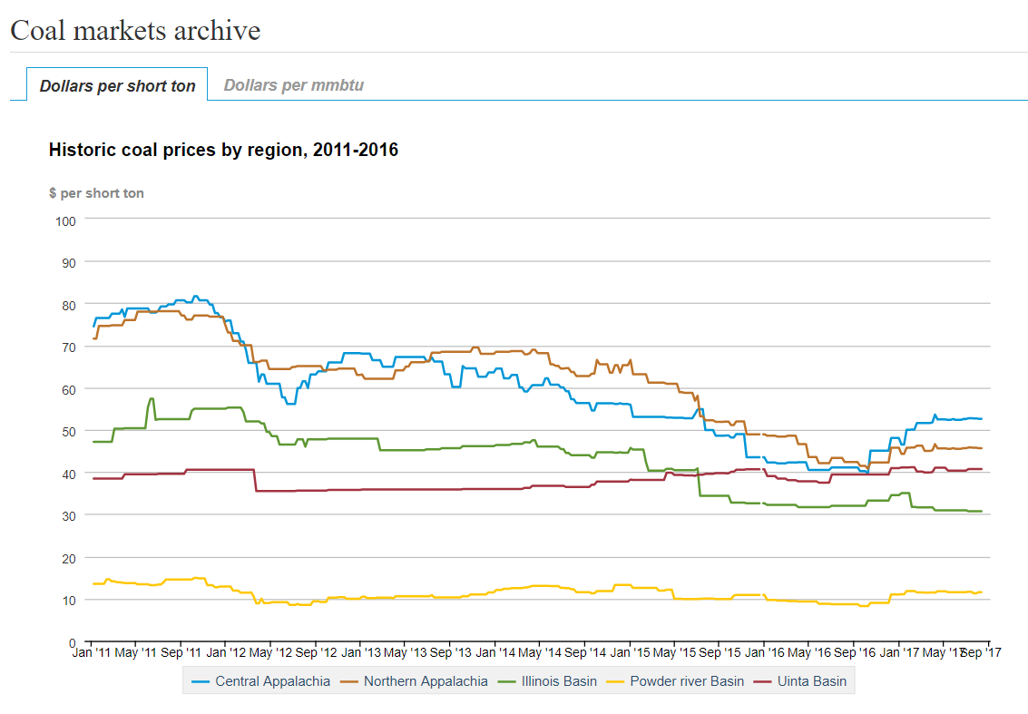
Coal Prices have Fallen Substantially from Five Years Ago
BTU content per pound varies between about 8000 and 15,000 Btu/lb, giving costs of around $1 to 2/Mbtu
Source: eia.gov/coal

Slide 26
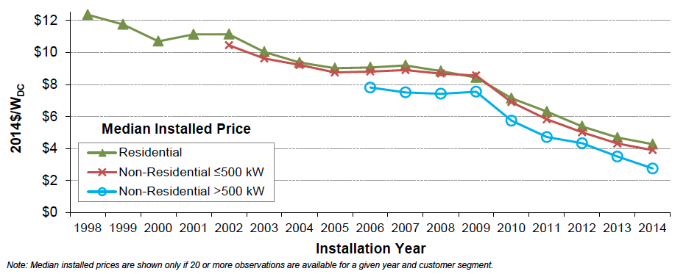
Solar PV Prices
Image: http://cleantechnica.com/2015/08/13/us-solar-pv-cost-fell-50-5-years-government-report/screen-shot-2015-08-12-at-12-33-53-pm/

Slide 27
Brief History of Electric Power
First real practical uses of electricity began with the telegraph (1860's) and then arc lighting in the 1870’s
Early 1880’s – Edison introduced Pearl Street dc system in Manhattan supplying 59 customers
1884 – Sprague produces practical dc motor
1885 – invention of transformer
Mid 1880’s – Westinghouse/Tesla introduce rival ac system
Late 1880’s – Tesla invents ac induction motor
1893 – Three-phase transmission line at 2.3 kV

Slide 28
History, cont’d
1896 – ac lines deliver electricity from hydro generation at Niagara Falls to Buffalo, 20 miles away; also 30kV line in Germany
Early 1900’s – Private utilities supply all customers in area (city); recognized as a natural monopoly; states step in to begin regulation
By 1920’s – Large interstate holding companies control most electricity systems

Slide 29
History, cont’d
1935 – Congress passes Public Utility Holding Company Act to establish national regulation, breaking up large interstate utilities (repealed 2005)
This gave rise to electric utilities that only operated in one state
1935/6 – Rural Electrification Act brought electricity to rural areas
1930’s – Electric utilities established as vertical monopolies
Frequency standardized in the 1930’s

Slide 30
Vertical Monopolies
Within a particular geographic market, the electric utility had an exclusive franchise
Generation
In return for this exclusive
franchise, the utility had the
obligation to serve all
existing and future customers
at rates determined jointly
by utility and regulators
It was a “cost plus” business
Transmission
Distribution
Customer Service

Slide 31
Vertical Monopolies
Within its service territory each utility was the only game in town
Neighboring utilities functioned more as colleagues than competitors
Utilities gradually interconnected their systems so by 1970 transmission lines crisscrossed North America, with voltages up to 765 kV
Economies of scale keep resulted in decreasing rates, so most every one was happy

Slide 32
History, cont’d -- 1970’s
1970’s brought inflation, increased fossil-fuel prices, calls for conservation and growing environmental concerns
Increasing rates replaced decreasing ones
As a result, U.S. Congress passed Public Utilities Regulator Policies Act (PURPA) in 1978, which mandated utilities must purchase power from independent generators located in their service territory (modified 2005)
PURPA introduced some competition

Slide 33
History, cont’d – 1990’s & 2000’s
Major opening of industry to competition occurred as a result of National Energy Policy Act of 1992
This act mandated that utilities provide “nondiscriminatory” access to the high voltage transmission
Goal was to set up true competition in generation
Result over the last few years has been a dramatic restructuring of electric utility industry (for better or worse!)
Energy Bill 2005 repealed PUHCA; modified PURPA

Slide 34
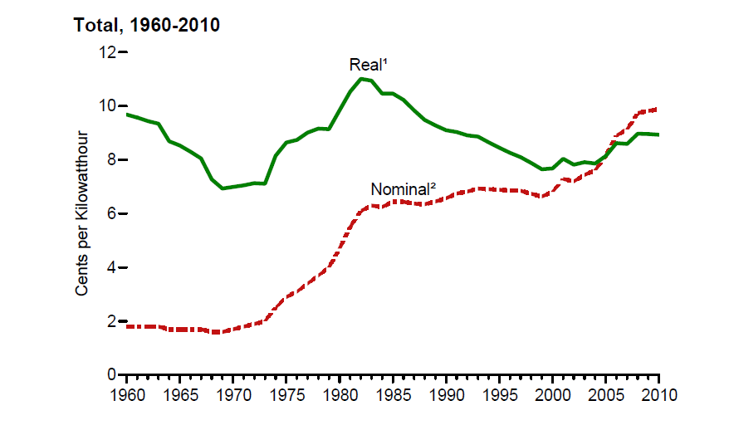
Electricity Prices, 1960-2010
Source: EIA, Annual Energy Review, 2010, Figure 8.10

Slide 35
Utility Restructuring
Driven by significant regional variations in electric rates
Goal of competition is to reduce rates through the introduction of competition
Eventual goal is to allow consumers to choose their electricity supplier

Slide 36
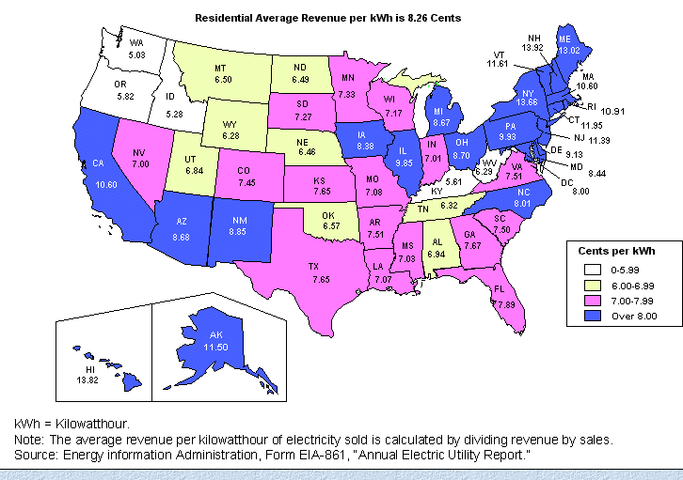
State Variation in Electric Rates

Slide 37
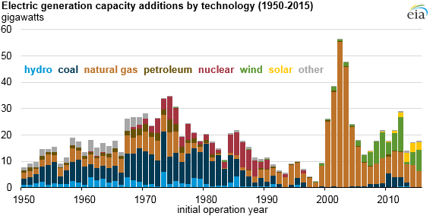
The Rise of Natural Gas Generation
Source: US EIA, 2016

Slide 38
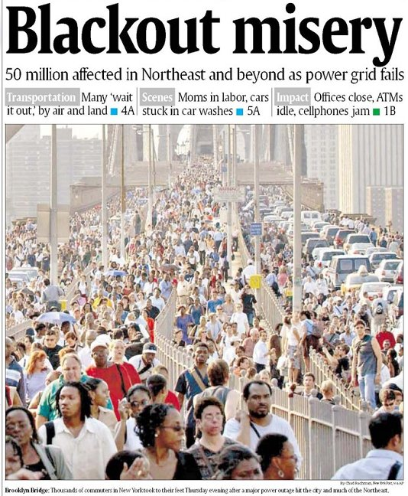
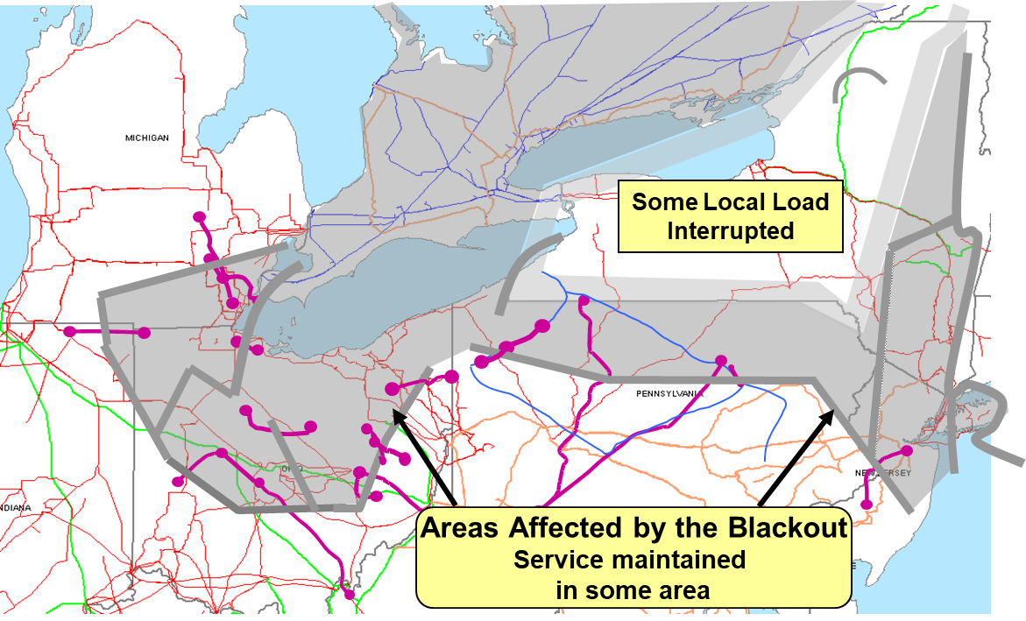
August 14th, 2003 Blackout
Above image from energy.gov, August 14, 2003 Blackout Final Report

