Slide 1
ECEN 460
Power System Operation and Control
Lecture 8: Load and Generator Models, Bus Admittance Matrix, Power Flow
Prof. Tom Overbye
Dept. of Electrical and Computer Engineering
Texas A&M University
overbye@tamu.edu

Slide 2
Announcements
Please read Chapter 2.4, and 6.1 to 6.6
HW 3 is 4.41, 5.14 (parts a,b), 5.38, 5.41(a,b), 5.43; due on Sept 28
  Answers will be posted next day so no credit for late homework
  Lowest homework score will be dropped
First exam is Thursday Oct 5 in class; one of my old exams is posted for reference; closed book, closed notes, one 8.5 by 11 inch note sheet allowed; calculators allowed

Slide 3
Load Models
Ultimate goal is to supply loads with electricity at constant frequency and voltage
Electrical characteristics of individual loads matter, but usually they can only be estimated
  actual loads are constantly changing, consisting of a large number of individual devices
  only limited network observability of load characteristics
Aggregate models are typically used for analysis
Two common models
  constant power: S_{i} = P_{i} + jQ_{i}
  constant impedance: S_{i} = |V|² / Z_{i}
We will talk more
about load models
with transient
stability

Slide 4
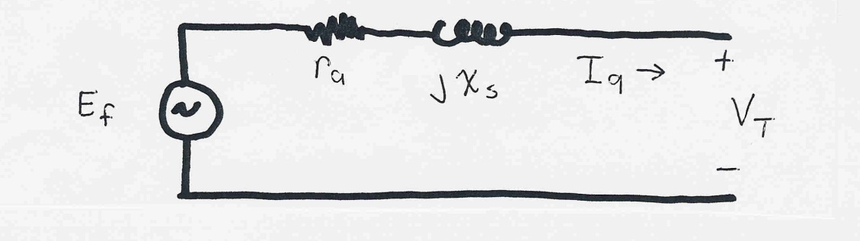
Generator Models
Engineering models depend upon application
Generators are usually synchronous machines
For generators we will use two different models:
  a steady-state model, treating the generator as a constant power source operating at a fixed voltage; this model will be used for power flow and economic analysis
  a short term model treating the generator as a constant voltage source behind a possibly time-varying reactance
We will return to
generator models
in a lecture or two

Slide 5
Power Flow Analysis
We now have the necessary models to start to develop the power system analysis tools
The most common power system analysis tool is the power flow (also known sometimes as the load flow)
  power flow determines how the power flows in a network
  also used to determine all bus voltages and all currents
  because of constant power models, power flow is a nonlinear analysis technique
  power flow is a steady-state analysis tool

Slide 6
Linear versus Nonlinear Systems
A function H is linear if
H(α₁μ₁ + α₂μ₂) = α₁H(μ₁) + α₂H(μ₂)
That is
1) the output is proportional to the input
2) the principle of superposition holds
Linear Example: y = H(x) = c x
y = c(x₁+x₂) = cx₁ + c x₂
Nonlinear Example: y = H(x) = c x²
y = c(x₁+x₂)² ≠ (cx₁)² + (c x₂)²

Slide 7
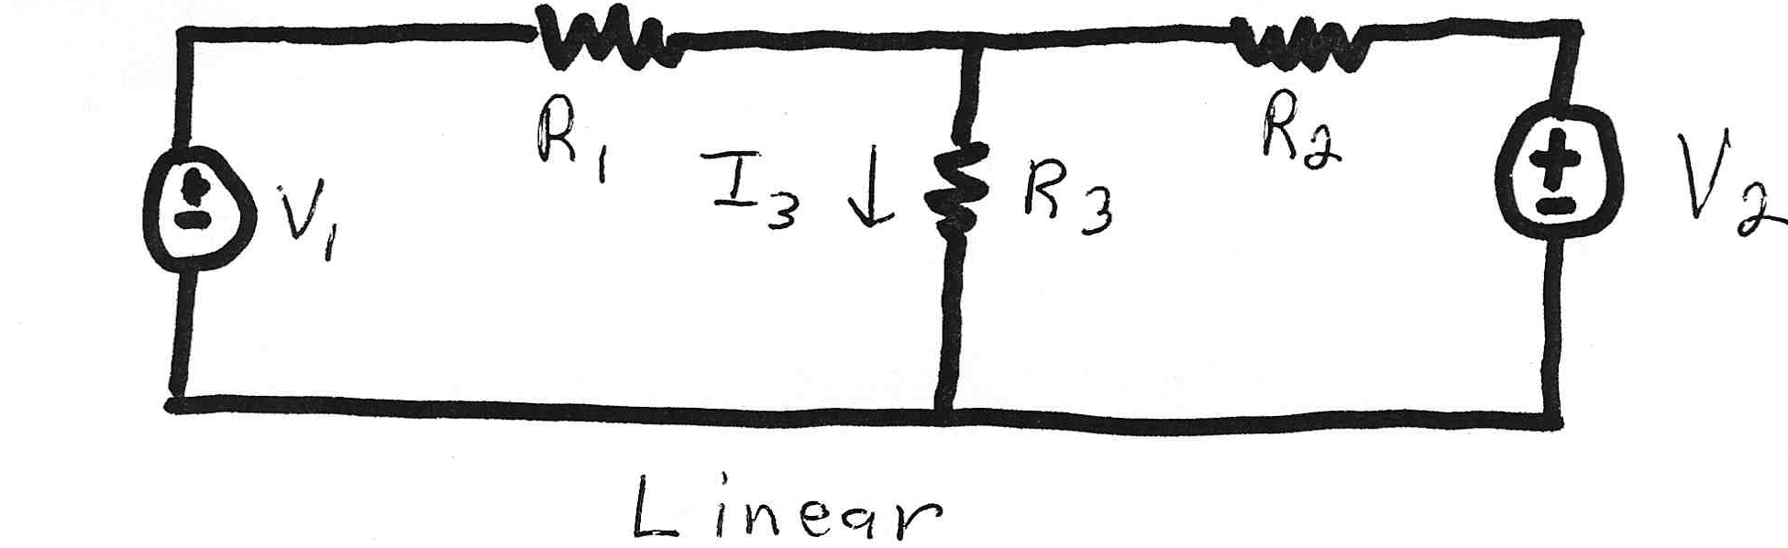
Linear Power System Elements

Slide 8
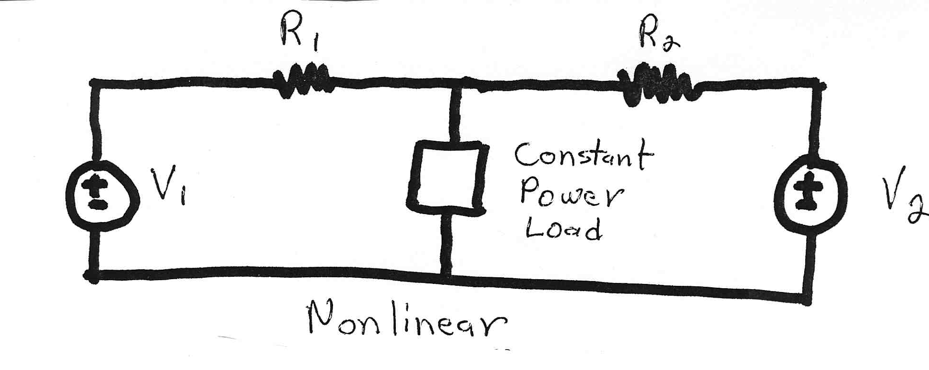
Nonlinear Power System Elements
Constant power loads and generator injections are nonlinear and hence systems with these elements can not be analyzed by superposition
Nonlinear problems can be very difficult to solve,
and usually require an iterative approach

Slide 9
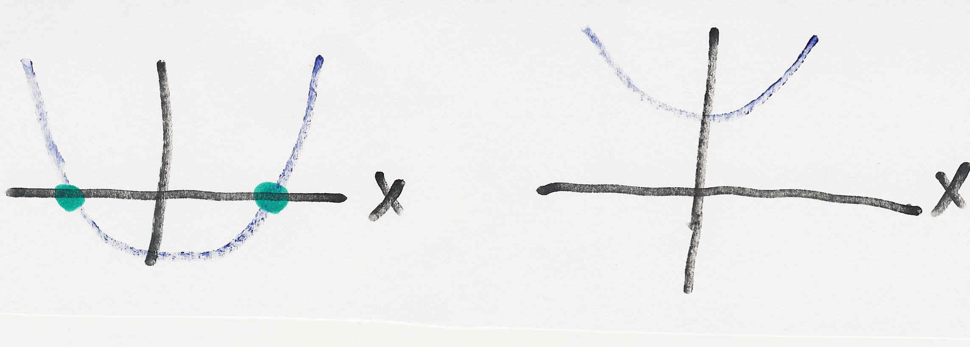
Nonlinear Systems May Have Multiple Solutions or No Solution
Example 1: x² - 2 = 0 has solutions x = ±1.414…
Example 2: x² + 2 = 0 has no real solution
f(x) = x² - 2
f(x) = x² + 2
two solutions where f(x) = 0
no solution f(x) = 0

Slide 10
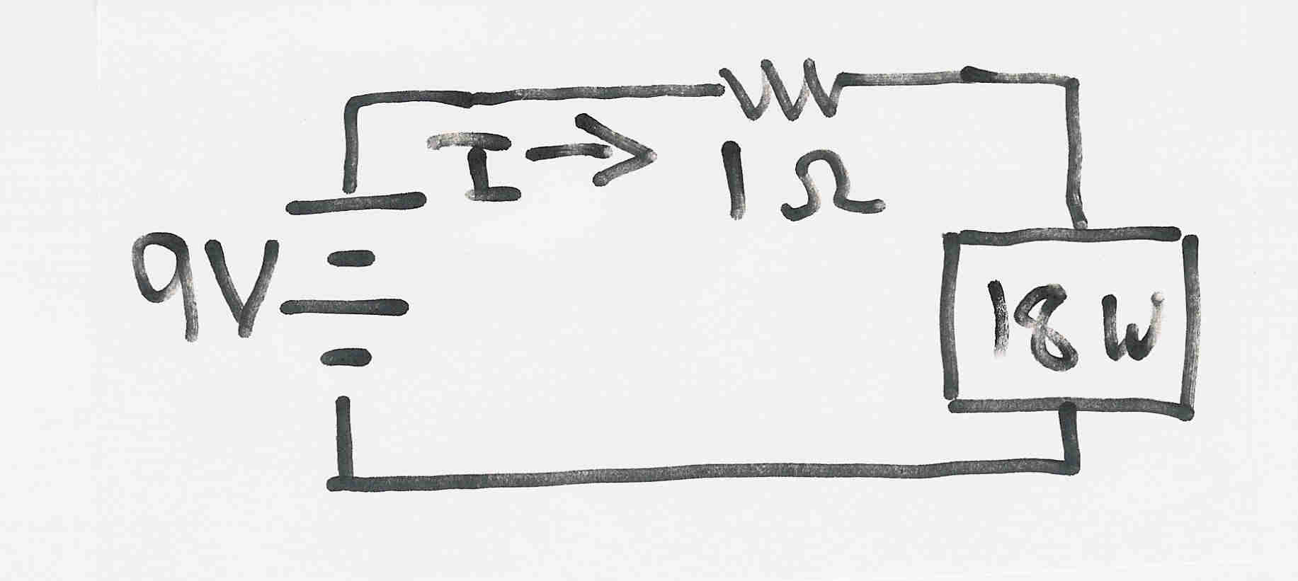
Multiple Solution Example 3
The dc system shown below has two solutions:
where the 18 watt
load is a resistive
load
What is the
maximum
P_{Load}?

Slide 11
Bus Admittance Matrix or Y_{bus}
First step in solving the power flow is to create what is known as the bus admittance matrix, often call the Y_{bus}.
The Y_{bus} gives the relationships between all the bus current injections, I, and all the bus voltages, V,
I = Y_{bus} V
The Y_{bus} is developed by applying KCL at each bus in the system to relate the bus current injections, the bus voltages, and the branch impedances and admittances

Slide 12
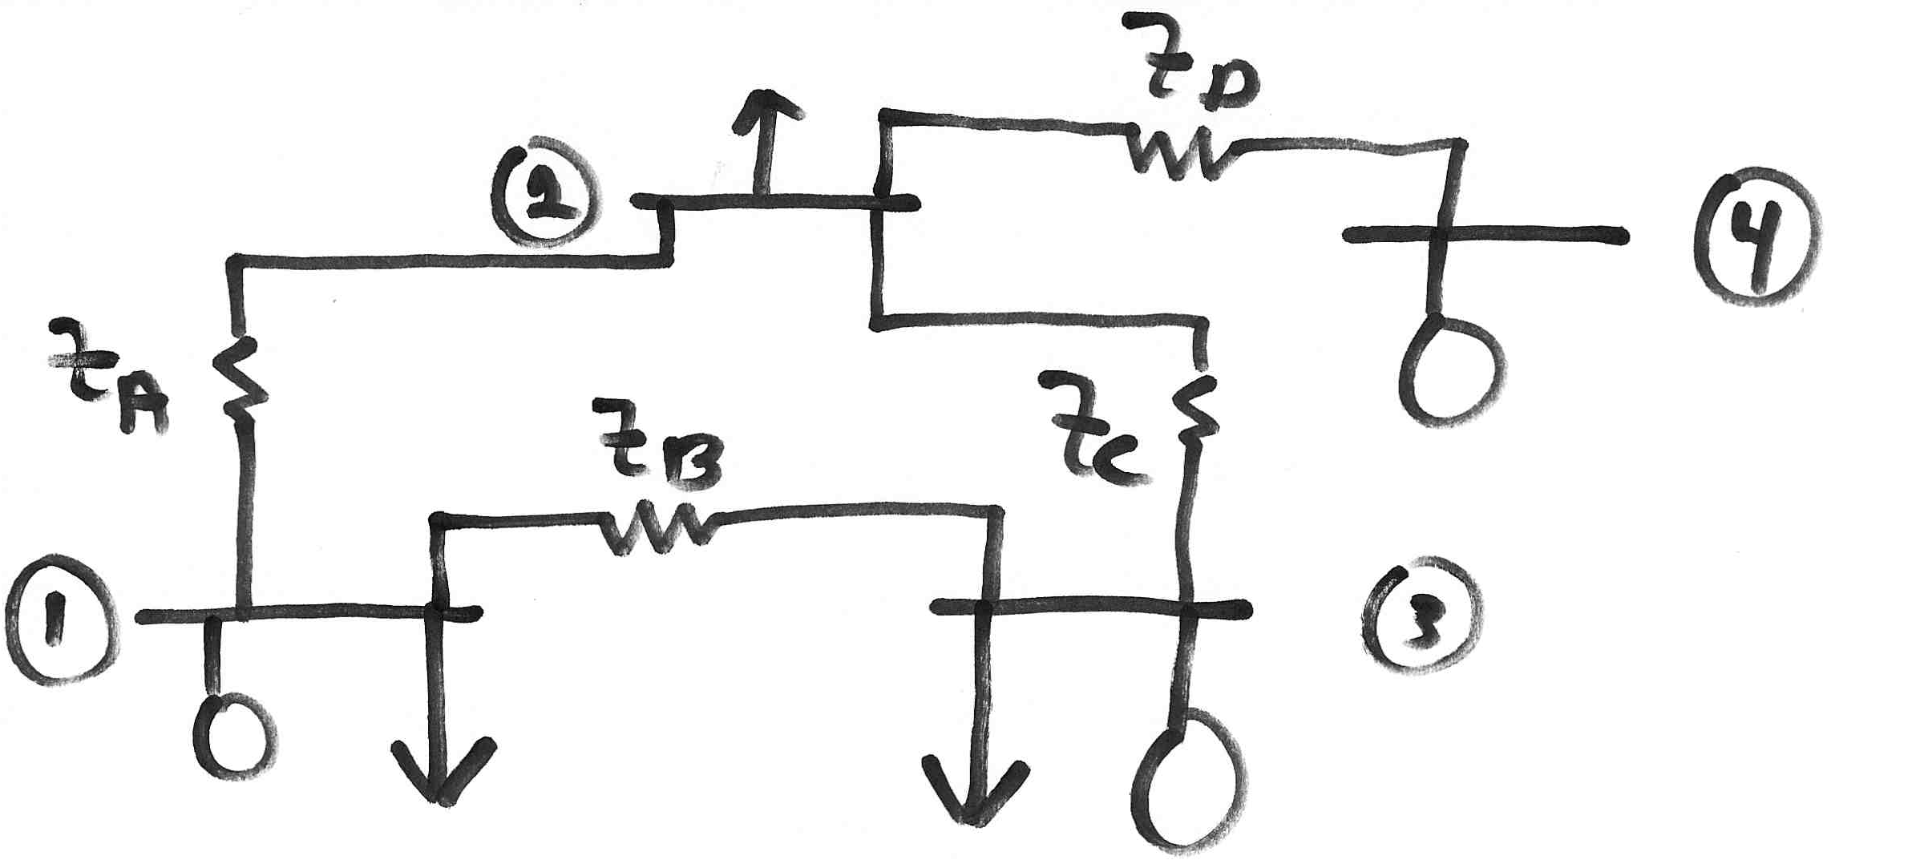
Y_{bus} Example
Determine the bus admittance matrix for the network
shown below, assuming the current injection at each
bus i is I_{i} = I_{Gi} - I_{Di} where I_{Gi} is the current injection into the
bus from the generator and I_{Di} is the current flowing into the load

Slide 13
Y_{bus} Example, cont’d

Slide 14
Y_{bus} Example, cont’d
For a system with n buses, Y_{bus} is an n by n
symmetric matrix (i.e., one where A_{ij} = A_{ji})

Slide 15
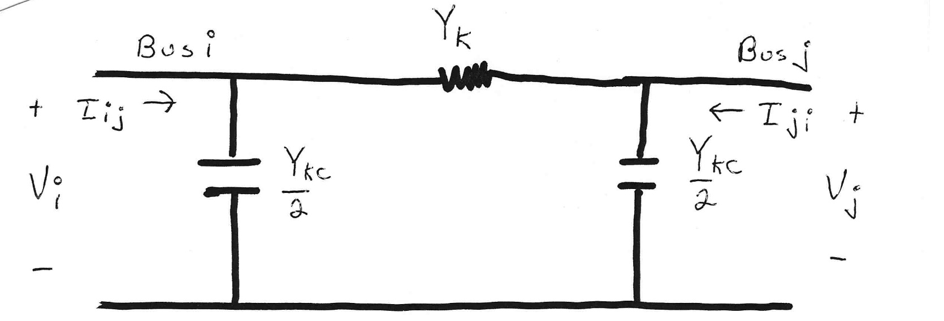
Modeling Shunts in the Y_{bus}

Slide 16
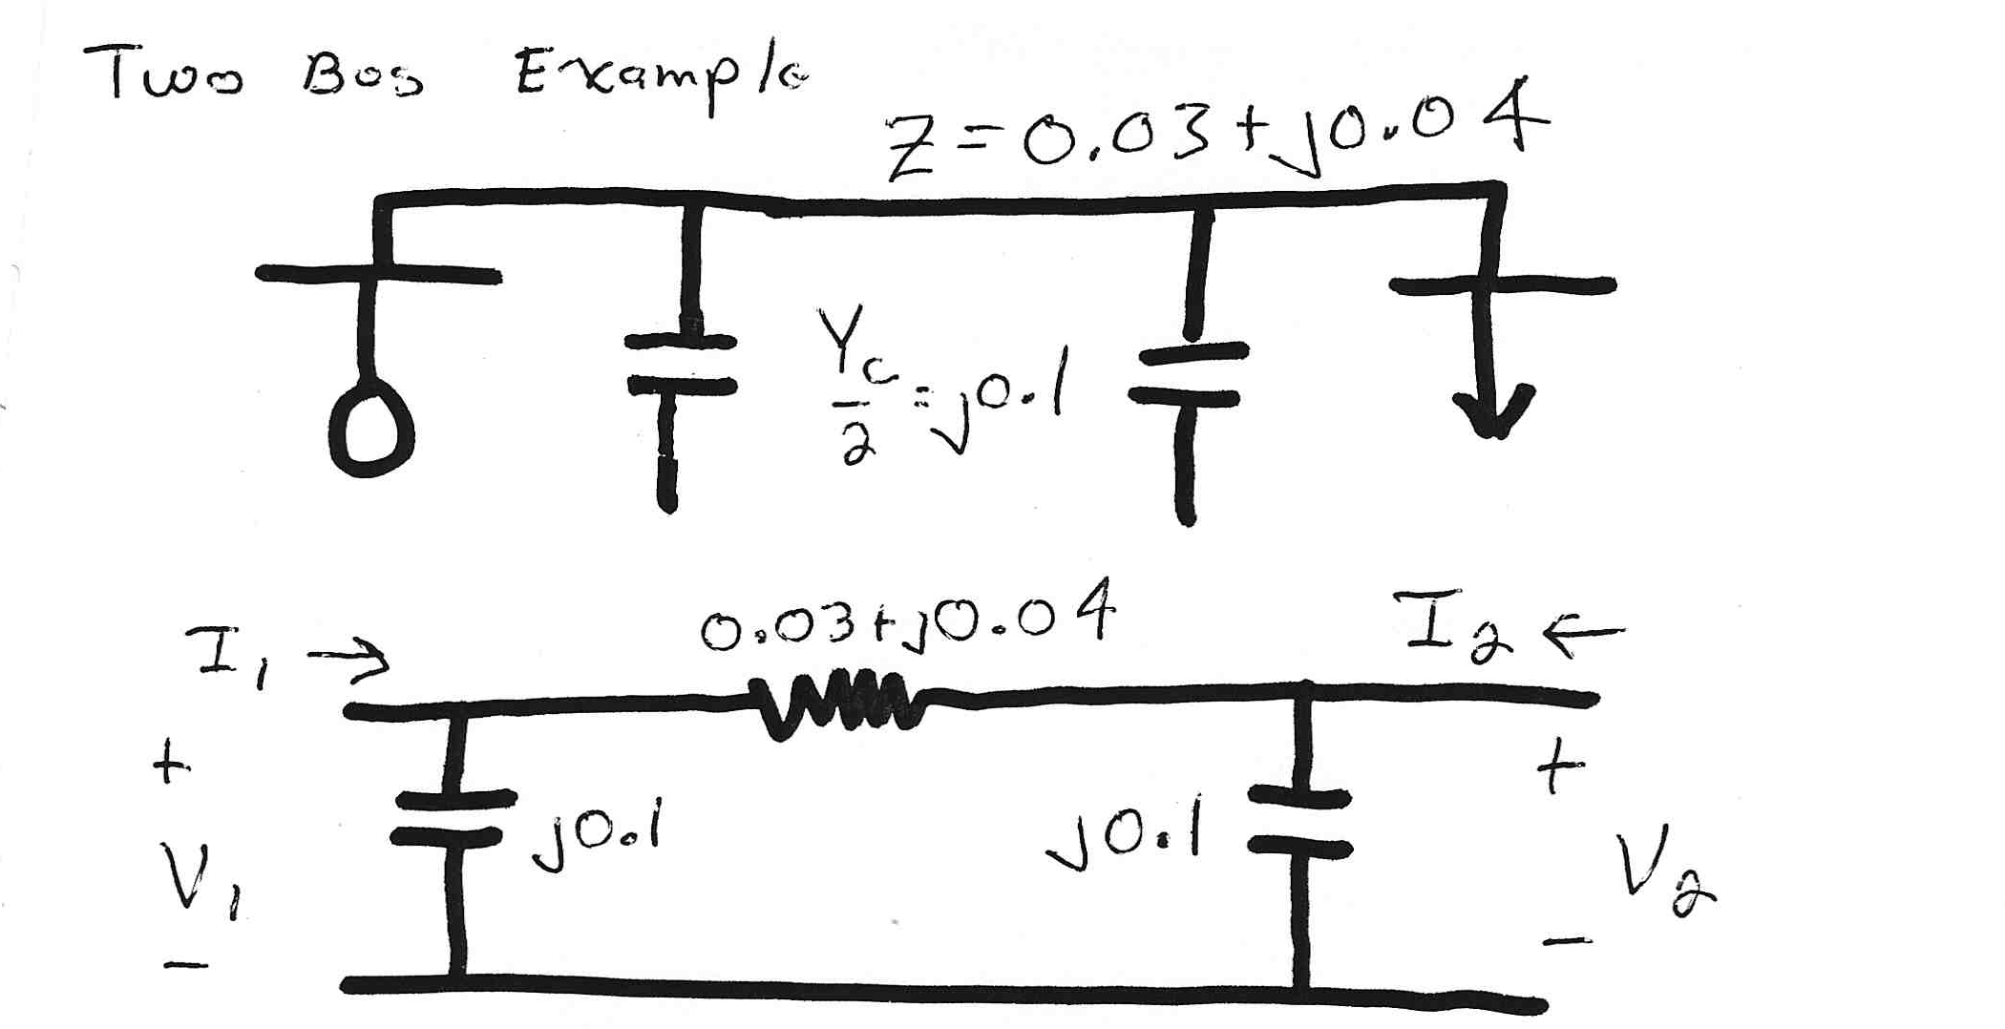
Two Bus System Example

Slide 17
Using the Y_{bus}

Slide 18
Solving for Bus Currents

Slide 19
Solving for Bus Voltages

Slide 20
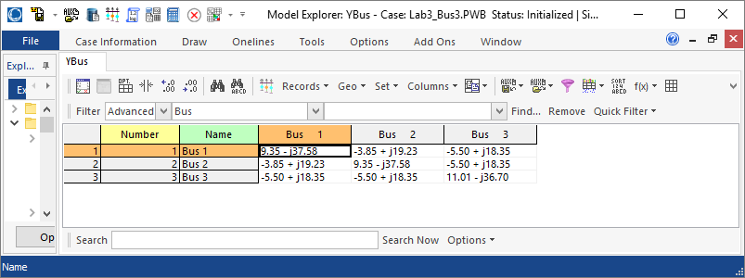
Y_{bus} in PowerWorld
To see the Y_{bus} in PowerWorld, select Case Information, Solution Details, Ybus
For large systems most of the Y_{bus} elements are zero, giving what is known as a sparse matrix
Y_{bus} for Lab 3 Three Bus System

Slide 21
Power Flow Analysis
When analyzing power systems we know neither the complex bus voltages nor the complex current injections
Rather, we know the complex power being consumed by the load, and the power being injected by the generators plus their voltage magnitudes
Therefore we can not directly use the Y_{bus} equations, but rather must use the power balance equations

Slide 22
Power Balance Equations

Slide 23
Power Balance Equations, cont’d

Slide 24
Real Power Balance Equations

Slide 25
Power Flow Requires Iterative Solution

Slide 26
Gauss Iteration

Slide 27
Gauss Iteration Example

Slide 28
Stopping Criteria

Slide 29
Gauss Power Flow

Slide 30
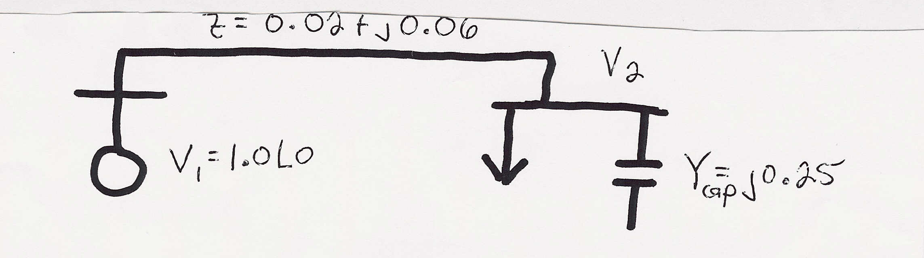
Gauss Two Bus Power Flow Example
A 100 MW, 50 Mvar load is connected to a generator
through a line with z = 0.02 + j0.06 p.u. and line charging of 5 Mvar on each end (100 MVA base). Also, there is a 25 Mvar capacitor at bus 2. If the generator voltage is 1.0 p.u., what is V₂?
S_{Load} = 1.0 + j0.5 p.u.

Slide 31
Gauss Two Bus Example, cont’d

Slide 32
Gauss Two Bus Example, cont’d

Slide 33
Gauss Two Bus Example, cont’d

Slide 34
Slack Bus
In previous example we specified S₂ and V₁ and then solved for S₁ and V₂.
We can not arbitrarily specify S at all buses because total generation must equal total load + total losses
We also need an angle reference bus.
To solve these problems we define one bus as the "slack" bus. This bus has a fixed voltage magnitude and angle, and a varying real/reactive power injection.

Slide 35
Stated Another Way
From exam problem 4.c we had
This Y_{bus} is actually singular!
So we cannot solve
This means (as you might expect), we cannot independently specify all the current injections I

Slide 36
Gauss with Many Bus Systems

Slide 37
Gauss-Seidel Iteration

Slide 38
Three Types of Power Flow Buses
There are three main types of power flow buses
  Load (PQ) at which P/Q are fixed; iteration solves for voltage magnitude and angle.
  Slack at which the voltage magnitude and angle are fixed; iteration solves for P/Q injections
  Generator (PV) at which P and |V| are fixed; iteration solves for voltage angle and Q injection
    special coding is needed to include PV buses in the Gauss-Seidel iteration (covered in book, but not in slides since Gauss-Seidel is no longer commonly used)

Slide 39
Accelerated G-S Convergence

Slide 40
Accelerated Convergence, cont’d

Slide 41
Gauss-Seidel Advantages/Disadvantages
Advantages
  Each iteration is relatively fast (computational order is proportional to number of branches + number of buses in the system
  Relatively easy to program
Disadvantages
  Tends to converge relatively slowly, although this can be improved with acceleration
  Has tendency to miss solutions, particularly on large systems
  Tends to diverge on cases with negative branch reactances (common with compensated lines)
  Need to program using complex numbers

Slide 42
Newton-Raphson Algorithm
The second major power flow solution method is the Newton-Raphson algorithm
Key idea behind Newton-Raphson is to use sequential linearization

Slide 43
Newton-Raphson Method (scalar)

Slide 44
Newton-Raphson Method, cont’d

Slide 45
Newton-Raphson Example

Slide 46
Newton-Raphson Example, cont’d

Slide 47
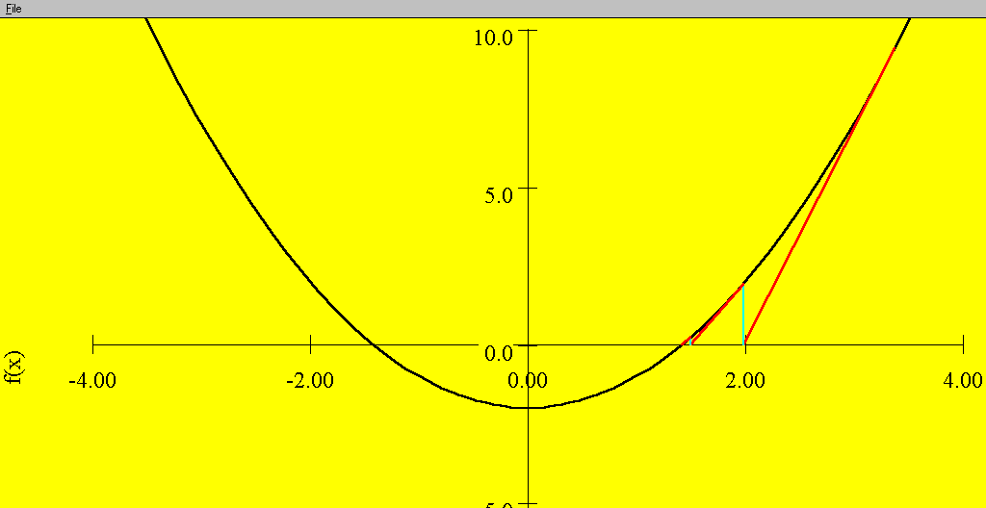
Sequential Linear Approximations
At each
iteration the
N-R method
uses a linear
approximation
to determine
the next value
for x
Function is f(x) = x² - 2 = 0.
Solutions are points where
f(x) intersects f(x) = 0 axis

Slide 48
Newton-Raphson Comments
When close to the solution the error decreases quite quickly -- method has quadratic convergence
f(x^{(v)}) is known as the mismatch, which we would like to drive to zero
Stopping criteria is when ⏐f(x^{(v)}) ⏐ < ε
Results are dependent upon the initial guess. What if we had guessed x⁽⁰⁾ = 0, or x ⁽⁰⁾ = -1?
A solution’s region of attraction (ROA) is the set of initial guesses that converge to the particular solution. The ROA is often hard to determine

