Slide 1
ECEN 460
Power System Operation and Control
Lecture 19: Power Markets
Prof. Tom Overbye
Dept. of Electrical and Computer Engineering
Texas A&M University
overbye@tamu.edu

Slide 2
Announcements
Begin reading Chapter 11
Design project is due on Dec 2; details on the website
Homework 7 is 6.65, 6.69, 6.72, 11.4, 11.7; it should be done before second exam but need not be turned in
No lab week of Nov 13; lab 9 is on Nov 20/21 and lab 10 is on Nov 27/28; no lab week of Dec 4
Exam 2 is during class on November 14
  My UIUC ECE 476 exam 2 is posted, but the 476 content is slightly different from 460
  Closed booked, closed notes, two note sheets and calculators
  Email me question suggestions before COB on Thursday

Slide 3
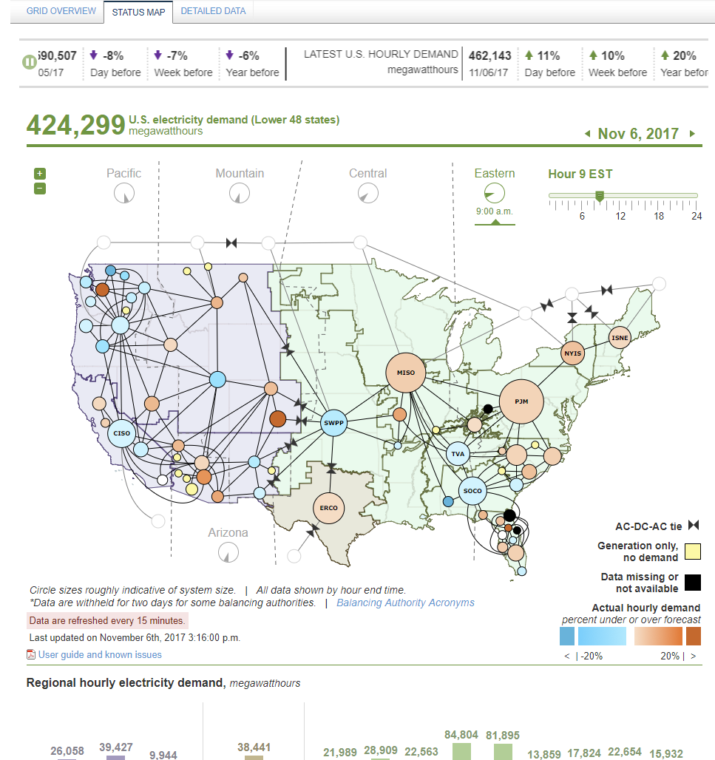
Real-Time US Electric Grid Operating Data
EIA has setup a visualization of US grid data
Source: www.eia.gov/beta/realtime_grid/?src=home-f1#/status?end=20171106T09

Slide 4
In the News: Vistra Energy and Dynegy Seek to Merge
On Oct 30, 2017 Vistra (parent of TXU Energy and Luminant) and Dynergy announced that their boards had approved a merger agreement
  Luminant has 18 GW of generation in ERCOT (2.3 GW nuclear, 8 GW coal and 7.5 natural gas)
  Dynergy has 27 GW of generation across the country (9 GW coal, 17 GW natural gas) (4.5 GW in ERCOT)
Headquarters will stay in Irving TX (Vistra’s current HQ, Dynergy is in Houston)
Merger needs to be reviewed by regulators
ERCOT’s total generation capacity is 78 GW

Slide 5
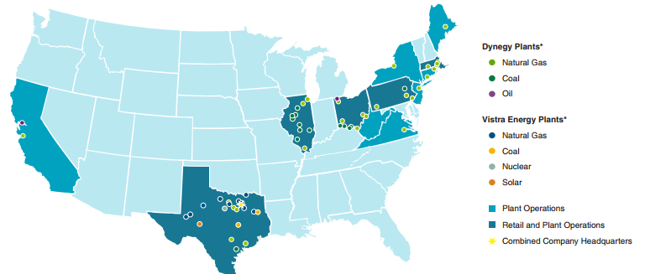
In the News: Vistra Energy and Dynegy Seek to Merge
Combined company power plants

Slide 6
Horizontal Market Power
One issue is whether a particular group of generators has market power
Market power is the antithesis of competition
    It is the ability of a particular group of sellers to maintain prices above competitive levels, usually by withholding supply
  The extreme case is a single supplier of a product (i.e., a monopoly)
  In the short run what a monopolistic producer can charge depends upon the price elasticity of the demand
  Sometimes market power can result in decreased prices in the long-term by quickening the entry of new players or new innovation

Slide 7
Market Power and Scarcity Rents
A generator owner exercises market power when it is unwilling to make energy available at a price that is equal to that unit’s variable cost of production, even thought there is currently unloaded generation capacity (i.e., there is no scarcity).
Scarcity rents occur when the level of electric demand is such that there is little, if any, unused capacity
Scarcity rents are used to recover fixed costs

Slide 8
Scarcity Rents
No market power is required to earn scarcity rents
  a corn farmer earns scarcity rents when the price of corn exceeds the marginal cost of supply
  generator owners earn scarcity rents in a uniform price auction on their lower cost units
High prices do not necessarily indicate market power; there may just be a scarcity.
Distinguishing between market power situations and scarcity rents can be difficult

Slide 9
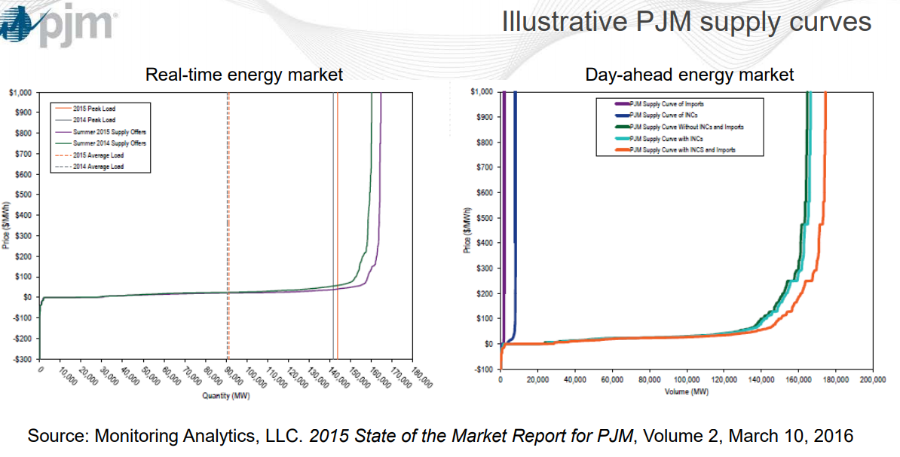
Example Supply Curves (PJM)
Source: www.pjm.com/-/media/committees-groups/task-forces/ccppstf/20170306/20170306-item-06-economics-behind-capacity-construct.ashx

Slide 10
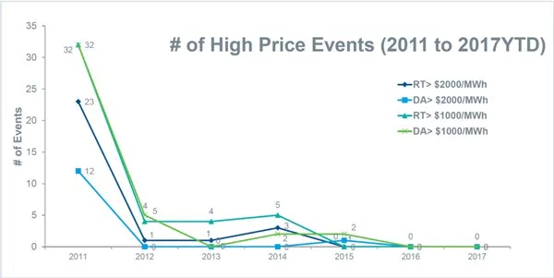
ERCOT Price Spike on Oct 9, 2017
ERCOT’s real-time prices went up to $1251/MWh
  Partially due to high temperatures and units on maintenance
Source: www.rtoinsider.com/ercot-ferc-heat-wave-natural-gas-prices-77210/

Slide 11
Symptoms of Market Power
Economic theory tells us that in a market with perfect competition, prices should be equal to the marginal cost to supply the product
Therefore prices above marginal cost can indicate market power
Proof: Let the amount of product = q, price = p, the supply cost = C(s), and Profit = P=q*p – C(s)

Slide 12
Market Power Analysis
In general market power analysis requires three steps
  Identify relevant product or service (e.g., non-firm energy, capacity)
  Identify relevant geographic market
    Challenge in electric grids is the market can change with transmission system loading
  Evaluate market concentration
    One general measure of market power is the Herfindahl-Hirshman Index (HHI)

Slide 13
HHI Examples
For a monopoly the HHI = 10,000
If N=4, q₁=40%, q₂=25%, q₃=25%, q₄=10%, then HHI = 2950
DOJ/FTC standards, adopted by FERC in 1992 for merger analysis
  HHI below 1000 is considered to represent an unconcentrated market
  anything above 1800 is considered concentrated
Values were updated in 2010 to < 1500 for unconcentrated, and > 2500 highly concentrated

Slide 14
HHI Examples
A company with 15 GW of generation seeks to merge with a company with 5 GW of generation in an 80 GW market. Assuming the new company is the largest in the market, what is the largest possible value for the new HHI?
  The new company would have 25% market share. Since it is the largest, the highest HHI would be if there were three other companies almost as large (say close to 25% each). So the HHI in this case would be 4 × 25² = 2500. Of course if there are lots of other small companies it would be substantially less.

Slide 15
Collusion and Price Fixing
Sherman Antitrust Act of 1890 attempts to prevent the artificial rising of prices by restriction of trade or supply
  Goal is to preserve a competitive marketplace and prevent consumers from abuses
  An “innocent monopoly” is allowed, but trying to artificially maintain that status is not
Agreements between competitors to tamper with prices (price fixing) could be a Sherman Act violation
Competitors often need to collaborate but cannot collude (which is defined as acting together in secret to achieve an illegal purpose)

Slide 16
Profit Optimization in Markets
When studying markets we’d like to determine an equilibrium point with the assumption each player is trying to maximize their profit
This is called the Nash Equilibrium, which has the following definition:
  An individual looks at what its opponents are presently doing
  The individual’s best response to its opponents’ behavior is to continue its present behavior
  This is true for ALL individuals in the market
The movie “A Beautiful Mind” is about John Nash’s Life

Slide 17
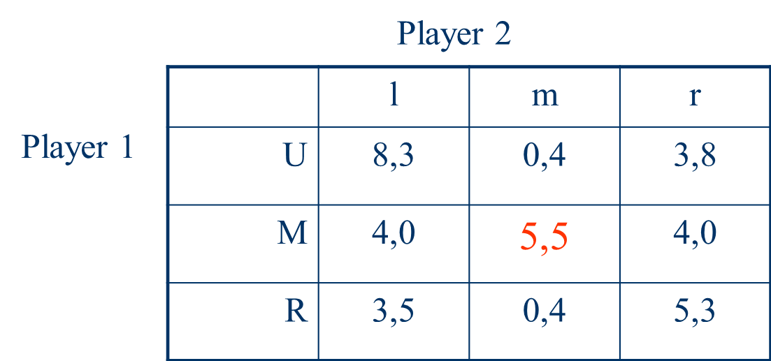
Nash Equilibrium Example
Consider a two player game, where each player has three choices. The table summaries the payoff for each player (player 1, player 2). The Nash equilibrium is shown in red.
A Nash equilibrium requires players have mutually correct assumptions.

Slide 18
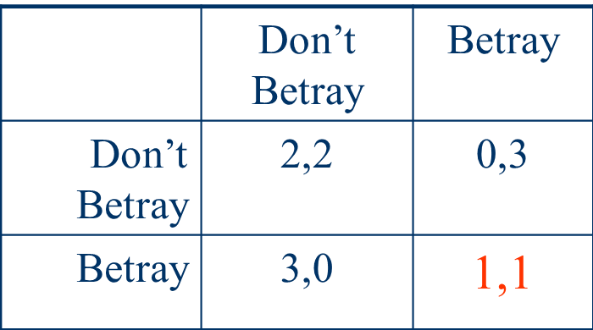
Nash Equilibrium and the Prisoner’s Dilemma
Two prisoners are being interrogated simultaneously. If they betray their fell criminal then they will get a lighter sentence, unless both of them betray each other. Then both serve a long sentence. If neither talks then the sentences will be lighter.
Here a higher number
is better, but the
Nash Equilibrium
is actually worse for
both

Slide 19
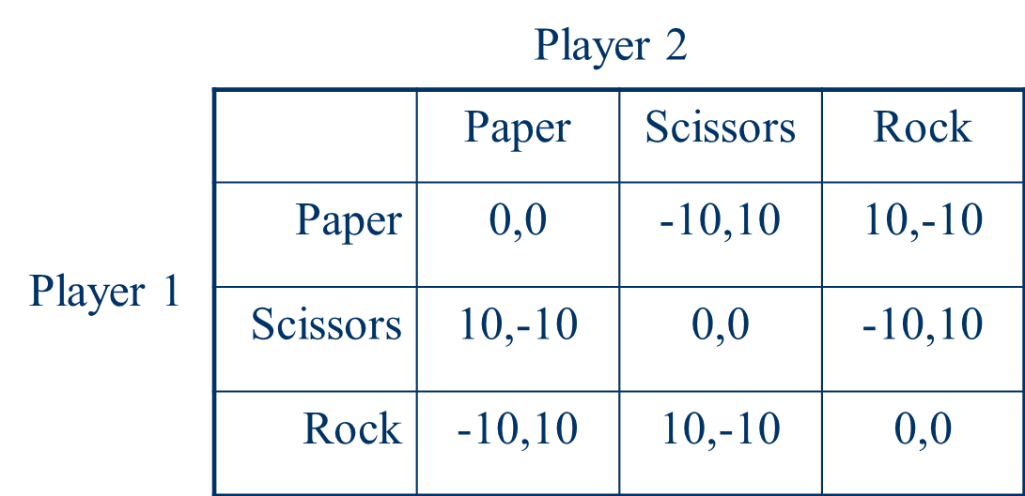
Nash Equilibrium in Which a Mixed Strategy is Best
Consider the Nash Equilibrium for the game paper, scissors & rock. This game has no Nash Equilibrium, indicating that a mixed strategy is best

Slide 20
Tragedy of the Commons
The Tragedy of the Commons is an economic theory (going back to William Forster in 1833) in which in a shared resource system people acting according to their own self-interest will behave contrary to the common good of all
  Cattle grazing on public lands is a common example
For electric power systems this could include the transmission system
Challenge for power markets is to create the correct incentives for continued investment in the transmission system
19

Slide 21
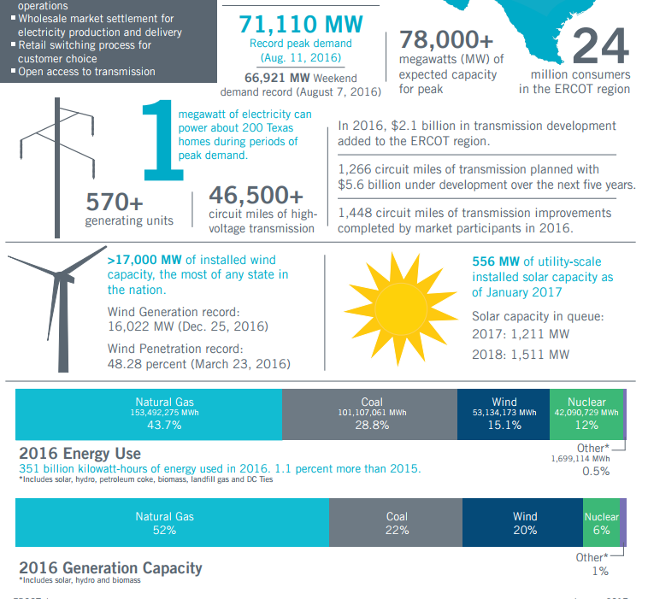
ERCOT At a Glance
20
www.ercot.com/content/wcm/lists/114739/ERCOT_Quick_Facts_11117.pdf

Slide 22
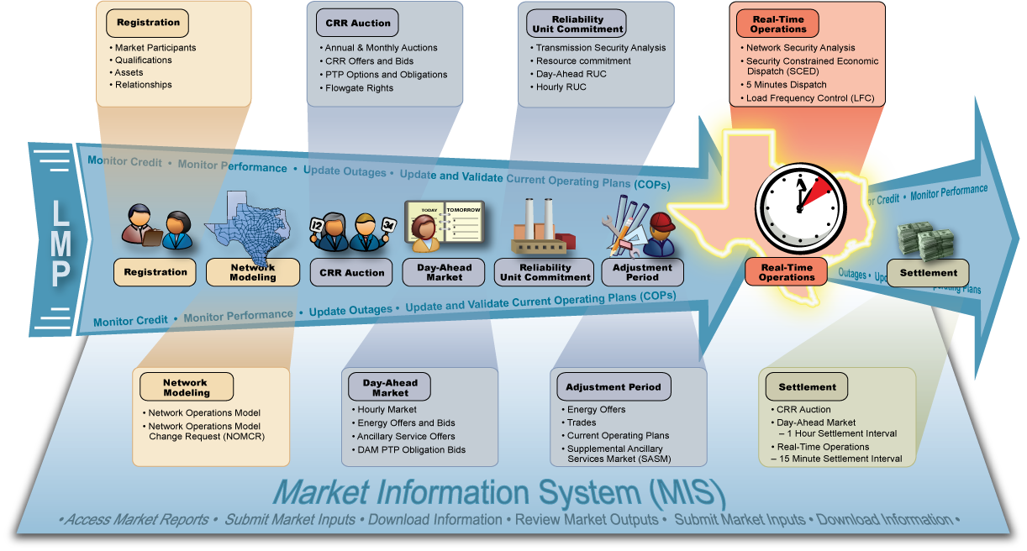
ERCOT Nodal Market Overview
Image source: ERCOT market education, transmission 101
21

Slide 23
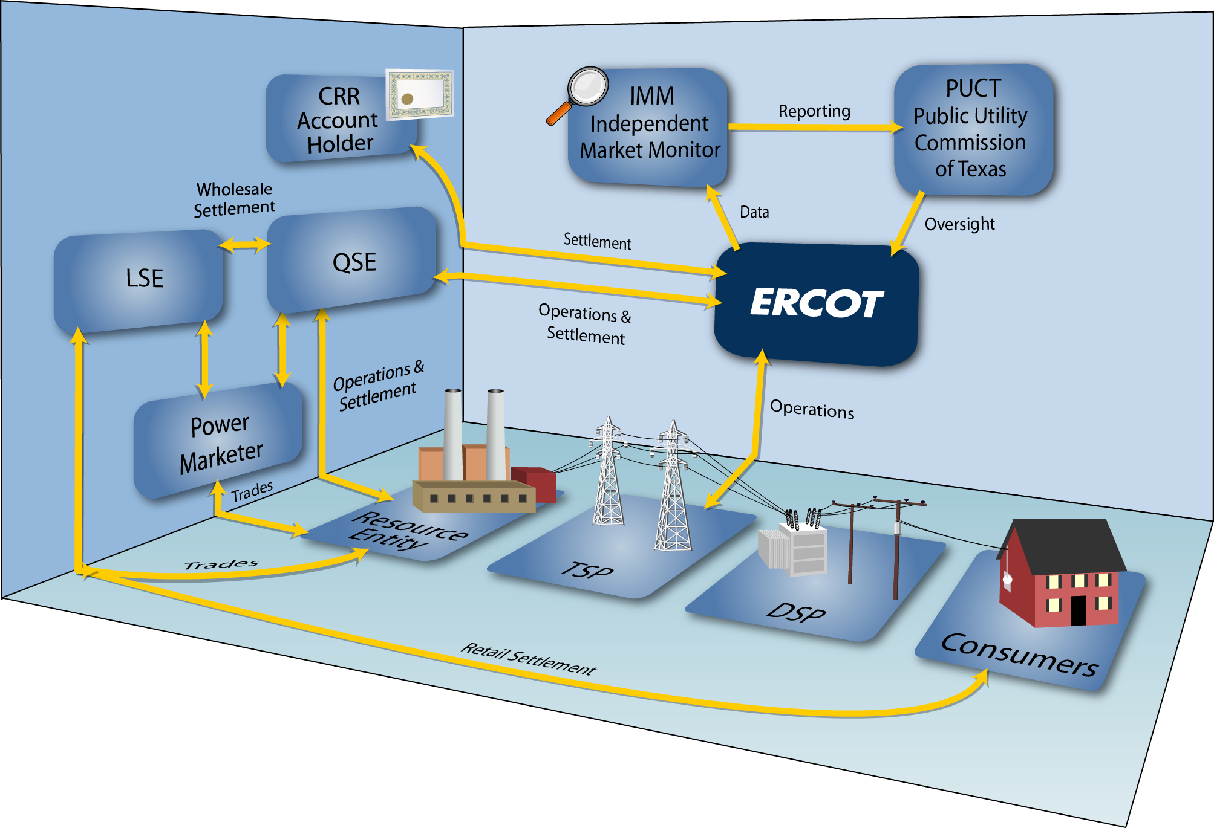
ERCOT Market Relationships
LSE is load
serving entity;
QSE is
qualified
scheduling
entity
Image source: ERCOT market education, transmission 101
22

Slide 24
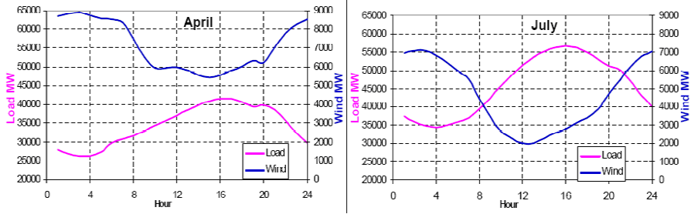
Wind Generation in ERCOT
Challenges: 1) intermittent, 2) wind and load patterns, 3) forecasting wind, 4) transmission system limitations
Source: www.ercot.com/content/wcm/training_courses/55/wind_operations_41111.pdf
23

Slide 25
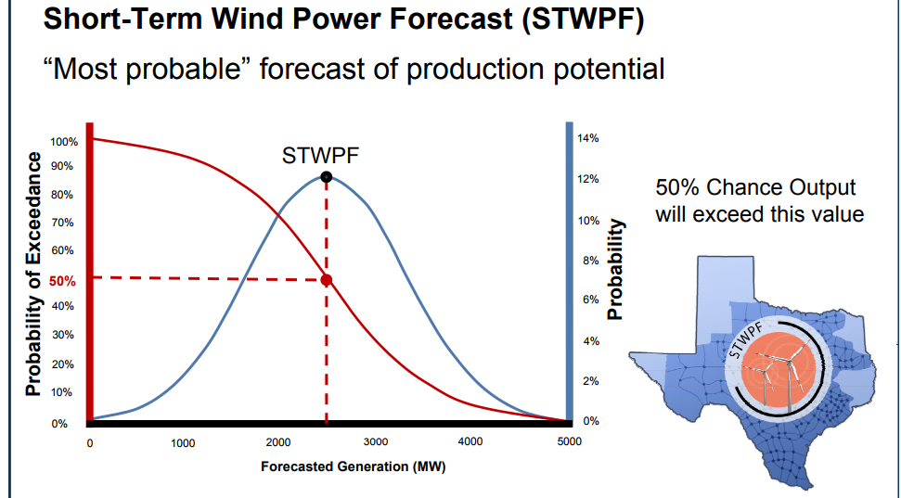
Wind Generation in ERCOT
ERCOT uses a variety of forecasts to estimate a wind power probability distribution
  E.g., total hourly capacity for next 48 hours, short-term forecasts for each wind generation resource (WGR) (hourly for next 48 hours)
Forecasts are used to set MW values used in the current operating plan (COP), which goes into the day
ahead market
Source: www.ercot.com/content/wcm/training_courses/55/wind_operations_41111.pdf
24

Slide 26
ERCOT Congestion Revenue Rights
Congestion revenue rights (CRRs) are financial instruments that result in a charge or payment to the owner when the ERCOT transmission system is congested in the day ahead market
They are tradable financial instruments for hedging of transmission congestion charges
There is a payment to the owner (or perhaps payment from the owner) when there are LMP cost differences
  Options (only payments), Obligations (payments or charges)
Can be acquired by CRR auction, bilateral trades or allocation
Source: www.ercot.com/mktinfo/crr
25

Slide 27
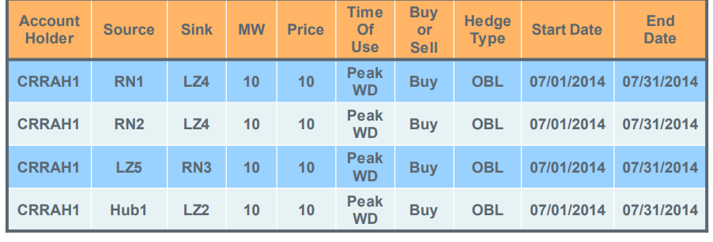
ERCOT Congestion Revenue Rights
Prior to auction ERCOT determines its system capacity
  Set on a monthly basis
  Modified based on pre-assigned CRRs (e.g., long-term supply)
They use a dc power flow model in the analysis
Auctioned or allocated in one month strips in time-of-use blocks (off-peak, peak weekday, peak weekend)
Source: www.ercot.com/content/wcm/training_courses/109553/CRR_2017_May.pdf
26

Slide 28
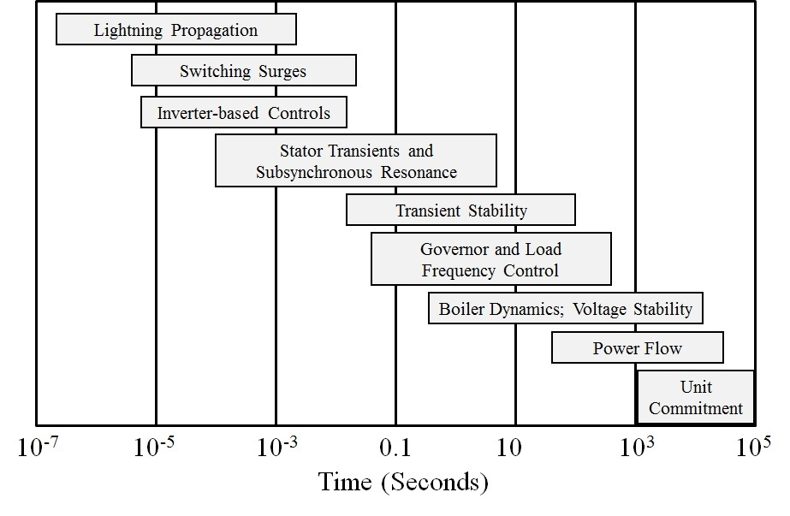
Power System Time Scales and Transient Stability
Image source: P.W. Sauer, M.A. Pai, Power System Dynamics and Stability, 1997, Fig 1.2, modified
27

Slide 29
Power System Stability Terms
Terms continue to evolve, but a good reference is [1]; image shows Figure 1 from this reference
[1] IEEE/CIGRE Joint Task Force on Stability Terms and Definitions, “Definitions and Classification of Power System Stability,” IEEE Transactions Power Systems, May 2004, pp. 1387-1401
28

Slide 30
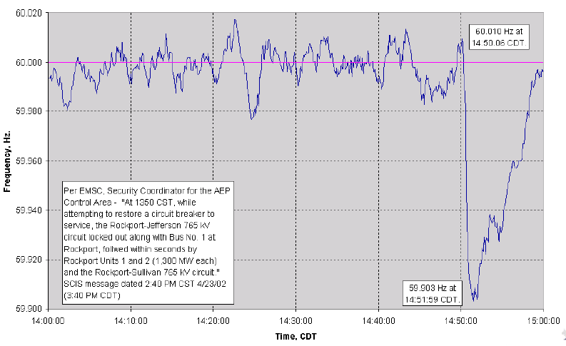
Example of Frequency Variation
Figure shows Eastern Interconnect frequency variation after loss of 2600 MWs
29

Slide 31
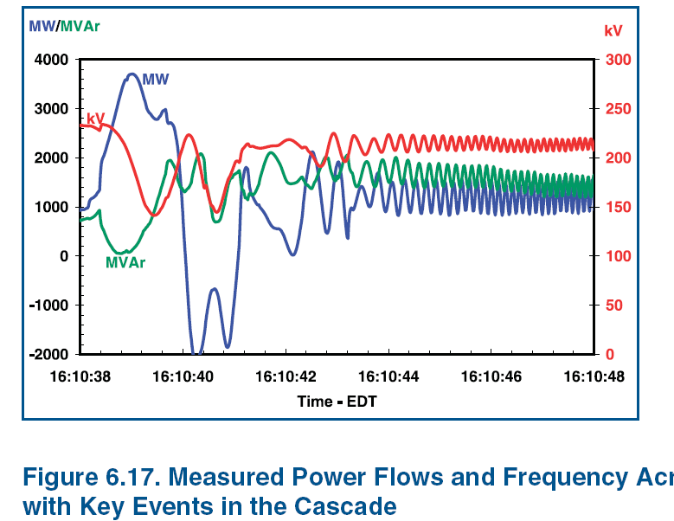
Example of Dynamics Behavior
Source: August 14th 2003 Blackout Final Report
30

Slide 32
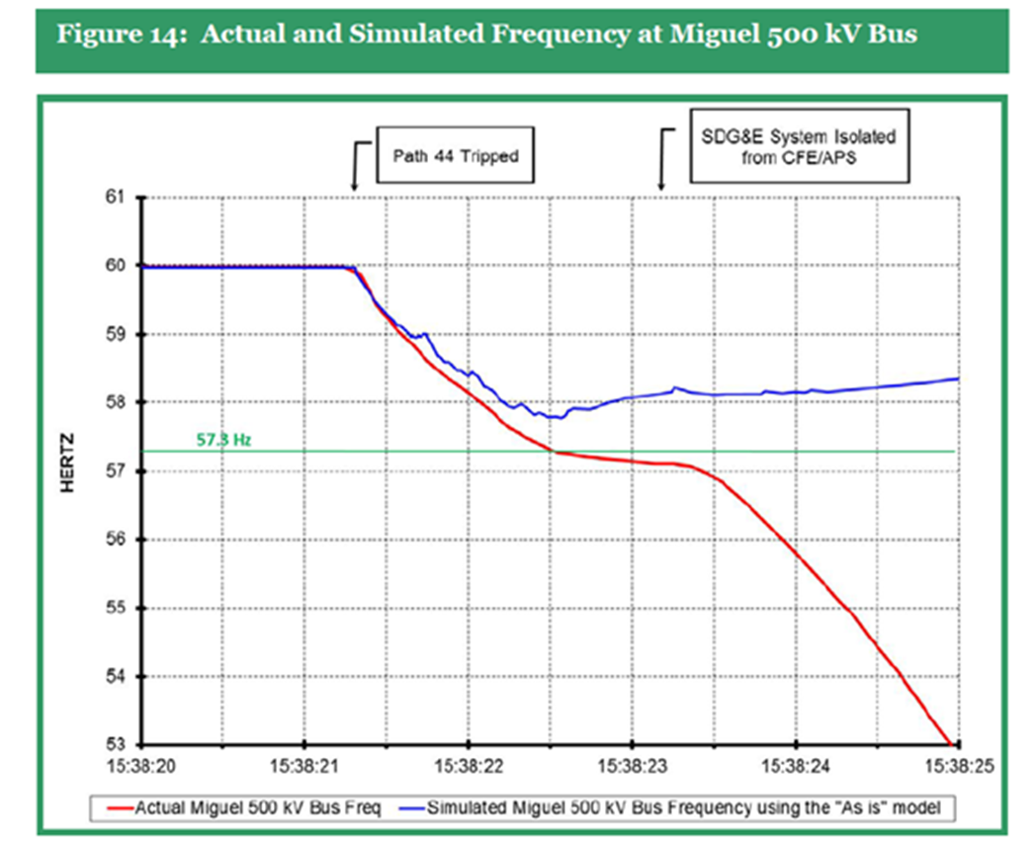
Power System Dynamics Motivation: Frequency Decline September 2011 Blackout
Image Source: Arizona-Southern California Outages on September 8, 2011 Report, FERC and NERC,April 2012
31

Slide 33
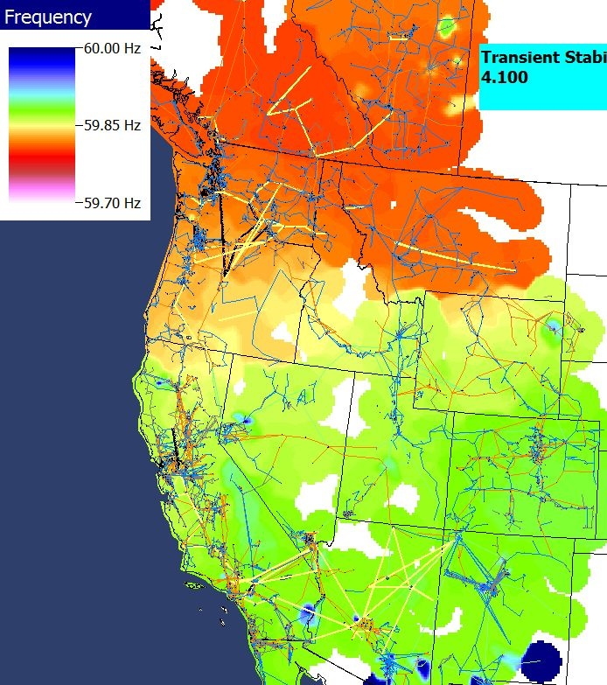
Power Grid Disturbance Example
Figures show the frequency change as a result of the sudden loss of a large amount of generation in the Southern WECC
Green is bus quite close to location of generator trip while blue and red are quite distant.
Time in Seconds
Frequency Contour
32

