Slide 1
ECEN 615 Methods of Electric Power Systems Analysis
Lecture 1: Power Systems Overview
Prof. Tom Overbye
Dept. of Electrical and Computer Engineering
Texas A&M University
overbye@tamu.edu

Slide 2
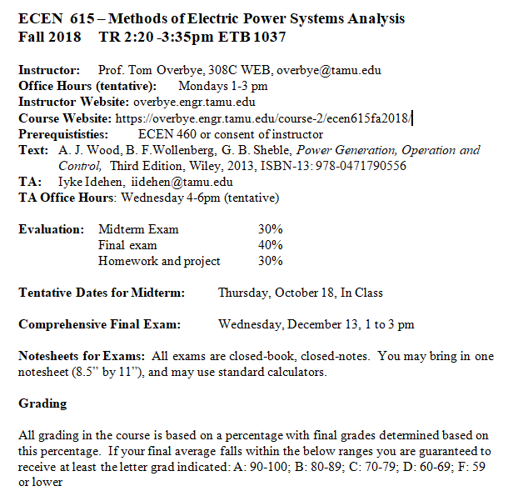
Syllabus
Slides will be posted before each lecture on the website

Slide 3
Course Topics
Introduction to Power Systems
Overview of Power System Modeling and Operation
Power Flow
Sparse Matrices in Power System Analysis
Sensitivity Analysis and Equivalents
Power System Data Analytics and Visualization
Optimal Power Flow and Power Markets
Power System State Estimation
Black start Analysis

Slide 4
Announcements
Start reading chapters 1 to 3 from the book (more background material)
Download the 42 bus educational version of PowerWorld Simulator at
https://www.powerworld.com/gloveroverbyesarma

Slide 5
About Me: Professional
Received BSEE, MSEE, and Ph.D. all from University of Wisconsin at Madison (83, 88, 91)
Worked for eight years as engineer for an electric utility (Madison Gas & Electric)
Was at UIUC from 1991 to 2016, doing teaching and doing research in the area of electric power systems
Joined TAMU in January 2017
Taught many power systems classes over last 27 years
Developed commercial power system analysis package, known now as PowerWorld Simulator. This package has been sold to about 600 different corporate entities worldwide
DOE investigator for 8/14/2003 blackout
Member US National Academy of Engineering

Slide 6
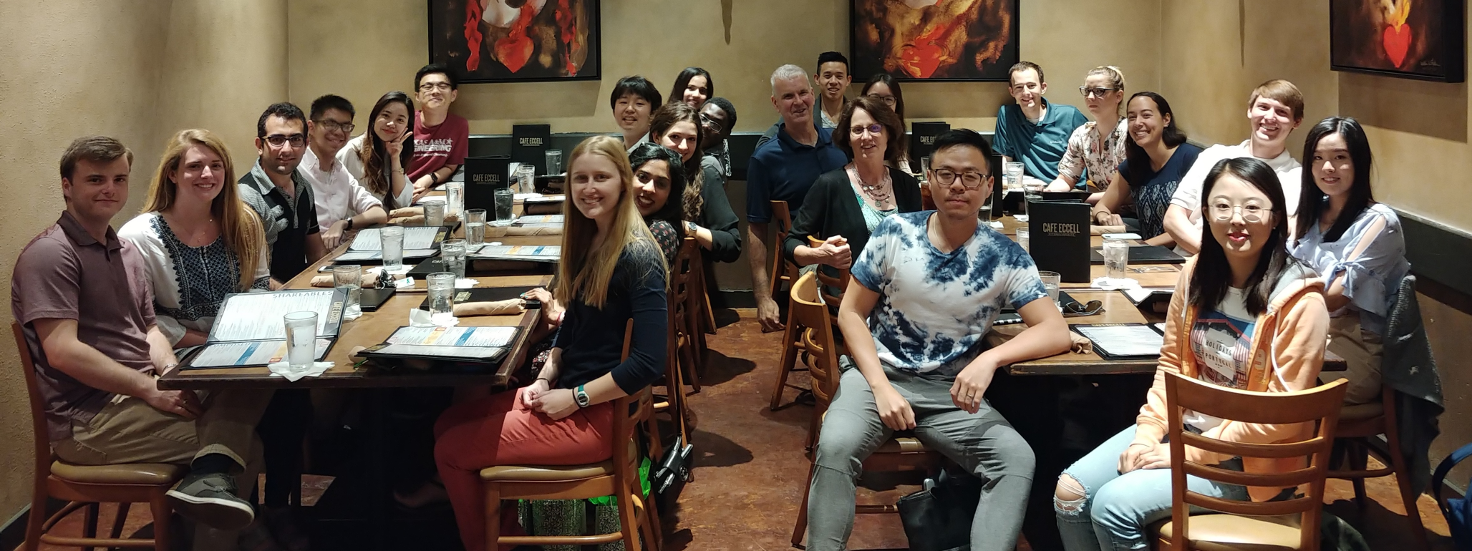
About Me: TAMU Research Group Spring and Summer 2018

Slide 7
About Me: Nonprofessional
Married to Jo
Have three children: Tim, Hannah and Amanda
We homeschooled our kids with Tim now starting an ME PhD at TAMU, Hannah a senior at UIUC in psychology, and Amanda a sophomore at Belmont in environmental sciences
Jo is finishing a master’s in counseling, we attend Grace Bible Church in College Station (and teach the 3rd and 4th graders sometimes); I also like swimming, biking and watching football (Aggies and Packers!)

Slide 8
About TA Iyke Idehen
Fifth year graduate student
BSc (ECE, University of Benin, Nigeria)
MSc (EE, Tuskegee University, Alabama)
Spent 2.3 years at UIUC, now at TAMU
Research Area
Power Systems and Control
Data Analytics, Visualization
Large-Scale Systems
Advisor: Prof. Tom Overbye
Hobbies & Interests: Soccer, Music, Travel
Former Co-chair, TPEC 2018
Hollywood, 2014
Co-Chair, Texas Power and Energy Conference (TPEC) 2018

Slide 9
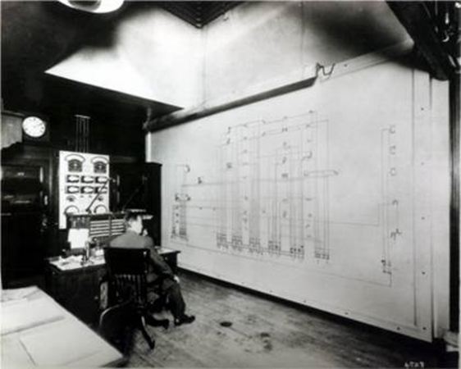
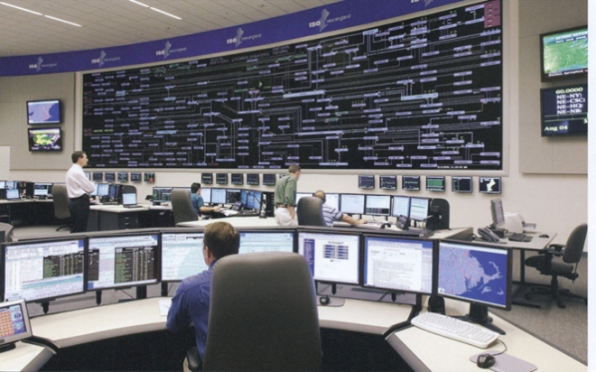
ECEN 615 Motivation: A Vision for a Long-Term Sustainable Electric Future
In 2000 the US National Academy of Engineering (NAE) named Electrification (the vast networks of electricity that power the developed world) as the top engineering technology of the 20th century
Beating automobiles (2), airplanes (3), water (4), electronics (5)
Electricity has changed the world!
For the 21th century the winner could be “Development of a sustainable and resilient electric infrastructure for the entire world”

Slide 10
Power System Examples
Electric utility: can range from quite small, such as an island, to one covering half the continent
there are four major interconnected ac power systems in North American, each operating at 60 Hz ac; 50 Hz is used in some other countries.
Microgrids can power smaller areas (like a campus) and can be optionally connected to the main grid
Airplanes and Spaceships: reduction in weight is primary consideration; frequency is 400 Hz.
Ships and submarines
Automobiles: dc 12 V standard; 360-376 V for electric
Battery operated portable systems

Slide 11
North America Interconnections

Slide 12
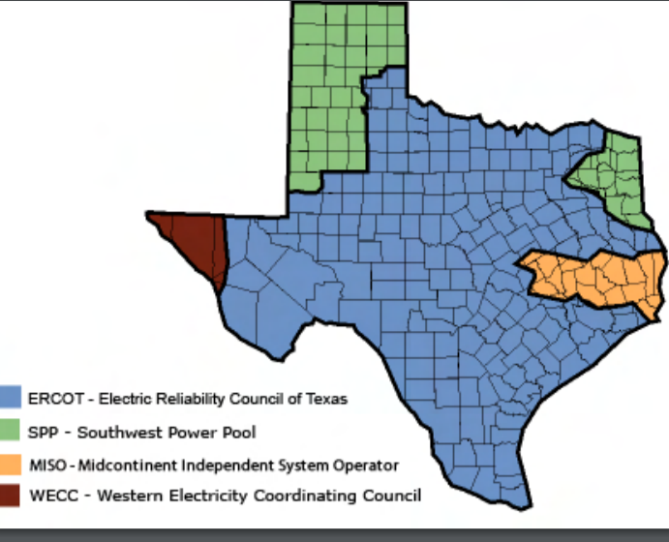
Electric Interconnections in Texas
Source: www.puc.texas.gov/industry/maps/maps/ERCOT.pdf

Slide 13
Electric Systems in Energy Context
Class focuses on electric power systems, but we first need to put the electric system in context of the total energy delivery system
Electricity is used primarily as a means for energy transportation
Use other sources of energy to create it, and it is usually converted into another form of energy when used
About 40% of US energy is transported in electric form
Concerns about need to reduce CO2 emissions and fossil fuel depletion are becoming main drivers for change in world energy infrastructure

Slide 14
Looking at the 2017 Energy Pie: Where the USA Got Its Energy
About 40% of our energy is consumed in the form of electricity, a percentage that is gradually increasing. The vast majority on the non-fossil fuel energy is electric!
In 2017 we got about 2.4% of our energy from wind and 0.8% from solar (PV and solar thermal), 2.8% from hydro
About 80% Fossil Fuels (89% in 1980 and 85% in 2000)
Total of 97.7 Quad; 1 Quad = 293 billion kWh (actual), 1 Quad = 98 billion kWh (used, taking into account efficiency)
EIA is US DOE Energy Information Administration
Source: EIA Monthly Energy Review, July 2018

Slide 15
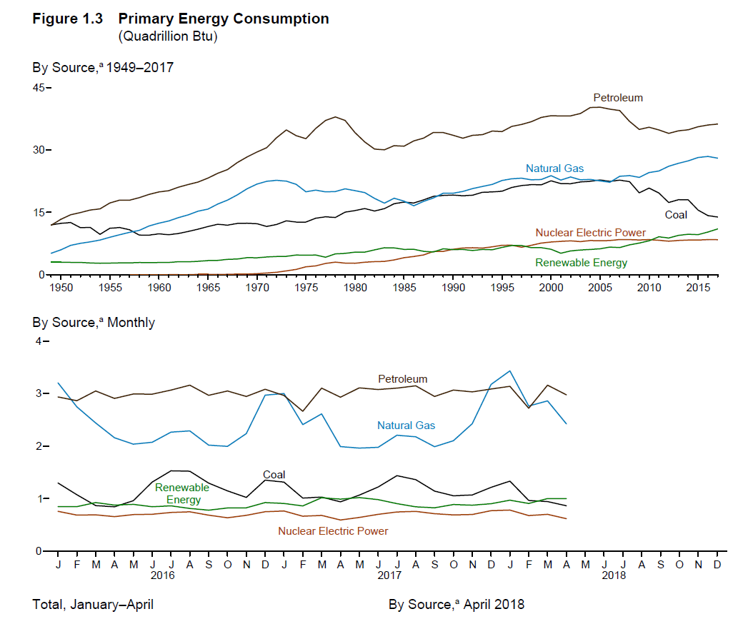
US Historical Energy Usage
Source: EIA Monthly Energy Review, July 2018

Slide 16
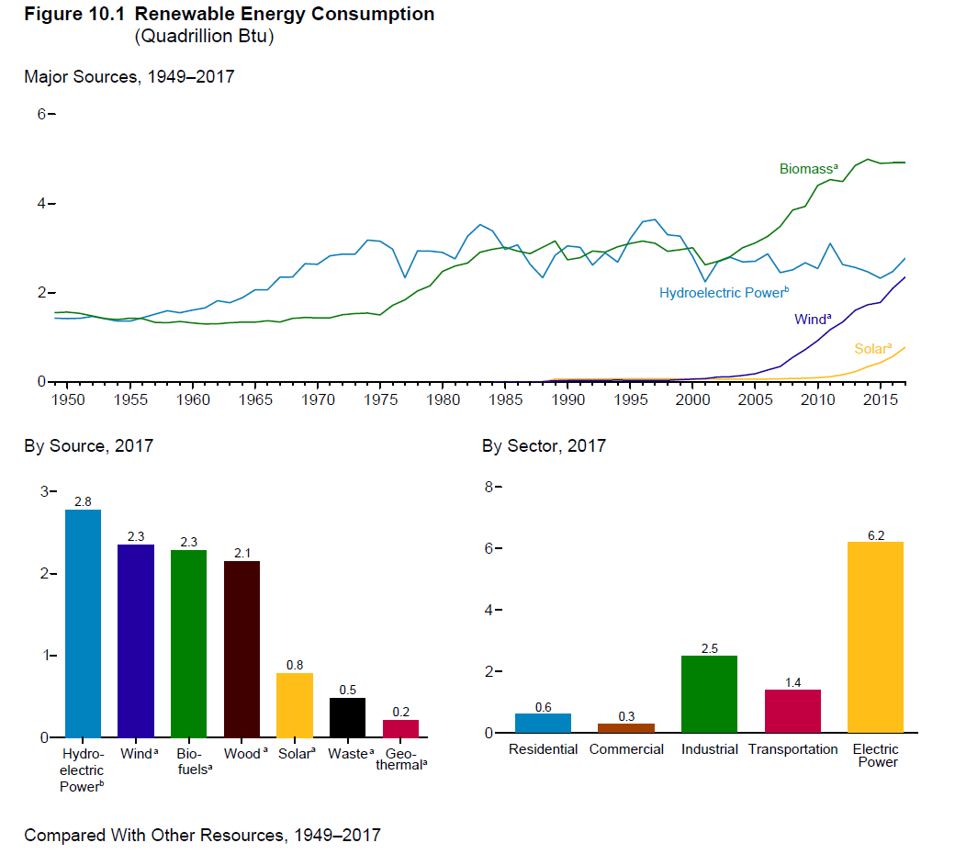
Renewable Energy Consumption
Source: EIA Monthly Energy Review, July 2018

Slide 17
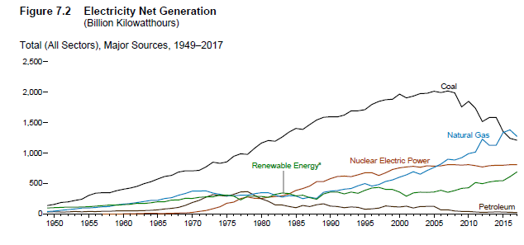
US Electricity Generation
In 2017 the major sources were coal (31%), natural gas (30.5%), nuclear (20.9%), hydro (7.7), wind (6.7%), and solar (2.0)
Wind and solar are rapidly growing (12% and 40% growth in 2017)
Source: EIA Monthly Energy Review, July 2018

Slide 18
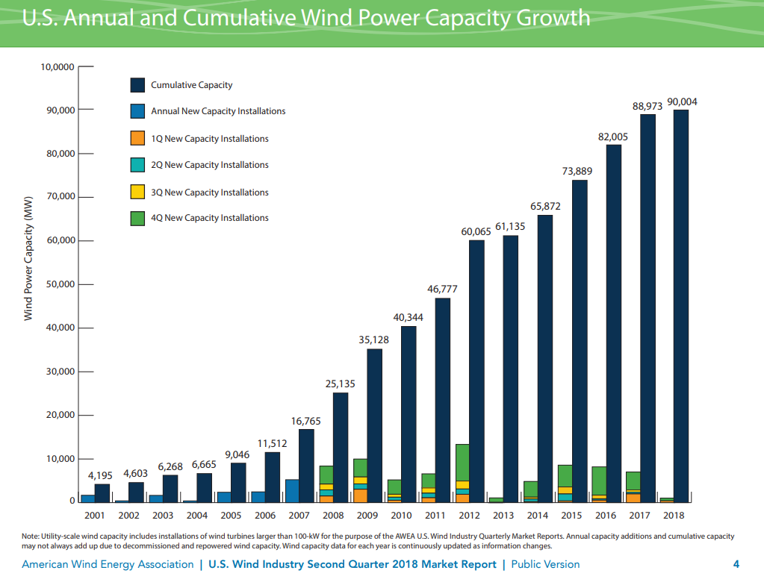
Growth in US Wind Power Capacity
Source: AWEA Wind Power Outlook Second Quarter, 2018

Slide 19
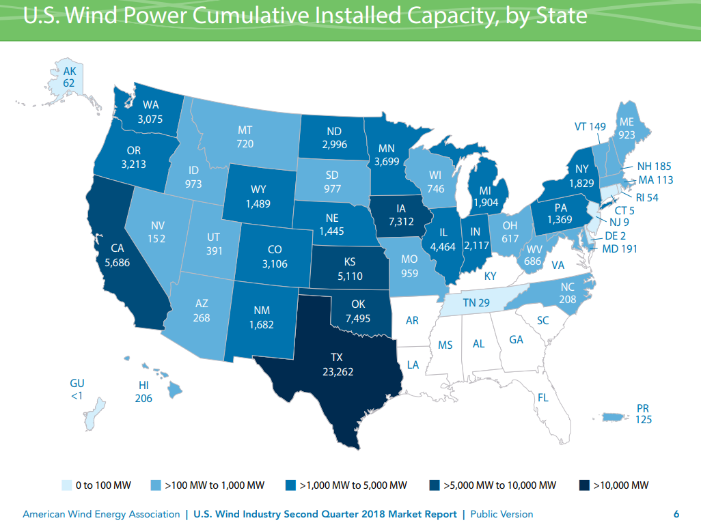
Wind Capacity Installations by State
Texas is number one!
Source: AWEA Wind Power Outlook Second Quarter, 2018

Slide 20
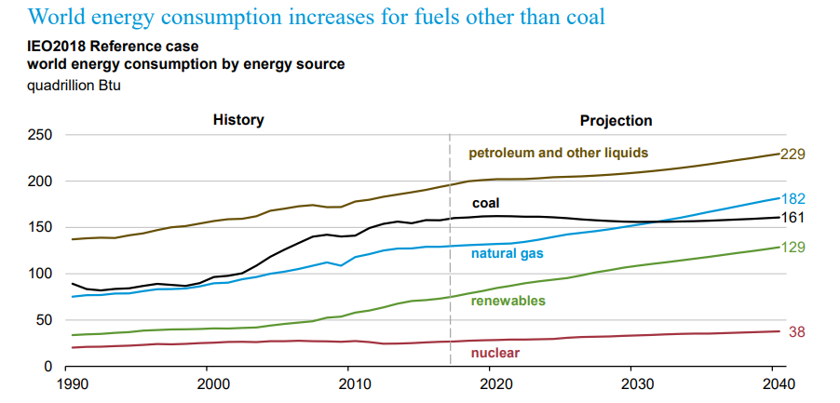
The World
Source: EIA, International Energy Outlook 2018

Slide 21
Energy Economics
Electric generating technologies involve a tradeoff between fixed costs (costs to build them) and operating costs
Nuclear and solar high fixed costs, but low operating costs (though cost of solar has decreased substantially recently)
Natural gas/oil have low fixed costs but can have higher operating costs (dependent upon fuel prices)
Coal, wind, hydro are in between
Also the units capacity factor is important to determining ultimate cost of electricity

Slide 22
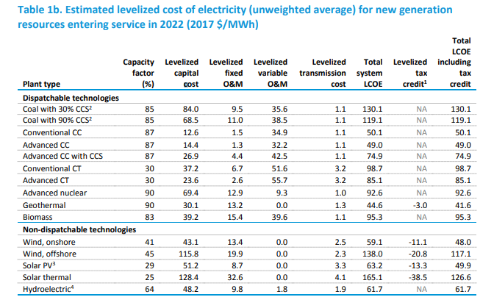
Estimated Energy Costs for New Generation
Source: www.eia.gov/outlooks/aeo/pdf/electricity_generation.pdf (March 2018)

Slide 23
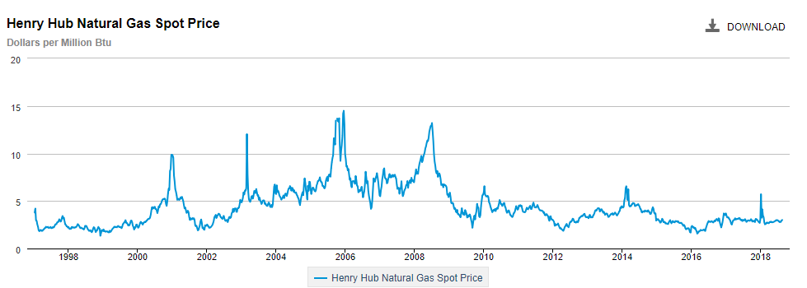
Natural Gas Prices 1997 to 2018
Marginal cost for natural gas fired electricity price
in $/MWh is about 7-10 times gas price
Source: http://www.eia.gov/dnav/ng/hist/rngwhhdW.htm

Slide 24
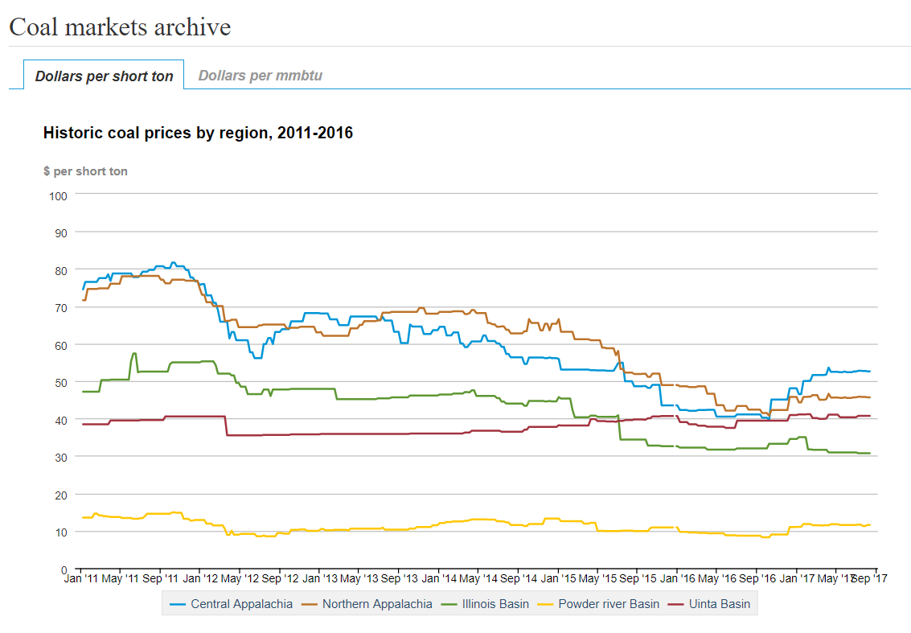
Coal Prices had Fallen But Are Now Back to Values from Five Years Ago
BTU content per pound varies between about 8000 and 15,000 Btu/lb, giving costs of around $1 to 2/Mbtu
Source: eia.gov/coal

Slide 25
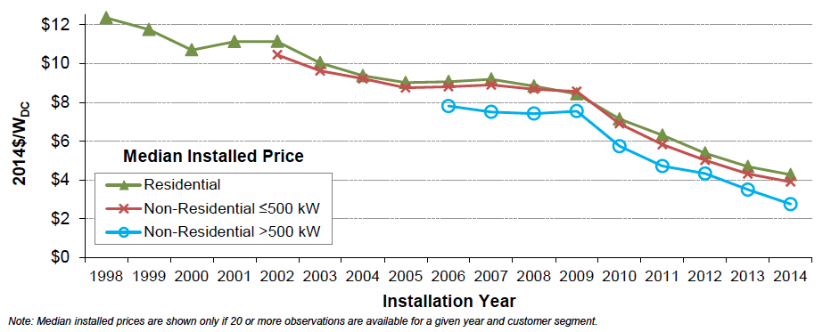
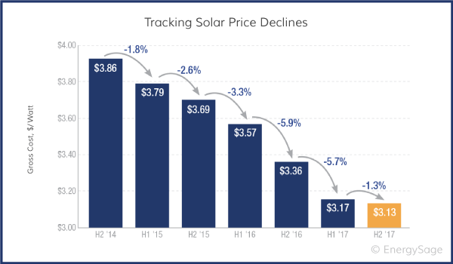
Solar PV Prices
Images: http://cleantechnica.com/2015/08/13/us-solar-pv-cost-fell-50-5-years-government-report/screen-shot-2015-08-12-at-12-33-53-pm/ and https://news.energysage.com/how-much-does-the-average-solar-panel-installation-cost-in-the-u-s/

Slide 26
Brief History of Electric Power
First real practical uses of electricity began with the telegraph (1860's) and then arc lighting in the 1870’s
Early 1880’s – Edison introduced Pearl Street dc system in Manhattan supplying 59 customers
1884 – Sprague produces practical dc motor
1885 – invention of transformer
Mid 1880’s – Westinghouse/Tesla introduce rival ac system
Late 1880’s – Tesla invents ac induction motor
1893 – Three-phase transmission line at 2.3 kV

Slide 27
History, cont’d
1896 – ac lines deliver electricity from hydro generation at Niagara Falls to Buffalo, 20 miles away; also 30kV line in Germany
Early 1900’s – Private utilities supply all customers in area (city); recognized as a natural monopoly; states step in to begin regulation
By 1920’s – Large interstate holding companies control most electricity systems

Slide 28
History, cont’d
1935 – Congress passes Public Utility Holding Company Act to establish national regulation, breaking up large interstate utilities (repealed 2005)
This gave rise to electric utilities that only operated in one state
1935/6 – Rural Electrification Act brought electricity to rural areas
1930’s – Electric utilities established as vertical monopolies
Frequency standardized in the 1930’s

Slide 29
Vertical Monopolies
Within a particular geographic market, the electric utility had an exclusive franchise
Generation
In return for this exclusive
franchise, the utility had the
obligation to serve all
existing and future customers
at rates determined jointly
by utility and regulators
It was a “cost plus” business
Transmission
Distribution
Customer Service

Slide 30
Vertical Monopolies
Within its service territory each utility was the only game in town
Neighboring utilities functioned more as colleagues than competitors
Utilities gradually interconnected their systems so by 1970 transmission lines crisscrossed North America, with voltages up to 765 kV
Economies of scale keep resulted in decreasing rates, so most every one was happy

Slide 31
History, cont’d -- 1970’s
1970’s brought inflation, increased fossil-fuel prices, calls for conservation and growing environmental concerns
Increasing rates replaced decreasing ones
As a result, U.S. Congress passed Public Utilities Regulator Policies Act (PURPA) in 1978, which mandated utilities must purchase power from independent generators located in their service territory (modified 2005)
PURPA introduced some competition

Slide 32
History, cont’d – 1990’s & 2000’s
Major opening of industry to competition occurred as a result of National Energy Policy Act of 1992
This act mandated that utilities provide “nondiscriminatory” access to the high voltage transmission
Goal was to set up true competition in generation
Result over the last few years has been a dramatic restructuring of electric utility industry (for better or worse!)
Energy Bill 2005 repealed PUHCA; modified PURPA

Slide 33
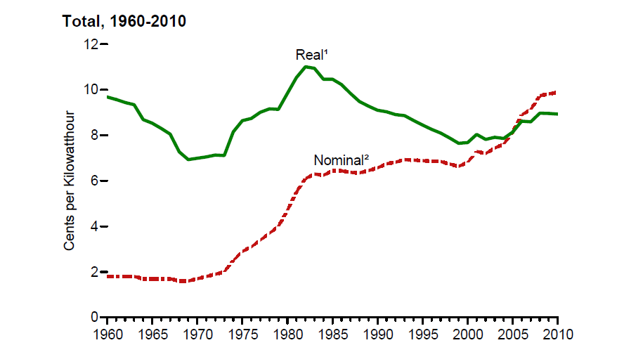
Electricity Prices, 1960-2010
Source: EIA, Annual Energy Review, 2010, Figure 8.10

Slide 34
Utility Restructuring
Driven by significant regional variations in electric rates
Goal of competition is to reduce rates through the introduction of competition
Eventual goal is to allow consumers to choose their electricity supplier

Slide 35
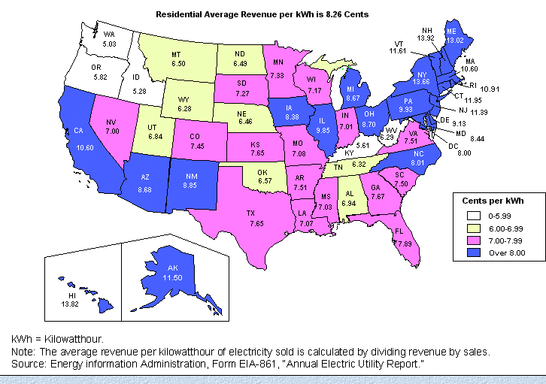
State Variation in Electric Rates

Slide 36
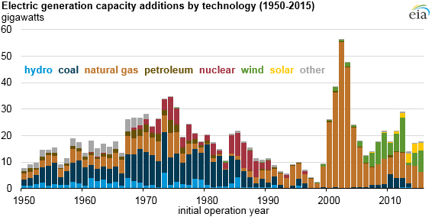
The Rise of Natural Gas Generation
Source: US EIA, 2016

Slide 37
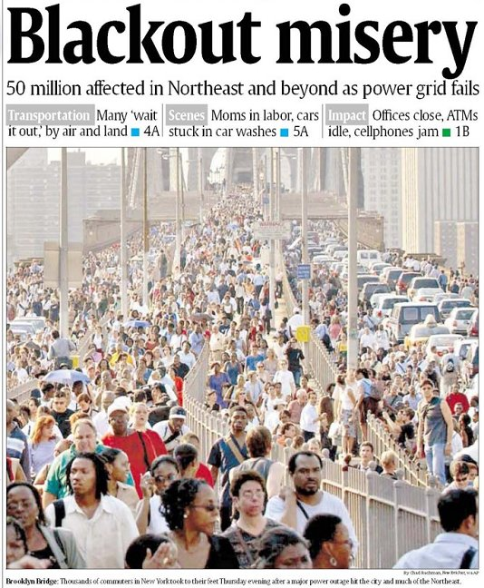
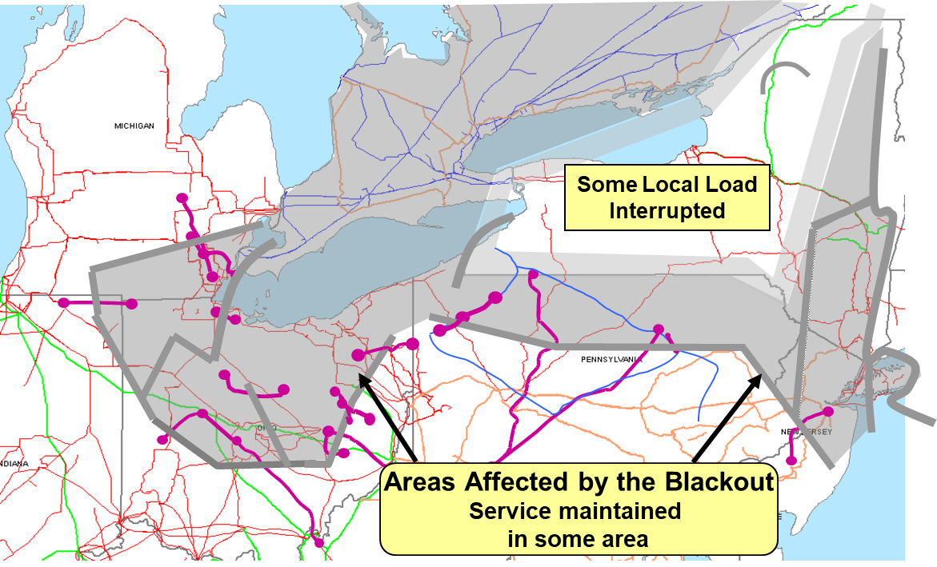
August 14th, 2003 Blackout
Above image from energy.gov, August 14, 2003 Blackout Final Report

