Slide 1
ECEN 615
Methods of Electric Power Systems Analysis
Lecture 22: Voltage Stability, PV and QV Curves, Geomagnetic Disturbances
Prof. Tom Overbye
Dept. of Electrical and Computer Engineering
Texas A&M University
overbye@tamu.edu

Slide 2
Announcements
Homework 5 is due today
Homework 6 is due on Tuesday Nov 27
Read Chapters 3 and 8 (Economic Dispatch and Optimal Power Flow)
2

Slide 3
Small Disturbance Voltage Collapse
At constant frequency (e.g., 60 Hz) the complex power transferred down a transmission line is S=VI*
  V is phasor voltage, I is phasor current
  This is the reason for using a high voltage grid
Line real power losses are given by RI² and reactive power losses by XI²
  R is the line’s resistance, and X its reactance; for a high voltage line X >> R
Increased reactive power tends to drive down the voltage, which increases the current, which further increases the reactive power losses
3

Slide 4
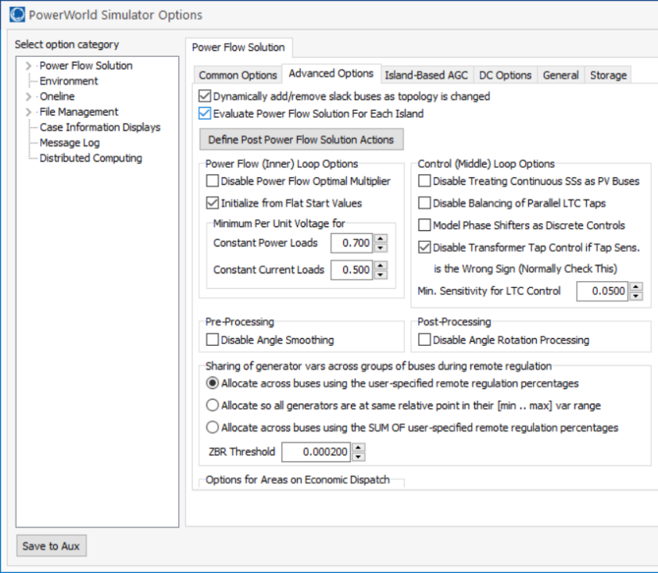
PowerWorld Two Bus Example
Commercial power flow software usually auto converts constant power loads at low voltages; set these fields to zero to disable this conversion
4

Slide 5
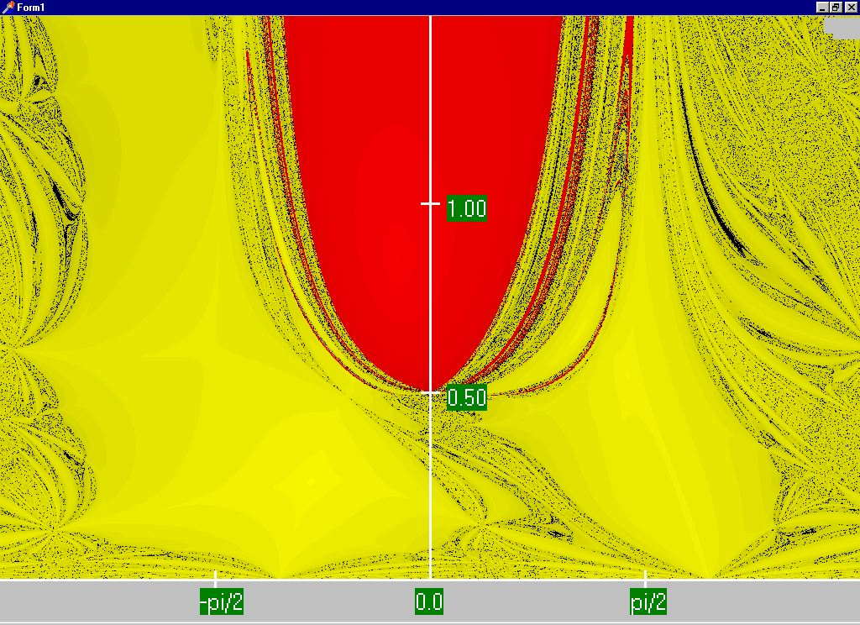
Power Flow Region of Convergence
Convergence
regions with
P=100 MW,
Q=0 Mvar
5

Slide 6
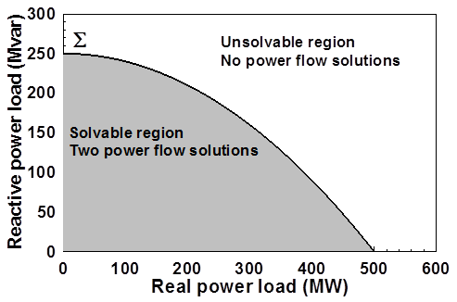
Load Parameter Space Representation
With a constant power model there is a maximum loadability surface, Σ
  Defined as point in which the power flow Jacobian is singular
  For the lossless two bus system it can be determined as
6

Slide 7
Load Model Impact
With a static load model regardless of the voltage dependency the same PV curve is traced
  But whether a point of maximum loadability exists depends on the assumed load model
    If voltage exponent is > 1 then multiple solutions do not exist (see B.C. Lesieutre, P.W. Sauer and M.A. Pai “Sufficient conditions on static load models for network solvability,”NAPS 1992, pp. 262-271)
Change load to constant impedance; hence it becomes a linear model
7

Slide 8
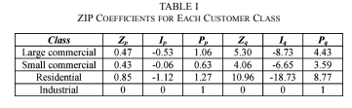
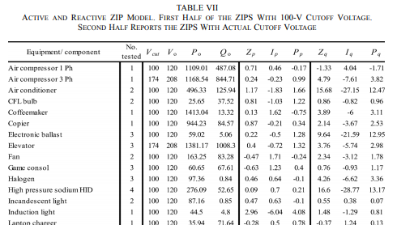
ZIP Model Coefficients
One popular static load model is the ZIP; lots of papers on the “correct” amount of each type
Table 1 from M. Diaz-Aguilo, et. al., “Field-Validated Load Model for the Analysis of CVR in Distribution Secondary Networks: Energy Conservation,” IEEE Trans. Power Delivery, Oct. 2013
Table 7 from A, Bokhari, et. al., “Experimental Determination of the ZIP Coefficients for Modern Residential, Commercial, and Industrial Loads,” IEEE Trans. Power Delivery, June. 2014
8

Slide 9
Application: Conservation Voltage Reduction (CVR)
If the “steady-state” load has a true dependence on voltage, then a change (usually a reduction) in the voltage should result in a total decrease in energy consumption
If an “optimal” voltage could be determined, then this could result in a net energy savings
Some challenges are 1) the voltage profile across a feeder is not constant, 2) the load composition is constantly changing, 3) a decrease in power consumption might result in a decrease in useable output from the load, and 4) loads are dynamic and an initial increase might be balanced by a later increase
9

Slide 10
Determining a Metric to Voltage Collapse
The goal of much of the voltage stability work was to determine an easy to calculate metric (or metrics) of the current operating point to voltage collapse
  PV and QV curves (or some combination) can determine such a metric along a particular path
  Goal was to have a path independent metric. The closest boundary point was considered,
  but this could be quite misleading
  if the system was not going to
  move in that direction
  Any linearization about the current operating point (i.e., the Jacobian) does not consider important nonlinearities like generators hitting their reactive power limits
10

Slide 11
Determining a Metric to Voltage Collapse
A paper by Dobson in 1992 (see below) noted that at a saddle node bifurcation, in which the power flow Jacobian is singular, that
  The right eigenvector associated with the Jacobian zero eigenvalue tells the direction in state space of the voltage collapse
  The left eigenvector associated with the Jacobian zero eigenvalue gives the normal in parameter space to the boundary Σ. This can then be used to estimate the minimum distance in parameter space to bifurcation.
I. Dobson, “Observations on the Geometry of Saddle Node Bifurcation and Voltage Collapse in Electrical Power
Systems,” IEEE Trans. Circuits and Systems, March 1992
11

Slide 12
Determining a Metric to Voltage Collapse Example
For the previous two bus example we had
12

Slide 13
Determining a Metric to Voltage Collapse Example
Calculating the right and left eigenvalues associated with the zero eigenvalue we get
13

Slide 14
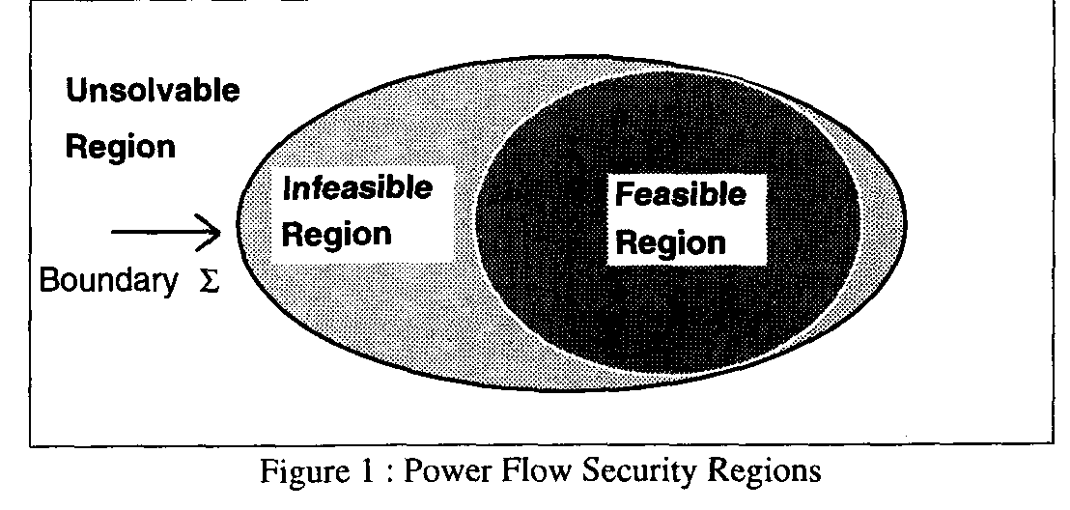
Quantifying Power Flow Unsolvability
Since lack of power flow convergence can be a major problem, it would be nice to have a measure to quantify the degree of unsolvability of a power flow
  And then figure out the best way to restore solvabiblity
T.J. Overbye, “A Power Flow Measure for Unsolvable Cases,” IEEE Trans. Power Systems, August 1994
14

Slide 15
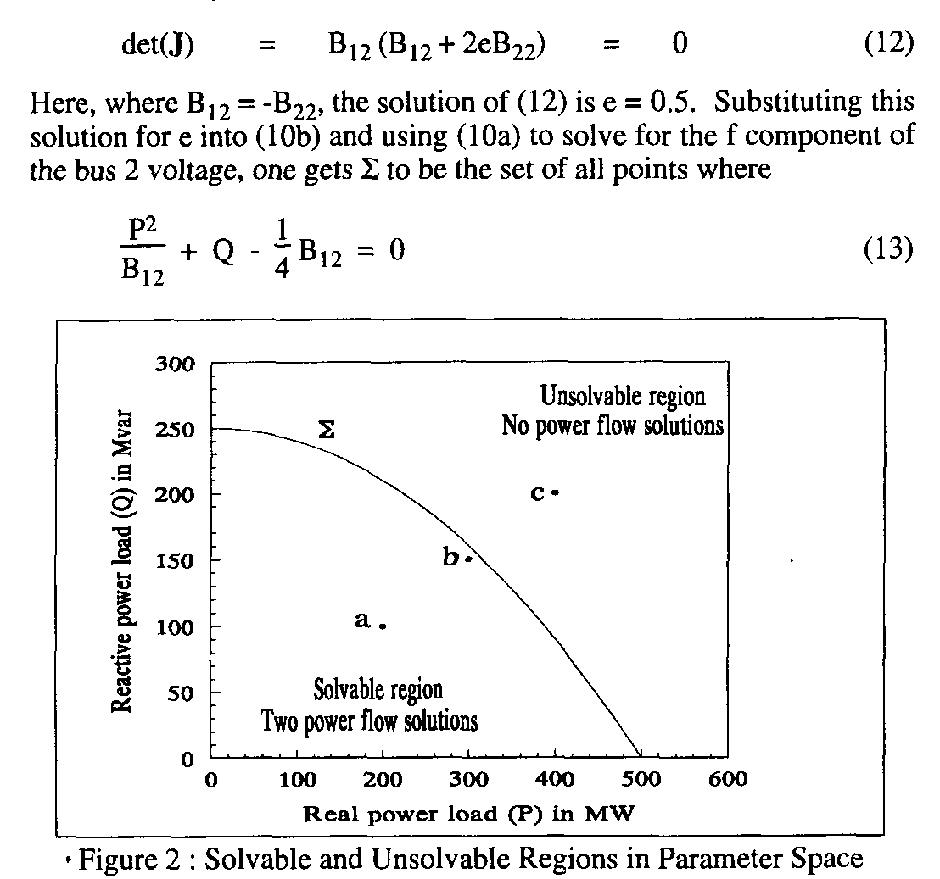
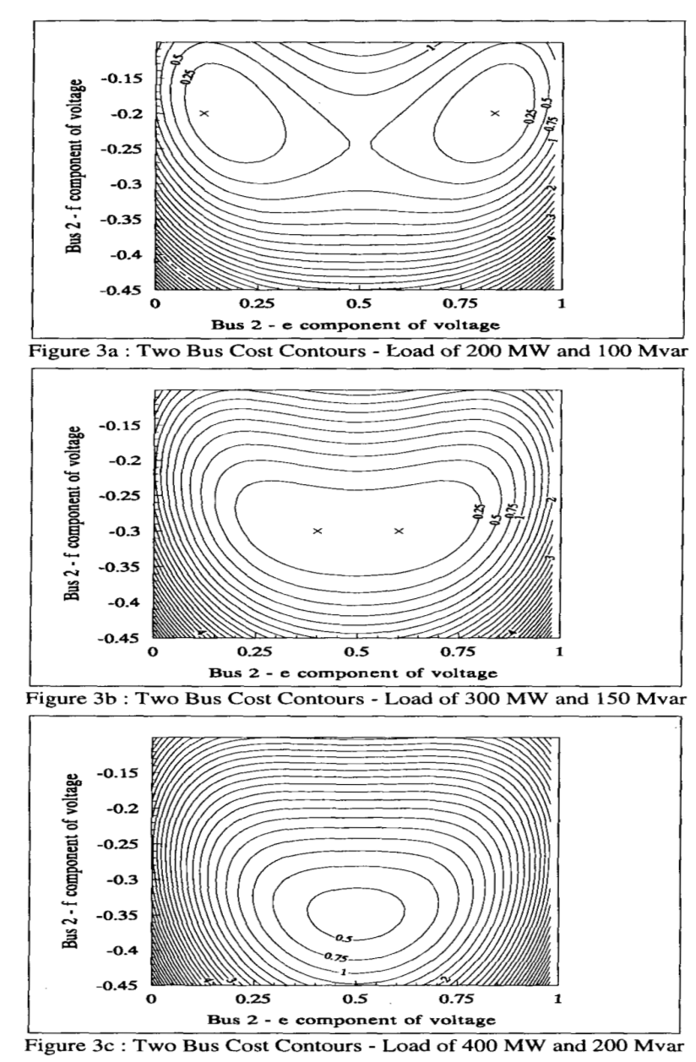
Quantifying Power Flow Unsolvability
15

Slide 16
Quantifying Power Flow Unsolvability
To setup the problem, first consider the power flow iteration without and with the optimal multiplier
16

Slide 17
Quantifying Power Flow Unsolvability
However, when there is not solution the standard power flow would diverge. But the approach with the optimal multiplier tends to point in the direction of minimizing F(x^{k+1}). That is,
17

Slide 18
Quantifying Power Flow Unsolvability
The only way we cannot reduce the cost function some would be if the two directions were perpendicular, hence with a zero dot product. So
18

Slide 19
Quantifying Power Flow Unsolvability
The left eigenvector associated with the zero eigenvalue of the Jacobian (defined as w^{i*}) is perpendicular to Σ (as noted in the early 1992 Dobson paper)
We can get the closest point on the Σ just by iterating, updating the S Vector as
(here S is the initial power injection, x^{i*} a boundary solution)
Converges when
19

Slide 20
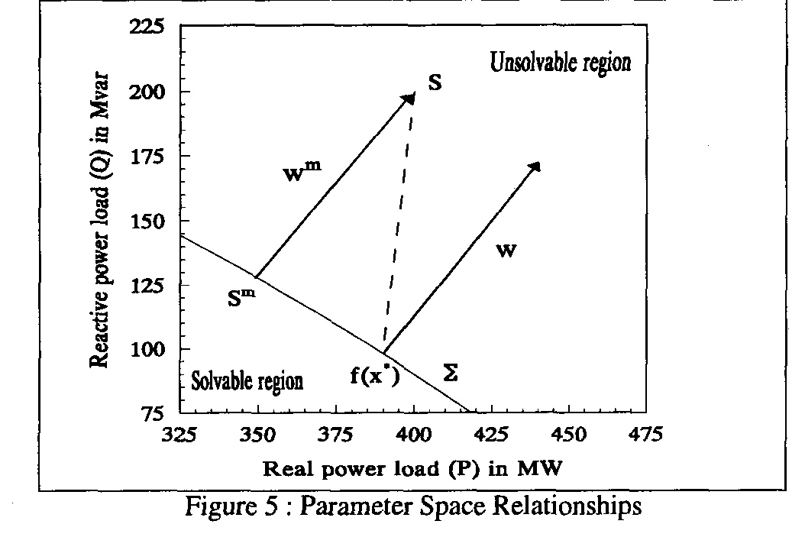
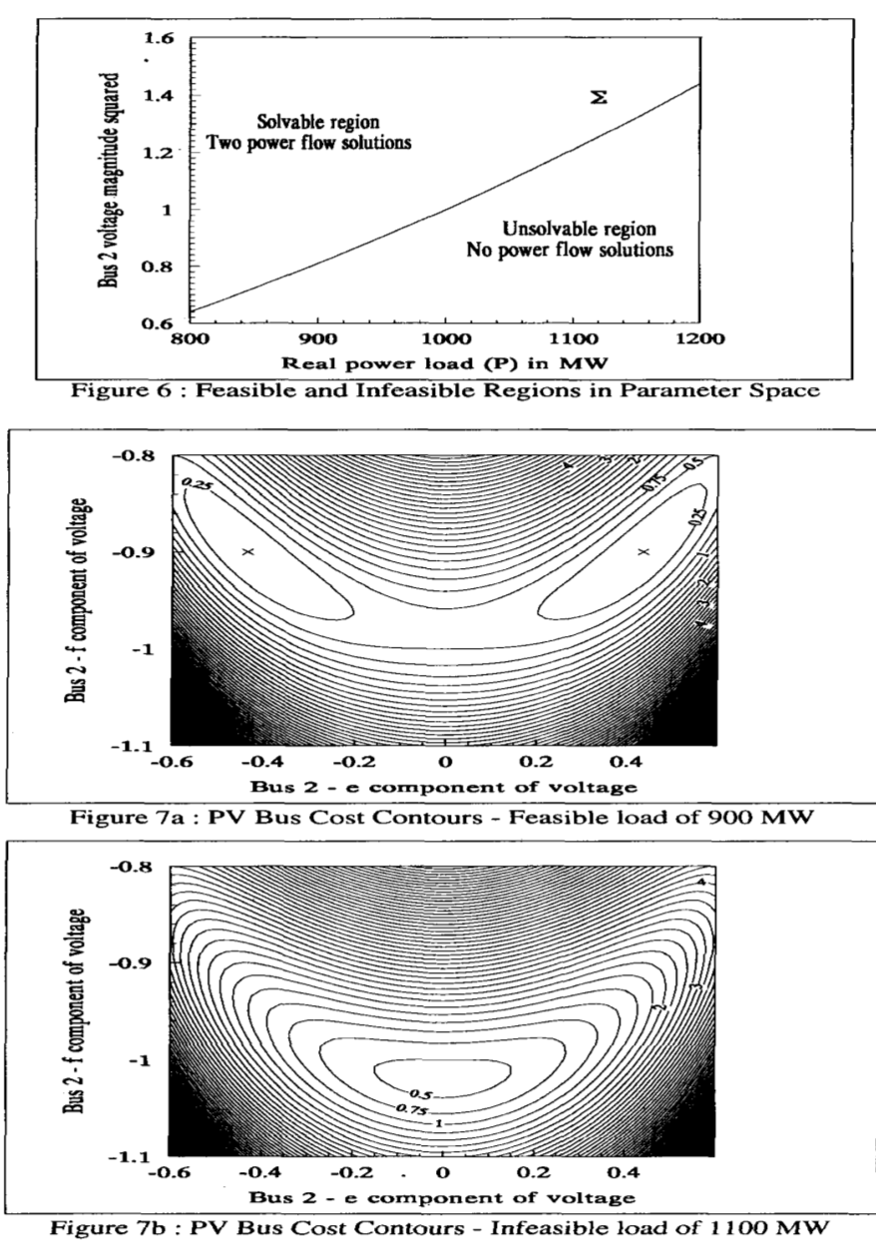
Quantifying Power Flow Unsolvability
If Σ were flat then w is parallel to w^{m}
20

Slide 21
Challenges
The key issues is actual power systems are quite complex, with many nonlinearities. For example, generators hitting reactive power limits, switched shunts, LTCs, phase shifters, etc.
Practically people would like to know how far some system parameters can be changed before running into some sort of limit violation, or maximum loadability.
  The system is changing in a particular direction, such as a power transfer; his often includes contingency analysis
Line limits and voltage magnitudes are considered
  Lower voltage lines tend to be thermally constrained
Solution is to just to trace out the PV or QV curves
21

Slide 22
PV and QV Analysis in PowerWorld
Requires setting up what is known in PowerWorld as an injection group
  An injection group specifies a set of objects, such as generators and loads, that can inject or absorb power
  Injection groups can be defined by selecting Case Information, Aggregation, Injection Groups
The PV and/or QV analysis then varies the injections in the injection group, tracing out the PV curve
This allows optional consideration of contingencies
The PV tool can be displayed by selecting Add-Ons, PV
22

Slide 23
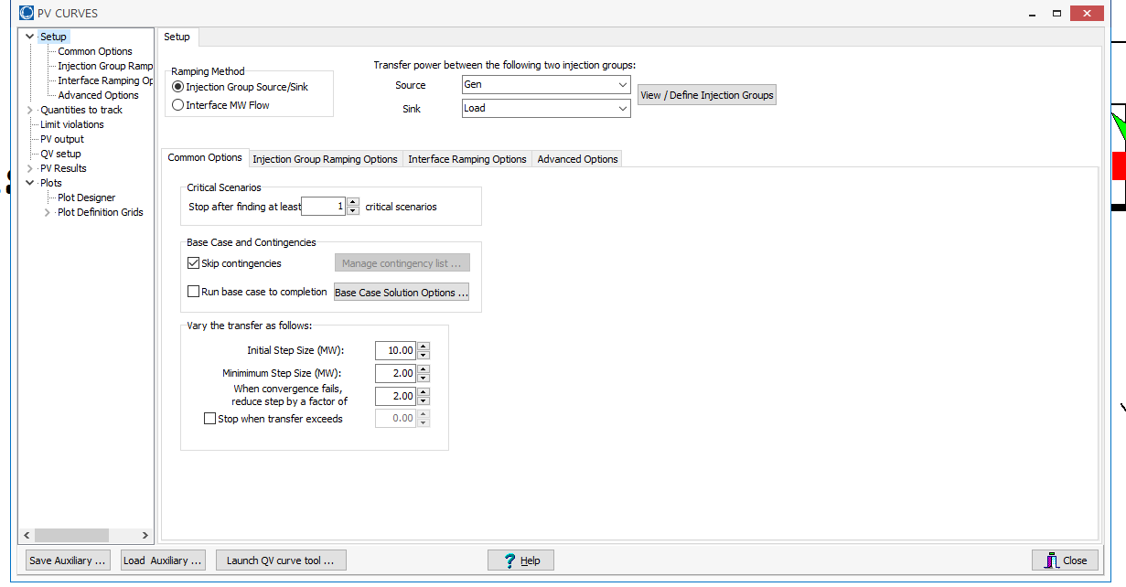
PV and QV Analysis in PowerWorld: Two Bus Example
Setup page defines the source and sink and step size
23

Slide 24
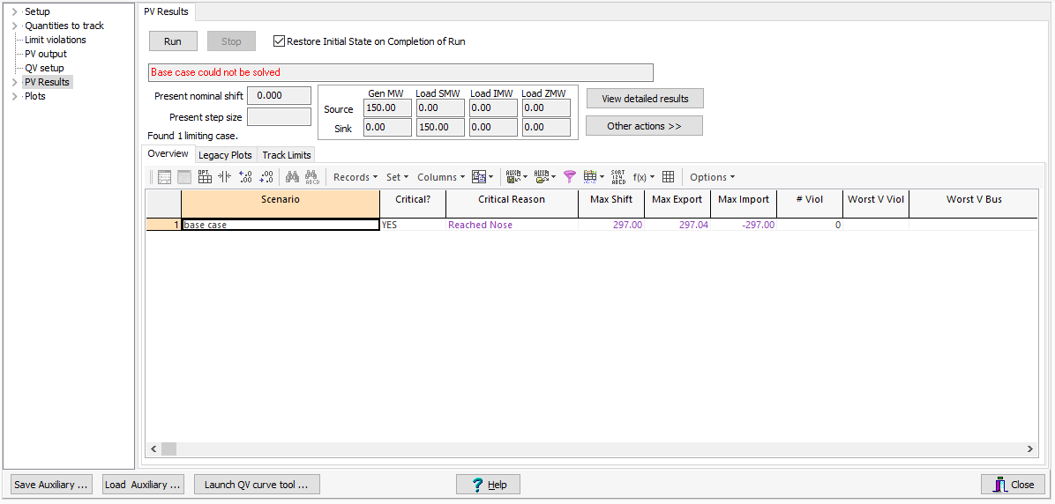
PV and QV Analysis in PowerWorld: Two Bus Example
The PV Results Page does the actual solution
  Plots can be defined to show the results
  Other Actions, Restore initial state restores the pre-study state
Click the Run button
to run the PV analysis;
Check the Restore
Initial State on
Completion of Run to
restore the pre-PV
state (by default it is
not restored)
24

Slide 25
PV and QV Analysis in PowerWorld: Two Bus Example
25

Slide 26
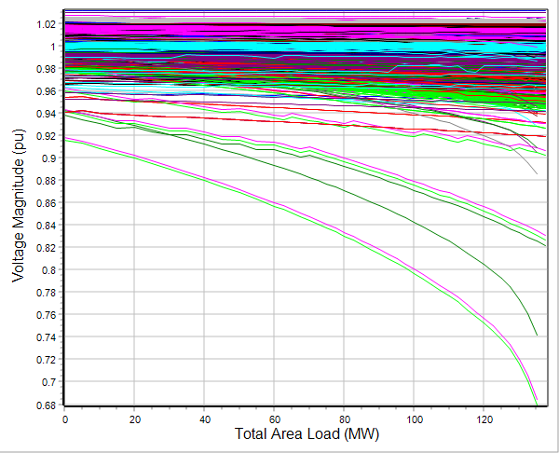
PV and QV Analysis in PowerWorld: 37 Bus Example
Usually other limits also need to be considered in
doing a realistic PV analysis
26

Slide 27
High-Impact, Low-Frequency Events
Growing concern to consider what the NERC calls calls High-Impact,
Low-Frequency Events
(HILFs); others call them
black sky days
  Large-scale, potentially long duration blackouts
  HILFs identified by NERC
  were 1) a coordinated cyber,
  physical or blended attacks, 2) pandemics, 3) geomagnetic disturbances (GMDs), and 4) HEMPs
The next several slides will consider GMDs and HEMPs
Image Source: NERC, 2012
27

Slide 28
Geomagnetic Disturbances (GMDs)
GMDs are caused by solar corona mass ejections (CMEs) impacting the earth’s magnetic field
A GMD caused a blackout in 1989 of Quebec
They have the potential to severely disrupt the electric grid by causing quasi-dc geomagnetically induced currents (GICs) in the high voltage grid
Until recently power engineers had few tools to help them assess the impact of GMDs
GMD assessment tools are now moving into the realm of power system planning and operations engineers; required by NERC Standards (TPL 007-1, 007-2)
28

Slide 29
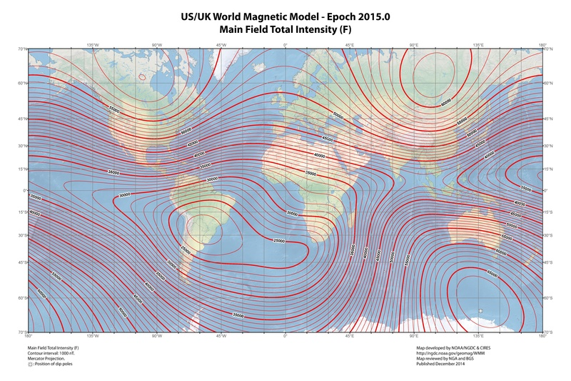
Earth’s Magnetic Field
The earth’s
magnetic
field is
usually
between
25,000 and
65,000 nT
Image Source: Wikepedia
29

Slide 30
Earth’s Magnetic Field Variations
The earth’s magnetic field is constantly changing, though usually the variations are not significant
  Larger changes tend to occur closer to the earth’s magnetic poles
The magnitude of the variation at any particular location is quantified with a value known as the K-index
  Ranges from 1 to 9, with the value dependent on nT variation in horizontal direction over a three hour period
  This is station specific; higher variations are required to get a k=9 closer to the poles
The Kp-index is a weighted average of the individual station K-indices; G scale approximately is Kp - 4
30

Slide 31
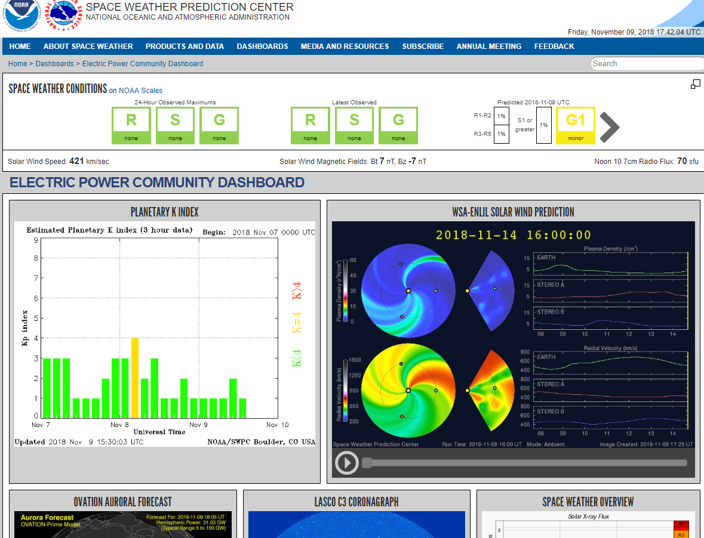
Space Weather Prediction Center has an Electric Power Dashboard
www.swpc.noaa.gov/communities/electric-power-community-dashboard
31

Slide 32
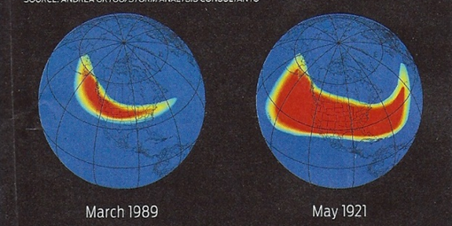
GMD and the Grid
Large solar corona mass ejections (CMEs) can cause large changes in the earth’s magnetic field (i.e., dB/dt). These changes in turn produce a non-uniform electric field at the surface
  Changes in the magnetic flux are usually expressed in nT/minute; from a 60 Hz perspective they are almost dc
  1989 North America storm produced
  a change of 500 nT/minute, while a
  stronger storm, such as the ones in
  1859 or 1921, could produce
  2500 nT/minute variation
  Storm “footprint” can be continental in scale
32

Slide 33
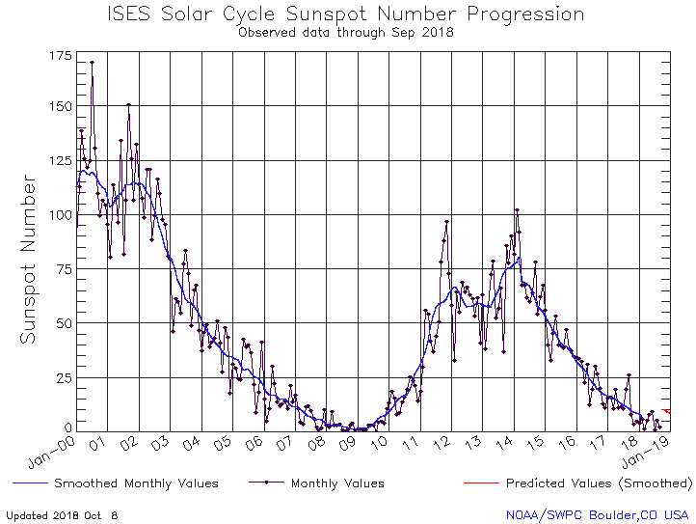
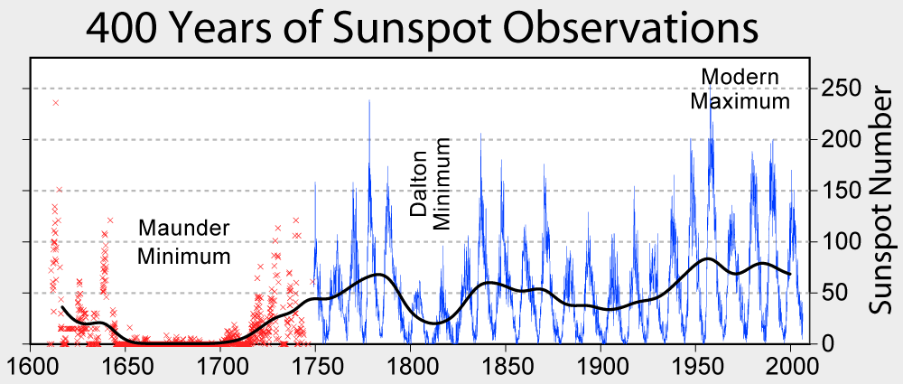
Solar Cycles
Sunspots follow an 11 year cycle, and have been observed for hundreds of years
We're in solar cycle 24 (first numbered cycle was in 1755); minimum was in 2009, maximum in 2014/2015
Images from NASA, NOAA
33

Slide 34
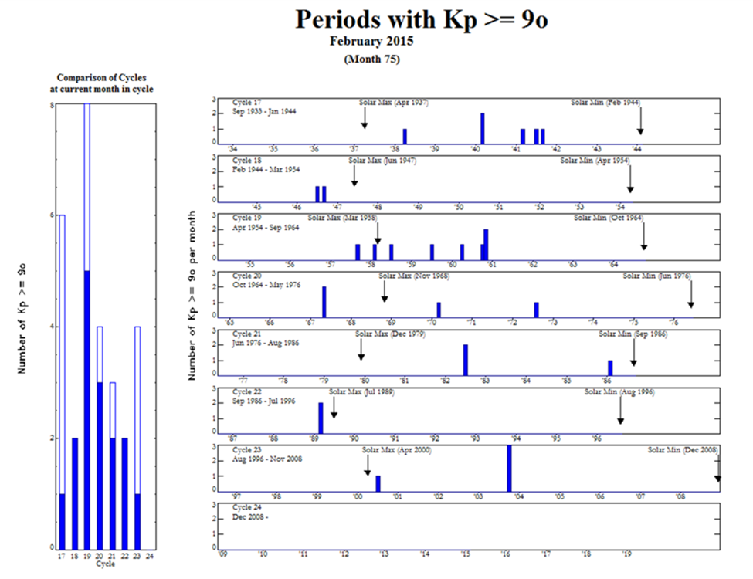
But Large CMEs Are Not Well Correlated with Sunspot Maximums
The large
1921 storm
occurred
four years
after the
1917
maximum
34

Slide 35
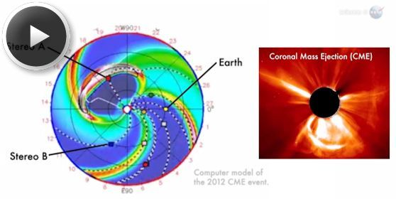
July 2012 GMD Near Miss
In July 2014 NASA said in July of 2012 there was a solar CME that barely missed the earth
  It would likely have
  caused the largest
  GMD that we have
  seen in the last 150
  years
There is still lots of
uncertainly about
how large a storm
is reasonable to
consider in electric utility planning
Image Source: science.nasa.gov/science-news/science-at-nasa/2014/23jul_superstorm/
35

Slide 36
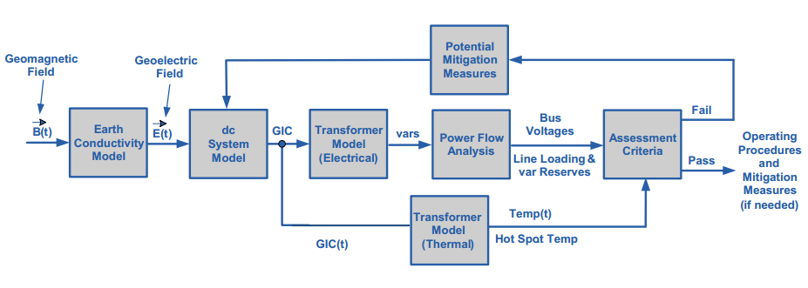
Overview of GMD Assessments
In is a quite interdisciplinary problem
Starting Here
The two key concerns from a big storm are 1) large-scale blackout
due to voltage collapse, 2) permanent transformer damage due to
overheating
Image Source: http://www.nerc.com/pa/Stand/WebinarLibrary/GMD_standards_update_june26_ec.pdf
36

Slide 37
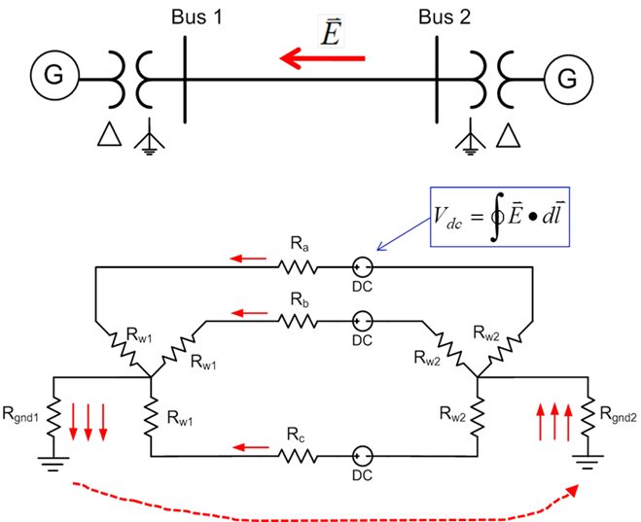
Geomagnetically Induced Currents (GICs
GMDs cause slowly varying electric fields
Along length of a high voltage transmission line, electric fields can be modeled as a dc voltage source superimposed on the lines
These voltage sources
produce quasi-dc
geomagnetically induced
currents (GICs) that are
superimposed on the ac
(60 Hz) flows
37

Slide 38
GIC Calculations for Large Systems
With knowledge of the pertinent transmission system parameters and the GMD-induced line voltages, the dc bus voltages and flows are found by solving a linear equation I = G V (or J = G U)
  J and U may be used to emphasize these are dc values, not the power flow ac values
  The G matrix is similar to the Y_{bus} except 1) it is augmented to include substation neutrals, and 2) it is just resistive values (conductances)
    Only depends on resistance, which varies with temperature
  Being a linear equation, superposition holds
  The current vector contains the Norton injections associated with the GMD-induced line voltages
38

Slide 39
GIC Calculations for Large Systems
Factoring the sparse G matrix and doing the forward/backward substitution takes about 1 second for the 60,000 bus Eastern Interconnect Model
The current vector (I) depends upon the assumed electric field along each transmission line
  This requires that substations have correct geo-coordinates
With nonuniform fields an exact calculation would be path dependent, but just a assuming a straight line path is probably sufficient (given all the other uncertainties!)
39

Slide 40
Four Bus Example (East-West Field)
The line and transformer resistance and current values are per phase so the total current is three times this value. Substation grounding values are total resistance. Brown arrows show GIC flow.
Case name is GIC_FourBus
40

Slide 41
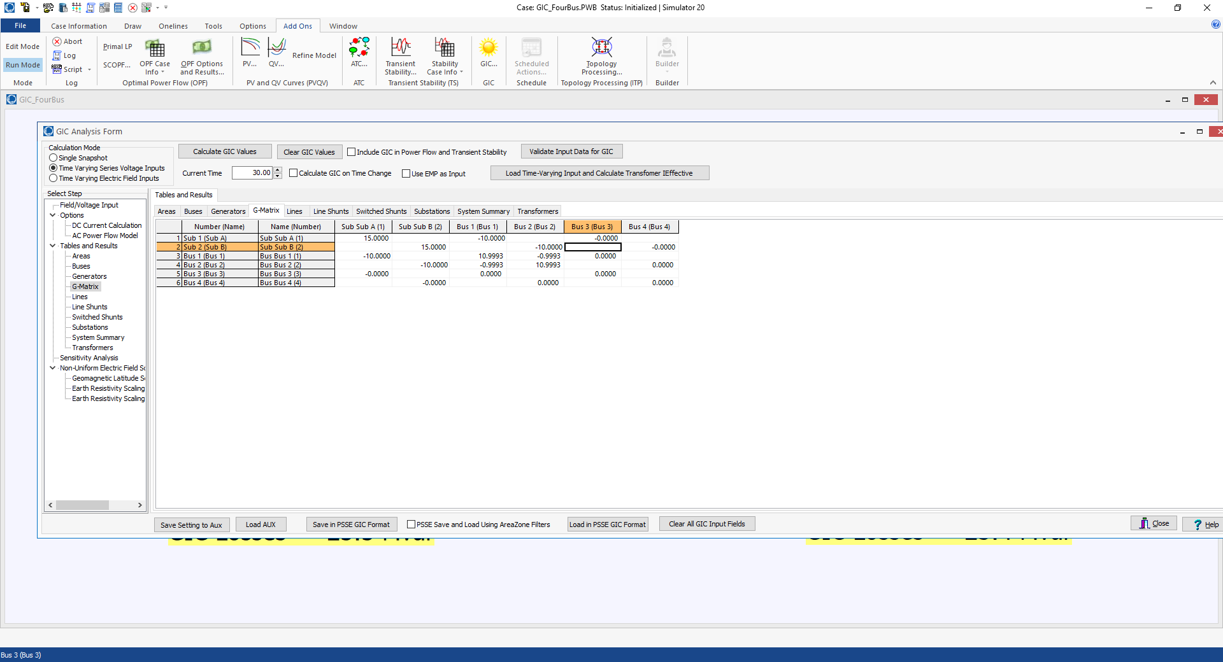
Four Bus Example GIC G Matrix
41

Slide 42
GICs, Generic EI, 5 V/km East-West
42

Slide 43
GICs, Generic EI, 5 V/km North-South
43

Slide 44
Determining GMD Storm Scenarios
The starting point for the GIC analysis is an assumed storm scenario; sets the line dc voltages
Matching an actual storm can be complicated, and requires detailed knowledge of the geology
GICs vary linearly with the assumed electric field magnitudes and reactive power impacts on the transformers is also mostly linear
Working with space weather community to determine highest possible storms
NERC proposed a non-uniform field magnitude model that FERC has partially accepted
44

Slide 45
Electric Field Linearity
If an electric field is assumed to have a uniform direction everywhere (like with the current NERC model), then the calculation of the GICs is linear
  The magnitude can be spatially varying
This allows for very fast computation of the impact of time-varying functions (like with the NERC event)
PowerWorld now provides support for loading a specified time-varying sequence, and quickly calculating all of the GIC values
45

Slide 46
Overview of GMD Assessments
In is a quite interdisciplinary problem
Next we go here
The two key concerns from a big storm are 1) large-scale blackout
due to voltage collapse, 2) permanent transformer damage due to
overheating
Image Source: http://www.nerc.com/pa/Stand/WebinarLibrary/GMD_standards_update_june26_ec.pdf
46

