Slide 1
ECEN 615
Methods of Electric Power Systems Analysis
Lecture 26: Optimal Power Flow, Security Constrained OPF, Optimization
Prof. Tom Overbye
Dept. of Electrical and Computer Engineering
Texas A&M University
overbye@tamu.edu

Slide 2
Announcements
Homework 6 is due now
Course evaluations are now available. Goto pica.tamu.edu
  Please do the evaluation!!
Final exam is Wednesday Dec 12, 1 to 3pm
  Closed book, closed notes. Two 8.5 by 11 inch notesheets allowed; calculators allowed
2

Slide 3
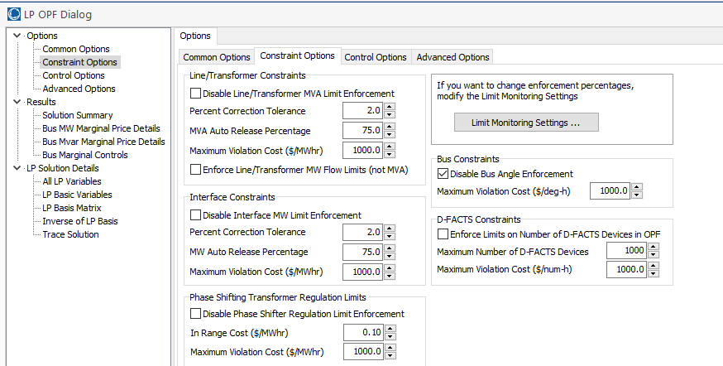
LP OPF Introductory Example, cont
On use Options, Constraint Options to enable the enforcement of the Line/Transformer MVA limits
3

Slide 4
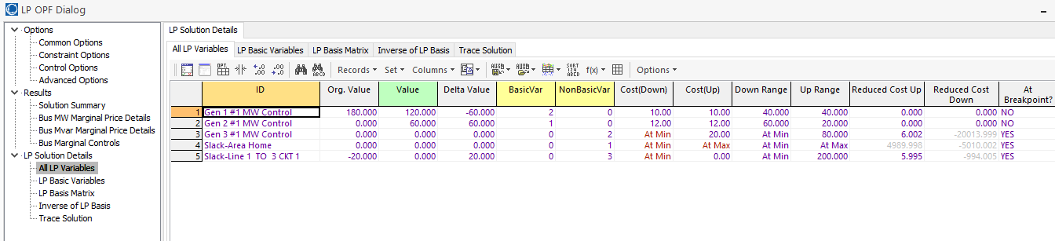
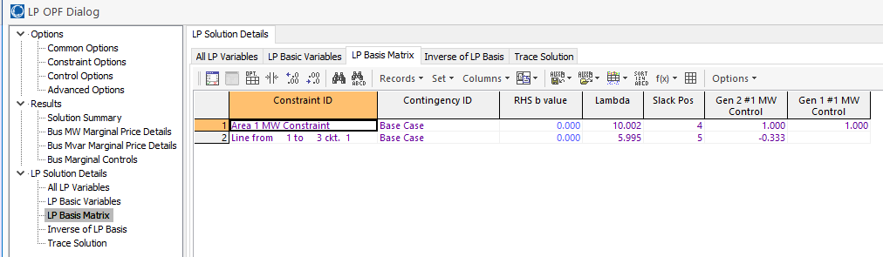
LP OPF Introductory Example, cont
4

Slide 5
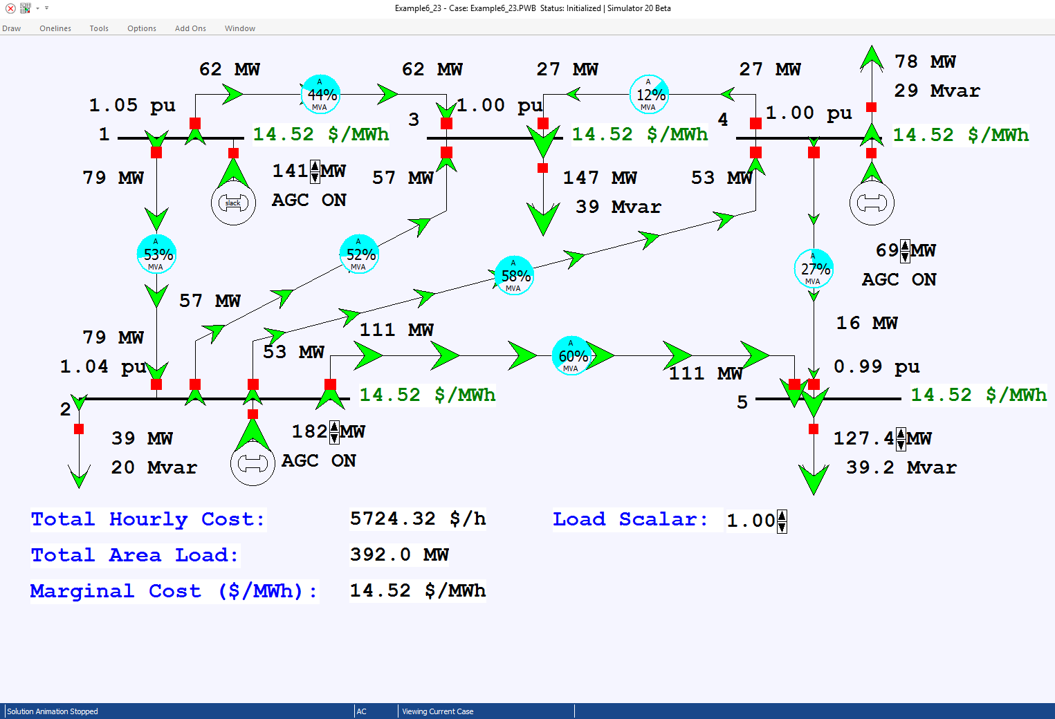
Example 6_23 Optimal Power Flow
In the example the load is gradually increased
5

Slide 6
Locational Marginal Costs (LMPs)
In an OPF solution, the bus LMPs tell the marginal cost of supplying electricity to that bus
The term “congestion” is used to indicate when there are elements (such as transmission lines or transformers) that are at their limits; that is, the constraint is binding
Without losses and without congestion, all the LMPs would be the same
Congestion or losses causes unequal LMPs
LMPs are often shown using color contours; a challenge is to select the right color range!
6

Slide 7
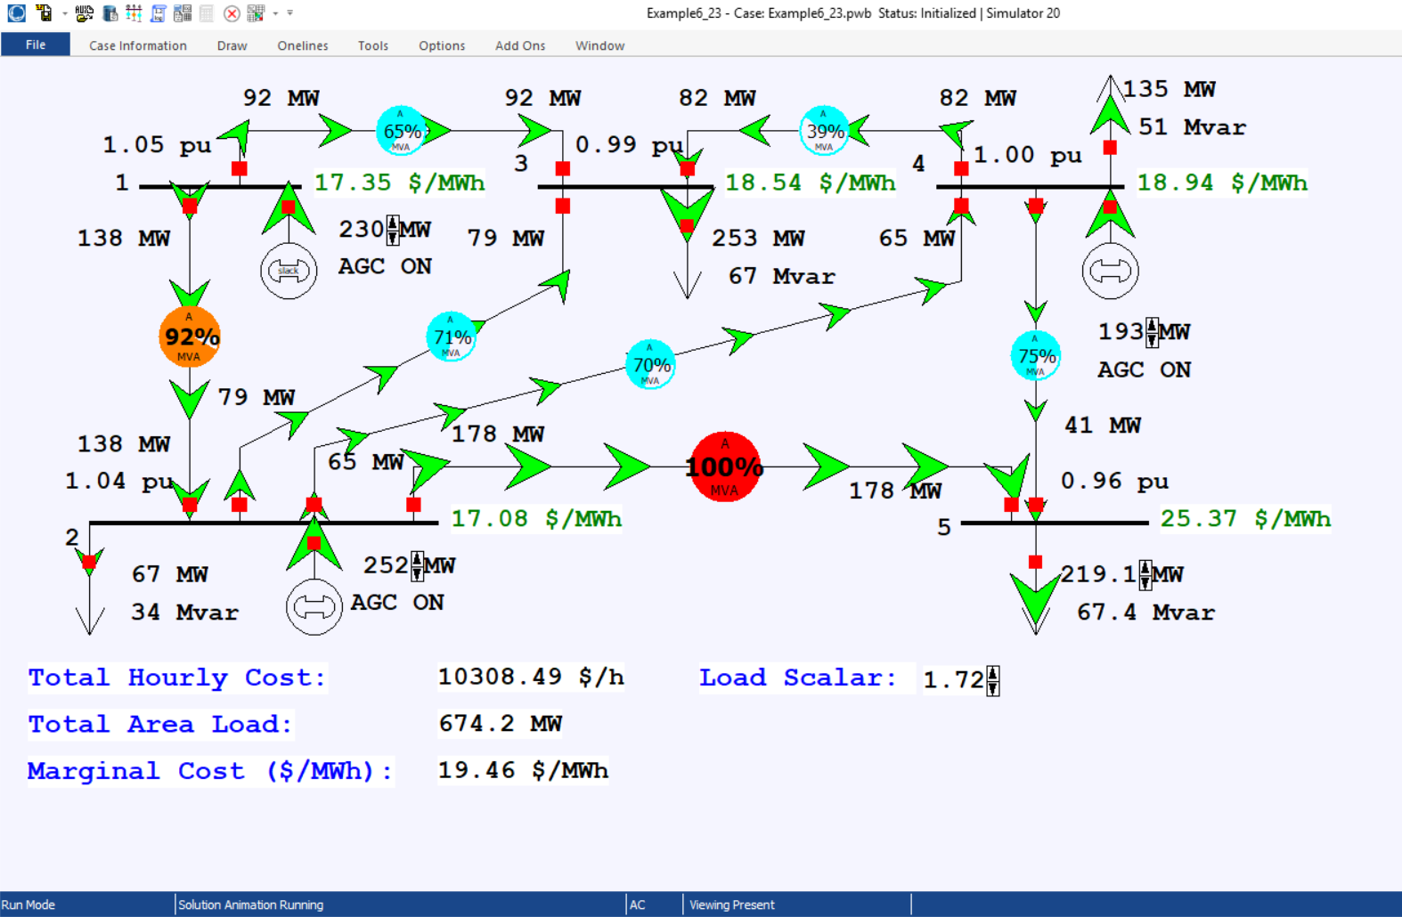
Example 6_23 Optimal Power Flow with Load Scale = 1.72
7

Slide 8
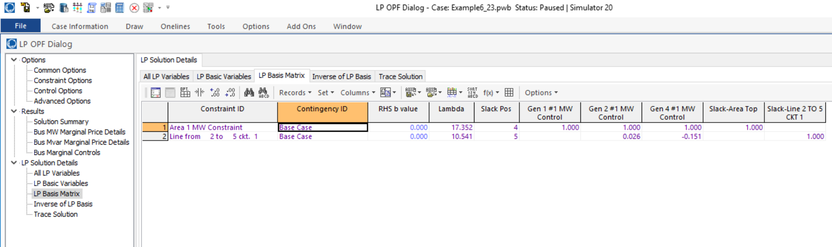
Example 6_23 Optimal Power Flow with Load Scale = 1.72
LP Sensitivity Matrix (A Matrix)
The first row is the power balance constraint, while
the second row is the line flow constraint. The matrix
only has the line flows that are being enforced.
8

Slide 9
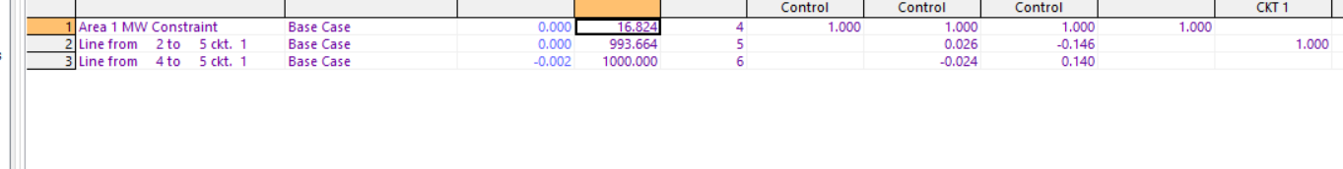
Example 6_23 Optimal Power Flow with Load Scale = 1.82
This situation is infeasible, at least with available controls. There is a solution because the OPF is allowing one of the constraints to violate (at high cost)
9

Slide 10
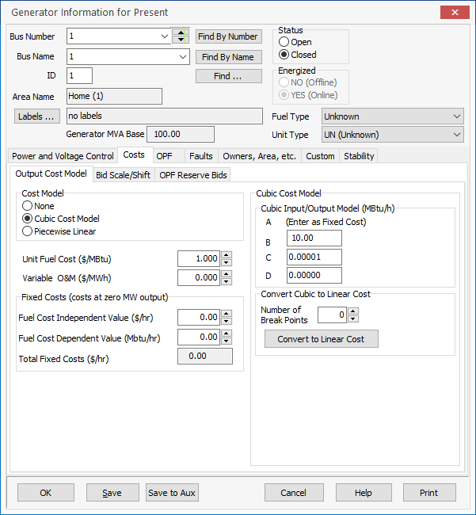
Generator Cost Curve Modeling
LP algorithms require linear cost curves, with piecewise linear curves used to approximate a nonlinear cost function
Two common ways
of entering cost
information are
  Quadratic function
  Piecewise linear curve
The PowerWorld OPF
supports both types
10

Slide 11
Security Constrained OPF
Security constrained optimal power flow (SCOPF) is similar to OPF except it also includes contingency constraints
  Again the goal is to minimize some objective function, usually the current system cost, subject to a variety of equality and inequality constraints
  This adds significantly more computation, but is required to simulate how the system is actually operated (with N-1 reliability)
A common solution is to alternate between solving a power flow and contingency analysis, and an LP
11

Slide 12
Security Constrained OPF, cont.
With the inclusion of contingencies, there needs to be a distinction between what control actions must be done pre-contingent, and which ones can be done post-contingent
  The advantage of post-contingent control actions is they would only need to be done in the unlikely event the contingency actually occurs
Pre-contingent control actions are usually done for line overloads, while post-contingent control actions are done for most reactive power control and generator outage re-dispatch
12

Slide 13
SCOPF Example
We’ll again consider Example 6_23, except now it has been enhanced to include contingencies and we’ve also greatly increased the capacity on the line between buses 4 and 5
Original with line 4-5 limit
of 60 MW with 2-5 out
Modified with line 4-5 limit
of 200 MVA with 2-5 out
13

Slide 14
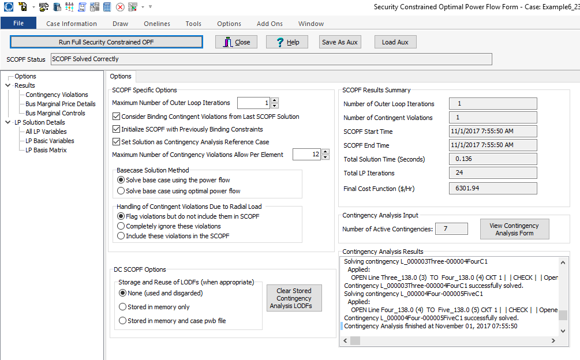
PowerWorld SCOPF Application
Just click the button to solve
Number of times
to redo contingency
analysis
14

Slide 15
LP OPF and SCOPF Issues
The LP approach is widely used for the OPF and SCOPF, particularly when implementing a dc power flow approach
A key issue is determining the number of binding constraints to enforce in the LP tableau
  Enforcing too many is time-consuming, enforcing too few results in excessive iterations
The LP approach is limited by the degree of linearity in the power system
  Real power constraints are fairly linear, reactive power constraints much less so
15

Slide 16
OPF Solution by Newton’s Method
An alternative to using the LP approach is to use Newton’s method, in which all the equations are solved simultaneously
Key paper in area is
  D.I. Sun, B. Ashley, B. Brewer, B.A. Hughes, and W.F. Tinney, "Optimal Power Flow by Newton Approach", IEEE Trans. Power App and Syst., October 1984
Problem is
For simplicity x represents all the variables and we can use h to impose limits on individual variables
16

Slide 17
OPF Solution by Newton’s Method
During the solution the inequality constraints are either binding (=0) or nonbinding (<0)
  The nonbinding constraints do not impact the final solution
We’ll modify the problem to split the h vector into the binding constraints, h₁ and the nonbinding constraints, h₂
17

Slide 18
OPF Solution by Newton’s Method
To solve first define the Lagrangian
A necessary condition for a minimum is that the gradient is zero
Both μ and λ are Lagrange Multipliers
18

Slide 19
OPF Solution by Newton’s Method
Solve using Newton’s method. To do this we need to define the Hessian matrix
Because this is a second order method, as opposed to a first order linearization, it can better handle system nonlinearities
19

Slide 20
OPF Solution by Newton’s Method
Solution is then via the standard Newton’s method. That is
No iteration is needed for a quadratic function with linear constraints
20

Slide 21
Example
Solve
No iteration is needed so any “guess” is fine. Pick (1,1,0)
Because λ is positive the constraint is binding
21

Slide 22
Newton OPF Comments
The Newton OPF has the advantage of being better able to handle system nonlinearities
There is still the issue of having to deal with determining which constraints are binding
The Newton OPF needs to implement second order derivatives plus all the complexities of the power flow solution
  The power flow starts off simple, but can rapidly get complex when dealing with actual systems
There is still the issue of handling integer variables
22

Slide 23
Mixed-Integer Programming
A mixed-integer program (MIP) is an optimization problem of the form
23

Slide 24
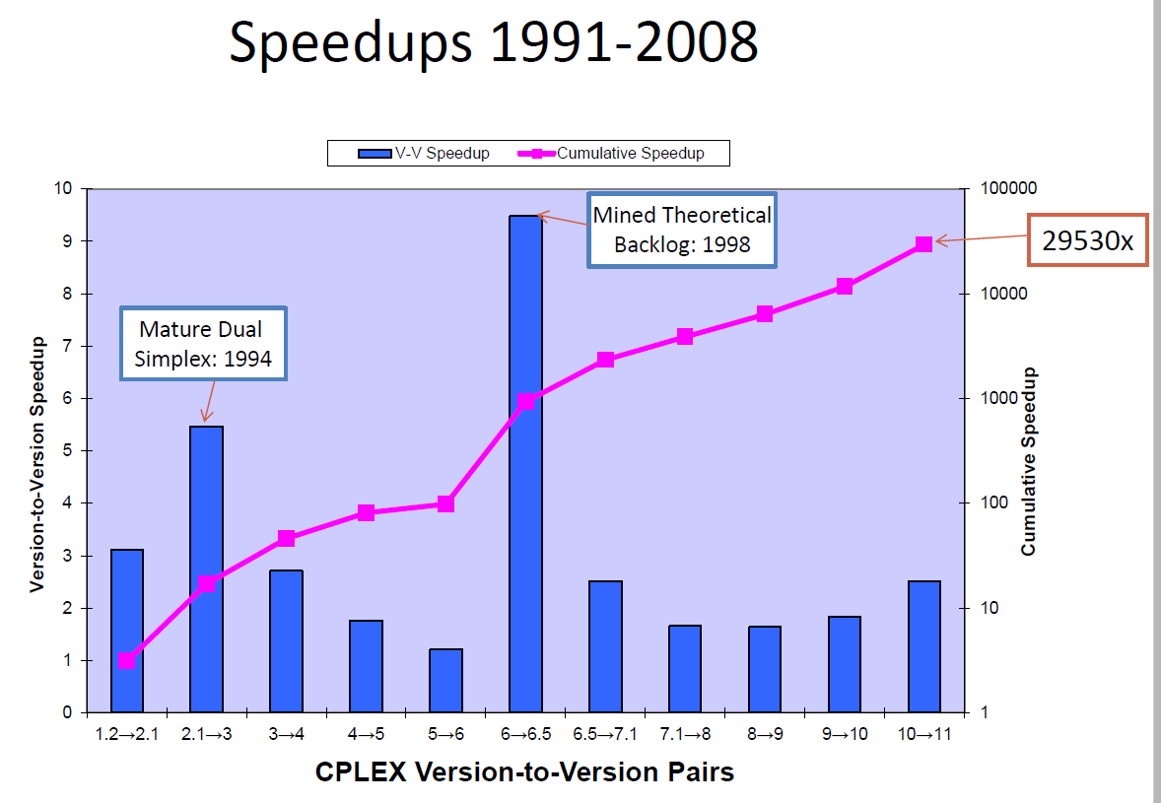
Mixed-Integer Programming
The advances in the algorithms have been substantial
Speedups
from 2009
to 2015 were
about a factor
of 30!
Notes are partially based on a presentation at Feb 2015 US National Academies Analytic
Foundations of the Next Generation Grid by Robert Bixby from Gurobi Optimization titled
“Advances in Mixed-Integer Programming and the Impact on Managing Electrical Power Grids”
24

Slide 25
Mixed-Integer Programming
Suppose you were given the following choices?
  Solve a MIP with today’s solution technology on a 1991 machine
  Solve a MIP with a 1991 solution on a machine from today?
The answer is to choose option 1, by a factor of approximately 300
This leads to the current debate of whether the OPF (and SCOPF) should be solved using generic solvers or more customized code (which could also have quite good solvers!)
Notes are partially based on a presentation at Feb 2015 US National Academies Analytic
Foundations of the Next Generation Grid by Robert Bixby from Gurobi Optimization titled
“Advances in Mixed-Integer Programming and the Impact on Managing Electrical Power Grids”
25

Slide 26
More General Solvers Overview
OPF is currently an area of active research
Many formulations and solution methods exist…
  As do many tools for highly complex, large-scale computing!
While many options exist, some may work better for certain problems or with certain programs you already use
Consider experimenting with a new language/solver!
26

Slide 27
Gurobi and CPLEX
Gurobi and CPLEX are two well-known commercial optimization solvers/packages for linear programming (LP), quadratic programming (QP), quadratically constrained programming (QCP), and the mixed integer (MI) counterparts of LP/QP/QCP
Gurobi and CPLEX are accessible through object-oriented interfaces (C++, Java, Python, C), matrix-oriented interfaces (MATLAB) and other modeling languages (AMPL, GAMS)
27

Slide 28
Solver Comparison
Algorithm Type ------------------ Solver | LP/MILP linear/mixed integer linear program | QP/MIQP quadratic/mixed integer quadratic program | SOCP second order cone program | SDP semidefinite program
CPLEX* | x | x | x
GLPK | x
Gurobi* | x | x | x
IPOPT |  | x
Mosek* | x | x | x | x
SDPT3/SeDuMi |  |  | x | x
Linear programming can be solved by quadratic programming, which can be solved by second-order cone programming, which can be solved by semidefinite programming.
28

Slide 29
Modeling Tools
 | AMPL | CVX (Matlab) | GAMS | Pyomo (Python) | YALMIP (Matlab)
CPLEX | x |  | x | x | x
GLPK |  |  |  | x | x
Gurobi | x | x | x | x | x
IPOPT | x |  |  | x | x
Mosek | x | x | x |  | x
SDPT3/SeDuMi |  | x | x |  | x
29
Notes:
Not comprehensive

Slide 30
Introduction to AMPL
AMPL (A Mathematical Programming Language) is a modeling language that enables the compact and logical representation of optimization models
Visit http://www.ampl.com to download and start using a student version.
  To actually solve problems with AMPL, you’ll also need a solver!
  CPLEX is a good one to start with (already included in Windows download)
There is an AMPL book and many examples also available for download at http://www.ampl.com
30

Slide 31
Introduction to AMPL
The model file (.mod) declares the data parameters, the variables, the objective function and the constraints
The data is provided in the data file (.dat)
  You don’t need to change the model for every small change in the data!
Every declaration ends in a semicolon ;
Comments begin with a pound sign #
Parameters in the data file must first be declared in the model file
31

Slide 32
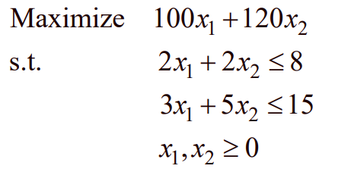
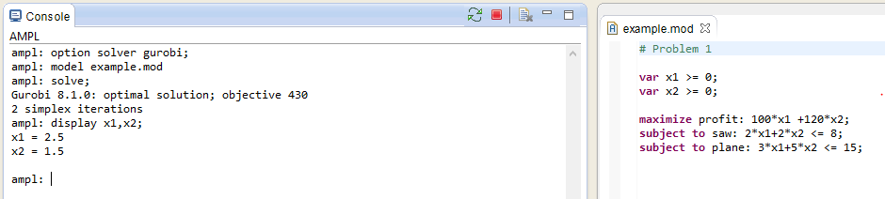
An AMPL Example
Example 1 (lumber mill problem) from Lecture 24
32

Slide 33
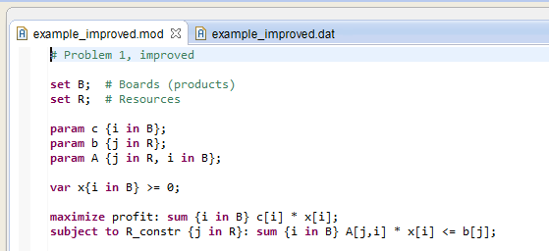
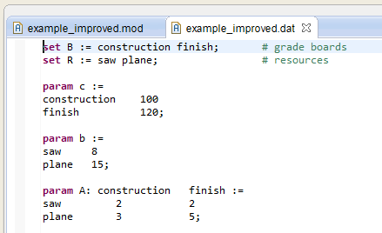
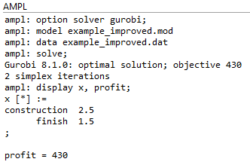
An (Improved) AMPL Example
Example 1 (lumber mill problem) from Lecture 24
Can change the values in the .dat file, change solver, etc. with just a few quick clicks!
33

Slide 34
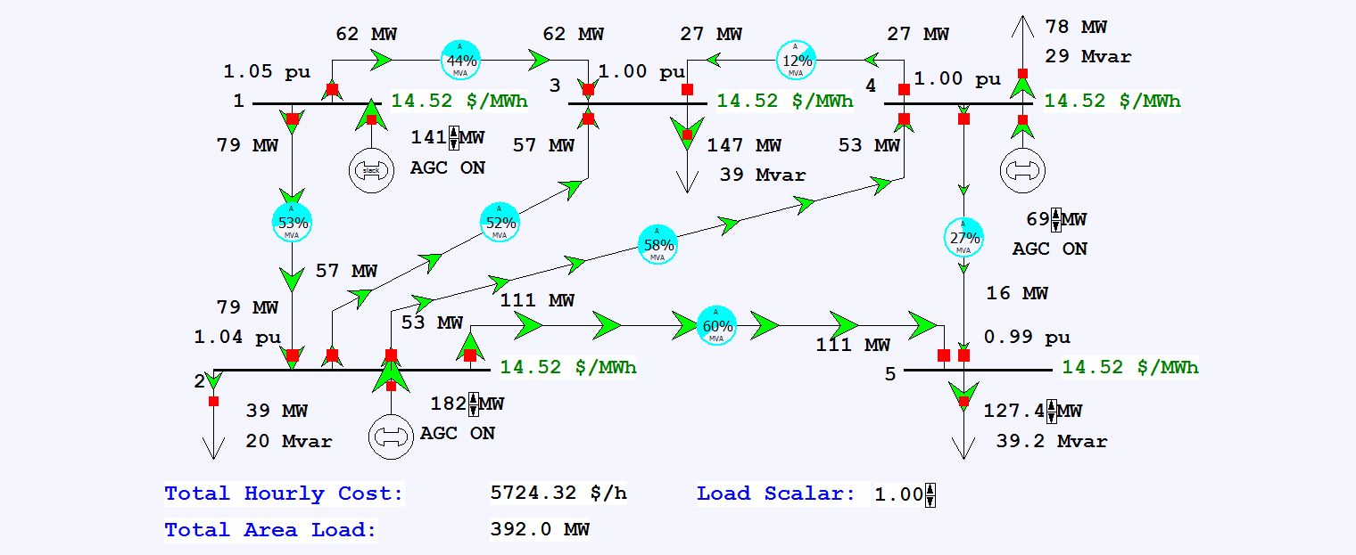
DCOPF in AMPL
Example 6_23
34

Slide 35
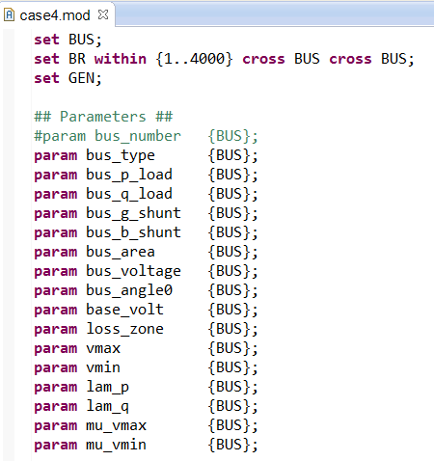
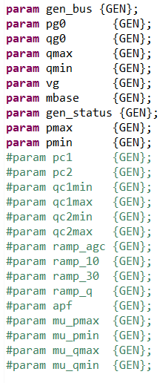
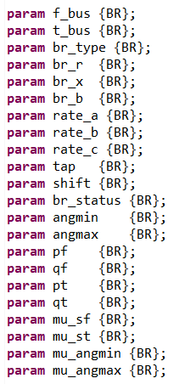
DCOPF in AMPL: Parameters
LOTS of parameters (not all are used in this example, but the framework is there for more involved examples)
35

Slide 36
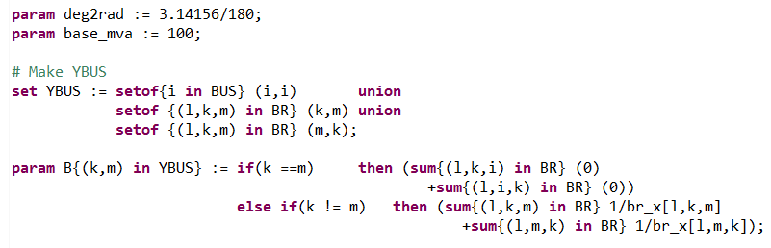
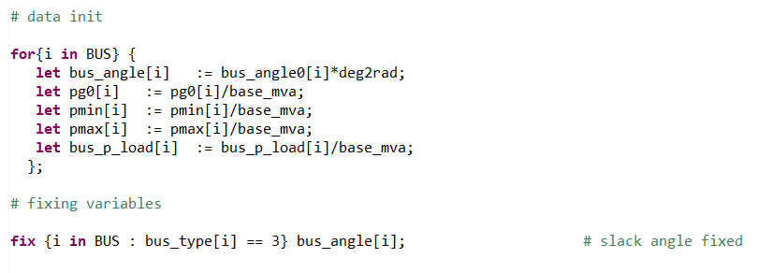
DCOPF in AMPL: Parameters, cont.
Initialization
36

Slide 37
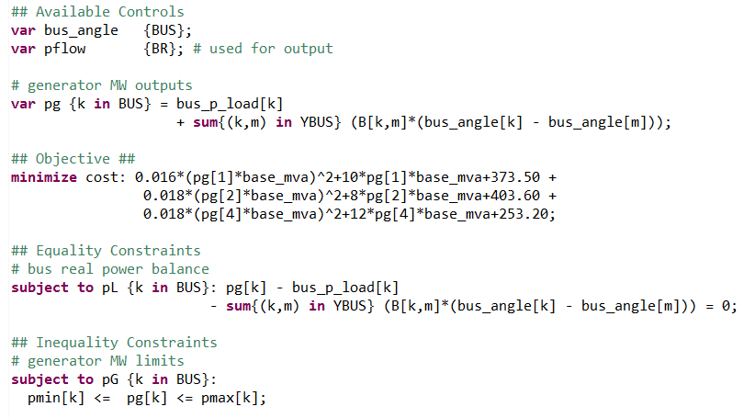
DCOPF in AMPL: Model
Objective: Polynomial
37

Slide 38
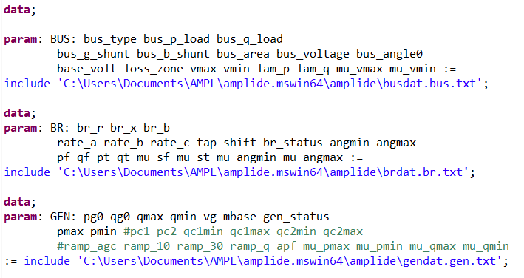
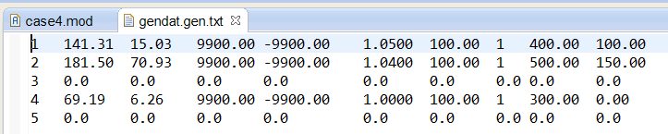
DCOPF in AMPL: Data
Bus, Branch, and Generator data saved in .txt files
38

Slide 39
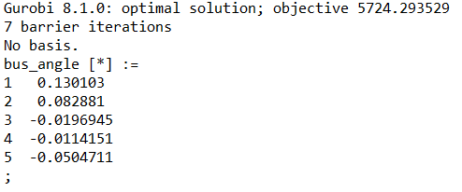
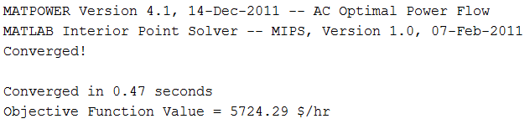
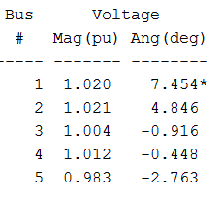

DCOPF in AMPL: Solution
Ang (deg)
7.454
4.748
-1.128
-0.654
-2.892
AMPL+Gurobi DCOPF with polynomial objective function and linear constraints
PowerWorld OPF solution
MATPOWER ACOPF with polynomial objective function
39
Notes:
Gurobi: 0.015625 s
MINOS: ampl_time = 0.03125;

Slide 40
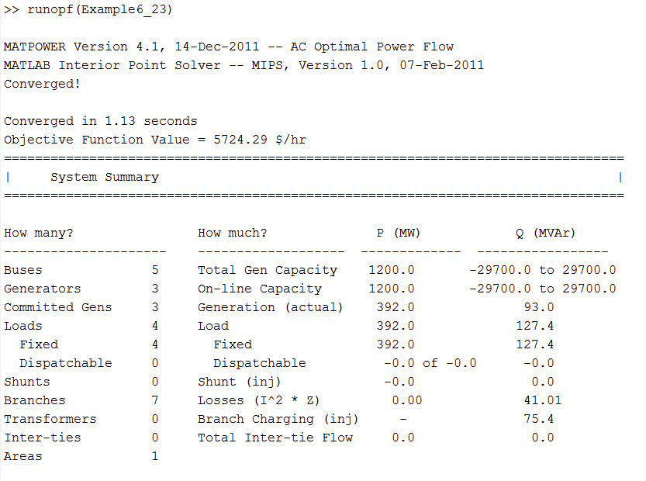
MATPOWER
Uses data stored in MATLAB struct
40

Slide 41
MATPOWER Solvers
Section 6.5 of manual
  Originally used MATLAB’s Optimization Toolbox
  Now can use MINOPF/TSPOPF packages, IPOPT solver (open-source), CPLEX/MOSEK/Gurobi (for DC OPF), KNITRO (for AC OPFs)
  Default: own primal-dual interior point method implementation MIPS (MATPOWER Interior Point Solver) for AC and DC (QP solver)
http://www.pserc.cornell.edu/matpower/
41

Slide 42
Questions
What changes would you make to the .mod file to do a full ACOPF?
What sensitivity analysis could you do by only changing the .dat/.txt files?
What might you consider when comparing solvers?
What tools best fit your needs?
42

