Slide 1
ECEN 615
Methods of Electric Power Systems Analysis
Lecture 27: Power System Restoration and Visualization
Prof. Tom Overbye
Dept. of Electrical and Computer Engineering
Texas A&M University
overbye@tamu.edu

Slide 2
Announcements
Final exam is Wednesday Dec 12, 1 to 3pm
  Closed book, closed notes. Two 8.5 by 11 inch notesheets allowed; calculators allowed
2

Slide 3

Where We’ve Come
3

Slide 4
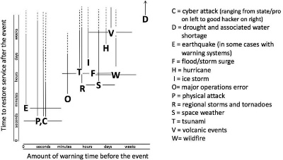
Blackout in Power Systems
Blackout
  Loss of the electricity supply to a part/whole of the power system
What causes blackouts
  Disasters such as Earthquake or Tsunamis
  Overloading/damage of transmission lines
  Failure of protection/control systems
  Severe weather events
  Physical/cyber attacks
  Operation errors
  Combination of above
Source: nap.edu

Slide 5
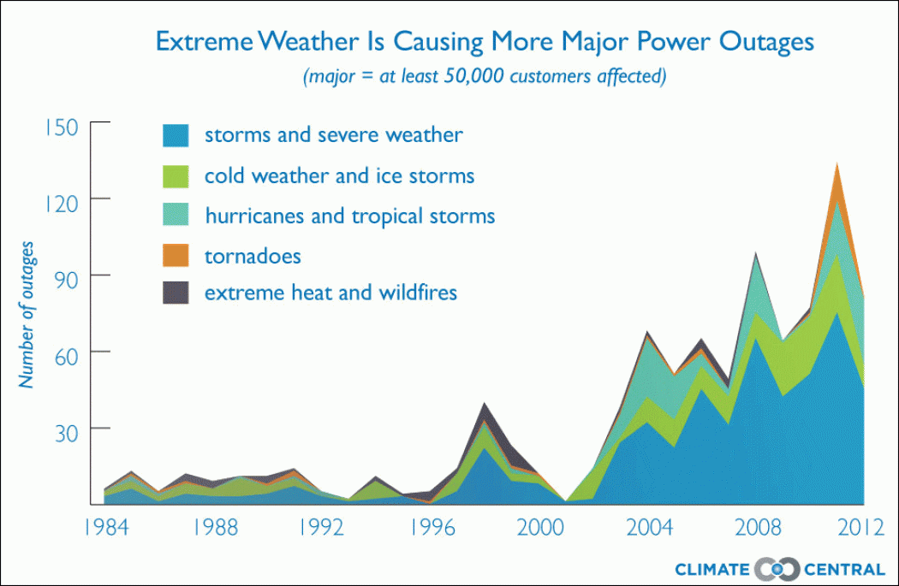
Blackout in Power Systems
Weather-related Blackouts Doubled Since 2003
Source: climatecentral.org

Slide 6
Blackout in Power Systems
Impact of blackouts
  Economic losses
    Power system equipment damage
    Money system fails
    Factories shut down
    Transportation system stops
  Limited basic activities
    Food distribution systems cease
    Difficult to cook
    Lack of municipal water
    No heating/cooling
  Social chaos and violence
  Etc.

Slide 7
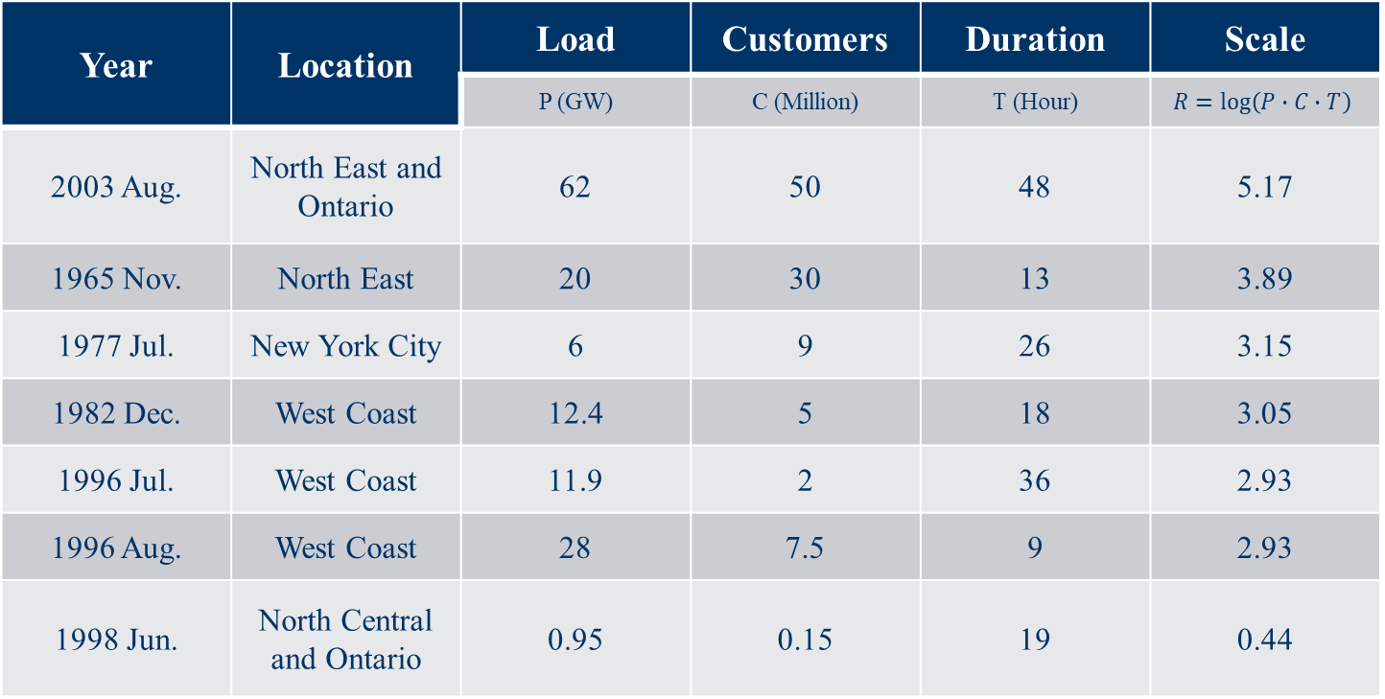
Blackout in Power Systems
7 major disturbances in US in the order of impact
Year | Location | Load | Customers | Duration | Scale
 |  | P (GW) | C (Million) | T (Hour) | $$R=\log\left(P∙C∙T\right)$$
2003 Aug. | North East and Ontario | 62 | 50 | 48 | 5.17
1965 Nov. | North East | 20 | 30 | 13 | 3.89
1977 Jul. | New York City | 6 | 9 | 26 | 3.15
1982 Dec. | West Coast | 12.4 | 5 | 18 | 3.05
1996 Jul. | West Coast | 11.9 | 2 | 36 | 2.93
1996 Aug. | West Coast | 28 | 7.5 | 9 | 2.93
1998 Jun. | North Central and Ontario | 0.95 | 0.15 | 19 | 0.44
Source: 2003 US-Canada Blackout Report

Slide 8
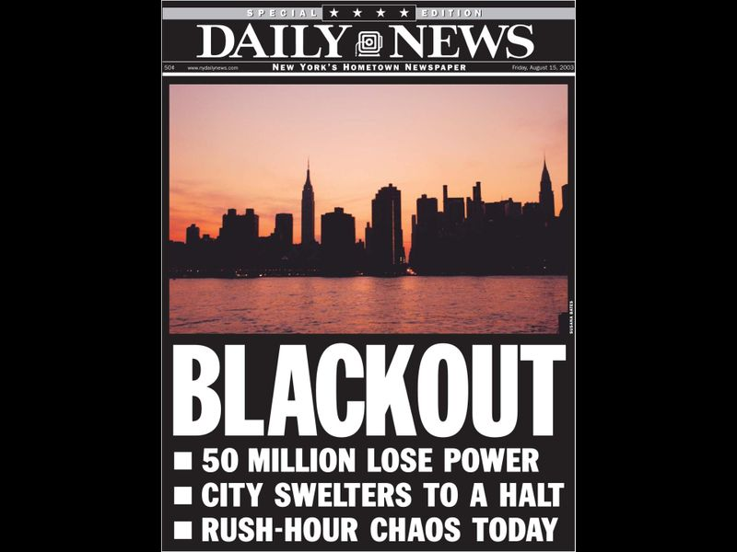
2003 Aug. Blackout
Source: nydailynews.com

Slide 9
2003 Aug. Blackout
Causes
  State estimator and contingency analysis of MISO were not fully functioning
  Power plant unit (Eastlake Unit 5) tripping with inadequate system understanding
  Power line tripping caused by the short circuit to ground fault due to tree contacts
  Alarm/logging system not functioning
  Insufficient coordination and communication between transmission system operators
Investigation performed
  Final Report on the August 14, 2003 Blackout in the US and Canada: Causes and Recommendations

Slide 10
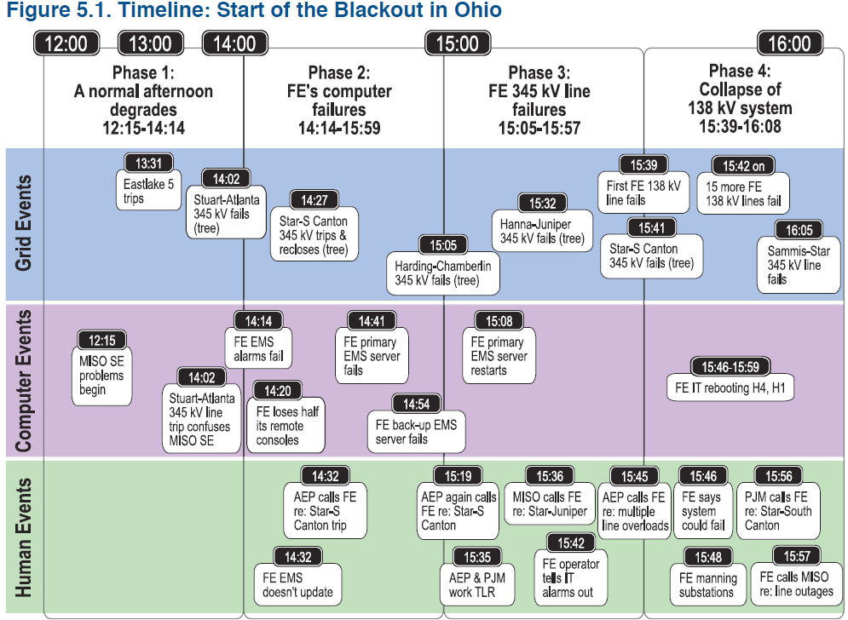
2003 Aug. Blackout
Source: 2003 US-Canada Blackout Report

Slide 11
Power System Restoration
Power System Restoration or blackstart
  A procedure to restore power in the event of a partial or total shutdown of the power system
  A highly complex decision problem
Object is to serve the load as soon as possible without violating operating constraints
  Actions are time critical
Primarily manual work by operators
Offline restoration planning usually based on simulations
Limited online implementation due to the nature

Slide 12
Power System Restoration
Common characteristics of restoration (even though strategies are different)
  Immediate resupply of station service
  Time consuming nature of switching operation
  Start-up timings of thermal units
  Voltage rise problems of energizing unloaded transmission lines
  Frequency response of prime movers to a sudden load pickup
  Cold load inrush, power factors and coincident demand factors

Slide 13
System Restoration Efforts - IEEE
After 1977 New York City blackout, DOE required operating companies to develop a power system restoration plan, train personnel, regularly update and maintain the plan.
In response to this requirement in 1978, the Power System Operation Committee established the Power System Restoration Task Force within the System Operation Subcommittee of the Power System Engineering Committee.
A few years later, the PSR TF was upgraded to PSR WG.

Slide 14
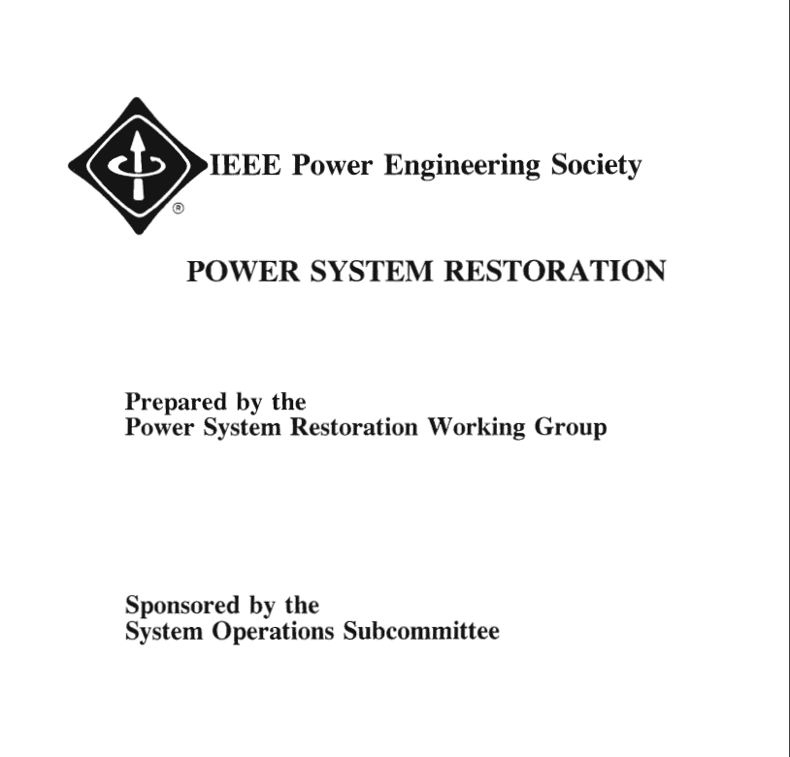
System Restoration Efforts - IEEE
In 1993
A 110 page brochure was prepared by PSR WG and published by the IEEE PES
Includes:
  14 IEEE Committee Reports
  5 SRWG member papers in IEEE publication
  13 related IEEE transaction papers

Slide 15
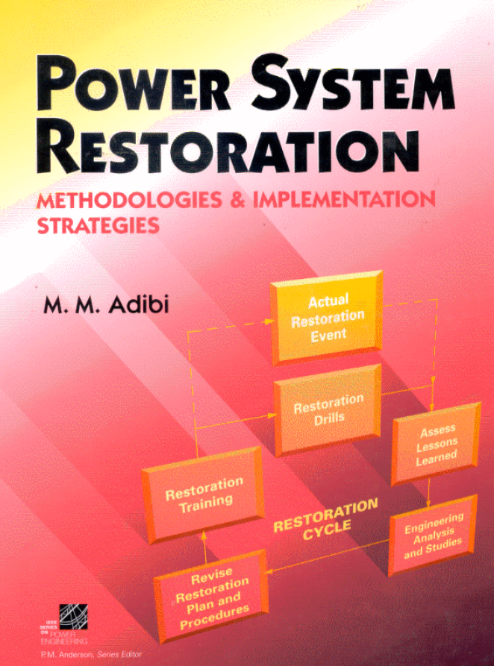
System Restoration Efforts - IEEE
In 2000
700 page book is prepared by PSRWG and published by Wiley-IEEE Press
Includes 87 papers including 14 papers in the original 1993 collection

Slide 16

System Restoration Efforts - IEEE
In 2014
40 IEEE papers by 110 authors
Including 42 panelists of Restoration Dynamics Task Force
Covers:
  Real power balance and control of frequency
  Reactive power balance and control of voltages
  Critical tasks (time sensitive functions)
  Analyses and simulations

Slide 17
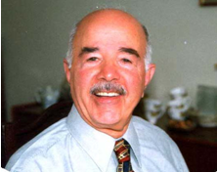
Mahmood Mike Adibi (1924 – 2018)
The godfather of power system restoration
B.S.E. in 1950 from University of Birmingham, U.K.
M.S.E in 1960 from Polytech Institute of Brooklyn, NY
IEEE Life Fellow
Founder and chairman of the IEEE System Restoration Working Group in 1979
Author of the book, “Power System Restoration – Methodologies and Implementation Strategies”
  A great review book of IEEE papers between 1987 and 1999
Developed restoration plans for over a dozen utilities

Slide 18
Other Good References
PJM Manual 36: System Restoration
EPRI, “Development of Power System Restoration Tool Based on Generic Restoration Milestones,” 2010.
PSERC, “Development and Evaluation of System Restoration Strategies from a Blackout,” 2009.
IESO, “Part 7.8: Ontario Power System Restoration Plan,” 2017.
K. Sun et al., “Power System Control Under Cascading Failures: Understanding, Mitigation, and System Restoration,” Wiley-IEEE Press. 2019.
Yutian Liu, Rui Fan, and Vladimir Terzija, “Power system restoration: a literature review from 2006 to 2016,” J. Mod. Power Syst. Clean Energy, 2016, 4(3), pp. 332-341

Slide 19
NERC Standards on Restoration
NERC System Restoration and Blackstart standards
  EOP-005-2 & EOP-005-3
    System Restoration from Blackstart Resources
    Ensure plans, Facilities, and personnel are prepared to enable System restoration from Blackstart Resources to assure reliability is maintained during restoration and priority is placed on restoring the Interconnection
  EOP-006-2 & EOP-006-3
    System Restoration Coordination
    Ensure plans are established and personnel are prepared to enable effective coordination of the System restoration process to ensure reliability is maintained during restoration and priority is placed on restoring the Interconnection.

Slide 20
Common Issues during Restoration
Active power balance and frequency control
  Need to maintain system frequency within limits by system stability and protection settings
  Can be accomplished by picking up loads in increments
Reactive power balance and overvoltage control
  Energizing few high voltage lines
  Operating generators at minimum voltage levels
  Deactivating switched shunt capacitors
  Connecting shunt reactors
  Adjusting transformer taps
  Picking up reactive loads

Slide 21
Common Issues during Restoration
Transient switching voltages
  Switching surges occur when energizing equipment
Self-excitation
  When the charging current is high relative to the size of generators
  When opening a line at the sending end but leaving the line connected to a large motor
  This causes overvoltage and damages equipment
Cold load pickup
  When load has been de-energized for several hours or more
  Inrush current can be as high as 8 – 10 times of the normal value

Slide 22
Common Issues during Restoration
System stability
  Voltage should be within limits
  Angle stability have to be maintained
  Frequency is the main issue in stability assessment
Protective systems and load control
  Continuous change in system configuration and in operating conditions may trigger undesirable operation of relays
  Load shedding can be useful in case of low frequency conditions

Slide 23
Common Issues during Restoration
Partitioning system into islands
  Necessary to speed up the process, especially for large systems
  NERC standards
    Each islands must have sufficient blackstart capability
    Each islands should have enough cranking paths to gens and loads
    Each islands should be able to match generation and load within prescribed frequency limits
    Each islands should have adequate voltage controls
    All tie points must be capable of synchronization with adjacent subsystems
    All islands should share information with other islands

Slide 24
Generic Restoration Steps
Preparation stage (1 – 2 hours)
  Evaluate pre- and post-disturbance conditions
  Define the target system
  Restart generators and rebuild transmission network
System restoration stage (3 – 4 hours)
  Energize transmission paths
  Restore load to stabilize generation and voltage
  Synchronize islands and reintegrate bulk power system
Load restoration stage (8 – 10 hours)
  Load restoration is the governing control objective
  Load pickup is scheduled based on generation availability
  Load restoration is effected in increasingly larger steps

Slide 25
System Restoration Tasks
Know the status of the grid
List and rank critical loads by priority
List and rank initial sources of power by availability
  Maximize generation capabilities with the available black start resources
Determine the most effective ways of brining the two together
  Schedule tasks and resources during restoration
  Establish transmission capability and paths while meeting operating constraints

Slide 26
Initial Power and Load
Initial source of power
Initial critical loads
Type | Time (min) | Success probability
Run-of-the-River Hydro | 5-10 | High
Pump-Storage Hydro | 5-10 | High
Combustion Turbine | 5-15 | Medium
Tie-line with Adjacent Systems | Short
Type | Priorities
Cranking drum-type units | High
Pipe-type cables pumping plants | High
Transmission stations | High to Medium depending on location
Distribution stations | High to Medium depending on location
Industrial loads | Medium to low

Slide 27
Algorithm for Restoration Automation
Assumption
  Each Area/island has a BSU and critical loads
  Input: a PW case
Overall process
  Restore each area in parallel
  Stabilize each area
  Synchronize all the areas
4 Criteria to be set up first
  Whether a generator or a load to pick up next
    Pick up a generator if available online GenMW is smaller than the next load to pickup
    Pick up a load if available online GenMW is larger than the next load to pickup

Slide 28
Algorithm for Restoration Automation
  For selecting which offline Gen to pick up next
    Largest MWMax
    Time related characteristics such as startup time, ramp time, personnel dispatch time, etc.
    Distance from online area or control center
    Others
  For selecting which offline load to pick up next
    Largest MW
    Smallest MW
    Distance from online area
    Others
  For stopping the restoration process
    90% of the total loads is online
    others

Slide 29
Algorithm for Restoration Automation
Pre-process
  Get data from case
  Check device status
  Compare total generation and total load in each area
1st stage: From BSU to Critical Loads
  Close BSU
  Find cranking path to critical loads
  Energy the path and pick up the load
  Commit more generators if necessary

Slide 30
Algorithm for Restoration Automation
2nd stage: Restore the remaining system
  While Criterion 4: stopping restoration process is not met
  Select gen or load to pick up next with Criterion 1, 2 and 3
  Find cranking path (shortest path) from online area
  Energize the path
  Pick up load
3rd stage (optional)
  Close offline branches and generators
  Change transformer tap setting
4th stage: Connect areas

Slide 31
Example - WSCC 9-bus Case
Before restoration
BSU: bus 1
Critical Load: Bus 6
No sub-area
Dummy gen and load

Slide 32
Example - WSCC 9-bus Case
Steady state after restoration
BSU: bus 1
Critical Load: Bus 6
No sub-area

Slide 33
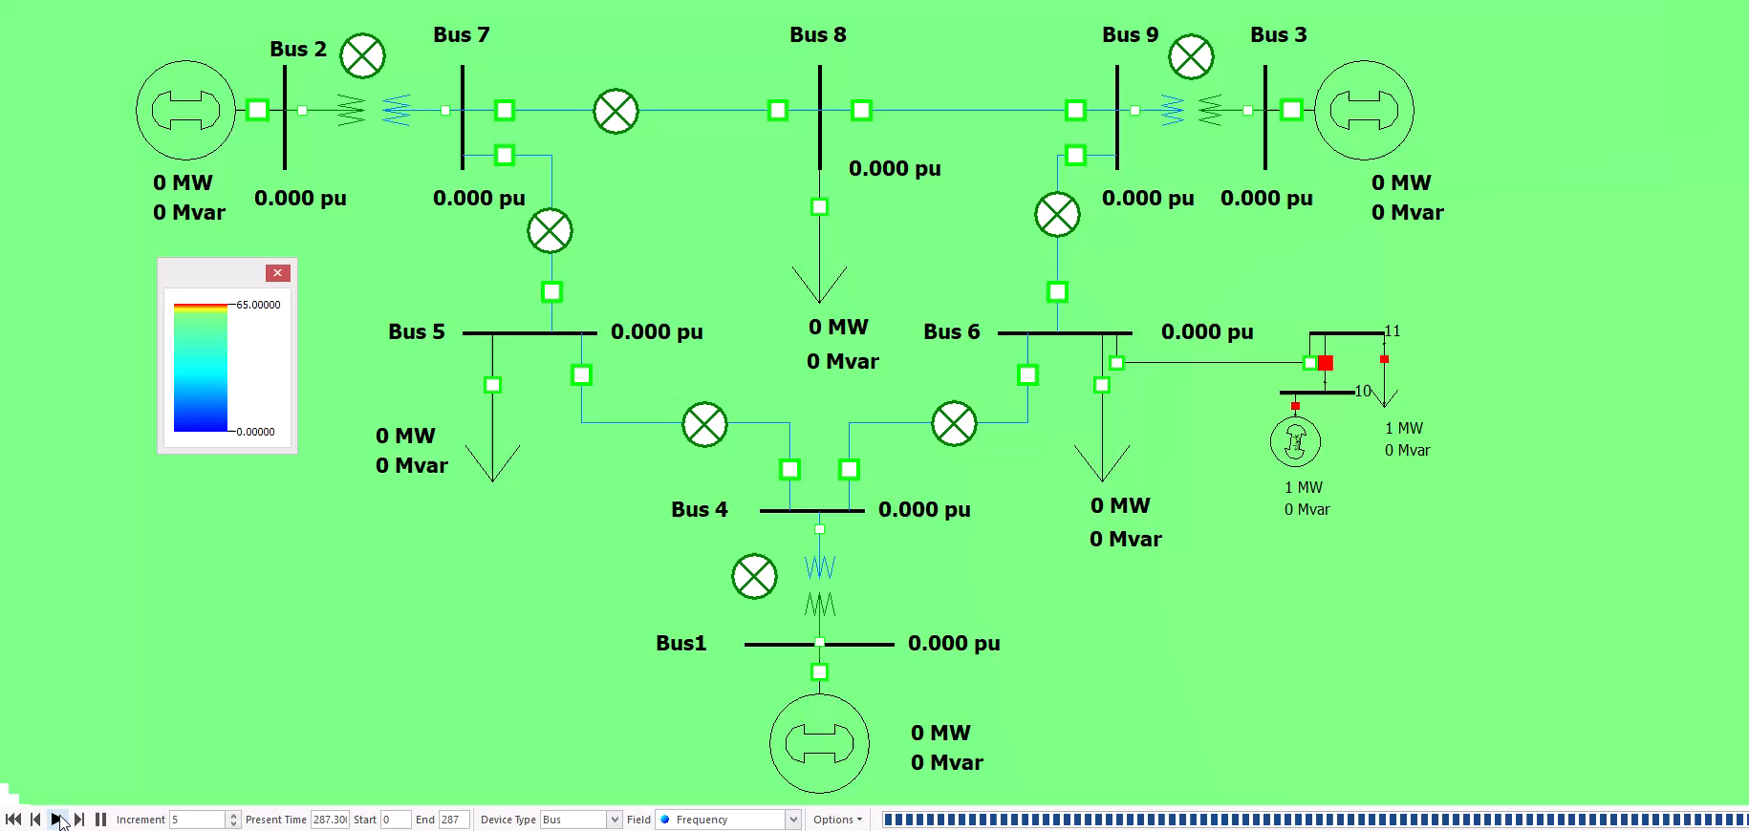
Example - WSCC 9-bus Case
During restoration
BSU: bus 1
Critical Load: Bus 6
No sub-area

Slide 34
Example – Synthetic 200-bus Case
Before restoration
6 Zones are restored independently in parallel, and they are connected at the end
Each zone has a BSU and 1 or 2 Critical Loads

Slide 35
Example – Synthetic 200-bus Case
Steady state after restoration
6 Zones are restored independently in parallel, and they are connected at the end
Each zone has a BSU and 1 or 2 Critical Loads

Slide 36
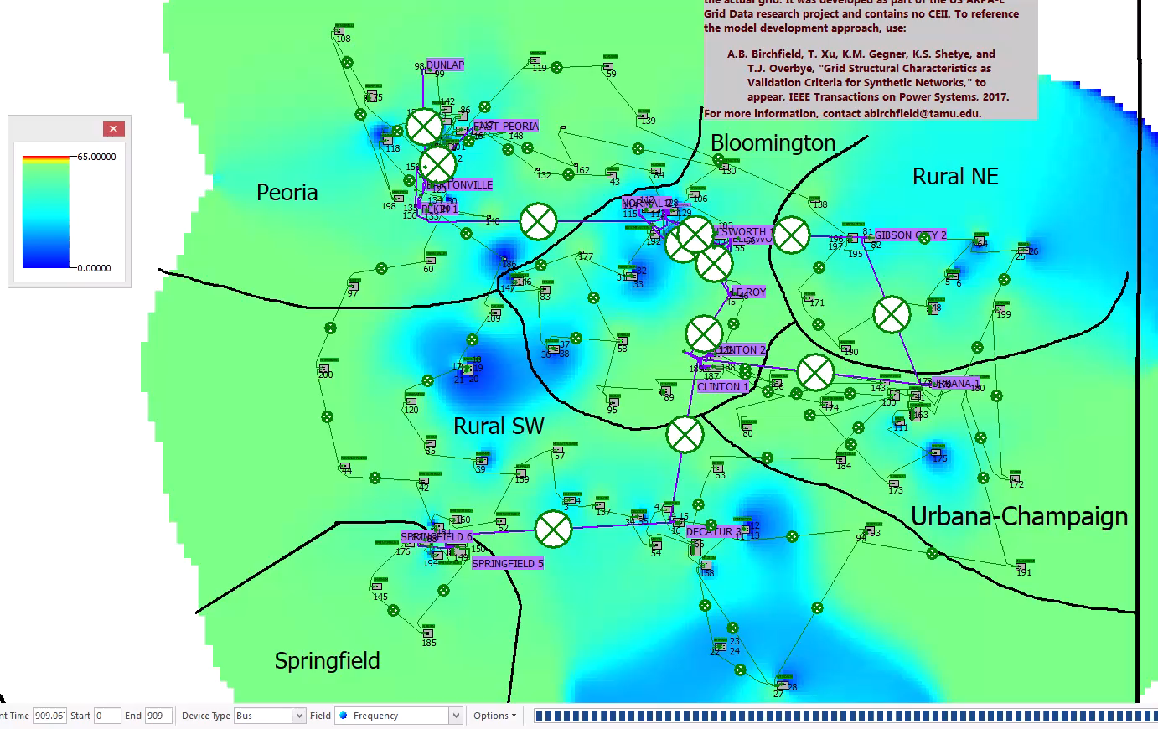
Example – Synthetic 200-bus Case
During restoration
6 Zones are restored independently in parallel, and they are connected at the end
Each zone has a BSU and 1 or 2 Critical Loads

Slide 37
Restoration Automation
Things to consider
  Status of devices has to be tracked
    This prevents duplicate actions
  Closing a large load can fail restoration in simulation
    Loads are gradually picked up if it is larger than a threshold
  Distributed generators are not picked up during restoration
  If the area cannot support all the loads with the generators in it, loads should be curtailed
  Line overloading has to be monitored
  May close offline branches and generators after the restoration process is done

Slide 38
Restoration Automation Challenges
Dynamic and protection issues
  Frequency excursion
    Under frequency occurs during restoration when large loads are picked up
    Balance between generation and load need careful coordination
  Overvoltage issue
    Transient overvoltage due to switching actions
    Sustained overvoltage due to harmonics
  Voltage collapse
    Generator under excitation
    Startup of motor loads require a lot of reactive power
  Control and protective schemes have to be coordinated
  Capability of each BSU has to be determined in advance

Slide 39
Restoration Automation Challenges
Network configuration
  Forming islands with adequate amount of real/reactive power and load
  Establishing a stable backbone network
  Unit start-up sequence to maximize generation capacity
  Restoration path section problem
    Which path to energize?
Load restoration time/amount
Time consuming process
  A lot of try-and-errors for better results
  Feedback loop results in huge time consumption

Slide 40
Wide-Area Power System Visualization
Power system operations and planning are generating more data than ever
  In operations thousands of PMUs are now deployed
  In planning many thousand of studies are now routinely run, with a single transient stability run creating millions of values
How data is transformed into actionable information is a crucial, yet often unemphasized, part of the software design process
Presentation addresses some issues associated with dealing with this data

Slide 41
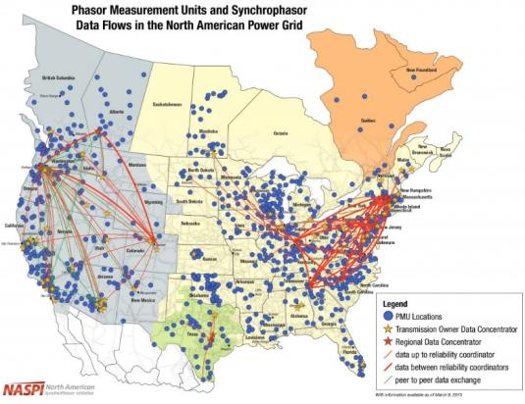
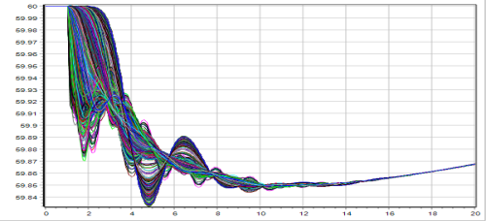
Examples of Power System
“Big Data”
Power system operations and planning are a rich source of data
  SCADA has traditionally
  provided a grid data at scan
  rates of several seconds
  Thousands of PMUs are
  now deployed providing data
  at 30 times per second
  In planning many thousand
  of studies are now routinely
  run, with a single transient
  stability run creating gigabytes

Slide 42
Examples of Power System “Big Data”
A 100,000 bus grid solved hourly for one year generates 100K times 8760 = 876 million values
Each hourly simulation may have 10,000 contingencies, giving 8.76 trillion bus values
Each contingencies could also be run as a time domain simulation, which is sampled at PMU frequency (30 per second) for 30 seconds each gives about 8 quadrillion bus values

Slide 43
Visualization Software Design
Key question: what are the desired tasks that need to be accomplished?
  Needs for real-time operations might be quite different than what is needed in planning
Understanding the entire processes in which the visualizations are embedded is key
Software should help humans make the more complex decisions, i.e., those requiring information and knowledge
  Enhance human capabilities
  Alleviate their limitations (like adding up bus flows)

Slide 44
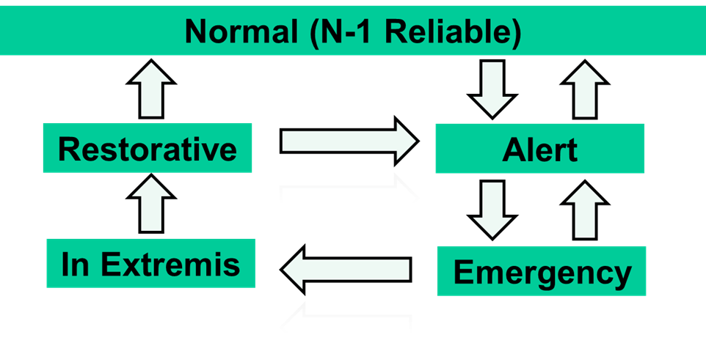
Power System Operating States
Effective data analysis and visualization for operations requires considering the different operating states
Effective visualization is most needed for the more rare situations and for planning
Image Derived From L.H. Fink and K. Carlsen, Operating under stress and strain, IEEE Spectrum, March 1978, pp. 48-53

Slide 45
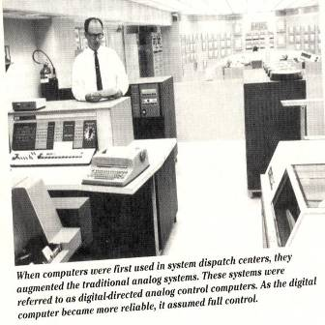
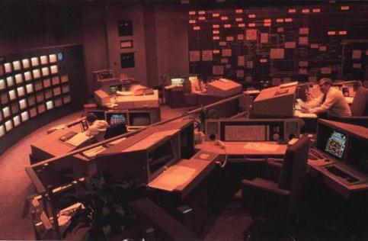
Power System Visualization History
PSE&G Control Center in 1988
Left Source: W. Stagg, M. Adibi, M. Laughton, J.E. Van Ness, A.J. Wood, “Thirty Years of Power Industry Computer Applications,” IEEE Computer Applications in Power, April 1994, pp. 43-49
Right Source: J.N. Wrubel, R. Hoffman, “The New Energy Management System at PSE&G,” IEEE Computer Applications in Power, July 1988, pp. 12-15.

Slide 46
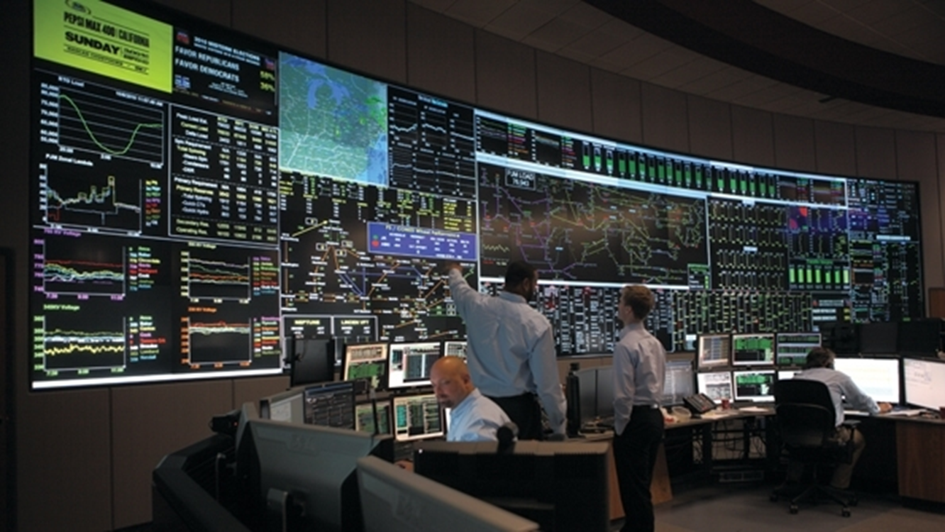
Present: PJM Control Center
Image Source: http://tdworld.com/site-files/tdworld.com/files/imagecache/large_img/uploads/2013/07/pjmcontrolroom117.jpg

Slide 47
Blackouts and Operator Intervention
Many large-scale blackouts have time scales of several minutes to a few dozen minutes
  this time scale allows for operator intervention, but it must occur quickly to be effective (extreme emergency control)
Operators can’t respond effectively if they do not know what is going on– they need “situational awareness”

Slide 48
Extreme Emergency Control
How the control room environment might be different during such an event
  advanced network analysis applications could be unavailable or overwhelmed
  system state could be quite different, with unfamiliar flows and voltages
  lots of alarms and phone calls
  high level of stress for control room participants with many tasks requiring their attention
  large number of decision makers might be present
Designing software for extreme conditions is challenging since conditions seldom encountered

Slide 49

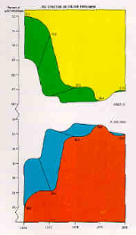
A Visualization Caution!
Just because information can be shown graphically, doesn’t mean it should be shown
Three useful design criteria from 1994 EPRI visualization report:
  1. natural encoding
  of information
  2. task specific graphics
  3. no gratuitous graphics

Slide 50
Visualization Background: Preattentive Processing
Good reference book: Colin Ware,
Information Visualization: Perception for Design, Third Edition, 2013
When displaying large amounts of data, take advantage of preattentive cognitive processing
  With preattentive processing the time spent to find a “target” is independent of the number of distractors
Graphical features that are preattentively processed include the general categories of form, color, motion, spatial position

Slide 51
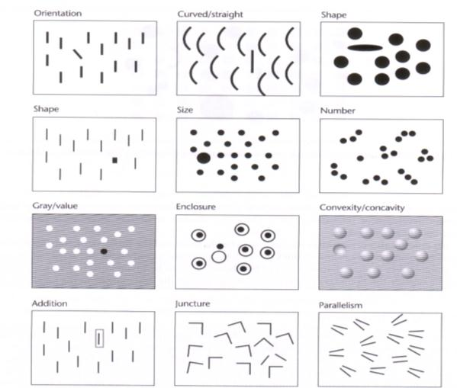
All are Preattentively Processed Except Juncture and Parallelism
Source: Information Visualization by Colin Ware, Fig 5.5

Slide 52
Preattentive Processing with
Color & Size

Slide 53
Use of Color
Some use of color can be quite helpful
  10% of male population has some degree of color blindness (1% for females)
Do not use more than about ten colors for coding if reliable identification is required
Color sequences can be used effectively for data maps (like contours)
  Grayscale is useful for showing forms
  Multi-color scales (like a spectrum) have advantages (more steps) but also disadvantages (effectively comparing values) compared to bi-color sequences

Slide 54
Color Sequence Example: Blue/Red, Discrete

Slide 55
Color Sequence Example: Spectrum, Continuous

