Slide 1
ECEN 667 Power System Stability
Lecture 10: Synchronous Machine Models,
Exciter Models
Prof. Tom Overbye
Dept. of Electrical and Computer Engineering
Texas A&M University, overbye@tamu.edu

Slide 2
Announcements
Read Chapter 4
Homework 3 is posted, due on Thursday Oct 5
Midterm exam is Oct 17 in class; closed book, closed notes, one 8.5 by 11 inch hand written notesheet allowed; calculators allowed

Slide 3
GENSAL Block Diagram
A quadratic saturation function is used. For initialization it only impacts the E_{fd} value

Slide 4
GENSAL Example
Assume same system as before with same common generator parameters: H=3.0, D=0, R_{a} = 0, X_{d} = 2.1, X_{q} = 2.0, X'_{d} = 0.3, X"_{d}=X"_{q}=0.2, X_{l} = 0.13, T'_{do} = 7.0, T"_{do} = 0.07, T"_{qo} =0.07, S(1.0) =0, and S(1.2) = 0.
Same terminal conditions as before
Current of 1.0-j0.3286 and generator terminal voltage of 1.072+j0.22 = 1.0946 ∠11.59 °
Use same equation to get initial δ
Same delta as with the other models

Slide 5
GENSAL Example
Then as before And

Slide 6
GENSAL Example
Giving the initial fluxes (with ω = 1.0)
To get the remaining variables set the differential equations equal to zero, e.g.,
Solving the d-axis requires solving two linear equations for two unknowns

Slide 7
GENSAL Example
0.4118
E_{q}’=1.1298
ψ_{d}’=0.9614
ψ_{d}”=1.031
0.5882
0.17
1.8
3.460
I_{d}=0.9909
E_{fd} = 1.1298+1.8*0.991=2.912

Slide 8
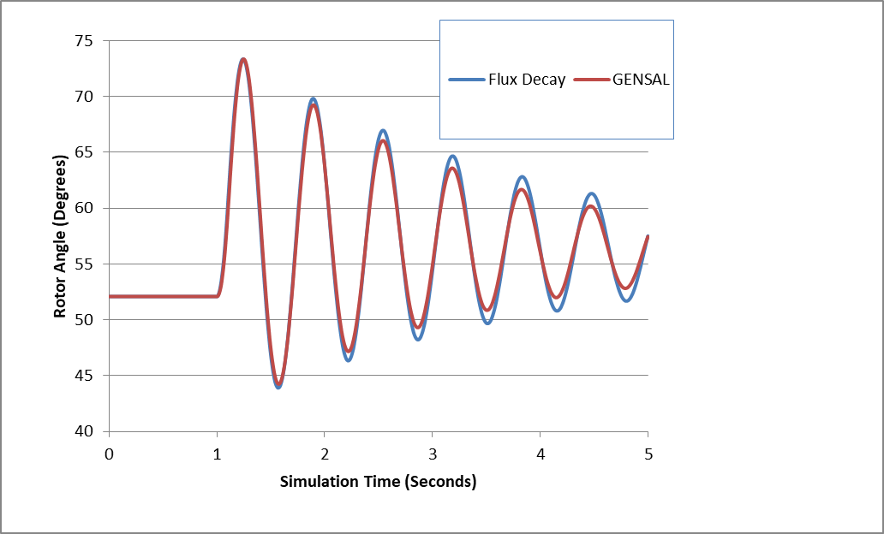
Comparison Between Gensal and Flux Decay

Slide 9
Nonlinear Magnetic Circuits
Nonlinear magnetic models are needed because magnetic materials tend to saturate; that is, increasingly large amounts of current are needed to increase the flux density
Linear

Slide 10
Saturation
The flux density (B) determines when a material saturates; measured in Tesla (T)

Slide 11
Relative Magnetic Strength Levels
Earth’s magnetic field is between 30 and 70 μT (0.3 to 0.7 gauss)
A refrigerator magnet might have 0.005 T
A commercial neodymium magnet might be 1 T
A magnetic resonance imaging (MRI) machine would be between 1 and 3 T
Strong lab magnets can be 10 T
Frogs can be levitated at 16 T (see www.ru.nl/hfml/research/levitation/diamagnetic
A neutron star can have 1 to 100 MT!

Slide 12
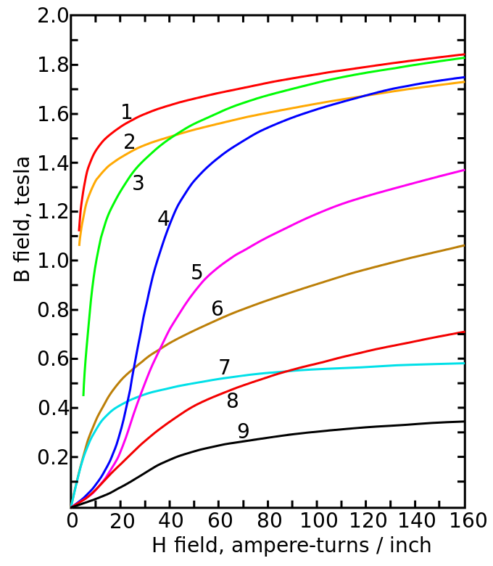
Magnetic Saturation and Hysteresis
The below image shows the saturation curves for various materials
Magnetization curves of 9 ferromagnetic materials, showing saturation. 1.Sheet steel, 2.Silicon steel, 3.Cast steel, 4.Tungsten steel, 5.Magnet steel, 6.Cast iron, 7.Nickel, 8.Cobalt, 9.Magnetite; highest saturation materials can get to around 2.2 or 2.3T
H is proportional to current
Image Source: en.wikipedia.org/wiki/Saturation_(magnetic)

Slide 13
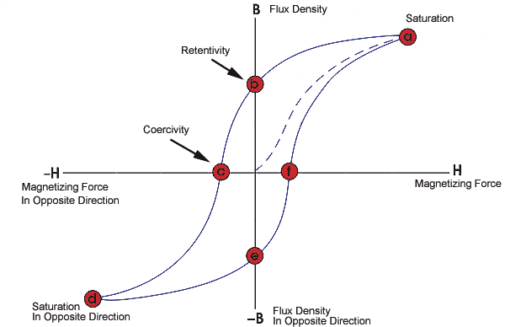
Magnetic Saturation and Hysteresis
Magnetic materials also exhibit hysteresis, so there is some residual magnetism when the current goes to zero; design goal is to reduce the area enclosed by the hysteresis loop
To minimize the amount of magnetic material, and hence cost and weight, electric machines are designed to operate close to saturation
Image source: www.nde-ed.org/EducationResources/CommunityCollege/MagParticle/Graphics/BHCurve.gif

Slide 14
Saturation Models
Many different models exist to represent saturation
There is a tradeoff between accuracy and complexity
Book presents the details of fully considering saturation in Section 3.5
One simple approach is to replace
With

Slide 15
Saturation Models
In steady-state this becomes
Hence saturation increases the required E_{fd} to get a desired flux
Saturation is usually modeled using a quadratic function, with the value of Se specified at two points (often at 1.0 flux and 1.2 flux)
A and B are determined from the two data points

Slide 16
Saturation Example
If Se = 0.1 when the flux is 1.0 and 0.5 when the flux is 1.2, what are the values of A and B using the

Slide 17
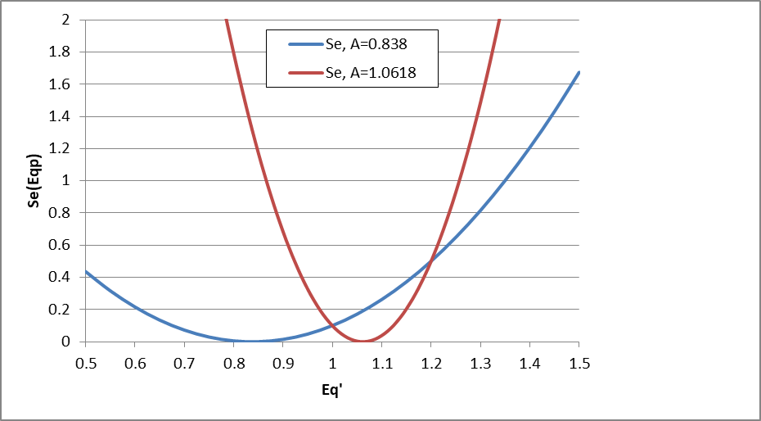
Saturation Example: Selection of A
When selecting which of the two values of A to use, we do not want the minimum to be between the two specified values. That is Se(1.0) and Se(1.2).

Slide 18
Implementing Saturation Models
When implementing saturation models in code, it is important to recognize that the function is meant to be positive, so negative values are not allowed
In large cases one is almost guaranteed to have special cases, sometimes caused by user typos
What to do if Se(1.2) < Se(1.0)?
What to do if Se(1.0) = 0 and Se(1.2) <> 0
What to do if Se(1.0) = Se(1.2) <> 0
Exponential saturation models have also been used

Slide 19
GENSAL Example with Saturation
Once E'_{q} has been determined, the initial field current (and hence field voltage) are easily determined by recognizing in steady-state the E'_{q} is zero
Saturation coefficients were determined from the two initial values
Saved as case B4_GENSAL_SAT

Slide 20
GENROU
The GENROU model has been widely used to model round rotor machines
Saturation is assumed to occur on both the d-axis and the q-axis, making initialization slightly more difficult

Slide 21
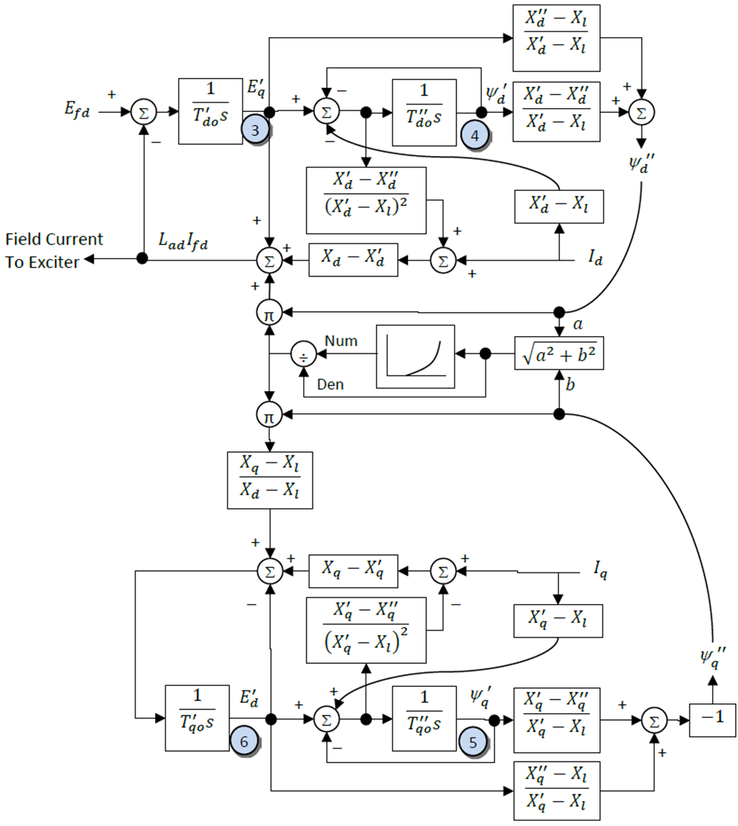
GENROU Block Diagram
The d-axis is similar to that of the GENSAL; the q-axis is now similar to the d-axis. Note that saturation now affects both axes.

Slide 22
GENROU Initialization
Because saturation impacts both axes, the simple approach will no longer work
Key insight for determining initial δ is that the magnitude of the saturation depends upon the magnitude of ψ", which is independent of δ
Solving for δ requires an iterative approach; first get a guess of δ using 3.229 from the book
This point is crucial!

Slide 23
GENROU Initialization
Then solve five nonlinear equations for five unknowns
The five unknowns are δ, E'_{q}, E'_{d}, ψ '_{q}, and ψ '_{d}
Five equations come from the terminal power flow constraints (which allow us to define ψ_{d} " and ψ_{q}" as a function of the power flow voltage, current and δ) and from the differential equations initially set to zero
The ψ_{d} " and ψ_{q}" block diagram constraints
Two differential equations for the q-axis, one for the d-axis (the other equation is used to set the field voltage
Values can be determined using Newton’s method, which is needed for the nonlinear case with saturation

Slide 24
GENROU Initialization
Use dq transform to express terminal current as
Get expressions for ψ "_{q} and ψ "_{d} in terms of the initial terminal voltage and δ
Use dq transform to express terminal voltage as
Then from
These values will change during the iteration as δ changes
Recall X_{d}"=X_{q}"=X" and ω=1 (in steady-state)
Expressing complex equation as two real equations

Slide 25
GENROU Initialization Example
Extend the two-axis example
For two-axis assume H = 3.0 per unit-seconds, R_{s}=0, X_{d} = 2.1, X_{q} = 2.0, X'_{d}= 0.3, X'_{q} = 0.5, T'_{do} = 7.0, T'_{qo} = 0.75 per unit using the 100 MVA base.
For subtransient fields assume X"_{d}=X"_{q}=0.28, X_{l} = 0.13, T"_{do} = 0.073, T"_{qo} =0.07
for comparison we'll initially assume no saturation
From two-axis get a guess of δ

Slide 26
GENROU Initialization Example
And the network current and voltage in dq reference
Which gives initial subtransient fluxes (with R_{s}=0),

Slide 27
GENROU Initialization Example
Without saturation this is the exact solution
Initial values are: δ = 52.1, E'_{q}=1.1298, E'_{d}=0.533, ψ '_{q} =0.6645, and ψ '_{d}=0.9614
E_{fd}=2.9133
Saved as case B4_GENROU_NoSat

Slide 28
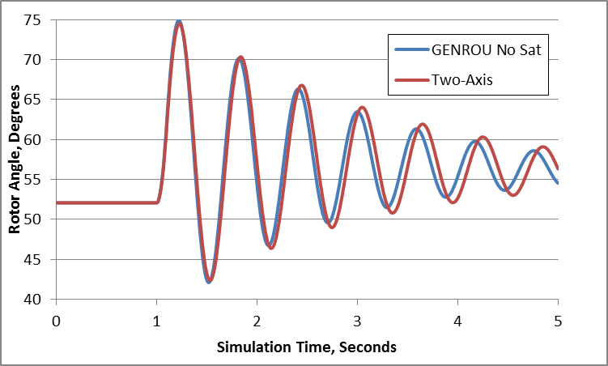
Two-Axis versus GENROU Response
Figure compares rotor angle for bus 3 fault, cleared at t=1.1 seconds

Slide 29
GENROU with Saturation
Nonlinear approach is needed in common situation in which there is saturation
Assume previous GENROU model with S(1.0) = 0.05, and S(1.2) = 0.2.
Initial values are: δ = 49.2, E'_{q}=1.1591, E'_{d}=0.4646, ψ '_{q} =0.6146, and ψ '_{d}=0.9940
Efd=3.2186
Saved as case B4_GENROU_Sat

Slide 30
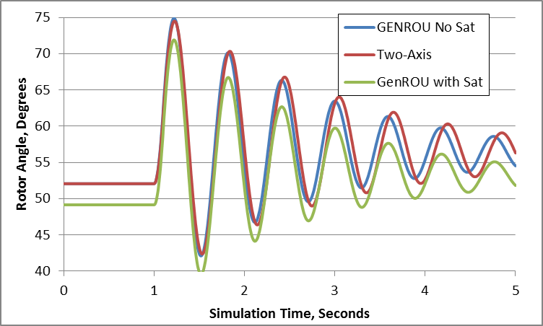
Two-Axis versus GENROU Response

Slide 31
GENTPF and GENTPJ Models
These models were introduced into PSLF in 2009 to provide a better match between simulated and actual system results for salient pole machines
Desire was to duplicate functionality from old BPA TS code
Allows for subtransient saliency (X"_{d} <> X"_{q})
Can also be used with round rotor, replacing GENSAL and GENROU
Useful reference is available at below link; includes all the equations, and saturation details
https://www.wecc.biz/Reliability/gentpj-typej-definition.pdf

Slide 32
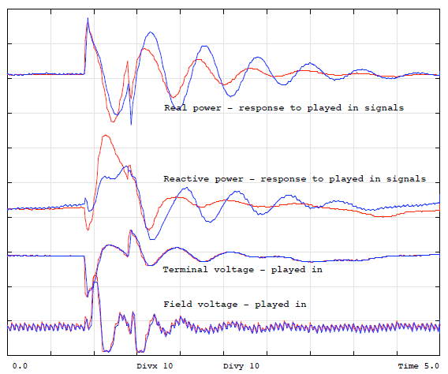
GENSAL Results
Chief Joseph
disturbance playback
GENSAL
BLUE = MODEL
RED = ACTUAL
Image source :https://www.wecc.biz/library/WECC%20Documents/Documents%20for %20Generators/Generator%20Testing%20Program/gentpj%20and%20gensal%20morel.pdf

Slide 33
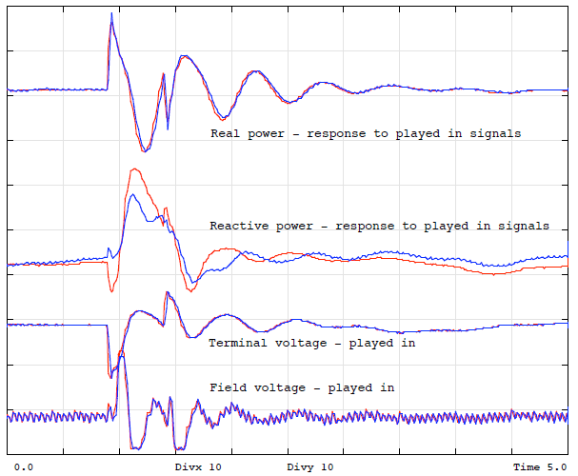
GENTPJ Results
Chief Joseph
disturbance playback
GENTPJ
BLUE = MODEL
RED = ACTUAL

Slide 34
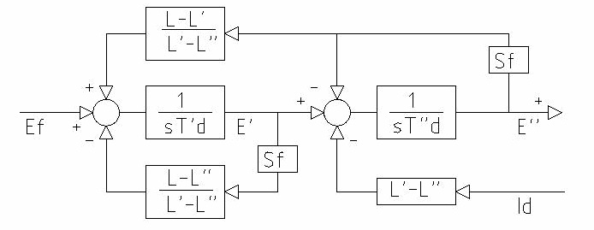
GENTPF and GENTPJ Models
GENTPF/J d-axis block diagram
GENTPJ allows saturation function to include a component that depends on the stator current
Most of WECC machine models are now GENTPF or GENTPJ
Se = 1 + fsat(ψ _{ag} + Kis*It)
If nonzero, Kis typically ranges from 0.02 to 0.12

Slide 35
Theoretical Justification for GENTPF and GENTPJ
In the GENROU and GENSAL models saturation shows up purely as an additive term of E_{q}’ and E_{d}’
Saturation does not come into play in the network interface equations and thus with the assumption of X_{q}”=X_{d}” a simple circuit model can be used
The advantage of the GENTPF/J models is saturation really affects the entire model, and in this model it is applied to all the inductance terms simultaneously
This complicates the network boundary equations, but since these models are designed for X_{q}”≠ X_{d}” there is no increase in complexity

Slide 36
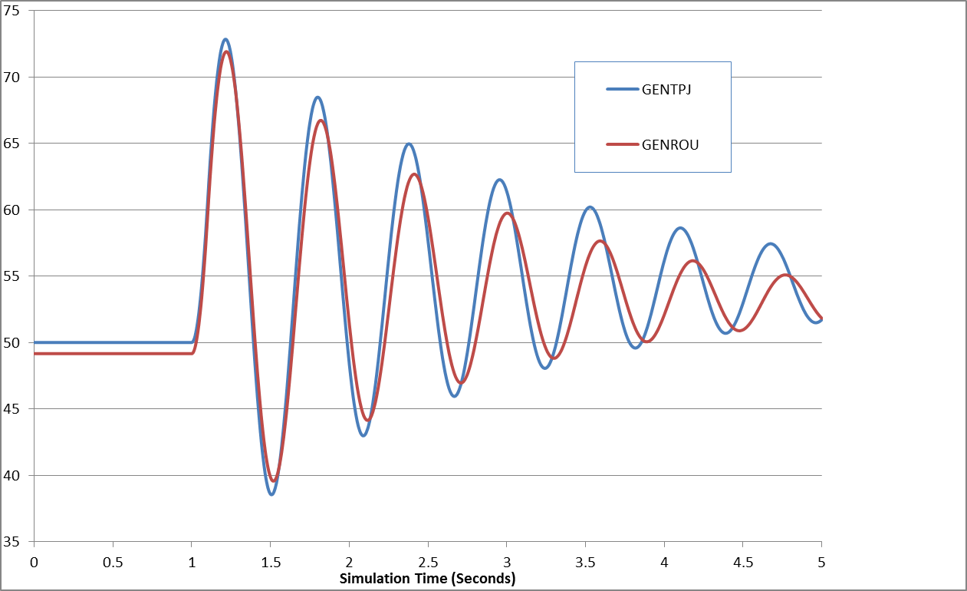
GENROU/GENTPJ Comparison
Easy Paper Suggestion (Done by Birchfield in 2017 GM)!

Slide 37
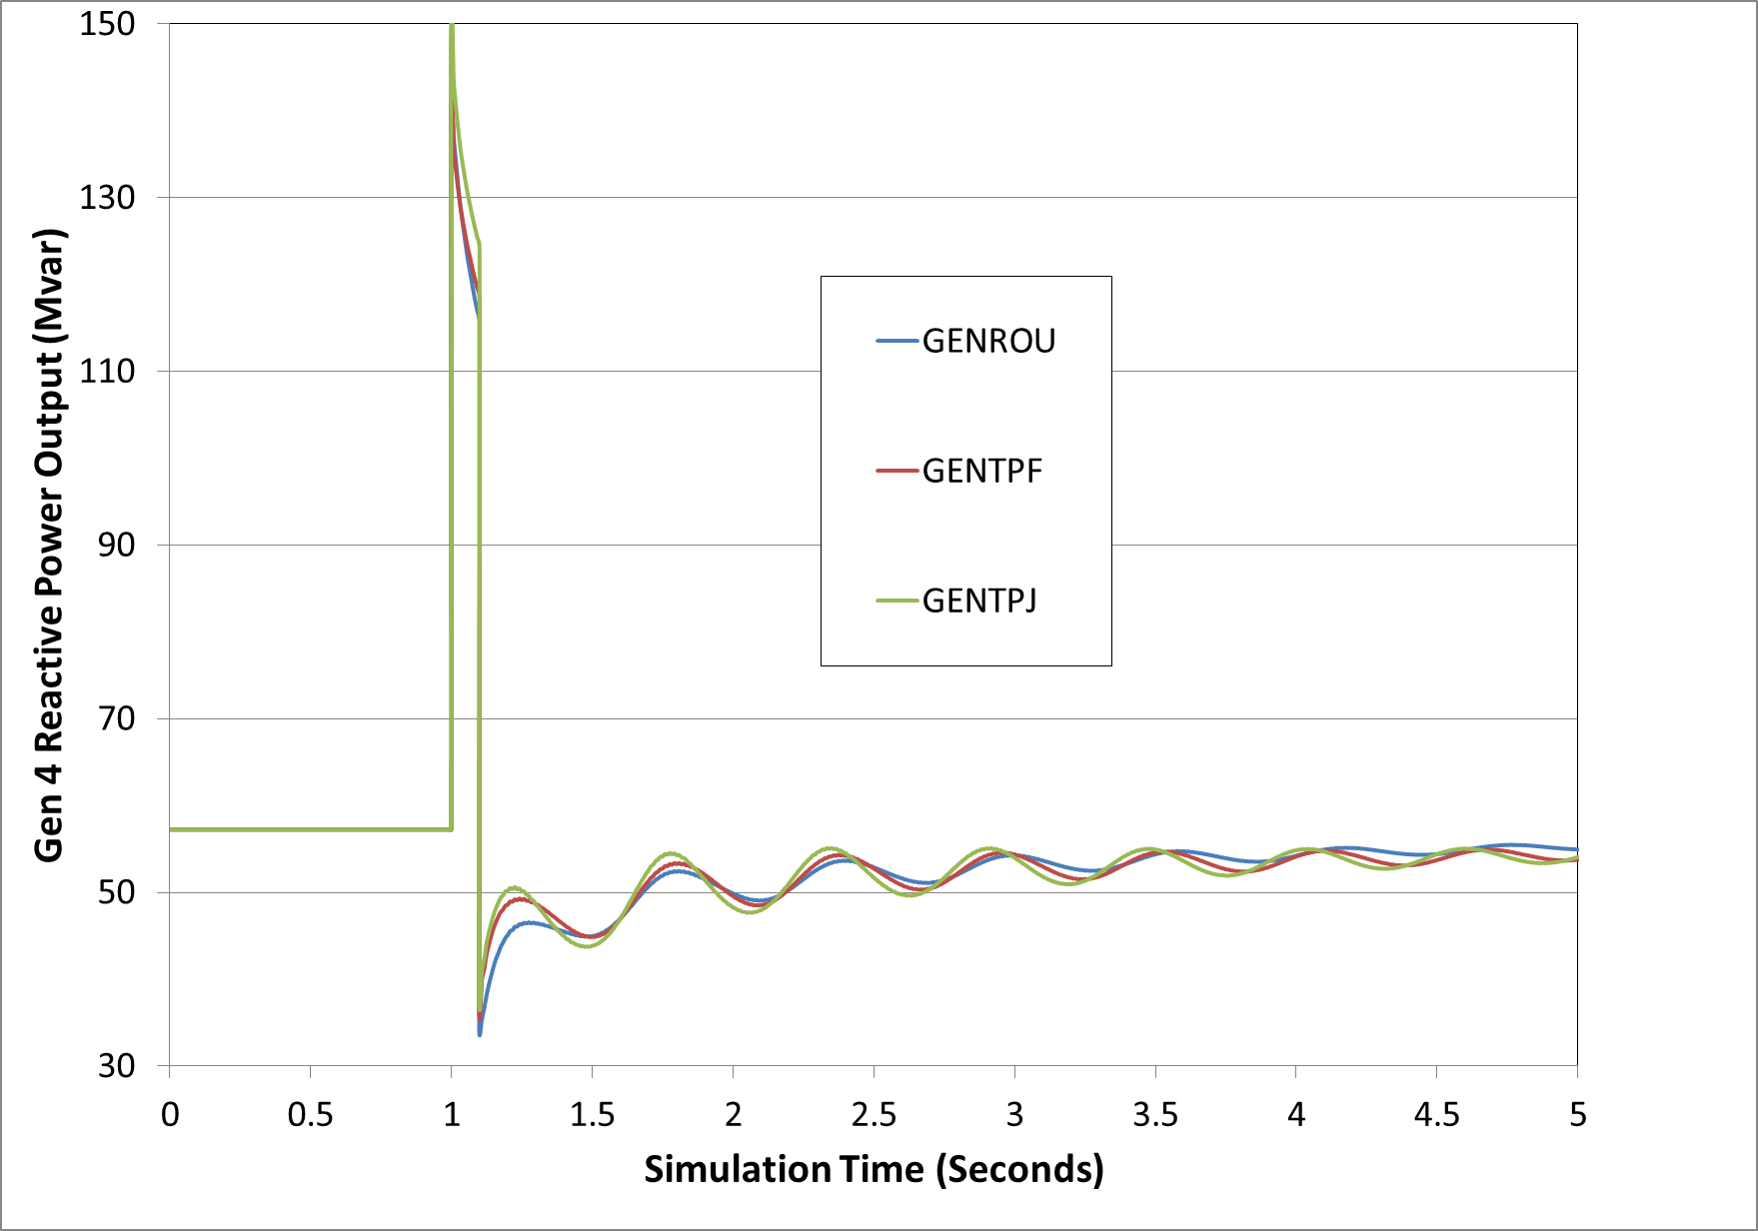
GenRou, GenTPF, GenTPJ
Figure compares gen 4 reactive power output for the 0.1 second fault

Slide 38
Voltage and Speed Control

Slide 39
Exciters, Including AVR
Exciters are used to control the synchronous machine field voltage and current
Usually modeled with automatic voltage regulator included
A useful reference is IEEE Std 421.5-2016
Just updated from the 2005 edition!
Covers the major types of exciters used in transient stability
Continuation of standard designs started with "Computer Representation of Excitation Systems," IEEE Trans. Power App. and Syst., vol. pas-87, pp. 1460-1464, June 1968
Another reference is P. Kundur, Power System Stability and Control, EPRI, McGraw-Hill, 1994
Exciters are covered in Chapter 8 as are block diagram basics

Slide 40
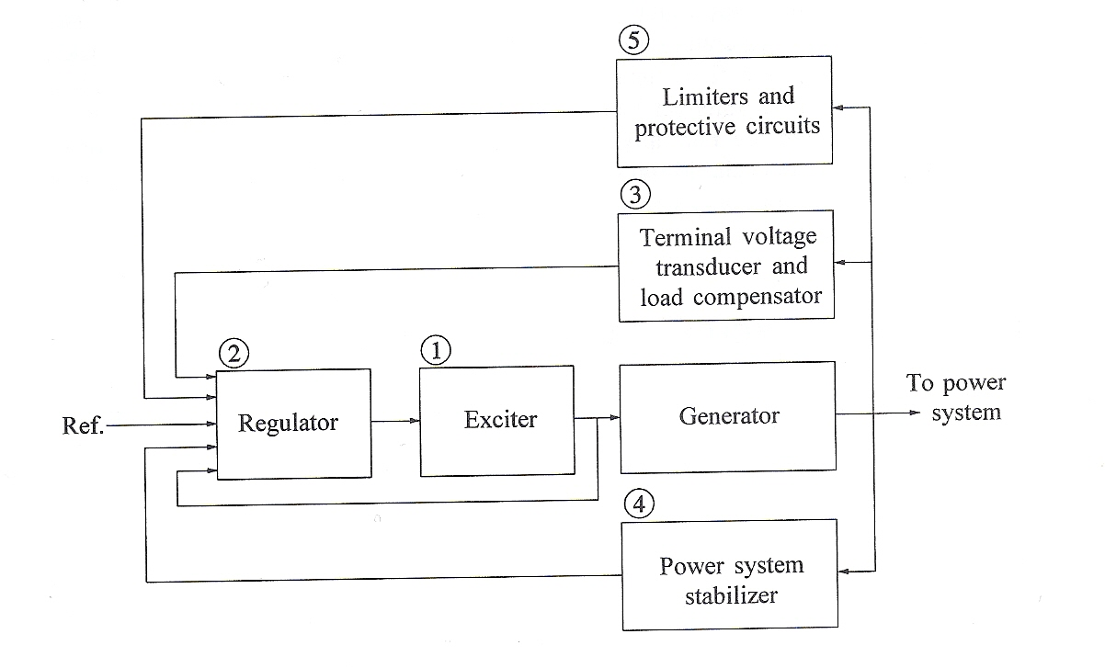
Functional Block Diagram
Image source: Fig 8.1 of Kundur, Power System Stability and Control

Slide 41
Types of Exciters
None, which would be the case for a permanent magnet generator
primarily used with wind turbines with ac-dc-ac converters
DC: Utilize a dc generator as the source of the field voltage through slip rings
AC: Use an ac generator on the generator shaft, with output rectified to produce the dc field voltage; brushless with a rotating rectifier system
Static: Exciter is static, with field current supplied through slip rings

