Slide 1
ECEN 667
Power System Stability
Lecture 26: Renewable Energy Systems
Prof. Tom Overbye
Dept. of Electrical and Computer Engineering
Texas A&M University, overbye@tamu.edu

Slide 2
Announcements
Read Chapter 9
Final is as per TAMU schedule. That is, Friday Dec 8 from 3 to 5pm here

Slide 3
Renewable Resource Modeling
With the advent of more renewable generation in power systems worldwide it is important to have correct models
Hydro systems have already been covered
Solar thermal and geothermal are modeled similar to existing stream generation, so they are not covered here
Coverage will focus on transient stability level models for wind and solar PV for integrated system studies
  More detailed EMTP-level models may be needed for individual plant issues, like subsynchronous resonance
  Models are evolving, with a desire by many to have as generic as possible models

Slide 4
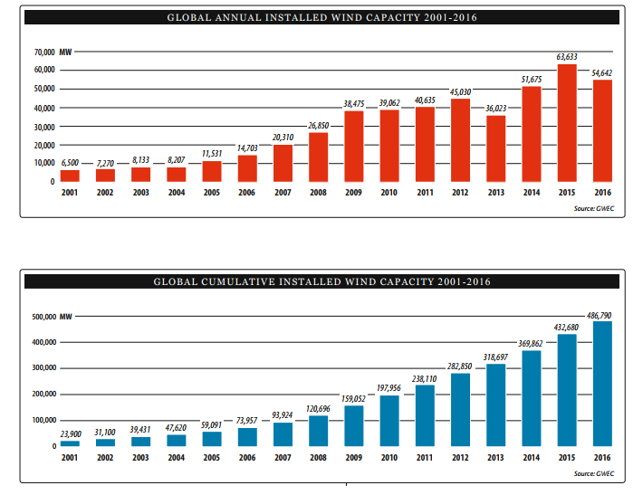
Growth in Wind Worldwide
Source: Global Wind 2016 Report, Global Wind Energy Council
4

Slide 5
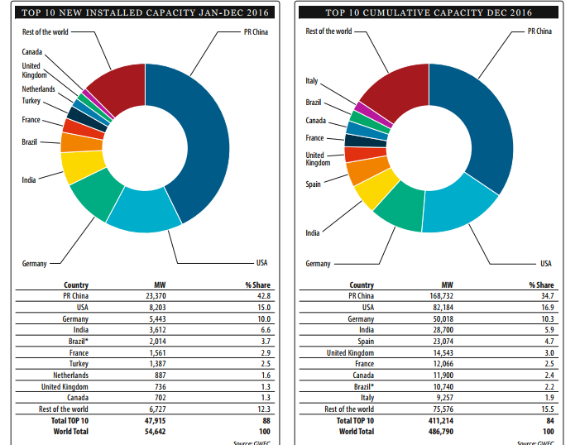
Growth in Wind Worldwide
Source: Global Wind 2016 Report, Global Wind Energy Council
5

Slide 6
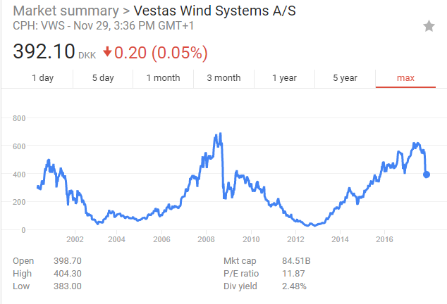
Vestas Wind Systems Stock Price
Vestas’s stock has increased by more than 15times from their 2012/2013 lows!
Their price
fell significantly
in November
due to increased
competition
in wind power
markets
6

Slide 7
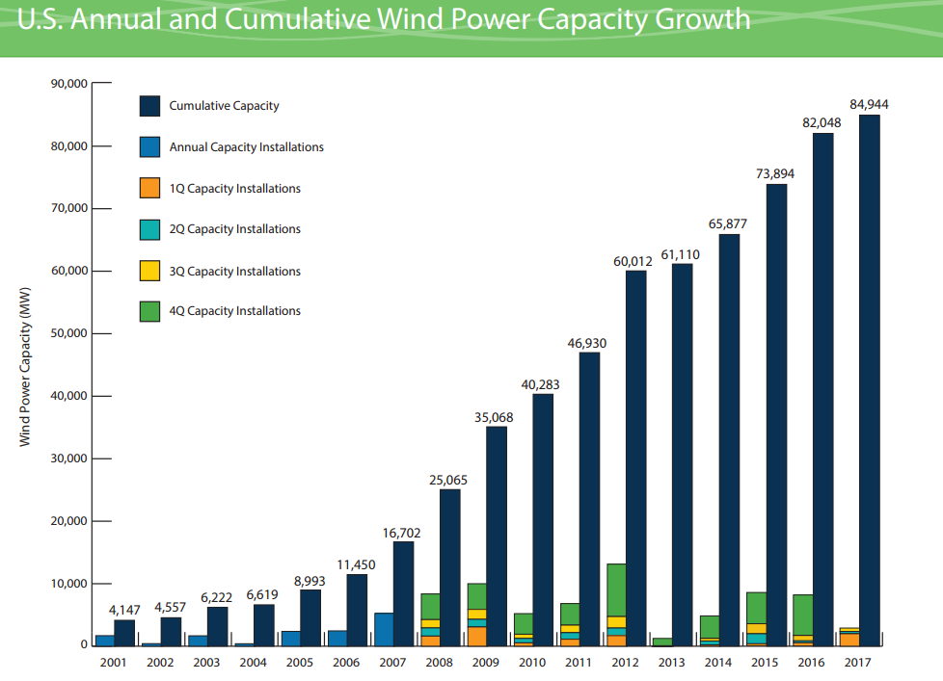
Growth in US Wind
Production tax credit of $24/MWh being phased out
  100% in 2016, 80% in 2017, 60% in 2018, 40% in 2019
7
Source: American Wind Energy Association 2017 Third Quarter Market Report

Slide 8
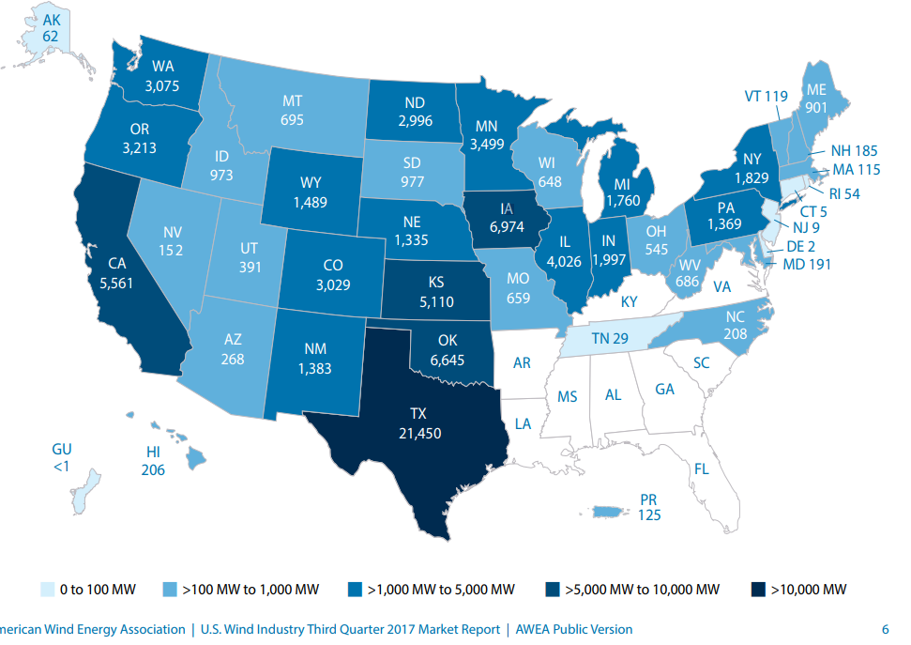
2016 Installed Capacity by State:
Texas Continues to Dominate!
8
Source: American Wind Energy Association 2017 Third Quarter Market Report

Slide 9
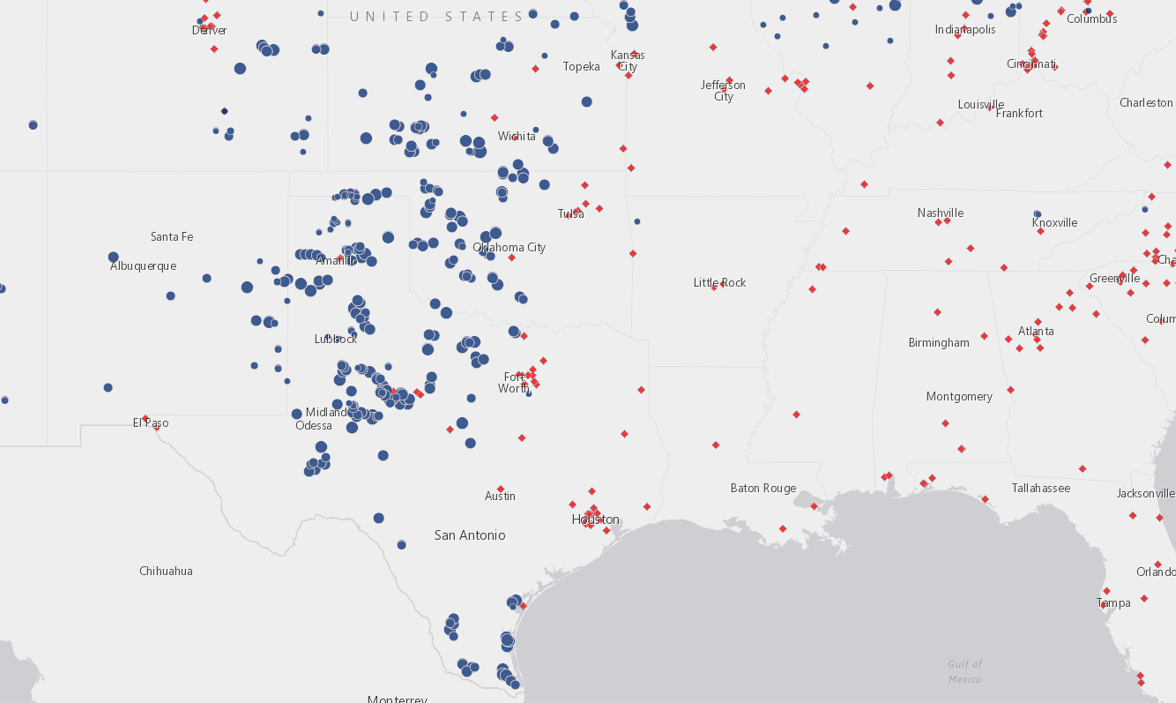
Wind Farm and Wind-Related Plant Locations
http://gis.awea.org/arcgisportal/apps/webappviewer/index.html?id=eed1ec3b624742f8b18280e6aa73e8ec
9

Slide 10
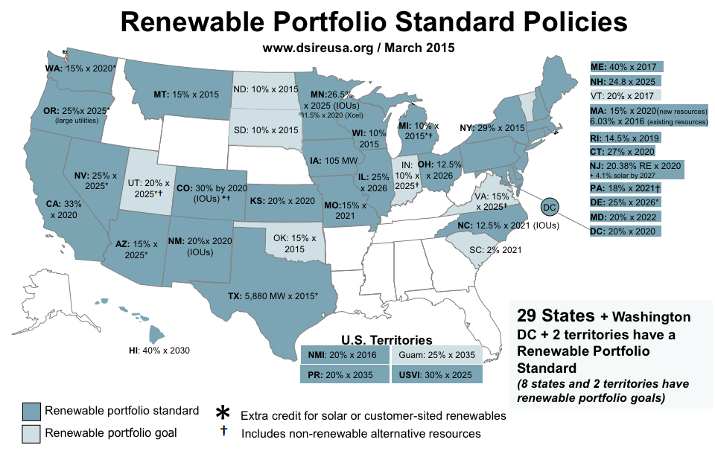
State Renewable Portfolio Standards
Texas
has a goal
of 10 GW
by 2025,
but that
has already
been
achieved
(by more
than double!)
Image source: dsireusa.org (see for updated information)
10

Slide 11
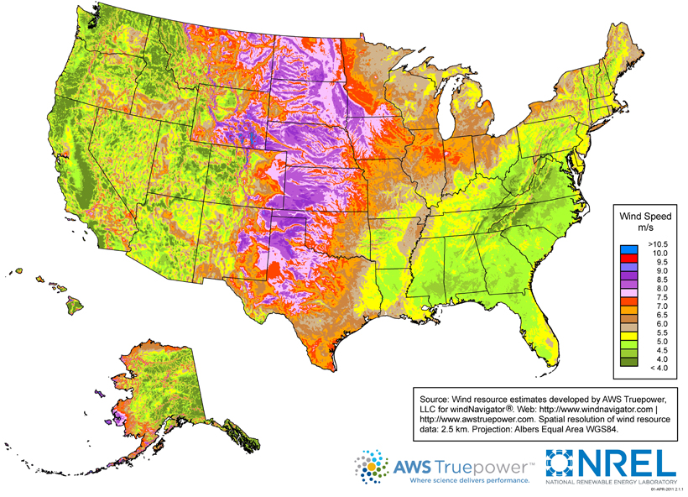
US Wind Resources
11
Source: http://www.windpoweringamerica.gov/wind_maps.asp

Slide 12
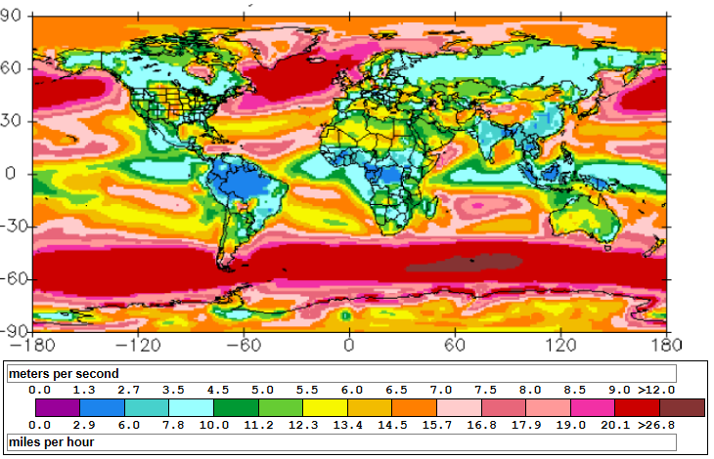
Global Wind Speed 50m Map
http://www.climate-charts.com/World-Climate-Maps.html#wind-speed
12

Slide 13
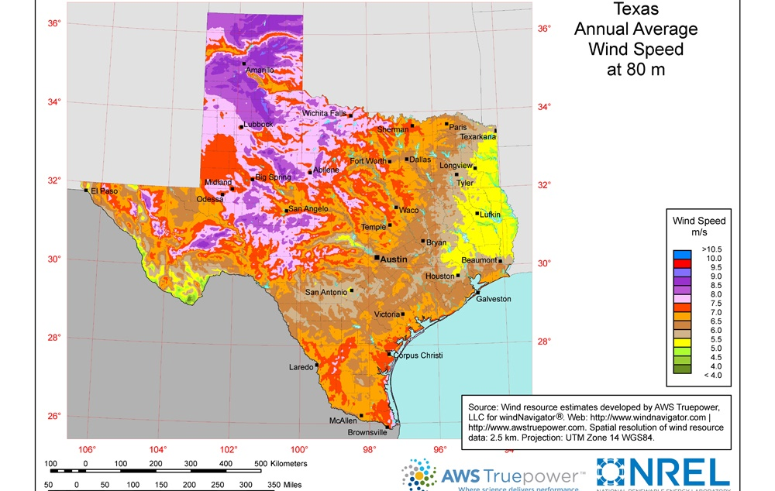
Wind Map Texas– 80m Height
https://windexchange.energy.gov/files/u/visualization/image/tx_80m.jpg
13

Slide 14
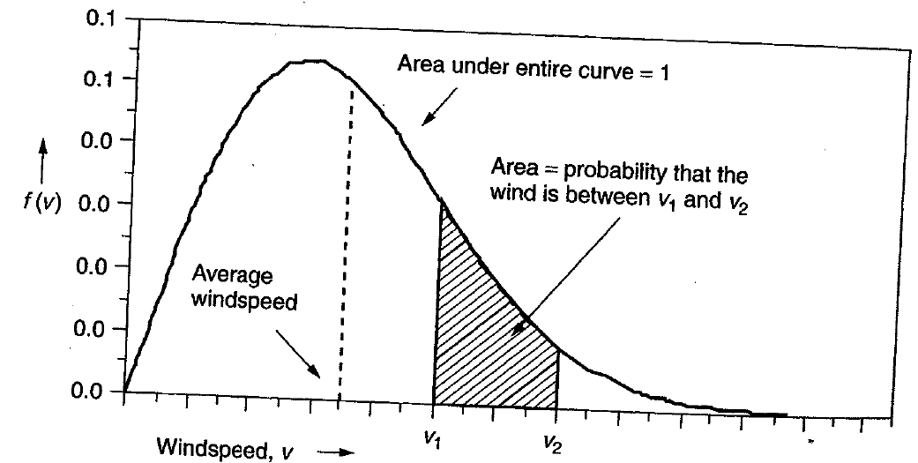
Power in the Wind
The power in the wind is proportional to the cube of the wind speed
  Velocity increases with height, with more increase over rougher terrain (doubling at 100m compared to 10m for a small town, but only increasing by 60% over crops or 30% over calm water)
Maximum rotor efficiency is 59.3%, from Betz' law
Expected available
energy depends on
the wind speed
probability density
function (pdf)
14

Slide 15
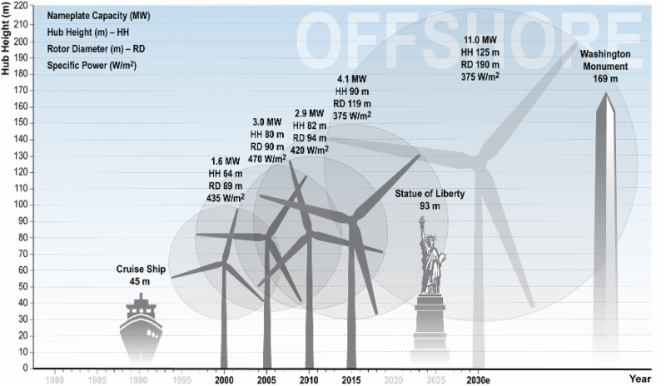
Wind Turbine Height and Size
The current
largest wind
turbine by
capacity is
the Vestas
V164 which
has a capacity
of 8 MW, a
height of
220 m,
and diameter
of 164 m.
15
Source: cdn.arstechnica.net/wp-content/uploads/2016/11/6e9cb9fc-0c18-46db-9176-883cbb08eace.png

Slide 16
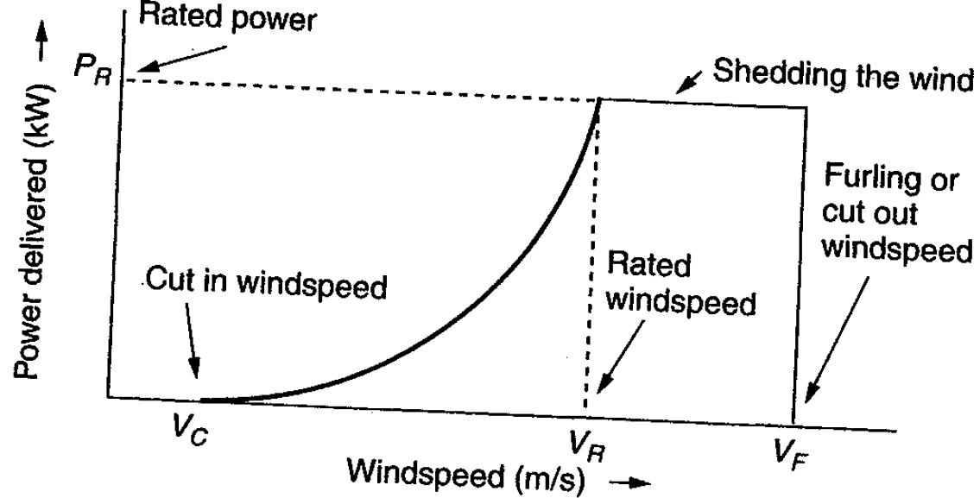
Extracted Power
WTGs are designed for rated power and windspeed
  For speeds above this blades are pitched to operate at rated power; at furling speed the WTG is cut out
16

Slide 17
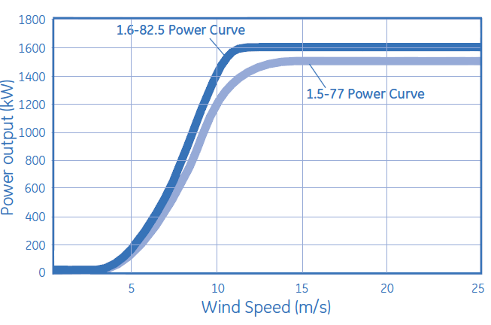
Example: GE 1.5 and 1.6
MW Turbines
Power speed curves for the GE 1.5 and 1.6 MW WTGs
  Hub height is 80/100 m; cut-out at 25 m/s wind
Source: http://site.ge-energy.com/prod_serv/products/wind_turbines/en/15mw/index.htm
17

Slide 18
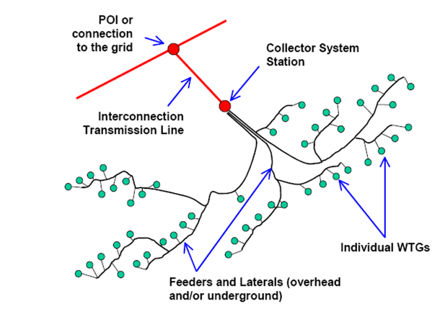
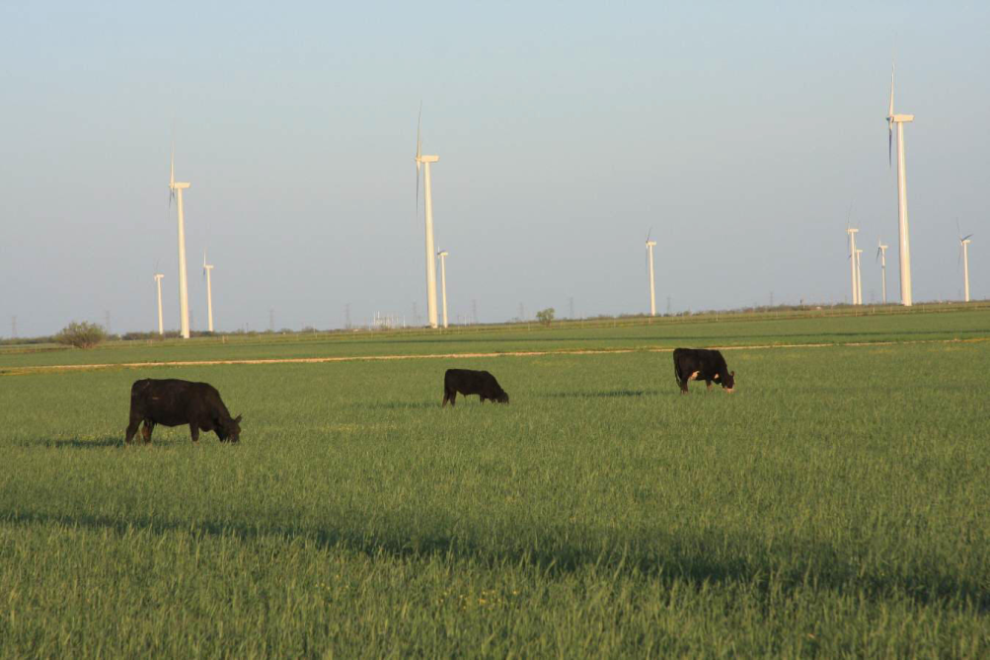
Wind Farms (or Parks)
Usually wind farm is modeled in aggregate for grid studies; wind farm can consist of many small (1 to 3 MW) wind turbine-generators (WTGs) operating at low voltage (e.g. 0.6kV) stepped up to distribution level (e.g., 34.5 kV)
Photo Source: www.energyindustryphotos.com/photos_of_wind_farm_turbines.htm
18

Slide 19
Economies of Scale
Presently large wind farms produce electricity more economically than small operations
Factors that contribute to lower costs are
  Wind power is proportional to the area covered by the blade (square of diameter) while tower costs vary with a value less than the square of the diameter
  Larger blades are higher, permitting access to faster winds, but size limited by transportation for most land wind farms
  Fixed costs associated with construction (permitting, management) are spread over more MWs of capacity
  Efficiencies in managing larger wind farms typically result in lower O&M costs (on-site staff reduces travel costs)
19

Slide 20
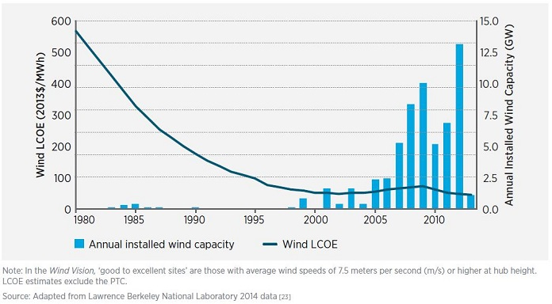
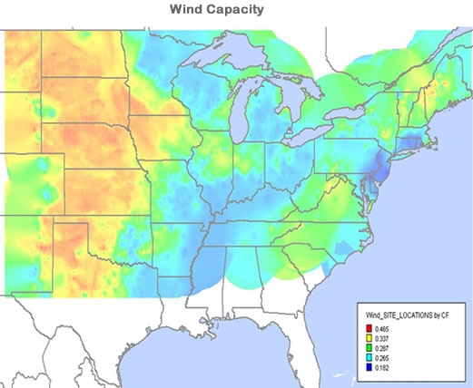
Wind Energy Economics
Most of the cost is in the initial purchase and construction (capital costs); current estimate is about $1690/kW; how much wind is generated depends on the capacity factor, best is about 40%
Source: www.awea.org/falling-wind-energy-costs
20

Slide 21
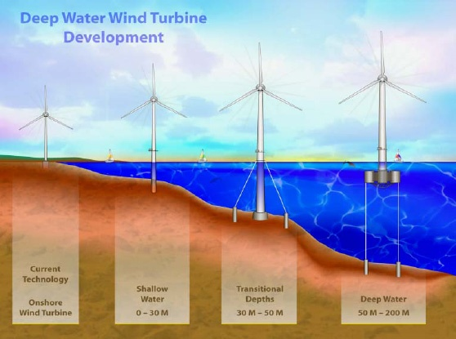
Offshore Wind
Offshore wind turbines currently need to be in relatively shallow water, so maximum distance from shore depends on the seabed
Capacity
factors tend
to increase
as turbines
move further
off-shore
Image Source: National Renewable Energy Laboratory
21

Slide 22
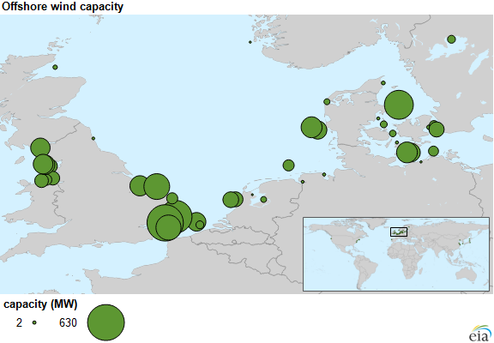
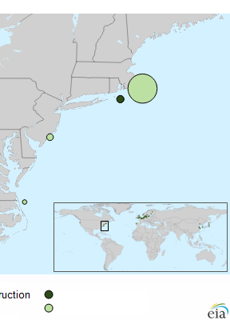
Offshore Wind Installations
The first US offshore wind, Block Island (Rhode Island)
with 30 MW, became operational in December 2016; Cape
Wind in Massachusetts was just officially cancelled this month
Source: EIA August 14, 2015 and dwwind.com/project/block-island-wind-farm/
22

Slide 23
Offshore: Advantages and Disadvantages
All advantages/disadvantages are somewhat site specific
Advantages
  Can usually be sited much closer to the load (often by coast)
  Offshore wind speeds are higher and steadier
  Easier to transport large wind turbines by ship
  Minimal sound impacts and visual impacts (if far enough offshore), no land usage issues
Disadvantages
  High construction costs, particularly since they are in windy (and hence wavy) locations
  Higher maintenance costs
  Some environmental issues (e.g., seabed disturbance)
23

Slide 24
Types of Wind Turbines for Power Flow and Transient Stability
Several different approaches to aggregate modeling of wind farms in power flow and transient stability
  Wind turbine manufacturers provide detailed, public models of their WTGs; these models are incorporated into software packages; example is GE 1.5, 1.6 and 3.6 MW WTGs (see Modeling of GE Wind Turbine-Generators for Grid Studies, version 4.6, March 2013, GE Energy)
  Proprietary models are included as user defined models; covered under NDAs to maintain confidentiality
  Generic models are developed to cover the range of WTGs, with parameters set based on the individual turbine types
    Concern by some manufacturers that the generic models to not capture their WTGs' behavior, such as during low voltage ride through (LVRT)

Slide 25
Types of Wind Turbines for Power Flow and Transient Stability
Electrically there are four main generic types of wind turbines
  Type 1: Induction machine; treated as PQ bus with negative P load; dynamically modeled as an induction motor
  Type 2: Induction machine with varying rotor resistance; treated as PQ bus in power flow; induction motor model with dynamic slip adjustment
  Type 3: Doubly Fed Asynchronous Generator (DFAG) (or DFIG); treated as PV bus in power flow
  Type 4: Full Asynchronous Generator; treated as PV bus in power flow
New wind farms (or parks) are primarily of Type 3 or 4

Slide 26
Generic Modeling Approach
The generic modeling approach is to divide the wind farm models by functionality
  Generator model: either an induction machine for Type 1 and 2's or a voltage source converter for Type 3 and 4
  Reactive power control (exciter): none for Type 1, rotor resistance control for Type 2, commanded reactive current for Type 3 and 4
  Drive train models: Type 1 and 2 in which the inertia appears in the transient stability
  Aerodynamics and Pitch Models: Model impact of changing blade angles (pitch) on power output

Slide 27
Wind Turbine Issues
Models are designed to represent the system level impacts of the aggregate wind turbines during disturbances such as low voltages (nearby faults) and frequency deviations
Low voltage ride through (LVRT) is a key issue, in which the wind turbines need to stay connected to the grid during nearby faults
Active and reactive power control is also an issue

Slide 28
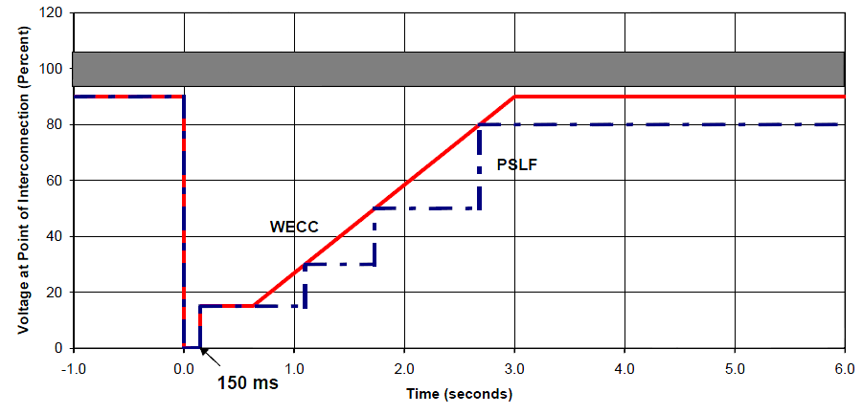
Low Voltage Ride Through (LVRT)
The concern is if during low voltages, such as during faults, the WTGs trip, it could quickly setup a cascading situation particularly in areas with lots of Type 3 WTGs
  Tripping had been a strategy to protect the DFAG from high rotor currents and over voltages in the dc capacitor.
  When there were just a few WTGs, tripping was acceptable
Standards now require specific low voltage performance
Image from California ISO presentation

Slide 29
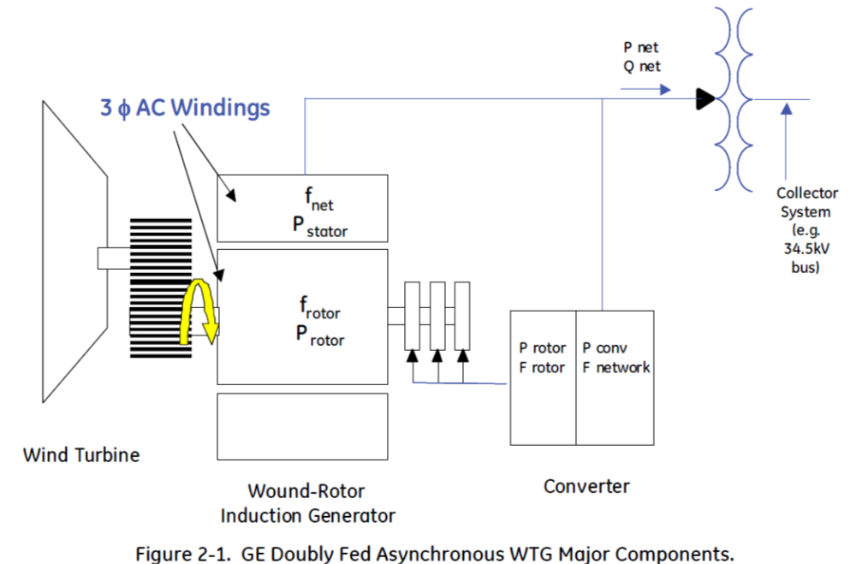
Type 3: Doubly Fed Asynchronous Generators (DFAG)
Doubly fed asynchronous generators (DFAG) are usually a conventional wound rotor induction generator with an ac-dc-ac power converter in the rotor circuit
  Power that would have been lost in external rotor resistance is now used
Electrical dynamics are
dominated by the voltage-
source inverter, which
has dynamics much
faster than the transient
stability time frame
Image Source: Figure 2.1 from Modeling of GE Wind Turbine-Generators for Grid Studies, version 4.6, March 2013, GE Energy

Slide 30
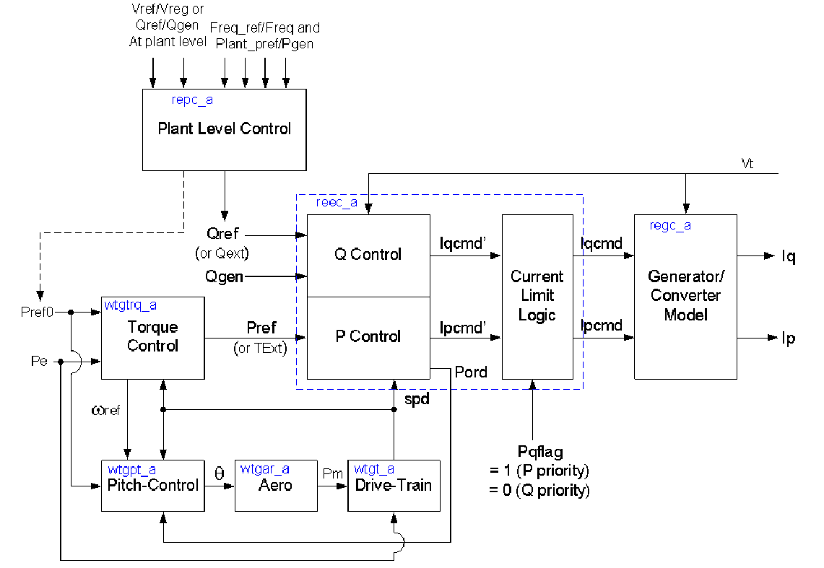
Overall Type 3 WTG Model
Transient stability
models are transitioning
Image Source: WECC Type 3 Wind Turbine Generator Model –Phase II, January 23, 2014, WECC TSS

Slide 31
Type 3 Converters
A voltage source converter (VSC) takes a dc voltage, usually held constant by a capacitor, and produces a controlled ac output
A phase locked loop (PLL) is used to synchronize the phase of the wind turbine with that of the ac connection voltage
  Operates much faster than the transient stability time step, so is often assumed to be in constant synchronism
Under normal conditions the WTG has a controllable real power current and reactive power current
WTG voltages are not particularly high, say 600V

Slide 32
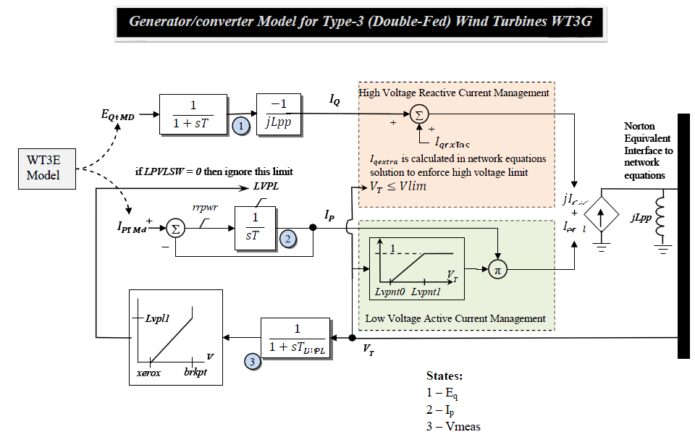
Type 3 WT3G Converter Model
Network interface
is a Norton current
in parallel with
a reactance jX"

Slide 33
Type 3 Converters
Type 3 machines can operate at a potentially widely varying slip
  Example, rated speed might be 120% (72 Hz for a 60 Hz system) with a slip of -0.2, but with a control range of +/- 30%
Control systems are used to limit the real power during faults (low voltage)
  Current ramp rate limits are used to prevent system stress during current recovery
Reactive current limits are used during high voltage conditions

Slide 34
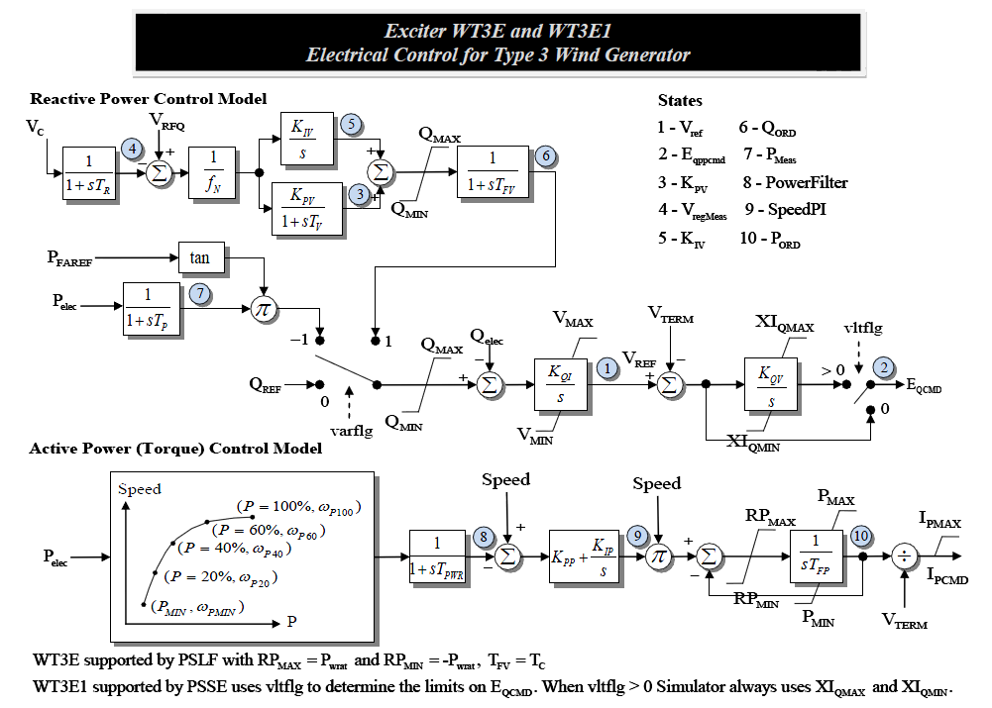
Type 3 Reactive Power Control

Slide 35
Aerodynamics
Type 3 and 4 models have more detailed models that directly incorporate the blade angle, so a brief coverage of the associated aerodynamics is useful
The power in the wind is given by
Modeling of GE Wind Turbine-Generators for Grid Studies, version 4.6, March 2013, GE Energy

Slide 36
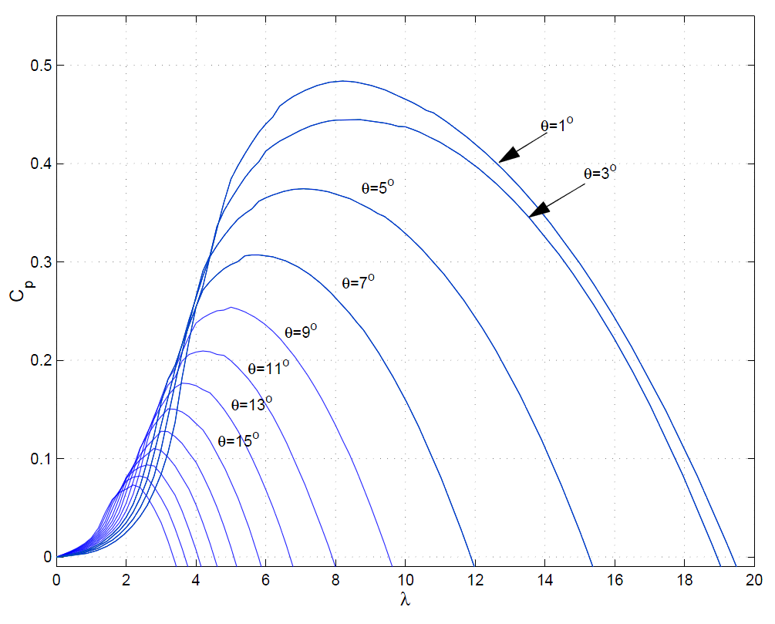
Aerodynamics
The C_{p}(θ,λ) function can be quite complex, with the GE 1.5 curves given below
If such a detailed curve is used, the initialization is from the power flow P. There are potentially three independent
variables, v_{w}, θ and ω. One approach is to fix ω at rated (e.g., 1.2) and θ at θ_{min}
Source: Modeling of GE Wind Turbine-Generators for Grid Studies, version 4.6, March 2013, GE Energy

Slide 37
Simplified Aerodynamics Model
A more simplified model is to approximate this curve as

Slide 38
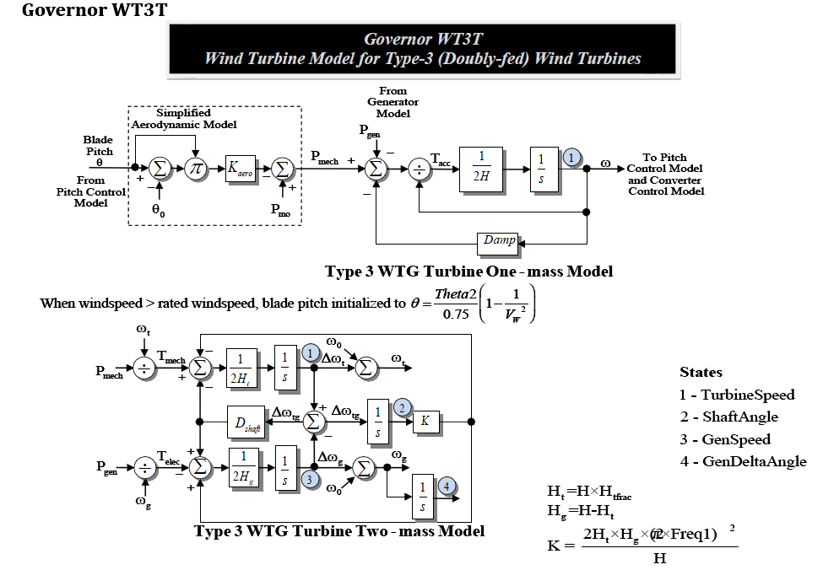
WT3T Model (Drive Train and Aero)

Slide 39
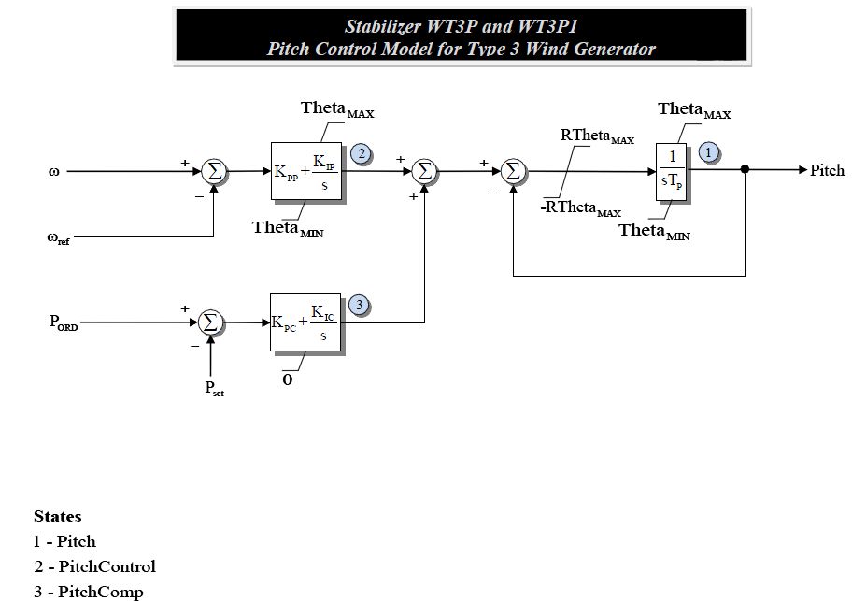
WT3P Model (Pitch Control)

Slide 40
Type 3 Example Case
Previous WSCC case, with the same line 6 to 9 fault, is modified so gen 3 is represented by a WT3G, WT3E, WT3T, and WT3P
Graph at left shows a
zoomed (2 second)
view of the gen 3
real power output,
with the value falling to
zero during the fault,
and then ramping
back up

Slide 41
Type 3 Example Case
Below graphs show the response of the WTG speed and blade angle

Slide 42
Type 4 Converters
Type 4 WTGs pass the entire output of the WTG through the ac-dc-ac converter
Hence the system characteristics are essentially independent of the type of generator
  Because of this decoupling, the generator speed can be as variable as needed
  This allows for different generator technologies, such as permanent magnet synchronous generators (PMSGs)
  Traditionally gearboxes have been used to change the slow wind turbine speed (e.g., 15 rpm) to a more standard generator speed (e.g., 1800 rpm); with Type 4 direct drive technologies can also be used

Slide 43
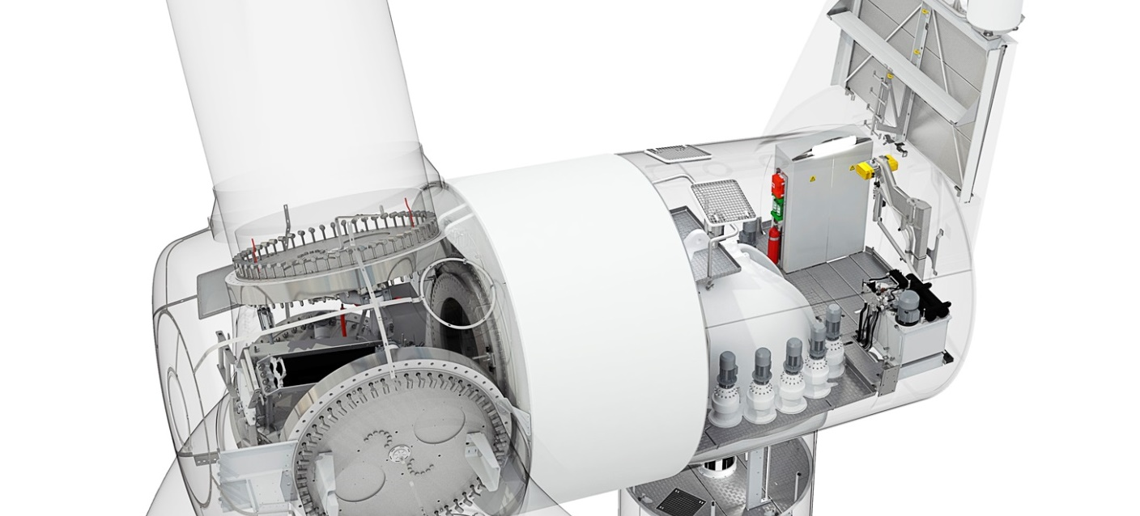
Example: Siemens SWT-2.3-113
The Siemens-2.3-113 is a 2.3 MW WTG that has a rotor diameter of 113m. It is a gearless design based on a compact permanent magnet generator
  No excitation power, slip rings or excitation control system
Image: www.siemens.com/press/pool/de/pressebilder/2011/renewable_energy/300dpi/soere201103-02_300dpi.jpg

Slide 44
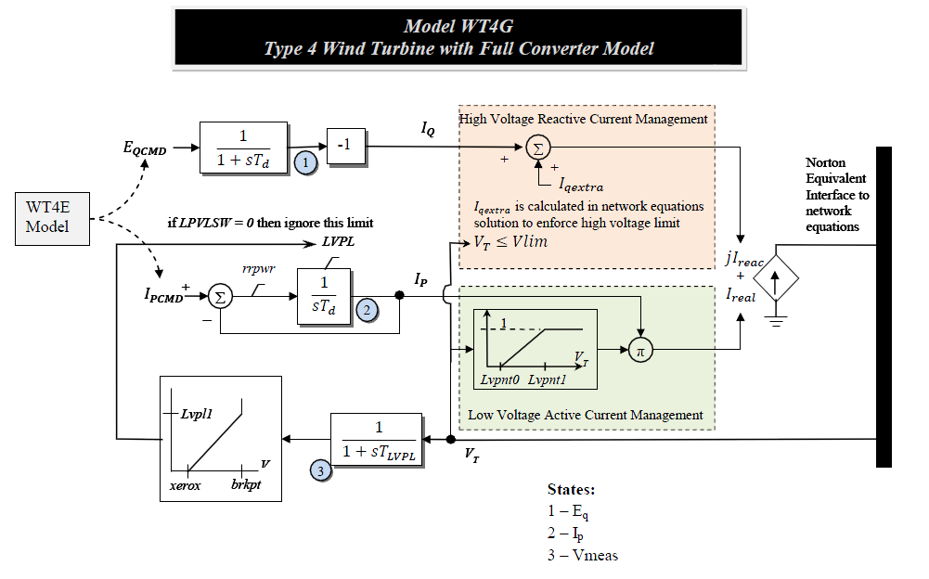
Type WTG4 Model
Very similar to the WTG3, except there is no X"

Slide 45
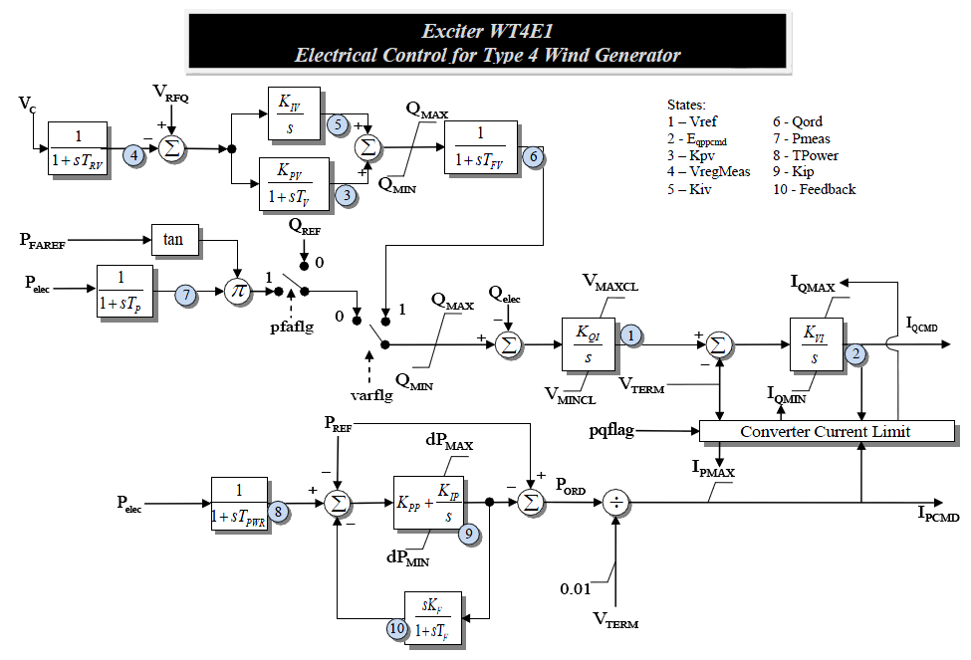
Type 4 Reactive Power Control
Also similar to the Type 3's, as are the other models

Slide 46
Solar Photovoltaic (PV)
Photovoltaic definition- a material or device that is capable of converting the energy contained in photons of light into an electrical voltage and current
Solar cells are diodes, creating dc power, which in grid applications is converted to ac by an inverter
For terrestrial applications, the capacity factor is limited by night, relative movement of the sun, the atmosphere, clouds, shading, etc
  A ballpark figure for Illinois is 18%
  "One sun" is defined a 1 kw/m²,which is the maximum insolation the reaches the surface of the earth (sun right overhead)

Slide 47
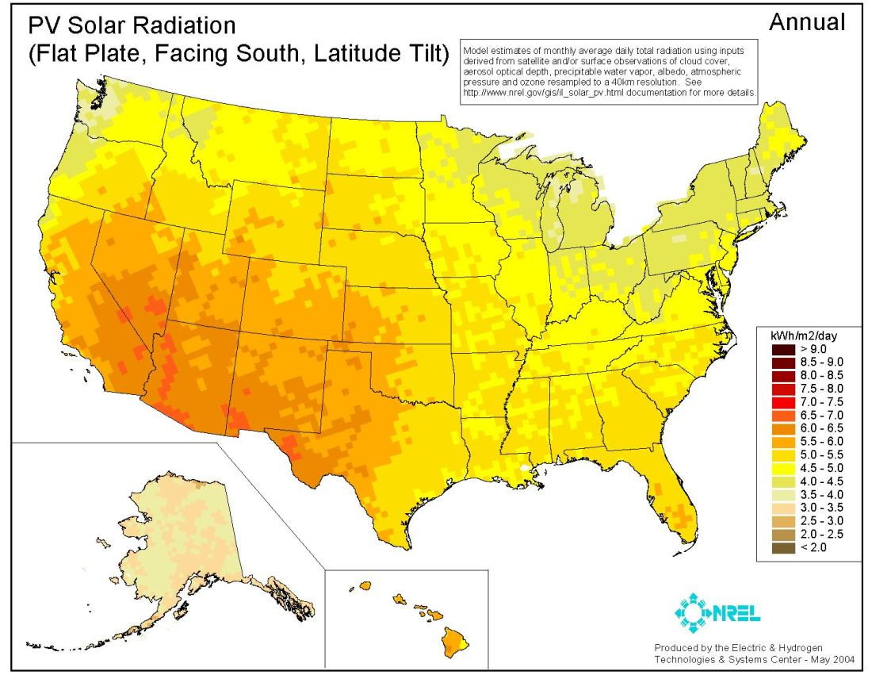
US Annual Insolation
The capacity
factor is
roughly this
number
divided by
24 hours
per day

Slide 48
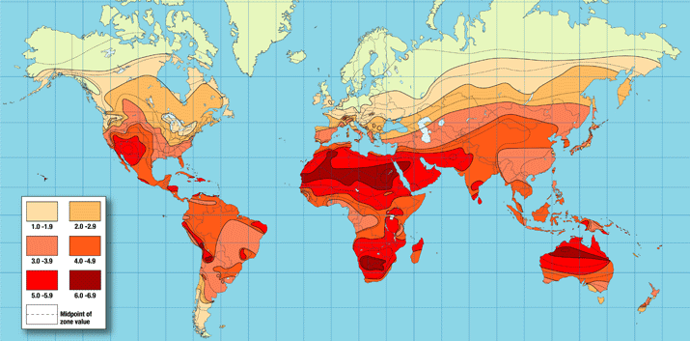
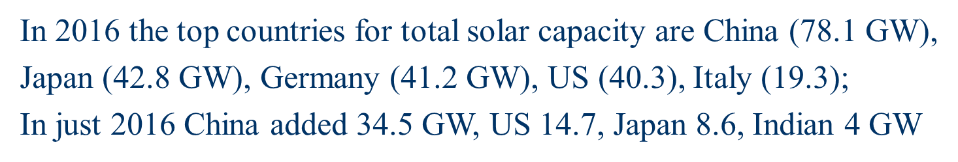
Worldwide Annual Insolation

Slide 49
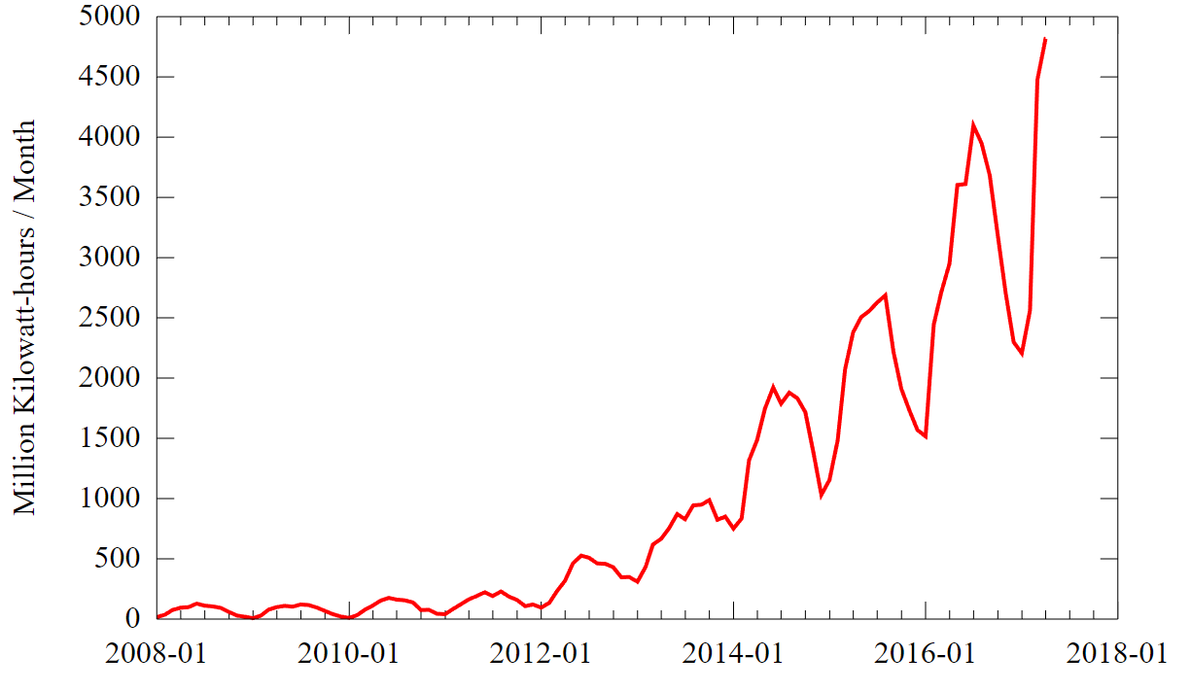
US Solar Generated Electricity
https://upload.wikimedia.org/wikipedia/commons/4/4e/US_Monthly_Solar_Power_Generation.svg
49

Slide 50
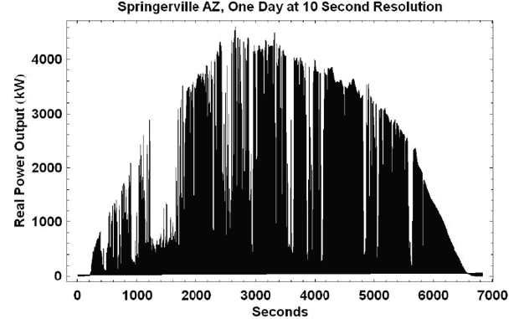
Solar PV can be Quite Intermittent
Because of Clouds
Intermittency
can be reduced
some when
PV is
distributed
over a larger
region; key
issue is
correlation
across an area
Image: http://www.megawattsf.com/gridstorage/gridstorage.htm
50

Slide 51
Modeling Solar PV
Since a large portion of the solar PV is distributed in small installations in the distribution system (e.g., residential rooftop), solar PV modeling is divided into two categories
  Central station, which is considered a single generation plant
  As part of the load model

Slide 52
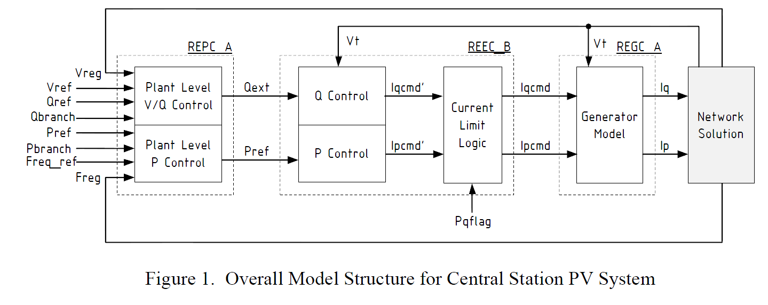
Central Station PV System Modeling
The below block diagram shows the overall structure
Solar PV has no inertia, and in contrast to wind there
is not even the ability to mimic an inertia response since
there is no energy storage in the system
Source: "Generic Solar Photovoltaic System Dynamic Simulation Model Specification," WECC Renewable Energy Modeling Task Force, Sept. 2012 (same source for figures on the next three slides)

Slide 53
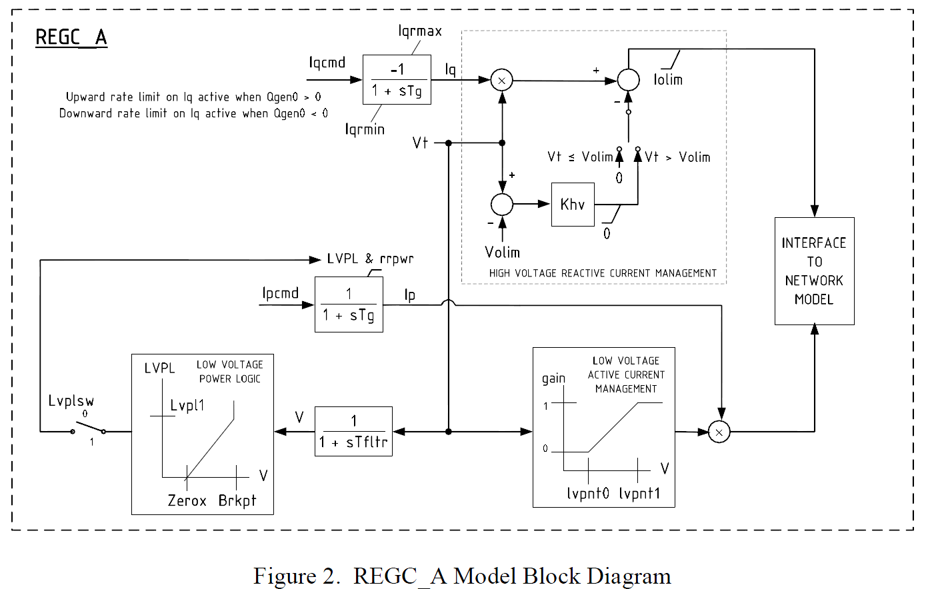
Central Station PV System Modeling
The generator model is similar to the Type 4 wind model, which is not surprising since this is modeling the converter operation
Source: "Generic Solar Photovoltaic System Dynamic Simulation Model Specification," WECC Renewable Energy Modeling Task Force, Sept. 2012

Slide 54
Distributed PV System Modeling
PV in the distribution system is usually operated at unity power factor
  There is research investigating the benefits of changing this
  IEEE Std 1547 now allows both non-unity power factor and voltage regulation
  A simple model is just as negative constant power load
An issue is tripping on abnormal frequency or voltage conditions
  IEEE Std 1547 says, "The DR unit shall cease to energize the Area EPS for faults on the Area EPS circuit to which it is connected.” (note EPS is electric power system)

Slide 55
Distributed PV System Modeling
An issue is tripping on abnormal frequency or voltage conditions (from IEEE 1547-2003, 2014 amendment)
  This is a key safety requirement!
  Units need to disconnect if the voltage is < 0.45 pu in 0.16 seconds, in 1 second between 0.45 and 0.6 pu, in 2 seconds if between 0.6 and 0.88 pu; also in 1 second if between 1.1 and 1.2, and in 0.16 seconds if higher
  Units need to disconnect in 0.16 seconds if the frequency is > 62 or less than 57 Hz; in 2 seconds if > 60.5 or < 59.5
  Reconnection is after minutes
  Values are defaults; different values can be used through mutual agreement between EPS and DR operator

