Slide 1
ECEN 615 Methods of Electric Power Systems Analysis
Lecture 8: Advanced Power Flow, Gaussian Elimination, Sparse Systems
Prof. Tom Overbye
Dept. of Electrical and Computer Engineering
Texas A&M University
overbye@tamu.edu

Slide 2
Announcements
Read Chapter 7 from the book
Homework 2 is due on Thursday September 26

Slide 3
Bus Branch versus Node Breaker
Due to a variety of issues during the 1970’s and 1980’s the real-time operations and planning stages of power systems adopted different modeling approaches
Real-Time Operations
Use detailed node/breaker model
EMS system as a set of integrated applications and processes
Real-time operating system
Real-time databases
Planning
Use simplified bus/branch model
PC approach
Use of files
Stand-alone applications
Entire data sets and software tools developed around these two distinct power system models

Slide 4
Circuit Breakers and Disconnects
Circuit breakers are devices that are designed to clear fault current, which can be many times normal operating current
AC circuit breakers take advantage of the current going through zero twice per cycle
Transmission faults can usually be cleared in less than three cycles
Disconnects cannot clear fault current, and usually not normal current. They provide a visual indication the line is open. Can be manual or motorized.
In the power flow they have essentially no impedance; concept of a zero branch reactance (ZBR)

Slide 5
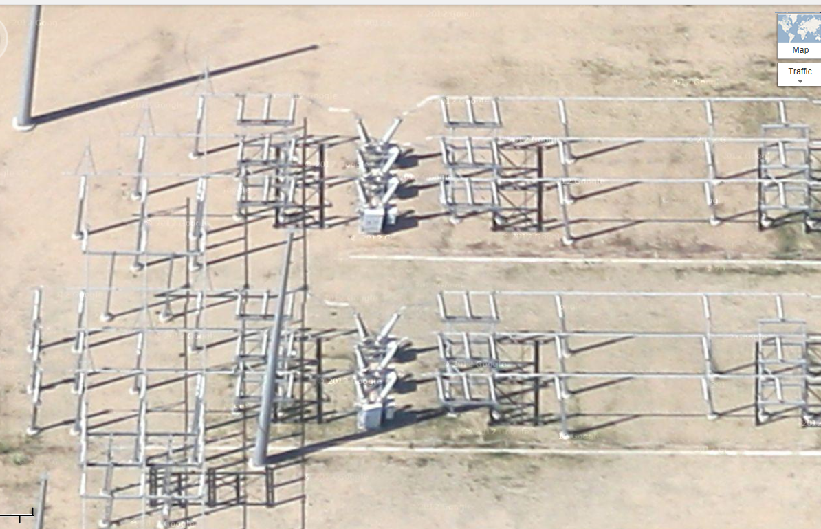
Google View of a 345 kV Substation

Slide 6
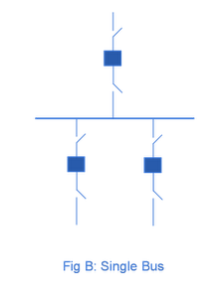
Substation Configurations
Several different substation breaker/disconnect configurations are common:
Single bus: simple but a fault any where requires taking out the entire substation; also doing breaker or disconnect maintenance requires taking out the associated line
Source: http://www.skm-eleksys.com/2011/09/substation-bus-schemes.html

Slide 7
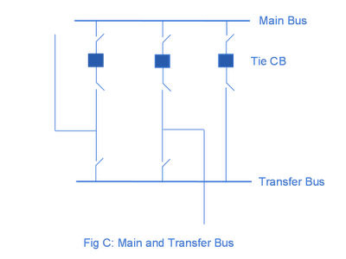
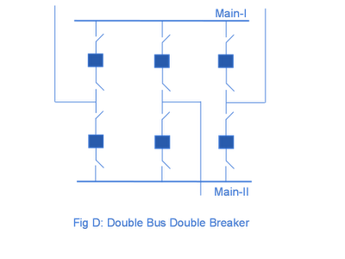
Substation Configurations, cont.
Main and Transfer Bus: Now the breakers can be taken out for maintenance without taking out a line, but protection is more difficult, and a fault on one line will take out at least two
Double Bus Breaker: Now each line is fully protected when a breaker is out, so high reliability, but more costly
Source: http://www.skm-eleksys.com/2011/09/substation-bus-schemes.html

Slide 8
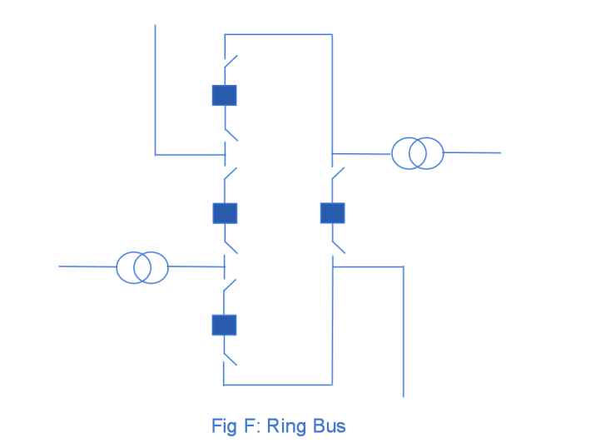
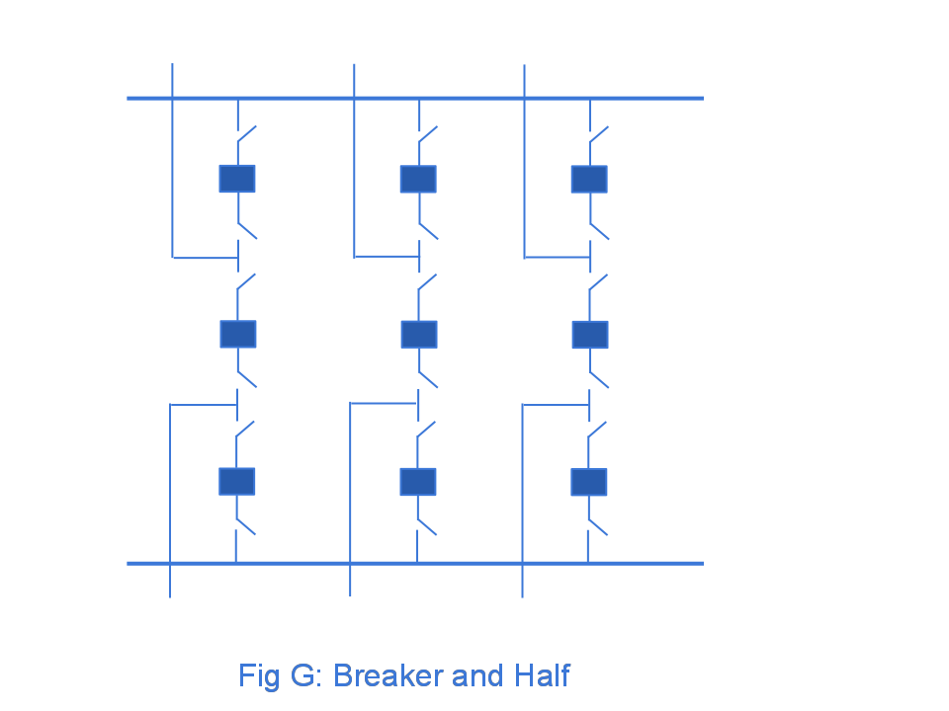
Ring Bus, Breaker and Half
As the name implies with a ring bus the breakers form a ring; number of breakers is same as number of devices; any breaker can be removed for maintenance
The breaker and half has two buses and uses three breakers for two devices; both breakers and buses can be removed for maintenance
Source: http://www.skm-eleksys.com/2011/09/substation-bus-schemes.html

Slide 9
EMS and Planning Models
EMS Model
Used for real-time operations
Called full topology model
Has node-breaker detail
Planning Model
Used for off-line analysis
Called consolidated model by PowerWorld
Has bus/branch detail
-30 MW
-18 Mvar
50 MW
20 Mvar
-30 MW
-18 Mvar
10 MW
3 Mvar
10 MW
3 Mvar
-40 MW
-10 Mvar
10 MW
5 Mvar
-40 MW
-10 Mvar
10 MW
5 Mvar

Slide 10
Node-Breaker Consolidation
One approach to modeling systems with large numbers of ZBRs (zero branch reactances, such as from circuit breakers) is to just assume a small reactance and solve
This results in lots of buses and branches, resulting in a much larger problem
This can cause numerical problems in the solution
The alterative is to consolidate the nodes that are connected by ZBRs into a smaller number of buses
After solution all nodes have the same voltage; use logic to determine the device flows

Slide 11
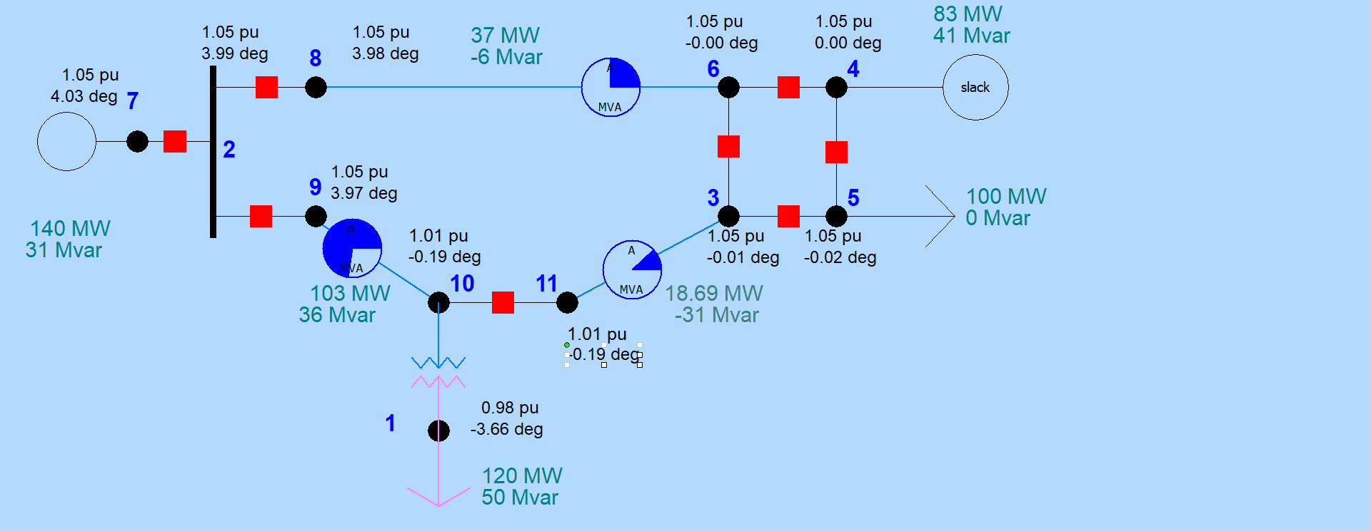
Node-Breaker Example
Case name is FT_11Node. PowerWorld consolidates nodes (buses) into super buses; available in the Model Explorer: Solution, Details, Superbuses.

Slide 12
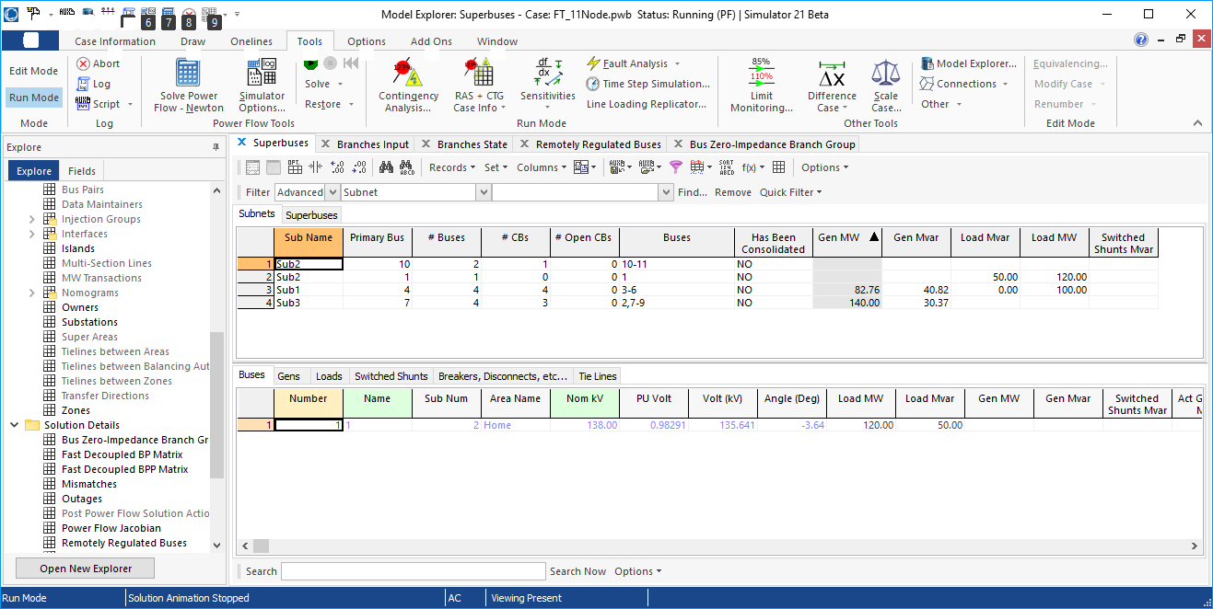
Node-Breaker Example
Note there is ambiguity on how much power is flowing in each device in the ring bus (assuming each device really has essentially no impedance)

Slide 13
Linear System Solution: Introduction
A problem that occurs in many is fields is the solution of linear systems Ax = b where A is an n by n matrix with elements a_{ij}, and x and b are n-vectors with elements x_{i} and b_{i} respectively
In power systems we are particularly interested in systems when n is relatively large and A is sparse
How large is large is changing
A matrix is sparse if a large percentage of its elements have zero values
Goal is to understand the computational issues (including complexity) associated with the solution of these systems

Slide 14
Introduction, cont.
Sparse matrices arise in many areas, and can have domain specific structures
Symmetric matrices
Structurally symmetric matrices
Tridiagnonal matrices
Banded matrices
A good (and free) book on sparse matrices is available at www-users.cs.umn.edu/~saad/IterMethBook_2ndEd.pdf
ECEN 615 is focused on problems in the electric power domain; it is not a general sparse matrix course
Much of the early sparse matrix work was done in power!

Slide 15
Gaussian Elimination
The best known and most widely used method for solving linear systems of algebraic equations is attributed to Gauss
Gaussian elimination avoids having to explicitly determine the inverse of A, which is O(n³)
Gaussian elimination can be readily applied to sparse matrices
Gaussian elimination leverages the fact that scaling a linear equation does not change its solution, nor does adding on linear equation to another

Slide 16
Gaussian Elimination, cont.
Gaussian elimination is the elementary procedure in which we use the first equation to eliminate the first variable from the last n-1 equations, then we use the new second equation to eliminate the second variable from the last n-2 equations, and so on
After performing n-1 such eliminations we end up with a triangular system which is easily solved in a backward direction

Slide 17
Example 1
We need to solve for x in the system
The three elimination steps are given on the next slides; for simplicity, we have appended the r.h.s. vector to the matrix
First step is set the diagonal element of row 1 to 1 (i.e., normalize it)

Slide 18
Example 1, cont.
Eliminate x₁ by subtracting row 1 from all the rows below it

Slide 19
Example 1, cont.
Eliminate x₂ by subtracting row 2 from all the rows below it

Slide 20
Example 1, cont.
Elimination of x₃ from row 3 and 4

Slide 21
Example 1, cont.
Then, we solve for x by “going backwards”, i.e., using back substitution:

Slide 22
Triangular Decomposition
In this example, we have:
triangularized the original matrix by Gaussian elimination using column elimination
then, we used back substitution to solve the triangularized system
The following slides present a general scheme for triangular decomposition by Gaussian elimination
The assumption is that A is a nonsingular matrix (hence its inverse exists)
Gaussian elimination also requires the diagonals to be nonzero; this can be achieved through ordering
If b is zero then we have a trivial solution x = 0

Slide 23
Triangular Decomposition
We form the matrix A_{a} using A and b with
and show the steps of the triangularization scheme

Slide 24
Triangular Decomposition, Step 1
Step 1: normalize the first equation

Slide 25
Triangular Decomposition, Step 2
Step 2: a) eliminate x₁ from row 2:
Step 2: b) normalize the second equation

Slide 26
Triangular Decomposition, Step 2
and we end up at the end of step 2 with

Slide 27
Triangular Decomposition, Step 3
Step 3: a) eliminate x₁ and x₂ from row 3:
Step 3: b) normalize the third equation:

Slide 28
Triangular Decomposition, Step 3
and we have the system at the end of step 3

Slide 29
Triangular Decomposition, Step k
In general, we have for step k: a) eliminate from row k: b) normalize the k^{th} equation:

Slide 30
Triangular Decomposition: Upper Triangular Matrix
and proceed in this manner until we obtain the upper triangular matrix (the n^{th} derived system):

Slide 31
Triangular Decomposition
Note that in the scheme presented, unlike in the first example, we triangularly decompose the system by eliminating row-wise rather than column-wise
In successive rows we eliminate (reduce to 0) each element to the left of the diagonal rather than those below the diagonal
Either could be used, but row-wise operations will work better for power system sparse matrices

Slide 32
Solving for X
To compute x we perform back substitution

Slide 33
Upper Triangular Matrix
The triangular decomposition scheme applied to the matrix A results in the upper triangular matrix U with the elements
The following theorem is important in the development of the sparse computational scheme

Slide 34
LU Decomposition Theorem
Any nonsingular matrix A has the following factorization:
where U could be the upper triangular matrix previously developed (with 1’s on its diagonals) and L is a lower triangular matrix defined by

Slide 35
LU Decomposition Application
As a result of this theorem we can rewrite
Can also be set so U has non unity diagonals
Once A has been factored, we can solve for x by first solving for y, a process known as forward substitution, then solving for x in a process known as back substitution
In the previous example we can think of L as a record of the forward operations preformed on b.

Slide 36
LDU Decomposition
In the previous case we required that the diagonals of U be unity, while there was no such restriction on the diagonals of L
An alternative decomposition is
where D is a diagonal matrix, and the lower triangular matrix is modified to require unity for the diagonals

Slide 37
Symmetric Matrix Factorization
The LDU formulation is quite useful for the case of a symmetric matrix
Hence only the upper triangular elements and the diagonal elements need to be stored, reducing storage by almost a factor of 2

Slide 38
Symmetric Matrix Factorization
There are also some computational benefits from factoring symmetric matrices. However, since symmetric matrices are not common in power applications, we will not consider them in-depth
However, topologically symmetric sparse matrices are quite common, so those will be our main focus

Slide 39
Pivoting
An immediate problem that can occur with Gaussian elimination is the issue of zeros on the diagonal; for example
This problem can be solved by a process known as “pivoting,” which involves the interchange of either both rows and columns (full pivoting) or just the rows (partial pivoting)
Partial pivoting is much easier to implement, and actually can be shown to work quite well

Slide 40
Pivoting, cont.
In the previous example the (partial) pivot would just be to interchange the two rows obviously we need to keep track of the interchanged rows!
Partial pivoting can be helpful in improving numerical stability even when the diagonals are not zero
When factoring row k interchange rows so the new diagonal is the largest element in column k for rows j >= k

Slide 41
LU Algorithm Without Pivoting Processing by row
We will use the more common approach of having ones on the diagonals of L. Also in the common, diagonally dominant power system problems pivoting is not needed Below algorithm is in row form (useful with sparsity!)
For i := 2 to n Do Begin // This is the row being processed
For j := 1 to i-1 Do Begin // Rows subtracted from row i
A[i,j] = A[i,j]/A[j,j] // This is the scaling
For k := j+1 to n Do Begin // Go through each column in i
A[i,k] = A[i,k] - A[i,j]*A[j,k]
End;
End;
End;

Slide 42
LU Example
Starting matrix
First row is unchanged; start with i=2
Result with i=2, j=1; done with row 2

Slide 43
LU Example, cont.
Result with i=3, j=1;
Result with i=3, j=2; done with row 3; done!

Slide 44
LU Example, cont.
Original matrix is used to hold L and U
With this approach the original A matrix has been replaced by the factored values!

Slide 45
Forward Substitution
Forward substitution solves with values in b being over written (replaced by the y values) For i := 2 to n Do Begin // This is the row being processed
For j := 1 to i-1 Do Begin
b[i] = b[i] - A[i,j]*b[j] // This is just using the L matrix
End;
End;

Slide 46
Forward Substitution Example

Slide 47
Backward Substitution
Backward substitution solves (with values of y contained in the b vector as a result of the forward substitution)
For i := n to 1 Do Begin // This is the row being processed
For j := i+1 to n Do Begin
b[i] = b[i] - A[i,j]*b[j] // This is just using the U matrix
End;
b[i] = b[i]/A[i,i] // The A[i,i] values are <> 0 if it is nonsingular
End

Slide 48
Backward Substitution Example

Slide 49
Computational Complexity
Computational complexity indicates how the number of numerical operations scales with the size of the problem
Computational complexity is expressed using the “Big O” notation; assume a problem of size n
Adding the number of elements in a vector is O(n)
Adding two n by n full matrices is O(n²)
Multiplying two n by n full matrices is O(n³)
Inverting an n by n full matrix, or doing Gaussian elimination is O(n³)
Solving the traveling salesman problem by brute-force search is O(n!)

Slide 50
Computational Complexity
Knowing the computational complexity of a problem can help to determine whether it can be solved (at least using a particular method)
Scaling factors do not affect the computation complexity
an algorithm that takes n³/2 operations has the same computational complexity of one the takes n³/10 operations (though obviously the second one is faster!)
With O(n³) factoring a full matrix becomes computationally intractable quickly!
A 100 by 100 matrix takes a million operations (give or take)
A 1000 by 1000 matrix takes a billion operations
A 10,000 by 10,000 matrix takes a trillion operations!

Slide 51
Sparse Systems
The material presented so far applies to any arbitrary linear system
The next step is to see what happens when we apply triangular factorization to a sparse matrix
For a sparse system, only nonzero elements need to be stored in the computer since no arithmetic operations are performed on the 0’s
The triangularization scheme is adapted to solve sparse systems in such a way as to preserve the sparsity as much as possible

Slide 52
Sparse Matrix History
A nice overview of sparse matrix history is by Iain Duff at http://www.siam.org/meetings/la09/talks/duff.pdf
Sparse matrices developed simultaneously in several different disciplines in the early 1960’s with power systems definitely one of the key players (Bill Tinney from BPA)
Different disciplines claim credit since they didn’t necessarily know what was going on in the others

Slide 53
Sparse Matrix History
In power systems a key N. Sato, W.F. Tinney, “Techniques for Exploiting the Sparsity of the Network Admittance Matrix,” Power App. and Syst., pp 944-950, December 1963
In the paper they are proposing solving systems with up to 1000 buses (nodes) in 32K of memory!
You’ll also note that in the discussion by El-Abiad, Watson, and Stagg they mention the creation of standard test systems with between 30 and 229 buses (this surely included the now famous 118 bus system)
The BPA authors talk “power flow” and the discussors talk “load flow.”
Tinney and Walker present a much more detailed approach in their 1967 IEEE Proceedings paper titled “Direct Solutions of Sparse Network Equations by Optimally Order Triangular Factorization”

Slide 54
Sparse Matrix Computational Order
The computational order of factoring a sparse matrix, or doing a forward/backward substitution depends on the matrix structure
Full matrix is O(n³)
A diagonal matrix is O(n); that is, just invert each element
For power system problems the classic paper is F. L. Alvarado, “Computational complexity in power systems,” IEEE Transactions on Power Apparatus and Systems, ,May/June 1976
O(n^{1.4}) for factoring, O(n^{1.2}) for forward/backward
For a 100,000 by 100,000 matrix changes computation for factoring from 1 quadrillion to 10 million!

Slide 55
Inverse of a Sparse Matrix
The inverse of a sparse matrix is NOT in general a sparse matrix
We never (or at least very, very, very seldom) explicitly invert a sparse matrix
Individual columns of the inverse of a sparse matrix can be obtained by solving x = A⁻¹b with b set to all zeros except for a single nonzero in the position of the desired column
If a few desired elements of A⁻¹ are desired (such as the diagonal values) they can usually be computed quite efficiently using sparse vector methods (a topic we’ll be considering soon)
We can’t invert a singular matrix (with sparse or not)

Slide 56
Computer Architecture Impacts
With modern computers the processor speed is many times faster than the time it takes to access data in main memory
Some instructions can be processed in parallel
Caches are used to provide quicker access to more commonly used data
Caches are smaller than main memory
Different cache levels are used with the quicker caches, like L1, have faster speeds but smaller sizes; L1 might be 64K, whereas the slower L2 might be 1M
Data structures can have a significant impact on sparse matrix computation

