Slide 1
ECEN 460 Power System Operation and Control
Lecture 21: Transient Stability
Prof. Tom Overbye
Dept. of Electrical and Computer Engineering
Texas A&M University
overbye@tamu.edu
Special Guest Lecturer: TA Adam Birchfield

Slide 2
Announcements
Read Chapter 11
Design project is due on Dec 5; details on the website
Homework 8 is 11.12, 11.18 (part a only), 11.19, 11.21, 11.25, 11.26; due on Thursday Nov 30
Lab 9 is on Nov 20/21 and lab 10 is on Nov 27/28, both in WEB 115; no lab week of Dec 4
For lab 9 students with high profit values will not be required to turn in a lab; we’ll let you know the exact value in class on Nov 21, but expect it to be at least half the class

Slide 3
Lab 9: Electricity Markets
In lab 9 you will be competing in a simple electricity market that has a single buyer of electricity (an independent system operator [ISO]) and multiple sellers
You will be playing one of those sellers as the owner of a portfolio of generators; other students will have the exact same portfolio
Your goal is to maximize your profit over a number of trading periods, each considered to be one hour
There is no transmission system limitations

Slide 4
Lab 9: Electricity Markets
The lab 9 electricity market is designed to be similar to many existing electricity markets, but, of course, it needs to be simpler
For each trading period you submit offers in $/MWh to sell your electricity
The ISO accepts the least cost offers; the generation associated with the accepted offers is assumed to run (and hence can make a profit), whereas high offers are rejected and the associated generators do not run
That last accepted offer (LAO) sets the system lambda; with no transmission constraints all bus LMPs equal this value

Slide 5
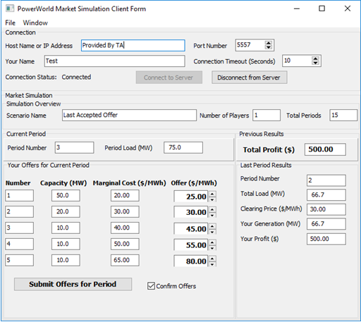
Lab 9: Electricity Markets
The lab considers two methods of paying generators that run
All generators are paid the LAO (i.e., their bus LMP); this is similar to what is done in many existing electricity markets
Generators are paid
what they offer
(pay as offer [PAO])
During the lab it is crucial that you not talk with the other students about the electricity markets!

Slide 6
Differential Algebraic Equations (DAEs)
Simple example
$$\frac{dx}{dt}=f\left(x\right)=−x$$
$$x\left(0\right)=10$$
Initial value problem (IVP): we know the starting value of $x$, we want to determine it for future time.
This one is separable, and an analytical solution is possible: exponential decay.
$$x\left(t\right)=10⋅e^{−t}$$
In general, with $x$ as a vector of many differentials
$$\dot{x}=f(x)$$

Slide 7
Power System Dynamics DAEs
Example power system problem with differential algebraic equations (DAEs) is the classical synchronous generator connected to an infinite bus.
$$\dot{δ}=ω$$
$$\frac{2H}{ω_{s}}\dot{ω}=T_{M}−\frac{E^{′}V_{s}}{X_{d}^{′}+X_{ep}}\sin\left(δ−θ_{vs}\right)−D⋅ω$$
The two differential variables are $δ$ and $ω$; in practice dynamic models can have many more.

Slide 8
Solving DAEs
General form:
$$\dot{x}=f\left(x,y\right)$$
$$0=g\left(x,y\right)$$
$$x\left(t_{0}\right)=x_{0}$$
We will consider the simpler case without $y$, the additional algebraic variables: $\dot{x}=f(x)$
We need the initial value of $x_{0}$, which is either given or found from an equilibrium point, where $\dot{x}=0$
Higher-order systems can be put in this form
Except for special cases, such as linear systems, an analytic solution is usually not possible – numerical methods must be used

Slide 9
Solving DAEs numerically
Numerical solution methods do not generate exact solutions; they practically always introduce some error
Methods assume time advances in discrete increments, called a stepsize (or time step), Δt
Speed accuracy tradeoff: a smaller Δt usually gives a better solution, but it takes longer to compute
Numeric round-off error due to finite floating point arithmetic
A solution exists as long as $f(x)$ is continuously differentiable

Slide 10
Error Propagation
At each time step the total round-off error is the sum of the local round-off at time and the propagated error from steps 1, 2 , … , k − 1
An algorithm with the desirable property that local round-off error decays with increasing number of steps is said to be numerically stable
Otherwise, the algorithm is numerically unstable
Numerically unstable algorithms can nevertheless give quite good performance if appropriate time steps are used
This is particularly true when coupled with algebraic equations

Slide 11
Euler’s method
The simplest technique for numerical integration is known as the forward Euler’s method.
Approximate $\dot{x}=f\left(x\left(t\right)\right)=\frac{dx}{dt}$ as $\frac{Δx}{Δt}$
Then
$$Δx≈Δt⋅f\left(x\left(t\right)\right)$$
$$x\left(t+Δt\right)≈x\left(t\right)+Δt⋅f(x\left(t\right))$$
Each step of $x$ depends only on the previous value
$f\left(x\right)$ only needs to be evaluated once.
Typically, smaller $Δt$ gives better approximations.

Slide 12
Euler’s Method Algorithm
Set $t=t_{0}$ (usually 0)
$x\left(t_{0}\right)=x_{0}$
Pick a time step $Δt$, which is problem specific
While $t≤t^{end}$ Do
$x\left(t+Δt\right)=x\left(t\right)+Δt⋅f\left(x\left(t\right)\right)$
$t=t+Δt$
End While
11

Slide 13
Runge-Kutta methods
Runge-Kutta methods improve on Euler's method by evaluating $f(x)$ at selected points within the time step
Simplest method is the second order method (RK2)
$x\left(t+Δt\right)=x\left(t\right)+\frac{1}{2}\left(k_{1}+k_{2}\right)$
$k_{1}=Δt⋅f\left(x\left(t\right)\right)$
$k_{2}=Δt⋅f(x\left(t\right)+k_{1})$
$k1$ is what we get from Euler's; $k2$ improves on this by reevaluating at the estimated end of the step
RK2 must evaluate $f(x)$ twice at each times step.

Slide 14
Other numerical solution methods
One-step methods: require information about solution just at one point, $x(t)$
Forward Euler and Runge-Kutta fall in this category
Multi-step methods: make use of information at more than one point, $x(t)$, $x(t−Δt)$, $x(t−2Δt)$…
Adams-Bashforth
Predictor-Corrector Methods: implicit
Backward Euler

Slide 15
Example #1
First problem has one variable and known analytical solution.
$$\frac{dx}{dt}=f\left(x\right)=−x$$
$$x\left(0\right)=10$$
Choose timestep of 0.1
$$x\left(t+Δt\right)=x\left(t\right)+Δt⋅f(x\left(t\right))$$
First time point after initial is
$$x\left(0.1\right)=x\left(0\right)+0.1⋅f\left(x\left(0\right)\right)$$
$$x\left(0.1\right)=10+0.1⋅f\left(10\right)=10+0.1⋅\left(−10\right)=9$$
Next time point: $x\left(0.2\right)=9+0.1⋅\left(−9\right)=8.1$

Slide 16
Example #1, cont.
$$t$$ | $$x(t)$$
 | Actual | Euler $$Δt=0.1$$ | Euler $Δt=0.$05 | Runge-Kutta 2 $$Δt=0.1$$
0 | 10 | 10 | 10 | 10
0.1 | 9.048 | 9 | 9.02 | 9.050
0.2 | 8.187 | 8.10 | 8.15 | 8.190
0.3 | 7.408 | 7.29 | 7.35 | 7.412
… | … | … | … | …
1.0 | 3.678 | 3.49 | 3.58 | 3.685
… | … | … | … | …
2.0 | 1.353 | 1.22 | 1.29 | 1.358

Slide 17
Example #2
Consider the equations describing the horizontal position of a cart attached to a lossless spring:
$${\dot{x}}_{1}=x_{2}$$
$${\dot{x}}_{2}=−x_{1}$$
Initial conditions $x_{1}\left(0\right)=1$ and $x_{2}\left(0\right)=0$
Analytical solution is $x_{1}\left(t\right)=\cos\left(t\right)$
Numerical solution:
$$x_{1}\left(t+Δt\right)=x_{1}\left(t\right)+Δt⋅f_{1}\left(x\left(t\right)\right)$$
$$x_{2}\left(t+Δt\right)=x_{2}\left(t\right)+Δt⋅f_{2}\left(x\left(t\right)\right)$$
Choose step size of 0.25
16

Slide 18
Example #2, cont.
Starting from the initial conditions at t=0 we next calculate the value of $x(t)$ at $t=0.25$.
$$x_{1}\left(0.25\right)=x_{1}\left(0\right)+0.25⋅x_{2}\left(0\right)=1.0$$
$$x_{2}\left(0.25\right)=x_{2}\left(0\right)−0.25⋅x_{1}\left(0\right)=−0.25$$
Then we continue to the next time step, t=0.5
$$x_{1}\left(0.5\right)=x_{1}\left(0.25\right)+0.25⋅x_{2}\left(0.25\right)$$
$$=1.0+0.25⋅\left(−0.25\right)=0.9375$$
$$x_{2}\left(0.5\right)=x_{2}\left(0.25\right)−0.25⋅x_{1}\left(0.25\right)$$
$$=−0.25−0.25⋅1.0=−0.5$$
17

Slide 19
Example #2, cont.
t | x₁^{actual}(t) | x₁(t) Δt=0.25
0 | 1 | 1
0.25 | 0.9689 | 1
0.50 | 0.8776 | 0.9375
0.75 | 0.7317 | 0.8125
1.00 | 0.5403 | 0.6289
… | … | …
10.0 | -0.8391 | -3.129
100.0 | 0.8623 | -151,983
Since we know from the exact solution that x₁ is bounded between -1 and 1, clearly the method is numerically unstable
18

Slide 20
Example #2, cont.
Below is a comparison of the solution values for x₁(t)
at time t = 10 seconds
Δt | x₁(10)
actual | -0.8391
0.25 | -3.129
0.10 | -1.4088
0.01 | -0.8823
0.001 | -0.8423
19

Slide 21
Example #3, transient stability
This example uses the synchronous machine classical model mentioned earlier
$$\dot{δ}=ω$$
$$\frac{2H}{ω_{s}}\dot{ω}=T_{M}−\frac{E^{′}V_{s}}{X_{d}^{′}+X_{ep}}\sin\left(δ−θ_{vs}\right)−D⋅ω$$
Two differential state variables: $δ$ (rotor angle), and $ω$ (per-unit speed deviation).
Constants of the machine: $ω_{s}$ (synchronous speed), $H$ (inertia), $X_{d}^{′}$ (reactance), $D$ (damping).
Algebraic variables: $T_{M}$(mechanical torque), $E′$ (machine internal voltage), $X_{ep}$ (system impedance), $V_{s}$ and $θ_{vs}$ (infinite bus voltage magnitude and angle).

Slide 22
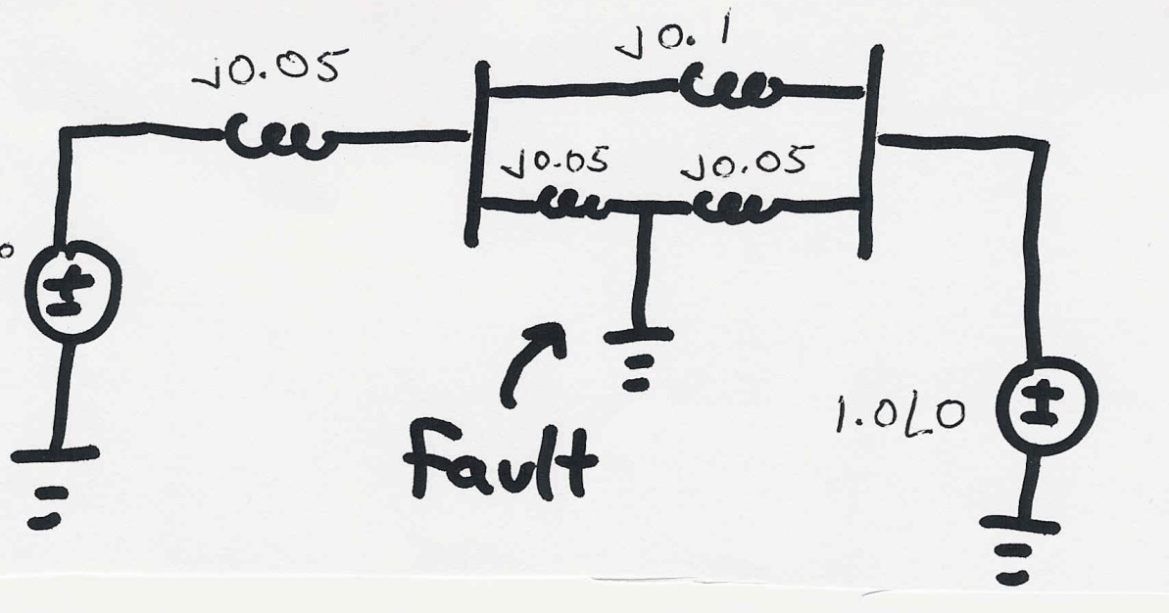
Example #3, transient stability
A 60 Hz generator is supplying 550 MW to an infinite bus (with 1.0 per unit voltage) through two parallel transmission lines. Determine initial angle change for a fault midway down one of the lines. H = 20 seconds, D = 0.1. Use Δt=0.01 second.

Slide 23
Example #3, transient stability
Before the fault, solve the circuit in steady-state
We know the initial active power is 550 MW
$$I=\frac{P}{V}=\frac{5.5}{1.0}=5.5$$
The total impedance pre-fault is
$$Z=j0.05+j0.1||j0.1=j0.1$$
Then we solve for the machine internal voltage.
$$E′∠δ=1.0+j0.1⋅5.5=1.141∠28.8°$$
So the initial value of $δ(0)$ is 28.8$°$
To find the initial value of $ω$, set the first differential equation to be at equilibrium
$$\dot{δ}=0=ω\left(0\right)$$

Slide 24
Example #3, transient stability
The swing equation is
$$\frac{2H}{ω_{s}}\dot{ω}=T_{M}−\frac{E^{′}V_{s}}{X_{d}^{′}+X_{ep}}\sin\left(δ−θ_{vs}\right)−D⋅ω$$
Before the fault at equilibrium, $\dot{ω}=0$
We use this to find the initial value of $T_{M}$
$$T_{M}=\frac{E^{′}V_{s}}{X_{d}^{′}+X_{ep}}\sin\left(δ\left(0\right)−θ_{vs}\right)−D⋅ω\left(0\right)$$
$$=\frac{1.141⋅1.0}{0.1}\sin\left(28.8°−0\right)−0.1⋅0$$
$$=5.5$$
Since system is lossless, $T_{M}$ is the power delivered.

Slide 25
Example #3, transient stability
After the fault, we need to find the Thevenin equivalent circuit with the fault included.
$$Z_{eq}=(j0.05|\left|j0.1\right)=j0.0333$$
$$V_{eq}=\left(1∠0°\right)⋅\left(\frac{j0.05}{j0.05+j0.1}\right)=0.333∠0°$$
So the swing equation post-fault becomes
$$\frac{2⋅20}{2π60}\dot{ω}=5.5−\frac{1.141⋅0.333}{0.05+0.0333}\sin\left(δ−0\right)−0.1⋅ω$$
$$\dot{ω}=51.838−43.015\sin{δ}−0.942ω$$
Now we can apply a numerical method such as Euler’s method

Slide 26
Example #3, transient stability
Applying Euler’s method, set $x_{1}=δ$ and $x_{2}=ω$
${\dot{x}}_{1}=f_{1}\left(x\right)=x_{2}$
$$\dot{x_{2}}=f_{2}\left(x\right)=51.838−43.015\sin\left(x_{1}\right)−0.942x_{2}$$
$x_{1}\left(0\right)=0.502$65
$x_{2}\left(0\right)=0$.0
First iteration, using step size $Δt=0.01$
$$x\left(0.01\right)=\left[\begin{matrix}x_{1}\left(0\right) \\ x_{2}\left(0\right)\end{matrix}\right]+0.01\left[\begin{matrix}f_{1}\left(x\left(0\right)\right) \\ f_{2}\left(x\left(0\right)\right)\end{matrix}\right]$$
$$=\left[\begin{matrix}0.50265 \\ 0.0\end{matrix}\right]+0.01\left[\begin{matrix}0 \\ 31.116\end{matrix}\right]=\left[\begin{matrix}0.050265 \\ 0.31116\end{matrix}\right]$$

Slide 27
Example #3, transient stability
Second iteration
$$x\left(0.02\right)=\left[\begin{matrix}x_{1}\left(0.01\right) \\ x_{2}\left(0.01\right)\end{matrix}\right]+0.01\left[\begin{matrix}f_{1}\left(x\left(0.01\right)\right) \\ f_{2}\left(x\left(0.01\right)\right)\end{matrix}\right]$$
$$=\left[\begin{matrix}0.50265 \\ 0.31116\end{matrix}\right]+0.01\left[\begin{matrix}0.31116 \\ 30.8224\end{matrix}\right]=\left[\begin{matrix}0.50576 \\ 0.61938\end{matrix}\right]$$
Third iteration
$$x\left(0.03\right)=\left[\begin{matrix}0.50576 \\ 0.61938\end{matrix}\right]+0.01\left[\begin{matrix}0.61938 \\ 30.41496\end{matrix}\right]$$
$$=\left[\begin{matrix}0.51195 \\ 0.92353\end{matrix}\right]$$

Slide 28
Example 11.5

Slide 29
Transient Stability Example, cont'd
28

Slide 30
Equal Area Criteria
The goal of the equal area criteria is to try to determine whether a system is stable or not without having to completely integrate the system response.
System will
be stable after
the fault if
the Decel Area is greater
than the
Accel. Area
29

Slide 31
Example 11.4: Equal Area
30

Slide 32
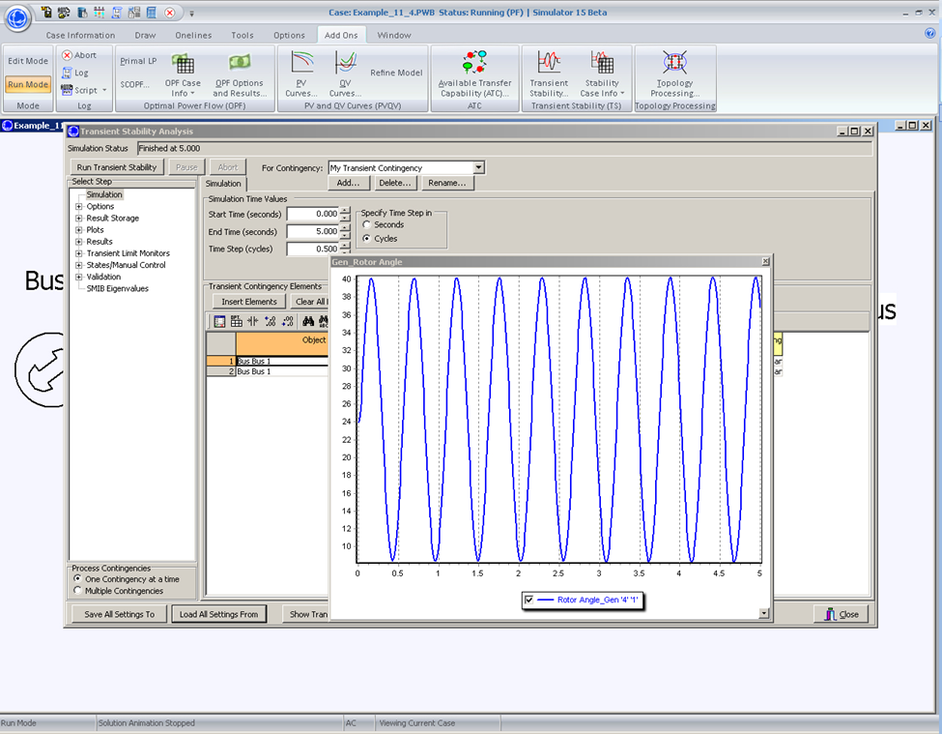
Example 11.4: Undamped
31

Slide 33
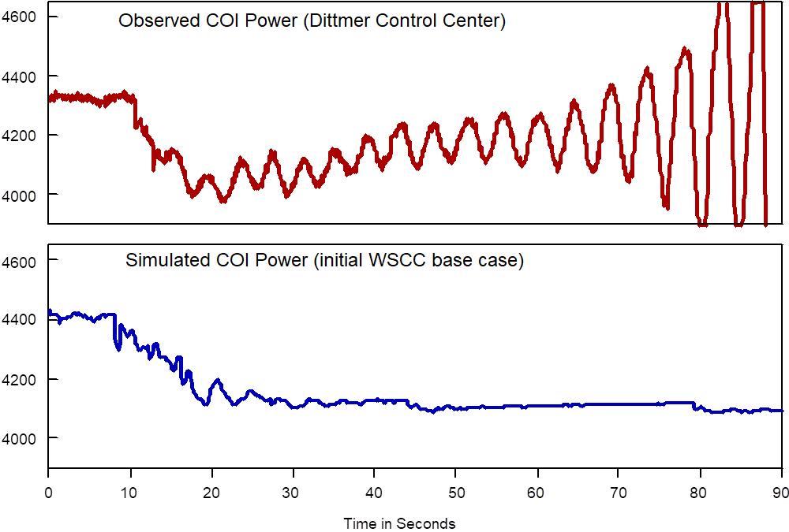
Power System Oscillation Examples
The below graph shows an oscillation that was observed during a 1996 WECC Blackout
32

Slide 34
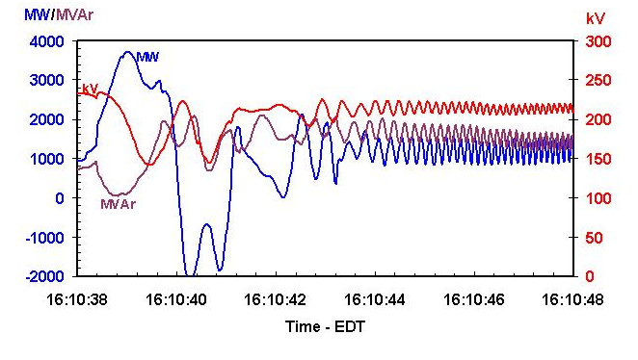
Example Oscillations
The below graph shows oscillations on the Michigan/Ontario Interface on 8/14/03
33

Slide 35
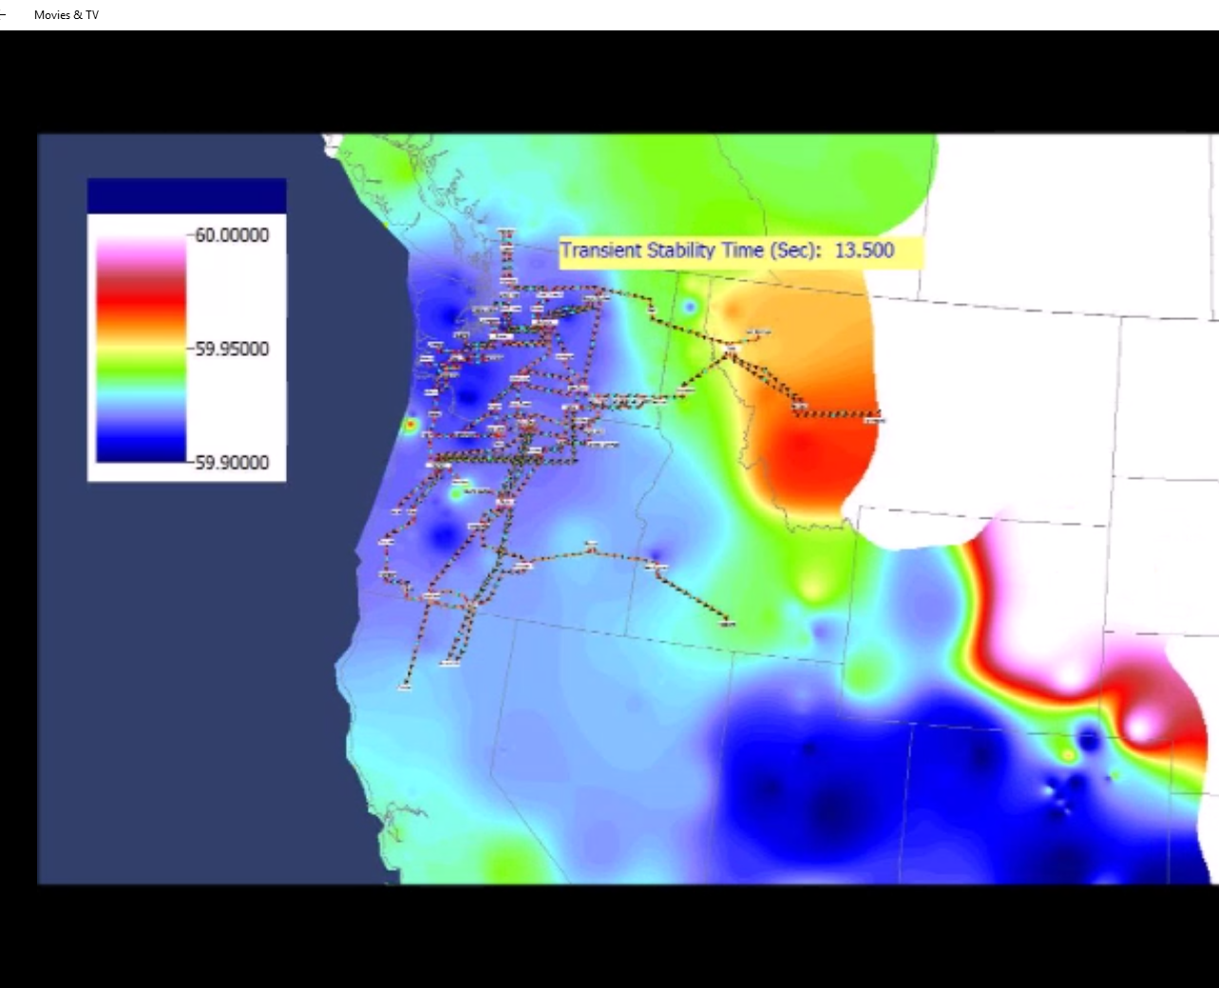
Fictitious System Oscillation
Movie shows an example of sustained oscillations in an fictitious power grid
34

Slide 36
Two-Axis Synchronous Machine Model
Classical model is appropriate only for the most basic studies; no longer widely used in practice
More realistic models are required to couple in other devices such as exciters and governors
A more realistic synchronous machine model requires that the machine be expressed in a reference frame that rotates at rotor speed
Standard approach is d-q reference frame, in which the major (direct or d-axis) is aligned with the rotor poles and the quadrature (q-axis) leads the direct axis by 90°
35

Slide 37
Synchronous Machine Modeling
Damper windings are added to damp out oscillations
3φ bal. windings (a,b,c) – stator
Field winding (fd) on rotor
Damper in “d” axis
(1d) on rotor
2 dampers in “q” axis
(1q, 2q) on rotor
36

Slide 38
Two Main Types of Synchronous Machines
Round Rotor
Air-gap is constant, used with higher speed machines
Salient Rotor (often called Salient Pole)
Air-gap varies circumferentially
Used with many pole, slower machines such as hydro
Narrowest part of gap in the d-axis and the widest along the q-axis

Slide 39
D-q Reference Frame
Machine voltage and current are “transformed” into the d-q reference frame using the rotor angle, δ
Terminal voltage in network (power flow) reference frame are V_{T} = V_{r} - V_{i}
38

Slide 40
Two-Axis Model Equations
Numerous models exist for synchronous machines. The following is a relatively simple model that represents the field winding and one damper winding; it also includes the generator swing eq.
39

Slide 41
Generator Torque and Initial Conditions
The generator electrical torque is given by
Recall p_{e} = T_{e}ω_{p.u} (sometimes ω_{p.u is} assumed=1.0)
Solving the differential equations requires determining δ; it is determined by noting that in steady-state Then δ is the angle of
40

Slide 42
Example 11.10
Determine the initial conditions for the Example 11.3 case with the classical generator replaced by a two-axis model with H = 3.0 per unit-seconds, D = 0, = 2.1, = 2.0, = 0.3, = 0.5, all per unit using the 100 MVA system base
First determine the current out of the generator from the initial conditions, then the terminal voltage
41

Slide 43
Example 11.10, cont.
We can then get the initial angle, and initial d and q values
42

Slide 44
Example 11.10, cont.
The initial state variable are determined by solving with the differential equations equal to zero.
The transient stability solution is then solved by numerically integrating the differential equations, coupled with solving the algebraic equations
43

Slide 45
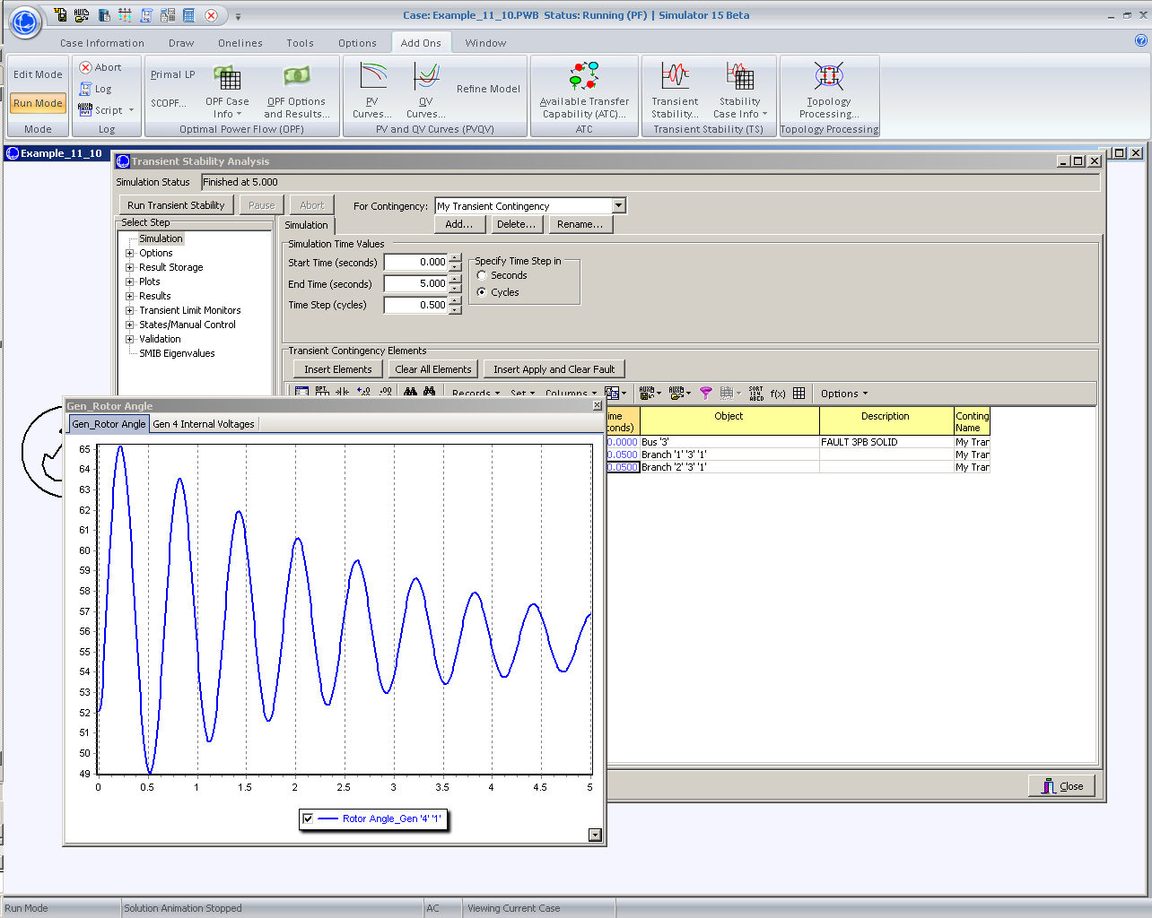
PowerWorld Solution of 11.10
44

