Slide 1
ECEN 460
Power System Operation and Control
Lecture 24: Modeling Load,
Renewable Energy Systems
Prof. Tom Overbye
Dept. of Electrical and Computer Engineering
Texas A&M University
overbye@tamu.edu

Slide 2
Announcements
Read Chapter 14
Design project is due on Dec 5; details on the website
  Counts as two homeworks
Homework 8 is 11.12, 11.18 (part a only), 11.19, 11.25, 11.26; due today
No labs week of Dec 4
Final exam is as per the TAMU schedule, Wednesday Dec 13 from 8 to 10am
  Closed book, closed notes; calculators and three 8.5 by 11 inch note sheets allowed (front and back)
  Comprehensive with more emphasis on material after exam 2
11.21 was removed on Tuesday

Slide 3
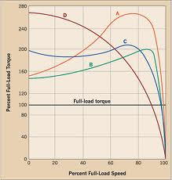
Induction Motor Classes
Four major classes of induction motors, based on application. Key values are starting torque, pull-out torque, full-load torque, and starting current
In steady-state the motor will operate on the right side
of the curve at the point at which the electrical torque
matches the mechanical torque
A: Fans, pumps machine tools
B: Similar to A
C: Compressors, conveyors
D: High inertia such as hoists
2
Image source: ecmweb.com/motors/understanding-induction-motor-nameplate-information

Slide 4
Induction Motor Stalling
The maximum of the torque-speed curve varies with the square of the terminal voltage
When the terminal voltage decreases, such as during a fault, the mechanical torque can exceed the electrical torque
  This causes the motor to decelerate, perhaps quite quickly, with the rate proportional to its inertia
  This deceleration causing the slip to increase, perhaps causing the motor to stall with s=1, resulting in a high reactive current draw
  Too many stalled motors can prevent the voltage from recovering
3

Slide 5
Motor Stalling Example
Using case WSCC_CIM5, which models the WSCC 9 bus case with 100% induction motor load
Change the fault scenario to say a fault midway between buses 5 and 7, cleared by opening the line
Results are for a 0.1 second fault
Usually
motor load
is much less
than 100%
4

Slide 6
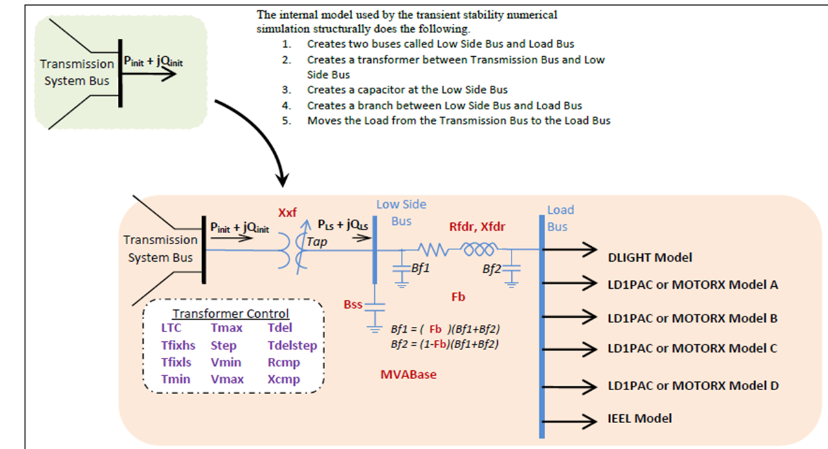
Composite Load Model
Contains up to four motors or single phase induction motor models; also includes potential for solar PV
5

Slide 7
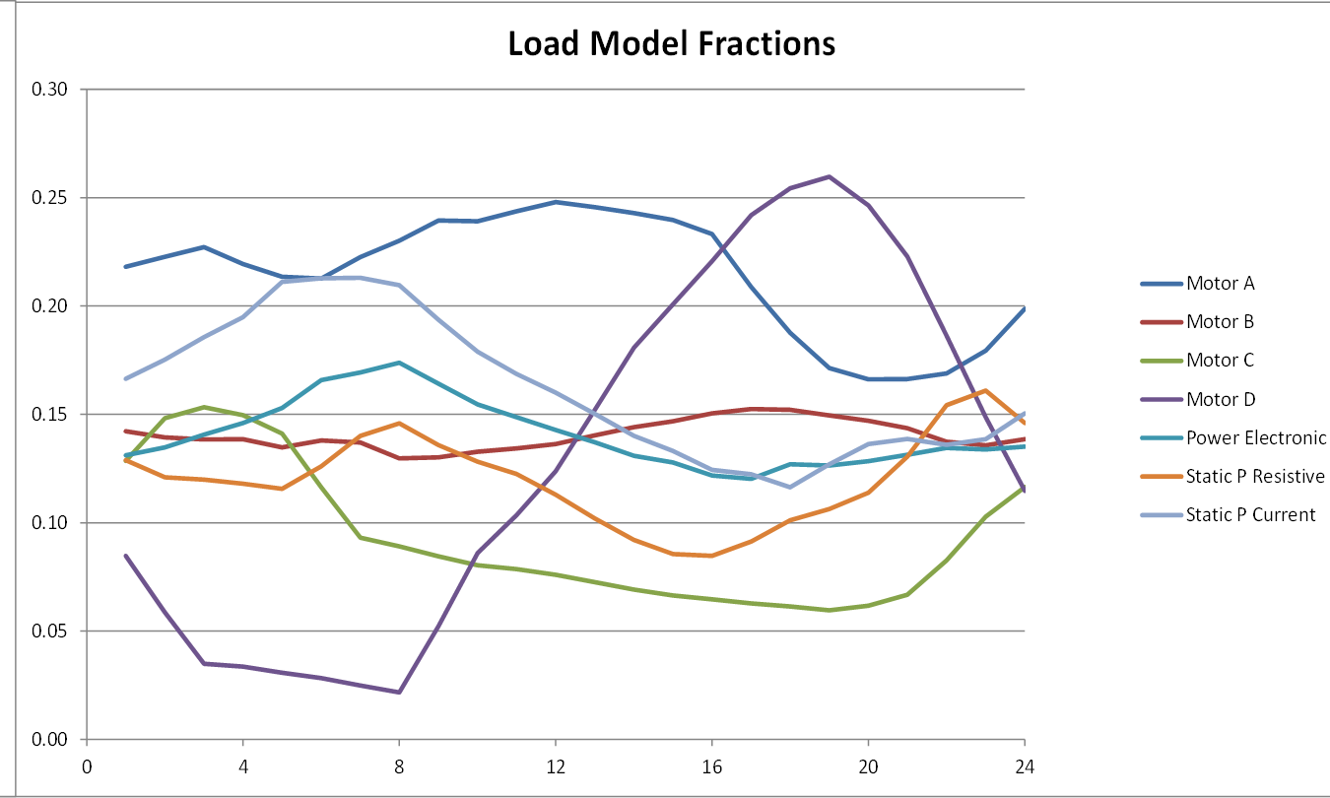
Modeling Time Variation in Load
Different time varying composite model parameters are now being used
Example of varying composite load percentages over a day
6

Slide 8
Motor Starting
Motor starting analysis looks at the impacts of starting a motor or a series of motors (usually quite large motors) on the power grid
  Examples are new load or black start plans
While not all transient stability motor load models allow the motor to start, some do
When energized, the initial condition for the motor is slip of 1.0
Motor starting can generate very small time constants
7

Slide 9
Motor Starting Example
Below graph shows the bus voltages for starting the four motors three seconds apart
8

Slide 10
Black Start
A black start is the process of restoring an electric grid following the outage of the entire grid
Key issue is large generators require substantial amounts electric load to start (station service); this would not be available following a blackout
Each utility would have a detailed process. An example is
  Have batteries to start a diesel generator
  Use that to start a hydro plant (which doesn’t require much power to start)
  Sequentially connect transmission lines to larger plants, making sure grid has enough capacity to start these plants
9

Slide 11
Renewable Resource Modeling
With the advent of more renewable generation in power systems worldwide it is important to have correct models
Hydro systems have already been covered
Solar thermal and geothermal are modeled similar to existing stream generation, so they are not covered here
Coverage will focus on wind and solar PV for integrated system studies
  Models are evolving, with a desire by many to have as generic as possible models
10

Slide 12
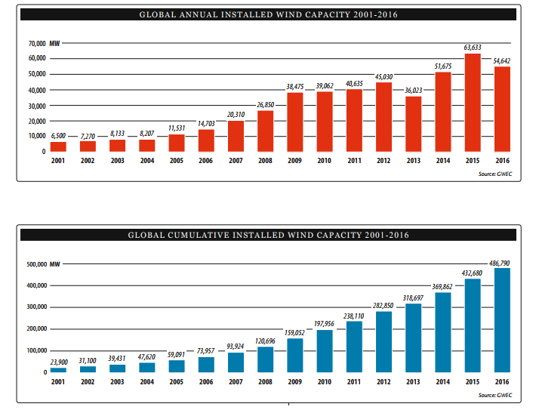
Growth in Wind Worldwide
Source: Global Wind 2016 Report, Global Wind Energy Council
11

Slide 13
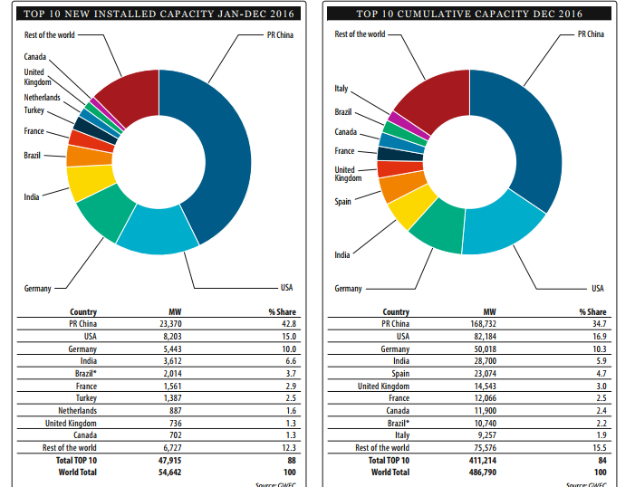
Growth in Wind Worldwide
Source: Global Wind 2016 Report, Global Wind Energy Council
12

Slide 14
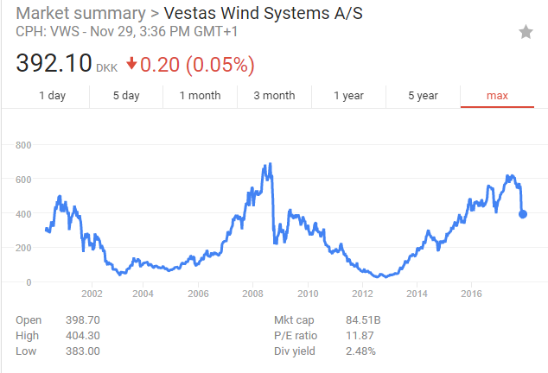
Vestas Wind Systems Stock Price
Vestas’s stock has increased by more than 15times from their 2012/2013 lows!
Their price
fell significantly
in November
due to increased
competition
in wind power
markets
13

Slide 15
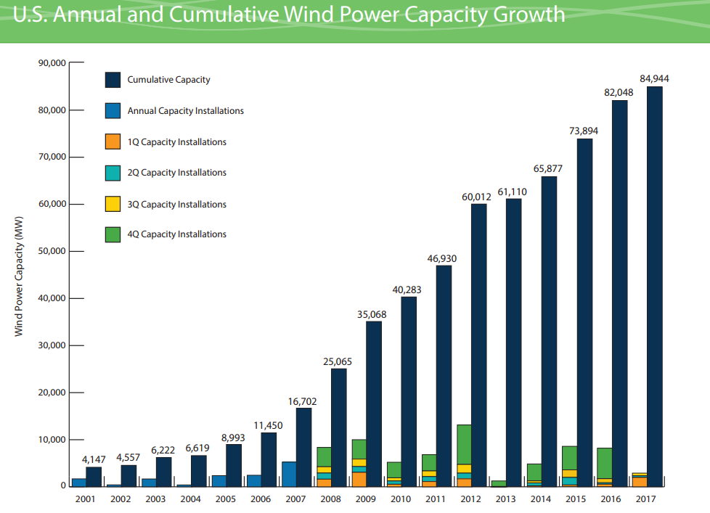
Growth in US Wind
Production tax credit of $24/MWh being phased out
  100% in 2016, 80% in 2017, 60% in 2018, 40% in 2019
14
Source: American Wind Energy Association 2017 Third Quarter Market Report

Slide 16
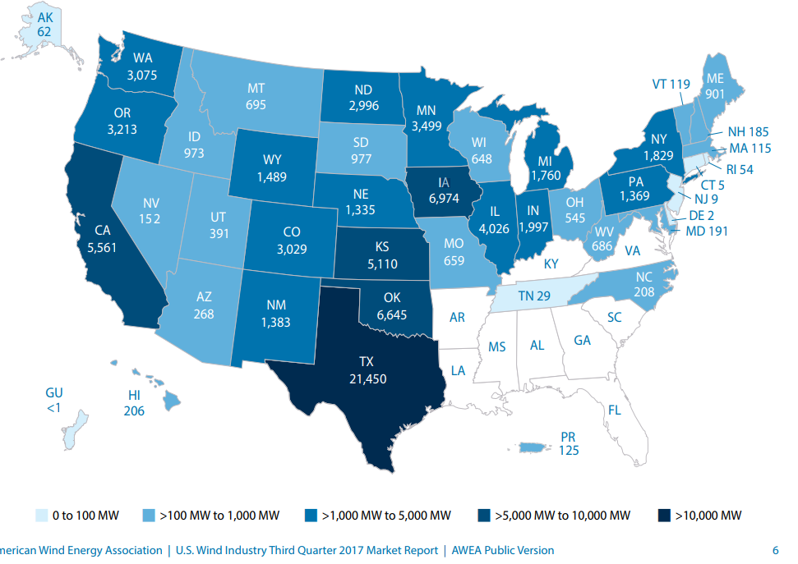
2016 Installed Capacity by State:
Texas Continues to Dominate!
15
Source: American Wind Energy Association 2017 Third Quarter Market Report

Slide 17
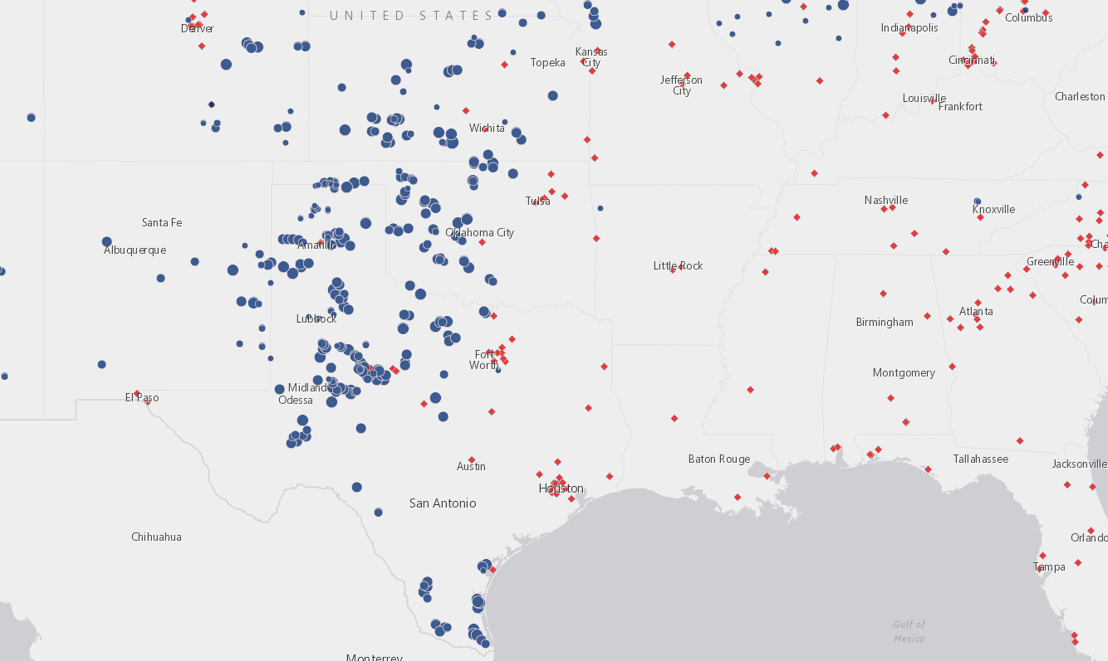
Wind Farm and Wind-Related Plant Locations
http://gis.awea.org/arcgisportal/apps/webappviewer/index.html?id=eed1ec3b624742f8b18280e6aa73e8ec
16

Slide 18
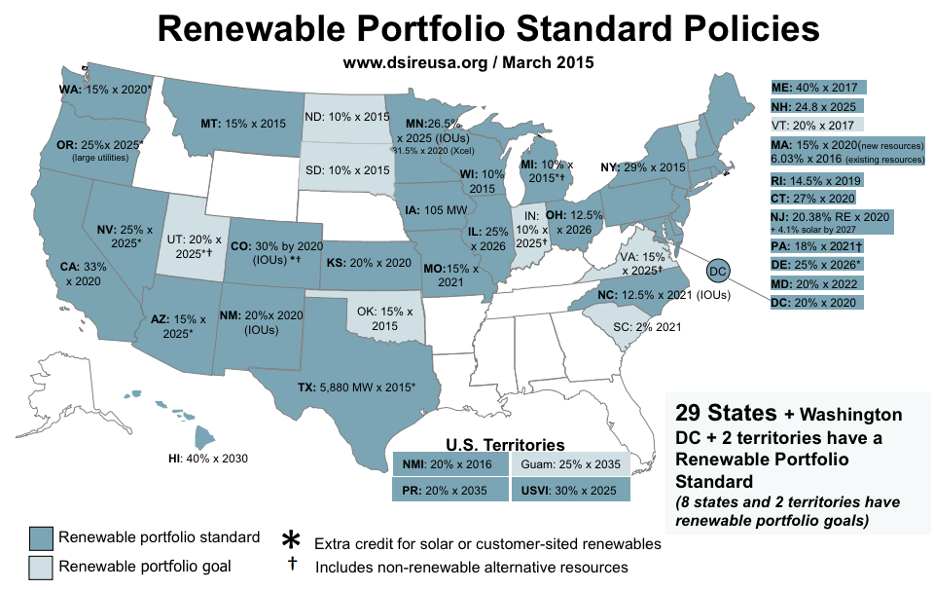
State Renewable Portfolio Standards
Texas
has a goal
of 10 GW
by 2025,
but that
has already
been
achieved
(by more
than double!)
Image source: dsireusa.org (see for updated information)
17

Slide 19
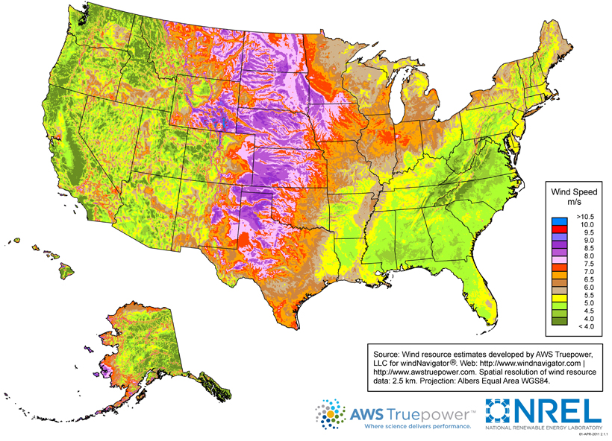
US Wind Resources
18
Source: http://www.windpoweringamerica.gov/wind_maps.asp

Slide 20
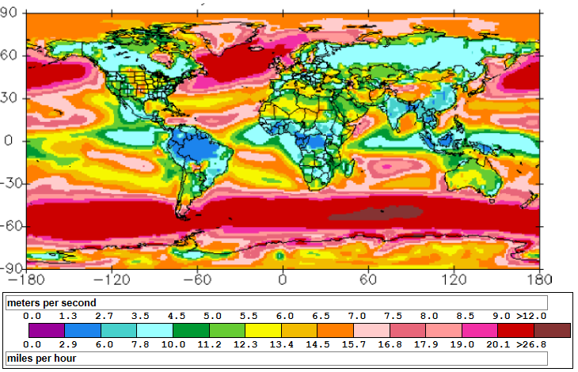
Global Wind Speed 50m Map
http://www.climate-charts.com/World-Climate-Maps.html#wind-speed
19

Slide 21
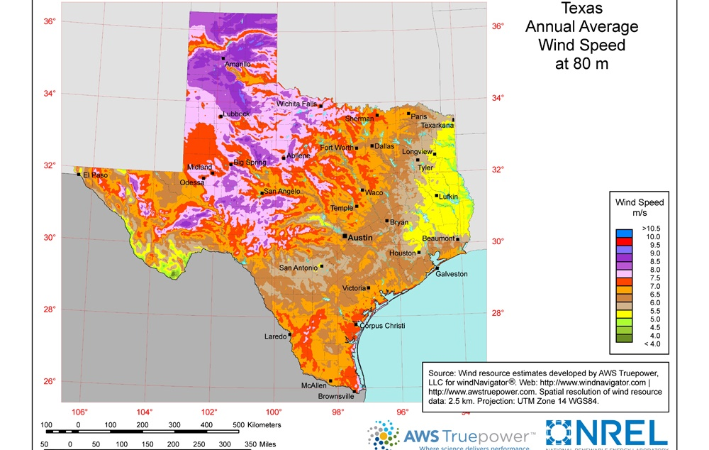
Wind Map Texas– 80m Height
https://windexchange.energy.gov/files/u/visualization/image/tx_80m.jpg
20

Slide 22
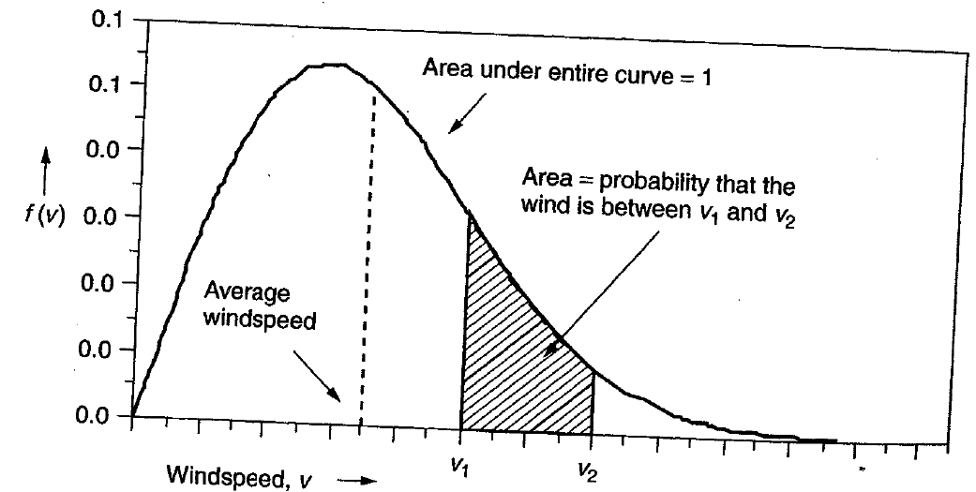
Power in the Wind
The power in the wind is proportional to the cube of the wind speed
  Velocity increases with height, with more increase over rougher terrain (doubling at 100m compared to 10m for a small town, but only increasing by 60% over crops or 30% over calm water)
Maximum rotor efficiency is 59.3%, from Betz' law
Expected available
energy depends on
the wind speed
probability density
function (pdf)
21

Slide 23
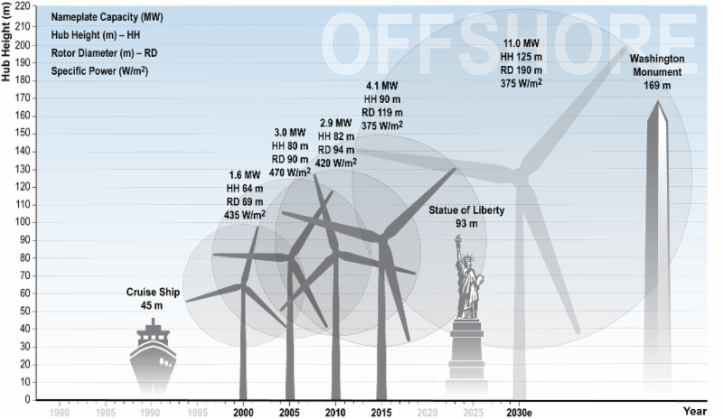
Wind Turbine Height and Size
The current
largest wind
turbine by
capacity is
the Vestas
V164 which
has a capacity
of 8 MW, a
height of
220 m,
and diameter
of 164 m.
22
Source: cdn.arstechnica.net/wp-content/uploads/2016/11/6e9cb9fc-0c18-46db-9176-883cbb08eace.png

Slide 24
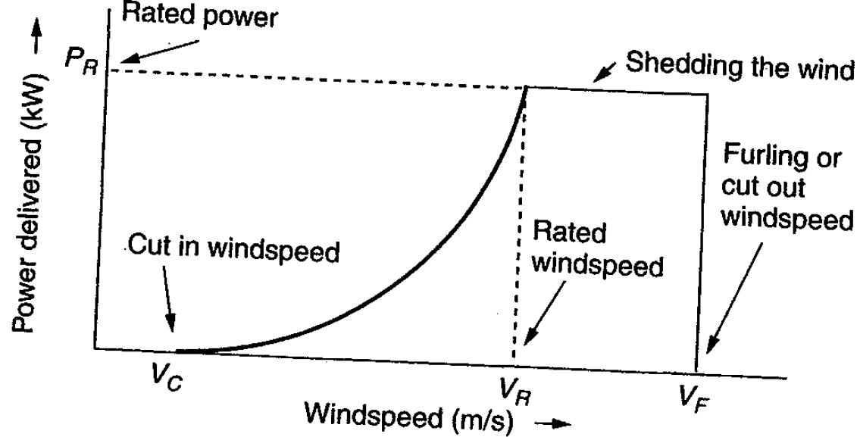
Extracted Power
WTGs are designed for rated power and windspeed
  For speeds above this blades are pitched to operate at rated power; at furling speed the WTG is cut out
23

Slide 25
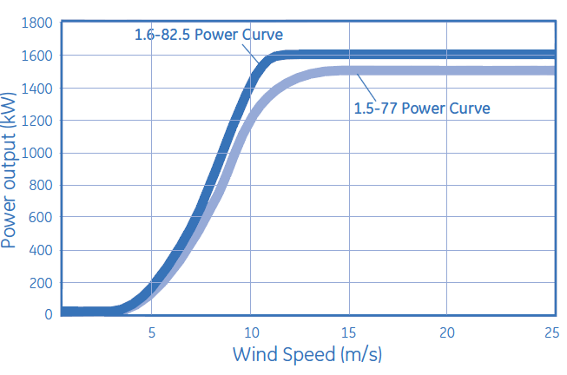
Example: GE 1.5 and 1.6
MW Turbines
Power speed curves for the GE 1.5 and 1.6 MW WTGs
  Hub height is 80/100 m; cut-out at 25 m/s wind
Source: http://site.ge-energy.com/prod_serv/products/wind_turbines/en/15mw/index.htm
24

Slide 26
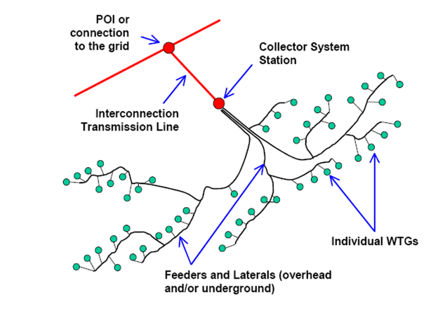
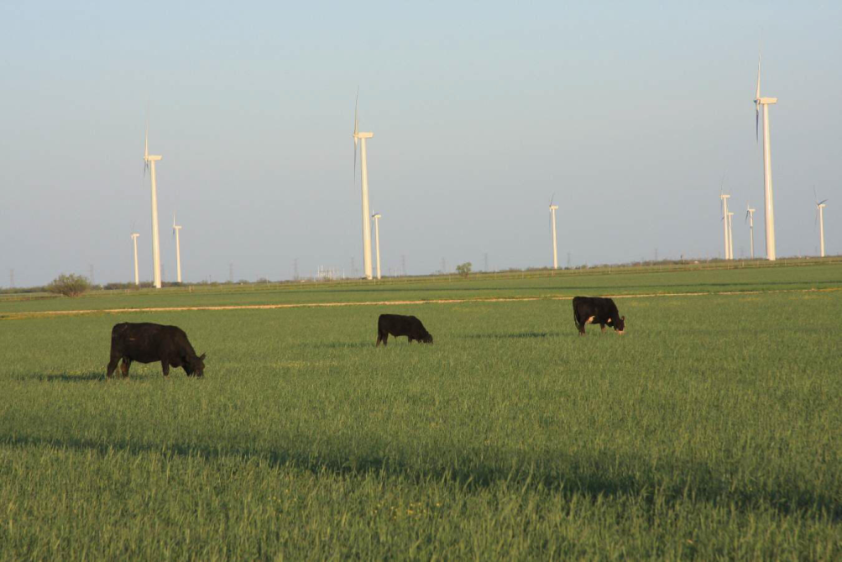
Wind Farms (or Parks)
Usually wind farm is modeled in aggregate for grid studies; wind farm can consist of many small (1 to 3 MW) wind turbine-generators (WTGs) operating at low voltage (e.g. 0.6kV) stepped up to distribution level (e.g., 34.5 kV)
Photo Source: www.energyindustryphotos.com/photos_of_wind_farm_turbines.htm
25

Slide 27
Economies of Scale
Presently large wind farms produce electricity more economically than small operations
Factors that contribute to lower costs are
  Wind power is proportional to the area covered by the blade (square of diameter) while tower costs vary with a value less than the square of the diameter
  Larger blades are higher, permitting access to faster winds, but size limited by transportation for most land wind farms
  Fixed costs associated with construction (permitting, management) are spread over more MWs of capacity
  Efficiencies in managing larger wind farms typically result in lower O&M costs (on-site staff reduces travel costs)
26

Slide 28
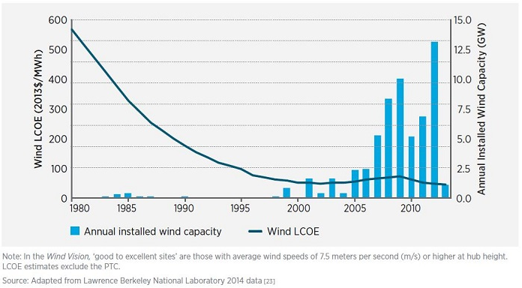
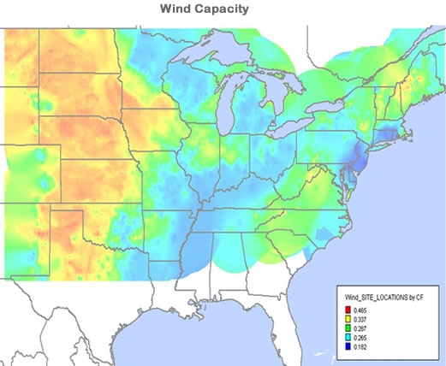
Wind Energy Economics
Most of the cost is in the initial purchase and construction (capital costs); current estimate is about $1690/kW; how much wind is generated depends on the capacity factor, best is about 40%
Source: www.awea.org/falling-wind-energy-costs
27

Slide 29
Environmental Aspects of Wind Energy
US National Academies issued report on issue in 2007
Wind system emit no air pollution and no carbon dioxide; they also have essentially no water requirements
Wind energy serves to displace the production of energy from other sources (usually fossil fuels) resulting in a net decrease in pollution
Other impacts of wind energy are on animals, primarily birds and bats, and on humans
28

Slide 30
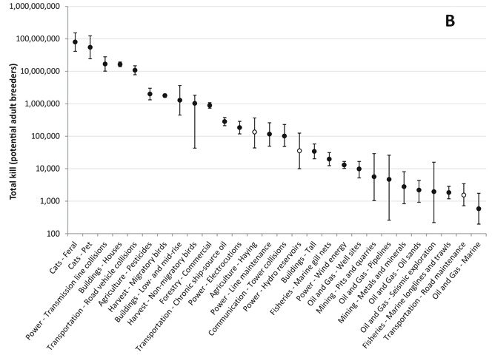
Environmental Aspects of Wind Energy, Birds and Bats
Wind turbines certainly kill birds and bats, but so do lots of other things; cats kill hundreds of millions of birds in North America, and windows do in about 100 million
Source: Avian and Conservation Ecology Journal, 2013, Canada data; www.ace-eco.org/vol8/iss2/art11/
29

Slide 31
Environmental Aspects of Wind Energy, Birds and Bats
Of course most people do not equate killing a little bird, like a sparrow, the same as killing a bigger bird, like an eagle (less prone to hit windows or die by the cat).
  Large bird (raptor) mortalities are about 0.04 bird/MW/year, but these values vary substantially by location with Altamont Pass (CA) killing about 1 raptor/MW/year.
Turbine design and location has a large impact on mortality
  Ideally sited on already “altered” habitats like farmland; not
  by migratory bottlenecks, or by endangered species areas
  Use nighttime lighting that avoids collisions, like strobe lights
  Buried transmission lines
30

