Slide 1
ECEN 667
Power System Stability
Lecture 16: Transient Stability Solutions
Prof. Tom Overbye
Dept. of Electrical and Computer Engineering
Texas A&M University, overbye@tamu.edu

Slide 2
Announcements
Read Chapter 7
Homework 5 is assigned today, due on Oct 31

Slide 3
Adding Network Equations
Previous slides with the network equations embedded in the differential equations were a special case
In general with the explicit approach we'll be alternating between solving the differential equations and solving the algebraic equations
Voltages and currents in the network reference frame can be expressed using either polar or rectangular coordinates
In rectangular with the book's notation we have

Slide 4
Adding Network Equations
Network equations will be written as Y V- I(x,V) = 0
  Here Y is as from the power flow, except augmented to include the impact of the generator's internal impedance
  Constant impedance loads are also embedded in Y; non-constant impedance loads are included in I(x,V)
If I is independent of V then this can be solved directly: V = Y⁻¹I(x)
In general an iterative solution is required, which we'll cover shortly, but initially we'll go with just the direct solution

Slide 5
Two Bus Example, Except with No Infinite Bus
To introduce the inclusion of the network equations, the previous example is extended by replacing the infinite bus at bus 2 with a classical model with X_{d2}'=0.2, H₂=6.0
PowerWorld Case B2_CLS_2Gen

Slide 6
Bus Admittance Matrix
The network admittance matrix is
This is augmented to represent the Norton admittances associated with the generator models (X_{d1}'=0.3, X_{d2}'=0.2)
In PowerWorld you can see this matrix by selecting Transient Stability, States/Manual Control, Transient Stability Ybus

Slide 7
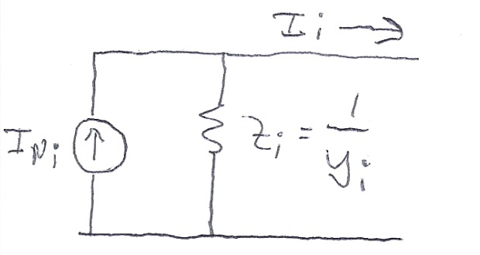
Current Vector
For the classical model the Norton currents are given by
The initial values of the currents come from the power flow solution
As the states change (δ_{i} for the classical model), the Norton current injections also change

Slide 8
B2_CLS_Gen Initial Values
The internal voltage for generator 1 is as before
We likewise solve for the generator 2 internal voltage
The Norton current injections are then
0.4179 radians
0.2108 radians
Keep in mind the
Norton current
injections are not
the current out of the generator

Slide 9
B2_CLS_Gen Initial Values
To check the values, solve for the voltages, with the values matching the power flow values

Slide 10
Swing Equations
With the network constraints modeled, the swing equations are modified to represent the electrical power in terms of the generator's state and current values
Then swing equation is then
I_{Di}+jl_{Qi} is the current
being injected into
the network by
the generator

Slide 11
Two Bus, Two Generator Differential Equations
The differential equations for the two generators are
In this example
P_{M1} = 1 and
P_{M2} = -1

Slide 12
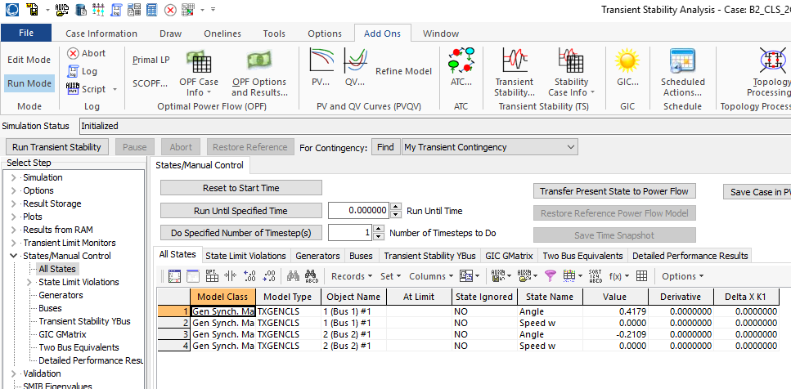
PowerWorld GENCLS Initial States

Slide 13
Solution at t=0.02
Usually a time step begins by solving the differential equations. However, in the case of an event, such as the solid fault at the terminal of bus 1, the network equations need to be first solved
Solid faults can be simulated by adding a large shunt at the fault location
  Amount is somewhat arbitrary, it just needs to be large enough to drive the faulted bus voltage to zero
With Euler's the solution after the first time step is found by first solving the differential equations, then resolving the network equations

Slide 14
Solution at t=0.02
Using Y_{fault} = -j1000, the fault-on conditions become

Slide 15
Solution at t=0.02
Then the differential equations are evaluated, using the new voltages and currents
  These impact the calculation of P_{Ei} with P_{E1}=0, P_{E2}=0
If solving with Euler's this is the final state value; using these state values the network equations are resolved, with the solution the same here since the δ's didn't vary

Slide 16
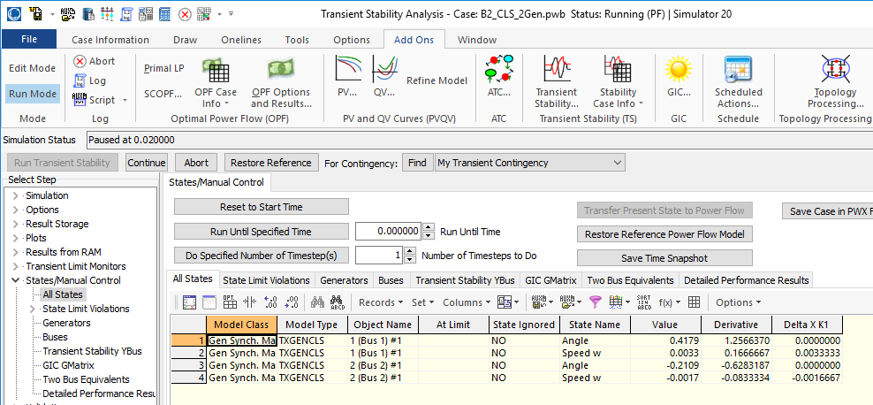
PowerWorld GENCLS at t=0.02

Slide 17
Solution Values Using Euler's
The below table gives the results using Δt = 0.02 for the beginning time steps
Time (Sec) | Gen 1 Rotor Angle | Gen 1 Speed (Hz) | Gen 2 Rotor Angle | Gen2 Speed (Hz)
0 | 23.9462 | 60 | -12.0829 | 60
0.02 | 23.9462 | 60.2 | -12.0829 | 59.9
0.04 | 25.3862 | 60.4 | -12.8029 | 59.8
0.06 | 28.2662 | 60.6 | -14.2429 | 59.7
0.08 | 32.5862 | 60.8 | -16.4029 | 59.6
0.1 | 38.3462 | 61 | -19.2829 | 59.5
0.1 | 38.3462 | 61 | -19.2829 | 59.5
0.12 | 45.5462 | 60.9128 | -22.8829 | 59.5436
0.14 | 52.1185 | 60.7966 | -26.169 | 59.6017
0.16 | 57.8541 | 60.6637 | -29.0368 | 59.6682
0.18 | 62.6325 | 60.5241 | -31.426 | 59.7379
0.2 | 66.4064 | 60.385 | -33.3129 | 59.8075
0.22 | 69.1782 | 60.2498 | -34.6988 | 59.8751
0.24 | 70.9771 | 60.1197 | -35.5982 | 59.9401
0.26 | 71.8392 | 59.9938 | -36.0292 | 60.0031
0.28 | 71.7949 | 59.8702 | -36.0071 | 60.0649

Slide 18
Solution at t=0.02 with RK2
With RK2 the first part of the time step is the same as Euler's, that is solving the network equations with
Then calculate k2 and get a final value for x(t+Δt)
Finally solve the network equations using the final value for x(t+Δt)

Slide 19
Solution at t=0.02 with RK2
From the first half of the time step
Then

Slide 20
Solution at t=0.02 with RK2
The new values for the Norton currents are

Slide 21
Solution Values Using RK2
The below table gives the results using Δt = 0.02 for the beginning time steps
Time (Sec) | Gen 1 Rotor Angle | Gen 1 Speed (Hz) | Gen 2 Rotor Angle | Gen2 Speed (Hz)
0 | 23.9462 | 60 | -12.0829 | 60
0.02 | 24.6662 | 60.2 | -12.4429 | 59.9
0.04 | 26.8262 | 60.4 | -13.5229 | 59.8
0.06 | 30.4262 | 60.6 | -15.3175 | 59.7008
0.08 | 35.4662 | 60.8 | -17.8321 | 59.6008
0.1 | 41.9462 | 61 | -21.0667 | 59.5008
0.1 | 41.9462 | 61 | -21.0667 | 59.5008
0.12 | 48.7754 | 60.8852 | -24.4759 | 59.5581
0.14 | 54.697 | 60.7538 | -27.4312 | 59.6239
0.16 | 59.6315 | 60.6153 | -29.8931 | 59.6931
0.18 | 63.558 | 60.4763 | -31.8509 | 59.7626
0.2 | 66.4888 | 60.3399 | -33.3109 | 59.8308
0.22 | 68.4501 | 60.2071 | -34.286 | 59.8972
0.24 | 69.4669 | 60.077 | -34.789 | 59.9623
0.26 | 69.5548 | 59.9481 | -34.8275 | 60.0267
0.28 | 68.7151 | 59.8183 | -34.4022 | 60.0916

Slide 22
Angle Reference
The initial angles are given by the angles from the power flow, which are based on the slack bus's angle
As presented the transient stability angles are with respect to a synchronous reference frame
  Sometimes this is fine, such as for either shorter studies, or ones in which there is little speed variation
  Oftentimes this is not best since the when the frequencies are not nominal, the angles shift from the reference frame
Other reference frames can be used, such as with respect to a particular generator's value, which mimics the power flow approach; the selected reference has no impact on the solution

Slide 23
Subtransient Models
The Norton current injection approach is what is commonly used with subtransient models in industry
If subtransient saliency is neglected (as is the case with GENROU and GENSAL in which X"_{d}=X"_{q}) then the current injection is
  Subtransient saliency can be handled with this approach, but it is more involved (see Arrillaga, Computer Analysis of Power Systems, section 6.6.3)

Slide 24
Subtransient Models
Note, the values here are on the dq reference frame
We can now extend the approach introduced for the classical machine model to subtransient models
Initialization is as before, which gives the δ's and other state values
Each time step is as before, except we use the δ's for each generator to transfer values between the network reference frame and each machine's dq reference frame
  The currents provide the coupling

Slide 25
Two Bus Example with Two GENROU Machine Models
Use the same system as before, except with we'll model both generators using GENROUs
  For simplicity we'll make both generators identical except set H₁=3, H₂=6; other values are X_{d}=2.1, X_{q}=0.5, X'_{d}=0.2, X'_{q}=0.5, X"_{q}=X"_{d}=0.18, X_{l}=0.15, T'_{do} = 7.0, T'_{qo}=0.75, T"_{do}=0.035, T"_{qo}=0.05; no saturation
  With no saturation the value of the δ's are determined (as per Lecture 11) by solving
  Hence for generator 1

Slide 26
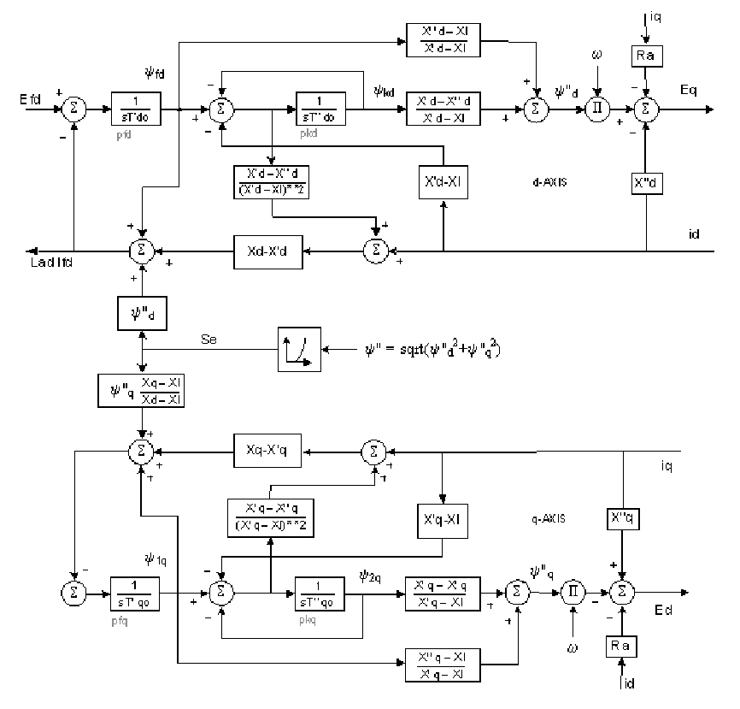
GENROU Block Diagram
E'_{q}
E'_{d}

Slide 27
Two Bus Example with Two GENROU Machine Models
Using the approach from Lecture 11 the initial state vector is
Note that this is a salient pole machine with X'_{q}=X_{q}; hence E'_{d} will always be zero
The initial currents in the
dq reference frame are
I_{d1}=0.7872, I_{q1}=0.6988,
I_{d2}=0.2314, I_{q2}=-1.0269
Initial values of ψ"_{q1}= -0.2236,
and ψ"_{d1} = 1.179

Slide 28
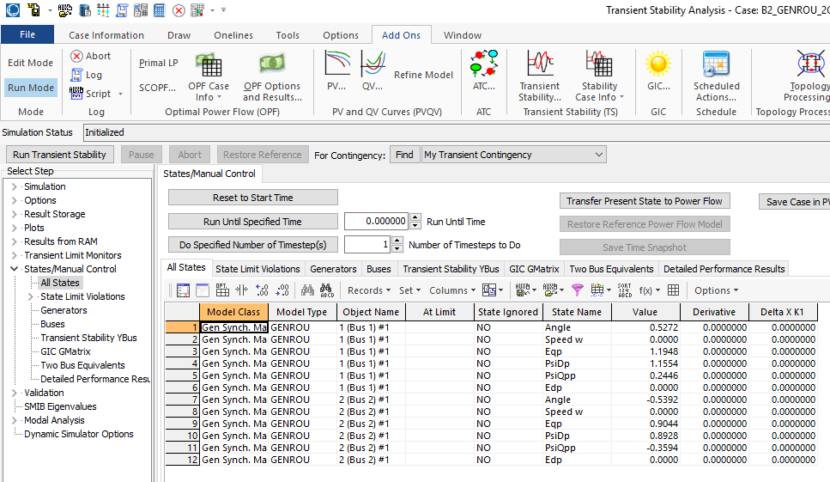
PowerWorld GENROU Initial States

Slide 29
Solving with Euler's
We'll again solve with Euler's, except with Δt set now to 0.01 seconds (because now we have a subtransient model with faster dynamics)
  We'll also clear the fault at t=0.05 seconds
For the more accurate subtransient models the swing equation is written in terms of the torques
Other equations
are solved
based upon
the block
diagram

Slide 30
Norton Equivalent Current Injections
The initial Norton equivalent current injections on the dq base for each machine are
Recall the dq values
are on the machine's
reference frame and
the DQ values are on
the system reference
frame

Slide 31
Moving between DQ and dq
Recall
And
The currents provide
the key coupling
between the
two reference
frames

Slide 32
Bus Admittance Matrix
The bus admittance matrix is as from before for the classical models, except the diagonal elements are augmented using

Slide 33
Algebraic Solution Verification
To check the values solve (in the network reference frame)

Slide 34
Results
The below graph shows the results for four seconds of simulation, using Euler's with Δt=0.01 seconds
PowerWorld
case is
B2_GENROU_2GEN_EULER

Slide 35
Results for Longer Time
Simulating out 10 seconds indicates an unstable solution, both using Euler's and RK2 with Δt=0.005, so it is really unstable!
Euler's with Δt=0.01
RK2 with Δt=0.005

Slide 36
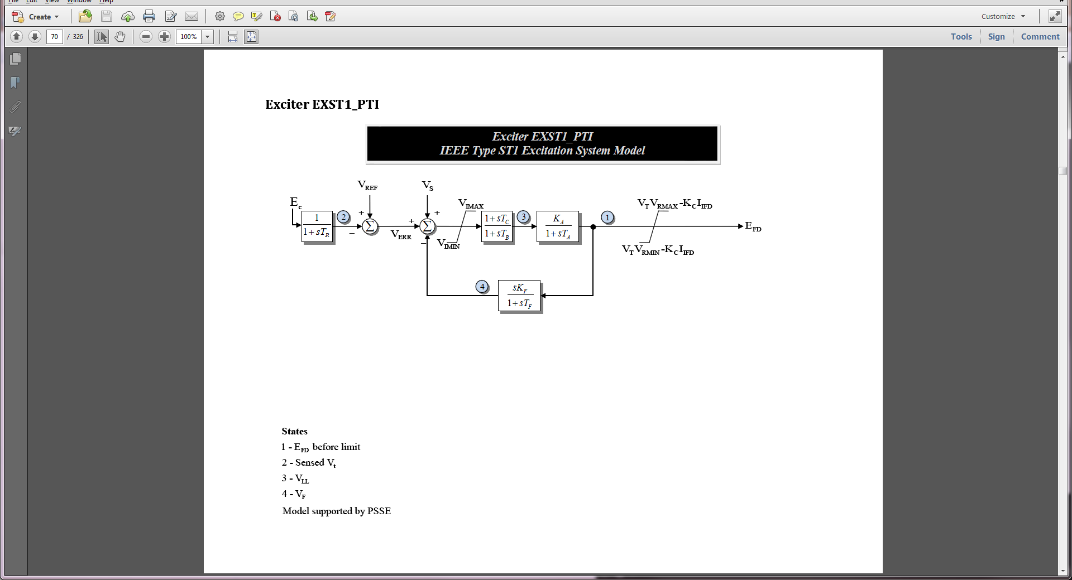
Adding More Models
In this situation the case is unstable because we have not modeled exciters
To each generator add an EXST1 with T_{R}=0, T_{C}=T_{B}=0, K_{f}=0, K_{A}=100, T_{A}=0.1
  This just adds one differential equation per generator

Slide 37
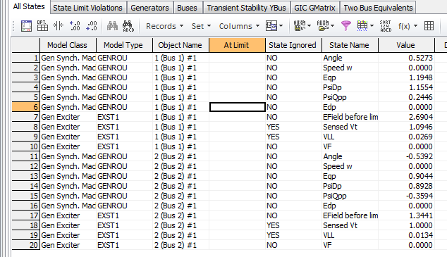
Two Bus, Two Gen With Exciters
Below are the initial values for this case from PowerWorld
Because of the zero values the other differential equations for the exciters are included but treated as ignored
Case is B2_GENROU_2GEN_EXCITER

Slide 38
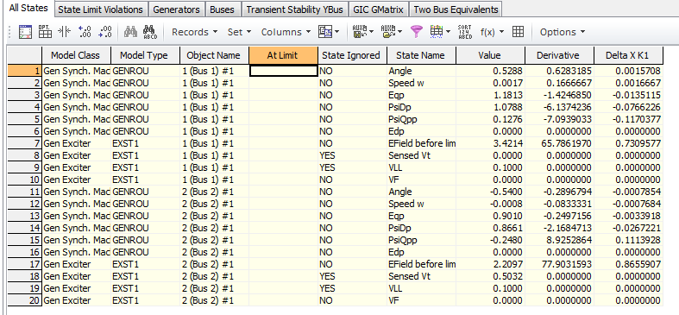
Viewing the States
PowerWorld allows one to single-step through a solution, showing the f(x) and the K₁ values
  This is mostly used for education or model debugging
Derivatives shown are evaluated at the end of the time step

Slide 39
Two Bus Results with Exciters
Below graph shows the angles with Δt=0.01 and a fault clearing at t=0.05 using Euler's
  With the addition of the exciters case is now stable

Slide 40
Constant Impedance Loads
The simplest approach for modeling the loads is to treat them as constant impedances, embedding them in the bus admittance matrix
  Only impact the Ybus diagonals
The admittances are set based upon their power flow values, scaled by the inverse of the square of the power flow bus voltage
In PowerWorld the
default load model is
specified on Transient
Stability, Options,
Power System Model

Slide 41
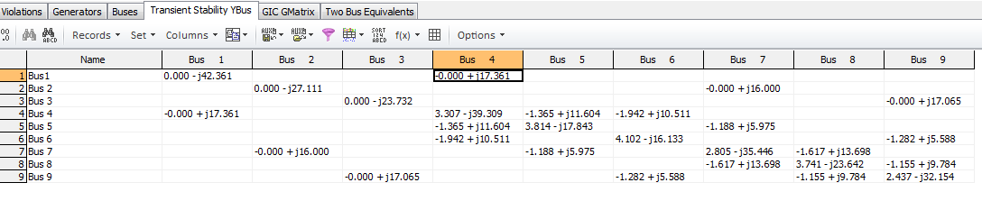
Example 7.4 Case (WSCC 9 Bus)
PowerWorld Case Example_7_4 duplicates the example 7.4 case from the book, with the exception of using different generator models

Slide 42
Nonlinear Network Equations
With constant impedance loads the network equations can usually be written with I independent of V, then they can be solved directly (as we've been doing)
In general this is not the case, with constant power loads one common example
Hence a nonlinear solution with Newton's method is used
We'll generalize the dependence on the algebraic variables, replacing V by y since they may include other values beyond just the bus voltages

Slide 43
Nonlinear Network Equations
Just like in the power flow, the complex equations are rewritten, here as a real current and a reactive current
YV – I(x,y) = 0
The values for bus i are
For each bus we add two new variables and two new equations
If an infinite bus is modeled then its variables and equations are omitted since its voltage is fixed
This is a rectangular
formulation; we also
could have written
the equations in
polar form

Slide 44
Nonlinear Network Equations
The network variables and equations are then

Slide 45
Nonlinear Network Equation Newton Solution

Slide 46
Network Equation Jacobian Matrix
The most computationally intensive part of the algorithm is determining and factoring the Jacobian matrix, J(y)

Slide 47
Network Jacobian Matrix
The Jacobian matrix can be stored and computed using a 2 by 2 block matrix structure
The portion of the 2 by 2 entries just from the Y_{bus} are
The major source of the current vector voltage sensitivity comes from non-constant impedance loads; also dc transmission lines
The "hat" was
added to the
g functions to
indicate it is just
the portion from
the Y_{bus}

Slide 48
Example: Constant Current and Constant Power Load
As an example, assume the load at bus k is represented with a ZIP model
The constant impedance portion is embedded in the Y_{bus}
Usually solved in per unit on network MVA base
The base load
values are
set from the
power flow

Slide 49
Example: Constant Current and Constant Power Load
The current is then
Multiply the numerator and denominator by V_{DK}+jV_{QK} to write as the real current and the reactive current

Slide 50
Example: Constant Current and Constant Power Load
The Jacobian entries are then found by differentiating with respect to V_{DK} and V_{QK}
  Only affect the 2 by 2 block diagonal values
Usually constant current and constant power models are replaced by a constant impedance model if the voltage goes too low, like during a fault

