Slide 1
ECEN 667
Power System Stability
Lecture 24:Stabilizer Design, Measurement Based Modal Analysis
Prof. Tom Overbye
Dept. of Electrical and Computer Engineering
Texas A&M University, overbye@tamu.edu

Slide 2
Announcements
Read Chapter 9
Homework 7 is posted; due on Thursday Nov 30
Final is as per TAMU schedule. That is, Friday Dec 8 from 3 to 5pm

Slide 3
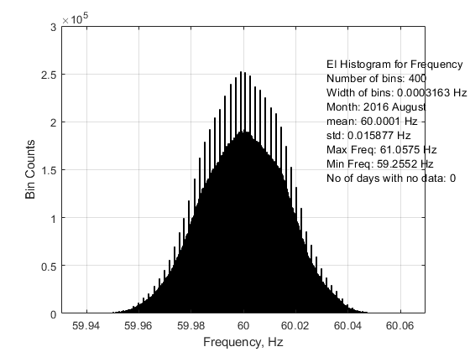
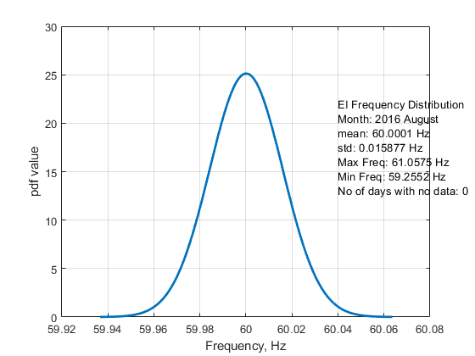
Eastern Interconnect Frequency Distribution
Results Provided by Ogbonnaya Bassey using FNET Data

Slide 4
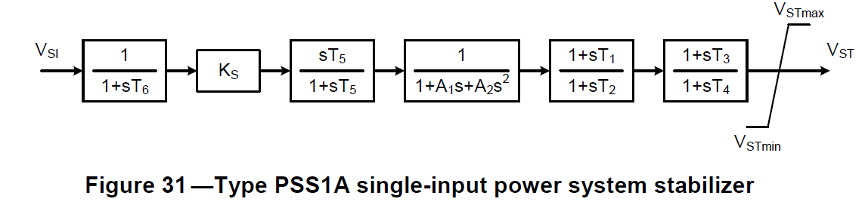
Stabilizer Design
The following slides give an example of stabilizer design using the below single-input power system stabilizer (type PSS1A from IEEE Std. 421-5)
  We already considered the theory in lecture 22
  The PSS1A is very similar to the IEEEST Stabilizer and STAB1
Image Source: IEEE Std 421.5-2016

Slide 5
Stabilizer References
Key papers on the example approach are
  E. V. Larsen and D. A. Swann, "Applying Power System Stabilizers Part I: General Concepts," in IEEE Transactions on Power Apparatus and Systems, vol.100, no. 6, pp. 3017-3024, June 1981.
  E. V. Larsen and D. A. Swann, "Applying Power System Stabilizers Part II: Performance Objectives and Tuning Concepts," in IEEE Transactions on Power Apparatus and Systems, vol.100, no. 6, pp. 3025-3033, June 1981.
  E. V. Larsen and D. A. Swann, "Applying Power System Stabilizers Part III: Practical Considerations," in IEEE Transactions on Power Apparatus and Systems, vol.100, no. 6, pp. 3034-3046, June 1981.
  Shin, Jeonghoon & Nam, Su-Chul & Lee, Jae-Gul & Baek, Seung-Mook & Choy, Young-Do & Kim, Tae-Kyun. (2010). A Practical Power System Stabilizer Tuning Method and its Verification in Field Test. Journal of Electrical Engineering and Technology. 5. 400-406.

Slide 6
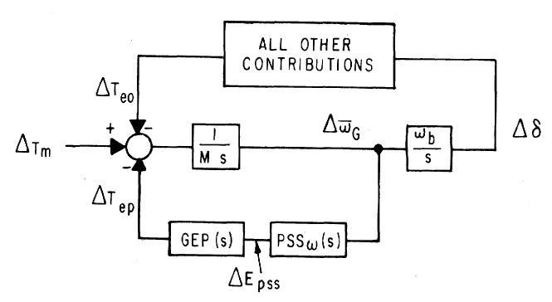
Stabilizer Design
As noted by Larsen, the basic function of stabilizers is to modulate the generator excitation to damp generator oscillations in frequency range of about 0.2 to 2.5 Hz
  This requires adding a torque that is in phase with the speed variation; this requires compensating for the gain and phase characteristics of the excitation system, generator, and power system
The stabilizer input is
typically shaft speed
Image Source: Figure 1 from Larsen, 1981, Part 1

Slide 7
Stabilizer Design
T₆ is used to represent measurement delay; it is usually zero (ignoring the delay) or a small value (< 0.02 sec)
The washout filter removes low frequencies; T₅ is usually several seconds (with an average of say 5)
  Some guidelines say less than ten seconds to quickly remove the low frequency component
  Some stabilizer inputs include two washout filters
Image Source: IEEE Std 421.5-2016

Slide 8
Example Washout Filter Values
Graph plots the equivalent of T₅ for an
example actual system
With T₅= 10
at 0.1 Hz the
gain is 0.987;
with T₅= 1
at 0.1 Hz
the gain is
0.53

Slide 9
Stabilizer Design
The Torsional filter is a low pass filter to attenuate the torsional mode frequency
  We will ignore it here
Key parameters to be tuned at the gain, K_{s}, and the time constants on the two lead-lag blocks (to provide the phase compensation)
  We’ll assume T₁=T₃ and T₂=T₄

Slide 10
Stabilizer Design Phase Compensation
Goal is to move the eigenvalues further into the left-half plane
Initial direction the eigenvalues move as the stabilizer gain is increased from zero depends on the phase at the oscillatory frequency
  If the phase is close to zero, the real component changes significantly but not the imaginary component
  If the phase is around -45° then both change about equally
  If the phase is close to -90° then there is little change in the real component but a large change in the imaginary component

Slide 11
Stabilizer Design Tuning Criteria
Theoretic tuning criteria:
  Compensated phase should pass -90º after 3.5 Hz
  The compensated phase at the oscillatory frequency should be in the range of [-45º, 0º], preferably around -20º
  Ratio (T₁T₃)/(T₂T₄) at high frequencies should not be too large
A peak phase lead provided by the compensator occurs at the center frequency
  The peak phase lead increases as ratio T₁/T₂ increases
A practical method is:
  Select a reasonable ratio T₁/T₂; select T₁ such that the center frequency is around the oscillatory frequency without the PSS

Slide 12
Example T₁ and T₂ Values
The average T₁ value
is about 0.25 seconds
and T₂ is 0.1 seconds,
but most T₂ values
are less than 0.05;
the average T₁/T₂
ratio is 6.3

Slide 13
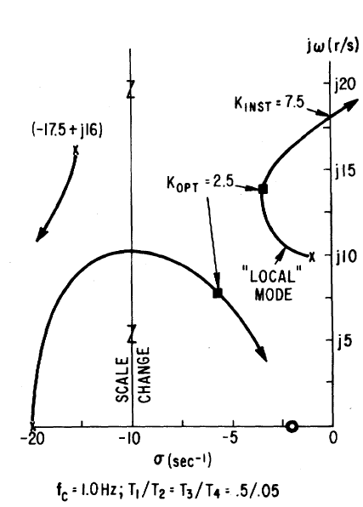
Stabilizer Design Tuning Criteria
Eigenvalues moves as K_{s} increases
A practical method is to find K_{INST}, then set K_{OPT} as about 1/3 or ¼ this value
  K_{OPT} is where the damping is maximized
  K_{INST} is the gain at which sustained oscillations or an instability occur

Slide 14
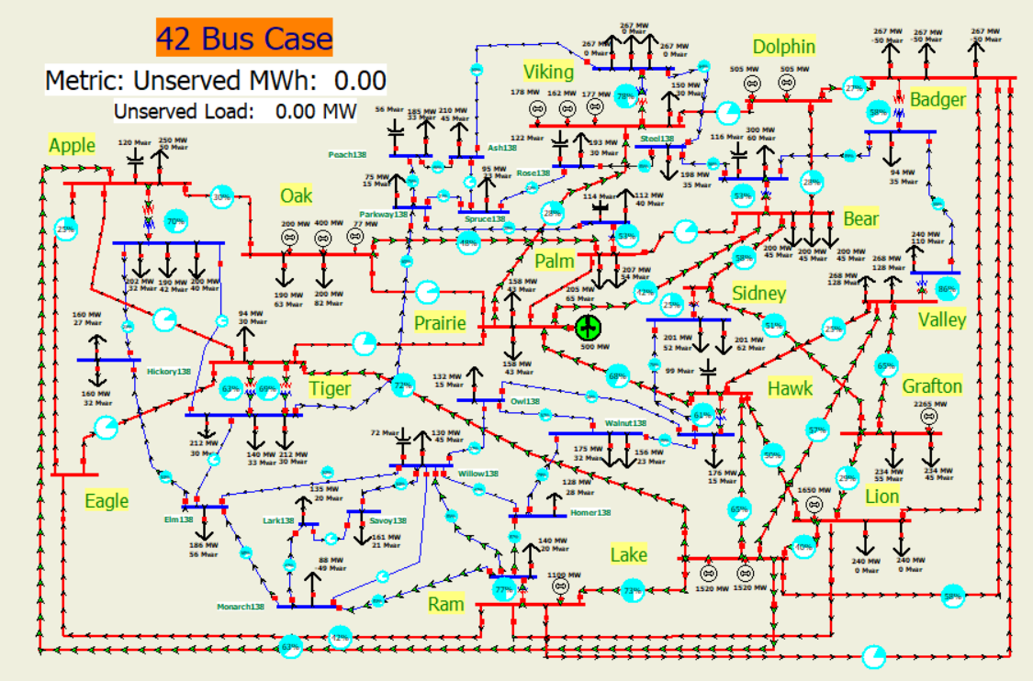
Example with 42 Bus System
A three-phase fault is applied to the middle of the 345 kV transmission line between Prairie (bus 22) and Hawk (bus 3) with both ends opened at 0.05 seconds

Slide 15
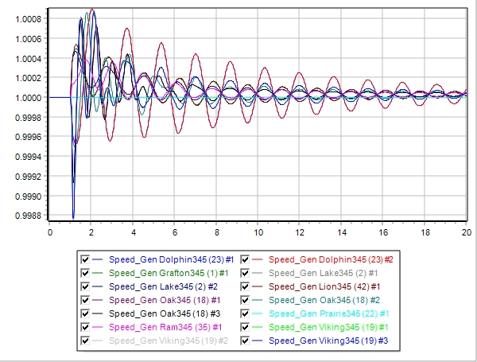
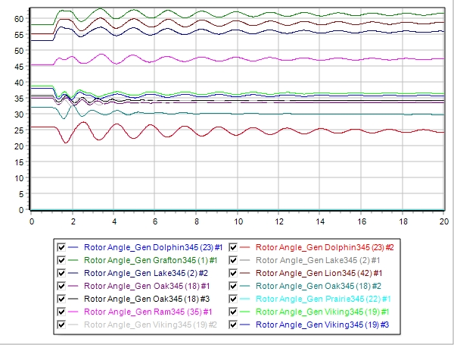
Step 1: Decide Generators to Tune and Frequency
Generator speeds and rotor angles are observed to have a poorly damped oscillation around 0.6 Hz.

Slide 16
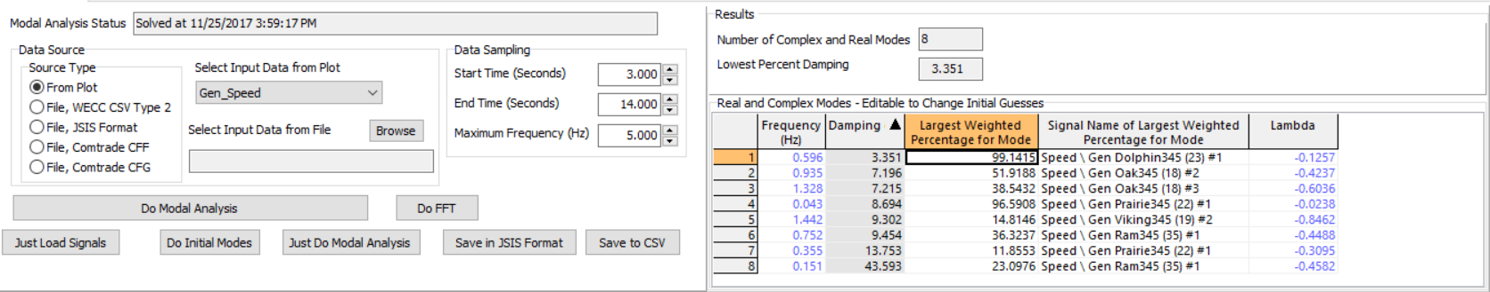
Step 1: Decide Generators to Tune and Frequency
In addition to interpreting from those plots, a modal analysis tool could assist in finding the oscillation information
We are going to tune PSS1A models for all generators using the same parameters (doing them individually would be better by more time consuming)

Slide 17
Step 2: Phase Compensation
Select a ratio of T₁/T₂ to be ten
Select T₁ so f_{c} is 0.6 Hz

Slide 18
Step 3: Gain Tuning
Find the K_{INST}, which is the gain at which sustained oscillations or an instability occur
This occurs at about 9 for the gain
Easiest to see the
oscillations just by
plotting the stabilizer
output signal

Slide 19
Step 4: Testing on Original System
With gain set to 3
Better tuning would be possible with customizing for the individual generators

Slide 20
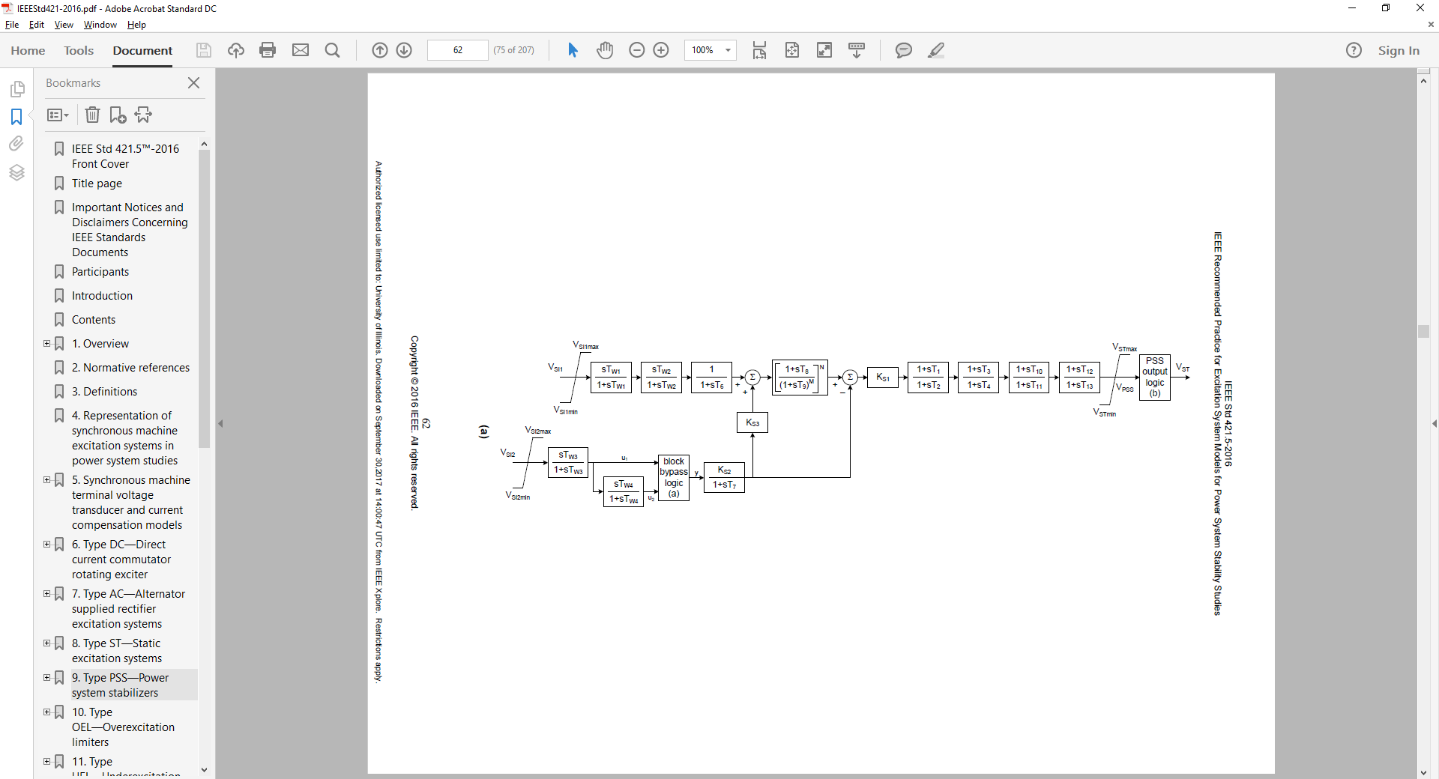
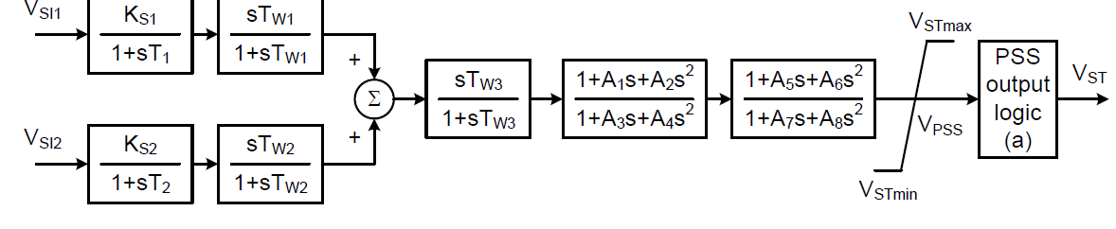
Dual Input Stabilizers
PSS2C
The PSS2C supersedes
the PSS2B, adding an
additional lead-lag block
and bypass logic
PSS3C
Images Source: IEEE Std 421.5-2016

Slide 21
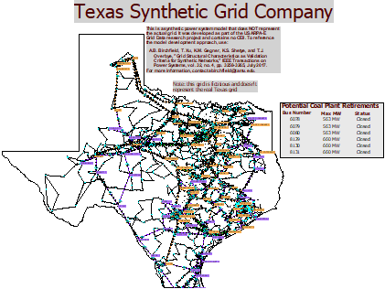
TSGC 2000 Bus VPM Example

Slide 22
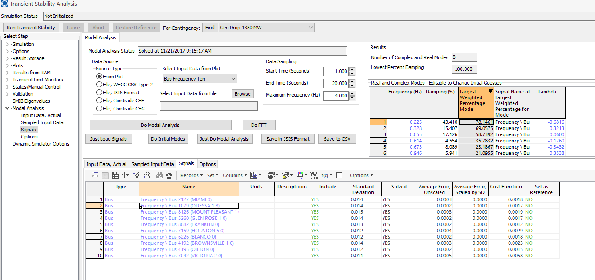
TSGC 2000 Bus Example
Results obtained with a time period from 1 to 20 seconds, sampling at 4 Hz
Most significant
frequencies are
at 0.225 and 0.328
Hz

Slide 23
Mode Observability, Shape, Controllability and Participation Factors
In addition to frequency and damping, there are several other mode characteristics
Observability tells how much of the mode is in a signal, hence it is associated with a particular signal
Mode Shape is a complex number that tells the magnitude and phase angle of the mode in the signal (hence it quantifies observability)
Controllability specifies the amount by which a mode can be damped by a particular controller
Participation facts is used to quantify how much damping can be provided for a mode by a PSS

Slide 24
Determining Modal Shape Example
Example uses the four generator system shown below in which the generators are represented by a combination of GENCLS and GENROU. The contingency is a self-clearing fault at bus 1
  The generator speeds (the signals)
  are as shown in the right figure
Case is saved as B4_Modes

Slide 25
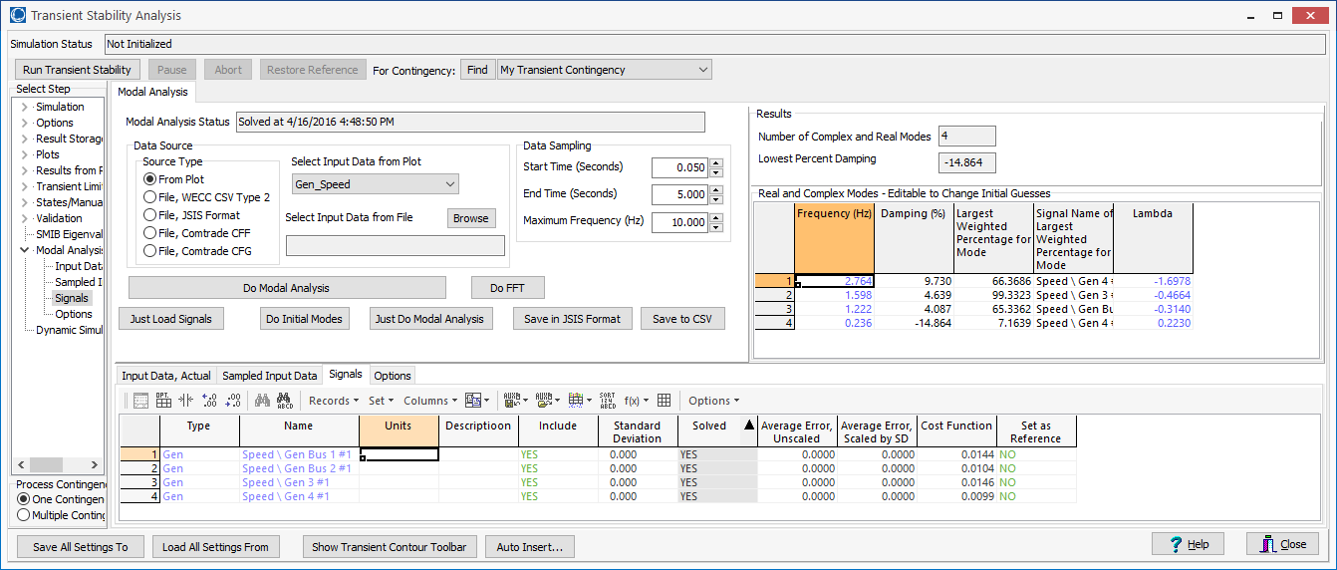
Determining Modal Shape Example
Example uses the multi-signal VPM to determine the key modes in the signals
  Four modes were identified, though the key ones were at 1.22, 1.60 and 2.76 Hz

Slide 26
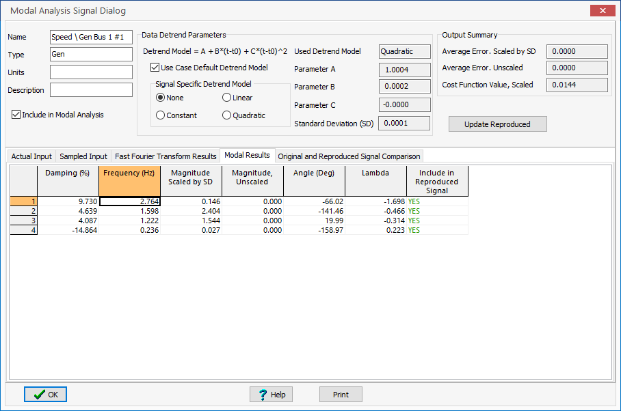
Determining Modal Shape Example
Information about the mode shape is available for each signal; the mode content in each signal can also be isolated
Graph shows original and
the reproduced signal

Slide 27
Determining Modal Shape Example
Graph shows the contribution provided by each mode in the generator 1 speed signal
Reproduced without 1.22 and
2.76 Hz
Reproduced without 2.76 Hz

Slide 28
Modes Shape by Generator (for Speed)
The table shows the contributions by mode for the different generator speed signals
Mode (Hz) | Gen 1 | Gen 2 | Gen 3 | Gen 4
0.244 | 0.07 | 0.082 | 0.039 | 0.066
1.22 | 1.567 | 1.494 | 0.097 | 0.01
1.6 | 2.367 | 2.203 | 2.953 | 1.639
2.76 | 0.174 | 0.378 | 0.927 | 4.913
Image on the right shows the Gen 4
2.76 Hz mode; note it is highly damped

Slide 29
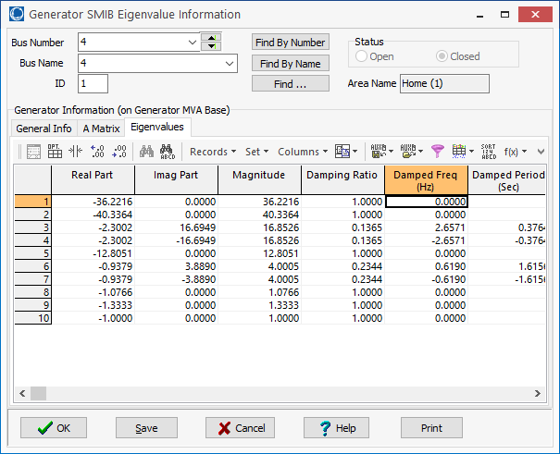
Modes Depend on the Signals!
The below image shows the bus voltages for the previous system, with some (poorly tuned) exciters
  Response includes a significant 0.664 Hz mode from the gen
  4 exciter (which can be seen in its SMIB eigenvalues)

Slide 30
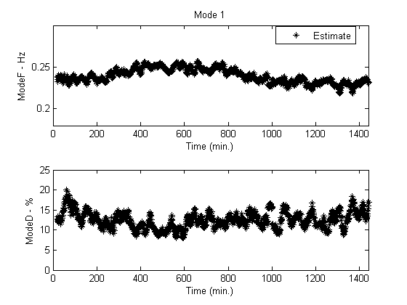
Inter-Area Modes in the WECC
The dominant inter-area modes in the WECC have been well studied
A good reference paper is D. Trudnowski, “Properties of the Dominant Inter-Area Modes in the WECC Interconnect,” 2012
  Four well known modes are
  NS Mode A (0.25 Hz),
  NS Mode B (or Alberta Mode),
  (0.4 Hz), BC Mode (0.6 Hz),
  Montana Mode (0.8 Hz)
Below figure from
paper shows NS Mode A
On May 29, 2012

Slide 31
Example WECC Results
Figure shows bus frequencies at several WECC buses
following a large system disturbance

Slide 32
Example WECC Results
The VPM was run simultaneously on all the signals
  Frequencies of 0.20 Hz (16% damping and 0.34 Hz (11.8% damping)
Angle of 58.7° at 0.34 Hz
and 132 ° at 0.20 Hz
Angle of -137.1° at 0.34 Hz
and 142° at 0.20 Hz

Slide 33
Fast Fourier Transform (FFT) Applications: Motivational Example
The below graph shows a slight frequency oscillation in a transient stability run
  The question is to figure out the source of the oscillation (shown here in
  the bus frequency)
  Plotting all the frequency
  values is one option,
  but sometimes small
  oscillations could get lost
  A solution is to do an FFT

