Slide 1
ECEN 667
Power System Stability
Lecture 6: Transient Stability Intro, Synchronous Machine Models
Prof. Tom Overbye
Dept. of Electrical and Computer Engineering
Texas A&M University
overbye@tamu.edu

Slide 2
Announcements
Read Chapter 3, skip 3.7 for now
Homework 2, which is posted on the website, is due on Thursday Sept 21

Slide 3
WSCC Case One-line
The initial contingency
is to trip the generator
at bus 3. Select
Run Transient Stability
to get the results.

Slide 4
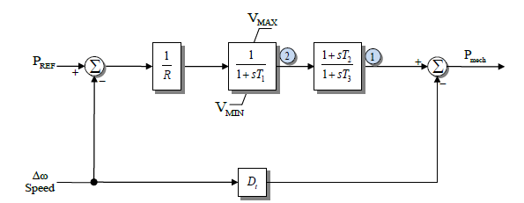
Generator Governors
Governors are used to control the generator power outputs, helping the maintain a desired frequency
Covered in sections 4.4 and 4.5
As was the case with machine models and exciters, governors can be entered using the Generator Dialog.
Add TGOV1 models for all three generators using the default values.

Slide 5
Additional WSCC Case Changes
Use the “Add Plot” button on the plot designer to insert new plots to show 1) the generator speeds, and 2) the generator mechanical input power.
Change contingency to be the opening of the bus 3 generator at time t=1 second. There is no “fault” to be cleared in this example, the only event is opening the generator. Run case for 20 seconds.
Case Name: WSCC_9Bus_WithGovernors

Slide 6
Generator Angles on Different Reference Frames
Average of Generator Angles
Reference Frame
Synchronous Reference
Frame
Both are equally “correct”, but it is much easier
to see the rotor angle variation when using the
average of generator angles reference frame

Slide 7
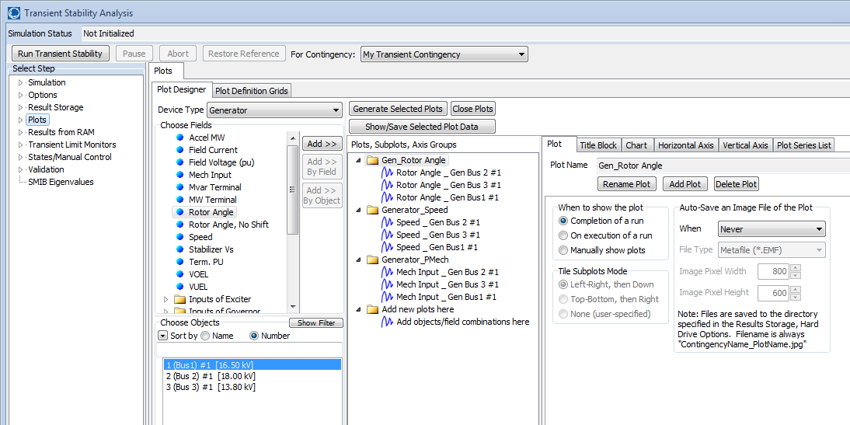
Plot Designer with New Plots
Note that when new plots are added using “Add Plot”, new Folders appear in the plot list. This will result in separate plots for each group

Slide 8
Gen 3 Open Contingency Results
The left figure shows the generator speed, while the right figure shows the generator mechanical power inputs for the loss of generator 3. This is a severe contingency since more than 25% of the system generation is lost, resulting in a frequency dip of almost one Hz. Notice frequency does not return to 60 Hz.

Slide 9
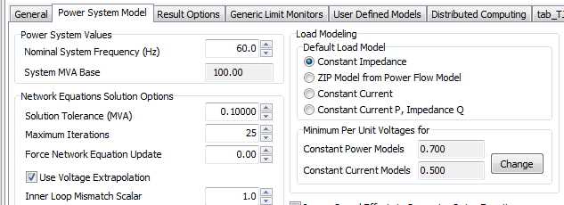
Load Modeling
The load model used in transient stability can have a significant impact on the results
By default PowerWorld uses constant impedance models but makes it very easy to add more complex loads.
The default (global) models are specified on the Options, Power System Model page.
These models are used only
when no other models are
specified.

Slide 10
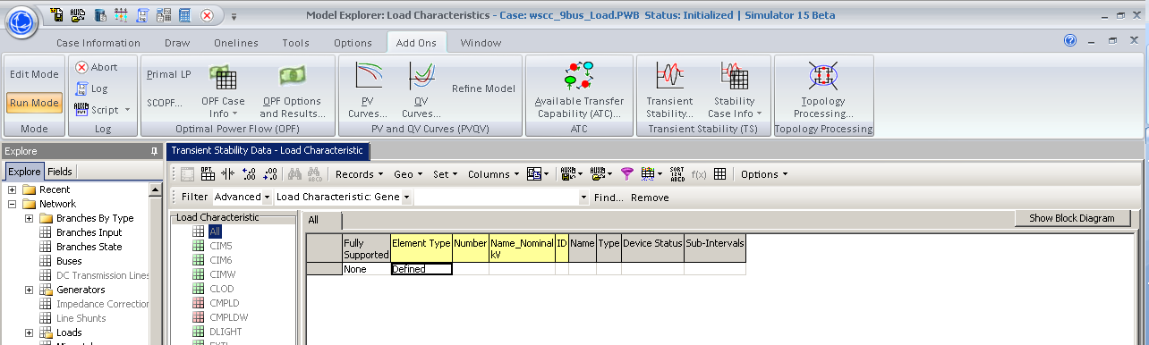
Load Modeling
More detailed models are added by selecting “Stability Case Info” from the ribbon, then Case Information, Load Characteristics Models.
Models can be specified for the entire case (system), or individual areas, zones, owners, buses or loads.
To insert a load model click right click and select insert
to display the Load Characteristic Information dialog.
Right click
here to get
local menu and
select insert.

Slide 11
Dynamic Load Models
Loads can either be static or dynamic, with dynamic models often used to represent induction motors
Some load models include a mixture of different types of loads; one example is the CLOD model represents a mixture of static and dynamic models
Loads models/changed in PowerWorld using the Load Characteristic Information Dialog
Next slide shows voltage results for static versus dynamic load models
Case Name: WSCC_9Bus_Load

Slide 12
WSCC Case Without/With Complex Load Models
Below graphs compare the voltage response following a fault with a static impedance load (left) and the CLOD model, which includes induction motors (right)

Slide 13
Under-Voltage Motor Tripping
In the PowerWorld CLOD model, under-voltage motor tripping may be set by the following parameters
  Vi = voltage at which trip will occur (default = 0.75 pu)
  Ti (cycles) = length of time voltage needs to be below Vi before trip will occur (default = 60 cycles, or 1 second)
In this example change the tripping values to 0.8 pu and 30 cycles and you will see the motors tripping out on buses 5, 6, and 8 (the load buses) – this is especially visible on the bus voltages plot. These trips allow the clearing time to be a bit longer than would otherwise be the case.
Set Vi = 0 in this model to turn off motor tripping.

Slide 14
37 Bus System
Next we consider a slightly larger, 9 generator, 37 bus system. To view this system open case GOS_37Bus. The system one-line is shown below.
To see summary
listings of the transient stability models in this case
select “Stability Case Info” from the ribbon, and then either “TS Generator
Summary” or “TS
Case Summary”

Slide 15
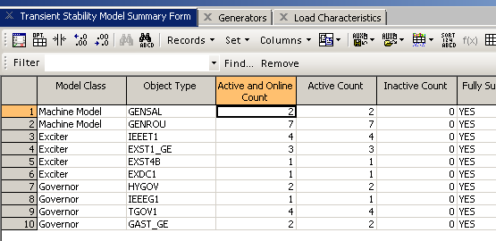
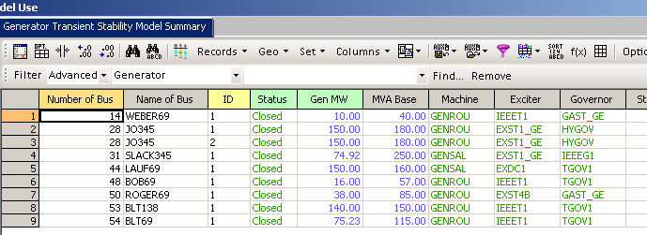
Transient Stability Case and Model Summary Displays
Right click on a line
and select “Show
Dialog” for more
information.

Slide 16
37 Bus Case Solution
Graph
shows the
generator
frequency
response
following
the loss
of one
generator

Slide 17
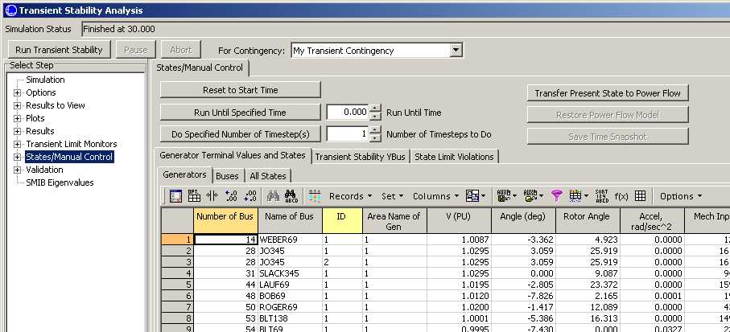
Stepping Through a Solution
Simulator provides functionality to make it easy to see what is occurring during a solution. This functionality is accessed on the States/Manual Control Page
Transfer results
to Power Flow
to view using
standard
PowerWorld
displays and
one-lines
See detailed results
at the Paused Time
Run a Specified Number of Timesteps or Run Until a Specified Time, then Pause.

Slide 18
Synchronous Machine Modeling
Electric machines are used to convert mechanical energy into electrical energy (generators) and from electrical energy into mechanical energy (motors)
  Many devices can operate in either mode, but are usually customized for one or the other
Vast majority of electricity is generated using synchronous generators and some is consumed using synchronous motors, so that is where we'll start
Much literature on subject, and sometimes overly confusing with the use of different conventions and nominclature

Slide 19
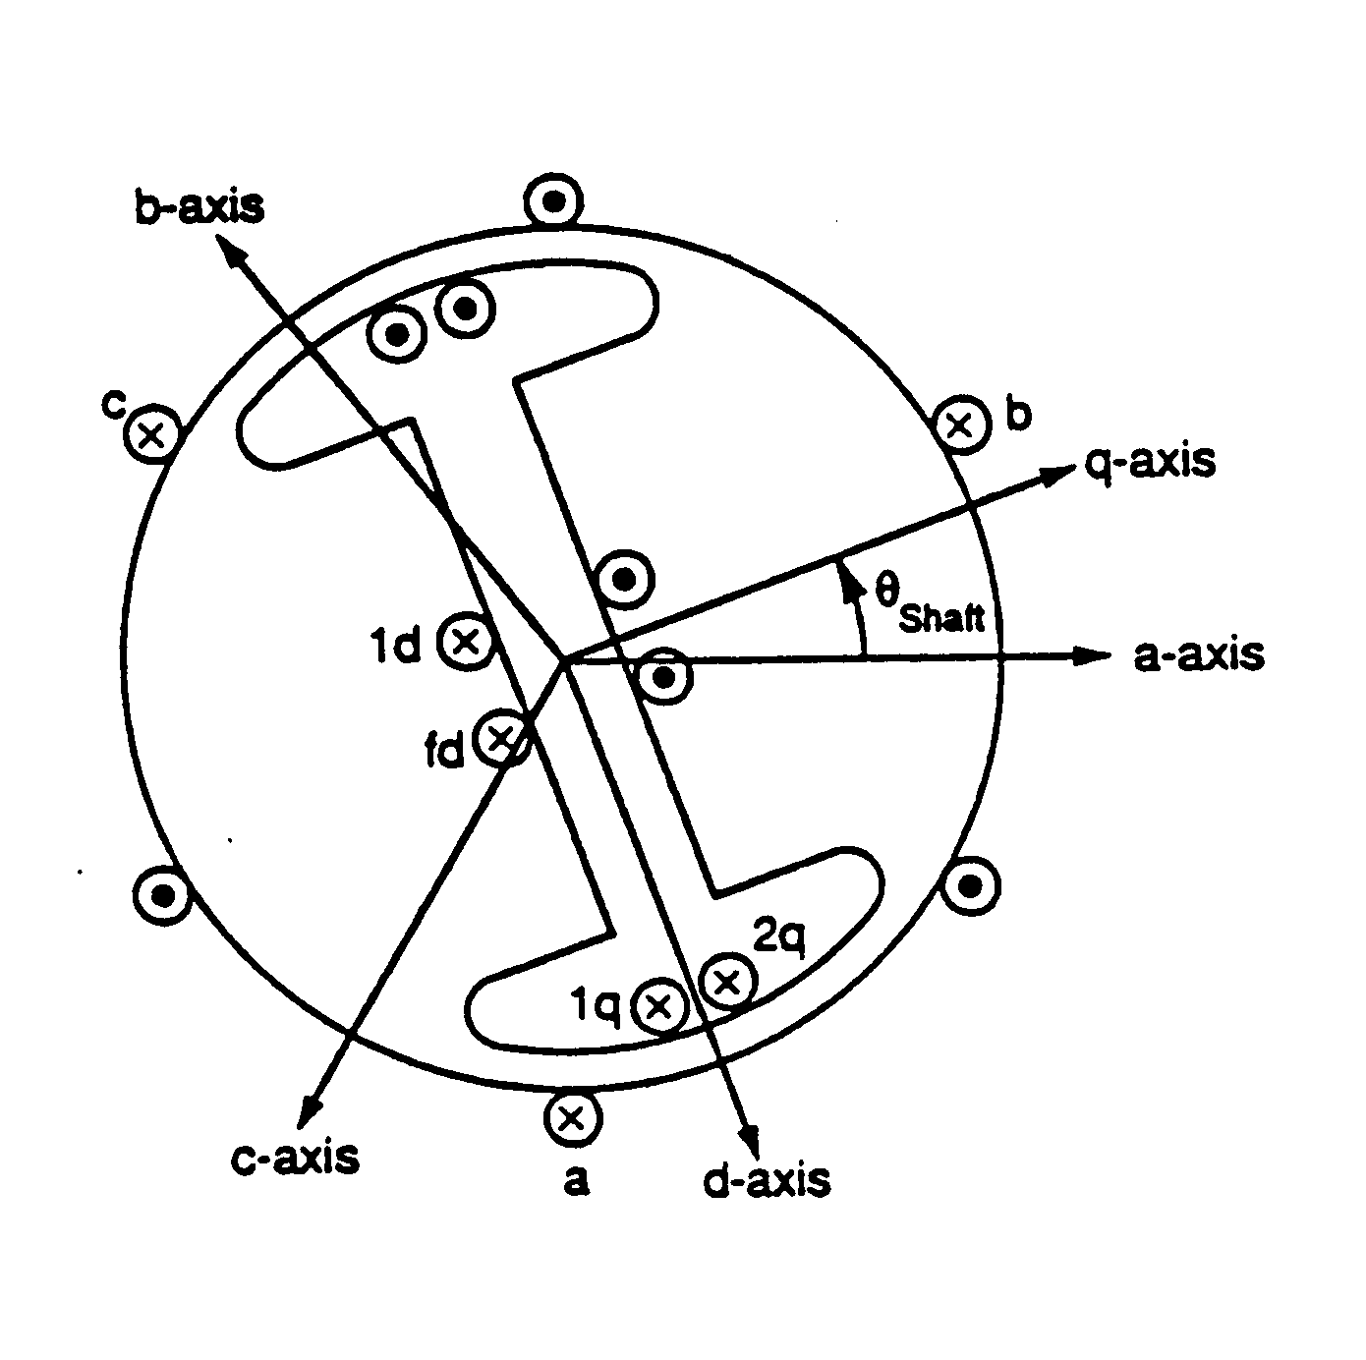
Synchronous Machine Modeling
3φ bal. windings (a,b,c) – stator
Field winding (fd) on rotor
Damper in “d” axis
(1d) on rotor
2 dampers in “q” axis
(1q, 2q) on rotor

Slide 20
Dq0 Reference Frame
Stator is stationary,rotor is rotating at synchronous speed
Rotor values need to be transformed to fixed reference frame for analysis
Done using Park's transformation into what is known as the dq0 reference frame (direct, quadrature, zero)
  Parks’ 1929 paper voted 2nd most important power paper of 20th century (1st was Fortescue’s sym. components paper)
Convention used here is the q-axis leads the d-axis (which is the IEEE standard)
  Others (such as Anderson and Fouad) use a q-axis lagging convention

Slide 21
Fundamental Laws
Kirchhoff’s Voltage Law, Ohm’s Law, Faraday’s Law, Newton’s Second Law
Stator
Rotor
Shaft

Slide 22
Dq0 transformations

Slide 23
Dq0 transformations
with the inverse,

Slide 24
Transformed System
Stator
Rotor
Shaft

Slide 25
Electrical & Mechanical Relationships
Electrical system:
Mechanical system:

Slide 26
Derive Torque
Torque is derived by looking at the overall energy balance in the system
Three systems: electrical, mechanical and the coupling magnetic field
  Electrical system losses in form of resistance
  Mechanical system losses in the form of friction
Coupling field is assumed to be lossless, hence we can track how energy moves between the electrical and mechanical systems

Slide 27
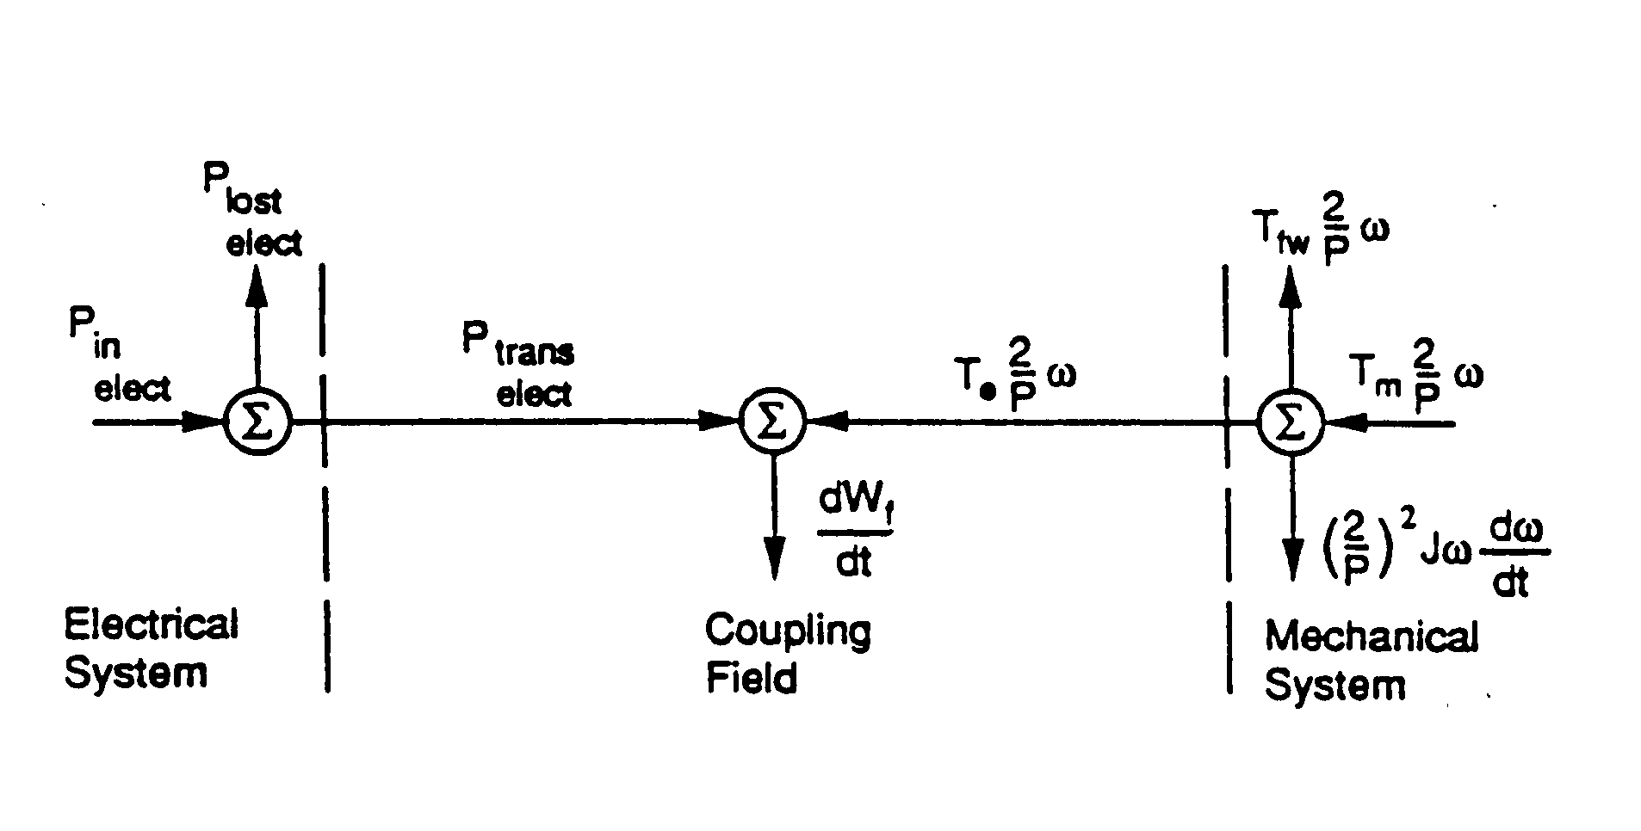
Energy Conversion
Look at the instantaneous power:

Slide 28
Change to Conservation of Power

Slide 29
With the Transformed Variables

Slide 30
With the Transformed Variables

Slide 31
Change in Coupling Field Energy
This requires the lossless coupling field assumption

Slide 32
Change in Coupling Field Energy
For independent states θ, λ_{a}, λ_{b}, λ_{c}, λ_{fd}, λ_{1d}, λ_{1q}, λ_{2q}

Slide 33
Equate the Coefficients
etc.
There are eight such “reciprocity conditions for this model.
These are key conditions – i.e. the first one gives an expression for the torque in terms of the coupling field energy.

Slide 34
Equate the Coefficients
These are key conditions – i.e. the first one gives an expression for the torque in terms of the coupling field energy.

Slide 35
Coupling Field Energy
The coupling field energy is calculated using a path independent integration
  For integral to be path independent, the partial derivatives of all integrands with respect to the other states must be equal
Since integration is path independent, choose a convenient path
  Start with a de-energized system so all variables are zero
  Integrate shaft position while other variables are zero, hence no energy
  Integrate sources in sequence with shaft at final θ_{shaft} value

Slide 36
Do the Integration

Slide 37
Torque
Assume: i_{q}, i_{d}, i_{o}, i_{fd}, i_{1d}, i_{1q}, i_{2q} are independent of θ_{shaft} (current/flux linkage relationship is independent of θ_{shaft})
Then W_{f} will be independent of θ_{shaft} as well
Since we have

Slide 38
Define Unscaled Variables
ω_{s} is the rated
synchronous speed
δ plays an important role!

Slide 39
Convert to Per Unit
As with power flow, values are usually expressed in per unit, here on the machine power rating
Two common sign conventions for current: motor has positive currents into machine, generator has positive out of the machine
Modify the flux linkage current relationship to account for the non power invariant “dqo” transformation

Slide 40
Convert to Per Unit
where V_{BABC} is rated RMS line-to-neutral stator voltage and

Slide 41
Convert to Per Unit
where V_{BDQ} is rated peak line-to-neutral stator voltage and

Slide 42
Convert to Per Unit
Hence the ψ variables are just normalized
flux linkages

Slide 43
Convert to Per Unit
Where the rotor circuit base voltages are
And the rotor circuit base flux linkages are

Slide 44
Convert to Per Unit

Slide 45
Convert to Per Unit
Almost done with the per unit conversions! Finally define inertia constants and torque

Slide 46
Synchronous Machine Equations

