Slide 1
ECEN 615 Methods of Electric Power Systems Analysis
Lecture 1: Power Systems Overview
Prof. Tom Overbye
Dept. of Electrical and Computer Engineering
Texas A&M University
overbye@tamu.edu

Slide 2
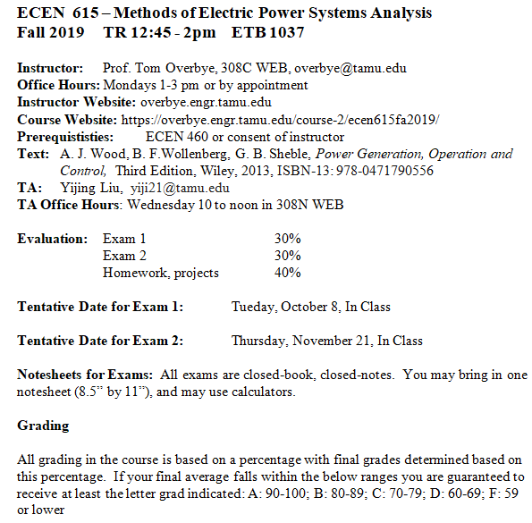
Syllabus
Slides will be posted before each lecture on the website

Slide 3
Course Topics
Introduction to Power Systems
Overview of Power System Modeling and Operation
Power Flow
Sparse Matrices in Power System Analysis
Sensitivity Analysis and Equivalents
Power System Data Analytics and Visualization
Optimal Power Flow and Power Markets
Power System State Estimation
High Impact, Low Frequency Events

Slide 4
Announcements
Start reading chapters 1 to 3 from the book (more background material)
Download the 42 bus educational versions of PowerWorld Simulator and PowerWorld DS at
https://www.powerworld.com/gloveroverbyesarma

Slide 5
About Me: Professional
Received BSEE, MSEE, and Ph.D. all from University of Wisconsin at Madison (83, 88, 91)
Worked for eight years as engineer for an electric utility (Madison Gas & Electric)
Was at UIUC from 1991 to 2016, doing teaching and doing research in the area of electric power systems
Joined TAMU in January 2017
Taught many power systems classes over last 28 years
Developed commercial power system analysis package, known now as PowerWorld Simulator. This package has been sold to about 600 different corporate entities worldwide
DOE investigator for 8/14/2003 blackout
Member US National Academy of Engineering

Slide 6
About Me: TAMU Research Group Spring and Summer 2019

Slide 7
About Me: Nonprofessional
Married to Jo
Have three children: Tim, Hannah and Amanda
We homeschooled our kids with Tim now a PhD student at TAMU, Hannah working at Stanford, and Amanda a junior at Belmont in environmental sciences
Jo just finished a master’s in counseling, we attend Grace Bible Church in College Station (and teach the 3rd and 4th graders sometimes); I am the faculty advisor for Christian Engineering Leaders; I also like swimming, biking and watching football (Aggies and Packers!)

Slide 8
About TA Yijing Liu
Third year graduate student
BSc (EE, University of Electronic Science and 1Technology of China, China)
Research assistant since Fall, 2017
PhD Research Area
Power Systems Transient Stability Analysis
Power Systems Protection
Advisor: Prof. Tom Overbye
Hobbies: Movie, cooking, travelling
Award: Thomas W. Powell ’62 and Powell Industries Inc. Fellowship
Cancun, Mexico, 2018
The control room at the A&M Center for Infrastructure Renewal (CIR)

Slide 9
Electric Grid Control Room at CIR

Slide 10
TAMU ECE Energy and Power Group Picnic: September 27, 2019
This picture is from our event last spring. If you would like to join us this year, RSVP to Alex Bello
(zandra23@ece.tamu.edu)

Slide 11
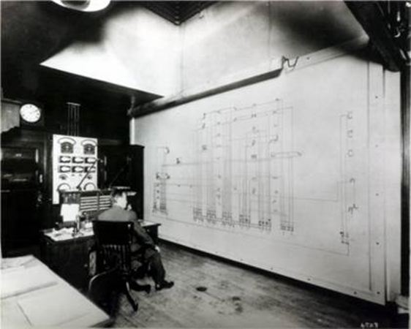
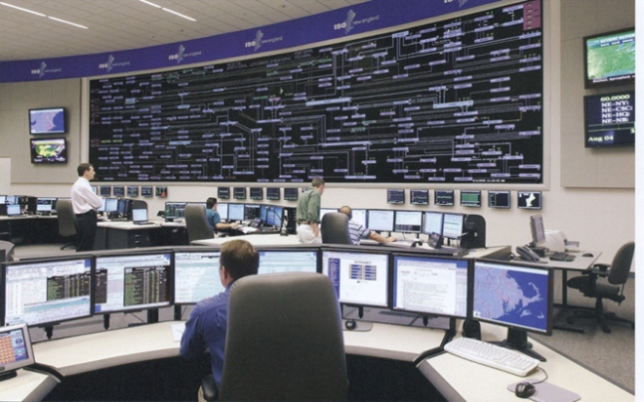
ECEN 615 Motivation: A Vision for a Long-Term Sustainable Electric Future
In 2000 the US National Academy of Engineering (NAE) named Electrification (the vast networks of electricity that power the developed world) as the top engineering technology of the 20th century
Beating automobiles (2), airplanes (3), water (4), electronics (5)
Electricity has changed the world!
For the 21th century the winner could be “Development of a sustainable and resilient electric infrastructure for the entire world”

Slide 12
Power System Examples
Electric utility: can range from quite small, such as an island, to one covering half the continent
there are four major interconnected ac power systems in North American, each operating at 60 Hz ac; 50 Hz is used in some other countries.
Microgrids can power smaller areas (like a campus) and can be optionally connected to the main grid
Airplanes and Spaceships: reduction in weight is primary consideration; frequency is 400 Hz.
Ships and submarines
Automobiles: dc 12 V standard; 360-376 V for electric
Battery operated portable systems

Slide 13
North America Interconnections

Slide 14
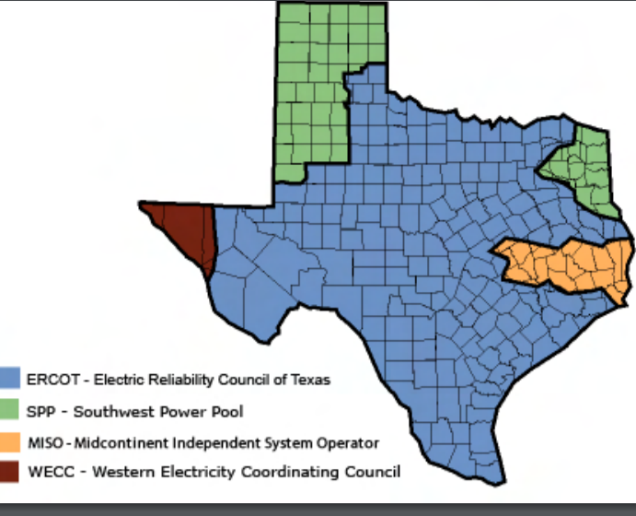
Electric Interconnections in Texas
Source: www.puc.texas.gov/industry/maps/maps/ERCOT.pdf

Slide 15
Electric Systems in Energy Context
Class focuses on electric power systems, but we first need to put the electric system in context of the total energy delivery system
Electricity is used primarily as a means for energy transportation
Use other sources of energy to create it, and it is usually converted into another form of energy when used
About 40% of US energy is transported in electric form
Concerns about need to reduce CO2 emissions and fossil fuel depletion are becoming main drivers for change in world energy infrastructure

Slide 16
Looking at the 2018 Energy Pie: Where the USA Got Its Energy
About 40% of our energy is consumed in the form of electricity, a percentage that is gradually increasing. The vast majority on the non-fossil fuel energy is electric!
In 2018 we got about 2.5% of our energy from wind and 0.94% from solar (PV and solar thermal), 2.7% from hydro
About 80% Fossil Fuels (89% in 1980 and 85% in 2000)
Total of 97.7 Quad; 1 Quad = 293 billion kWh (actual), 1 Quad = 98 billion kWh (used, taking into account efficiency)
EIA is US DOE Energy Information Administration
Source: EIA Monthly Energy Review, July 2019

Slide 17
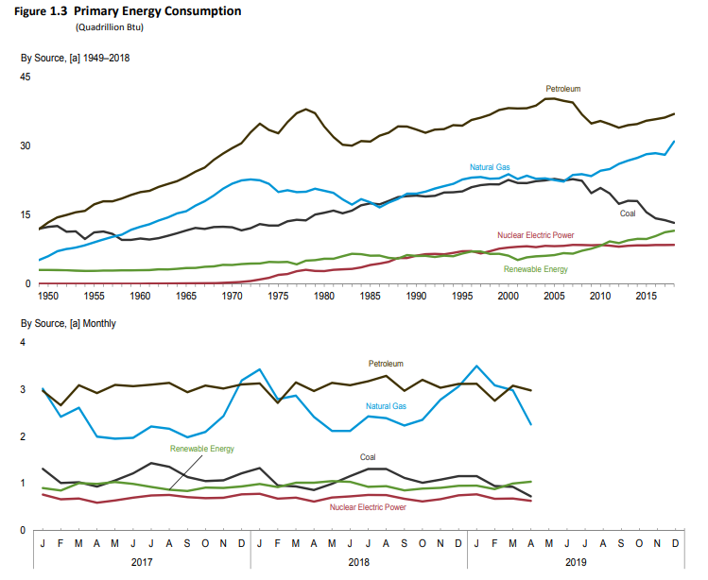
US Historical Energy Usage
Source: EIA Monthly Energy Review, July 2019

Slide 18
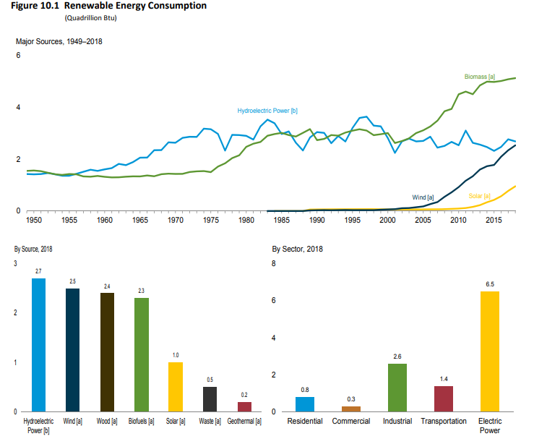
Renewable Energy Consumption
Source: EIA Monthly Energy Review, July 2019

Slide 19
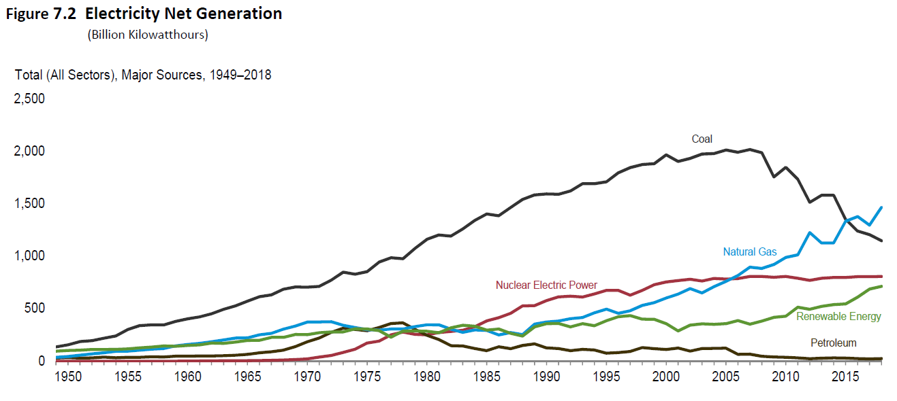
US Electricity Generation
In 2018 the major sources were natural gas (35.5%), coal (26.8%), nuclear (19.2%), hydro (6.8%), wind (6.4%), and solar (2.3%)
Wind and solar are rapidly growing (11% and 25% growth in 2018) though the growth is slowing (solar was a over 100% from 2012-13)
Source: EIA Monthly Energy Review, July 2019

Slide 20
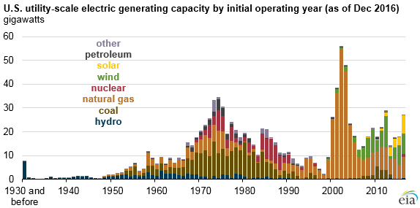
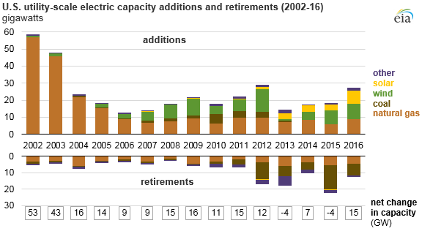
US Generator Capacity Additions
Natural gas and wind generation additions in the last decade dwarfed all other technologies, but with solar rapidly growing. The gas generation, and low natural gas prices were partially responsible for the recent decrease in carbon dioxide emissions.
Sources: www.eia.gov/todayinenergy/detail.php?id=25432

Slide 21
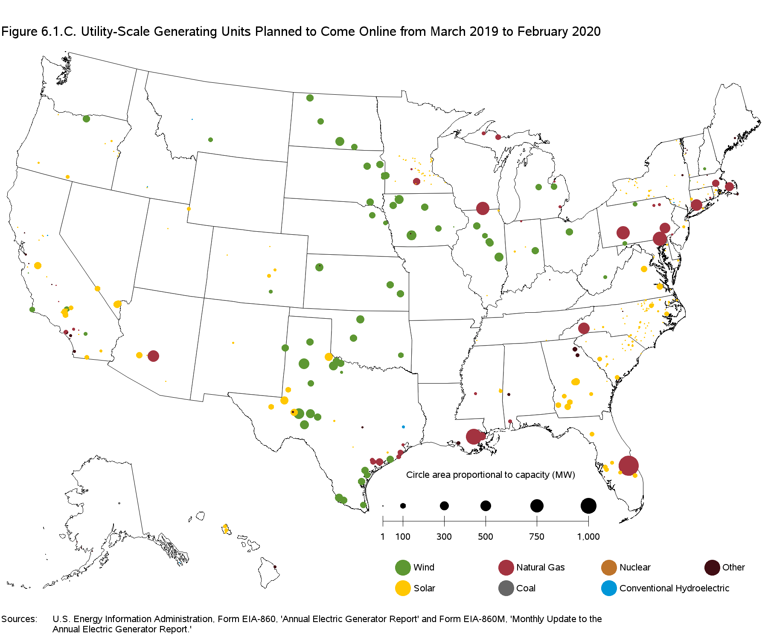
New Generation March 2019 to Feb 2020
Sources: EIA Electricity Monthly, April 2019

Slide 22
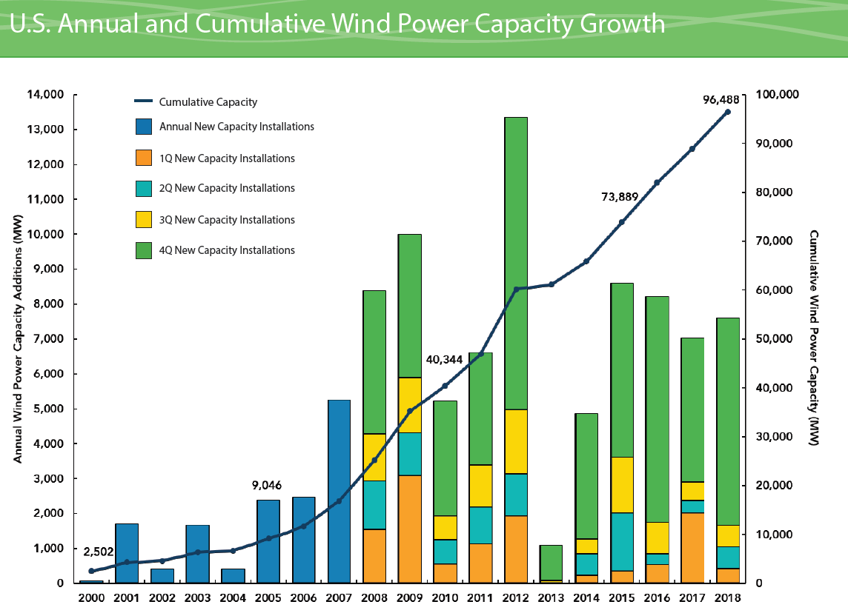
Growth in US Wind Power Capacity
Source: AWEA Wind Power Outlook Fourth Quarter, 2018

Slide 23
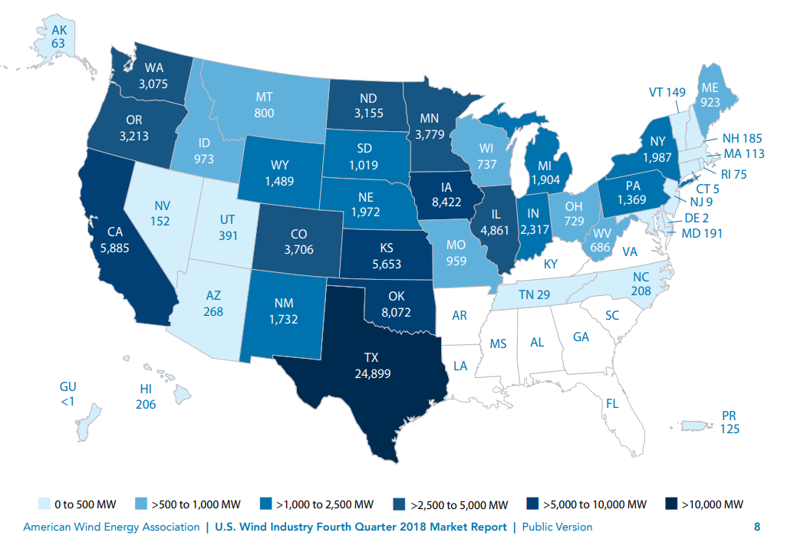
Wind Capacity Installations by State
Texas is number one!
Total capacity at end of 2017 was 89 GW and 96.5 at the end of 2018
Source: AWEA Wind Power Outlook Fourth Quarter, 2018

Slide 24
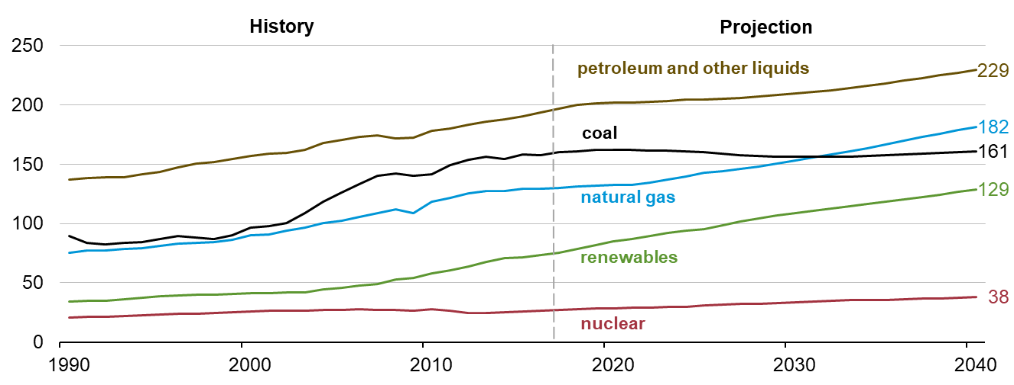
The World: Energy Consumption by Source
Source: EIA, International Energy Outlook 2018

Slide 25
Energy Economics
Electric generating technologies involve a tradeoff between fixed costs (costs to build them) and operating costs
Nuclear and solar high fixed costs, but low operating costs (though cost of solar has decreased substantially recently)
Natural gas/oil have low fixed costs but can have higher operating costs (dependent upon fuel prices)
Coal, wind, hydro are in between
Also the units capacity factor is important to determining ultimate cost of electricity

Slide 26
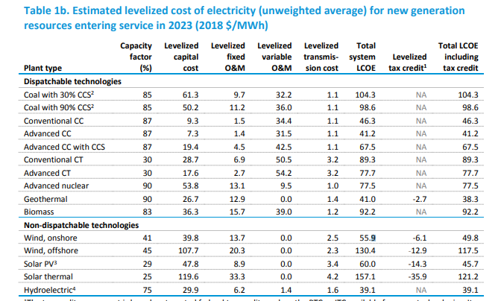
Estimated Energy Costs for New Generation
Source: www.eia.gov/outlooks/aeo/pdf/electricity_generation.pdf (February 2019)

Slide 27
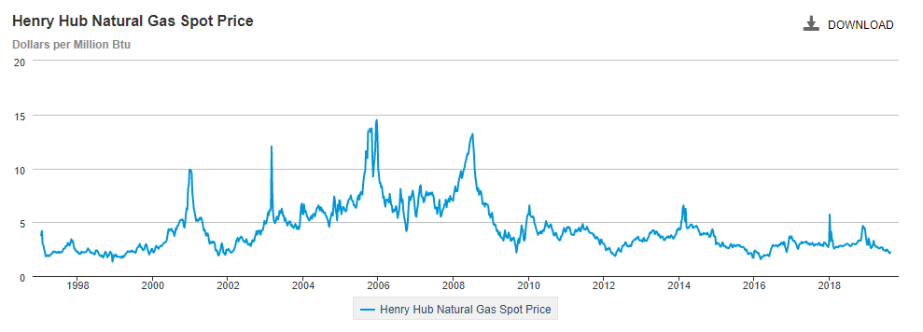
Natural Gas Prices 1997 to 2018
Marginal cost for natural gas fired electricity price
in $/MWh is about 7-10 times gas price; Henry Hub is a gas pipeline located in Erath, Louisiana.
Source: http://www.eia.gov/dnav/ng/hist/rngwhhdW.htm

Slide 28
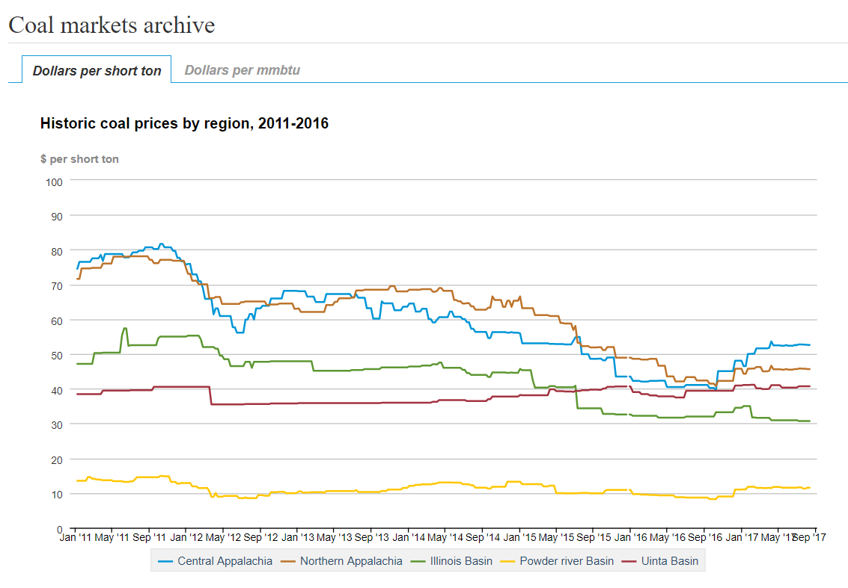
Coal Prices had Fallen But Are Now Back to Values from Five Years Ago
Current prices are about the same as in Sept. 2017
BTU content per pound varies between about 8000 and 15,000 Btu/lb, giving costs of around $1 to 2/Mbtu
Source: eia.gov/coal

Slide 29
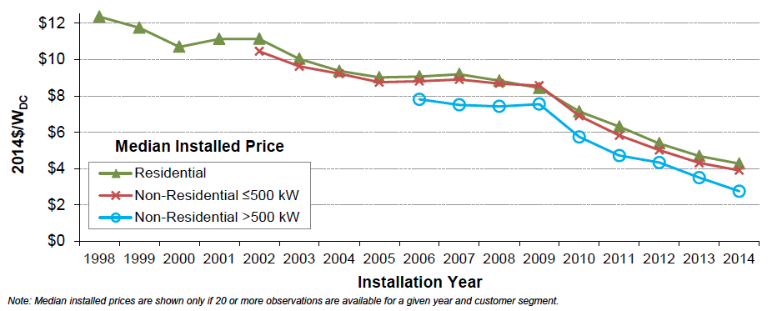
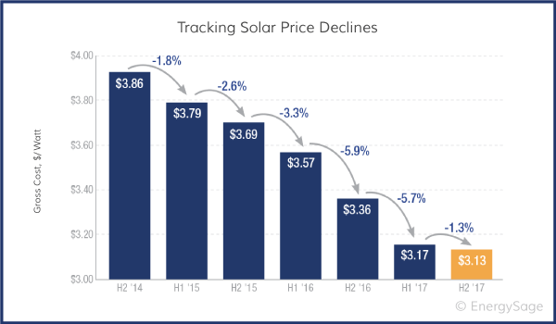
Solar PV Prices
Images: http://cleantechnica.com/2015/08/13/us-solar-pv-cost-fell-50-5-years-government-report/screen-shot-2015-08-12-at-12-33-53-pm/ and https://news.energysage.com/how-much-does-the-average-solar-panel-installation-cost-in-the-u-s/

Slide 30
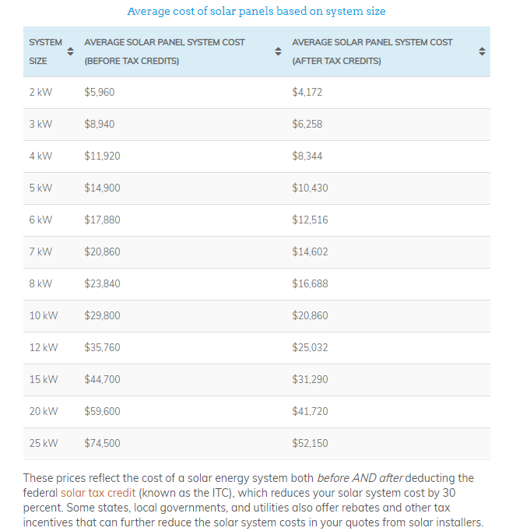
Average Cost of Solar Systems, 2019
For the cost for a 10 kW system is $2.98 per watt before the tax credit and $ 20.86 after
Source news.energysage.com/how-much-does-the-average-solar-panel-installation-cost-in-the-u-s/

Slide 31
Brief History of Electric Power
First real practical uses of electricity began with the telegraph (1860's) and then arc lighting in the 1870’s
Early 1880’s – Edison introduced Pearl Street dc system in Manhattan supplying 59 customers
1884 – Sprague produces practical dc motor
1885 – invention of transformer
Mid 1880’s – Westinghouse/Tesla introduce rival ac system
Late 1880’s – Tesla invents ac induction motor
1893 – Three-phase transmission line at 2.3 kV

