Slide 1
ECEN 615
Methods of Electric Power
Systems Analysis
Lecture 11: Sparse Vector Methods, Contingency Analysis, Sensitivity Methods
Prof. Tom Overbye
Dept. of Electrical and Computer Engineering
Texas A&M University
overbye@tamu.edu

Slide 2
Announcements
Read Chapter 7 from the book (the term reliability is now used instead of security)
Homework 3 should be done before the exam put does not need to be turned in
First exam is Tuesday October 8 in class; closed book, closed notes. One 8.5 by 11 inch note sheet and calculators allowed
  The exam from 2018 has been posted

Slide 3
Sparse Vector Methods
Sparse vector methods are useful for cases in solving Ax=b in which
  A is sparse
  b is sparse
  only certain elements of x are needed
In these right circumstances sparse vector methods can result in extremely fast solutions!
A common example is to find selected elements of the inverse of A, such as diagonal elements.
2

Slide 4
Sparse Vector Methods
Often times multiple solutions with varying b values are required
  A only needs to be factored once, with its factored form used many times
Key reference is
  W.F. Tinney, V. Brandwajn, and S.M. Chan, "Sparse Vector Methods", IEEE Transactions on Power Apparatus and Systems, vol. PAS-104, no. 2, February 1985, pp. 295-300
3

Slide 5
Sparse Vector Methods Introduced
Assume we are solving Ax = b with A factored so we solve LUx = b by first doing the forward substitution to solve Ly = b and then the backward substitution to solve Ux = y
A key insight: In the solution of Ly = b if b is sparse then only certain columns of L are required, and y is often sparse
=
y₁
.
.
.
y_{n}
b₁
.
.
.
b_{n}
x
=
4

Slide 6
Fast Forward Substitution
If b is sparse, then the fast forward (FF) substitution takes advantage of the fact that we only need certain columns of L
We define {FF} as the set of columns of L needed for the solution of Ly = b; this is equal to the nonzero elements of y
In general the solution of Ux = y will NOT result in x being a sparse vector
However, oftentimes only certain elements of x are desired
  E.g., the sensitivity of the flows on certain lines to a change in generation at a single bus; or a diagonal of A⁻¹
5

Slide 7
Fast Backward Substitution
In the case in which only certain elements of x are desired, then we only need to use certain rows in U below the desired elements of x; define these columns as {FB}
This is known as a fast backward substitution (FB), which is used to replace the standard backward substitution
x₁
x₂
.
.
.
x_{n}
y₁
y₂
.
.
.
y_{n}
x
=
6

Slide 8
Factorization Paths
We observe that
  {FF} depends on the sparsity structures of L and b
  {FB} depends on the sparsity structures of U and x
The idea of the factorization path provides a systematic way to construct these sets
A factorization path is an ordered set of nodes associated with the structure of the matrix
For FF the factorization path provides an ordered list of the columns of L
For FB the factorization path provides an ordered list of the rows of U
7

Slide 9
Factorization Path
The factorization path (f.p.) is traversed in the forward direction for FF and in the reverse direction for FB
  Factorization paths should be built using doubly linked lists
A singleton vector is a vector with just one nonzero element. If this value is equal to one then it is a unit vector as well..
8

Slide 10
Factorization Path, cont.
With a sparse matrix structure ordered based upon the permutation vector order the path for a singleton with a now zero at position arow is build using the following code:
p1:= rowDiag[arow];
While p1 <> nil Do Begin
AddToPath(p1.col); // Setup a doubly linked list!
p1 := rowDiag[p1.col].next;
End;
9

Slide 11
Path Table and Path Graph
The factorization path table is a vector that tells the next element in the factorization path for each row in the matrix
The factorization path graph shows a pictorial view of the path table
10

Slide 12
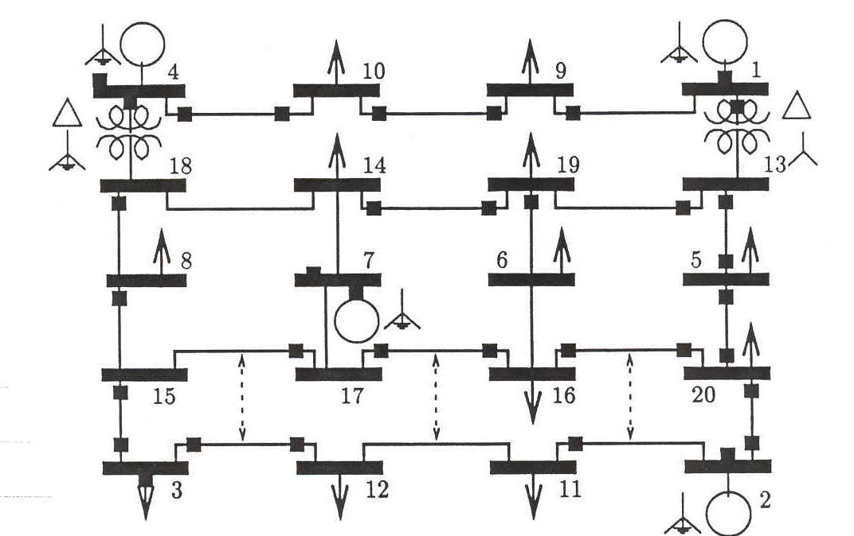
20 Bus Example
11

Slide 13
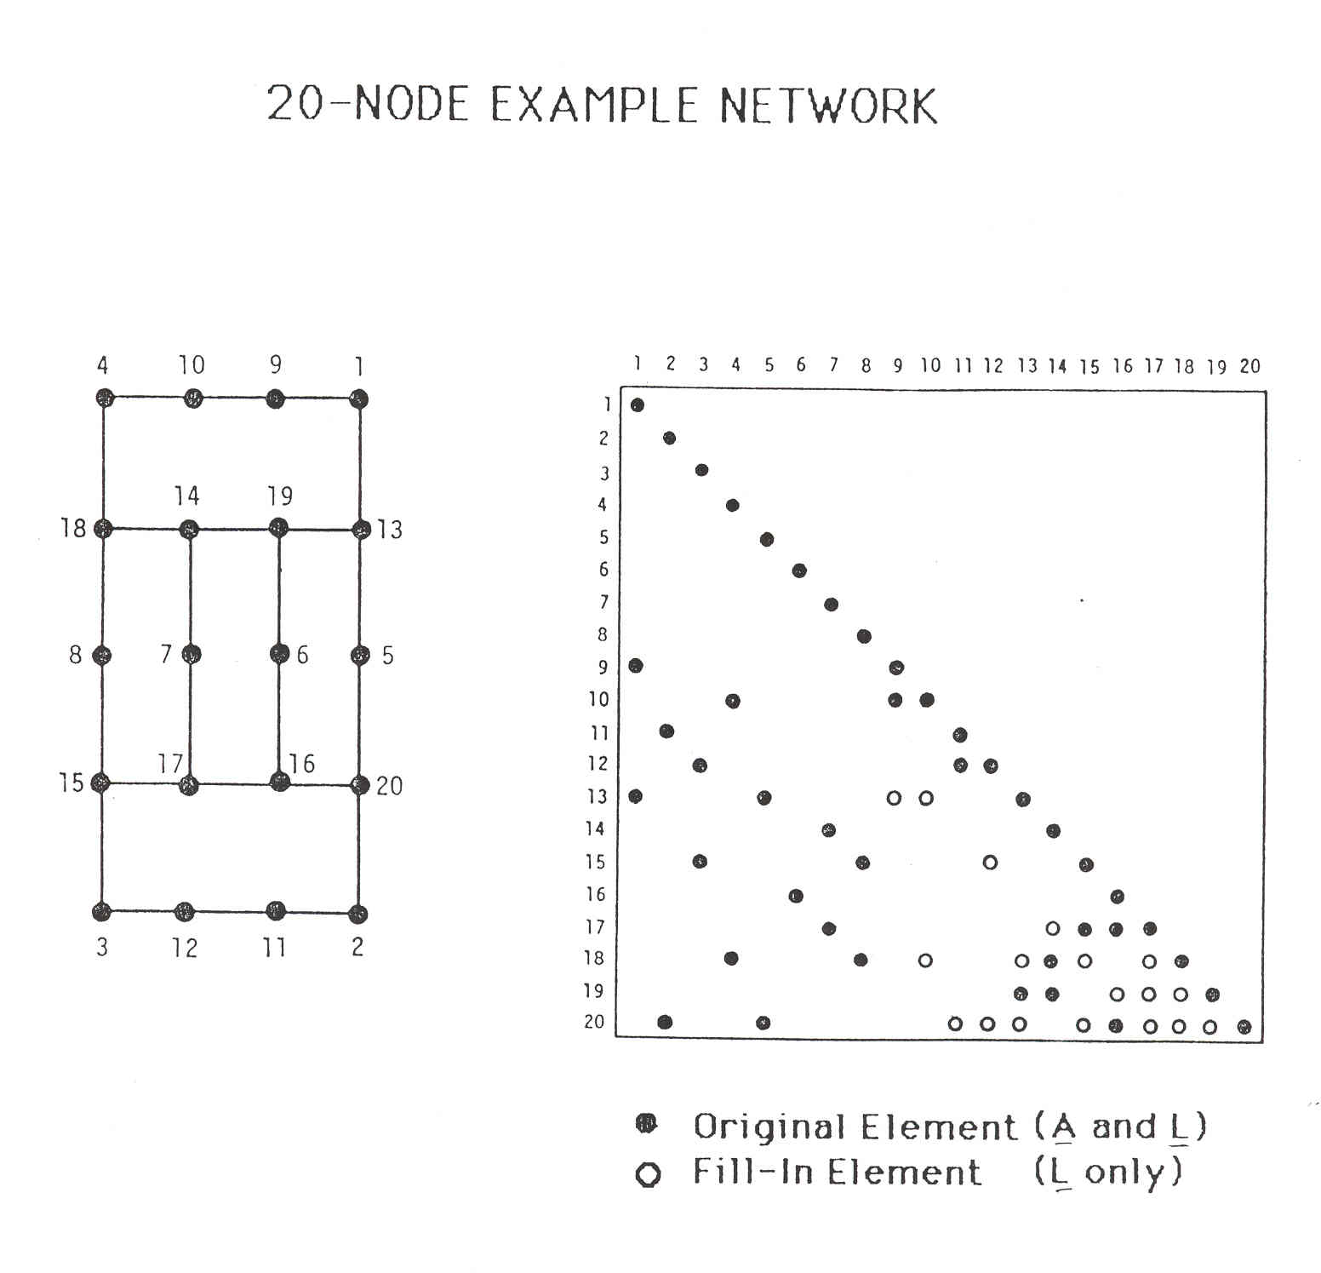
20 Bus Example
Only showing L
12

Slide 14
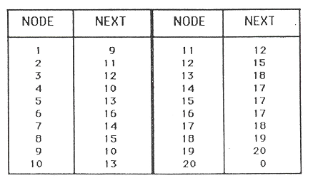
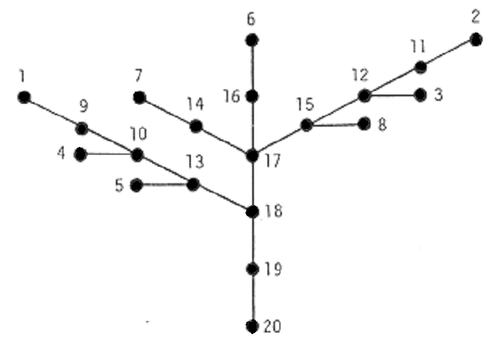
20 Bus Example
node k
p(k)
node k
p(k)
13

Slide 15
20 Bus Example
Suppose we wish to evaluate a sparse vector with the nonzero elements for components 2, 6, 7, and 12
From the path table or path graph, we obtain the following
This gives the following path elements
14

Slide 16
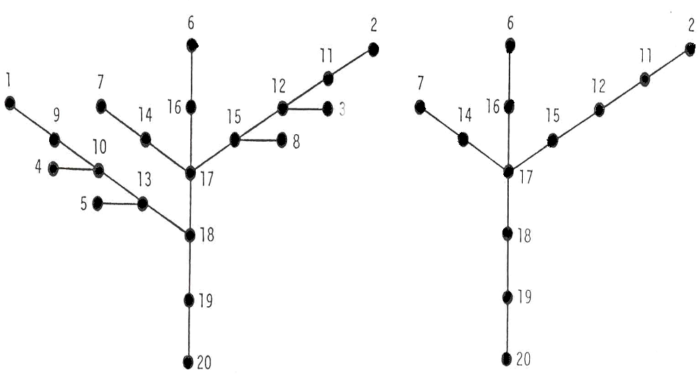
20 Bus Example
Full path
Desired subset
15

Slide 17
Remarks
Since various permutations may be used to order a particular path subgroup, a precedence rule is introduced to make the ordering valid
This involves some sorting operation; for the FF, the order value of a node cannot be computed until the order values of all lower numbered nodes are defined
The order of processing branches above a junction node is arbitrary; for each branch, however, the precedence rule in force applies
We can paraphrase this statement as: perform first everything above the junction point using the precedence ordering in each branch
16

Slide 18
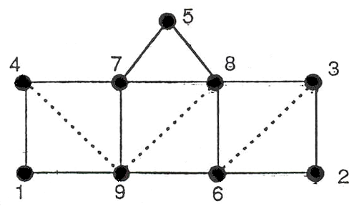
Nine Bus Example
We next consider the example of the 9-bus network shown below
For the given ordering, the sparsity structure leads to the following path graph and the table
17

Slide 19
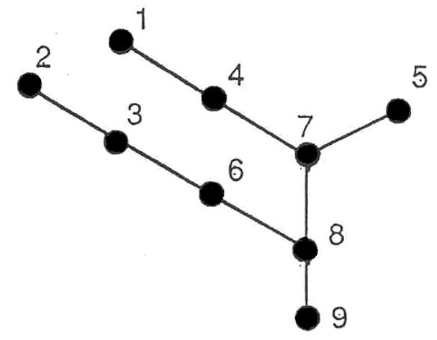
Nine Bus Example
k | p(k)
1 2 3 4 5 6 7 8 9 | 4 3 6 7 7 8 8 9 0
18

Slide 20
Nine Bus Example
Suppose next we are interested in the value determination of only component, node 1
  That is, calculating a diagonal of the inverse of the original matrix
FF involves going down the path from 1-4-7-8-9, and the FB requires coming back up, 9-8-7-4-1
This example makes evident the savings in operations we may realize from the effective use of a sparse vector scheme
19

Slide 21
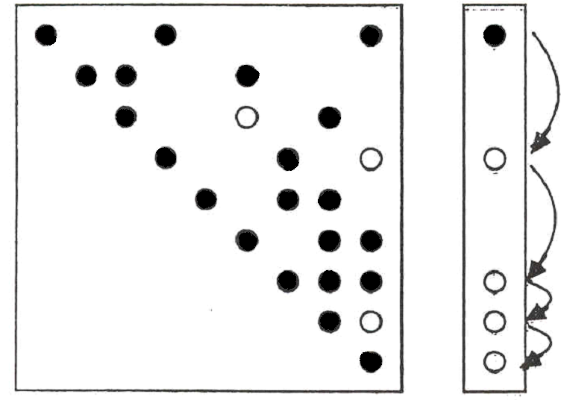
Nine Bus Example
20

Slide 22
Example Application
In ongoing geomagnetic disturbance modeling work we need to determine the sensitivity of the results to the assumed substation grounding resistance
  Since the induced voltages are quasi-dc, the network is modeled by setting up the conductance matrix G = R⁻¹
  Initial work focused on calculating the driving point impedance values, which required knowing diagonal elements of R, which were easily calculated with sparse vector methods
  But R_{ii} depends on the assumed grounding values are nearby substations, so we need to determine this impact as well; so we’d like small blocks of the inverse of R, which will require using the unions of the factorization paths to get some R_{ij}
21

Slide 23
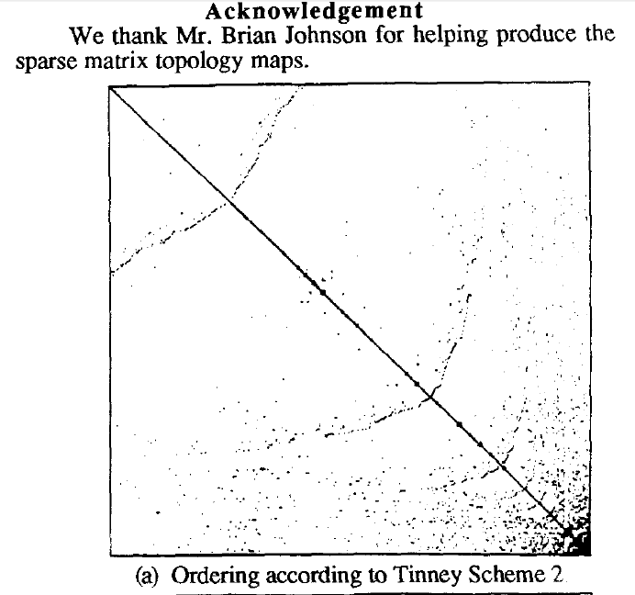
Ordering for Shorter Paths
The paper 1990 IEEE Transactions on Power Systems paper “Partitioned Sparse A⁻¹ Methods” (by Alvarado, Yu and Betancourt) they introduce ordering methods for decreasing the length of the factorization paths
Factorization paths also
indicate the degree to which
parallel processing could be
used in solving Ax = b by
LU factorization
  Operations in the various paths
  could be performed in parallel
Image from Alvarado 1990 paper
22

Slide 24
Computation with Complex and Blocked Matrices
In the previous analysis we have implicitly assumed that the values involved were real numbers (stored as singles or doubles in memory)
Nothing in the previous analysis prevents using other data structures for analysis
  Complex numbers would be needed if factoring the bus admittance matrix (Y_{bus}); this is directly supported in some programming languages and can be easily added to others; all values are complex numbers
  Two by two block matrices are common for power flow Jacobian factorization; for this we use 2 by 2 blocks in the matrices and 2 by 1 blocks in the vectors
23

Slide 25
2 by 2 Block Matrix Computation
By treating our data structures as two by two blocks, we reduce the computation required to add fills substantially
  Half the number of rows, and four times fewer elements
Overall computation is reduced somewhat since we have four times fewer elements, but we do have more computation per element
24

Slide 26
2 by 2 Block Matrix Example
In the backward substitution we had
For i := n downto 1 Do Begin
k = rowPerm[i];
p1 := rowDiag[k].next;
While p1 <> nil Do Begin
bvector[k] = bvector[k] – p1.value*bvector[p1.col];
p1 := p1.next;
End;
bvector[k] := bvector[k]/rowDiag[k].value;
End;
25

Slide 27
2 by 2 Block Matrix Example
We replace the scalar bvector entries by objects with fields .r and .i (for the real and imaginary parts) and we replace the p1.value field with four fields .ul, .ur, .ll and .lr corresponding to the upper left, upper right, lower left and lower right values.
The first multiply goes from
bvector[k] = bvector[k] – p1.value*bvector[p1.col]
to
26

Slide 28
2 by 2 Block Matrix Example
The second numeric calculation changes from
bvector[k] := bvector[k]/rowDiag[k].value
To
Which can be coded by directly doing the inverse as
27

Slide 29
Sparse Matrix and Vector Method Summary
Previous slides have presented sparse matrix and sparse vector methods commonly used in power system and some circuit analysis applications
These methods are widely used, and have the ability to substantially speed up power system computations
They will be applied as necessary throughout the remainder of the course
We’ll now move on to sensitivity analysis with a quick introduction of contingency analysis
28

Slide 30
Contingency Analysis
Contingency analysis is the process of checking the impact of statistically likely contingencies
  Example contingencies include the loss of a generator, the loss of a transmission line or the loss of all transmission lines in a common corridor
  Statistically likely contingencies can be quite involved, and might include automatic or operator actions, such as switching load
Reliable power system operation requires that the system be able to operate with no unacceptable violations even when these contingencies occur
  N-1 reliable operation considers the loss of any single element
29

Slide 31
Contingency Analysis
Of course this process can be automated with the usual approach of first defining a contingency set, and then sequentially applying the contingencies and checking for violations
  This process can naturally be done in parallel
  Contingency sets can get quite large, especially if one considers N-2 (outages of two elements) or N-1-1 (initial outage, followed by adjustment, then second outage
The assumption is usually most contingencies will not cause problems, so screening methods can be used to quickly eliminate many contingencies
  We’ll cover these later
30

Slide 32
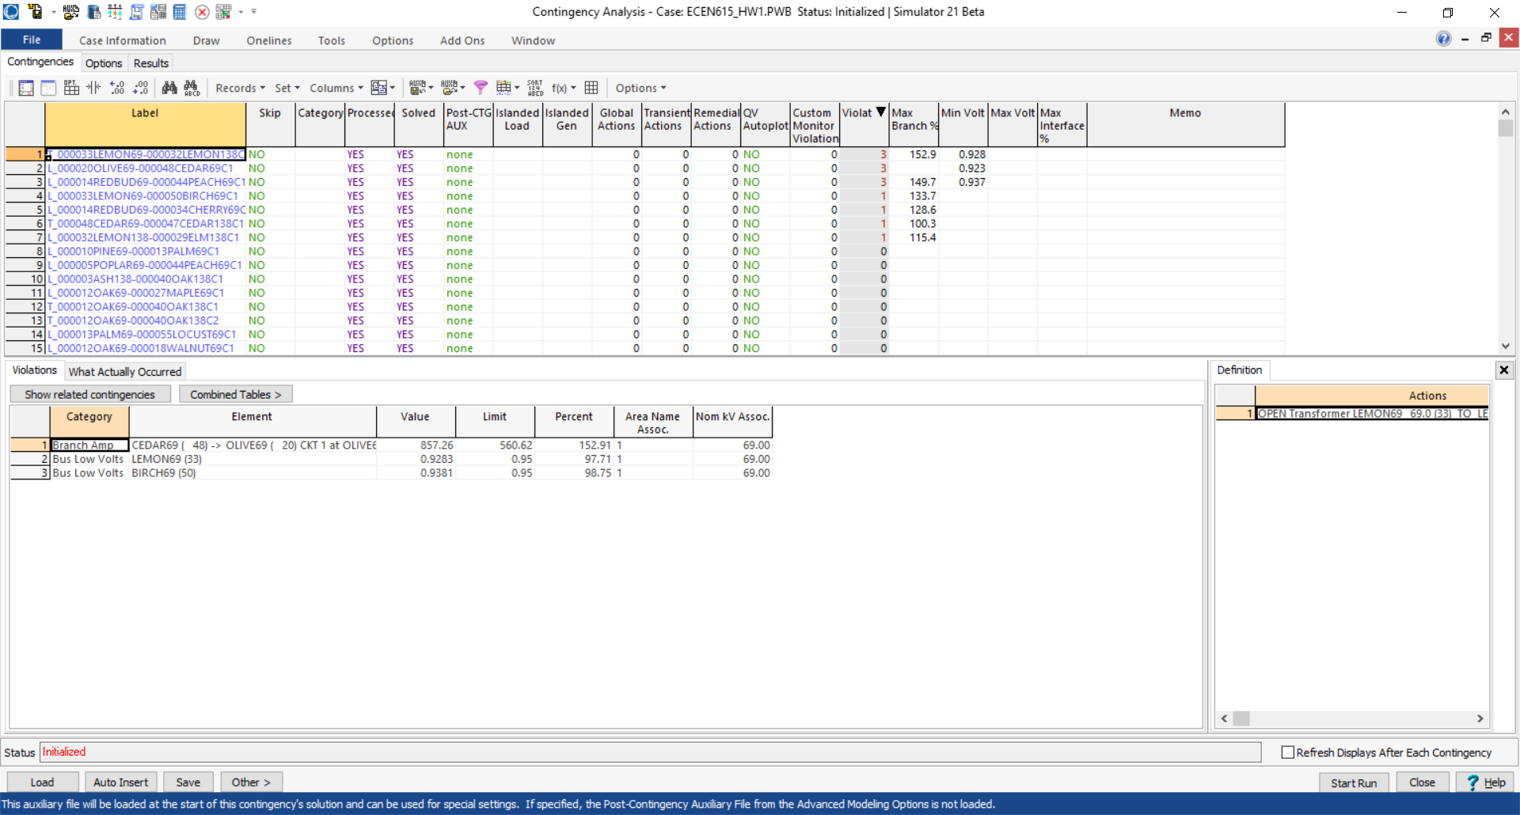
Contingency Analysis in PowerWorld
Automated using the Contingency Analysis tool
31

Slide 33
Power System Control and Sensitivities
A major issue with power system operation is the limited capacity of the transmission system
  lines/transformers have limits (usually thermal)
  no direct way of controlling flow down a transmission line (e.g., there are no valves to close to limit flow)
  open transmission system access associated with industry restructuring is stressing the system in new ways
We need to indirectly control transmission line flow by changing the generator outputs
Similar control issues with voltage
32

Slide 34
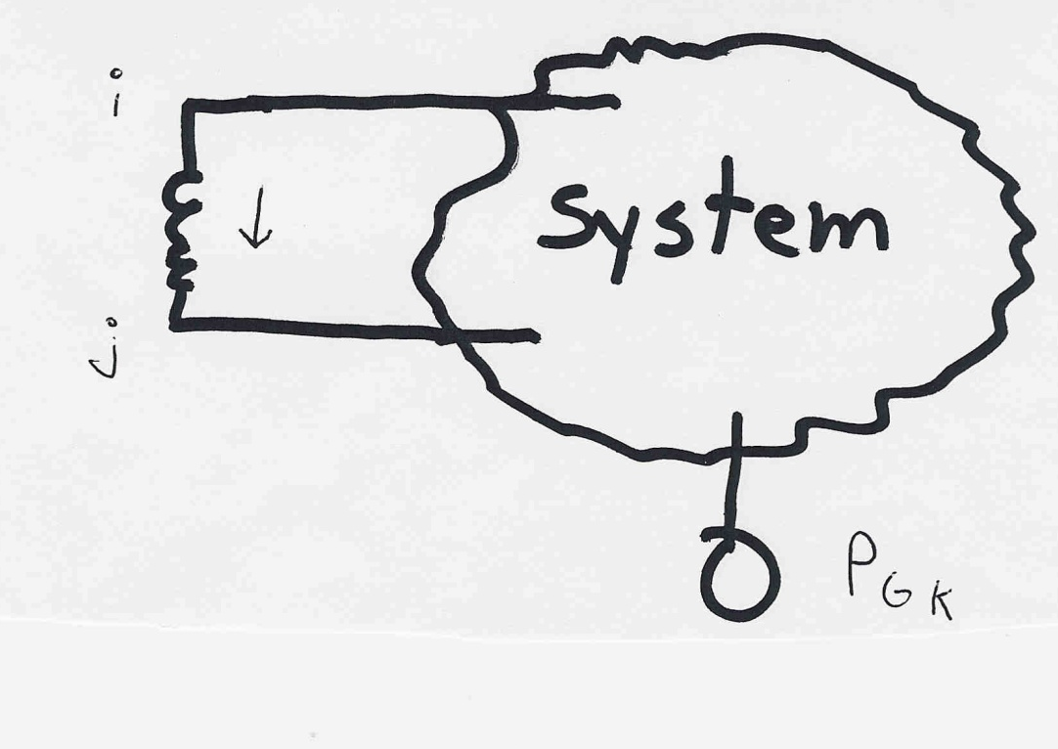
Indirect Transmission Line Control
What we would like to determine is how a change in generation at bus k affects the power flow on a line from bus i to bus j.
The assumption is
that the change
in generation is
absorbed by the
slack bus
33

Slide 35
Power Flow Simulation - Before
One way to determine the impact of a generator change is to compare a before/after power flow.
For example below is a three bus case with an overload
34

Slide 36
Power Flow Simulation - After
Increasing the generation at bus 3 by 95 MW (and hence decreasing it at bus 1 by a corresponding amount), results in a 30.3 MW drop in the MW flow on the line from bus 1 to 2, and a 64.7 MW drop
on the flow from 1 to 3.
Expressed as a
percent,
30.3/95 =32% and
64.7/95=68%
35

Slide 37
Analytic Calculation of Sensitivities
Calculating control sensitivities by repeat power flow solutions is tedious and would require many power flow solutions. An alternative approach is to analytically calculate these values
36

Slide 38
Analytic Sensitivities
37

Slide 39
Three Bus Sensitivity Example
38

Slide 40
More General Sensitivity Analysis: Notation
We consider a system with n buses and L lines given by the set given by the set
  Some authors designate the slack as bus zero; an alternative approach, that is easier to implement in cases with multiple islands and hence slacks, is to allow any bus to be the slack, and just set its associated equations to trivial equations just stating that the slack bus voltage is constant
We may denote the k^{th} transmission line or transformer in the system, _{k} , as
from node
to node
39

Slide 41
Notation, cont.
We’ll denote the real power flowing on _{k} from bus i to bus j as ƒ_{k}
The vector of real power flows on the L lines is:
which we simplify to
The bus real and reactive power injection vectors are
40

Slide 42
Notation, cont.
The series admittance of line  is g +jb and we define
We define the L×N incidence matrix
The component j of a_{i} is
nonzero whenever line _{i} is
coincident with node j. Hence
A is quite sparse, with two
nonzeros per row
41

