Slide 1
ECEN 615
Methods of Electric Power
Systems Analysis
Lecture 14: PSERC Webinar on Synthetic Grids
Prof. Tom Overbye
Dept. of Electrical and Computer Engineering
Texas A&M University
overbye@tamu.edu

Slide 2

PSERC Webinar: Enhancing Power System Innovation Through the Use of Highly Detailed Synthetic Grids
Tom Overbye
TEES Eminent Professor
Texas A&M University
overbye@tamu.edu
October 15, 2019

Slide 3
Acknowledgements
The work presented here has been a collaborative effort involving many! A large number of these folks are PSERC researchers or with PSERC industrial members
  ARPA-E: Tim Heidel, David Guarrera, Pat McGrath, Kory Hedman, Ashley Arigoni, Ray Duthu
  NSF: Anil Pahwa, Kishan Baheti
  TAMU: Adam Birchfield, Ti Xu, Hanyue Li, Jess Wert, Diana Wallison, Komal Shetye, Kate Davis, Ashly Bornsheuer, Juhee Yeo, Yijing Liu, Won Jang, Zeyu Mao, Maryam Kazerooni
  UIUC: Pete Sauer, Kathleen Gegner

Slide 4
Acknowledgements, cont.
  Cornell: Ray Zimmerman, Bob Thomas
  ASU: Anna Scaglione, Eran Schweitzer
  UT-Austin: Hao Zhu; PowerWorld: Jamie Weber
  Virginia Commonwealth: Zhifang Wang, Hadi Athari
  UW-Madison: Bernie Lesieutre, Scott Greene, Chris DeMarco, Line Roald, Jonathan Snodgrass
  NREL: Tarek Elgindy, Bryan Palmintier, Venkat Krishnan
  MIT: Pablo Dueñas; Comillas-IIT: Carlos Mateo, Tomás Gómez Fernando Postigo, Fernando de Cuarda
  LANL: Carleton Coffrin
  PNNL: Renke Huang, Ahmad Krishnan,
  Steve Elbert, Jesse Holzer

Slide 5
A Common Request From Industry
We’re gathering all this data. Can you help us figure out what to do with it?
However, often, after a lot of talks with lawyers to develop nondisclosure agreements (NDAs), at most a subset of the desired data and/or models is available
  The data and models usually cannot be shared, and often is a lot of associated metadata is removed
  There is a high cost to industry to provide this data
  It isn’t just the amount of data (e.g., who has the most terabytes!) but rather the breadth of the data and whether the data is coupled to models

Slide 6
Changing the Question
Assume you have all the information possible about the electric grid (data, models, coupled infrastructures) and can share it.
And it can be provided with low access cost.
What would you do with it?
  This allows for large amounts of data fusion!
The focus of this talk is mostly on how to develop this seemingly impossible information set
  And, of course, one can never know everything!

Slide 7
Talk Overview
The talk covers the development and application of high quality, geographically-based synthetic electric grids
  What are they?
  How can they provide all possible information?
  How can they help to drive innovation?
  How are they created?
  What is the current state-of-the-art?
  How are they being applied?
  What’s next?

Slide 8
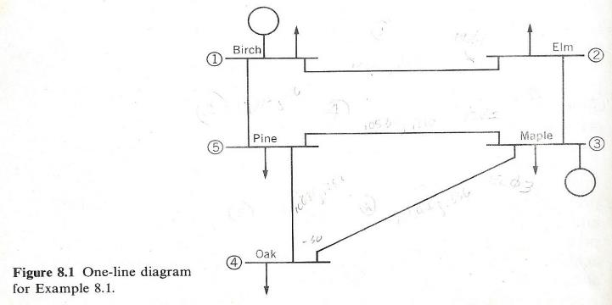
Synthetic Electric Grids
Synthetic electric grids are models of electric grids that were not created to represent any actual electric grid
The below image shows the five bus synthetic grid I used as an undergraduate
Image Source: W.D. Stevenson, Elements of Power Systems, Fourth Edition, McGraw-Hill Book Company
New York, 1982 (the first edition was in 1955)

Slide 9
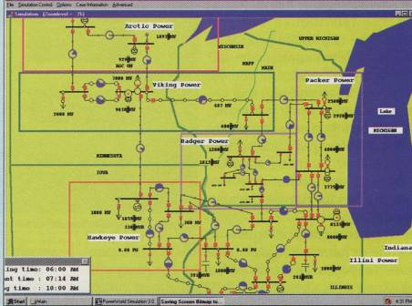
Geographically-Based Synthetic Electric Grids
Synthetic electric grids can be created with or without reference to actual geography
The image
shows an early
geographically-
based synthetic
electric grid
This grid was
designed to
show concepts
to regulators
Image Source: PowerWorld Corporation, 1995

Slide 10
High-Quality, Geographically-Based Synthetic Electric Grids
High-quality synthetic electric grids are designed to have a wide range of characteristics that are similar to those found in actual electric grids
  “Realistic but not real” to quote Wisconsin colleagues
  Fictional, but hopefully good fiction
  Developed techniques can be applied to real grids
However, importantly these grids are not designed to try to duplicate any actual grid
Over the last three years tremendous progress has been made through ARPA-E at both the transmission and distribution levels

Slide 11
A Guiding Thought
All models are wrong but some are useful," George Box, Empirical Model-Building and Response Surfaces, (1987, p. 424)
  Models are an approximation to reality, not reality, so they always have some degree of approximation
  Data might be “right”, but usually engineers want to use it to predict or control the future, requiring models
Synthetic grids can’t really be “wrong” but they can be unrealistic, so I welcome your feedback on where we have been unrealistic.

Slide 12
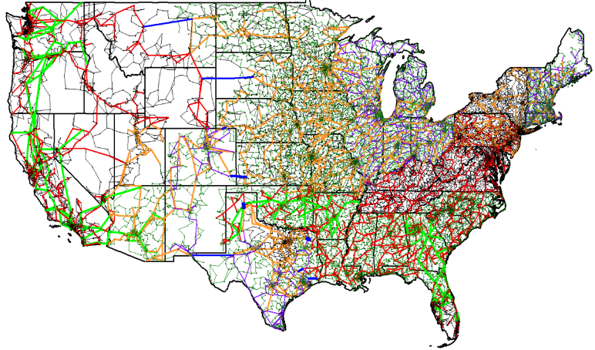
Current Status: Large-Scale Grids are Now Available
This is an 82,000 bus synthetic model that we publicly released
in summer 2018 at electricgrids.engr.tamu.edu
Grid has an
AC power flow
solution with
n-1 reliability

Slide 13
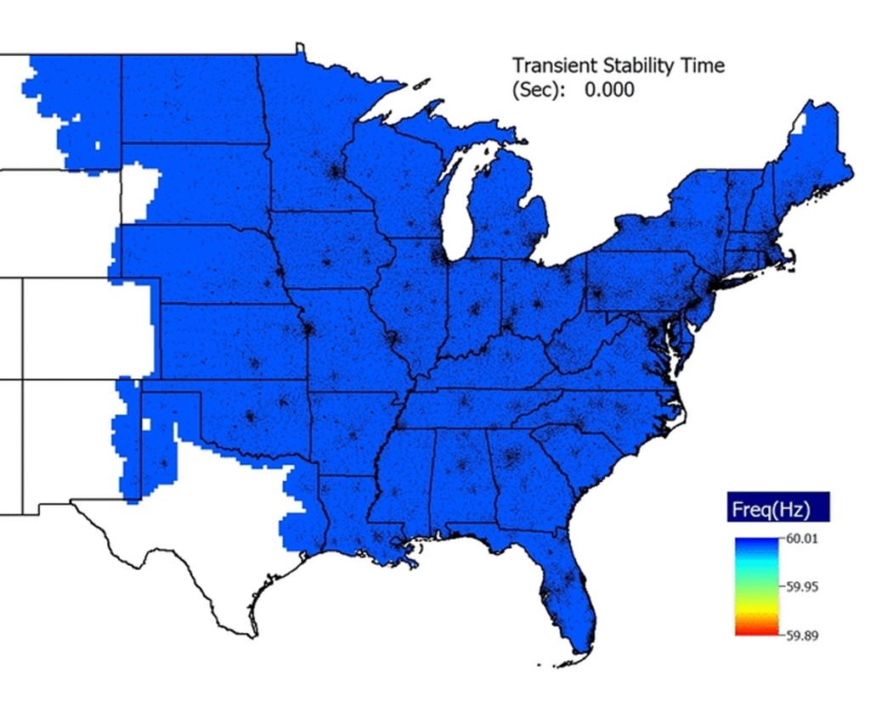
The Grids Have Dynamics Models
The models and
all the data
associated with
this image are
public
Ongoing research is focused on developing more detailed
dynamic models, including the protection systems

Slide 14
Highly Detailed Combined Transmission and Distribution Grids
Previous transmission grids were geographic to the zip code level
On current ARPA-E project we (with NREL, MIT and Comillas-IIT University) are developing “down to the meter” synthetic grids
Actual parcel data is used to determine location of the electric meters. The parcels are connected by a distribution system, and the distribution system by a transmission grid
Currently we have about 20% of the load in Texas done (Travis and Harris Counties)

Slide 15
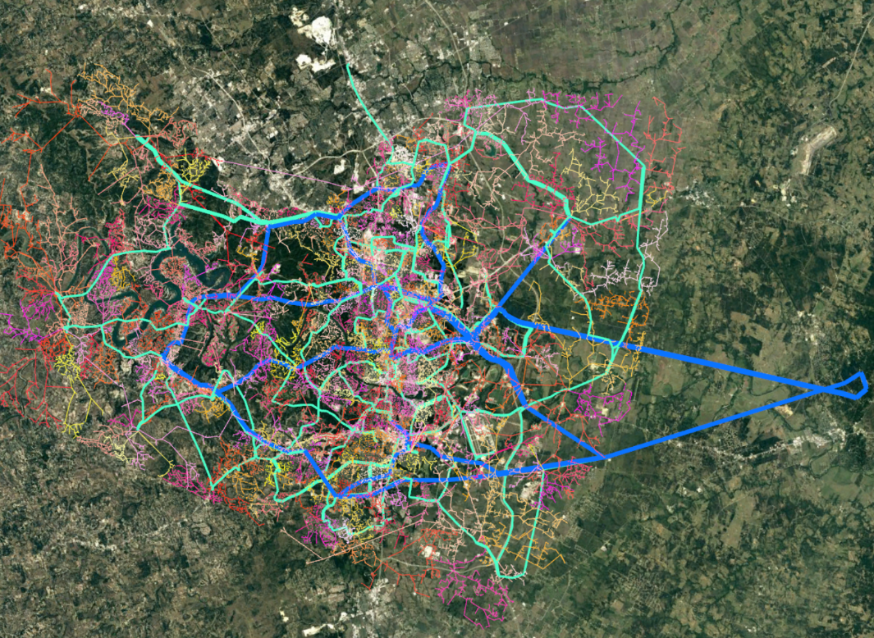
Travis County, Texas
(location of Austin, TX)
The figure shows the transmission system (blue is 230 kV and cyan 69 kV) and the distribution system modeled down to 307,000 meters. The distribution data is in the OpenDSS format.

Slide 16
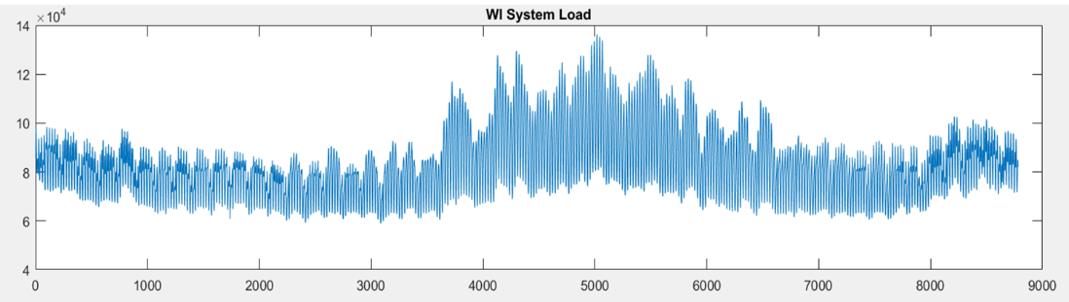
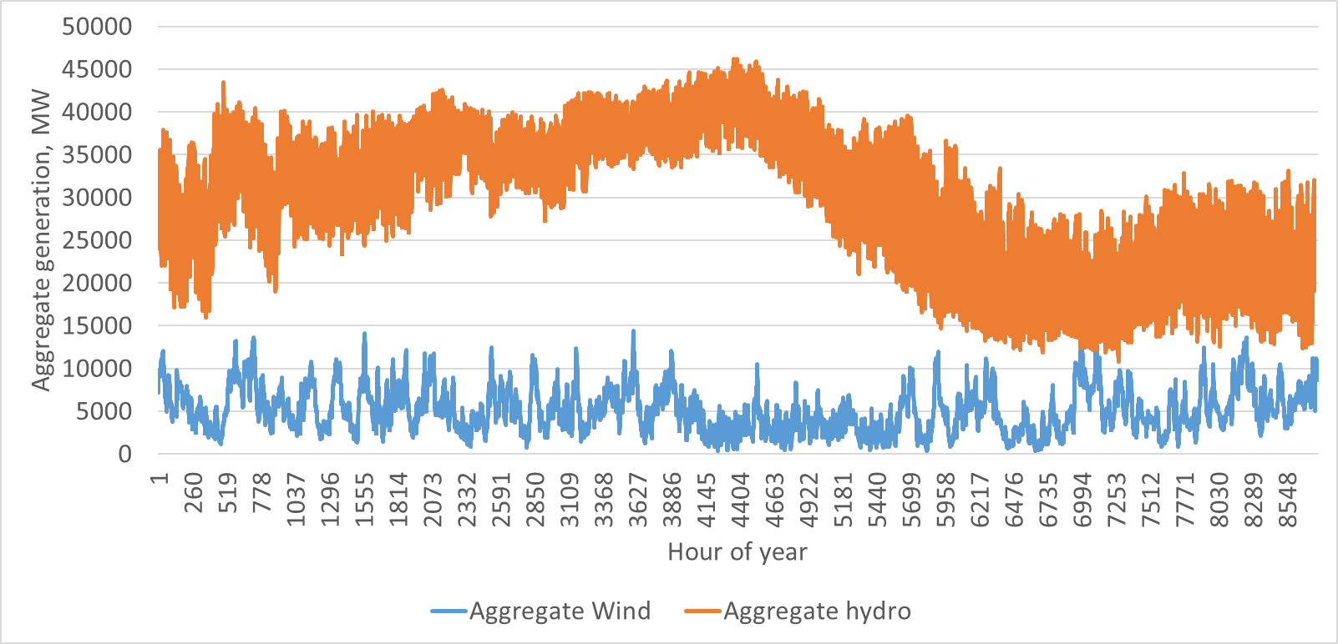
Synthetic Electric Grid Scenarios
We have developed detailed, yearly scenarios with variation of both bus level load and gen.
Transmission models
have hourly snapshots,
with nonconforming
bus loads modeled. The
“down to the meter”
grids have synthetic
loads every 15 minutes
for each meter
(provided by NREL).

Slide 17
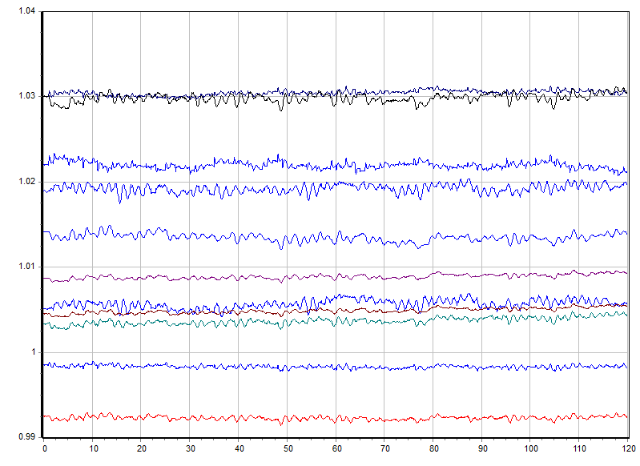
Synthetic PMU Data
To create synthetic PMU data we use dynamic simulations with realistic variation in the load and generation, and appropriate PMU errors.
On our 2000 bus Texas synthetic grid was can provide more then 10,000 signals at PMU data rates (30 times per second) in real-time. This is data creation at about 4GB per hour.

Slide 18
The Need for Synthetic Grids
Prior to 9/11/01, a lot of grid information was publically available
Now access to data and models about the actual power grid in the US is quite restricted (e.g., critical energy/electricity infrastructure [CEII])
  What is available is often partial, and can’t be shared
To do effective research, and to drive innovation, researchers need access to common, realistic grid models and data sets
  Scientific principle of reproducibility of results

Slide 19
The Need for Synthetic Grids, cont.
Synthetic grids and datasets are, of course, designed to augment, not replace actual grids
But the synthetic grids offer some significant advantages, both to industry and researchers
  Since there are no CEII or privacy concerns, full models and their associated datasets can be freely shared; this is particularly helpful for interdisciplinary research
  Synthetic grids can allow future grid scenarios to be considered in-depth (i.e., high renewables or high impact, low frequency events) yet still be potentially public

Slide 20
The Need for Synthetic Grids, cont.
Advantages, cont.
  Synthetic grids can be customized to represent particular grid idiosyncrasies; utilities can provide this to researchers or potential vendors
    We’ve deliberately designed ours using different voltage levels than those used in the actual grid (e.g., 500/230 versus 345/138 in Texas) to emphasis they are synthetic
  The highly detailed (down to the meter grid) allow coupling with real infrastructures
    We’re working with the Texas Transportation Institute to study electric grid/transportation couplings
  Synthetic grids can be used for education, including vendor training and short courses

Slide 21
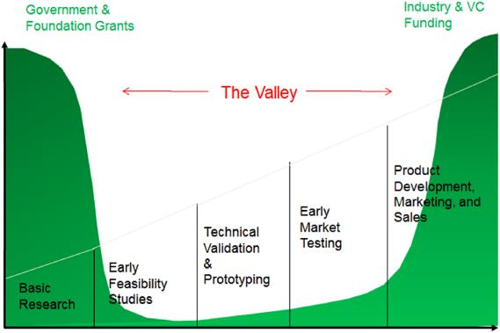
Crossing the Valley of Death
One of the greatest
perils to university research
commercialization is to
cross what is known in
as “the valley of death.”
On the one side is “well-funded” university research, pursued mostly by graduate students and postdocs, while on the other is a successful commercial product
  Synthetic grids and datasets can help bridge
  this gap!
Image Source: https://www.nap.edu/catalog/23645/a-vision-for-the-future-of-center-based-multidisciplinary-engineering-research

Slide 22
Our Synthetic Grid Approach
Make grids that look real and familiar by siting them geographically (North America for us) and serving a population density the mimics actual
Goal is to leverage widely available public data
  Geography
  Population density (easily available by post office)
  Load by utility (US FERC 714), state-wide averages
  Existing and planned generation (Form US EIA-860, which contains lots of generator information)
Substation locations and transmission system is entirely fictional (but hopefully good fiction!)

Slide 23
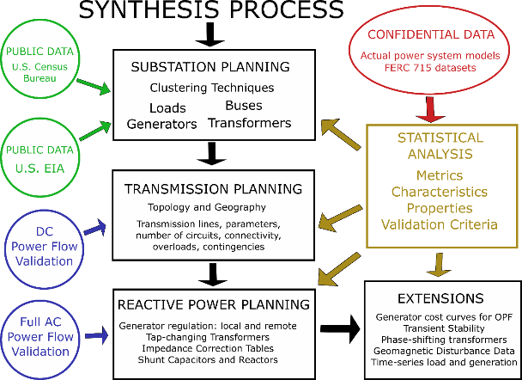
Synthetic Model Design Process
The assumed peak load is based on
population, scaled
by geographic values
Much of this is automated, but there is still some manual adjustment
This process can be augmented to couple with detailed distribution grids

Slide 24
More Details on Design Process
Substation planning: cluster actual population and energy data into correctly-sized substations and assign load, generation, bus voltage levels, and internal branches, along with parameters.
Transmission planning: use iterative penalty-based dc power flow algorithm to place transmission lines, with the Delaunay triangulation and neighborhood as base
Reactive power planning: iterative ac power flow starting from known solution to place capacitors and adjust generator set points.

Slide 25
Coupled Transmission-Distribution System Design
Our first approach to developing the highly detailed grids was to design the distribution first, then design the transmission
  Earlier Travis County case was an example
Now we design the overall transmission system first, and update it as more distribution systems become available
  We’re currently doing Texas on a county-by-county basis (Texas has 254 counties!)
  Updating the transmission grid is a mostly automated process

Slide 26
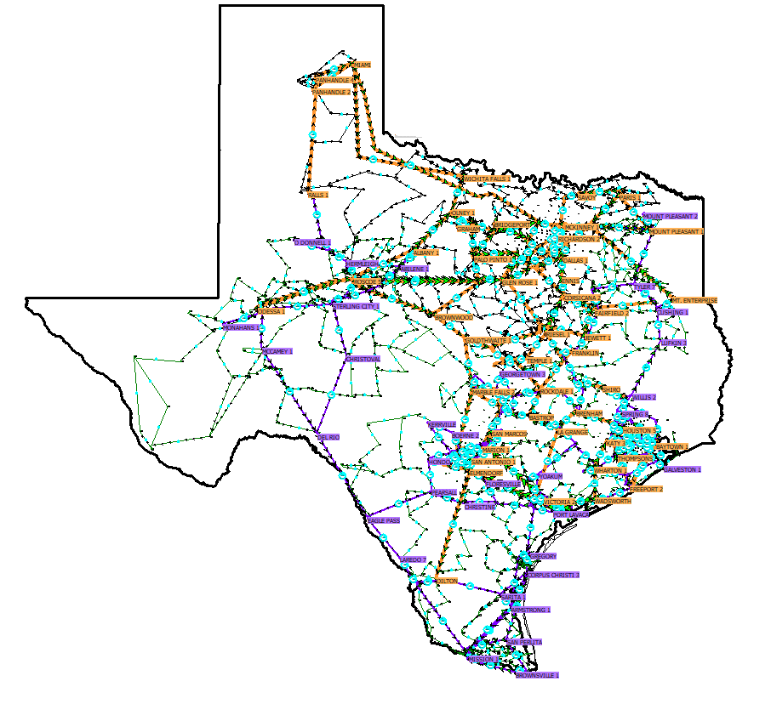
The Expanding Texas 2000 Bus Transmission Model
NREL is providing load data for each of the meters at 15 minute resolution for a year. This is driven by historical weather data. Eventually we will have about 10 million meters.
Area that has Austin distribution network details

Slide 27
Validation: Insuring High Quality
Based upon data from actual grids we’ve developed a large number of metrics that cover many aspects of both transmission and distribution grids
For example:
  Buses/substation, Voltage levels, Load at each bus
  Generator commitment, dispatch
  Transformer reactance, MVA limit, X/R ratio
  Percent of lines on minimum spanning tree and various neighbors of the Delaunay triangulation
  Bus phase angle differences, flow distribution

Slide 28
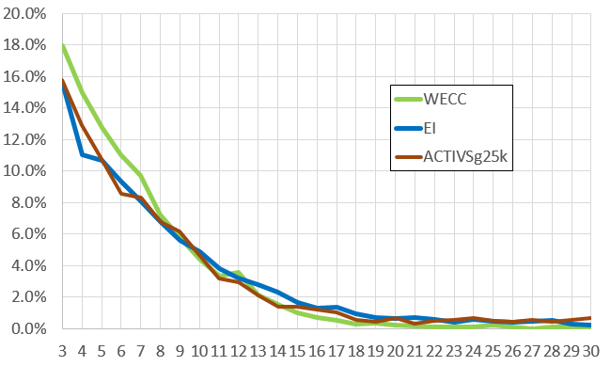
Validation Example: Cycle Sizes
Cycles are use loops of connected buses. Power systems have many cycles and an important metric to match is to have a similar cycle basis

Slide 29
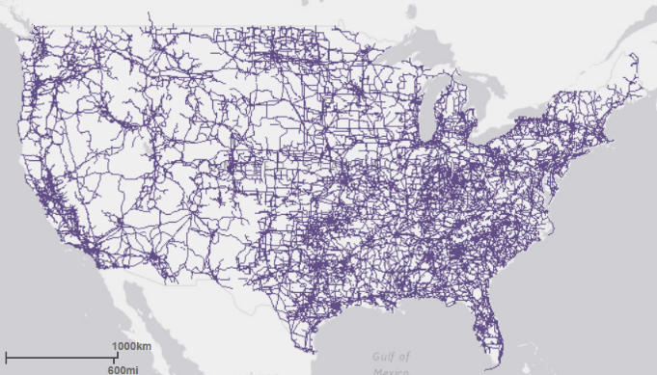
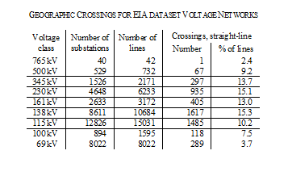
Intersections (Transmission Line Crossings)
We’ve found it is important to match properties of electric grids that depend on their physical layout; for example transmission line crossings
  Transmission line right-of-ways are available in EIA datasets; hence line crossings can be analyzed

Slide 30
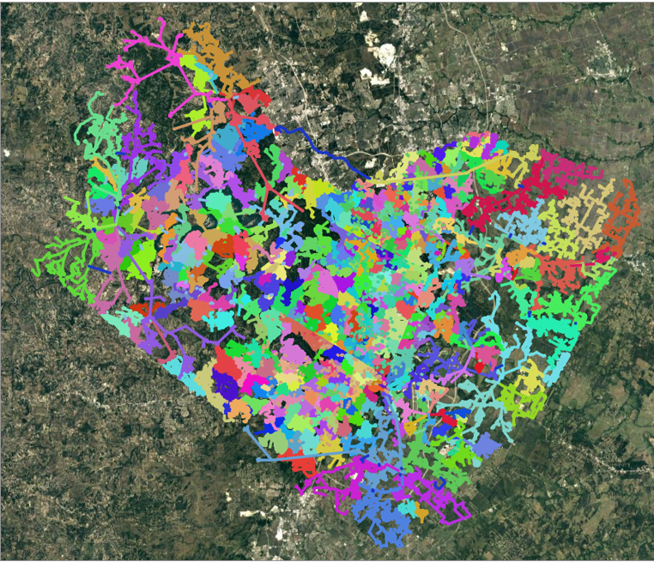
Detailed Transmission and Distribution Testing
Full transmission and distribution system studies are being done using a co-simulation framework
  PowerWorld Simulator
  is used to solve the
  transmission system
  and OpenDSS is used
  to solve each of the
  distribution circuits
  The simulations are
  coupled together
  using the national
  lab developed HELICS
  package; one year of simulations took about 3 hours
For Travis County (population 1.2 million) 307,236 meters are served by 488 distribution circuits

Slide 31
Different Levels of Modeling
Just because we have detailed grids, doesn’t mean we always simulate the coupled transmission and distribution models. Other options are
  Transmission only
  Distribution only
  Full transmission with distribution topology; this can be quite useful for doing multi-infrastructure simulation in which we just need to know what parts of the distribution system are out-of-service

Slide 32
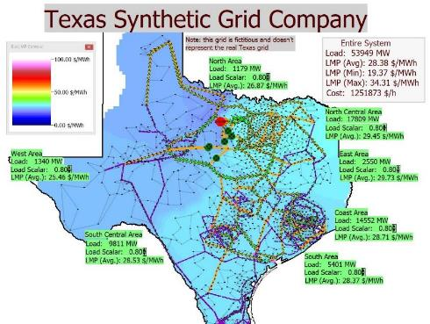
Synthetic Grid Applications: Innovative Electric Power Education
Lab assignments involving a 2000 bus case have been integrated into Texas A&M’s power classes
Class includes large-system exercises for power flow, economic dispatch, contingency analysis, SCOPF, and transient stability

Slide 33
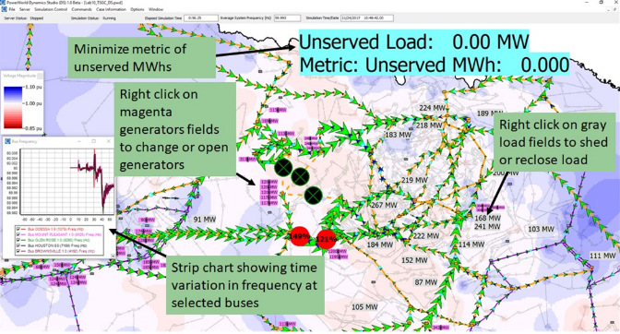
Innovative Electric Power Education
One lab challenges students to save the synthetic Texas grid from voltage collapse following a simulated tornado in real-time!
The lab was
introduced in
Fall 2017; in
Fall 2018 it was expanded to be a multi-user simulation. However it did not involve integrated analysis.

Slide 34
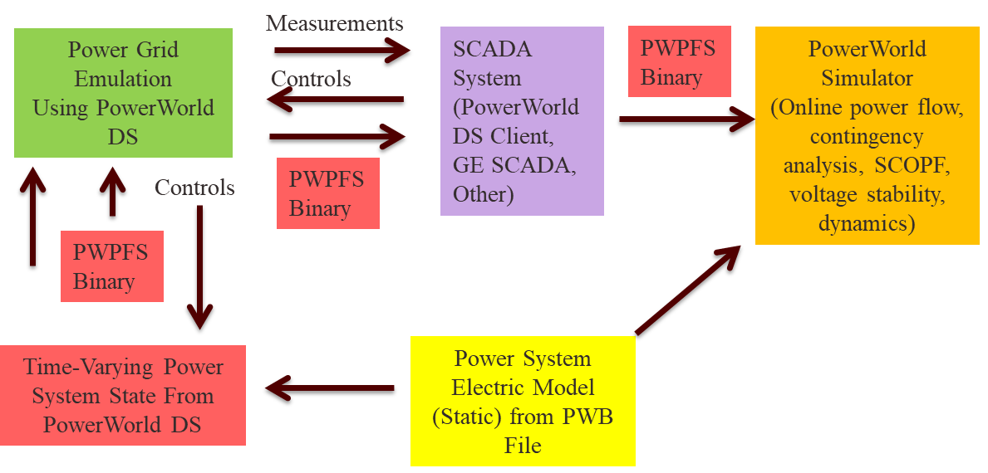
Fall 2019: EMS In-A-Box
Starting this semester during the event students will an use an integrated power flow and the OPF to determine the optimal system controls to use.

Slide 35
Giving Students (and Others) Experience In Grid Operations
Most electric power students have little or no experience in actually operating an electric grid (real or simulated)
One of our goals is to provide such an experience both in an individually and as part of a team
Developing this involves a combination of the electric grid, the scenario, and the associated simulation environment, and the path to give the users experience with the environment
This also generates data

Slide 36

The Simulation Environment

Slide 37
Applications: Visualization Research
With the now wide spread availability of large-scale, geographically based public synthetic grids, there has been increased need for better wide-area visualizations
Visualizations involve many trade-offs, with the best approach ultimately application dependent
Recent research using the synthetic grids is focused on how to maximize display space, while retaining some geographic context

Slide 38
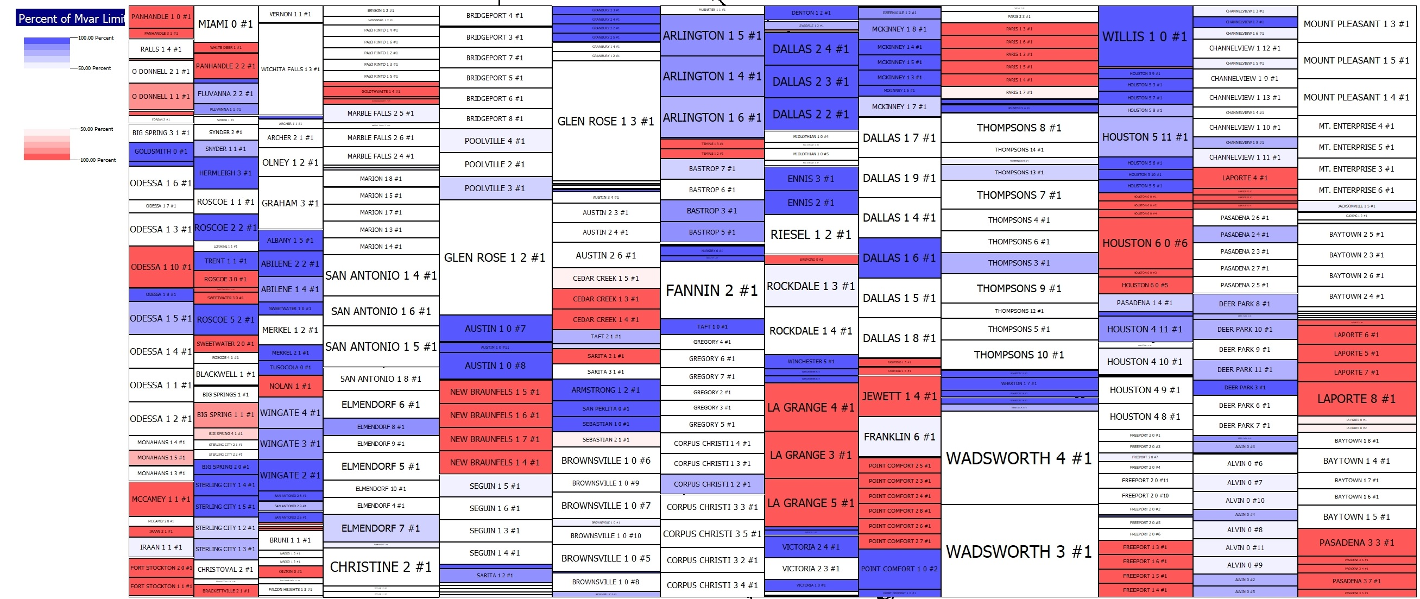
Pseudo-Geographic Mosaic Displays Can Maximize Screen Usage
Image visualizes percentage generator reactive power output. Image source: Overbye, Wert, Birchfield, Weber, “Wide-Area Electric Grid Visualization Using
Pseudo-Geographic Mosaic Displays,” Proc. 2019 North American Power Symposium (NAPS), Wichita, KS, Oct 2019

Slide 39
Visualizing 12,700 Line Flows:
Large-scale synthetic grids can help guide new visualization solutions. This image attempts to show 12,700 line flows, with object size based on the line’s MVA flow and its coloring based on percentage loading.

Slide 40
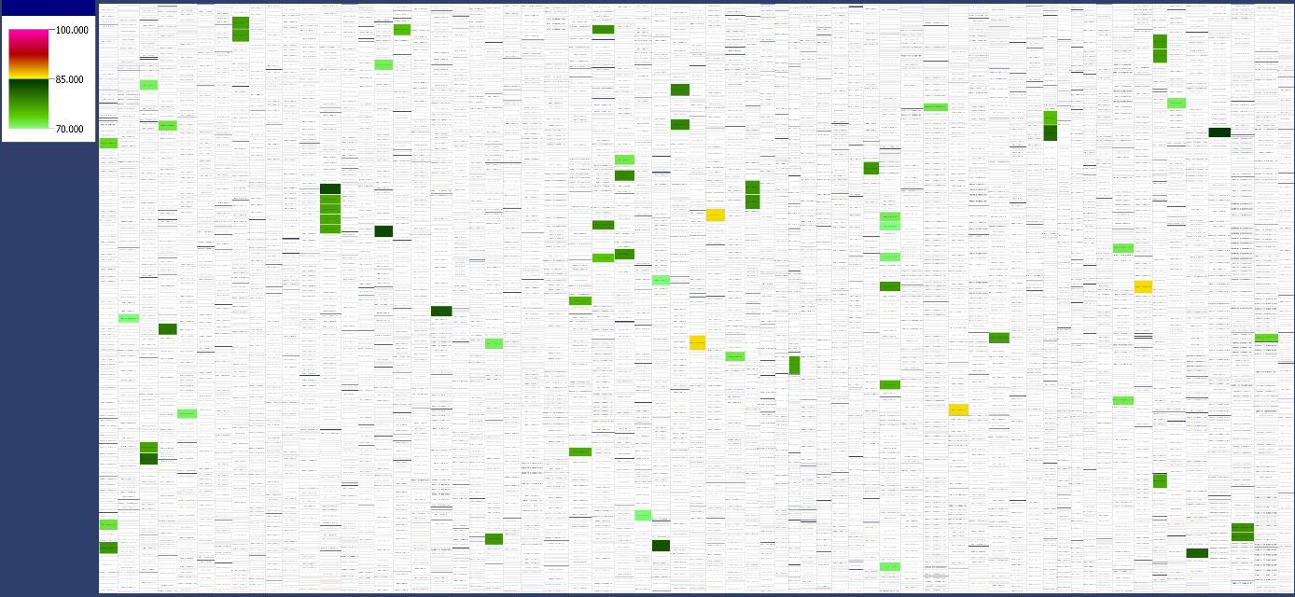
Visualizing 12,700 Line Flows:
Visualization using a pseudo-geographic mosaic approach with all rectangles linked to provide drill-down details
Image source: Overbye, Wert, Birchfield, Weber, “Wide-Area Electric Grid Visualization Using Pseudo-Geographic Mosaic Displays,” Proc. 2019 North American Power Symposium (NAPS), Wichita, KS, Oct 2019

Slide 41
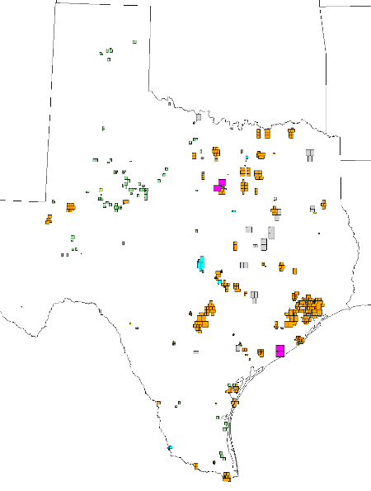
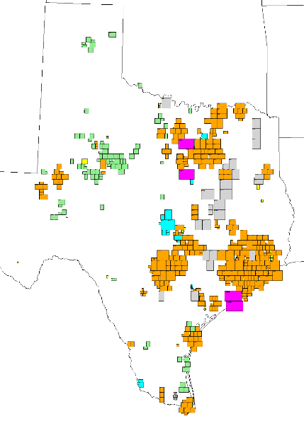
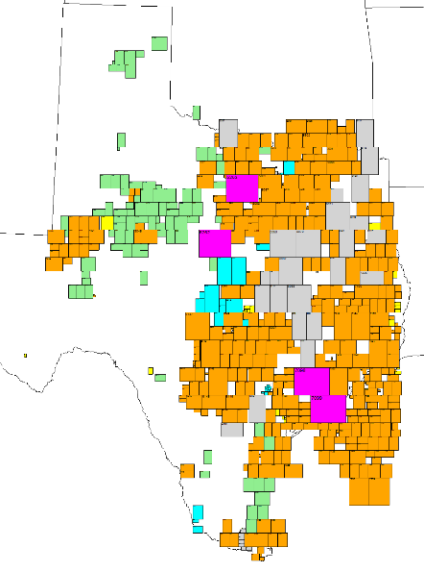
Auto Screen Layout Designed to Percentage Screen Fill
Images show generation by capacity and fuel type using different percentages of the available screen space
2%
10%
30%
Image source: Adam Birchfield

Slide 42
Applications: Coupled Infrastructures and Extreme Events
Since the highly detail synthetic grids are linked to actual parcels, they can be used in coupled infrastructure simulation
  Metadata is used to indicate the number of people at a meter and other attributions
By partnering with the Texas Transportation Institute (TTI) we’re moving forward with coupled electric grid/transportation studies
  Blackouts affect people, and large blackouts can affect a lot of people, causing transportation impacts
  Studies can be done looking at different rates of transportation electrification

Slide 43
Summary
Thanks to investment primarily by ARPA-E, large-scale, highly detailed synthetic grids are a reality
  Ongoing research on enhancements and applications
These can be used to generate large amounts of context-aware data, helping to enable a large amount of power system research
Coupled infrastructure research is now potentially available to a much broader audience
Lots of opportunities for PSERC involvement in this exciting and impactful area!!

Slide 44
Thank You!
Questions?

