Slide 1
ECEN 615
Methods of Electric Power
Systems Analysis
Lecture 17: Sensitivity Methods
Prof. Tom Overbye
Dept. of Electrical and Computer Engineering
Texas A&M University
overbye@tamu.edu

Slide 2
Announcements
Read Chapter 7 from the book (the term reliability is now used instead of security)
Homework 4 is due on Thursday October 31.

Slide 3
Sensitivity Problem Formulation
Denote the system state by
Denote the conditions corresponding to the existing commitment/dispatch by s⁽⁰⁾, p⁽⁰⁾ and f⁽⁰⁾ so that
the power flow equations
line real power flow vector
2

Slide 4
Sensitivity Problem Formulation
g includes the real and reactive
power balance equations
3

Slide 5
Sensitivity Problem Formulation
For a small change, Δp, that moves the injection from p⁽⁰⁾ to p⁽⁰⁾ + Δp , we have a corresponding change in the state Δx with
We then apply a first order Taylor’s series expansion
4

Slide 6
Sensitivity Problem Formulation
We consider this to be a “small signal” change, so we can neglect the higher order terms (h.o.t.) in the expansion
Hence we should still be satisfying the power balance equations with this perturbation; so
5

Slide 7
Sensitivity Problem Formulation
Also, from the power flow equations, we obtain
and then just the power flow Jacobian
6

Slide 8
Sensitivity Problem Formulation
With the standard assumption that the power flow Jacobian is nonsingular, then
We can then compute the change in the line real power flow vector
7

Slide 9
Sensitivity Comments
Sensitivities can easily be calculated even for large systems
  If Δp is sparse (just a few injections) then we can use a fast forward; if sensitivities on a subset of lines are desired we could also use a fast backward
Sensitivities are dependent upon the operating point
  They also include the impact of marginal losses
Sensitivities could easily be expanded to include additional variables in x (such as phase shifter angle), or additional equations, such as reactive power flow
8

Slide 10
Sensitivity Comments, cont.
Sensitivities are used in the optimal power flow; in that context a common application is to determine the sensitivities of an overloaded line to injections at all the buses
In the below equation, how could we quickly get these values?
  A useful reference is O. Alsac, J. Bright, M. Prais, B. Stott, “Further Developments in LP-Based Optimal Power Flow,” IEEE. Trans. on Power Systems, August 1990, pp. 697-711; especially see equation 3.
9

Slide 11
Sensitivity Example in PowerWorld
Open case B5_DistFact and then Select Tools, Sensitivities, Flow and Voltage Sensitivities
  Select Single Meter, Multiple Transfers, Buses page
  Select the Device Type (Line/XFMR), Flow Type (MW), then select the line (from Bus 2 to Bus 3)
  Click Calculate Sensitivities; this shows impact of a single injection going to the slack bus (Bus 1)
  For our example of a transfer from 2 to 3 the value is the result we get for bus 2 (0.5440) minus the result for bus 3
  (-0.1808) = 0.7248
  With a flow of 118 MW, we would hit the 150 MW limit
  with (150-118)/0.7248 =44.1MW, close to the limit we
  found of 45MW
10

Slide 12
Sensitivity Example in PowerWorld
If we change the conditions to the anticipated maximum loading (changing the load at 2 from 118 to 118+44=162 MW) and we re-evaluate the sensitivity we note it has changed little
(from -0.7248 to -0.7241)
  Hence a linear approximation (at least for this scenario) could be justified
With what we know so far, to handle the contingency situation, we would have to simulate the contingency, and reevaluate the sensitivity values
  We’ll be developing a quicker (but more approximate) approach next
11

Slide 13
Linearized Sensitivity Analysis
By using the approximations from the fast decoupled power flow we can get sensitivity values that are independent of the current state. That is, by using the B’ and B’’ matrices
For line flow we can approximate
12

Slide 14
Linearized Sensitivity Analysis
Also, for each line 
and so,

Slide 15
Sensitivity Analysis: Recall the Matrix Notation
The series admittance of line  is g +jb and we define
We define the L×N incidence matrix
where the component j of a_{i} is
nonzero whenever line _{i} is
coincident with node j. Hence
A is quite sparse, with at most two nonzeros per row

Slide 16
Linearized Active Power Flow Model
Under these assumptions the change in the real power line flows are given as
The constant matrix
is called the injection shift factor matrix (ISF)
15

Slide 17
Injection Shift Factors (ISFs)
The element in row  and column n of  is called the injection shift factor (ISF) of line  with respect to the injection at node n
  Absorbed at the slack bus, so it is slack bus dependent
Terms generation shift factor (GSF) and load shift factor (LSF) are also used (such as by NERC)
  Same concept, just a variation in the sign whether it is a generator or a load
  Sometimes the associated element is not a single line, but rather a combination of lines (an interface)
Terms used in North America are defined in the NERC glossary (http://www.nerc.com/files/glossary_of_terms.pdf)
16

Slide 18
ISF Interpretation
slack
node
is the fraction of the additional 1 MW injection at node n that goes though line 
17

Slide 19
ISF Properties
By definition, depends on the location of the slack bus
By definition, for since the injection and withdrawal buses are identical in this case and, consequently, no flow arises on any line 
The magnitude of is at most 1 since
Note, this is strictly true only for the linear (lossless)
case. In the nonlinear case, it is possible that a
transaction decreases losses. Hence a 1 MW injection
could change a line flow by more than 1 MW.
18

Slide 20
Five Bus Example Reference
19

Slide 21
Five Bus ISF, Line 4, Bus 2 (to Slack)
20

Slide 22
Five Bus Example
The row of A correspond to
the lines and transformers,
the columns correspond to
the non-slack buses (buses 2
to 5); for each line there
is a 1 at one end, a -1 at the
other end (hence an
assumed sign convention!).
Here we put a 1 for the
lower numbered bus, so positive flow is assumed from the lower numbered bus to the higher number
21

Slide 23
Five Bus Example
With bus 1 as the slack, the buses (columns) go for 2 to 5
22

Slide 24
Five Bus Example Comments
At first glance the numerically determined value of (128-118)/20=0.5 does not match closely with the analytic value of 0.5455; however, in doing the subtraction we are losing numeric accuracy
  Adding more digits helps (128.40 – 117.55)/20 = 0.5425
The previous matrix derivation isn’t intended for actual computation;  is a full matrix so we would seldom compute all of its values
Sparse vector methods can be used if we are only interested in the ISFs for certain lines and certain buses
23

Slide 25
Distribution Factors
Various additional distribution factors may be defined
  power transfer distribution factor (PTDF)
  line outage distribution factor (LODF)
  line addition distribution factor (LADF)
  outage transfer distribution factor (OTDF)
These factors may be derived from the ISFs making judicious use of the superposition principle
24

Slide 26
Definition: Basic Transaction
A basic transaction involves the transfer of a specified amount of power t from an injection node m to a withdrawal node n
25

Slide 27
Definition: Basic Transaction
We use the notation
to denote a basic transaction
injection node
withdrawal node
quantity
26

Slide 28
Definition: PTDF
NERC defines a PTDF as
  “In the pre-contingency configuration of a system under study, a measure of the responsiveness or change in electrical loadings on transmission system Facilities due to a change in electric power transfer from one area to another, expressed in percent (up to 100%) of the change in power transfer”
  Transaction dependent
We’ll use the notation to indicate the PTDF on line  with respect to basic transaction w
In the lossless formulation presented here (and commonly used) it is slack bus independent
27

Slide 29
PTDFs
Note, the PTDF is independent of the amount t; which is often expressed as a percent
28

Slide 30
PTDF Evaluation in Two Parts
=
+
29

Slide 31
PTDF Evaluation
30

Slide 32
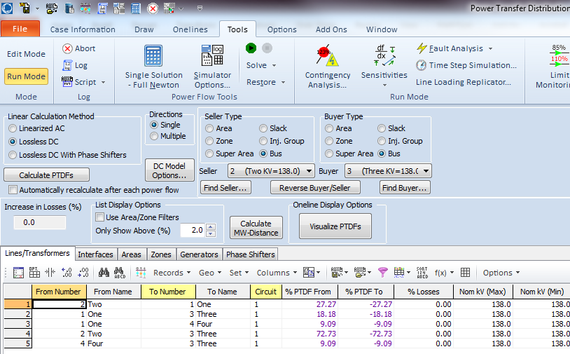
Calculating PTDFs in PowerWorld
PowerWorld provides a number of options for calculating and visualizing PTDFs
  Select Tools, Sensitivities, Power Transfer Distribution Factors (PTDFs)
Results are
shown for the
five bus case
for the Bus 2
to Bus 3
transaction
31

Slide 33
Five Bus PTDF Visualization
PowerWorld Case: B5_DistFact_PTDF
32

Slide 34
Nine Bus PTDF Example
Display shows
the PTDFs
for a basic
transaction
from Bus A
to Bus I. Note
that 100% of
the transaction
leaves Bus A
and 100%
arrives at
Bus I
PowerWorld Case: B9_PTDF
33

Slide 35
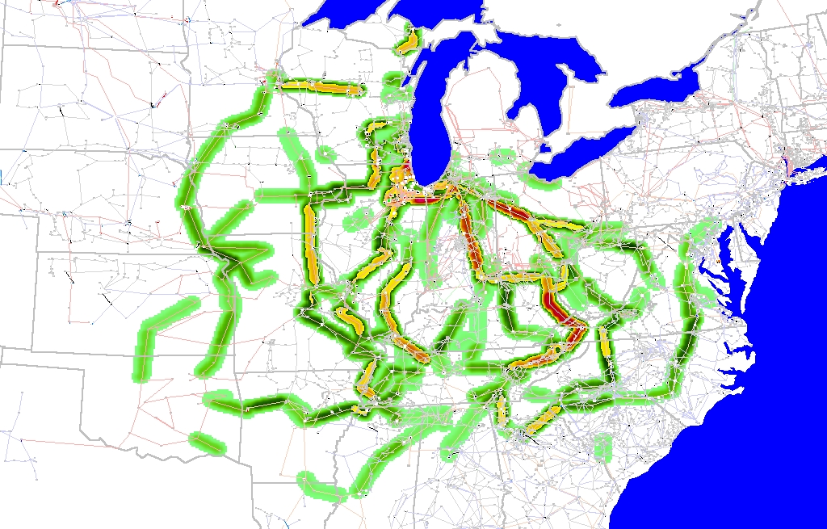
Eastern Interconnect Example: Wisconsin Utility to TVA PTDFs
In this
example
multiple
generators
contribute
for both
the seller
and the
buyer
Contours show lines that would carry at least 2% of a power transfer from Wisconsin to TVA
34

Slide 36
Line Outage Distribution Factors (LODFs)
Power system operation is practically always limited by contingencies, with line outages comprising a large number of the contingencies
Desire is to determine the impact of a line outage (either a transmission line or a transformer) on other system real power flows without having to explicitly solve the power flow for the contingency
These values are provided by the LODFs
The LODF is the portion of the pre-outage real power line flow on line k that is redistributed to line  as a result of the outage of line k
35

Slide 37
LODFs
outaged
base case
outage case
Best reference is Chapter 7 of the course book
36

Slide 38
LODF Evaluation
We simulate the impact of the outage of line k by adding the basic transaction
and selecting Δt_{k} in such a way that the flows on the dashed lines become exactly zero
In general this Δt_{k} is not
equal to the original line
flow
37

Slide 39
LODF Evaluation
We select Δt_{k} to be such that
where Δƒ _{k} is the active power flow change on the line k due to the transaction w_{k}
The line k flow from w_{k} depends on its PTDF
it follows that
38

Slide 40
LODF Evaluation
For the rest of the network, the impacts of the outage of line k are the same as the impacts of the additional basic transaction w_{k}
Therefore, by definition the LODF is
39

Slide 41
Five Bus Example
Assume we wish to calculate the values for the outage of line 4 (between buses 2 and 3); this is line k
Say we wish
to know the change in flow
on the line
3 (Buses 3 to 4). PTDFs for
a transaction
from 2 to 3
are 0.7273
on line 4
and 0.0909
on line 3
40

Slide 42
Five Bus Example
Hence we get
41

Slide 43
Five Bus Example Compensated
Here is the
system with the
compensation
added to bus
2 and removed
at bus 3; we
are canceling
the impact of
the line 4 flow
for the reset
of the network.
42

Slide 44
Five Bus Example
Below we see the network with the line actually outaged
The line 3
flow changed
from 63 MW
to 106 MW,
an increase
of 43 MW,
matching the
LODF
value
43

