Slide 1
ECEN 615
Methods of Electric Power
Systems Analysis
Lecture 16: Sensitivity Methods, Least Squares
Prof. Tom Overbye
Dept. of Electrical and Computer Engineering
Texas A&M University
overbye@tamu.edu

Slide 2
Announcements
Read Chapter 9 from the book
Homework 4 is due on Thursday October 31.

Slide 3
Line Outage Distribution Factors (LODFs)
Power system operation is practically always limited by contingencies, with line outages comprising a large number of the contingencies
Desire is to determine the impact of a line outage (either a transmission line or a transformer) on other system real power flows without having to explicitly solve the power flow for the contingency
These values are provided by the LODFs
The LODF is the portion of the pre-outage real power line flow on line k that is redistributed to line  as a result of the outage of line k
2

Slide 4
LODFs
outaged
base case
outage case
Best reference is Chapter 7 of the course book
3

Slide 5
LODF Evaluation
We simulate the impact of the outage of line k by adding the basic transaction
and selecting Δt_{k} in such a way that the flows on the dashed lines become exactly zero
In general this Δt_{k} is not
equal to the original line
flow
4

Slide 6
LODF Evaluation
We select Δt_{k} to be such that
where Δƒ _{k} is the active power flow change on the line k due to the transaction w_{k}
The line k flow from w_{k} depends on its PTDF
it follows that
5

Slide 7
LODF Evaluation
For the rest of the network, the impacts of the outage of line k are the same as the impacts of the additional basic transaction w_{k}
Therefore, by definition the LODF is
6

Slide 8
Five Bus Example
Assume we wish to calculate the values for the outage of line 4 (between buses 2 and 3); this is line k
Say we wish
to know the change in flow
on the line
3 (Buses 3 to 4). PTDFs for
a transaction
from 2 to 3
are 0.7273
on line 4
and 0.0909
on line 3
7

Slide 9
Five Bus Example
Hence we get
8

Slide 10
Five Bus Example Compensated
Here is the
system with the
compensation
added to bus
2 and removed
at bus 3; we
are canceling
the impact of
the line 4 flow
for the reset
of the network.
9

Slide 11
Five Bus Example
Below we see the network with the line actually outaged
The line 3
flow changed
from 63 MW
to 106 MW,
an increase
of 43 MW,
matching the
LODF
value
10

Slide 12
Developing a Critical Eye
In looking at the below formula you need to be thinking about what conditions will cause the formula to fail
Here the obvious situation is when the denominator is zero
That corresponds to a situation in which the contingency causes system islanding
  An example is line 6 (between buses 4 and 5)
  Impact modeled by injections at the buses within each viable island
11

Slide 13
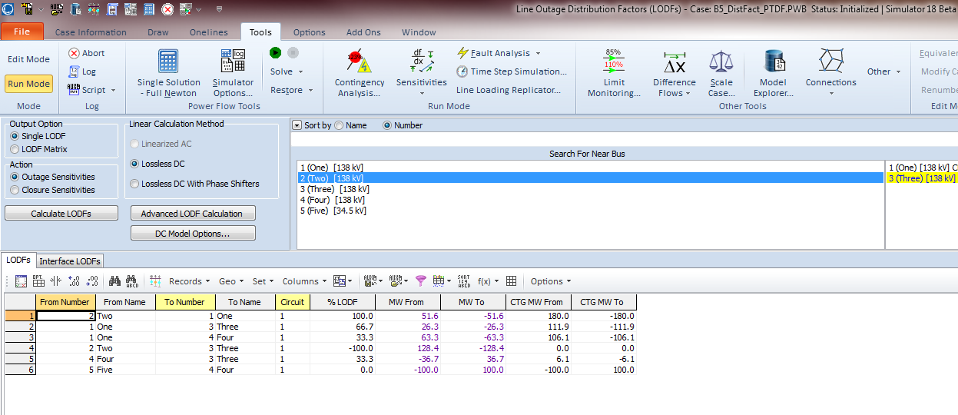
Calculating LODFs in PowerWorld
Select Tools, Sensitivities, Line Outage Distribution Factors
  Select the Line using dialogs on right, and click Calculate LODFS; below example shows values for line 4
12

Slide 14
Blackout Case LODFs
One of the issues associated with the 8/14/03 blackout was the LODF associated with the loss of the Hanna-Juniper 345 kV line (21350-22163) that was being used in a flow gate calculation was not correct because the Chamberlin-Harding 345 kV line outage was missed
  With the Chamberlin-Harding line assumed in-service the value was 0.362
  With this line assumed out-of-service (which indeed it was) the value increased to 0.464
13

Slide 15
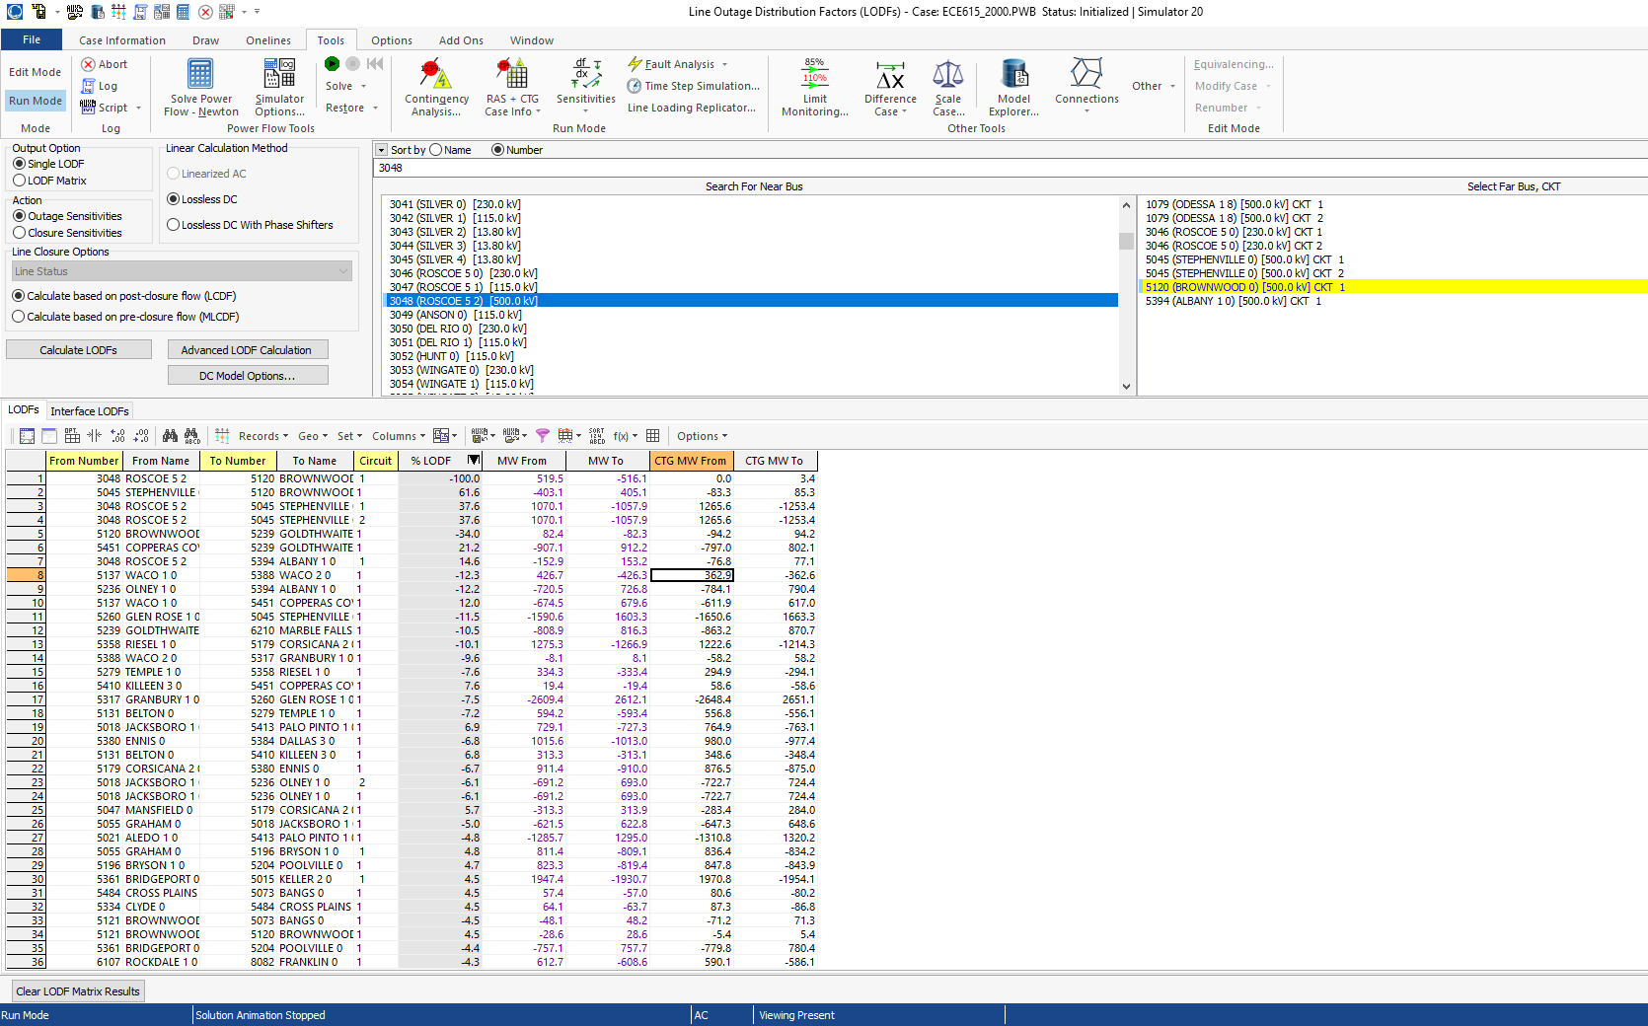
2000 Bus LODF Example
LODF is for line
between 3048 and
5120; values will
be proportional to
the PTDF values
14

Slide 16
2000 Bus LODF Example
Image visualizes the PTDFs between buses 3048 and 5120
15

Slide 17
Multiple Line LODFs
LODFs can also be used to represent multiple device contingencies, but it is usually more involved than just adding the effects of the single device LODFs
Assume a simultaneous outage of lines k₁ and k₂
Now setup two transactions, w_{k1} (with value Δt_{k1})and w_{k2} (with value Δt_{k2}) so
16

Slide 18
Multiple Line LODFs
Hence we can calculate the simultaneous impact of multiple outages; details for the derivation are given in
C.Davis, T.J. Overbye, "Linear Analysis of Multiple Outage Interaction," Proc. 42nd HICSS, 2009
Equation for the change in flow on line  for the outage of lines k₁ and k₂ is
17

Slide 19
Multiple Line LODFs
Example: Five bus case, outage of lines 2 and 5 to flow on line 4.
18

Slide 20
Multiple Line LODFs
Flow goes
from 117.5
to 118.0
19

Slide 21
Line Closure Distribution Factors (LCDFs)
Closed line
base case
line k addition case
20

Slide 22
LCDF Definition
The line closure distribution factor (LCDF), LCDF_{,k}, for the closure of line k (or its addition if it does not already exist) is the portion of the line active power flow on line k that is distributed to line  due to the closure of line k
Since line k is currently open, the obvious question is, "what flow on line k?"
Answer (in a dc power flow sense) is the flow that will occur when the line is closed (which we do not know)
21

Slide 23
LCDF Evaluation
We simulate the impact of the closure of line k by imposing the additional basic transaction
on the base case network and we select Δt_{k} so that
22

Slide 24
LCDF Evaluation
For the other parts of the network, the impacts of the addition of line k are the same as the impacts of adding the basic transaction w_{k}
Therefore, the definition is
The post-closure flow ƒ_{k} is determined (in a dc power flow sense) as the flow that would occur from the angle difference divided by (1 + )
23

Slide 25
Outage Transfer Distribution Factor
The outage transfer distribution factor (OTDF) is defined as the PTDF with the line k outaged
The OTDF applies only to the post-contingency configuration of the system since its evaluation explicitly considers the line k outage
This is a quite important value since power system operation is usually contingency constrained
24

Slide 26
Outage Transfer Distribution Factor (OTDF)
outaged
line
25

Slide 27
OTDF Evaluation
=
+
26

Slide 28
OTDF Evaluation
Since
and
then
so that
27

Slide 29
Five Bus Example
Say we would like to know the PTDF on line 1 for a transaction between buses 2 and 3 with line 2 out
28

Slide 30
Five Bus Example
Hence we want to calculate these values without having to explicitly outage line 2
Hence the
value we
are looking
for is 0.2
(20%)
29

Slide 31
Five Bus Example
Evaluating: the PTDF for the bus 2 to 3 transaction on line 1 is 0.2727; it is 0.1818 on line 2 (from buses 1 to 3); the LODF is on line 1 for the outage of line 2 is -0.4
Hence
For line 4 (buses 2 to 3) the value is
30

Slide 32
August 14, 2003 OTDF Example
Flowgate 2264 monitored the flow on Star-Juniper 345 kV line for contingent loss of Hanna-Juniper 345 kV normally the LODF for this flowgate is 0.361
  flowgate had a limit of 1080 MW
  at 15:05 EDT the flow as 517 MW on Star-Juniper, 1004 MW on Hanna-Juniper, giving a flowgate value of 520+0.361*1007=884 (82%)
  Chamberlin-Harding 345 opened at 15:05, but was missed
  At 15:06 EDT (after loss of Chamberlin-Harding 345) #2265 had an incorrect value because its LODF was not updated.
  Value should be 633+0.463*1174=1176 (109%)
  Value was 633 + 0.361*1174=1057 (98%)
31

Slide 33
UTC Revisited
We can now revisit the uncommitted transfer capability (UTC) calculation using PTDFs and LODFs
Recall trying to determine maximum transfer between two areas (or buses in our example)
For base case maximums are quickly determined with PTDFs
Note we are ignoring zero (or small) PTDFs; would also need to consider flow reversal
32

Slide 34
UTC Revisited
For the contingencies we use
Then as before
We would need to check all contingencies! Also, this is just a linear estimate and is not considering voltage violations.
33

Slide 35
Five Bus Example
34

Slide 36
Five Bus Example
Therefore, for the base case
35

Slide 37
Five Bus Example
For the contingency case corresponding to the outage of the line 2
The limiting value is line 4
Hence the UTC is limited by the contingency to 23.0
36

Slide 38
Additional Comments
Distribution factors are defined as small signal sensitivities, but in practice, they are also used for simulating large signal cases
Distribution factors are widely used in the operation of the electricity markets where the rapid evaluation of the impacts of each transaction on the line flows is required
Applications to actual system show that the distribution factors provide satisfactory results in terms of accuracy
For multiple applications that require fast turn around time, distribution factors are used very widely, particularly, in the market environment
They do not work well with reactive power!
37

Slide 39
Least Squares
So far we have considered the solution of Ax = b in which A is a square matrix; as long as A is nonsingular there is a single solution
  That is, we have the same number of equations (m) as unknowns (n)
Many problems are overdetermined in which there more equations than unknowns (m > n)
  Overdetermined systems are usually inconsistent, in which no value of x exactly solves all the equations
Underdetermined systems have more unknowns than equations (m < n); they never have a unique solution but are usually consistent
38

Slide 40
Method of Least Squares
The least squares method is a solution approach for determining an approximate solution for an overdetermined system
If the system is inconsistent, then not all of the equations can be exactly satisfied
The difference for each equation between its exact solution and the estimated solution is known as the error
Least squares seeks to minimize the sum of the squares of the errors
Weighted least squares allows differ weights for the equations
39

Slide 41
Least Squares Solution History
The method of least squares developed from trying to estimate actual values from a number of measurements
Several persons in the 1700's, starting with Roger Cotes in 1722, presented methods for trying to decrease model errors from using multiple measurements
Legendre presented a formal description of the method in 1805; evidently Gauss claimed he did it in 1795
Method is widely used in power systems, with state estimation the best known application, dating from Fred Schweppe's work in 1970
40

Slide 42
Least Squares and Sparsity
In many contexts least squares is applied to problems that are not sparse. For example, using a number of measurements to optimally determine a few values
  Regression analysis is a common example, in which a line or other curve is fit to potentially many points)
  Each measurement impacts each model value
In the classic power system application of state estimation the system is sparse, with measurements only directly influencing a few states
  Power system analysis classes have tended to focus on solution methods aimed at sparse systems; we'll consider both sparse and nonsparse solution methods
41

Slide 43
Least Squares Problem
Consider
or
42

Slide 44
Least Squares Solution
We write (a^{i})^{T} for the row i of A and a^{i} is a column vector
Here, m ≥ n and the solution we are seeking is that which minimizes Ax - b_{p}, where p denotes some norm
Since usually an overdetermined system has no exact solution, the best we can do is determine an x that minimizes the desired norm.
43

Slide 45
Choice of p
We discuss the choice of p in terms of a specific example
Consider the equation Ax = b with
(hence three equations and one unknown)
We consider three possible choices for p:
44

Slide 46
Choice of p
(i) p = 1
(ii) p = 2
(iii) p = ∞
45

