Slide 1
ECEN 615 Methods of Electric Power Systems Analysis
Lecture 18: State Estimation
Prof. Tom Overbye
Dept. of Electrical and Computer Engineering
Texas A&M University
overbye@tamu.edu

Slide 2
Announcements
Read Chapter 9 from the book
Homework 4 is due on Thursday October 31.

Slide 3
Nonlinear Formulation
A regular ac power system is nonlinear, so we need to use an iterative solution approach. This is similar to the Newton power flow. Here assume m measurements and n state variables (usually bus voltage magnitudes and angles) Then the Jacobian is the H matrix

Slide 4
Measurement Example
Assume we measure the real and reactive power flowing into one end of a transmission line; then the z_{i}-f_{i}(x) functions for these two are
Two measurements for four unknowns
Other measurements, such as the flow at the other end, and voltage magnitudes, add redundancy
3

Slide 5
SE Iterative Solution Algorithm
We then make an initial guess of x, x⁽⁰⁾ and iterate, calculating Δx each iteration
This is exactly the least squares form developed earlier with H^{T}R⁻¹H an n by n matrix. This could be solved with Gaussian elimination, but this isn't preferred because the problem is often ill-conditioned
Keep in mind that H is no longer constant, but varies as x changes. often ill-conditioned
4

Slide 6
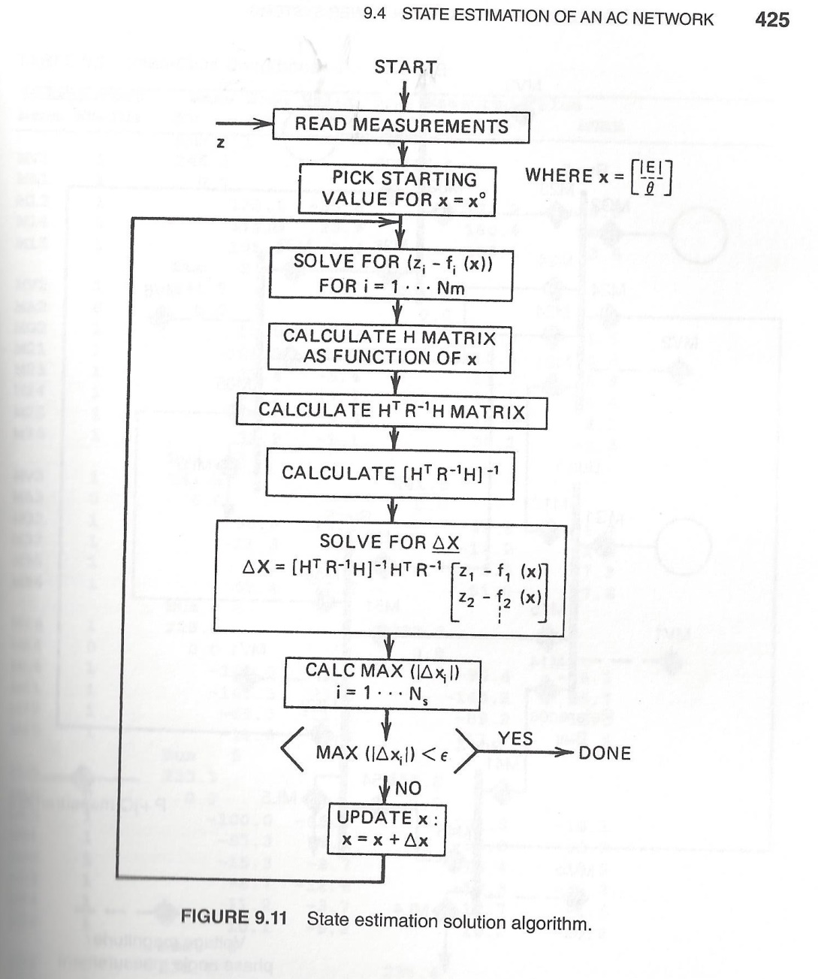
Nonlinear SE Solution Algorithm, Book Figure 9.11

Slide 7
Example: Two Bus Case
Assume a two bus case with a generator supplying a load through a single line with x=0.1 pu. Assume measurements of the p/q flow on both ends of the line (into line positive), and the voltage magnitude at both the generator and the load end. So B₁₂ = B₂₁=10.0
We need to assume a reference angle unless we directly measuring phase
6

Slide 8
Example: Two Bus Case
Let
We assume an angle reference of θ₁=0
7

Slide 9
Example: Two Bus Case
With a flat start guess we get
8

Slide 10
Example: Two Bus Case
9

Slide 11
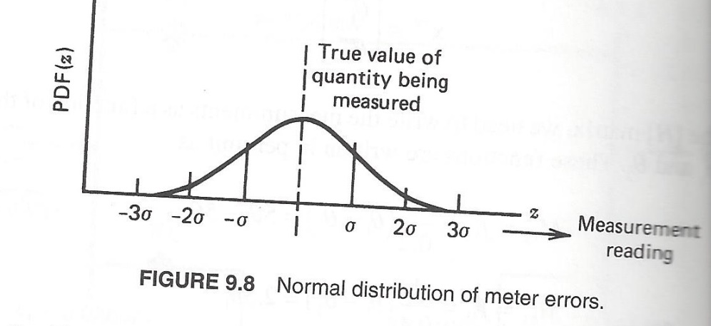
Assumed SE Measurement Accuracy
The assumed measurement standard deviations can have a significant impact on the resultant solution, or even whether the SE converges
The assumption is a Gaussian (normal) distribution of the error with no bias
10

Slide 12
SE Observability
In order to estimate all n states we need at least n measurements. However, where the measurements are located is also important, a topic known as observability
In order for a power system to be fully observable usually we need to have a measurement available no more than one bus away
At buses we need to have at least measurements on all the injections into the bus except one (including loads and gens)
Loads are usually flows on feeders, or the flow into a transmission to distribution transformer
Generators are usually just injections from the GSU
11

Slide 13
Pseudo Measurements
Pseudo measurements are used at buses in which there is no load or generation; that is, the net injection into the bus is know with high accuracy to be zero
In order to enforce the net power balance at a bus we need to include an explicit net injection measurement
To increase observability sometimes estimated values are used for loads, shunts and generator outputs
These “measurements” are represented as having a higher much standard deviation
12

Slide 14
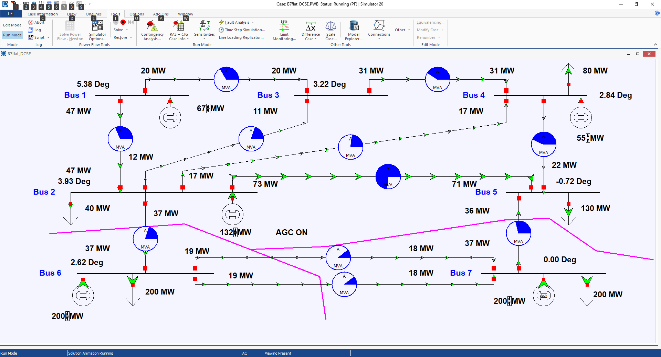
SE Observability Example
13

Slide 15
SE Bad Data Detection
The quality of the measurements available to an SE can vary widely, and sometimes the SE model itself is wrong. Causes include
Modeling Errors: perhaps the assumed system topology is incorrect, or the assumed parameters for a transmission line or transformer could be wrong
Data Errors: measurements may be incorrect because of in correct data specifications, like the CT ratios or even flipped positive and negative directions
Transducer Errors: the transductors may be failing or may have bias errors
Sampling Errors: SCADA does not read all values simultaneously and power systems are dynamic
14

Slide 16
SE Bad Data Detection
The challenge for SE is to determine when there is likely a bad measurement (or multiple ones), and then to determine the particular bad measurements
J(x) is random number, with a probability density function (PDF) known as a chi-squared distribution, χ²(K), where K is the degrees of freedom, K=m-n
It can be shown the expected mean for J(x) is K, with a standard deviation of
Values of J(x) outside of several standard deviations indicate possible bad measurements, with the measurement residuals used to track down the likely bad measurements
SE can be re-run without the bad measurements
15

Slide 17
Example SE Application: PJM and MISO
PJM provides information about their EMS model in
www.pjm.com/-/media/documents/manuals/m03a.ashx
Data here is from the Sept 2018 (Rev 16) document
16

Slide 18
Example SE Application: PJM and MISO
PJM measurements are required for 69 kV and up
PJM SE is triggered to execute every minute
PJM SE solves well over 98% of the time
Below reference provides info on MISO SE from March 2015
54,433 buses
54,415 network branches
6332 generating units
228,673 circuit breakers
289,491 mapped points
https://www.naspi.org/sites/default/files/2017-05/3a%20MISO-NASPIWokshop-Synchrophasor%20Data%20and%20State%20Estimation.pdf
17

Slide 19
Energy Management Systems (EMSs)
EMSs are now used to control most large scale electric grids
EMSs developed in the 1970’s and 1980’s out of SCADA systems
An EMS usually includes a SCADA system; sometimes called a SCADA/EMS
Having a SE is almost the definition of an EMS. The SE then feeds data to the more advanced functions
EMSs have evolved as the industry as evolved as the industry has evolved, with functionality customized for the application (e.g., a reliability coordinator or a vertically integrated utility)
18

Slide 20
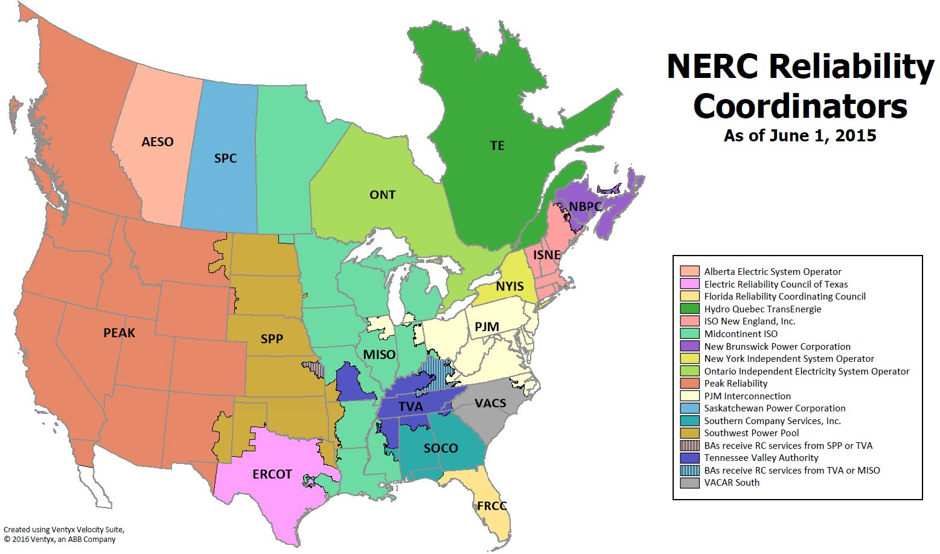
NERC Reliability Coordinators
Source: www.nerc.com/pa/rrm/TLR/Pages/Reliability-Coordinators.aspx
19

Slide 21
EEI Member Companies
20

Slide 22
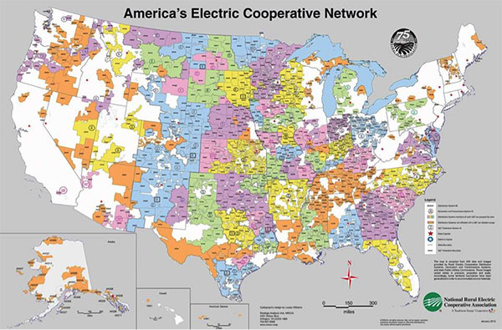
Electric Coops
21

Slide 23
Texas Electric Coops
22

Slide 24
ERCOT Control Center with EMS
23
Source: www.texastribune.org/2016/05/17/texas-market-forces-driving-shift-coal-study-says/

Slide 25
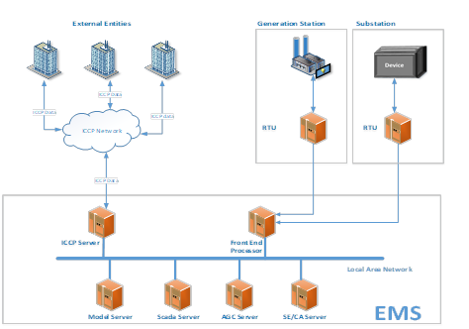
ERCOT EMS
Slide source: ERCOT, D. Penney, J. Mandavilli, M. Henry, “Loss of SCADA, EMS or LCC”
24

Slide 26
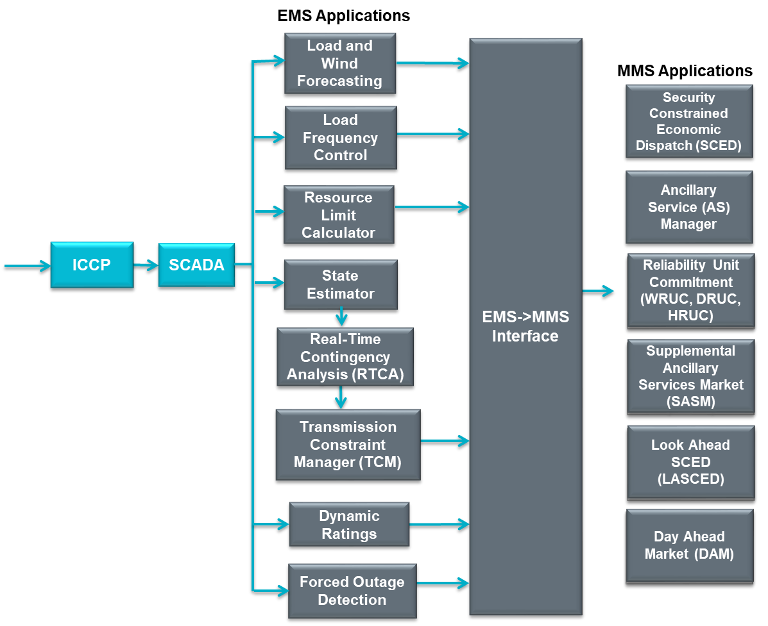
ERCOT EMS
25

