Slide 1
ECEN 615 Methods of Electric Power Systems Analysis
Lecture 2: Power Systems Overview
Prof. Tom Overbye
Dept. of Electrical and Computer Engineering
Texas A&M University
overbye@tamu.edu

Slide 2
Announcements
RSVP to Alex at zandra23@ece.tamu.edu for the TAMU ECE Energy and Power Group (EPG) picnic. It starts at 5pm on September 27, 2019
Start reading Chapters 1 to 3 from the book (more as background material)
Download the 42 bus educational versions of PowerWorld Simulator and the DS at
https://www.powerworld.com/gloveroverbyesarma

Slide 3
Texas Electricity Sources
In 2017 the Texas top five fuel sources for electricity were Natural Gas (45%), Coal (30%), Wind (14.8%), Nuclear (8.5%) and Other Gas (0.5%) (almost tied with Solar)
In 2017 the California top five fuel sources for electricity were Natural Gas (43%), Hydro (20.5%), Solar (11.8%), Nuclear (8.7%), and Wind (6.2%)
In 2017 the Kentucky top five fuel sources for electricity were Coal (78%), Natural Gas (14.2%), Hydro (6.1%), Petroleum (0.7%) and Wood (0.5%)
Source: www.eia.gov/electricity/state

Slide 4
History, cont’d
1896 – ac lines deliver electricity from hydro generation at Niagara Falls to Buffalo, 20 miles away; also 30kV line in Germany
Early 1900’s – Private utilities supply all customers in area (city); recognized as a natural monopoly; states step in to begin regulation
By 1920’s – Large interstate holding companies control most electricity systems

Slide 5
History, cont’d
1935 – Congress passes Public Utility Holding Company Act to establish national regulation, breaking up large interstate utilities (repealed 2005)
This gave rise to electric utilities that only operated in one state
1935/6 – Rural Electrification Act brought electricity to rural areas
1930’s – Electric utilities established as vertical monopolies
Frequency standardized in the 1930’s

Slide 6
Vertical Monopolies
Within a particular geographic market, the electric utility had an exclusive franchise
Generation
In return for this exclusive
franchise, the utility had the
obligation to serve all
existing and future customers
at rates determined jointly
by utility and regulators
It was a “cost plus” business
Transmission
Distribution
Customer Service

Slide 7
Vertical Monopolies
Within its service territory each utility was the only game in town
Neighboring utilities functioned more as colleagues than competitors
Utilities gradually interconnected their systems so by 1970 transmission lines crisscrossed North America, with voltages up to 765 kV
Economies of scale keep resulted in decreasing rates, so most every one was happy

Slide 8
History, cont’d -- 1970’s
1970’s brought inflation, increased fossil-fuel prices, calls for conservation and growing environmental concerns
Increasing rates replaced decreasing ones
As a result, U.S. Congress passed Public Utilities Regulator Policies Act (PURPA) in 1978, which mandated utilities must purchase power from independent generators located in their service territory (modified 2005)
PURPA introduced some competition

Slide 9
History, cont’d – 1990’s & 2000’s
Major opening of industry to competition occurred as a result of National Energy Policy Act of 1992
This act mandated that utilities provide “nondiscriminatory” access to the high voltage transmission
Goal was to set up true competition in generation
Result over the last few years has been a dramatic restructuring of electric utility industry (for better or worse!)
Energy Bill 2005 repealed PUHCA; modified PURPA

Slide 10
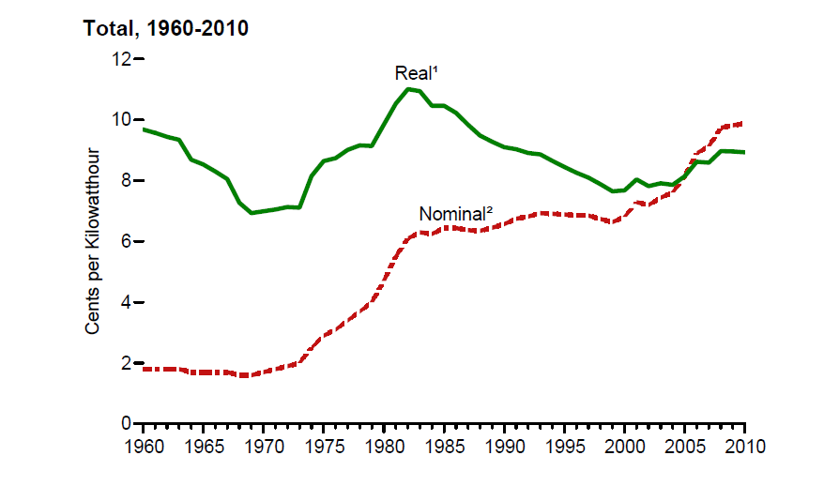
Electricity Prices, 1960-2010
Source: EIA, Annual Energy Review, 2010, Figure 8.10

Slide 11
Utility Restructuring
Driven by significant regional variations in electric rates
Goal of competition is to reduce rates through the introduction of competition
Eventual goal is to allow consumers to choose their electricity supplier

Slide 12
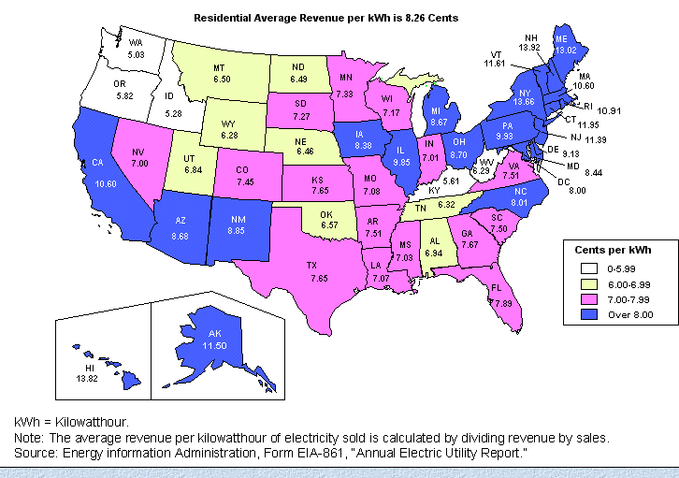
State Variation in Electric Rates

Slide 13
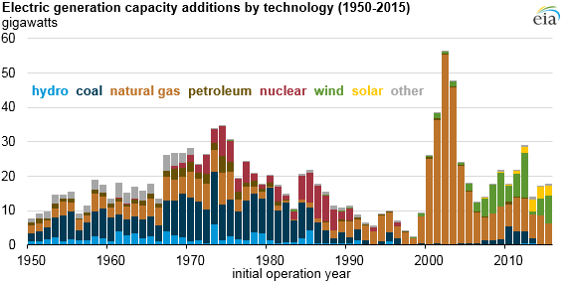
The Rise of Natural Gas Generation
Source: US EIA, 2016

Slide 14
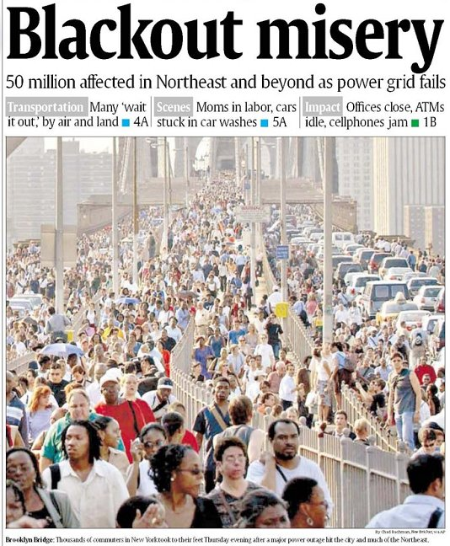
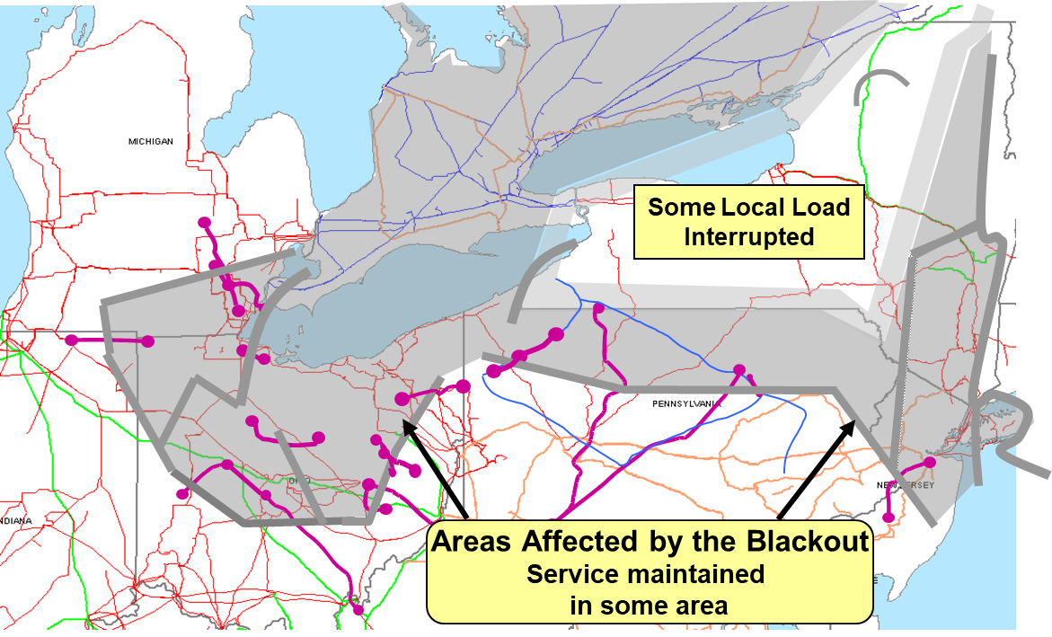
August 14th, 2003 Blackout
Above image from energy.gov, August 14, 2003 Blackout Final Report

Slide 15
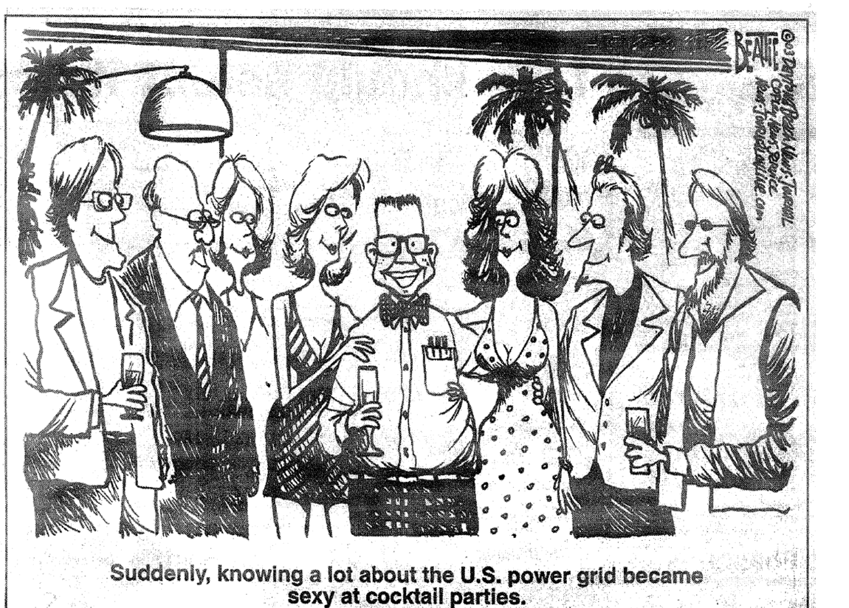
My Favorite 8/14/2003 Blackout Cartoon!

Slide 16
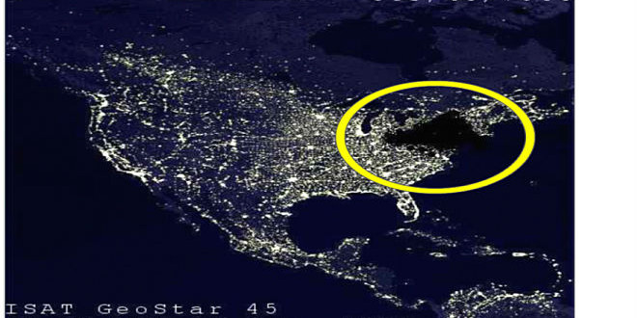
My Favorite Blackout Hoax Photo

Slide 17
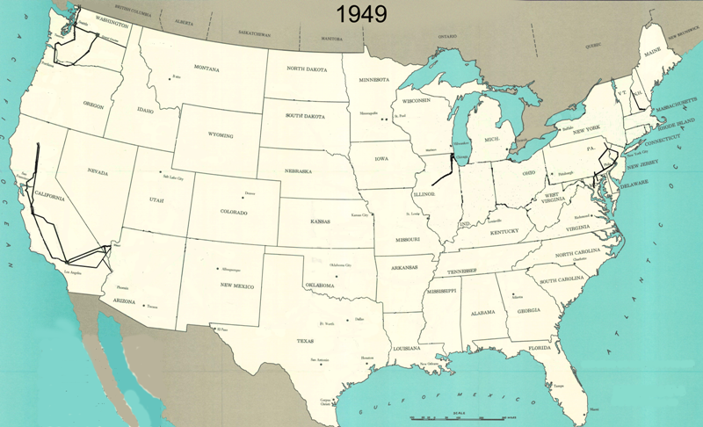
345 kV+ Transmission Growth at a Glance (From Jay Caspary)

Slide 18
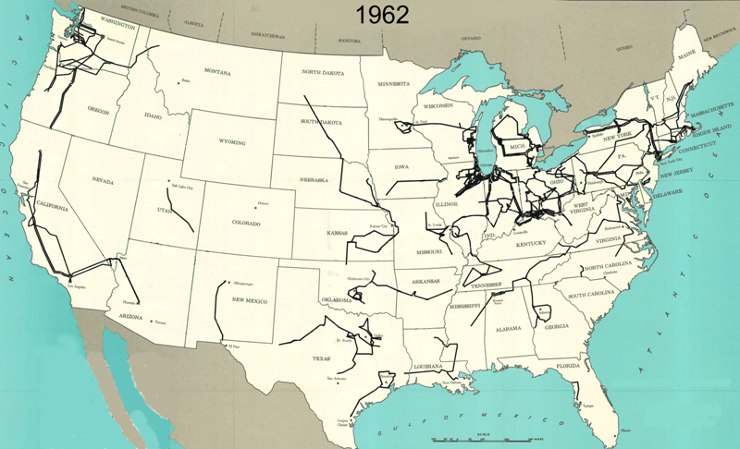
345 kV+ Transmission Growth at a Glance (From Jay Caspary)

Slide 19
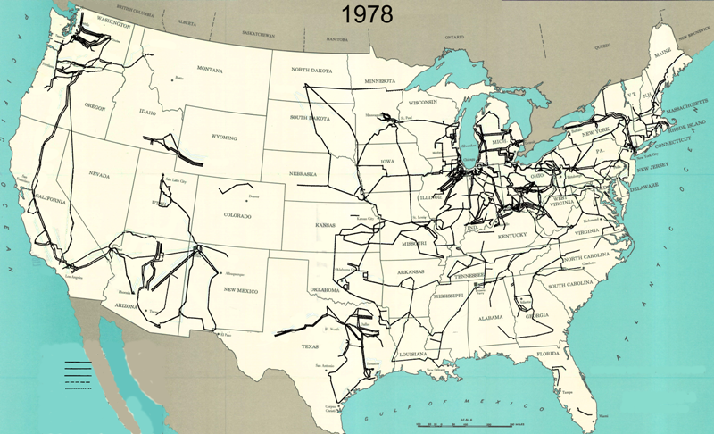
345 kV+ Transmission Growth at a Glance (From Jay Caspary)

Slide 20
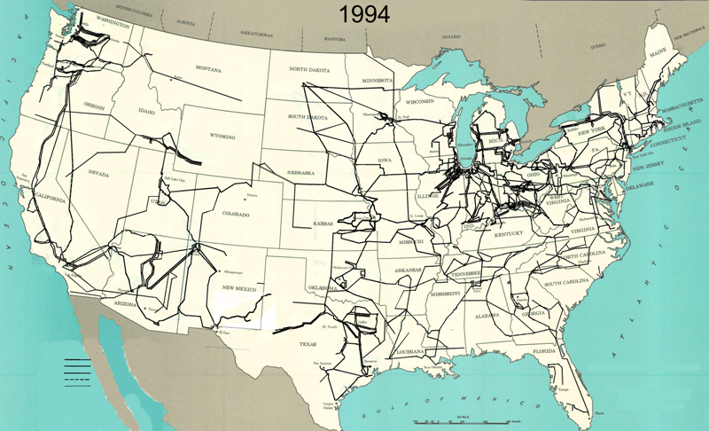
345 kV+ Transmission Growth at a Glance (From Jay Caspary)

Slide 21
The Smart Grid
The term “Smart Grid” dates officially to the 2007 “Energy Independence and Security Act”, Title 13 (“Smart Grid”)
Use of digital information and control techniques
Dynamic grid optimization with cyber-security
Deployment of distributed resources including
Customer participation and smart appliances
Integration of storage including PHEVs
Development of interoperability standards

Slide 22
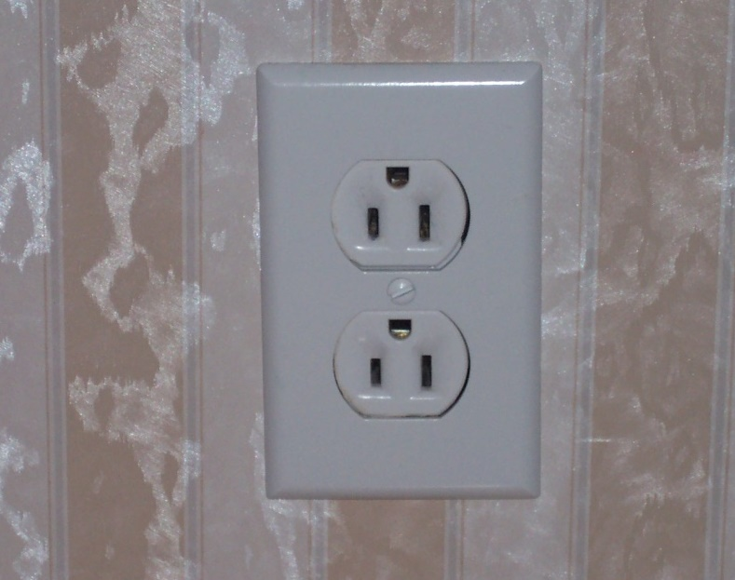
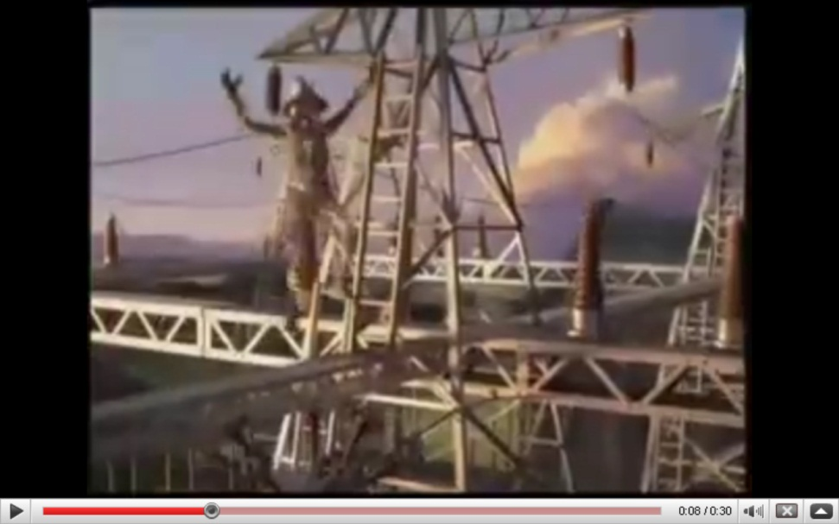
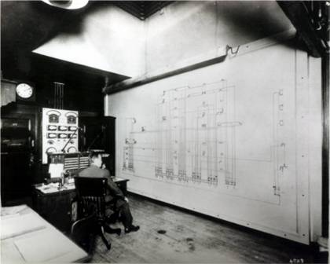
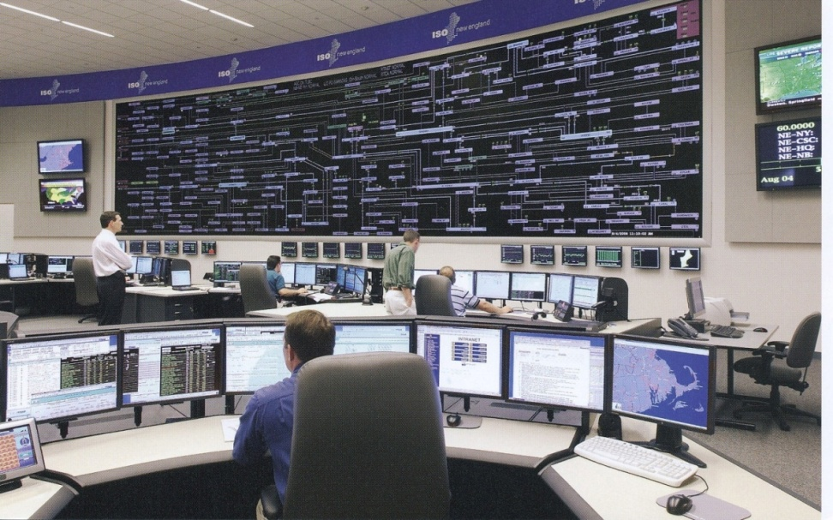
Smart Grid Perceptions (Some of Us Like the Term “Smarter”)

Slide 23
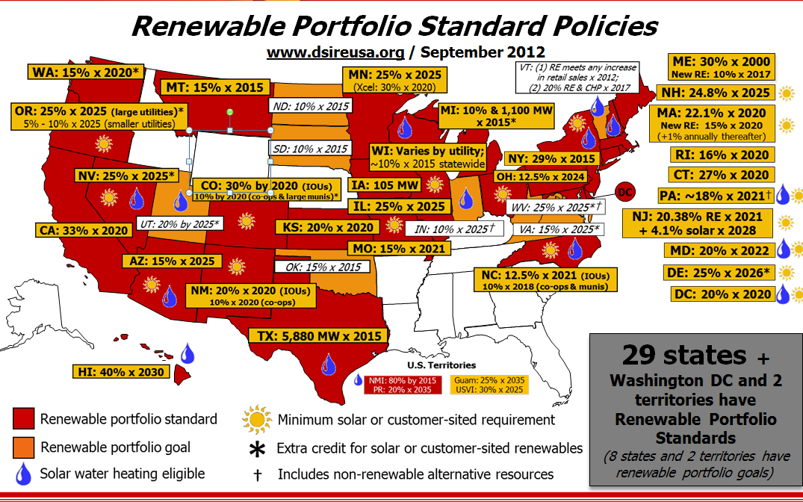
Renewable Portfolio Standards (September 2012)
TX is now 10 GW by 2025 which we’ve met (i.e., 25 GW of wind now); CA is 50% by 2030
Image source: http://www.dsireusa.org/
See also www.ncsl.org/research/energy/renewable-portfolio-standards.aspx

Slide 24
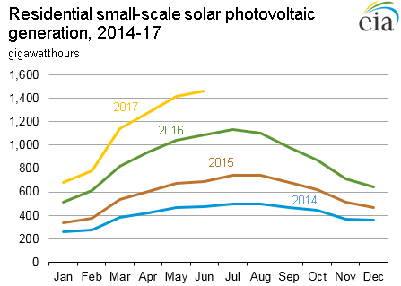
Growth in Solar PV
Value in April 2018 was 1596, up 24% from April 2017; the value in April of 2019 was 1963, up 23% from 2018!
Source: www.eia.gov/electricity/monthly/update/

Slide 25
Slowing Electric Load Growth
Much of the slowing load growth is due to distributed generation, such as solar PV, which sits on the customer side of the meter
Source: EIA Monthly Energy Review, July 2019

Slide 26
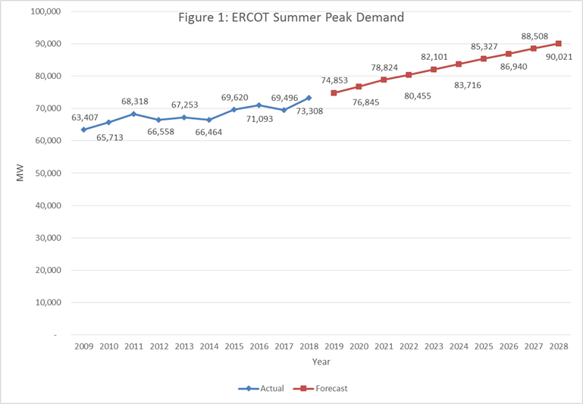
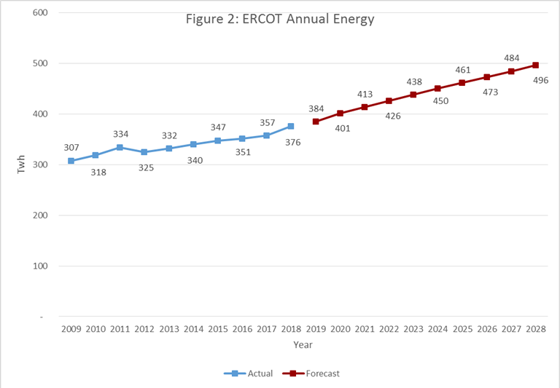
Except in Texas!
The left graph is peak demand, the right energy
ERCOT set a new peak electric load of 74.5 GW on 8/12/19, surpassing the 73.3 GW record from 2018; total energy in 2017 was 357 billion kWh
Source: www.ercot.com/gridinfo/load/forecast

Slide 27
Interconnected Power System Basic Characteristics
Three – phase AC systems:
generation and transmission equipment is usually three phase
industrial loads are three phase
residential and commercial loads are single phase and distributed equally among the phases; consequently, a balanced three – phase system results
Synchronous machines generate electricity
Exceptions: some wind is induction generators; solar PV
Interconnection transmits power over a wider region with subsystems operating at different voltage levels

Slide 28
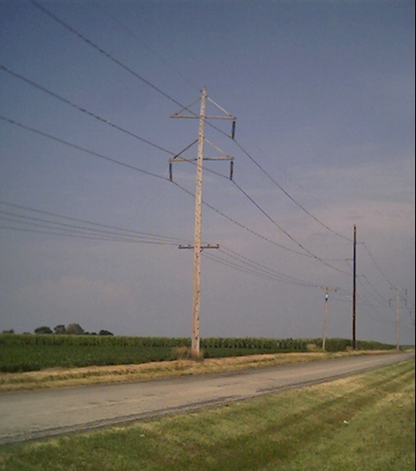
Power Systems: Basic Characteristics
The transmission network consists of following
the high voltage transmission system;
frequently, the subtransmission system;
sometimes, even the distribution system
The transmission system forms the backbone of the integrated power system and operates at the highest voltage levels; typically, above 150 kV
Less losses at high voltages (S=VI* and I²R losses), but more difficult to insulate.
The subtransmission levels are in the 69 to138 kV range

Slide 29
Power Systems: Basic Characteristics
The generator output voltages are typically in the 11kV to 35 kV range and step up transformers are used to transform the potentials to transmission system voltage levels
Wind turbines have voltages in 600V range
Bulk power system, which includes the transmission system and generators, is networked

Slide 30
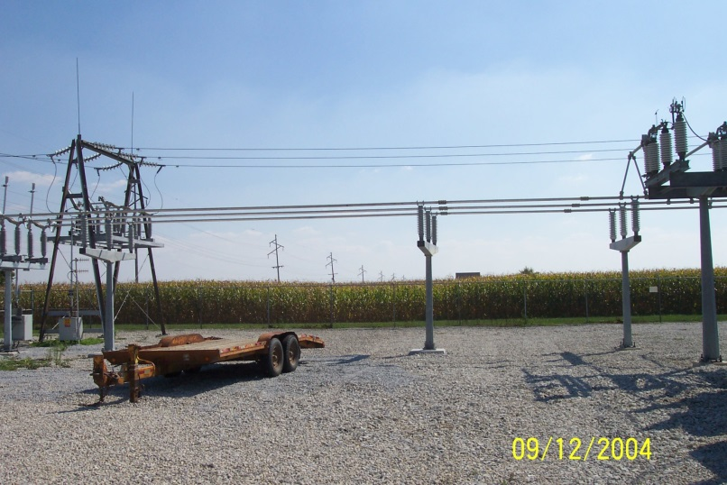
Power Systems: Basic Characteristics
Electrical devices are joined together at buses
The distribution system is used to supply the electricity to the consumers
primary distribution voltages are in the 4 kV to 34.5 kV range at which industrial customers obtain their electricity supply
secondary distribution voltage is 120/240 V to the residential/commercial customers
distribution system is usually radial, except in some urban areas
A Substation Bus

Slide 31
Electricity Supply
The basic function of a power system is to convert energy from one source to the electrical form; a key characteristic is that energy is not consumed as electricity but converted into heat, light, sound, mechanical energy or information
The widespread use of electricity is due to its ability to transport and control efficiently and reliably
Electricity is, by and large, a relatively clean source of energy
Most forms of renewable energy are created in the form of electricity; examples include hydro, wind and solar.

Slide 32
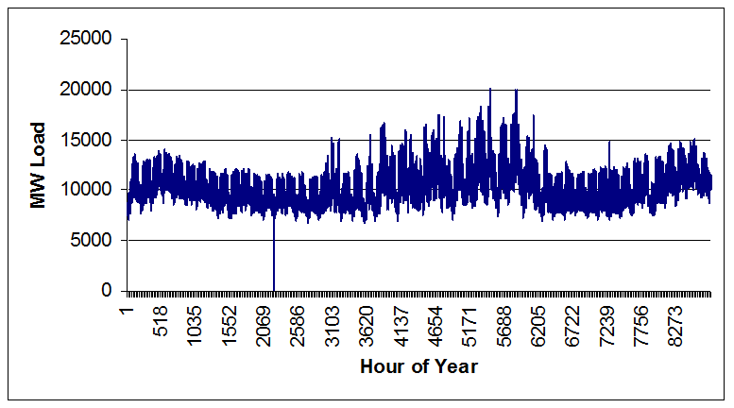
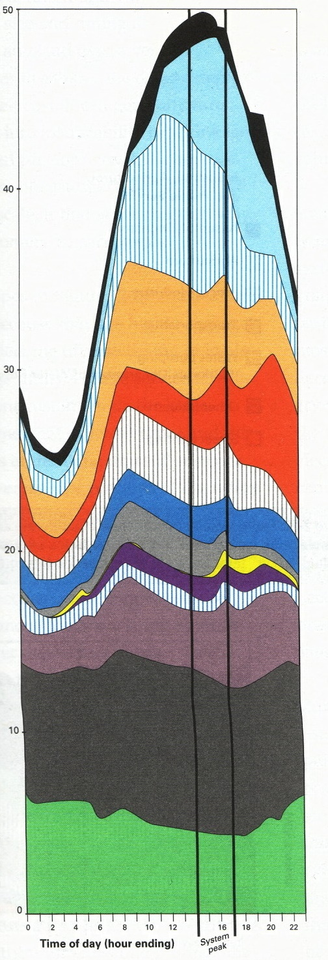
Fundamental Power System Requirements
System must be able to track load continuously: continuous balance of supply and demand
System must provide reliable supply of electricity at least cost
System must have least environmental impacts in providing electricity to meet its customers’ demands
Yearly Load Variation
Daily Load Variation

Slide 33
Fundamental Requirements of a Power System
Electric power delivery by the system must meet minimum standards of power quality
constant frequency
constant voltage
adequate reliability
System must be able to supply electricity even when subjected to a variety of unexpected contingencies, such as the loss of a transmission line or generator
A key focus of this course is the control capability to meet these requirements

Slide 34
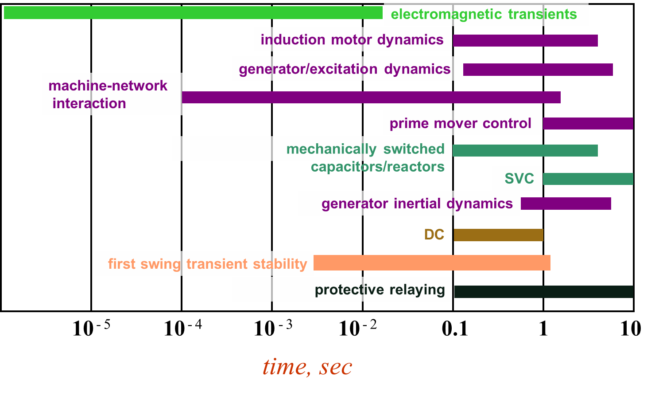
Power Systems Operate on Many Time Scales
Slide source: Prof. George Gross UIUC ECE 530

Slide 35
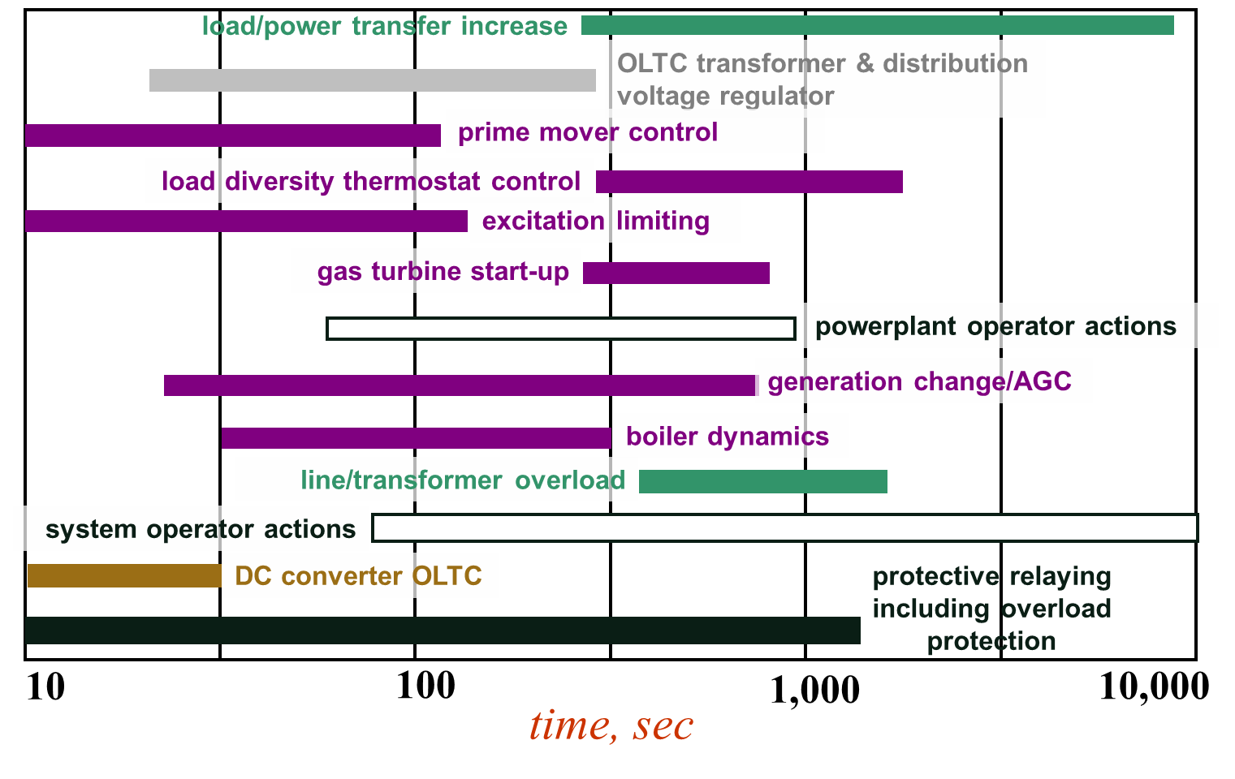
Power Systems Operate on Many Time Scales
Slide source: Prof. George Gross UIUC ECE 530

Slide 36
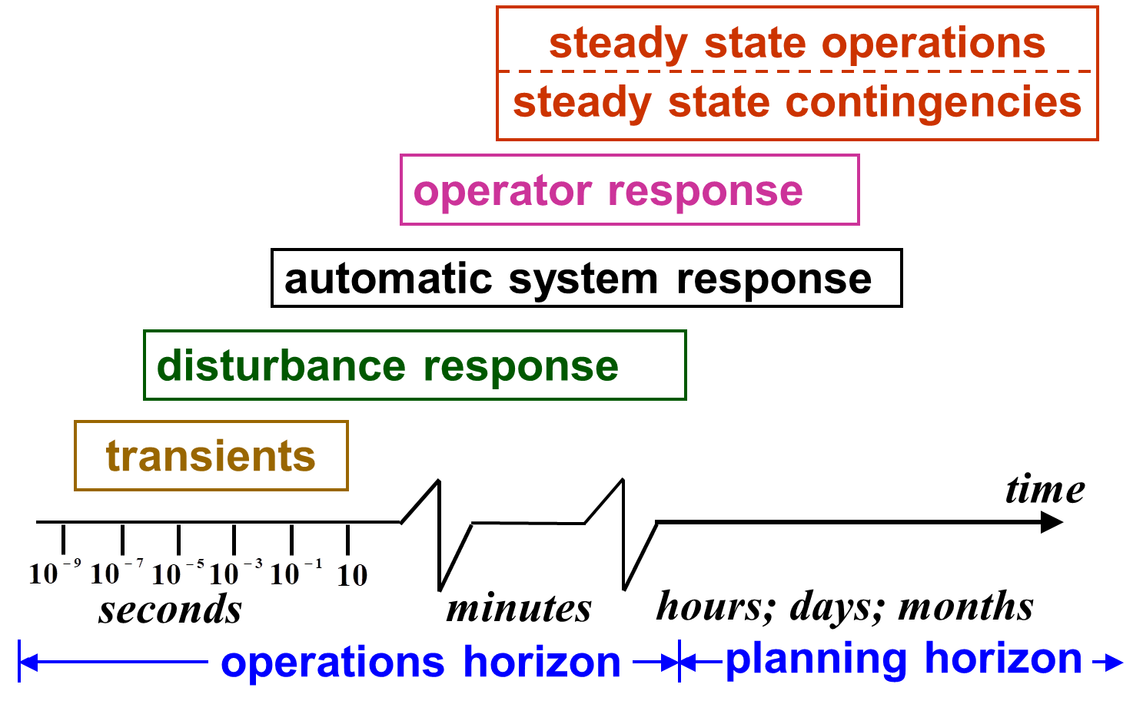
Power System Operation Regimes
Slide source: Prof. George Gross UIUC ECE 530

Slide 37
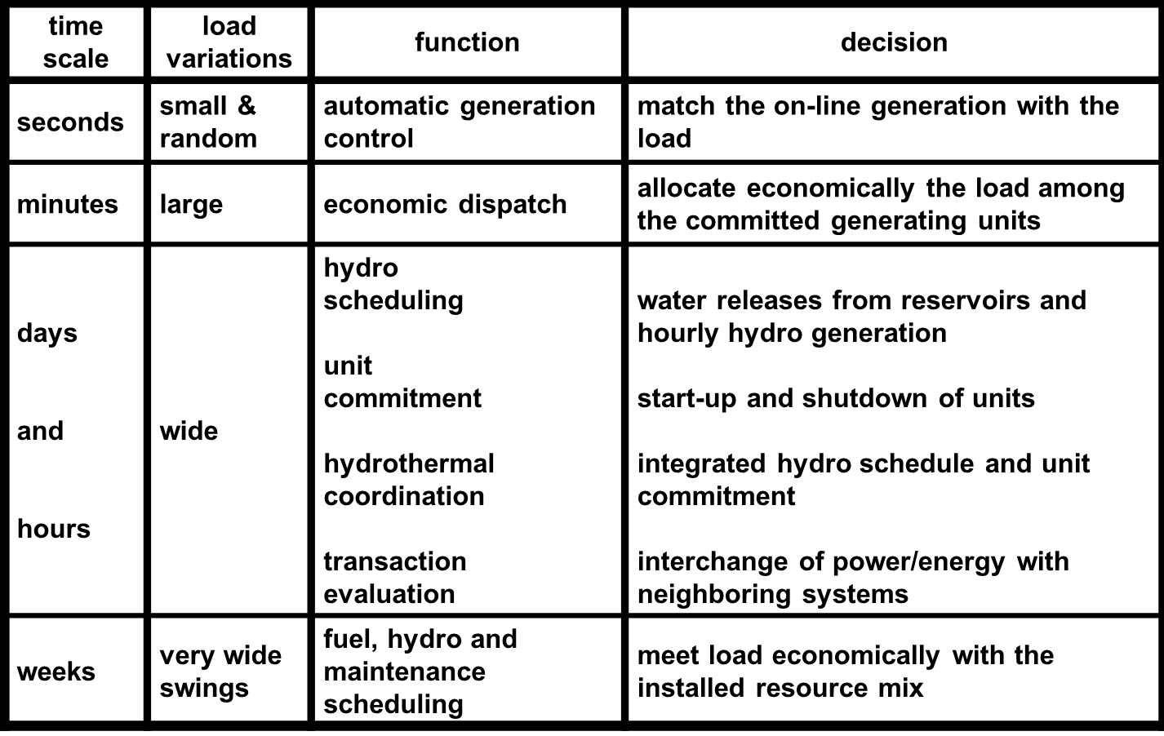
Generation Control and Scheduling Example
Slide source: Prof. George Gross UIUC ECE 530

Slide 38
Modeling Cautions!
"All models are wrong but some are useful," George Box, Empirical Model-Building and Response Surfaces, (1987, p. 424)
Models are an approximation to reality, not reality, so they always have some degree of approximation
Box went on to say that the practical question is how wrong to they have to be to not be useful
A good part of engineering is deciding what is the appropriate level of modeling, and knowing under what conditions the model will fail
Always keep in mind what problem you are trying to solve!

Slide 39
Course Objectives
Acquaint students with some key analytical aspects of large-scale systems
Stress the importance of problem formulation
Expose students to some of the major considerations in the design and operation of large-scale systems
Equip students with skills to read the relevant literature on analytical and computational techniques
Develop practical skills in solving these types of problems
Learn how to use example commercial software, especially with application to larger systems

Slide 40
Static Power System Analysis
One of the most common power system analysis tools is the power flow, which tells how power flows through a power system in the quasi-steady state time frame
Load flow is an alternative name for power flow; both terms have been used interchangeably for at least 50 years. I prefer power flow because the power flows, not the load
The power flow can be used to model the full, three-phase system, but usually (practically always) for transmission system analysis the system is assumed to be balanced. Hence a per phase equivalent model is used.

Slide 41
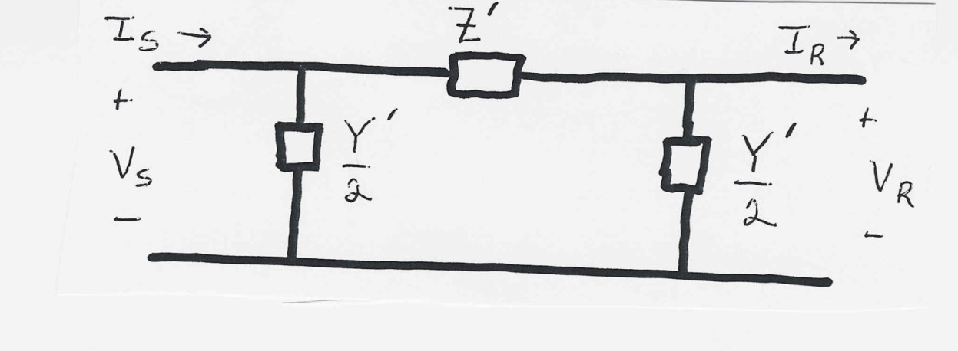
Power System Component Models: Transmission Lines
Power flow timeframe models for common power system devices, including transmission lines, transformers, generators and loads, are developed in the prerequisite courses ECEN 459 and 460
In 615 we will just be using the models, so it isn’t strictly required that you know the details on how they were developed; engineers need to know model validity range
Transmission lines will be modeled using the π circuit

Slide 42
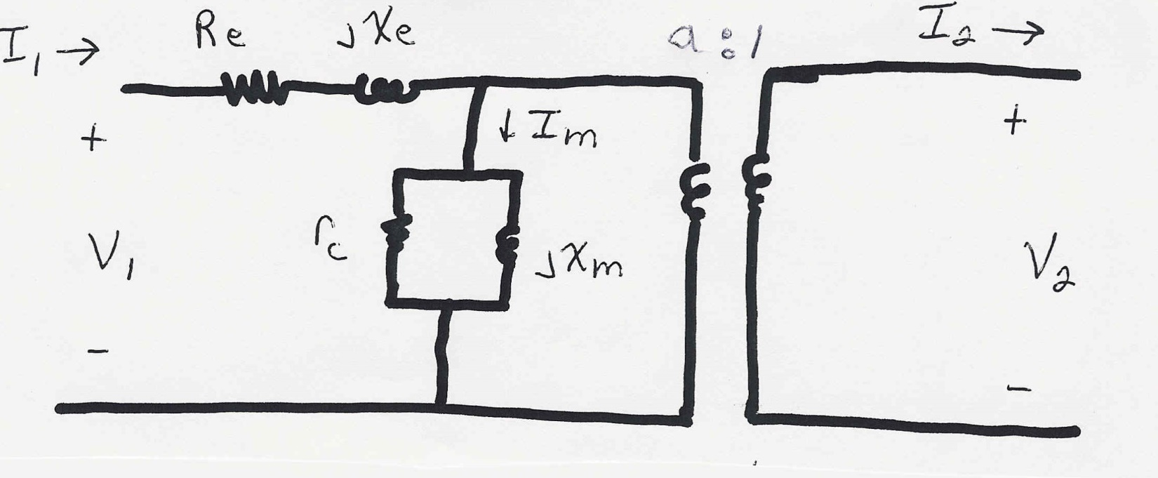
Power System Component Models: Transformers
Transformer equivalent model
In 615 the off-nominal turns ratio, a, will be a key control value. This is potentially a complex number (e.g., with a phase shifting transformer)

Slide 43
Power System Component Models: Generators
Engineering models depend upon application
Generators are usually synchronous machines
For generators we will use two different models:
a steady-state model, treating the generator as a constant power source operating at a fixed voltage; this model will be used for power flow and economic analysis
a short term model treating the generator as a constant voltage source behind a possibly time-varying reactance (with much more detailed modeled developed in ECEN 667)

Slide 44
Per Phase Calculations
A key problem in analyzing power systems is the large number of transformers.
It would be very difficult to continually have to refer impedances to the different sides of the transformers
This problem is avoided by a normalization of all variables.
This normalization is known as per unit analysis

Slide 45
Per Unit Conversion Procedure, 1φ
Pick a 1φ VA base for the entire system, S_{B}
Pick a voltage base for each different voltage level, V_{B}. Voltage bases are related by transformer turns ratios. Voltages are line to neutral.
Calculate the impedance base, Z_{B}= (V_{B})²/S_{B}
Calculate the current base, I_{B} = V_{B}/Z_{B}
Convert actual values to per unit
Note, per unit conversion only affects magnitudes, not
the angles. Also, per unit quantities no longer have
units (i.e., a voltage is 1.0 p.u., not 1 p.u. volts)

Slide 46
Per Unit Solution Procedure
Convert to per unit (p.u.) (many problems are already in per unit)
Solve
Convert back to actual as necessary

Slide 47
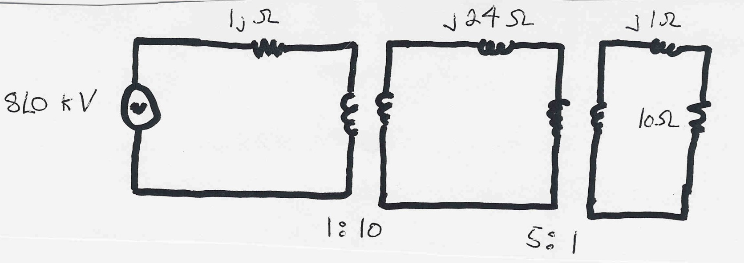
Single-Phase Per Unit Example
Solve for the current, load voltage and load power
in the circuit shown below using per unit analysis
with a single-phase S_{B} of 100 MVA, and voltage bases of
8 kV, 80 kV and 16 kV
Original Circuit

Slide 48
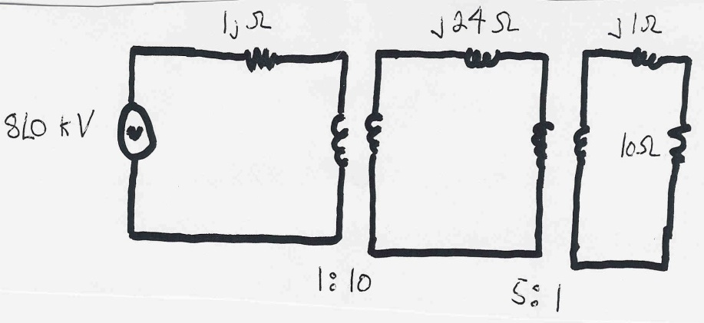
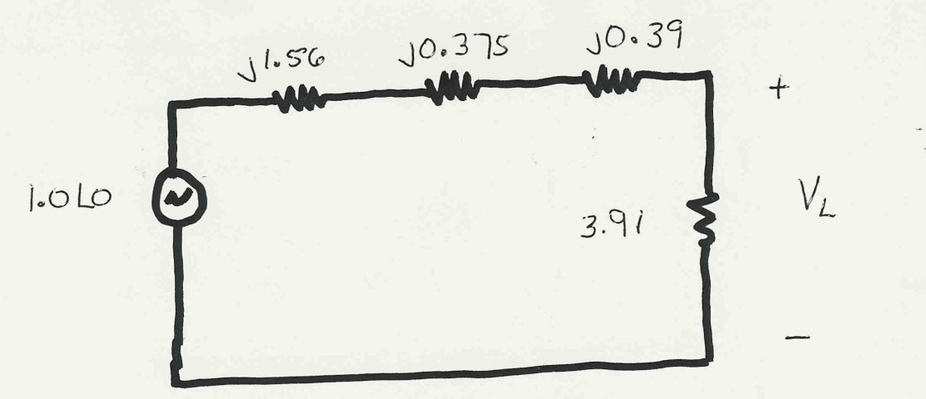
Per Unit Example, cont’d
Same circuit, with
values expressed
in per unit

Slide 49
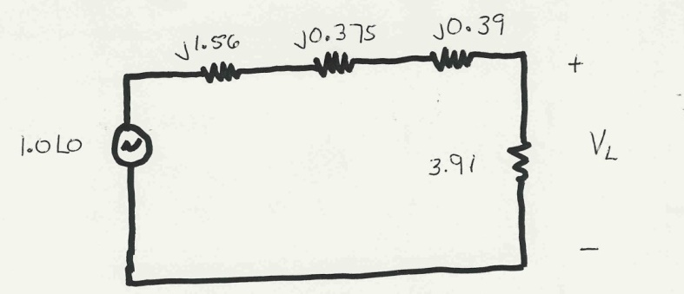
Per Unit Example, cont’d

Slide 50
Per Unit Example, cont’d
To convert back to actual values just multiply the
per unit values by their per unit base

