Slide 1
ECEN 615
Methods of Electric Power
Systems Analysis
Lecture 3: Per Unit, Ybus, Power Flow
Prof. Tom Overbye
Dept. of Electrical and Computer Engineering
Texas A&M University
overbye@tamu.edu

Slide 2
Announcements
RSVP to Alex at zandra23@ece.tamu.edu for the TAMU ECE Energy and Power Group (EPG) picnic. It starts at 5pm on September 27, 2019
Read Chapters 1 to 3 from the book (more as background material); starting reading Chapter 6
Homework 1 is assigned today. It is due on Thursday September 12

Slide 3
Load Models (Omitted from Lecture 2)
Ultimate goal is to supply loads with electricity at constant frequency and voltage
Electrical characteristics of individual loads matter, but usually they can only be estimated
  actual loads are constantly changing, consisting of a large number of individual devices
  only limited network observability of load characteristics
Aggregate models are typically used for analysis
Two common models
  constant power: S_{i} = P_{i} + jQ_{i}
  constant impedance: S_{i} = |V|² / Z_{i}
The ZIP model
combines constant
impedance, current
and power (P)

Slide 4
Reading Technical Papers
As a graduate student you should get in the habit of reading many technical papers, including all the ones mentioned in these notes
Papers are divided into 1) journal papers and 2) conference papers, with journal papers usually undergoing more review and of high quality
  There are LOTs of exceptions
Key journals in our area are from IEEE Power and Energy Society (PES); PSCC is a top conference
I read papers by looking at 1) title, 2) abstract, 3) summary, 4) results, 5) intro, 6) the rest; many papers never make it beyond step 1 or 2.

Slide 5
Learn to Write Well
Writing is a key skill for engineers, especially for students with advanced degrees
If you are not currently a good technical writer, use your time at TAMU to learn how to write well!
There are lots of good resources available to help you improve your writing. Books I’ve found helpful are
  Zinsser, “On Writing Well: The Classic Guide to Writing Nonfiction”
  Strunk and White, “The Elements of Style”
  Alred, Oliu, Brusaw, “The Handbook of Technical Writing”
TAMU Writing Center, writingcenter.tamu.edu/

Slide 6
Three-Phase Per Unit
Procedure is very similar to 1φ except we use a 3φ
VA base, and use line to line voltage bases
Pick a 3φ VA base for the entire system,
Pick a voltage base for each different voltage level, V_{B}. Voltages are line to line.
Calculate the impedance base
Exactly the same impedance bases as with single phase!

Slide 7
Three-Phase Per Unit, cont'd
Calculate the current base, I_{B}
Convert actual values to per unit
Exactly the same current bases as with single-phase!

Slide 8
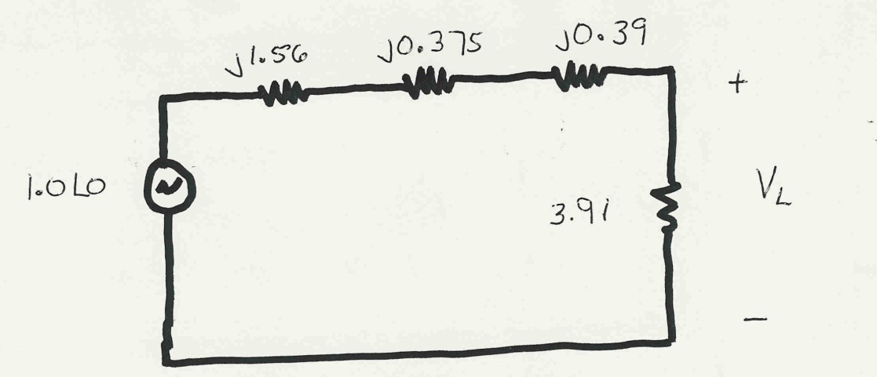
Three-Phase Per Unit Example
Solve for the current, load voltage and load power
in the previous circuit, assuming a 3φ power base of
300 MVA, and line to line voltage bases of 13.8 kV,
138 kV and 27.6 kV (square root of 3 larger than the 1φ example voltages). Also assume the generator is Y-connected so its line to line voltage is 13.8 kV.
Convert to per unit
as before. Note the
system is exactly the
same!

Slide 9
Three-Phase Per Unit Example, cont.
Again, analysis is exactly the same!

Slide 10
Three-Phase Per Unit Example, cont'd
Differences appear when we convert back to actual values

Slide 11
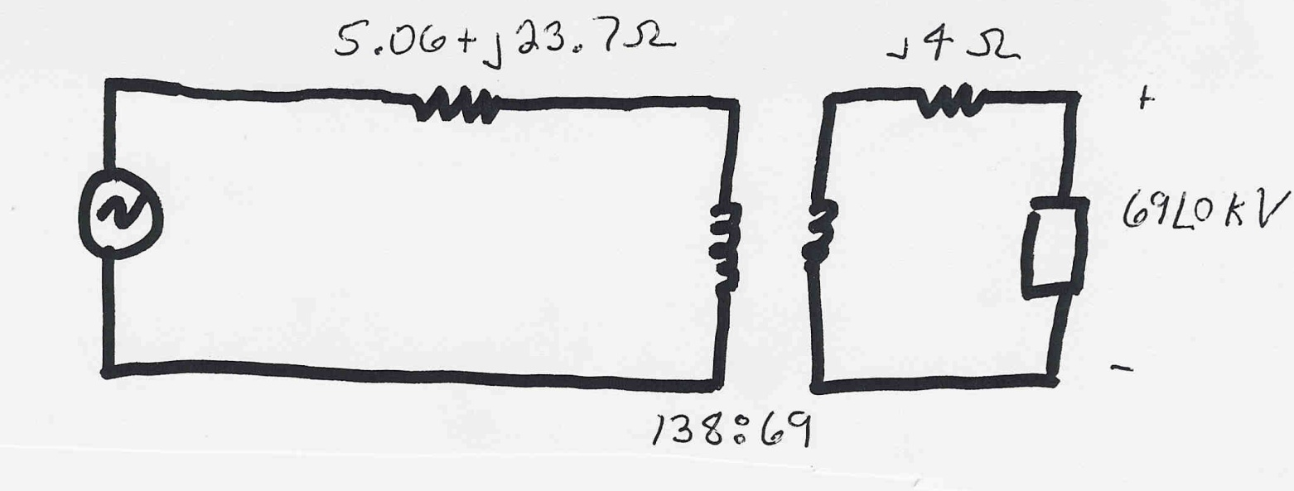
Three-Phase Per Unit Example 2
Assume a 3φ load of 100+j50 MVA with V_{LL} of 69 kV is connected to a source through the below network:
What is the supply current and complex power?
Answer: I=467 amps, S = 103.3 + j76.0 MVA

Slide 12
Power Flow Analysis
We now have the necessary models to start to develop the power system analysis tools
The most common power system analysis tool is the power flow (also known sometimes as the load flow)
  power flow determines how the power flows in a network
  also used to determine all bus voltages and all currents
  because of constant power models, power flow is a nonlinear analysis technique
  power flow is a steady-state analysis tool

Slide 13
Linear versus Nonlinear Systems
A function H is linear if
H(α₁μ₁ + α₂μ₂) = α₁H(μ₁) + α₂H(μ₂)
That is
1) the output is proportional to the input
2) the principle of superposition holds
Linear Example: y = H(x) = c x
y = c(x₁+x₂) = cx₁ + c x₂
Nonlinear Example: y = H(x) = c x²
y = c(x₁+x₂)² ≠ (cx₁)² + (c x₂)²

Slide 14
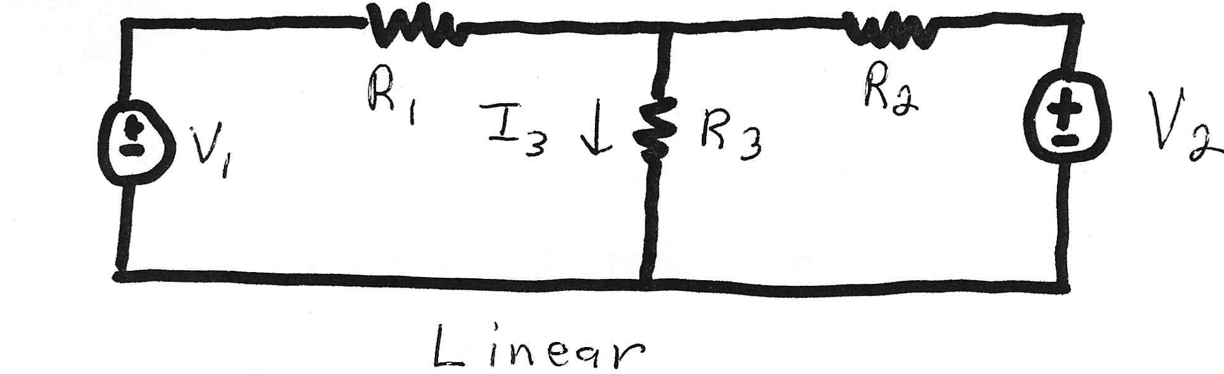
Linear Power System Elements

Slide 15
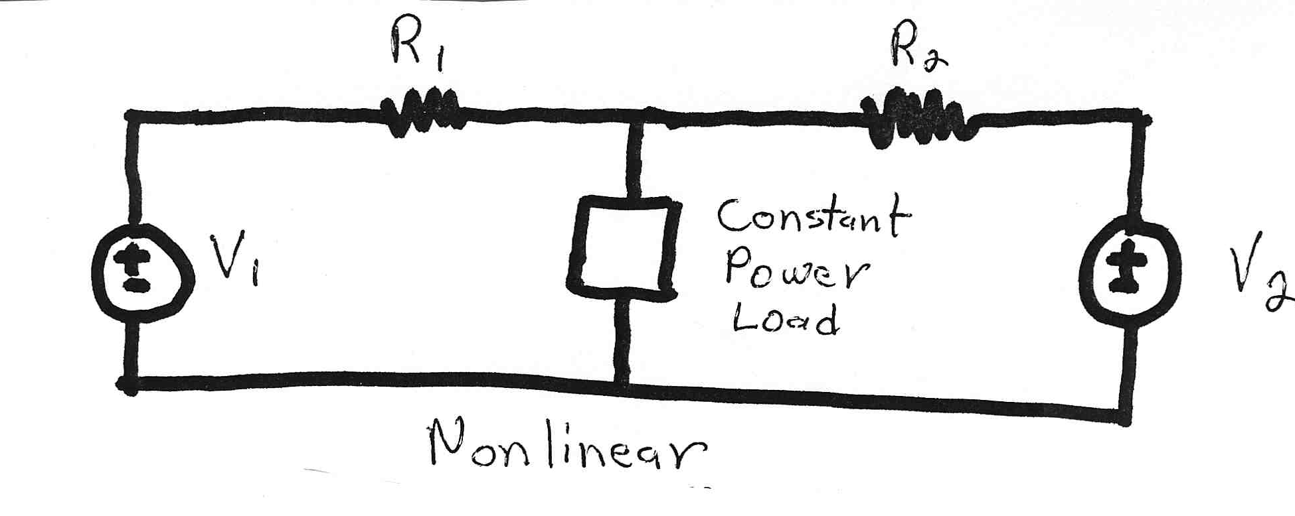
Nonlinear System Example
Constant power loads and generator injections are nonlinear and hence systems with these elements can not be analyzed by superposition
Nonlinear problems can be very difficult to solve,
and usually require an iterative approach

Slide 16
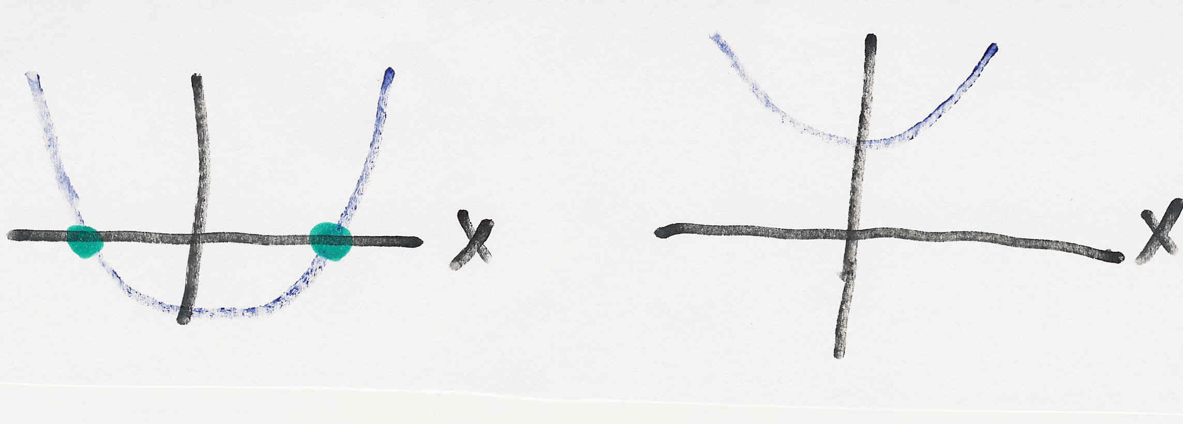
Nonlinear Systems May Have Multiple Solutions or No Solution
Example 1: x² - 2 = 0 has solutions x = ±1.414…
Example 2: x² + 2 = 0 has no real solution
f(x) = x² - 2
f(x) = x² + 2
two solutions where f(x) = 0
no solution f(x) = 0

Slide 17
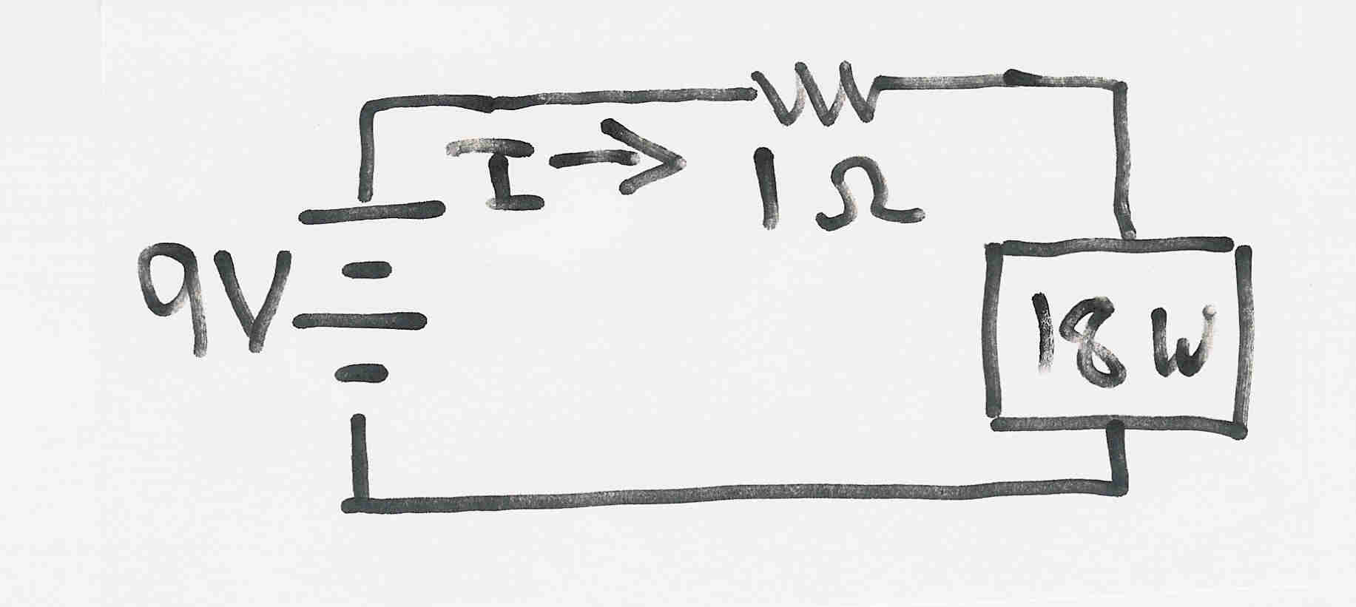
Multiple Solution Example
The dc system shown below has two solutions:
where the 18 watt
load is a resistive
load
What is the
maximum
P_{Load}?

Slide 18
Bus Admittance Matrix or Y_{bus}
First step in solving the power flow is to create what is known as the bus admittance matrix, often call the Y_{bus}.
The Y_{bus} gives the relationships between all the bus current injections, I, and all the bus voltages, V,
I = Y_{bus} V
The Y_{bus} is developed by applying KCL at each bus in the system to relate the bus current injections, the bus voltages, and the branch impedances and admittances

Slide 19
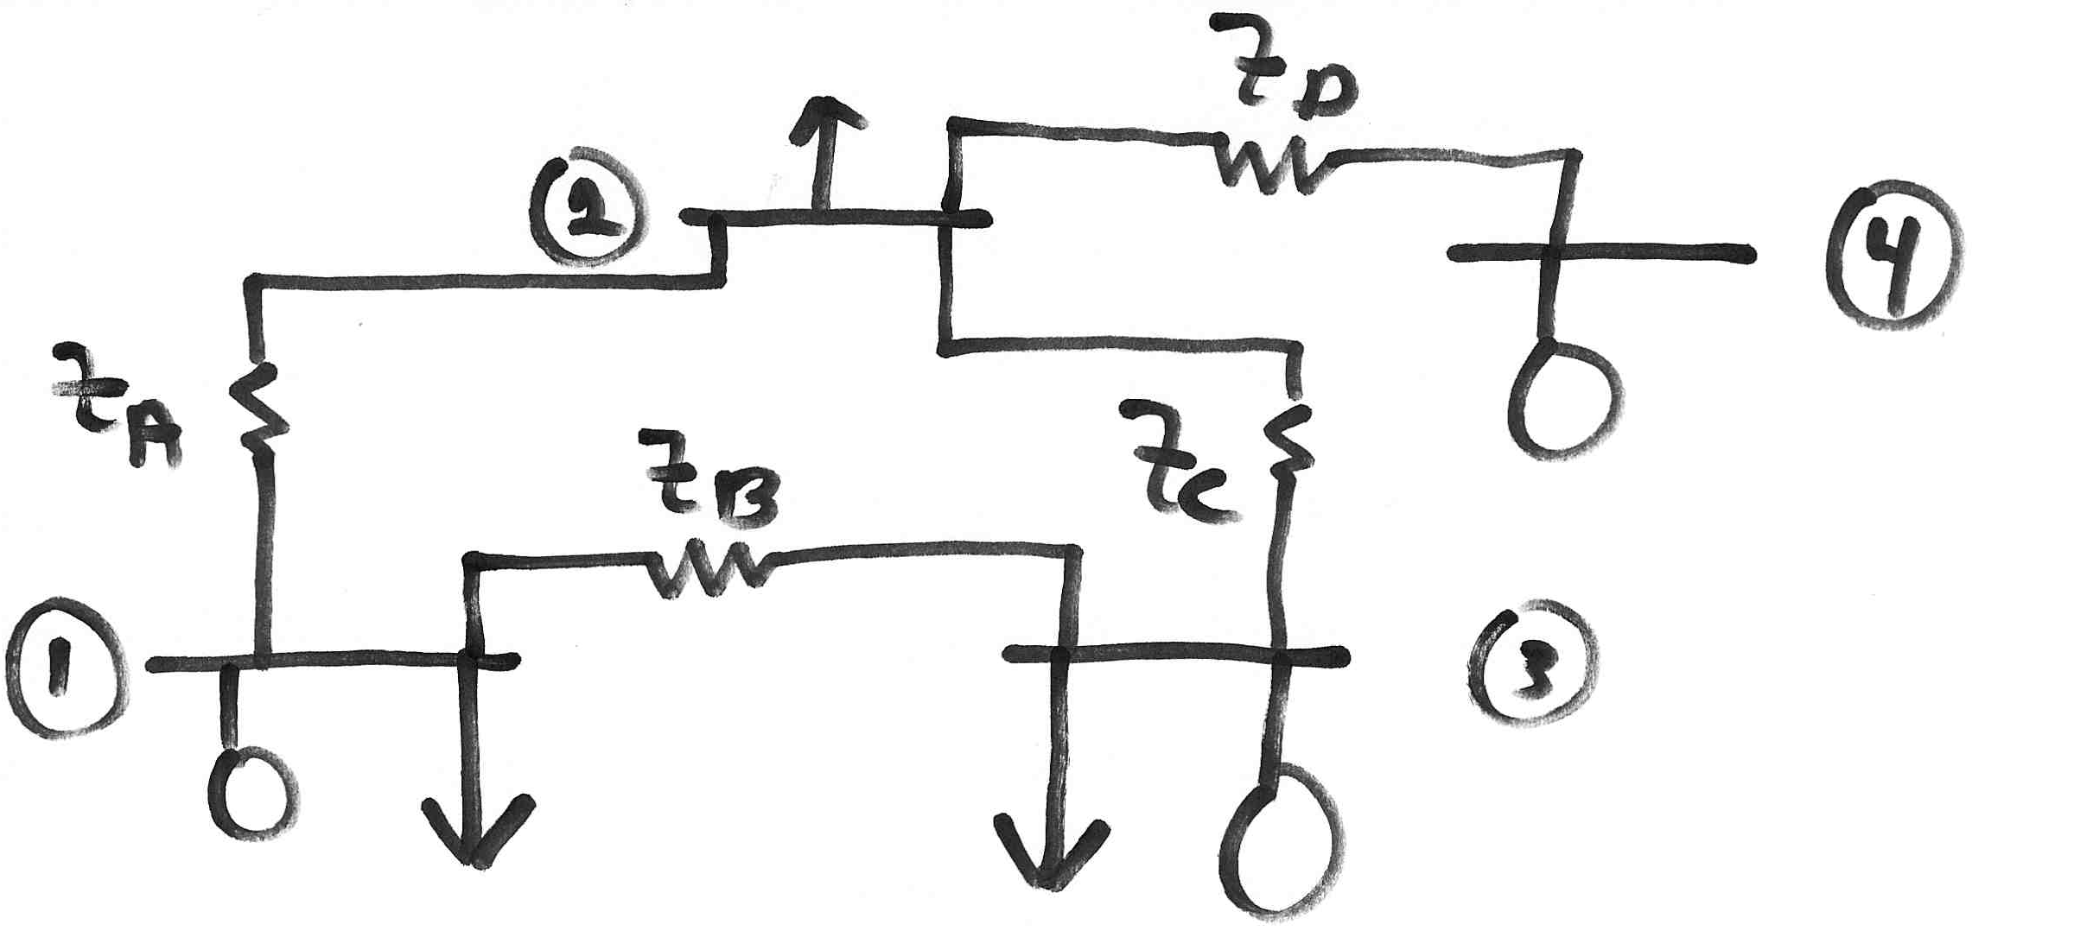
Y_{bus} Example
Determine the bus admittance matrix for the network
shown below, assuming the current injection at each
bus i is I_{i} = I_{Gi} - I_{Di} where I_{Gi} is the current injection into the
bus from the generator and I_{Di} is the current flowing into the
load

Slide 20
Y_{bus} Example, cont’d

Slide 21
Y_{bus} Example, cont’d
For a system with n buses the Y_{bus} is an n by n symmetric matrix (i.e., one where A_{ij} = A_{ji}); however this will not be true in general when we consider phase shifting transformers

Slide 22
Y_{bus} General Form
The diagonal terms, Y_{ii}, are the self admittance terms, equal to the sum of the admittances of all devices incident to bus i.
The off-diagonal terms, Y_{ij}, are equal to the negative of the sum of the admittances joining the two buses.
With large systems Y_{bus} is a sparse matrix (that is, most entries are zero)
Shunt terms, such as with the π line model, only affect the diagonal terms.

Slide 23
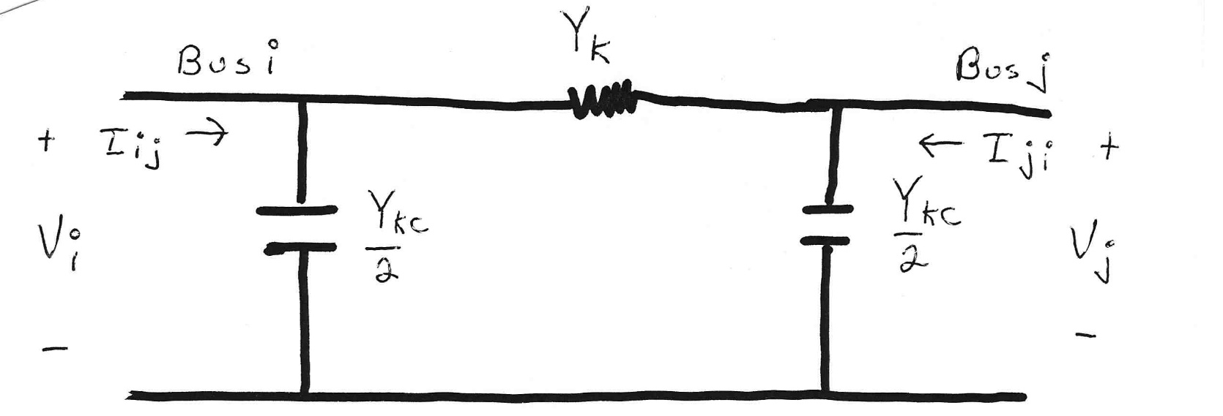
Modeling Shunts in the Y_{bus}

Slide 24
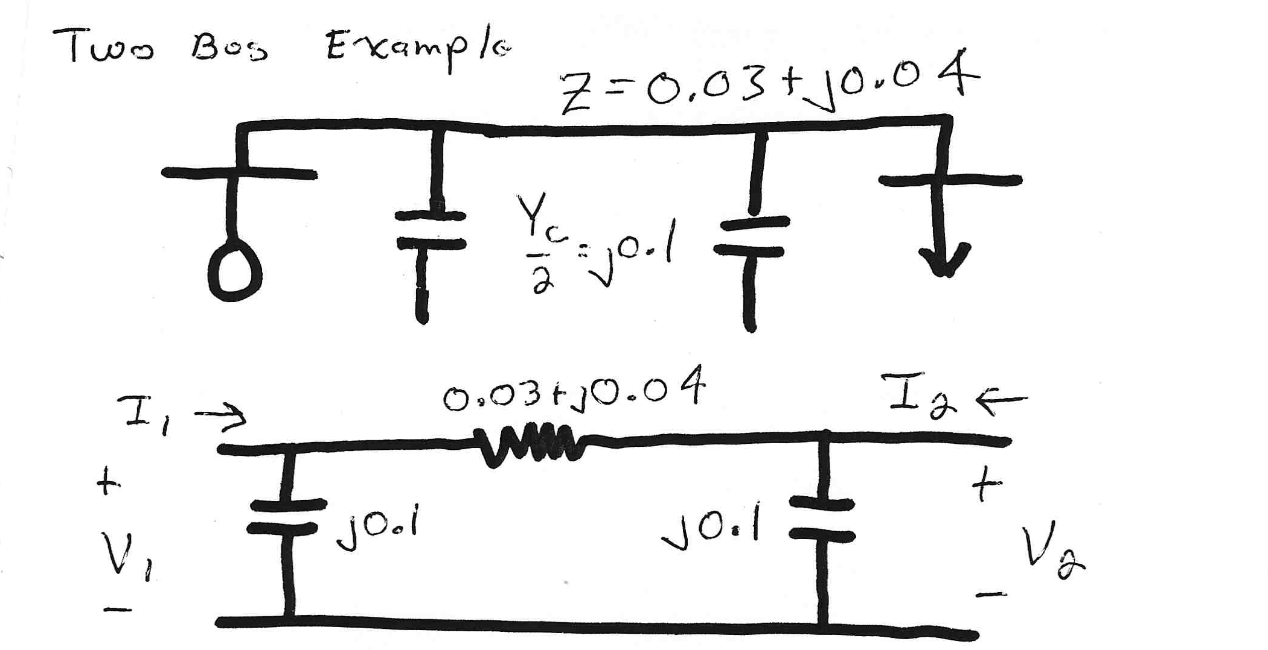
Two Bus System Example

Slide 25
Using the Y_{bus}
However, this requires that Y_{bus} not be singular; note it will be singular if there are no shunt connections!

Slide 26
Solving for Bus Currents

Slide 27
Solving for Bus Voltages

Slide 28
Power Flow Analysis
When analyzing power systems we know neither the complex bus voltages nor the complex current injections
Rather, we know the complex power being consumed by the load, and the power being injected by the generators plus their voltage magnitudes
Therefore we can not directly use the Y_{bus} equations, but rather must use the power balance equations

Slide 29
Power Balance Equations

Slide 30
Power Balance Equations, cont’d

Slide 31
Real Power Balance Equations

Slide 32
Power Flow Analysis
When analyzing power systems we know neither the complex bus voltages nor the complex current injections
Rather, we know the complex power being consumed by the load, and the power being injected by the generators plus their voltage magnitudes
Therefore we can not directly use the Y_{bus} equations, but rather must use the power balance equations

Slide 33
Power Flow Analysis
Classic paper for this lecture is W.F. Tinney and C.E. Hart, “Power Flow Solution by Newton’s Method,” IEEE Power App System, Nov 1967
Basic power flow is also covered in essentially any power system analysis textbooks.
We use the term “power flow” not “load flow” since power flows not load. Also, the power flow usage is not new (see title of Tinney’s 1967 paper, and note Tinney references Ward’s 1956 power flow paper)
  A nice history of the power flow is given in an insert by Alvarado and Thomas in T.J. Overbye, J.D. Weber, “Visualizing the Electric Grid,” IEEE Spectrum, Feb 2001.

Slide 34
Early Power Flow System Size
In 1957 Bill Tinney, in a paper titled “Digital Solutions for Large Power Networks,” studied a 100 bus, 200 branch system (with 2 KB of memory)!
In Tinney’s 1963 “Techniques for Exploiting Sparsity of the Network Admittance Matrix” paper (which gave us the Tinney Schemes 1, 2, and 3), uses 32 kB for 1000 nodes.
In Tinney’s classic 1967 “Power Flow Solution by Newton’s Method” paper he applies his method to systems with up to about 1000 buses (with 32 kB of memory) and provides a solution time of 51 seconds for a 487 bus system.

Slide 35
Slack Bus
We can not arbitrarily specify S at all buses because total generation must equal total load + total losses
We also need an angle reference bus.
To solve these problems we define one bus as the "slack" bus. This bus has a fixed voltage magnitude and angle, and a varying real/reactive power injection.
In an actual power system the slack bus does not really exist; frequency changes locally when the power supplied does not match the power consumed

Slide 36
Three Types of Power Flow Buses
There are three main types of power flow buses
  Load (PQ) at which P/Q are fixed; iteration solves for voltage magnitude and angle.
  Slack at which the voltage magnitude and angle are fixed; iteration solves for P/Q injections
  Generator (PV) at which P and |V| are fixed; iteration solves for voltage angle and Q injection

Slide 37
Newton-Raphson Algorithm
Most common technique for solving the power flow problem is to use the Newton-Raphson algorithm
Key idea behind Newton-Raphson is to use sequential linearization

Slide 38
Newton-Raphson Power Flow

Slide 39
Power Flow Variables

Slide 40
N-R Power Flow Solution

Slide 41
Power Flow Jacobian Matrix

Slide 42
Power Flow Jacobian Matrix, cont’d

Slide 43
Two Bus Newton-Raphson Example
For the two bus power system shown below, use the Newton-Raphson power flow to determine the voltage magnitude and angle at bus two. Assume that bus one is the slack and S_{Base} = 100 MVA.

Slide 44
Two Bus Example, cont’d

Slide 45
Two Bus Example, cont’d

Slide 46
Two Bus Example, First Iteration

Slide 47
Two Bus Example, Next Iterations

Slide 48
Two Bus Solved Values
Once the voltage angle and magnitude at bus 2 are known we can calculate all the other system values, such as the line flows and the generator reactive power output
PowerWorld Case Name: Bus2_Intro
Note, most PowerWorld cases will be available on
the course website

Slide 49
Two Bus Case Low Voltage Solution

Slide 50
Low Voltage Solution, cont'd

Slide 51
Practical Power Flow Software Note
Most commercial software packages have built in defaults to prevent convergence to low voltage solutions.
  One approach is to automatically change the load model from constant power to constant current or constant impedance when the load bus voltage gets too low
  In PowerWorld these defaults can be modified on the Tools, Simulator Options, Advanced Options page; note you also need to disable the “Initialize from Flat Start Values” option
  The PowerWorld case Bus2_Intro_Low is set solved to the low voltage solution
  Initial bus voltages can be set using the Bus Information Dialog

Slide 52
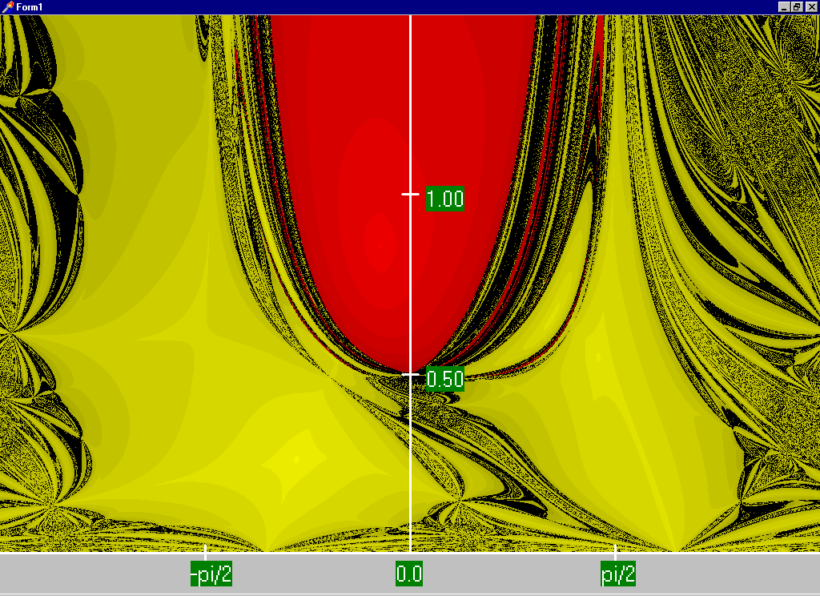
Two Bus Region of Convergence
Slide shows the region of convergence for different initial guesses of bus 2 angle (x-axis) and magnitude (y-axis)
Red region
converges
to the high
voltage
solution,
while the
yellow region
converges
to the low
voltage
solution

Slide 53
Power Flow Fractal Region of Convergence
Earliest paper showing fractal power flow regions of convergence is by C.L DeMarco and T.J. Overbye, “Low Voltage Power Flow Solutions and Their Role in Exit Time Bases Security Measures for Voltage Collapse,” Proc. 27th IEEE CDC, December 1988
A more widely known paper is J.S. Thorp, S.A. Naqavi, “Load-Flow Fractals Draw Clues to Erratic Behavior,” IEEE Computer Applications in Power, January 1997

