Slide 1
ECEN 615
Methods of Electric Power
Systems Analysis
Lecture 4: Power Flow
Prof. Tom Overbye
Dept. of Electrical and Computer Engineering
Texas A&M University
overbye@tamu.edu

Slide 2
Announcements
RSVP to Alex at zandra23@ece.tamu.edu for the TAMU ECE Energy and Power Group (EPG) picnic. It starts at 5pm on September 27, 2019
Read Chapter 6 from the book
  They formulate the power flow using the polar form for the Y_{bus} elements
Homework 1 is due on Thursday September 12

Slide 3
Two Bus Newton-Raphson Example
For the two bus power system shown below, use the Newton-Raphson power flow to determine the voltage magnitude and angle at bus two. Assume that bus one is the slack and S_{Base} = 100 MVA.

Slide 4
Two Bus Example, cont’d

Slide 5
Two Bus Example, cont’d

Slide 6
Two Bus Example, First Iteration

Slide 7
Two Bus Example, Next Iterations

Slide 8
Two Bus Solved Values
Once the voltage angle and magnitude at bus 2 are known we can calculate all the other system values, such as the line flows and the generator reactive power output
PowerWorld Case Name: Bus2_Intro
Note, most PowerWorld cases will be available on
the course website

Slide 9
Two Bus Case Low Voltage Solution

Slide 10
Low Voltage Solution, cont'd

Slide 11
Practical Power Flow Software Note
Most commercial software packages have built in defaults to prevent convergence to low voltage solutions.
  One approach is to automatically change the load model from constant power to constant current or constant impedance when the load bus voltage gets too low
  In PowerWorld these defaults can be modified on the Tools, Simulator Options, Advanced Options page; note you also need to disable the “Initialize from Flat Start Values” option
  The PowerWorld case Bus2_Intro_Low is set solved to the low voltage solution
  Initial bus voltages can be set using the Bus Information Dialog

Slide 12
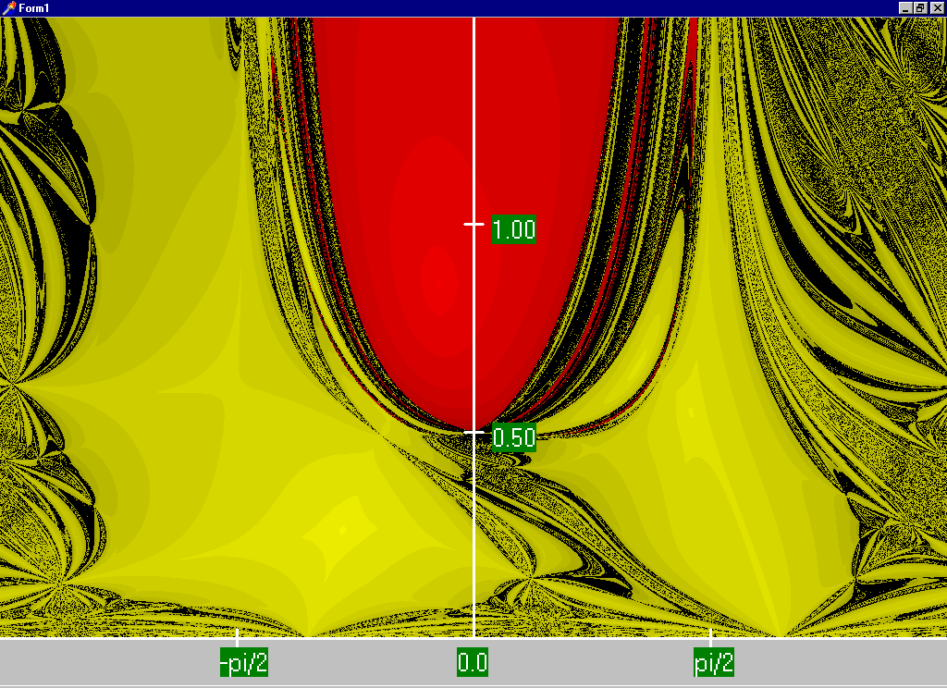
Two Bus Region of Convergence
Slide shows the region of convergence for different initial guesses of bus 2 angle (x-axis) and magnitude (y-axis)
Red region
converges
to the high
voltage
solution,
while the
yellow region
converges
to the low
voltage
solution

Slide 13
Power Flow Fractal Region of Convergence
Earliest paper showing fractal power flow regions of convergence is by C.L DeMarco and T.J. Overbye, “Low Voltage Power Flow Solutions and Their Role in Exit Time Bases Security Measures for Voltage Collapse,” Proc. 27th IEEE CDC, December 1988
A more widely known paper is J.S. Thorp, S.A. Naqavi, “Load-Flow Fractals Draw Clues to Erratic Behavior,” IEEE Computer Applications in Power, January 1997

Slide 14
PV Buses
Since the voltage magnitude at PV buses is fixed there is no need to explicitly include these voltages in x or write the reactive power balance equations
  the reactive power output of the generator varies to maintain the fixed terminal voltage (within limits)
  optionally these variations/equations can be included by just writing the explicit voltage constraint for the generator bus
  |V_{i} | – V_{i setpoint} = 0

Slide 15
Three Bus PV Case Example

Slide 16
Modeling Voltage Dependent Load

Slide 17
Voltage Dependent Load Example

Slide 18
Voltage Dependent Load, cont'd

Slide 19
Voltage Dependent Load, cont'd
With constant impedance load the MW/Mvar load at
bus 2 varies with the square of the bus 2 voltage
magnitude. This if the voltage level is less than 1.0,
the load is lower than 200/100 MW/Mvar
PowerWorld Case Name: Bus2_Intro_Z

Slide 20
Generator Reactive Power Limits
The reactive power output of generators varies to maintain the terminal voltage; on a real generator this is done by the exciter
To maintain higher voltages requires more reactive power
Generators have reactive power limits, which are dependent upon the generator's MW output
These limits must be considered during the power flow solution.

Slide 21
Generator Reactive Limits, cont'd
During the power flow once a solution is obtained there is a check to make sure the generator reactive power output is within its limits
If the reactive power is outside of the limits, fix Q at the max or min value, and resolve treating the generator as a PQ bus
  this is know as "type-switching"
  also need to check if a PQ generator can again regulate
Rule of thumb: to raise system voltage we need to supply more vars

Slide 22
The N-R Power Flow: 5-bus Example
T2
800 MVA
345/15 kV
1
T1
5
4
3
520 MVA
Line 3 345 kV
50 mi
400 MVA
15 kV
800 MVA
15 kV
400 MVA
15/345 kV
345 kV 100 mi
345 kV 200 mi
40 Mvar
80 MW
Line 2
Line 1
2
280 Mvar
800 MW
Single-line diagram
This five bus example is taken from Chapter 6 of Power
System Analysis and Design by Glover, Overbye, and Sarma,
6th Edition, 2016

Slide 23
The N-R Power Flow: 5-bus Example
Bus | Type | V per unit | δ degrees | P_{G} per unit | Q_{G} per unit | P_{L} per unit | Q_{L} per unit | Q_{Gmax} per unit | Q_{Gmin} per unit
1 | Swing | 1.0 | 0 | ⎯ | ⎯ | 0 | 0 | ⎯ | ⎯
2 | Load | ⎯ | ⎯ | 0 | 0 | 8.0 | 2.8 | ⎯ | ⎯
3 | Constant voltage | 1.05 | ⎯ | 5.2 | ⎯ | 0.8 | 0.4 | 4.0 | -2.8
4 | Load | ⎯ | ⎯ | 0 | 0 | 0 | 0 | ⎯ | ⎯
5 | Load | ⎯ | ⎯ | 0 | 0 | 0 | 0 | ⎯ | ⎯
Table 1.
Bus input
data
Bus-to-Bus | R’ per unit | X’ per unit | G’ per unit | B’ per unit | Maximum MVA per unit
2-4 | 0.0090 | 0.100 | 0 | 1.72 | 12.0
2-5 | 0.0045 | 0.050 | 0 | 0.88 | 12.0
4-5 | 0.00225 | 0.025 | 0 | 0.44 | 12.0
Table 2.
Line input data
Notes:
22

Slide 24
The N-R Power Flow: 5-bus Example
Bus-to-Bus | R per unit | X per unit | G_{c} per unit | B_{m} per unit | Maximum MVA per unit | Maximum TAP Setting per unit
1-5 | 0.00150 | 0.02 | 0 | 0 | 6.0 | —
3-4 | 0.00075 | 0.01 | 0 | 0 | 10.0 | —
Table 3.
Transformer
input data
Bus | Input Data | Unknowns
1 | V₁ = 1.0, δ₁ = 0 | P₁, Q₁
2 | P₂ = P_{G2}-P_{L2} = -8 Q₂ = Q_{G2}-Q_{L2} = -2.8 | V₂, δ₂
3 | V₃ = 1.05 P₃ = P_{G3}-P_{L3} = 4.4 | Q₃, δ₃
4 | P₄ = 0, Q₄ = 0 | V₄, δ₄
5 | P₅ = 0, Q₅ = 0 | V₅, δ₅
Table 4. Input data
and unknowns
Notes:
23

Slide 25
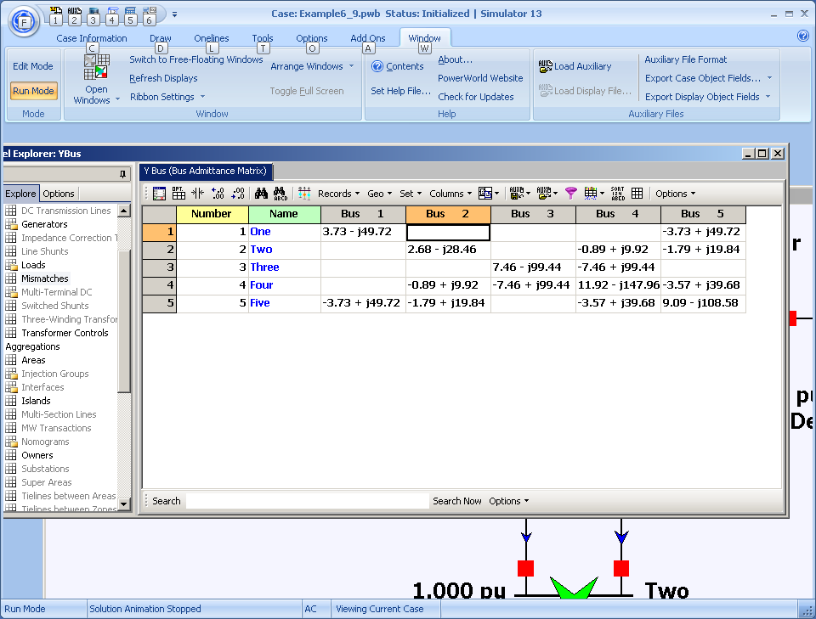
Five Bus Case Ybus
PowerWorld Case Name: GOS_FiveBus
Notes:
24

Slide 26
Ybus Calculation Details
Elements of Y_{bus} connected to bus 2
Notes:
25

Slide 27
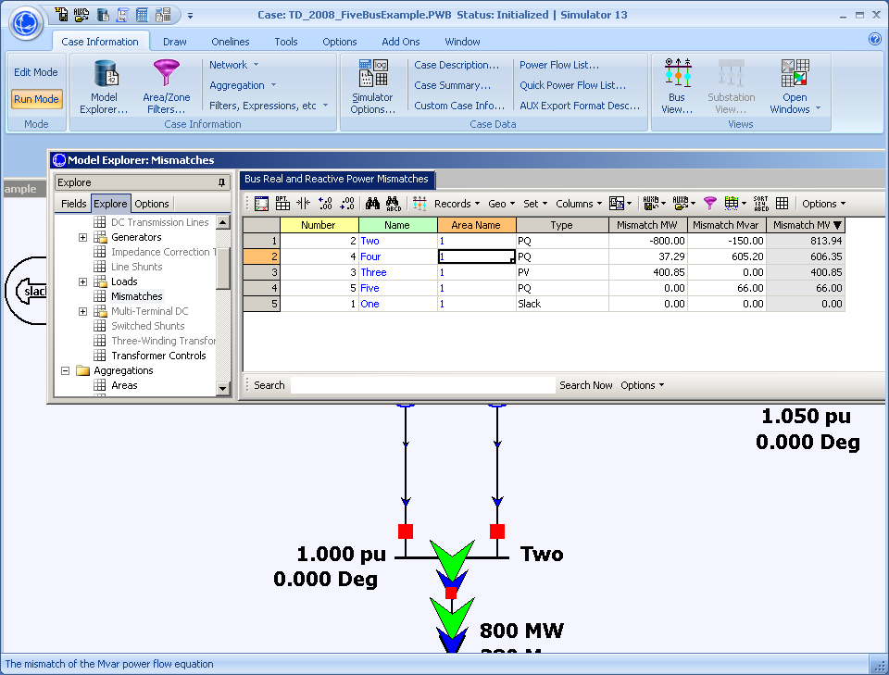
Initial Bus Mismatches
Notes:
26

Slide 28
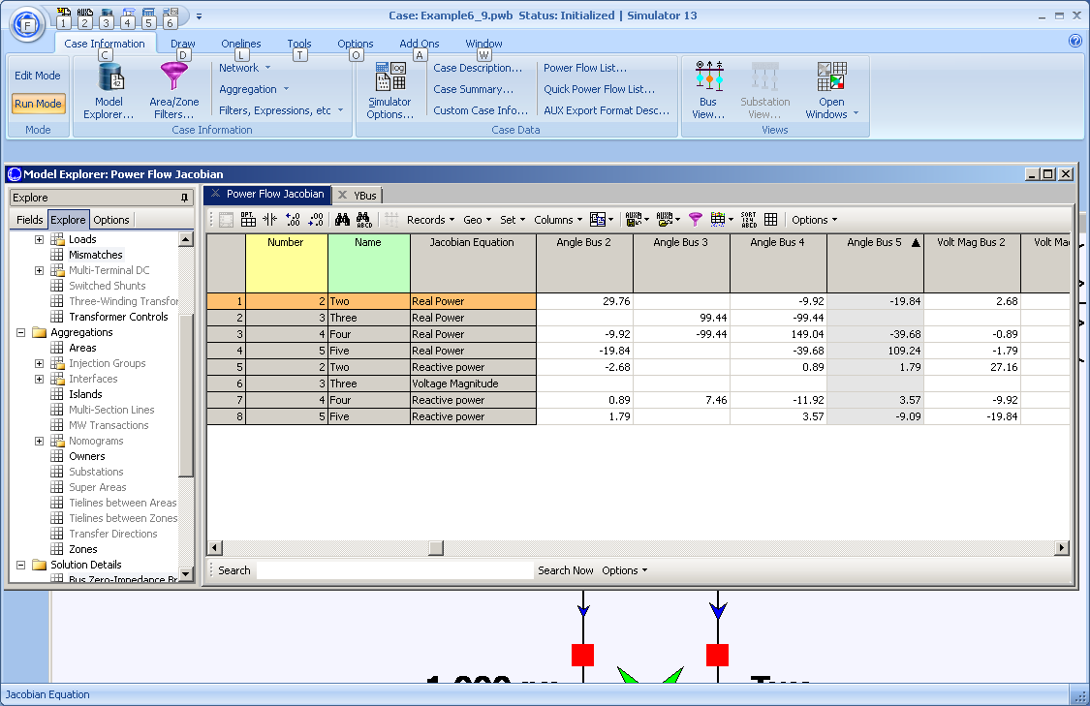
Initial Power Flow Jacobian
Notes:
27

Slide 29
Hand Calculation Details
Notes:
28

Slide 30
Five Bus Power System Solved
Notes:
29

Slide 31
37 Bus Case Example
PowerWorld Case Name: Aggieland37

Slide 32
Voltage Control Example: 37 Buses
PowerWorld Case Name: Bus37_VoltageControl

Slide 33
Power System Operations Overview
Goal is to provide an intuitive feel for power system operation
Emphasis will be on the impact of the transmission system
Introduce basic power flow concepts through small system examples

Slide 34
Power System Basics
All power systems have three major components: Generation, Load and Transmission/Distribution.
Generation: Creates electric power.
Load: Consumes electric power.
Transmission/Distribution: Transmits electric power from generation to load.
  Lines/transformers operating at voltages above 100 kV are usually called the transmission system. The transmission system is usually networked.
  Lines/transformers operating at voltages below 100 kV are usually called the distribution system (radial).

Slide 35
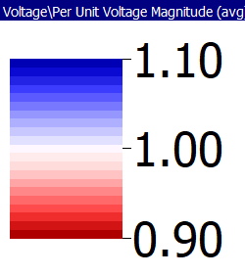
Large System Example: Texas 2000 Bus Synthetic System
This case requires the commercial version of PowerWorld
since the GOS Version is limited to 42 Buses

Slide 36
Three Bus PowerWorld Simulator Case
PowerWorld Case Name: B3Slow
Load with
green
arrows
indicating
amount
of MW
flow
Note the
power
balance at
each bus
Used
to control
output of
generator
Direction of green arrow is used to indicate
direction of real power (MW) flow; the blue
arrows show the reactive power

Slide 37
Basic Power Control
Opening a circuit breaker causes the power flow to instantaneously (nearly) change.
No other way to directly control power flow in a transmission line.
By changing generation we can indirectly change this flow.
Power flow in transmission line is limited by heating considerations
Losses (I^2 R) can heat up the line, causing it to sag.

Slide 38
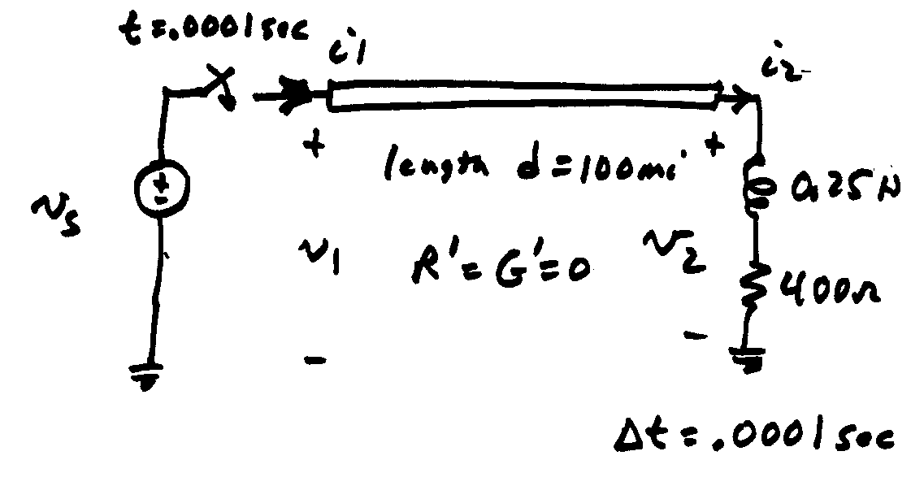
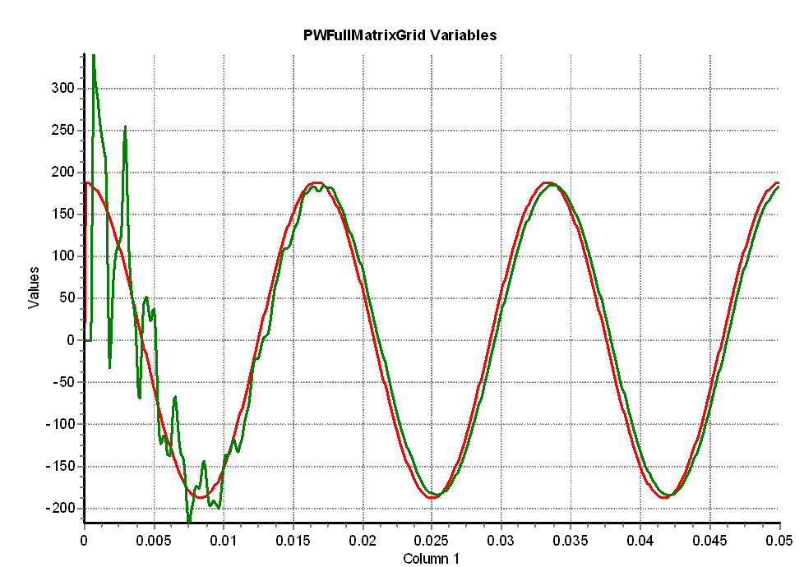
Modeling Consideration – Change is Not Really Instantaneous!
The change isn’t really instantaneous because of propagation delays, which are near the speed of light; there also wave reflection issues
  This is covered in ECEN 667
Red is the v_{s} end, green the v₂ end

Slide 39
Transmission Line Limits
Power flow in transmission line is limited by heating considerations.
Losses (I² R) can heat up the line, causing it to sag.
Each line has a limit; many utilities use winter/summer limits.

Slide 40
Overloaded Transmission Line

Slide 41
Interconnected Operation
Balancing Authority (BA) Areas
North American Eastern and Western grids are divided into balancing authority areas (BA)
  Often just called an area
Transmission lines that join two areas are known as tie-lines.
The net power out of an area is the sum of the flow on its tie-lines.
The flow out of an area is equal to
total gen - total load - total losses = tie-flow

Slide 42
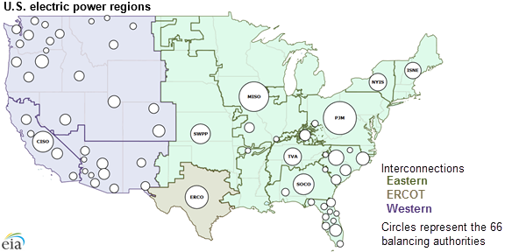
US Balancing Authorities

Slide 43
Area Control Error (ACE)
The area control error is the difference between the actual flow out of an area, and the scheduled flow
  ACE also includes a frequency component that we will probably consider later in the semester
Ideally the ACE should always be zero
Because the load is constantly changing, each utility (or ISO) must constantly change its generation to “chase” the ACE
ACE was originally computed by utilities; increasingly it is computed by larger organizations such as ISOs

Slide 44
Automatic Generation Control
Most utilities (ISOs) use automatic generation control (AGC) to automatically change their generation to keep their ACE close to zero.
Usually the control center calculates ACE based upon tie-line flows; then the AGC module sends control signals out to the generators every couple seconds.

Slide 45
Three Bus Case on AGC
Generation
is automatically
changed to match
change in load
Net tie flow is
close to zero

