Slide 1
ECEN 615
Methods of Electric Power
Systems Analysis
Lecture 5: Power Flow
Prof. Tom Overbye
Dept. of Electrical and Computer Engineering
Texas A&M University
overbye@tamu.edu

Slide 2
Announcements
RSVP to Alex at zandra23@ece.tamu.edu for the TAMU ECE Energy and Power Group (EPG) picnic. It starts at 5pm on September 27, 2019
Read Chapter 6 from the book
  They formulate the power flow using the polar form for the Y_{bus} elements
Homework 1 is due on Thursday September 12

Slide 3
Three Bus Case on AGC
Generation
is automatically
changed to match
change in load
Net tie flow is
close to zero

Slide 4
Generator Costs
There are many fixed and variable costs associated with power system operation
The major variable cost is associated with generation.
Cost to generate a MWh can vary widely
For some types of units (such as hydro and nuclear) it is difficult to quantify
More others such as wind and solar the marginal cost of energy is essentially zero (actually negative for wind!)
For thermal units it is straightforward to determine
Many markets have moved from cost-based to price-based generator costs

Slide 5
Economic Dispatch
Economic dispatch (ED) determines the least cost dispatch of generation for an area.
For a lossless system, the ED occurs when all the generators have equal marginal costs.
IC₁(P_{G,1}) = IC₂(P_{G,2}) = … = IC_{m}(P_{G,m})

Slide 6
Power Transactions
Power transactions are contracts between areas to do power transactions.
Contracts can be for any amount of time at any price for any amount of power.
Scheduled power transactions are implemented by modifying the area ACE:
ACE = P_{actual,tie-flow} - P_{sched}

Slide 7
100 MW Transaction
Net tie-line
flow is now
100 MW
Scheduled 100 MW transaction
from the Home Area to the
Other Area

Slide 8
Security Constrained ED
Transmission constraints often limit system economic operation.
Such limits required a constrained dispatch in order to maintain system security.
In the three bus case the generation at bus 3 must be constrained to avoid overloading the line from bus 2 to bus 3.

Slide 9
Security Constrained Dispatch
Dispatch is no longer optimal due to need to keep the line
from bus 2 to bus 3 from overloading

Slide 10
Multi-Area Operation
If areas have direct interconnections then they may directly transact, up to the capacity of their tie-lines.
Actual power flows through the entire network according to the impedance of the transmission lines.
Flow through other areas is known as “parallel path” or “loop flow.”

Slide 11
Seven Bus Case: One-line
System has three areas
Area Top
has five
buses
Area Left
has one
bus
Area Right has one bus
PowerWorld Case: B7Flat

Slide 12
Seven Bus Case: Area View
Actual
flow
between
areas
System has
40 MW of
“Loop Flow”
Scheduled
flow

Slide 13
Seven Bus - Loop Flow?
Transaction has actually decreased
the loop flow
Note that
Top’s
losses have
increased
from
7.1 MW to
9.6 MW
100 MW Transaction
between Left and Right

Slide 14
Power Transfer Distribution Factors (PTDFS)
PTDFs are used to show how a particular transaction will affect the system
The power transfers through the system according to the impedances of the lines, without respect to ownership
All transmission players in network could potentially be impacted (to a greater or lesser extent)
Later in the semester we’ll consider techniques for calculating PTDFs

Slide 15
PTDF Example: Nine Bus System, Actual Flows
PowerWorld Case: B9

Slide 16
PTDF Example: Nine Bus System, Transfer from A to I
Values now tell percentage of flow that will go on line

Slide 17
PTDF Example: Nine Bus System, Transfer From G to F
Values now tell percentage of flow that will go on line

Slide 18
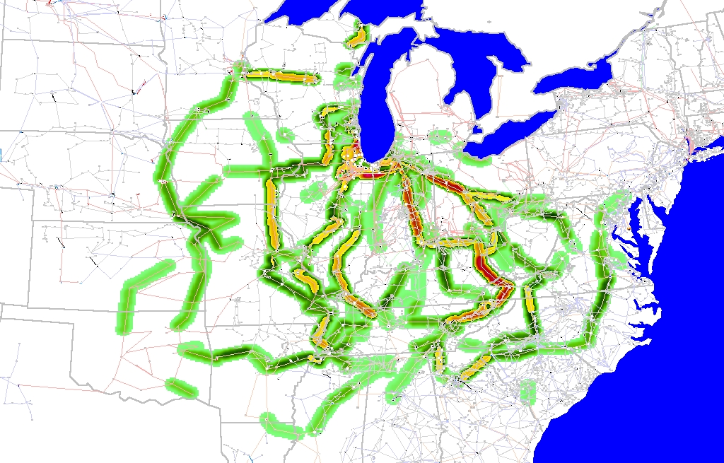
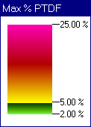
Wisconsin to TVA Line PTDF Contour
Contours show lines that would carry at least 2% of a power transfer from Wisconsin to TVA

Slide 19
NERC Flowgates
A convenient glossary of terms used for power system operations in North America is available at http://www.nerc.com/files/glossary_of_terms.pdf
One common term is a “flowgate,” which is a mathematical construct to measure the MW flow on one or more elements in the bulk transmission system
  Sometimes they include the impact of contingencies, something we will consider later in the semester
A simple flowgate would be the MW flow through a single transmission line or transformer

Slide 20
NERC TLRs
In the North American transmission loading relief procedures (TLRs) are used to mitigate the overloads on the bulk transmission system
  https://www.nerc.com/pa/Stand/Reliability%20Standards/IRO-006-5.pdf
  Called TLR in the East, WECC Unscheduled Flow Mitigation or Congestion Management Procedures (ERCOT)
In the Eastern Interconnect TLRs consider the PTDFs associated with transactions on flowgates if there is a flowgate violation

Slide 21
Loop Flow Impact:
Market Segmentation
During summer
of 1998 con-
gestion on just
two elements
pushed Midwest
spot market
prices up by a
factor of 200:
from $ 20/MWh
to $ 7500/MWh!

Slide 22
Pricing Electricity
Cost to supply electricity to bus is called the locational marginal price (LMP)
Presently some electric markets post LMPs on the web
In an ideal electricity market with no transmission limitations the LMPs are equal
Transmission constraints can segment a market, resulting in differing LMP
Determination of LMPs requires the solution on an Optimal Power Flow (OPF), which will be covered later in the semester

Slide 23
Three Bus LMPs – Constraints Ignored
Gen 2’s
cost
is $12
per
MWh
Gen 1’s
cost
is $10
per
MWh
Line from Bus 1 to Bus 3 is over-loaded; all buses have same marginal cost
PowerWorld Case: B3LP

Slide 24
Three Bus LMPs – Constraint Unforced
Line from 1 to 3 is no longer overloaded, but now
the marginal cost of electricity at bus 3 is $14 / MWh

Slide 25
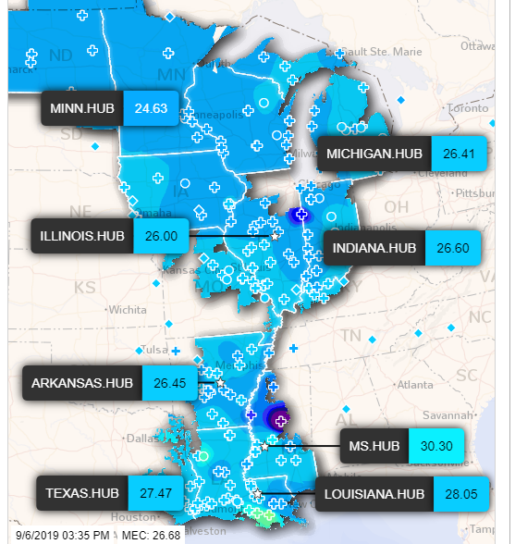
MISO LMPs on 9/6/2019, 3:35 PM
Five minute
LMPs are
posted online
for the MISO
footprint
Source: https://www.misoenergy.org/markets-and-operations/real-time--market-data/real-time-displays/

Slide 26
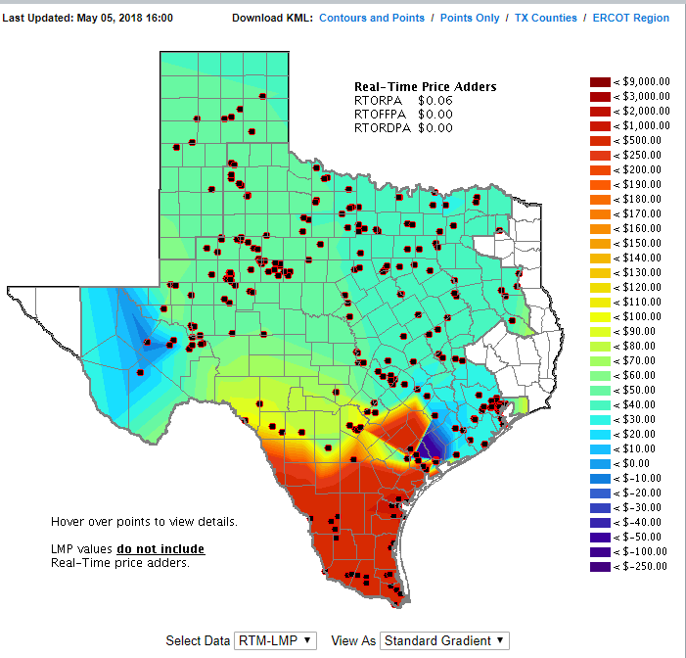
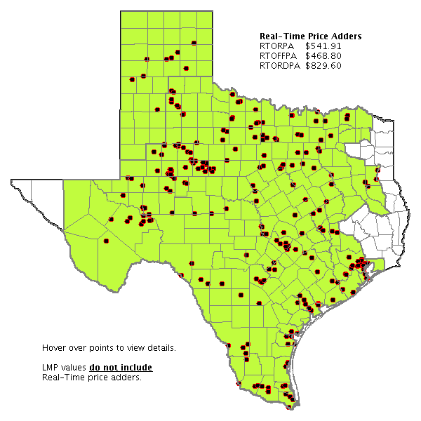
ERCOT LMPS: 5/5/18 and 9/6/19
Image Source: http://www.ercot.com/content/cdr/contours/rtmLmp.html

Slide 27
Advanced Power Flow
Next slides cover some more advanced power flow topics that need to be considered in many commercial power flow studies
An important consideration in the power flow is the assumed time scale of the response, and the assumed model of operator actions
  Planning power flow studies usually assume automatic modeling of operator actions and a longer time frame of response (controls have time to reach steady-state)
    For example, who is actually doing the volt/var control
  In real-time applications operator actions are usually not automated and controls may be more limited in time

Slide 28
Power Flow Optimal Multiplier
Classic reference on power flow optimal multiplier is S. Iwamoto, Y. Tamura, “A Load Flow Calculation Method for Ill-Conditioned Power Systems,” IEEE Trans. Power App. and Syst., April 1981
Another paper is J.E. Tate, T.J. Overbye, “A Comparison of the Optimal Multiplier in Power and Rectangular Coordinates,” IEEE Trans. Power Systems, Nov. 2005
Key idea is once NR method has selected a direction, we can analytically determine the distance to move in that direction to minimize the norm of the mismatch
  Goal is to help with stressed power systems

Slide 29
Power Flow with Optimal Multiplier
Consider an n bus power system with f(x) = S where S is the vector of the constant real and reactive power load minus generation at all buses except the slack, x is the vector of the bus voltages in rectangular coordinates: V_{i} = e_{i} + jf_{i,}
and f is the function of the power balance constraints

Slide 30
Power Flow with Optimal Multiplier
With a standard NR approach we would get
If we are close enough to the solution the iteration converges quickly, but if the system is heavily loaded it can diverge

Slide 31
Power Flow with Optimal Multiplier
Optimal multiplier approach modifies the iteration as
Scalar μ is chosen to minimize the norm of the mismatch F in direction Δx
Paper by Iwamoto, Y. Tamura from 1981 shows μ can be computed analytically with little additional calculation when rectangular voltages are used

Slide 32
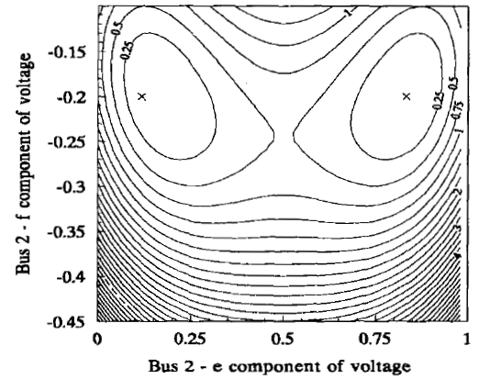
Power Flow with Optimal Multiplier
Determination of μ involves solving a cubic equation, which gives either three real solutions, or one real and two imaginary solutions
1989 PICA paper by Iba
(“A Method for Finding a
Pair of Multiple Load
Flow Solutions in Bulk
Power Systems”) showed
that NR tends to converge
along line joining the high
and a low voltage solution
However, there are some model restrictions

Slide 33
Quasi-Newton Power Flow Methods
First we consider some modified versions of the Newton power flow (NPF)
Since most of the computation in the NPF is associated with building and factoring the Jacobian matrix, J, the focus is on trying to reduce this computation
In a pure NPF J is build and factored each iteration
Over the years pretty much every variation of the NPF has been tried; here we just touch on the most common
Whether a method is effective can be application dependent
  For example, in contingency analysis we are usually just resolving a solved case with an often small perturbation

Slide 34
Quasi-Newton Power Flow Methods
The simplest modification of the NPF results when J is kept constant for a number of iterations, say k iterations
  Sometimes known as the Dishonest Newton
The approach balances increased speed per iteration, with potentially more iterations to perform
There is also an increased possibility for divergence
Since the mismatch equations are not modified, if it converges it should converge to the same solution as the NPF
These methods are not commonly used, except in very short duration, sequential power flows with small mismatches

Slide 35
Dishonest N-R Example
We pay a price
in increased
iterations, but
with decreased
computation
per iteration; that
price is too high
in this example

Slide 36
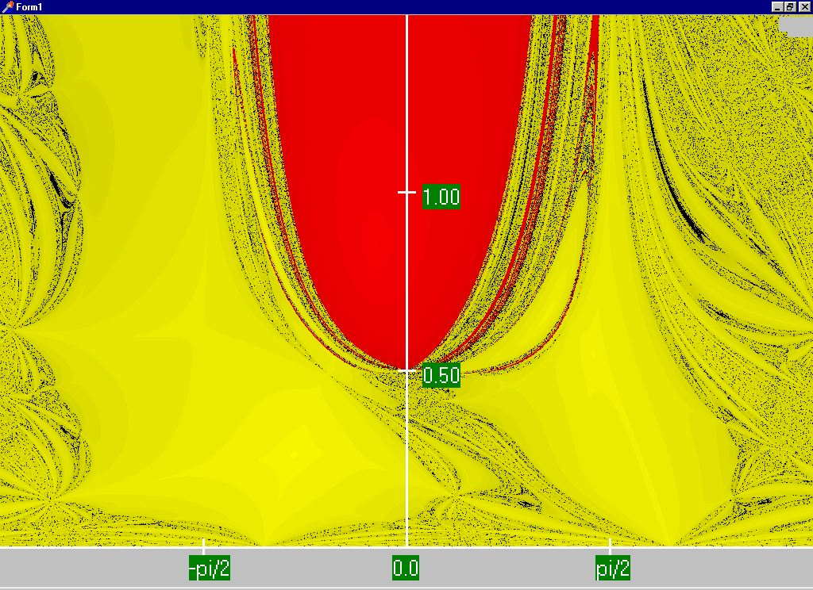
NPF (Honest) Region of for Two Bus Example Convergence
Red region
converges
to the high
voltage
solution,
while the
yellow region
converges
to the low
voltage
solution
Maximum
of 15
iterations

Slide 37
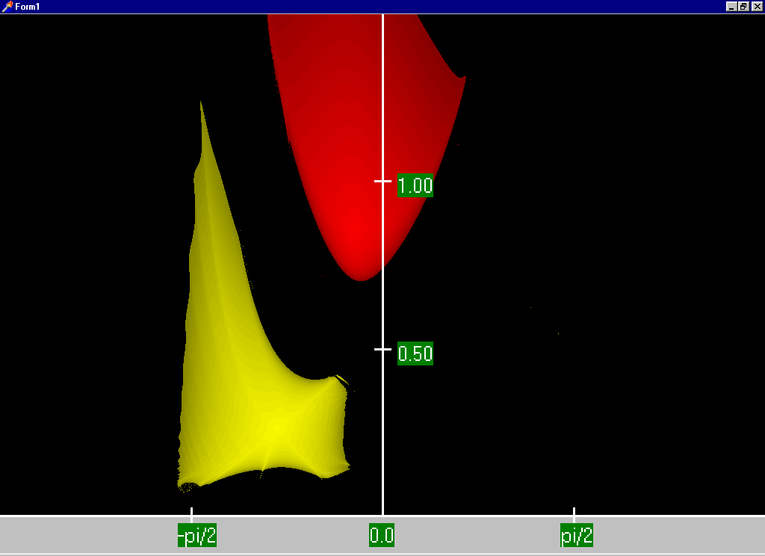
Two Bus Dishonest ROC
In this case
being honest
pays! At
least with
respect to
the
region of
convergence
(ROC)

Slide 38
Quasi-Newton Power Flow Methods
A second modification is to modify the step size in the direction given by the NPF
  This is one we’ve already considered with the optimal multiplier approach
The generalized approach is to solve what is known as the line search (i.e., a one-dimensional optimization) to determine μ

Slide 39
The Single Dimensional ψ (λ)
0

Slide 40
Line Search
We need a cost function, which is usually the Euclidean norm of the mismatch vector
The line search is a general optimization problem for which there are many potential solution approaches
  Determines a local optimum within some search boundaries
  Approaches depend on whether there is gradient information available
Aside from the optimal multiplier approach, which can be quite helpful with little additional computation, the convergence gain from determining the “optimal” μ is usually more than offset by the line search computation

Slide 41
Decoupled Power Flow
Rather than not updating the Jacobian, the decoupled power flow takes advantage of characteristics of the power grid in order to decouple the real and reactive power balance equations
  There is a strong coupling between real power and voltage angle, and reactive power and voltage magnitude
  There is a much weaker coupling between real power and voltage angle, and reactive power and voltage angle
Key reference is B. Stott, “Decoupled Newton Load Flow,” IEEE Trans. Power. App and Syst., Sept/Oct. 1972, pp. 1955-1959

Slide 42
Decoupled Power Flow Formulation

Slide 43
Decoupling Approximation

Slide 44
Off-diagonal Jacobian Terms
By assuming ½ the elements are zero, we only have to do
½ the computations

Slide 45
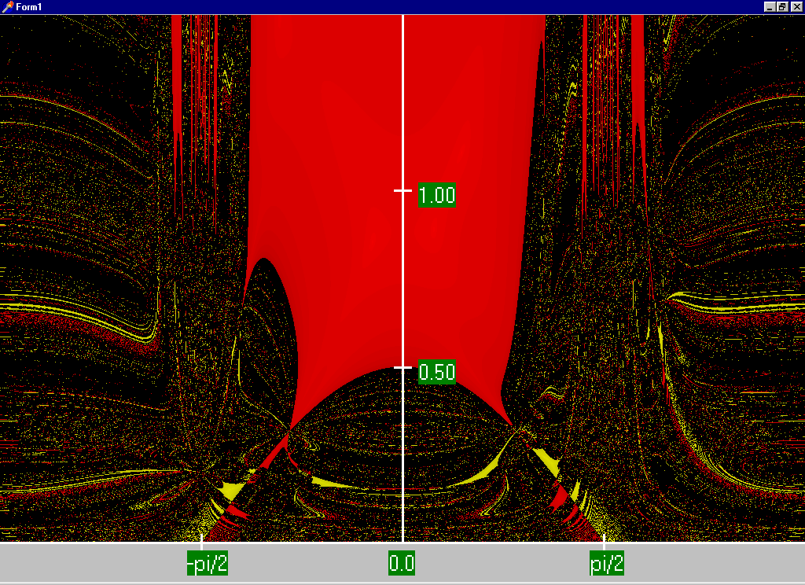
Decoupled N-R Region of Convergence
The high
solution ROC is actually
larger than with the standard
NPF. Obviously
this is not
a good a way to get the low
solution

Slide 46
Fast Decoupled Power Flow
By continuing with our Jacobian approximations we can actually obtain a reasonable approximation that is independent of the voltage magnitudes/angles.
This means the Jacobian need only be built/inverted once per power flow solution
This approach is known as the fast decoupled power flow (FDPF)

Slide 47
Fast Decoupled Power Flow, cont.
FDPF uses the same mismatch equations as standard power flow (just scaled) so it should have same solution
The FDPF is widely used, though usually only when we only need an approximate solution
Key fast decoupled power flow reference is B. Stott, O. Alsac, “Fast Decoupled Load Flow,” IEEE Trans. Power App. and Syst., May 1974, pp. 859-869
Modified versions also exist, such as D. Jajicic and A. Bose, “A Modification to the Fast Decoupled Power Flow for Networks with High R/X Ratios, “IEEE Transactions on Power Sys., May 1988, pp. 743-746

Slide 48
FDPF Approximations
To see the impact on the real power equations recall

Slide 49
FDPF Approximations
With the approximations for the diagonal term we get
Hence the Jacobian for the real equations can be approximated as –B

Slide 50
FPDF Approximations
For the reactive power equations we also scale by V_{i}
For the Jacobian off-diagonals we get

Slide 51
FDPF Approximations
And for the reactive power Jacobian diagonal we get
As derived the real and reactive equations have a constant Jacobian equal to –B
  Usually modifications are made to omit from the real power matrix elements that affect reactive flow (like shunts) and from the reactive power matrix elements that affect real power flow, like phase shifters
  We’ll call the real power matrix B’ and the reactive B”

