Slide 1
ECEN 615
Methods of Electric Power
Systems Analysis
Lecture 6: Power Flow
Prof. Tom Overbye
Dept. of Electrical and Computer Engineering
Texas A&M University
overbye@tamu.edu

Slide 2
Announcements
RSVP to Alex at zandra23@ece.tamu.edu for the TAMU ECE Energy and Power Group (EPG) picnic. It starts at 5pm on September 27, 2019
Read Chapter 6 from the book
  They formulate the power flow using the polar form for the Y_{bus} elements
Homework 1 is due today
Homework 2 is due on Thursday September 26

Slide 3
FDPF Three Bus Example
Use the FDPF to solve the following three bus system

Slide 4
FDPF Three Bus Example, cont’d

Slide 5
FDPF Three Bus Example, cont’d

Slide 6
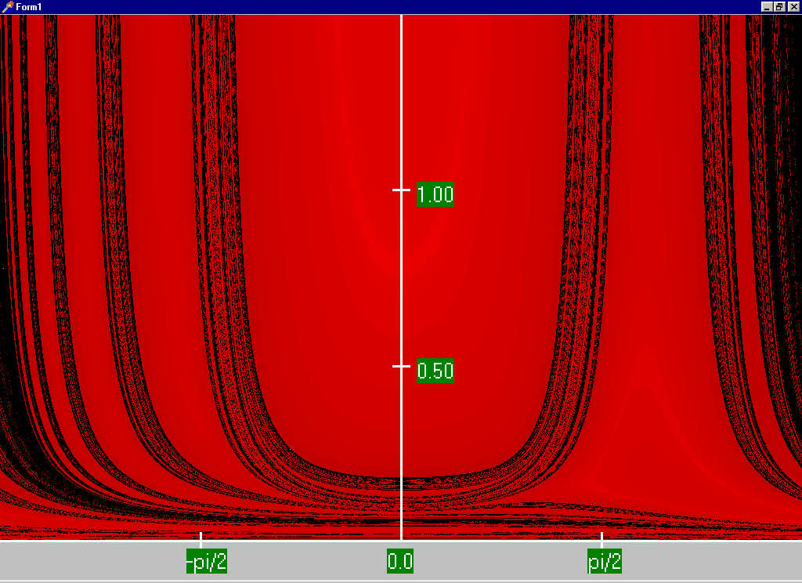
FDPF Region of Convergence

Slide 7
FDPF Cautions
The FDPF works well as long as the previous approximations hold for the entire system
With the movement towards modeling larger systems, with more of the lower voltage portions of the system represented (for which r/x ratios are higher) it is quite common for the FDPF to get stuck because small portions of the system are ill-behaved
The FDPF is commonly used to provide an initial guess of the solution or for contingency analysis

Slide 8
DC Power Flow
The “DC” power flow makes the most severe approximations:
  completely ignore reactive power, assume all the voltages are always 1.0 per unit, ignore line conductance
This makes the power flow a linear set of equations, which can be solved directly
The term dc power flow actually dates from the time of the old network analyzers (going back into the 1930’s)
Not to be confused with the inclusion of HVDC lines in the standard NPF
P sign convention is generation is positive

Slide 9
DC Power Flow References
I don’t think a classic dc power flow paper exists; a nice formulation is given in our book Power Generation and Control book by Wood, Wollenberg and Sheble
The August 2009 paper in IEEE Transactions on Power Systems, “DC Power Flow Revisited” (by Stott, Jardim and Alsac) provides good coverage
T. J. Overbye, X. Cheng, and Y. Sun, “A comparison of the AC and DC power flow models for LMP Calculations,” in Proc. 37th Hawaii Int. Conf. System Sciences, 2004, compares the accuracy of the approach

Slide 10
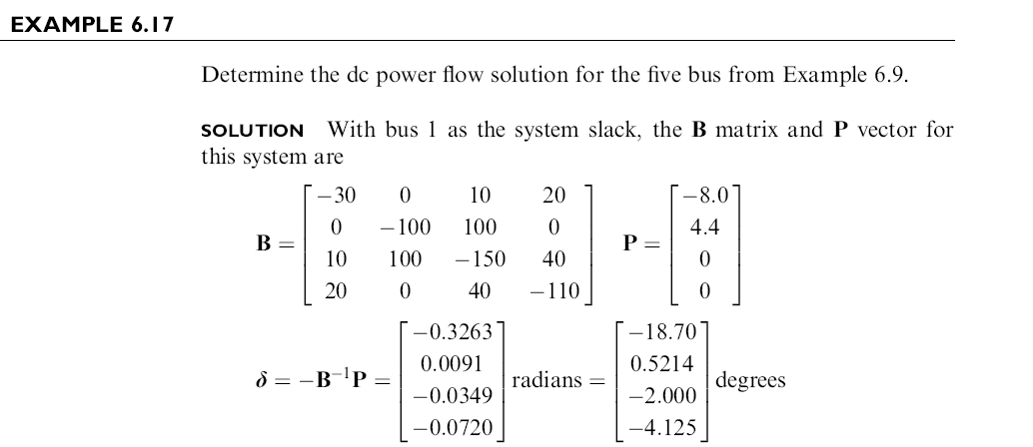
DC Power Flow Example
Example from Power System Analysis and Design, by Glover, Overbye, Sarma, 6th Edition

Slide 11
DC Power Flow in PowerWorld
PowerWorld allows for easy switching between the dc and ac power flows (case Aggieland37)
To use the
dc approach
in PowerWorld
select Tools,
Solve, DC
Power Flow
Notice there
are no
losses

Slide 12
Modeling Transformers with Off-Nominal Taps and Phase Shifts
If transformers have a turns ratio that matches the ratio of the per unit voltages than transformers are modeled in a manner similar to transmission lines.
However it is common for transformers to have a variable tap ratio; this is known as an “off-nominal” tap ratio
  The off-nominal tap is t, initially we’ll consider it a real number
  We’ll cover phase shifters shortly in which t is complex

Slide 13
Transformer Representation
The one–line diagram of a branch with a variable tap transformer
The network representation of a branch with off–nominal turns ratio transformer is
k
m
t :1
k
the tap is on
the side of bus k

Slide 14
Transformer Nodal Equations
From the network representation
Also

Slide 15
Transformer Nodal Equations
We may rewrite these two equations as
Y_{bus} is still symmetric
here (though this will
change with phase
shifters)
This approach was first presented in F.L. Alvarado, “Formation of Y-Node using the Primitive Y-Node Concept,” IEEE Trans. Power App. and Syst., December 1982

Slide 16
The π-Equivalent Circuit for a Transformer Branch
k
m

Slide 17
Variable Tap Voltage Control
A transformer with a variable tap, i.e., the variable t is not constant, may be used to control the voltage at either the bus on the side of the tap or at the bus on the side away from the tap
This constitutes an example of single criterion control since we adjust a single control variable (i.e., the transformer tap t) to achieve a specified criterion: the maintenance of a constant voltage at a designated bus
Names for this type of control are on-load tap changer (LTC) transformer or tap changing under load (TCUL)
Usually on low side; there may also be taps on high side that can be adjusted when it is de-energized

Slide 18
Variable Tap Voltage Control
An LTC is a discrete control, often with 32 incremental steps of 0.625% each, giving an automatic range of ± 10%
It follows from the π – equivalent model for the transformer that the transfer admittance between the buses of the transformer branch and the contribution to the self admittance at the bus away from the tap explicitly depend on t
However, the tap changes in discrete steps; there is also a built in time delay in how fast they respond
Voltage regulators are devices with a unity nominal ratio, and then a similar tap range

Slide 19
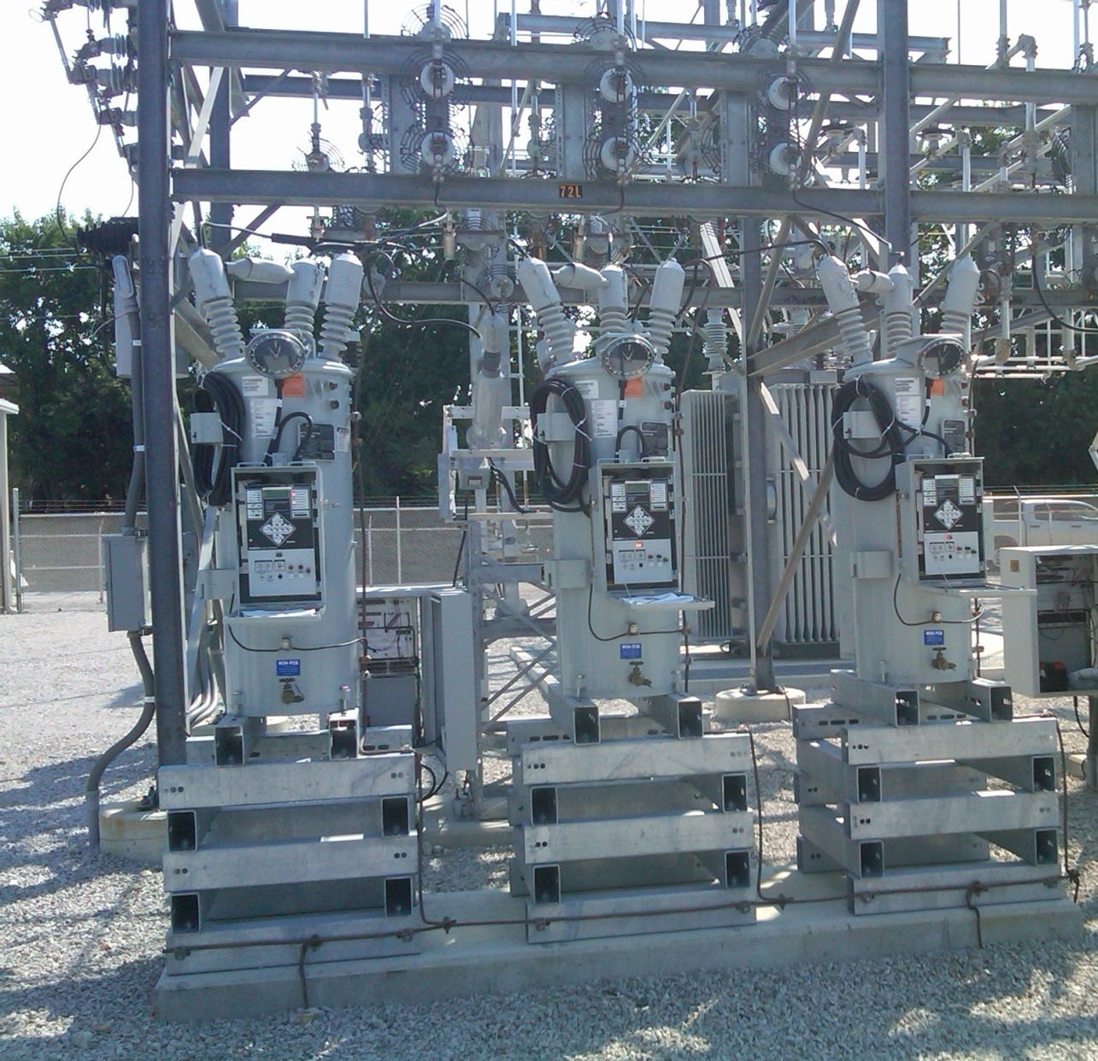
Ameren Champaign (IL) Test Facility Voltage Regulators
These are connected
on the low side of a
69/12.4 kV
transformer; each
phase can be
regulated separately

Slide 20
Variable Tap Voltage Control in the Power Flow
LTCs (or voltage regulators) can be directly included
in the power flow equations by modifying the
Y_{bus} entries; that is by scaling the terms by 1, 1/t or 1/t² as appropriate
If t is fixed then there is no change in the number of equations
If t is variable, such as to enforce a voltage equality, then it can be included either by adding an additional equation and variable (t) directly, or by doing an “outer loop” calculation in which t is varied outside of the NR solution
  The outer loop is used in PowerWorld because of limit issues

Slide 21
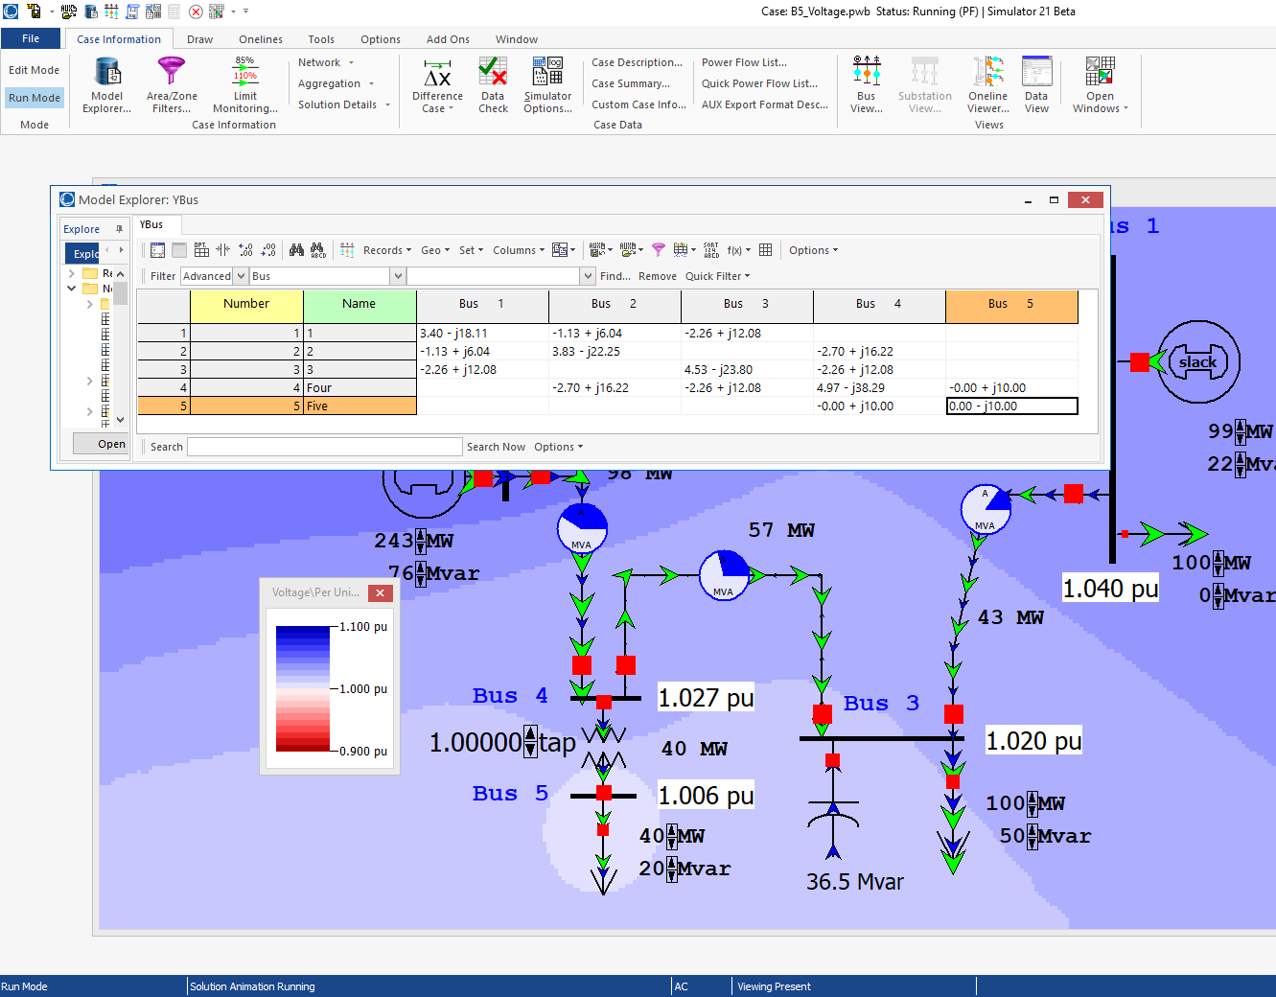
Five Bus PowerWorld Example
With an impedance
of j0.1 pu between
buses 4 and 5, the
y node primitive
with t=1.0 is
If t=1.1 then it is
PowerWorld Case: B5_Voltage

Slide 22
Circulating Reactive Power
Unbalanced transformer taps can cause large amounts of reactive power to circulating, increasing power system losses and overloading transformers
PowerWorld Case:
Bus3CirculatingVars

Slide 23
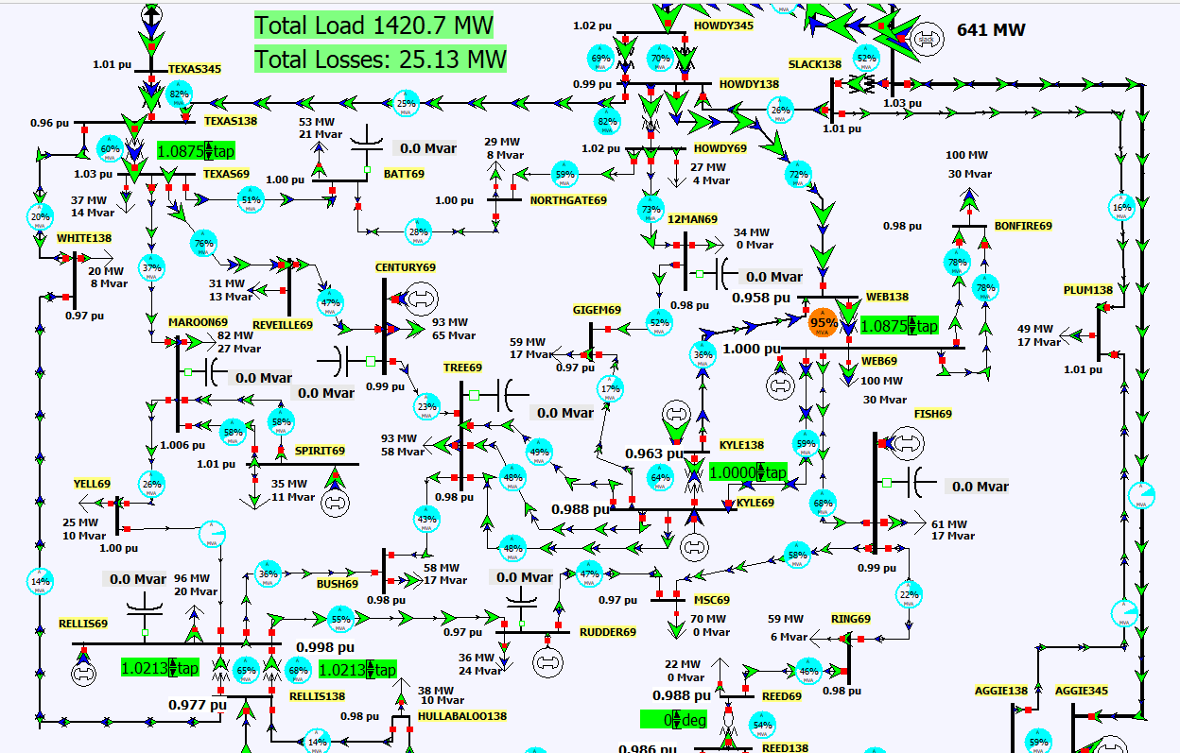
LTC Tap Coordination
Changing tap ratios can affect the voltages and var flow at nearby buses; hence coordinated control is needed
PowerWorld
Case:
Aggieland37_LTC

Slide 24
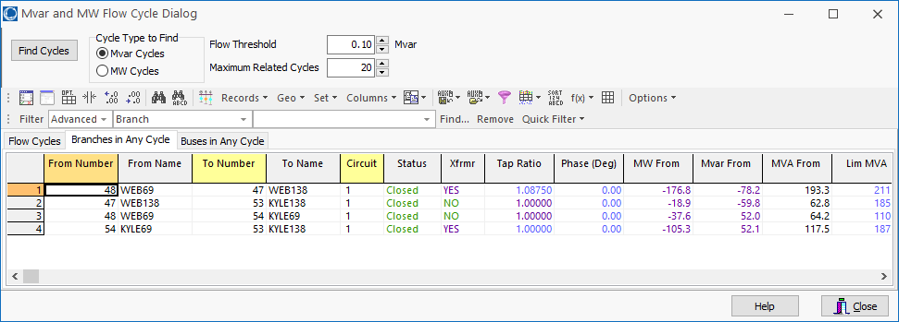
Auto Detection of Circulating Reactive or Real Power
Select Tools, Connections, Find Circulating MW or Mvar Flows to do an automatic determination of the circulating power in a case

Slide 25
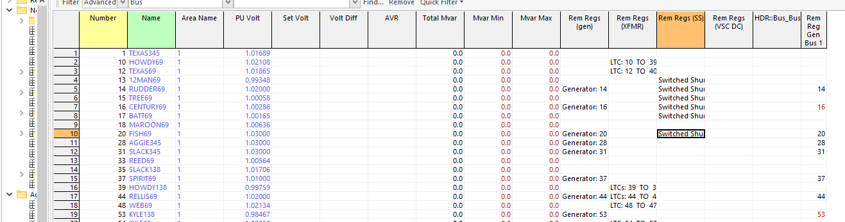
Coordinated Reactive Control
A number of different devices may be doing automatic reactive power control. They must be considered in some control priority
  One example would be 1) generator reactive power, 2) switched shunts, 3) LTCs
You can see the active controls in PowerWorld with Case Information, Solution Details, Remotely Regulated Buses

Slide 26
Coordinated Reactive Control
The challenge with implementing tap control in the power flow is it is quite common for at least some of the taps to reach their limits
  Keeping in mind a large case may have thousands of LTCs!
If this control was directly included in the power flow equations then every time a limit was encountered the Jacobian would change
  Also taps are discrete variables, so voltages must be a range
Doing an outer loop control can more directly include the limit impacts; often time sensitivity values are used
We’ll return to this once we discuss sparse matrices and sensitivity calculations

Slide 27
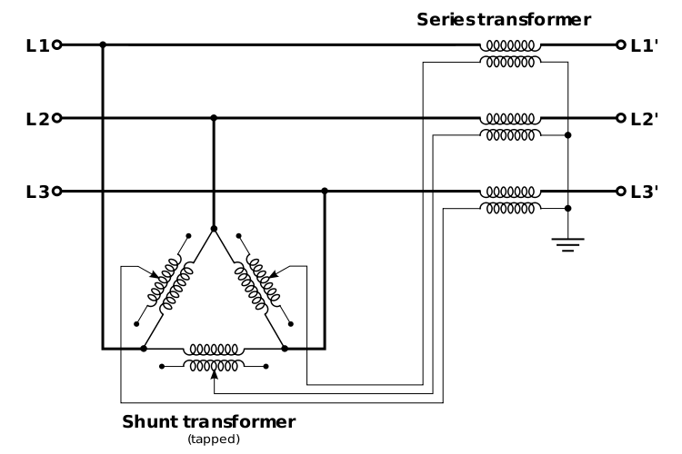
Phase-Shifting Transformers
Phase shifters are transformers in which the phase angle across the transformer can be varied in order to
control real power flow
  Sometimes they are called phase angle regulars (PAR)
  Quadrature booster (evidently British though I’ve never heard this term)
They are constructed
by include a delta-
connected winding
that introduces a 90º
phase shift that is added
to the output voltage
Image: http://en.wikipedia.org/wiki/Quadrature_booster

Slide 28
Phase-Shifter Model
We develop the mathematical model of a phase shifting transformer as a first step toward our study of its simulation
Let buses k and m be the terminals of the phase–shifting transformer, then define the phase shift angle as Φ_{km}
The latter differs from an off–nominal turns ratio LTC transformer in that its tap ratio is a complex quantity, i.e., a complex number, t_{km}∠Φ_{km}
The phase shift angle is a discrete value, with one degree a typical increment

Slide 29
Phase-Shifter Model
For a phase shifter located on the branch (k, m), the admittance matrix representation is obtained analogously to that for the LTC
Note, if there is a phase shift then Y_{bus} is no longer
symmetric!! In a large case there are almost always some phase shifters. Y-Δ transformers also introduce a phase shift that is often not modeled

Slide 30
Integrated Phase-Shifter Control
Phase shifters are usually used to control the real power flow on a device
Similar to LTCs, phase-shifter control can either be directly integrated into the power flow equations (adding an equation for the real power flow equality constraint, and a variable for the phase shifter value), or they can be handled in with an outer loop approach
As was the case with LTCs, limit enforcement often makes the outer loop approach preferred
Coordinated control is needed when there are multiple, close by phase shifters

Slide 31
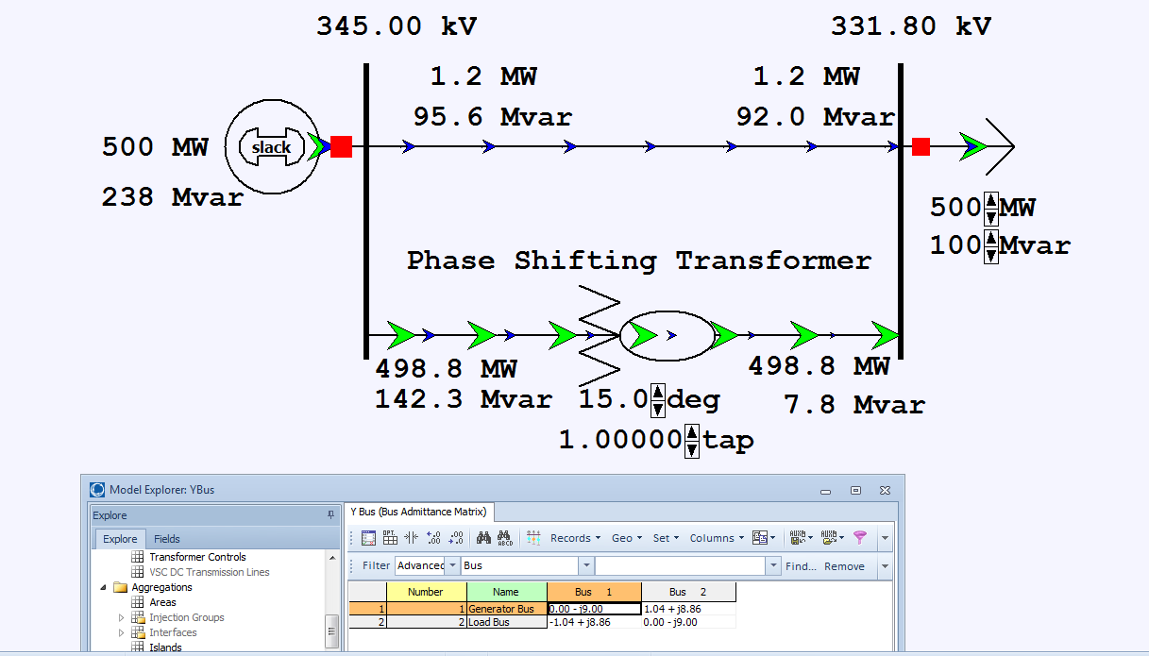
Two Bus Phase Shifter Example
Top line has
x=0.2 pu, while
the phase shifter
has x=0.25 pu.
PowerWorld Case: B2PhaseShifter

Slide 32
Aggieland37 With Phase Shifters
PowerWorld Case: Aggieland37_PhaseShifter

Slide 33
Large Case Phase Shifter Limits and Step Size

Slide 34
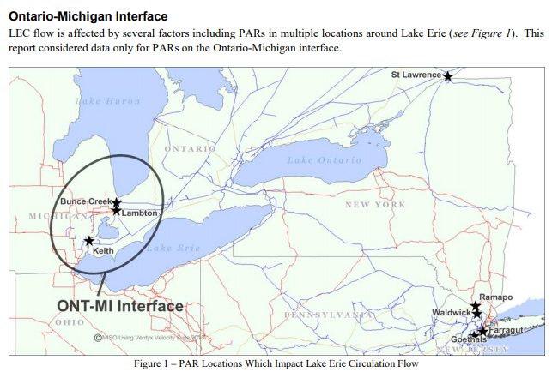
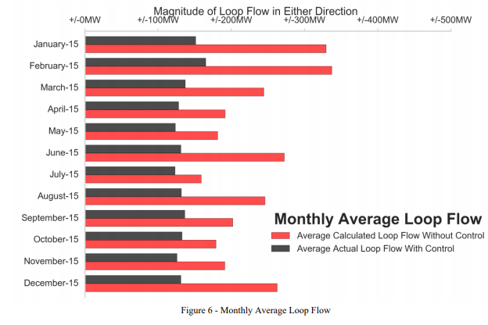
Example of Phase Shifters in Practice
The below report mentions issues associated with the Ontario-Michigan PARs
https://www.nyiso.com/public/webdocs/markets_operations/committees/bic_miwg/meeting_materials/2017-02-28/2016%20Ontario-Michigan%20Interface%20PAR%20Evaluation%20Final%20Report.pdf

