Slide 1
ECEN 615
Methods of Electric Power
Systems Analysis
Lecture 20: Voltage Stability
Prof. Tom Overbye
Dept. of Electrical and Computer Engineering
Texas A&M University
overbye@tamu.edu
Special Guest Lecturer: Yijing Liu

Slide 2
Announcements
Read Chapters 3 and 8 from the book
Homework 5 is due on Thursday November 14

Slide 3
Power System Voltage Stability
Voltage Stability: The ability to maintain system voltage so that both power and voltage are controllable. System voltage responds as expected (i.e., an increase in load causes proportional decrease in voltage).
Voltage Instability: Inability to maintain system voltage. System voltage and/or power become uncontrollable. System voltage does not respond as expected.
Voltage Collapse: Process by which voltage instability leads to unacceptably low voltages in a significant portion of the system. Typically results in loss of system load.
2

Slide 4
Voltage Stability
Two good references are
  P. Kundur, et. al., “Definitions and Classification of Power System Stability,” IEEE Trans. on Power Systems, pp. 1387-1401, August 2004.
  T. Van Cutsem, “Voltage Instability: Phenomena, Countermeasures, and Analysis Methods,” Proc. IEEE, February 2000, pp. 208-227.
Classified by either size of disturbance or duration
  Small or large disturbance: small disturbance is just perturbations about an equilibrium point (power flow)
  Short-term (several seconds) or long-term (many seconds to minutes) (covered in ECEN 667)
3

Slide 5
Small Disturbance Voltage Stability
Small disturbance voltage stability can be assessed using a power flow (maximum loadability)
Depending on the assumed load model, the power flow can have multiple (or no) solutions
PV curve is created by plotting power versus voltage
Assume V_{slack}=1.0
Where B is the line susceptance =-10,
V∠θ is the load voltage
4

Slide 6
Small Disturbance Voltage Stability
Question: how do the power flow solutions vary as the load is changed?
A Solution: Calculate a series of power flow solutions for various load levels and see how they change
Power flow Jacobian
5

Slide 7
Maximum Loadability When Power Flow Jacobian is Singular
An important paper considering this was by Sauer and Pai from IEEE Trans. Power Systems in Nov 1990, “Power system steady-state stability and the load-flow Jacobian”
Other earlier papers were looking at the characteristics of multiple power flow solutions
Work with the power flow optimal multiplier around the same time had shown that optimal multiplier goes to zero as the power flow Jacobian becomes singular
The power flow Jacobian depends on the assumed load model (we’ll see the impact in a few slides)
6

Slide 8
Relationship Between Stability and Power Flow Jacobian
The Sauer/Pai paper related system stability to the power flow Jacobian by noting the system dynamics could be written as a set of differential algebraic equations
7

Slide 9
Relationship Between Stability and Power Flow Jacobian
Then
What Sauer and Pai show is if ∂g/ ∂ y is singular then the system is unstable; if ∂g/ ∂ y is nonsingular then the system may or may not be stable
Hence it provides an upper bound on stability
8

Slide 10
Bifurcations
In general, bifurcation is the division of something into two branches or parts
For a dynamic system, a bifurcation occurs when small changes in a parameter cause a new quality of motion of the dynamic system
Two types of bifurcation are considered for voltage stability
  Saddle node bifurcation is the disappearance of an equilibrium point for parameter variation; for voltage stability it is two power flow solutions coalescing with parameter variation
  Hopf bifurcation is cause by two eigenvalues crossing into the right-half plane
9

Slide 11
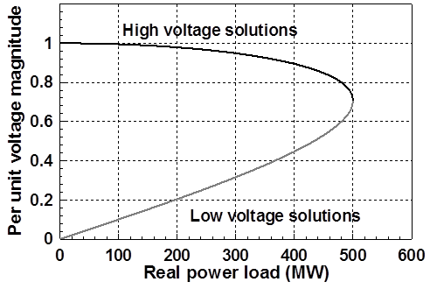
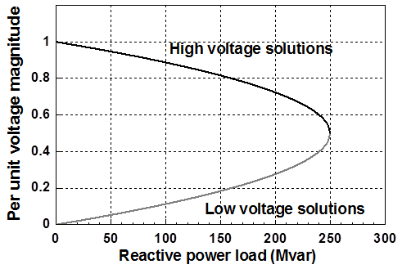
PV and QV Curves
PV curves can be traced by plotting the voltage as the real power is increased; QV curves as reactive power is increased
  At least for the upper portion of the curve
Two bus example PV and QV curves
10

Slide 12
Small Disturbance Voltage Collapse
At constant frequency (e.g., 60 Hz) the complex power transferred down a transmission line is S=VI*
  V is phasor voltage, I is phasor current
  This is the reason for using a high voltage grid
Line real power losses are given by RI² and reactive power losses by XI²
  R is the line’s resistance, and X its reactance; for a high voltage line X >> R
Increased reactive power tends to drive down the voltage, which increases the current, which further increases the reactive power losses
11

Slide 13
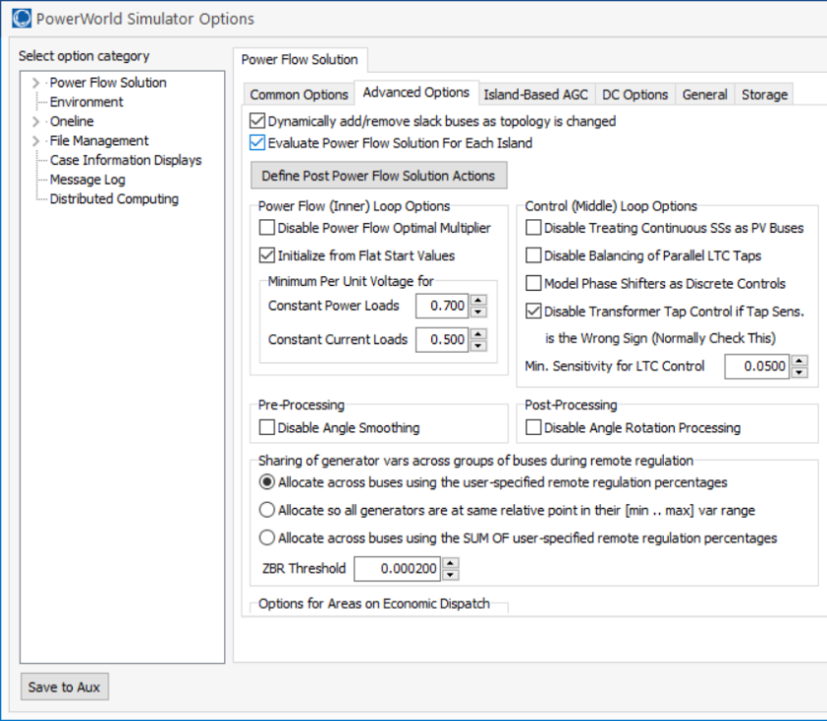
PowerWorld Two Bus Example
Commercial power flow software usually auto converts constant power loads at low voltages; set these fields to zero to disable this conversion
12

Slide 14
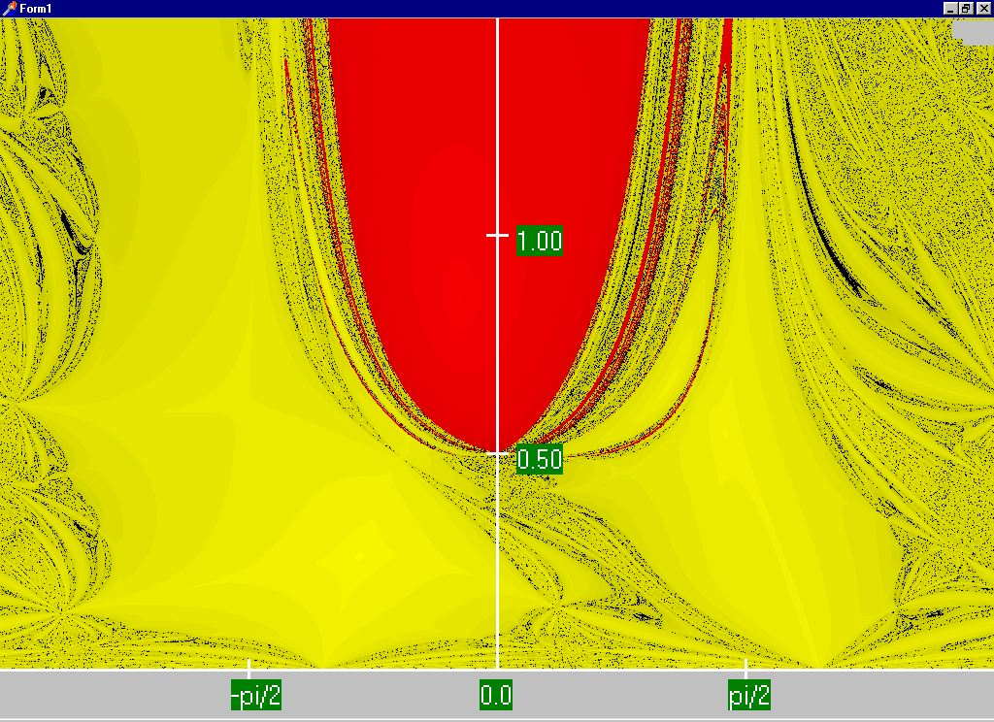
Power Flow Region of Convergence
Convergence
regions with
P=100 MW,
Q=0 Mvar
13

Slide 15
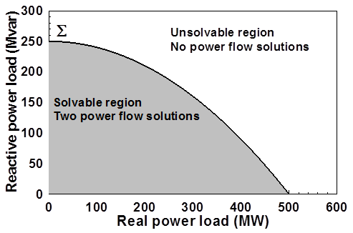
Load Parameter Space Representation
With a constant power model there is a maximum loadability surface, Σ
  Defined as point in which the power flow Jacobian is singular
  For the lossless two bus system it can be determined as
14

Slide 16
Load Model Impact
With a static load model regardless of the voltage dependency the same PV curve is traced
  But whether a point of maximum loadability exists depends on the assumed load model
    If voltage exponent is > 1 then multiple solutions do not exist (see B.C. Lesieutre, P.W. Sauer and M.A. Pai “Sufficient conditions on static load models for network solvability,”NAPS 1992, pp. 262-271)
Change load to constant impedance; hence it becomes a linear model
15

Slide 17
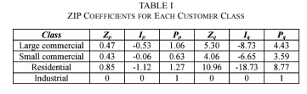
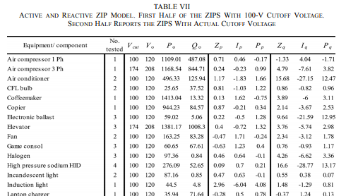
ZIP Model Coefficients
One popular static load model is the ZIP; lots of papers on the “correct” amount of each type
Table 1 from M. Diaz-Aguilo, et. al., “Field-Validated Load Model for the Analysis of CVR in Distribution Secondary Networks: Energy Conservation,” IEEE Trans. Power Delivery, Oct. 2013
Table 7 from A, Bokhari, et. al., “Experimental Determination of the ZIP Coefficients for Modern Residential, Commercial, and Industrial Loads,” IEEE Trans. Power Delivery, June. 2014
16

Slide 18
Application: Conservation Voltage Reduction (CVR)
If the “steady-state” load has a true dependence on voltage, then a change (usually a reduction) in the voltage should result in a total decrease in energy consumption
If an “optimal” voltage could be determined, then this could result in a net energy savings
Some challenges are 1) the voltage profile across a feeder is not constant, 2) the load composition is constantly changing, 3) a decrease in power consumption might result in a decrease in useable output from the load, and 4) loads are dynamic and an initial decrease might be balanced by a later increase
17

Slide 19
Determining a Metric to Voltage Collapse
The goal of much of the voltage stability work was to determine an easy to calculate metric (or metrics) of the current operating point to voltage collapse
  PV and QV curves (or some combination) can determine such a metric along a particular path
  Goal was to have a path independent metric. The closest boundary point was considered,
  but this could be quite misleading
  if the system was not going to
  move in that direction
  Any linearization about the current operating point (i.e., the Jacobian) does not consider important nonlinearities like generators hitting their reactive power limits
18

Slide 20
Determining a Metric to Voltage Collapse
A paper by Dobson in 1992 (see below) noted that at a saddle node bifurcation, in which the power flow Jacobian is singular, that
  The right eigenvector associated with the Jacobian zero eigenvalue tells the direction in state space of the voltage collapse
  The left eigenvector associated with the Jacobian zero eigenvalue gives the normal in parameter space to the boundary Σ. This can then be used to estimate the minimum distance in parameter space to bifurcation.
I. Dobson, “Observations on the Geometry of Saddle Node Bifurcation and Voltage Collapse in Electrical Power
Systems,” IEEE Trans. Circuits and Systems, March 1992
19

Slide 21
Determining a Metric to Voltage Collapse Example
For the previous two bus example we had
20

Slide 22
Determining a Metric to Voltage Collapse Example
Calculating the right and left eigenvectors associated with the zero eigenvalue we get
21

Slide 23
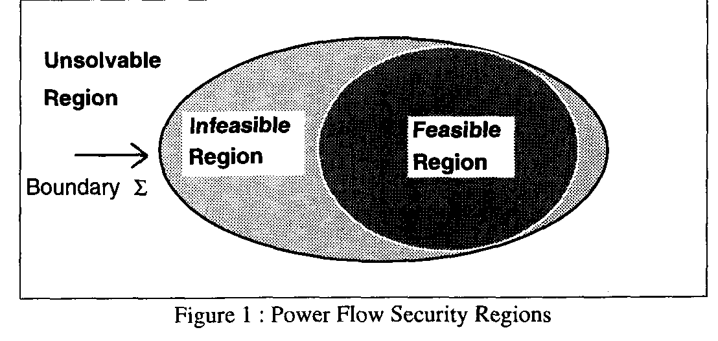
Quantifying Power Flow Unsolvability
Since lack of power flow convergence can be a major problem, it would be nice to have a measure to quantify the degree of unsolvability of a power flow
  And then figure out the best way to restore solvabiblity
T.J. Overbye, “A Power Flow Measure for Unsolvable Cases,” IEEE Trans. Power Systems, August 1994
22

Slide 24
Quantifying Power Flow Unsolvability
To setup the problem, first consider the power flow iteration without and with the optimal multiplier
23

Slide 25
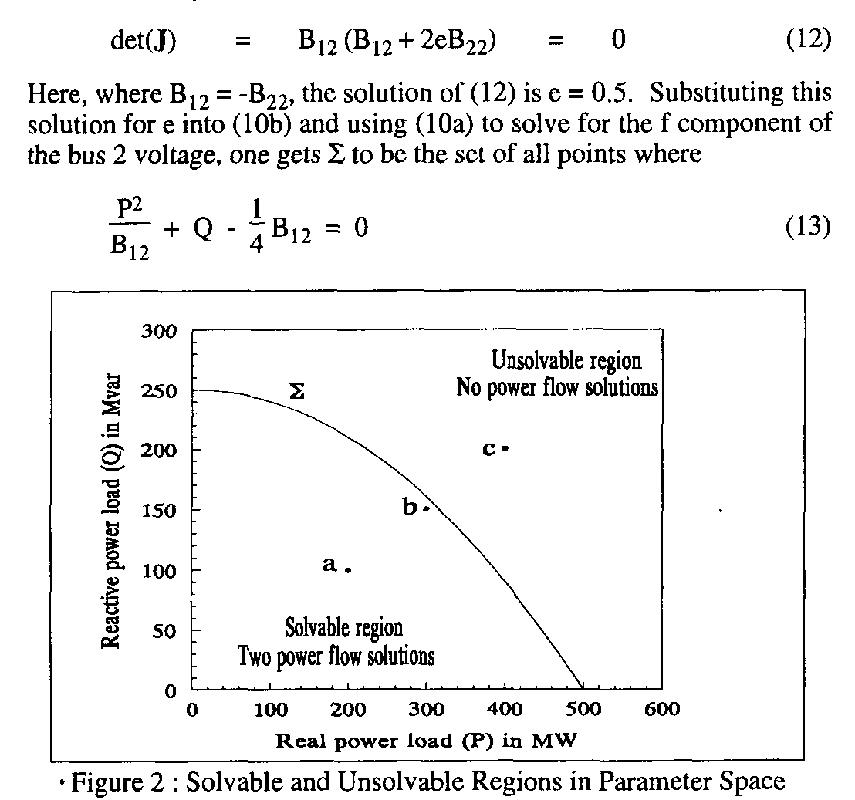
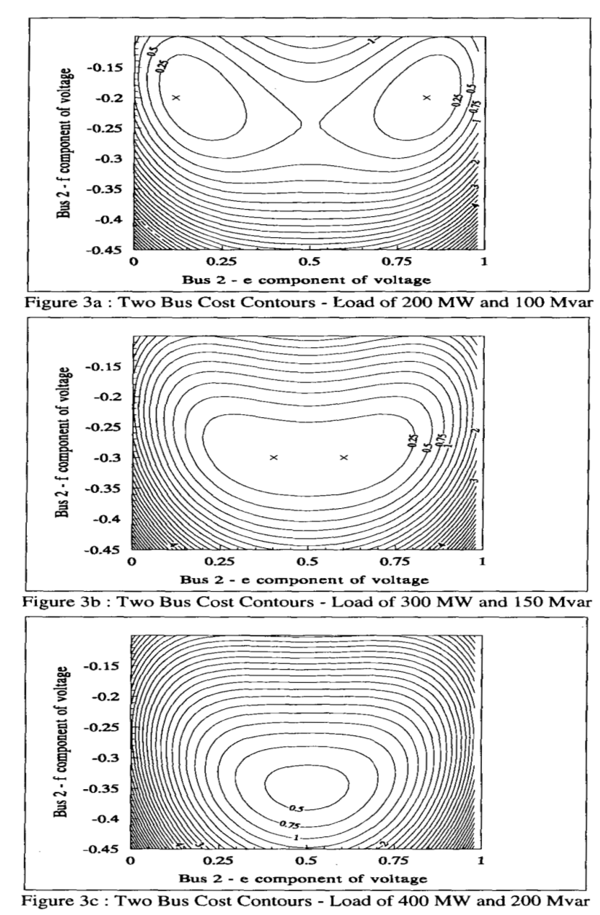
Quantifying Power Flow Unsolvability
24

Slide 26
Quantifying Power Flow Unsolvability
However, when there is no solution the standard power flow would diverge. But the approach with the optimal multiplier tends to point in the direction of minimizing F(x^{k+1}). That is,
25

Slide 27
Quantifying Power Flow Unsolvability
The only way we cannot reduce the cost function some would be if the two directions were perpendicular, hence with a zero dot product. So
26

Slide 28
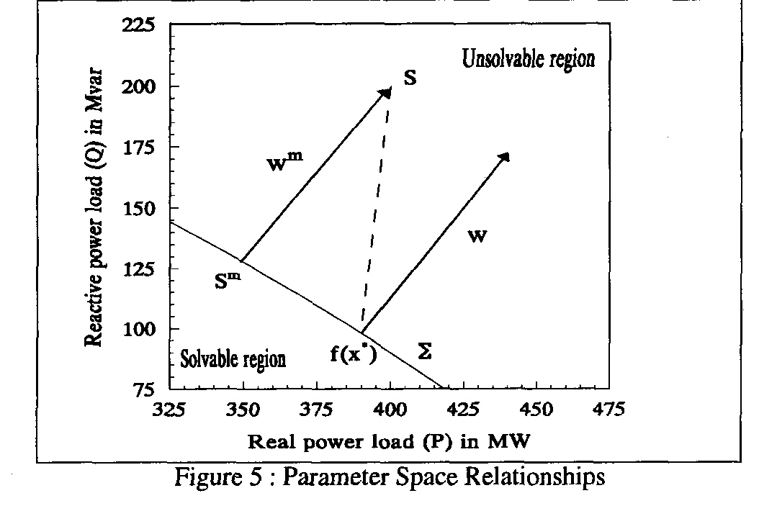
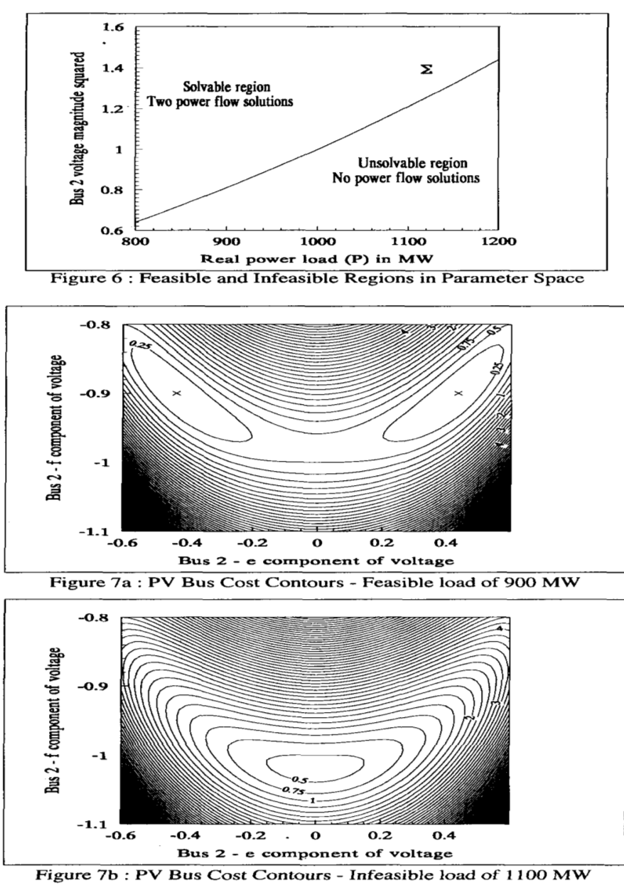
Quantifying Power Flow Unsolvability
If Σ were flat then w is parallel to w^{m}
27

Slide 29
Quantifying Power Flow Unsolvability
The left eigenvector associated with the zero eigenvalue of the Jacobian (defined as w^{i*}) is perpendicular to Σ (as noted in the early 1992 Dobson paper)
We can get the closest point on the Σ just by iterating, updating the S Vector as
(here S is the initial power injection, x^{i*} a boundary solution)
Converges when
28

Slide 30
Challenges
The key issues is actual power systems are quite complex, with many nonlinearities. For example, generators hitting reactive power limits, switched shunts, LTCs, phase shifters, etc.
Practically people would like to know how far some system parameters can be changed before running into some sort of limit violation, or maximum loadability.
  The system is changing in a particular direction, such as a power transfer; this often includes contingency analysis
Line limits and voltage magnitudes are considered
  Lower voltage lines tend to be thermally constrained
Solution is to just to trace out the PV or QV curves
29

Slide 31
PV and QV Analysis in PowerWorld
Requires setting up what is known in PowerWorld as an injection group
  An injection group specifies a set of objects, such as generators and loads, that can inject or absorb power
  Injection groups can be defined by selecting Case Information, Aggregation, Injection Groups
The PV and/or QV analysis then varies the injections in the injection group, tracing out the PV curve
This allows optional consideration of contingencies
The PV tool can be displayed by selecting Add-Ons, PV
30

Slide 32
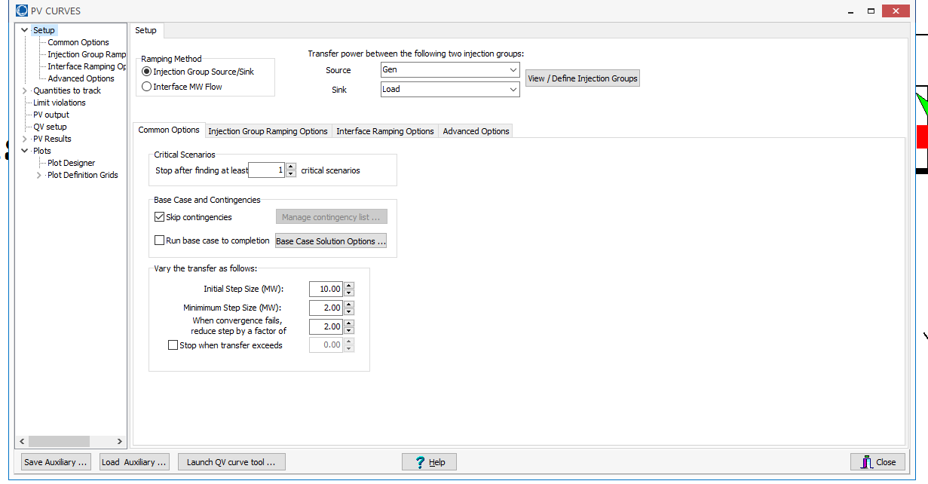
PV and QV Analysis in PowerWorld: Two Bus Example
Setup page defines the source and sink and step size
31

Slide 33
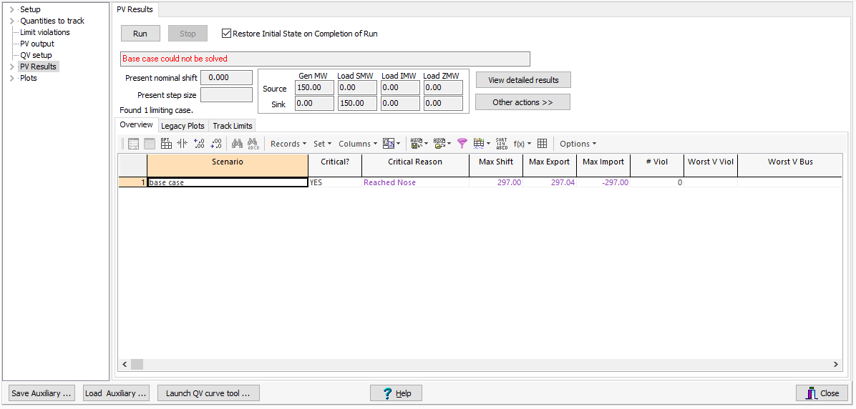
PV and QV Analysis in PowerWorld: Two Bus Example
The PV Results Page does the actual solution
  Plots can be defined to show the results
  Other Actions, Restore initial state restores the pre-study state
Click the Run button
to run the PV analysis;
Check the Restore
Initial State on
Completion of Run to
restore the pre-PV
state (by default it is
not restored)
32

Slide 34
PV and QV Analysis in PowerWorld: Two Bus Example
33

Slide 35
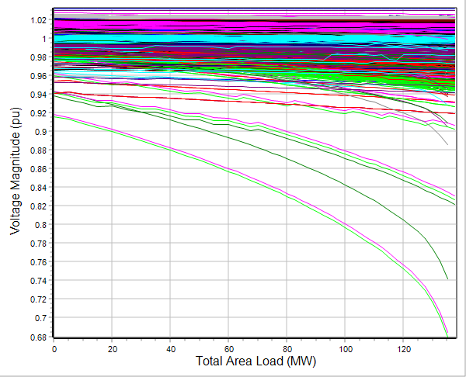
PV and QV Analysis in PowerWorld: 37 Bus Example
Usually other limits also need to be considered in
doing a realistic PV analysis
34

