Slide 1
ECEN 615
Methods of Electric Power
Systems Analysis
Lecture 24: Power Markets, GMD Modeling
Prof. Tom Overbye
Dept. of Electrical and Computer Engineering
Texas A&M University
overbye@tamu.edu

Slide 2
Announcements
Read Chapters 3 and 8 from the book
Second exam is in class on November 21
  Same format as with the first exam except you can bring in two note sheets (e.g., your sheet from the last exam and a new one)
  Exam covers up to the end of today’s material

Slide 3
LMP Energy Markets
In an LMP energy market the generation is paid the LMP at the bus, and the loads pay the LMP at the bus
  This is done in both the day ahead market and in the real-time market (which makes up the differences between actual and the day ahead)
The generator surplus (profit) is the difference between the LMP and the actual cost of generation
Generators that offer too high are not selected to run, and hence make no profit
A key decision for the generation owners is what values to offer

Slide 4
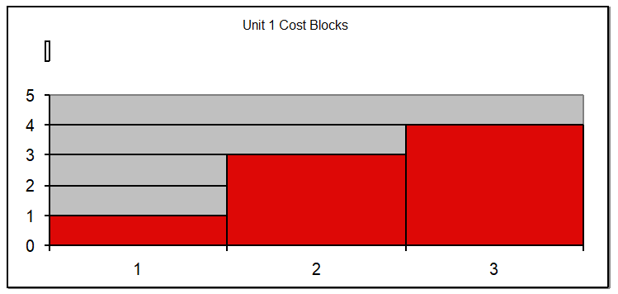
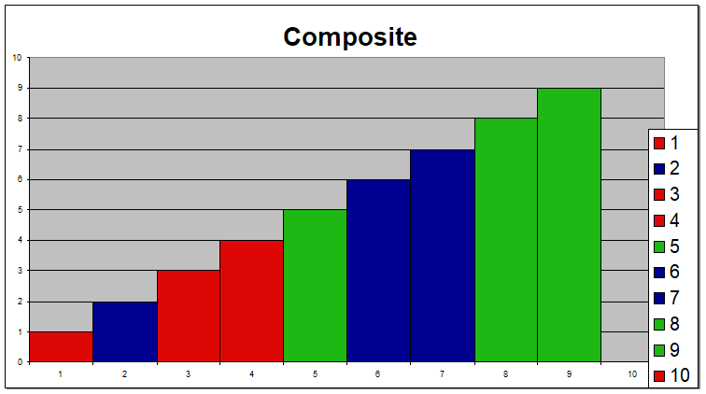
Generator Offers
Generator offers are given in piecewise linear curves; that is, a fixed $/MWh for so much power for a time period
In the absence of constraints (congestion) the ISO would just select the lowest offers to meet the anticipated load
Actual dispatch is determined using an SCOPF

Slide 5
General Guidelines
Generators with high fixed costs and low operating costs (e.g., wind, solar, nuclear) benefit from running many hours
  Usually they should submit offers close to their marginal costs
  Wind (and some others) receive a production tax credit for their first ten years of operation
    $23/MWh for systems starting construction before 1/1/2017
    $18.4/MWh for systems starting construction in 2017 (a 20% reduction)
    In 2018 the reduction is 40% and 60% in 2019; after that it is zero (unless, of course, changed by Congress)
Generators with low fixed costs and high operating cost can do fine operating fewer hours (at higher prices)

Slide 6
Auctions
In its simplest form, an auction is a mechanism of allocating scarce goods based upon competition
  a seller wishes to obtain as much money as possible, and a buyer wants to pay as little as necessary.
An auction is usually considered efficient if resources accrue to those who value them most highly
Auctions can be either one-sided with a single monopolist seller/buyer or a double auction with multiple parties in each category
  bid to buy, offer to sell
Most people’s experience is with one-side auctions with one seller and multiple buyers

Slide 7
Auctions, cont.
Electricity markets can be one-sided, with the ISO functioning as a monopolist buyer, while multiple generating companies make offers to sell their generation, or two-sided with load participation
Auction provides mechanism for participants to reveal their true costs while satisfying their desires to buy low and/or sell high.
Auctions differ on the price participants receive and the information they see along the way

Slide 8
Types of Single-Sided Auctions with Multiple Buyers, One Seller
Simultaneous auctions
  English (ascending price to buy)
  Dutch (descending price to buy)
Sealed-bid auctions (all participants submit offers simultaneously)
  First price sealed bid (pay highest price if one, discriminatory prices if multiple)
  Vickrey (uniform second price) (pay the second highest price if one, all pay highest losing price if many); this approach gives people incentive to bid their true value

Slide 9
Uniform Price Auctions: Multiple Sellers, One Buyer
Uniform price auctions are sealed offer auctions in which sellers make simultaneous decisions (done when submitting offers).
Generators are paid the last accepted offer
Provides incentive to offer at marginal cost since higher values cause offers to be rejected
  reigning price should match marginal cost
Price caps are needed to prevent prices from rising up to infinity during shortages
Some generators offering above their marginal costs are needed to cover their fixed costs

Slide 10
What to Offer Example
Below example shows 3 generator case, in which the bus 2 generator can vary its offer to maximize profit
Note, this example makes the unrealistic assumption that the other generators do not vary their offers in response

Slide 11
Horizontal Market Power
One issue is whether a particular group of generators has market power
Market power is the antithesis of competition
    It is the ability of a particular group of sellers to maintain prices above competitive levels, usually by withholding supply
  The extreme case is a single supplier of a product (i.e., a monopoly)
  In the short run what a monopolistic producer can charge depends upon the price elasticity of the demand
  Sometimes market power can result in decreased prices in the long-term by quickening the entry of new players or new innovation

Slide 12
Market Power and Scarcity Rents
A generator owner exercises market power when it is unwilling to make energy available at a price that is equal to that unit’s variable cost of production, even thought there is currently unloaded generation capacity (i.e., there is no scarcity).
Scarcity rents occur when the level of electric demand is such that there is little, if any, unused capacity
Scarcity rents are used to recover fixed costs

Slide 13
High-Impact, Low-Frequency Events
Growing concern to consider what the NERC calls calls High-Impact,
Low-Frequency Events
(HILFs); others call them
black sky days
  Large-scale, potentially long duration blackouts
  HILFs identified by NERC
  were 1) a coordinated cyber,
  physical or blended attacks, 2) pandemics, 3) geomagnetic disturbances (GMDs), and 4) HEMPs
The next several slides will consider GMDs and HEMPs
Image Source: NERC, 2012
12

Slide 14
Geomagnetic Disturbances (GMDs)
GMDs are caused by solar corona mass ejections (CMEs) impacting the earth’s magnetic field
A GMD caused a blackout in 1989 of Quebec
They have the potential to severely disrupt the electric grid by causing quasi-dc geomagnetically induced currents (GICs) in the high voltage grid
Until recently power engineers had few tools to help them assess the impact of GMDs
GMD assessment tools are now moving into the realm of power system planning and operations engineers; required by NERC Standards (TPL 007-1, 007-2)
13

Slide 15
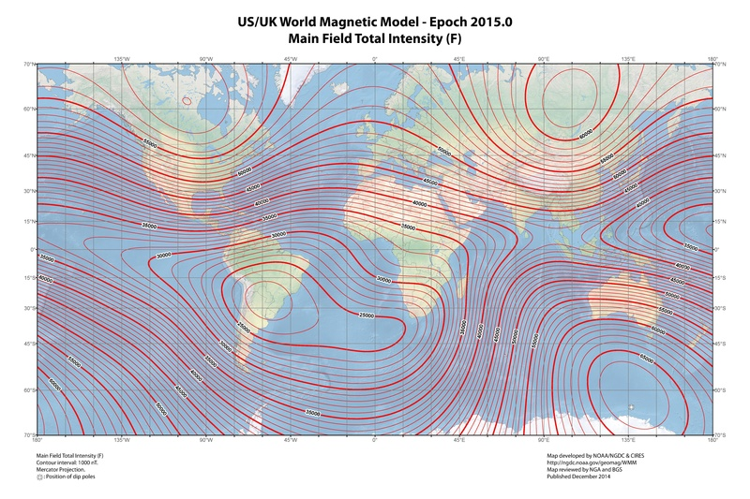
Earth’s Magnetic Field
The earth’s
magnetic
field is
usually
between
25,000 and
65,000 nT
Image Source: Wikepedia
14

Slide 16
Earth’s Magnetic Field Variations
The earth’s magnetic field is constantly changing, though usually the variations are not significant
  Larger changes tend to occur closer to the earth’s magnetic poles
The magnitude of the variation at any particular location is quantified with a value known as the K-index
  Ranges from 1 to 9, with the value dependent on nT variation in horizontal direction over a three hour period
  This is station specific; higher variations are required to get a k=9 closer to the poles
The Kp-index is a weighted average of the individual station K-indices; G scale approximately is Kp - 4
15

Slide 17
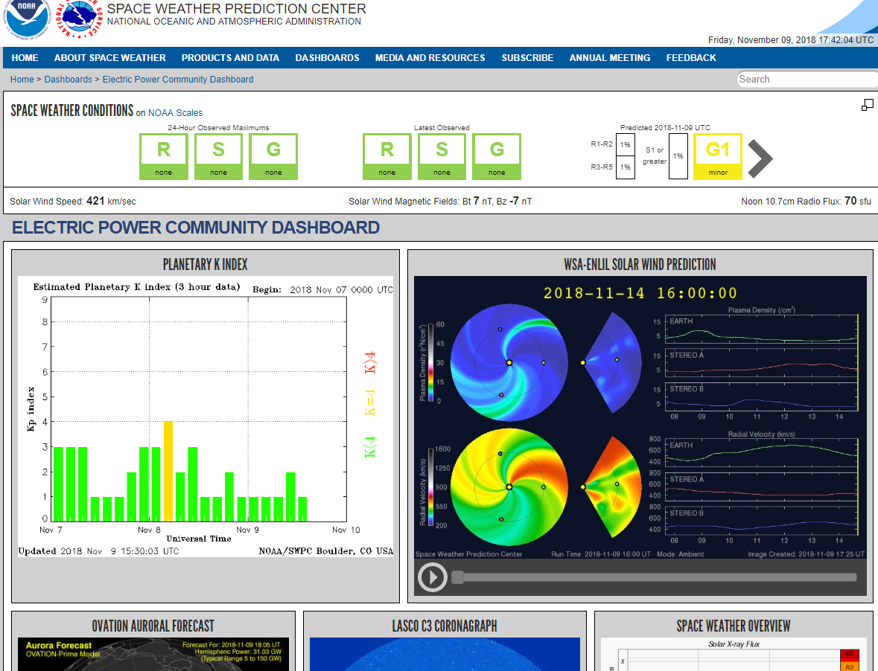
Space Weather Prediction Center has an Electric Power Dashboard
www.swpc.noaa.gov/communities/electric-power-community-dashboard
16

Slide 18
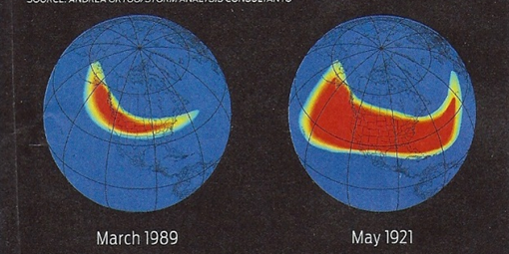
GMD and the Grid
Large solar corona mass ejections (CMEs) can cause large changes in the earth’s magnetic field (i.e., dB/dt). These changes in turn produce a non-uniform electric field at the surface
  Changes in the magnetic flux are usually expressed in nT/minute; from a 60 Hz perspective they are almost dc
  1989 North America storm produced
  a change of 500 nT/minute, while a
  stronger storm, such as the ones in
  1859 or 1921, could produce
  2500 nT/minute variation
  Storm “footprint” can be continental in scale
17

Slide 19
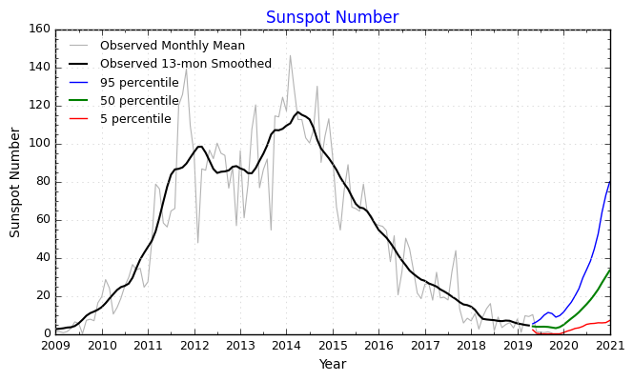
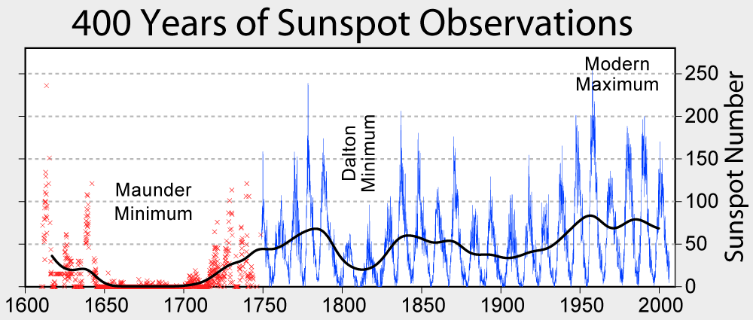
Solar Cycles
Sunspots follow an 11 year cycle, and have been observed for hundreds of years
We're in solar cycle 24 (first numbered cycle was in 1755); minimum was in 2009, maximum in 2014/2015
Images from NASA, NOAA
18

Slide 20
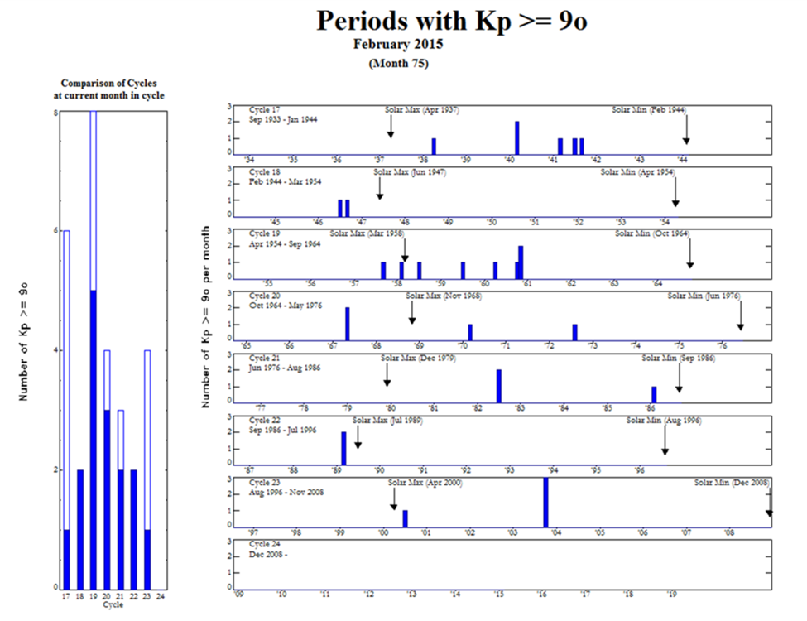
But Large CMEs Are Not Well Correlated with Sunspot Maximums
The large
1921 storm
occurred
four years
after the
1917
maximum
19

Slide 21
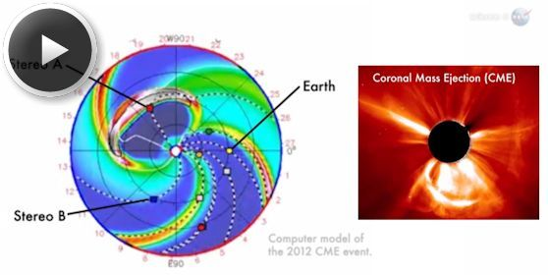
July 2012 GMD Near Miss
In July 2014 NASA said in July of 2012 there was a solar CME that barely missed the earth
  It would likely have
  caused the largest
  GMD that we have
  seen in the last 150
  years
There is still lots of
uncertainly about
how large a storm
is reasonable to
consider in electric utility planning
Image Source: science.nasa.gov/science-news/science-at-nasa/2014/23jul_superstorm/
20

Slide 22
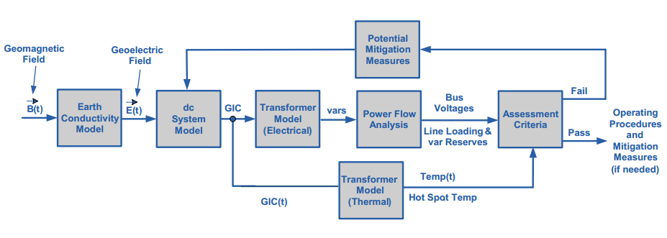
Overview of GMD Assessments
In is a quite interdisciplinary problem
Starting Here
The two key concerns from a big storm are 1) large-scale blackout
due to voltage collapse, 2) permanent transformer damage due to
overheating
Image Source: http://www.nerc.com/pa/Stand/WebinarLibrary/GMD_standards_update_june26_ec.pdf
21

Slide 23
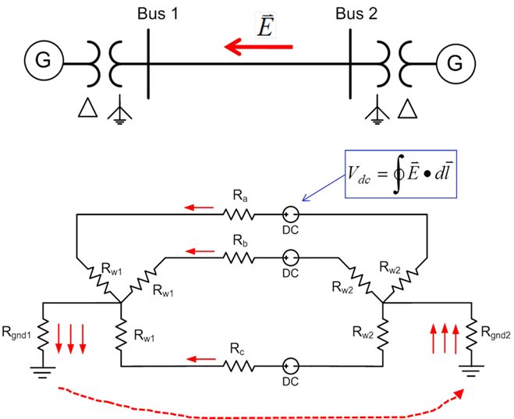
Geomagnetically Induced Currents (GICs
GMDs cause slowly varying electric fields
Along length of a high voltage transmission line, electric fields can be modeled as a dc voltage source superimposed on the lines
These voltage sources
produce quasi-dc
geomagnetically induced
currents (GICs) that are
superimposed on the ac
(60 Hz) flows
22

Slide 24
GIC Calculations for Large Systems
With knowledge of the pertinent transmission system parameters and the GMD-induced line voltages, the dc bus voltages and flows are found by solving a linear equation I = G V (or J = G U)
  J and U may be used to emphasize these are dc values, not the power flow ac values
  The G matrix is similar to the Y_{bus} except 1) it is augmented to include substation neutrals, and 2) it is just resistive values (conductances)
    Only depends on resistance, which varies with temperature
  Being a linear equation, superposition holds
  The current vector contains the Norton injections associated with the GMD-induced line voltages
23

Slide 25
GIC Calculations for Large Systems
Factoring the sparse G matrix and doing the forward/backward substitution takes about 1 second for the 60,000 bus Eastern Interconnect Model
The current vector (I) depends upon the assumed electric field along each transmission line
  This requires that substations have correct geo-coordinates
With nonuniform fields an exact calculation would be path dependent, but just a assuming a straight line path is probably sufficient (given all the other uncertainties!)
24

Slide 26
Four Bus Example (East-West Field)
The line and transformer resistance and current values are per phase so the total current is three times this value. Substation grounding values are total resistance. Brown arrows show GIC flow.
Case name is GIC_FourBus
25

Slide 27
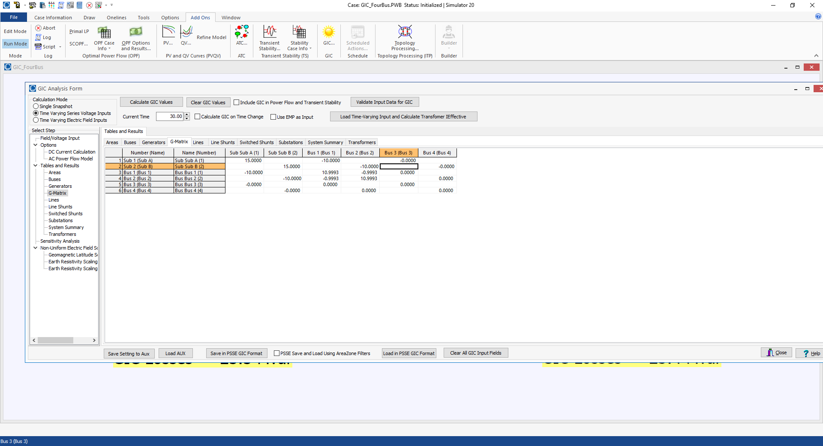
Four Bus Example GIC G Matrix
26

Slide 28
GICs, Generic EI, 5 V/km East-West
27

Slide 29
GICs, Generic EI, 5 V/km North-South
28

Slide 30
Determining GMD Storm Scenarios
The starting point for the GIC analysis is an assumed storm scenario; sets the line dc voltages
Matching an actual storm can be complicated, and requires detailed knowledge of the geology
GICs vary linearly with the assumed electric field magnitudes and reactive power impacts on the transformers is also mostly linear
Working with space weather community to determine highest possible storms
NERC proposed a non-uniform field magnitude model that FERC has partially accepted, but also with hotspots
29

Slide 31
Electric Field Linearity
If an electric field is assumed to have a uniform direction everywhere (like with the current NERC model), then the calculation of the GICs is linear
  The magnitude can be spatially varying
This allows for very fast computation of the impact of time-varying functions (like with the NERC event)
PowerWorld now provides support for loading a specified time-varying sequence, and quickly calculating all of the GIC values
30

Slide 32
Overview of GMD Assessments
Next we go here
Image Source: http://www.nerc.com/pa/Stand/WebinarLibrary/GMD_standards_update_june26_ec.pdf
31

Slide 33
Impact of Earth Models: Relationship Between dB/dT and E
The magnitude of the induced electric field depends upon the rate of change in the magnetic field, and the deep earth (potentially 100’s of km) conductivity
The relationship between changing magnetic fields and electric fields are given by the Maxwell-Faraday Equation
32

Slide 34
Relationship Between dB/dT and E
If the earth is assumed to have a single conductance, σ, then
The magnitude relationship is then
A more resistive earth gives higher electric fields
33

Slide 35
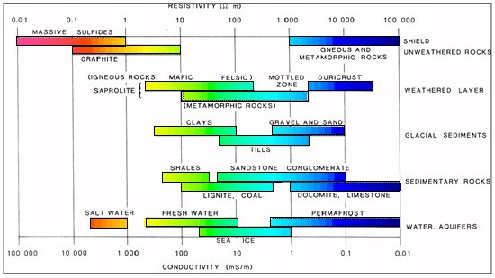
Typical Conductance and Resistivity Values
Soil conductance is often expressed in its inverse of resistivity in Ω-m; values can vary widely
  Topsoil varies widely with moisture content, from 2500 Ω-m when dry to about 20 Ω-m when very wet
  Clay is between 100-200 Ω-m
Image source: https://www.eoas.ubc.ca/courses/eosc350/content/foundations/properties/resistivity.htm
34

Slide 36
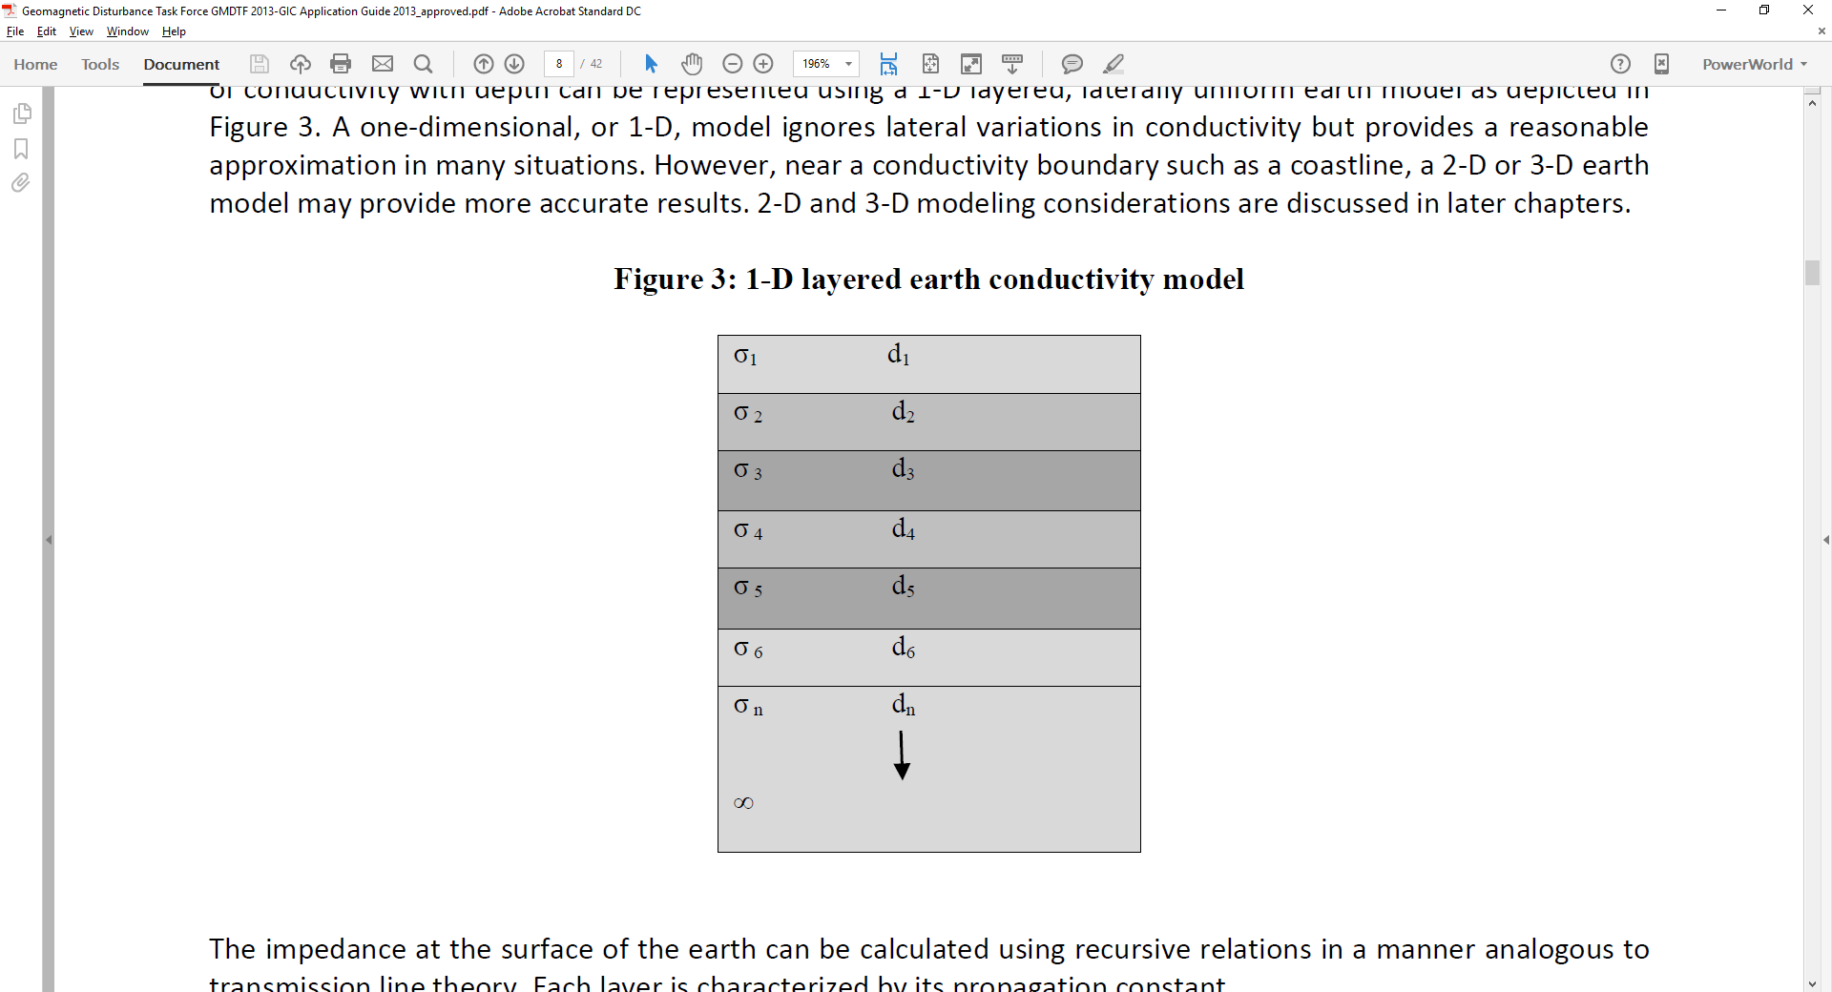
1-D Earth Models
With a 1-D model the earth is model as a series of conductivity layers of varying thickness
The impedance at a particular frequency
is calculated using a recursive
approach, starting at the bottom,
with each layer m having
a propagation constant
At the bottom level n
1-D Layers
35

Slide 37
1-D Earth Models
Above the bottom layer each layer m, has a reflection coefficient associated with the layer below
With the impedance at the top of layer m given as
Recursion is applied up to the surface layer
36

Slide 38
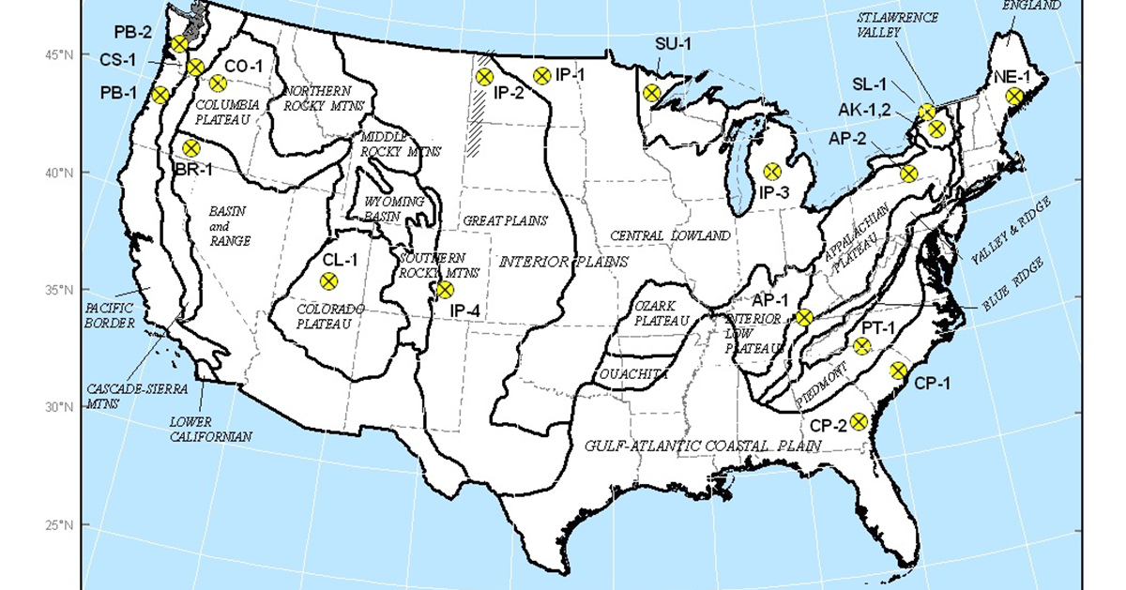
USGS 1-D Conductivity Regions
The USGS has broken the continental US into about 20 conductivity (resistivity) regions
These
regional
scalings
are now
being
used
for power
flow GMD
analysis,
and are
being
updated
Image from the NERC report; data is available at http://geomag.usgs.gov/conductivity/
37

Slide 39
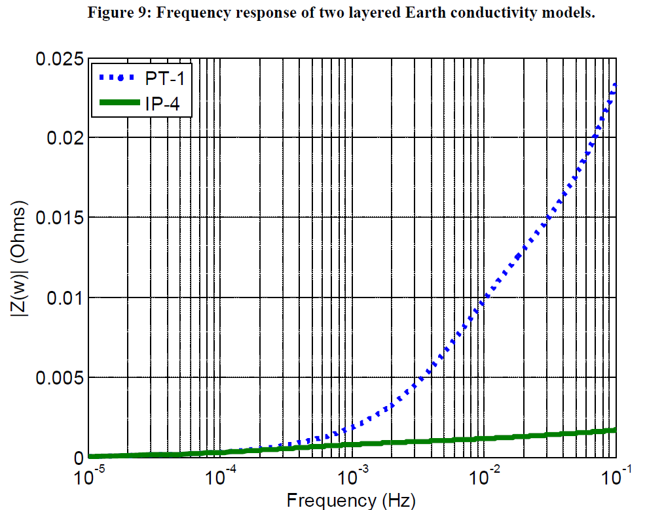
1-D Earth Models
Image on the bottom left shows an example 1-D model, whereas image on bottom right shows the Z(ω) variation for two models
38

Slide 40
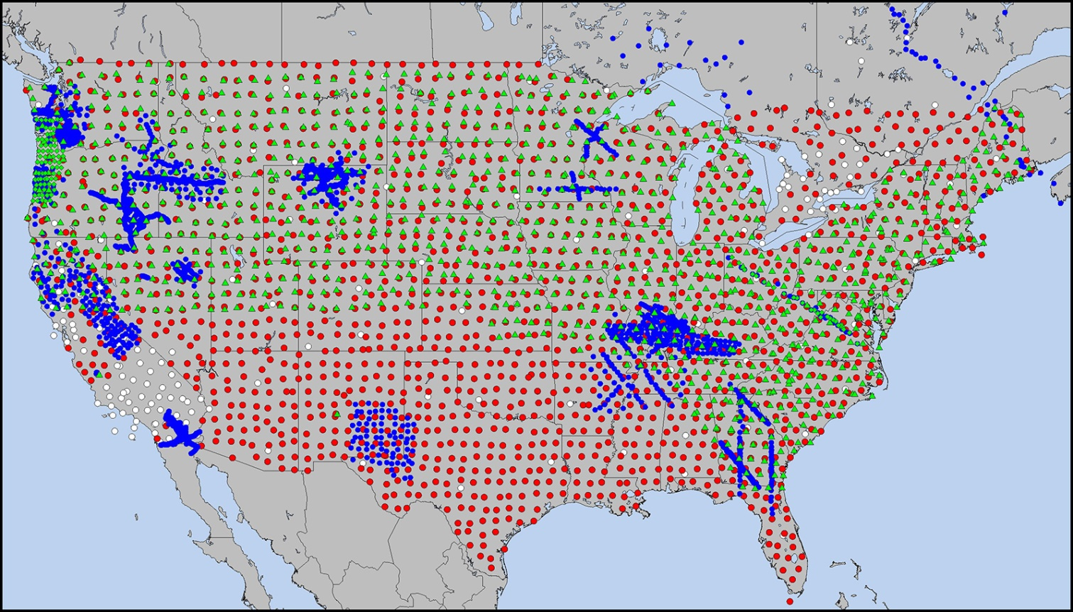
3-D Models and EarthScope
USArray in the Lower 48 U.S. and Southeastern Canada. Transportable Array (TA) stations (red), Flexible Array (FA) stations (blue), and Magnetotelluric (MT) array (green) operated at different scales from 2004–2018. MT stations are subdivided between MT-TA (green triangles) and MT-FA (tight cluster of green diamonds in the Pacific Northwest and dense line across the Mid-Atlantic). Backbone stations (white) were used as part of the TA at its outset and in Canada. Over 200 TA stations have been permanently adopted across the country, and there are active efforts across the federal government to complete the MT-TA across the southern one-third of the U.S.
Source: https://www.earthscope.org/articles/Reflections_on_USArray.html
39

Slide 41


3-D Models and EarthScope
Earthscope data is processed into magnetotelluric transfer functions that:
  Define the frequency dependent linear relationship between EM components at a single site.
(simplified for the 1D case)
Can be used to relate a magnetic field input to and electric field output at a single site
Are provided in 2x2 impedance tensors by USArray
Reference: Kelbert et al., IRIS DMC Data Services Products, 2011.
40

Slide 42
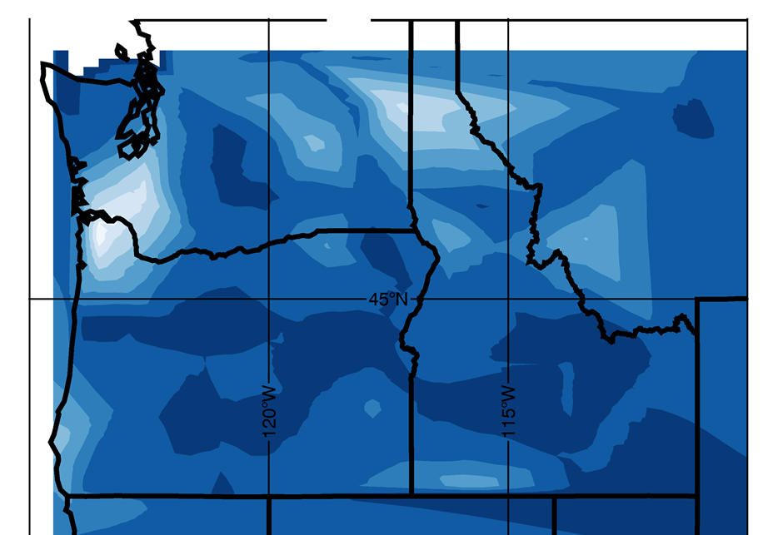
Example 3-D Earthscope Model Results
Image provides a snapshot visualization of the time-varying surface electric fields using Earthscope data
White ~ 10 V/km
Image Provided by Jenn Gannon
41

Slide 43
Input Electric Field Considerations
The current vector (I) depends upon the assumed electric field along each transmission line
With a uniform electric field determination of the transmission line’s GMD-induced voltage is path independent
  Just requires geographic knowledge of the transmission line’s terminal substations
With nonuniform fields an exact calculation would be path dependent, but just a assuming a straight line path is probably sufficient (given all the other uncertainties!)
42

Slide 44
Overview of GMD Assessments
Next we go here
43

Slide 45
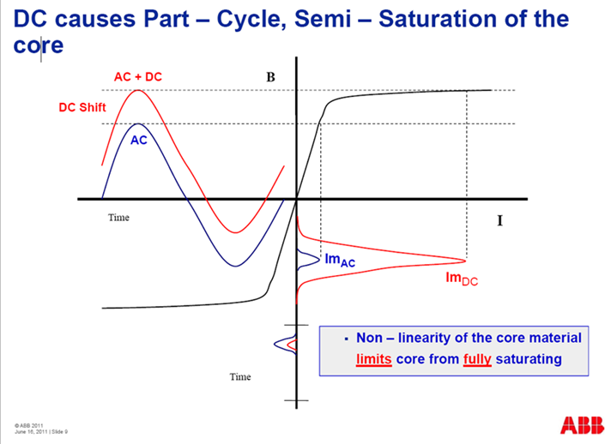
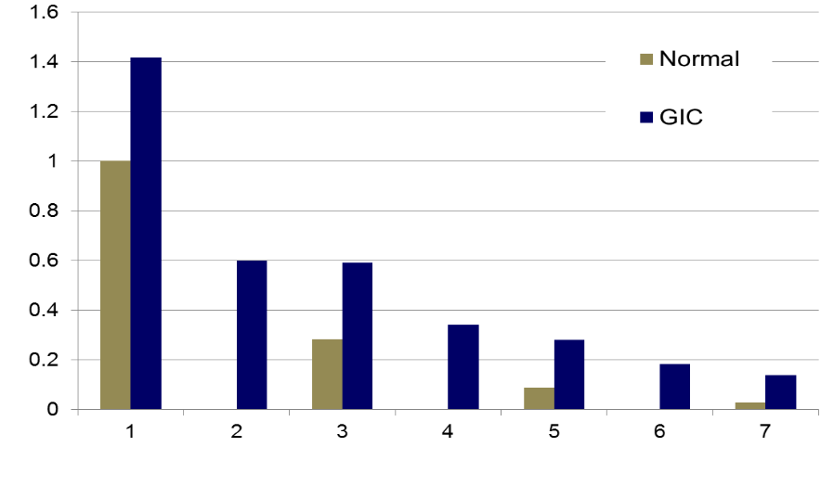
Transformer Impacts of GICs
The GICs superimpose on the ac current, causing transformers saturation for part of the ac cycle
This can cause large harmonics; in the positive sequence these harmonics can be represented by increased reactive power losses in the transformer
Harmonics
Images: Craig Stiegemeier and Ed Schweitzer, JASON Presentations,
June 2011
44

