Slide 1
ECEN 615
Methods of Electric Power
Systems Analysis
Lecture 25: Inertia Power Flow,
GMD Modeling, Black Start
Prof. Tom Overbye
Dept. of Electrical and Computer Engineering
Texas A&M University
overbye@tamu.edu

Slide 2
Announcements
Problem Set 6 is due on Dec 10 (I’ll actually accept it up until Dec 11 at 1245pm)
  It counts as two problem sets, with problems 1-4 as one set, and problem 5 as a second

Slide 3
Inertia and Governor Power Flows
In the regular power flow a single slack bus is used so total load + losses = total generation
The slack bus is characterized by having a fixed voltage magnitude and angle
  A slack bus is needed for each island though nothing precludes having multiple slack buses in an island
If an area is on AGC then the outputs for the other generators can be changed either before or during the power flow solution
This does not match the initial change in the generator output following a contingency

Slide 4
Inertia and Governor Power Flows
Following a generation and/or load contingency the changes in the generator outputs will be
  Initially determined by the generator’s inertia
  After several seconds the output will be determined by the generator’s governor response, which takes into account limits
  After dozens of seconds to minutes the AGC will respond
A governor or an inertia power flow seeks to match this initial response
  A useful reference is M. Lotfalian, R. Schlueter, et. al., “Inertial, Governor and AGC/Economic Dispatch Load Flow Simulations of Loss of Generation Contingencies,” IEEE Trans. Power Apparatus and Systems, Nov. 1985

Slide 5
Generator Output Example
Example shows the generator outputs following the loss of a 250 MW generator (at Kyle138)

Slide 6
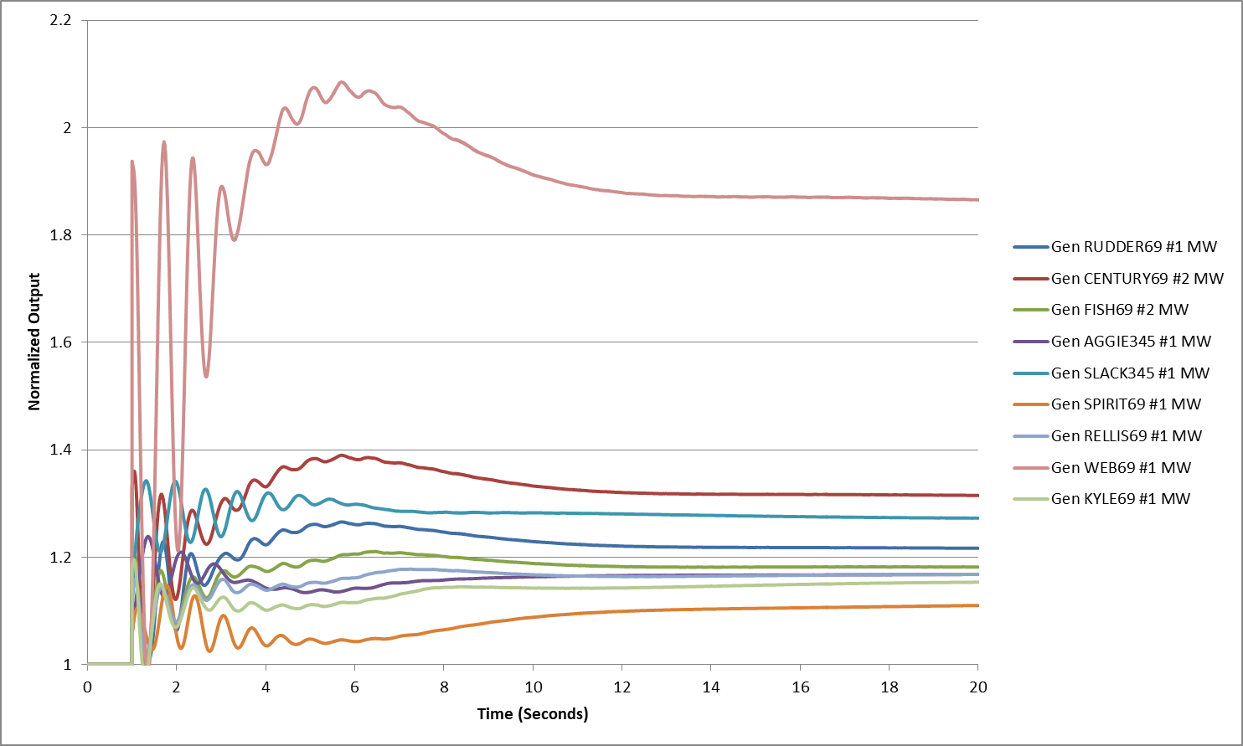
Generator Output Example, cont.
Graph shows the normalized change in output, with the initial value based on the inertia then on the governor

Slide 7
Inertia and Governor Power Flows
The inertia and governor power flows seek to match this response by including in each real power balance equation an additional term that the allocates this power mismatch to each generator in proportion to its relative percentage inertia or relative percentage governor response
This is a distributed slack approach since the allocation occurs inside the power flow iteration
There is still a slack bus to provide an angle reference

Slide 8
Inertia Power Flow
In an inertia power flow let α be the accelerating power. Then at each generator bus i the generator output is
The accelerating power can just be included as a solution variable
Real power flow equations are then written for all the buses, but the slack angle is not a solution variable

Slide 9
Two Bus DC Power Flow Example
Assume a two bus system with the buses connected with a lossless line with X=0.1. Let bus 2 be the slack with θ₂=0, generators at both buses with P_{G1} =1 and a single load (at bus 1) with P_{L1}=3. Assume equal inertia for the generators
In a traditional dc power flow there is one equation

Slide 10
Two Bus DC Power Flow Example
With the inertia approach there would be two equations and the power is specified at both buses (say P_{G2}=1.5)
Solving gives

Slide 11
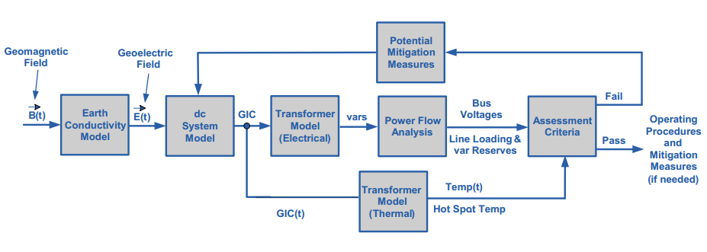
Back to GMD: The Assessment
In is a quite interdisciplinary problem
Starting Here
The two key concerns from a big storm are 1) large-scale blackout
due to voltage collapse, 2) permanent transformer damage due to
overheating
Image Source: http://www.nerc.com/pa/Stand/WebinarLibrary/GMD_standards_update_june26_ec.pdf
10

Slide 12
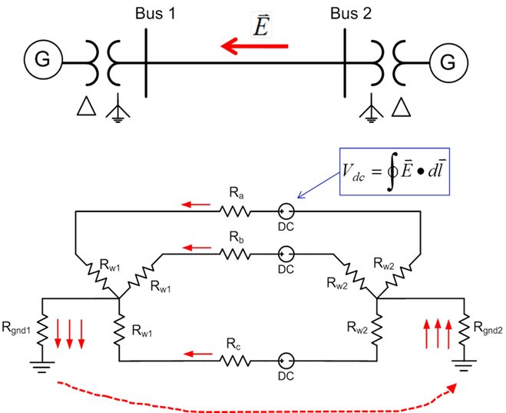
Geomagnetically Induced Currents (GICs
GMDs cause slowly varying electric fields
Along length of a high voltage transmission line, electric fields can be modeled as a dc voltage source superimposed on the lines
These voltage sources
produce quasi-dc
geomagnetically induced
currents (GICs) that are
superimposed on the ac
(60 Hz) flows
11

Slide 13
GIC Calculations for Large Systems
With knowledge of the pertinent transmission system parameters and the GMD-induced line voltages, the dc bus voltages and flows are found by solving a linear equation I = G V (or J = G U)
  J and U may be used to emphasize these are dc values, not the power flow ac values
  The G matrix is similar to the Y_{bus} except 1) it is augmented to include substation neutrals, and 2) it is just resistive values (conductances)
    Only depends on resistance, which varies with temperature
  Being a linear equation, superposition holds
  The current vector contains the Norton injections associated with the GMD-induced line voltages
12

Slide 14
GIC Calculations for Large Systems
Factoring the sparse G matrix and doing the forward/backward substitution takes about 1 second for the 60,000 bus Eastern Interconnect Model
The current vector (I) depends upon the assumed electric field along each transmission line
  This requires that substations have correct geo-coordinates
With nonuniform fields an exact calculation would be path dependent, but just a assuming a straight line path is probably sufficient (given all the other uncertainties!)
13

Slide 15
Four Bus Example (East-West Field)
The line and transformer resistance and current values are per phase so the total current is three times this value. Substation grounding values are total resistance. Brown arrows show GIC flow.
Case name is GIC_FourBus
14

Slide 16
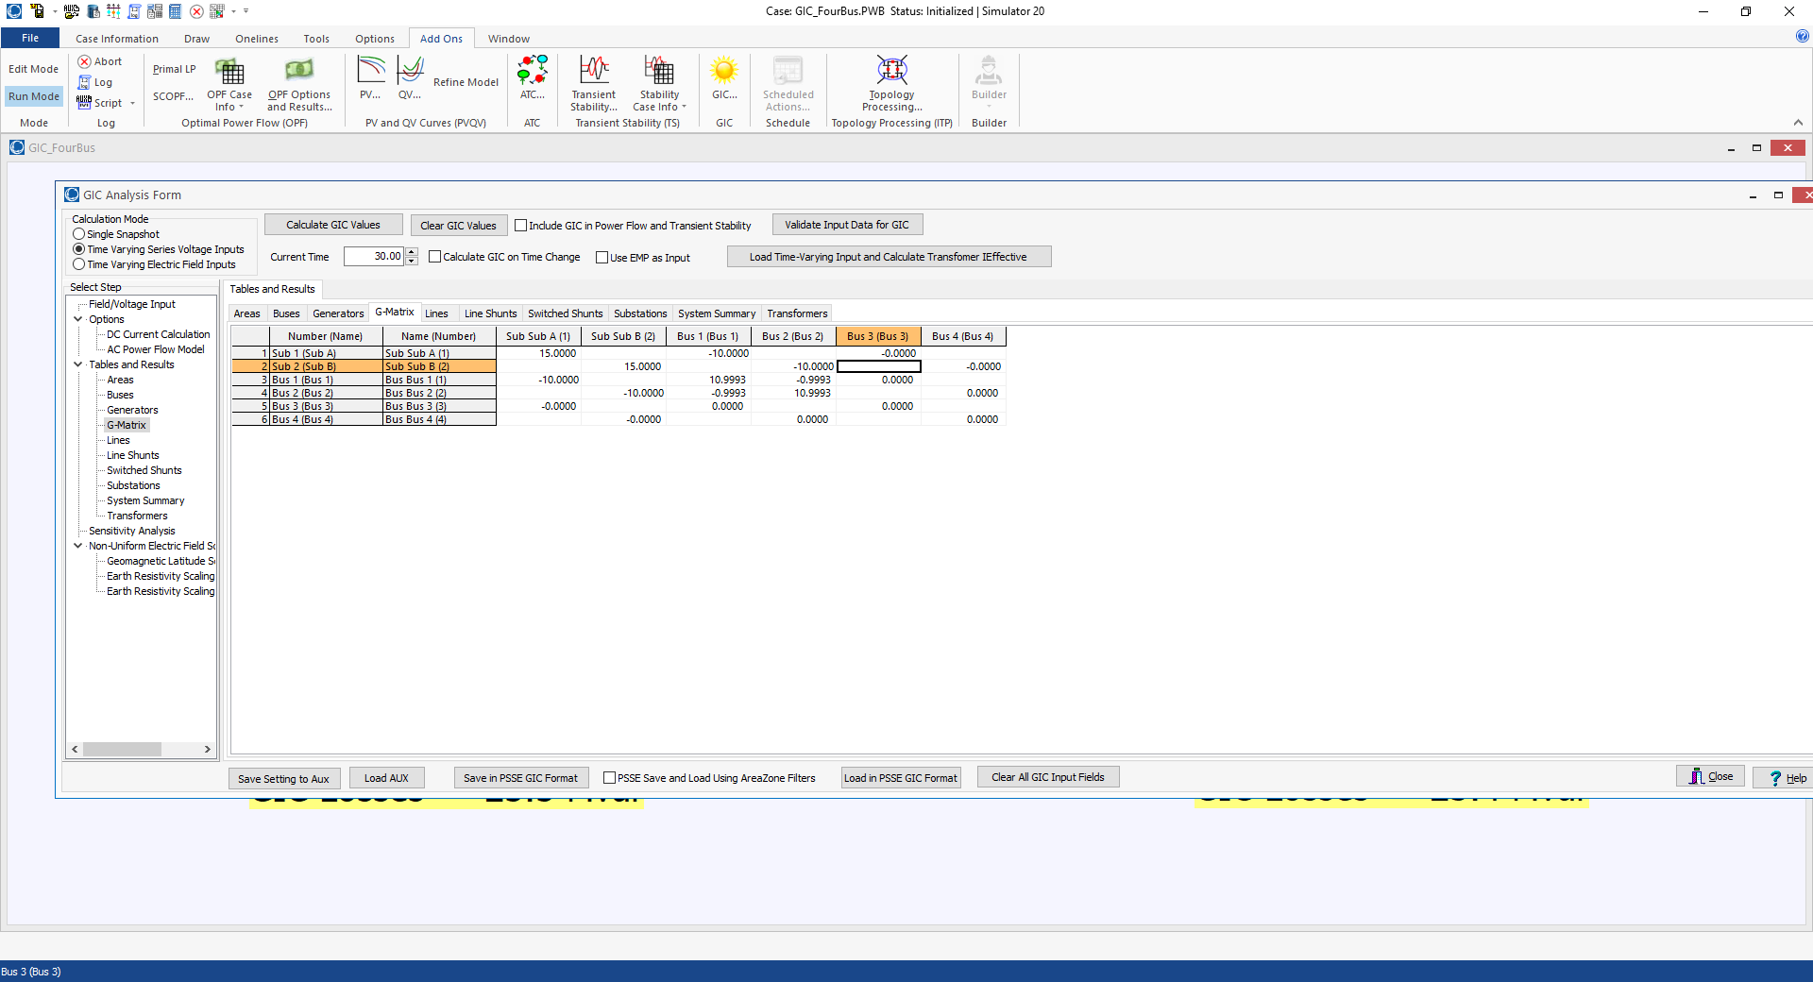
Four Bus Example GIC G Matrix
15

Slide 17
GICs, Generic EI, 5 V/km East-West
16

Slide 18
GICs, Generic EI, 5 V/km North-South
17

Slide 19
Determining GMD Storm Scenarios
The starting point for the GIC analysis is an assumed storm scenario; sets the line dc voltages
Matching an actual storm can be complicated, and requires detailed knowledge of the geology
GICs vary linearly with the assumed electric field magnitudes and reactive power impacts on the transformers is also mostly linear
Working with space weather community to determine highest possible storms
NERC proposed a non-uniform field magnitude model that FERC has partially accepted, but also with hotspots
18

Slide 20
Electric Field Linearity
If an electric field is assumed to have a uniform direction everywhere (like with the current NERC model), then the calculation of the GICs is linear
  The magnitude can be spatially varying
This allows for very fast computation of the impact of time-varying functions (like with the NERC event)
PowerWorld now provides support for loading a specified time-varying sequence, and quickly calculating all of the GIC values
19

Slide 21
Overview of GMD Assessments
Next we go here
Image Source: http://www.nerc.com/pa/Stand/WebinarLibrary/GMD_standards_update_june26_ec.pdf
20

Slide 22
Impact of Earth Models: Relationship Between dB/dT and E
The magnitude of the induced electric field depends upon the rate of change in the magnetic field, and the deep earth (potentially 100’s of km) conductivity
The relationship between changing magnetic fields and electric fields are given by the Maxwell-Faraday Equation
21

Slide 23
Relationship Between dB/dT and E
If the earth is assumed to have a single conductance, σ, then
The magnitude relationship is then
A more resistive earth gives higher electric fields
22

Slide 24
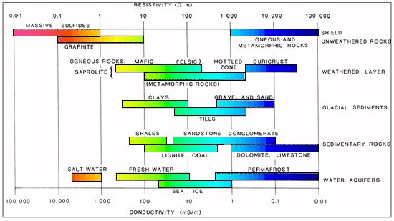
Typical Conductance and Resistivity Values
Soil conductance is often expressed in its inverse of resistivity in Ω-m; values can vary widely
  Topsoil varies widely with moisture content, from 2500 Ω-m when dry to about 20 Ω-m when very wet
  Clay is between 100-200 Ω-m
Image source: https://www.eoas.ubc.ca/courses/eosc350/content/foundations/properties/resistivity.htm
23

Slide 25
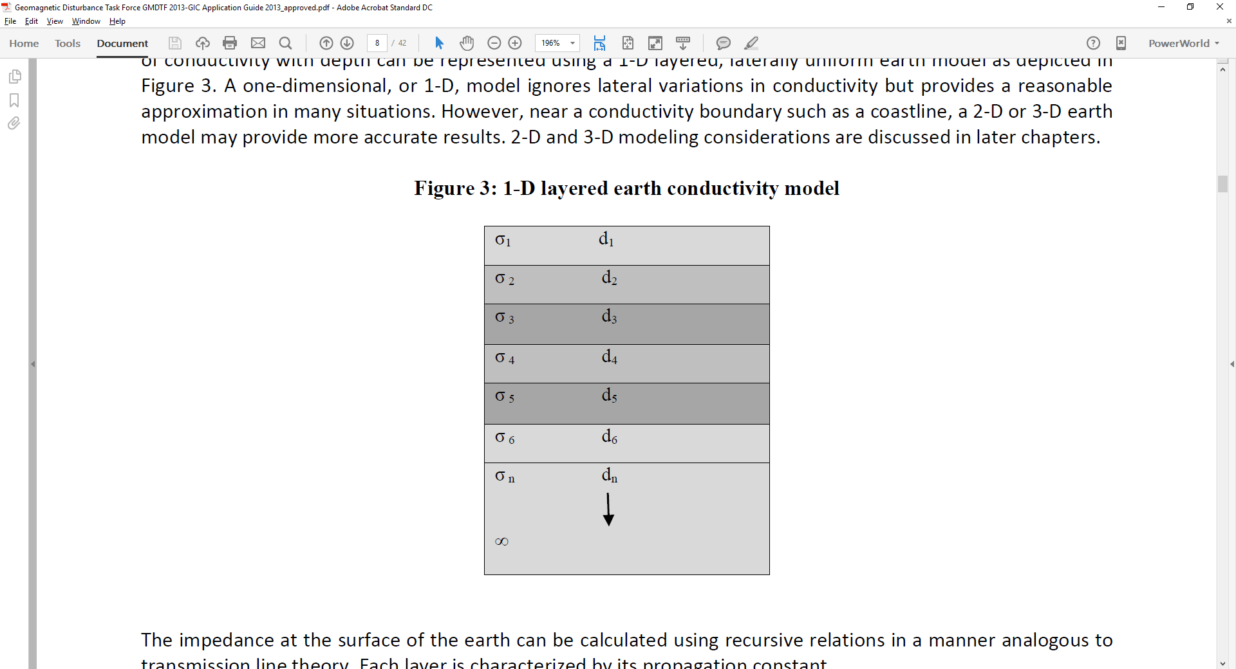
1-D Earth Models
With a 1-D model the earth is model as a series of conductivity layers of varying thickness
The impedance at a particular frequency
is calculated using a recursive
approach, starting at the bottom,
with each layer m having
a propagation constant
At the bottom level n
1-D Layers
24

Slide 26
1-D Earth Models
Above the bottom layer each layer m, has a reflection coefficient associated with the layer below
With the impedance at the top of layer m given as
Recursion is applied up to the surface layer
25

Slide 27
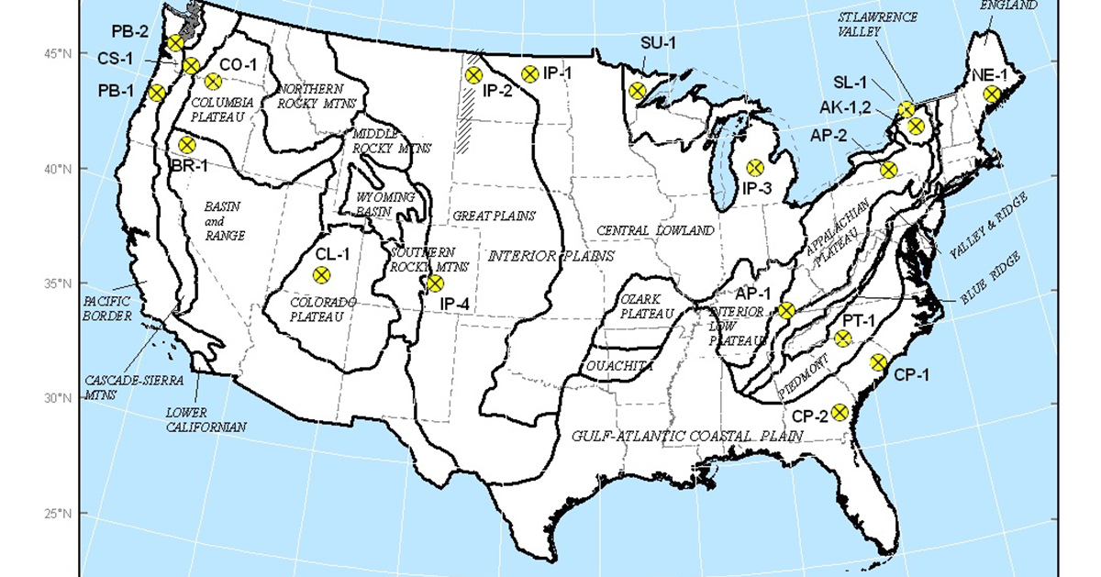
USGS 1-D Conductivity Regions
The USGS has broken the continental US into about 20 conductivity (resistivity) regions
These
regional
scalings
are now
being
used
for power
flow GMD
analysis,
and are
being
updated
Image from the NERC report; data is available at http://geomag.usgs.gov/conductivity/
26

Slide 28
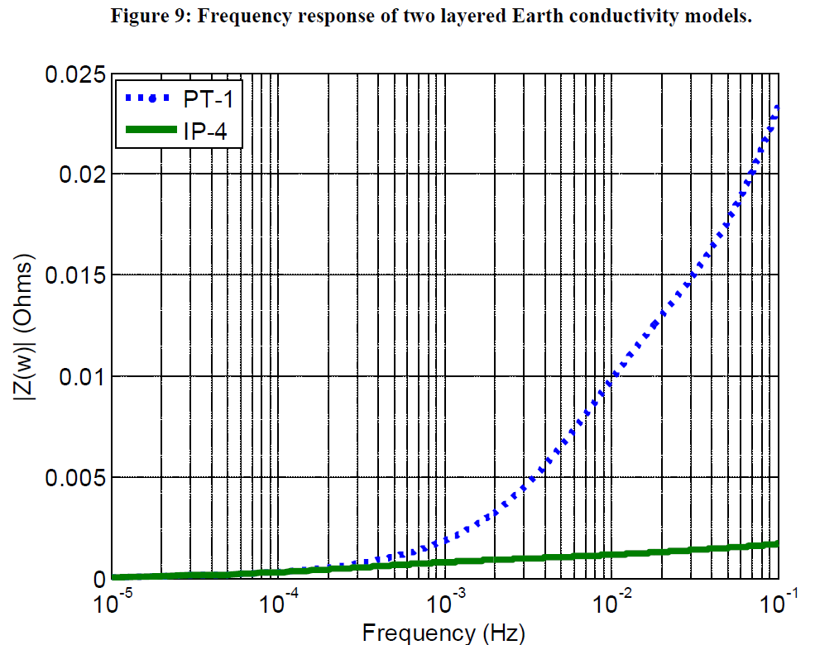
1-D Earth Models
Image on the bottom left shows an example 1-D model, whereas image on bottom right shows the Z(ω) variation for two models
27

Slide 29
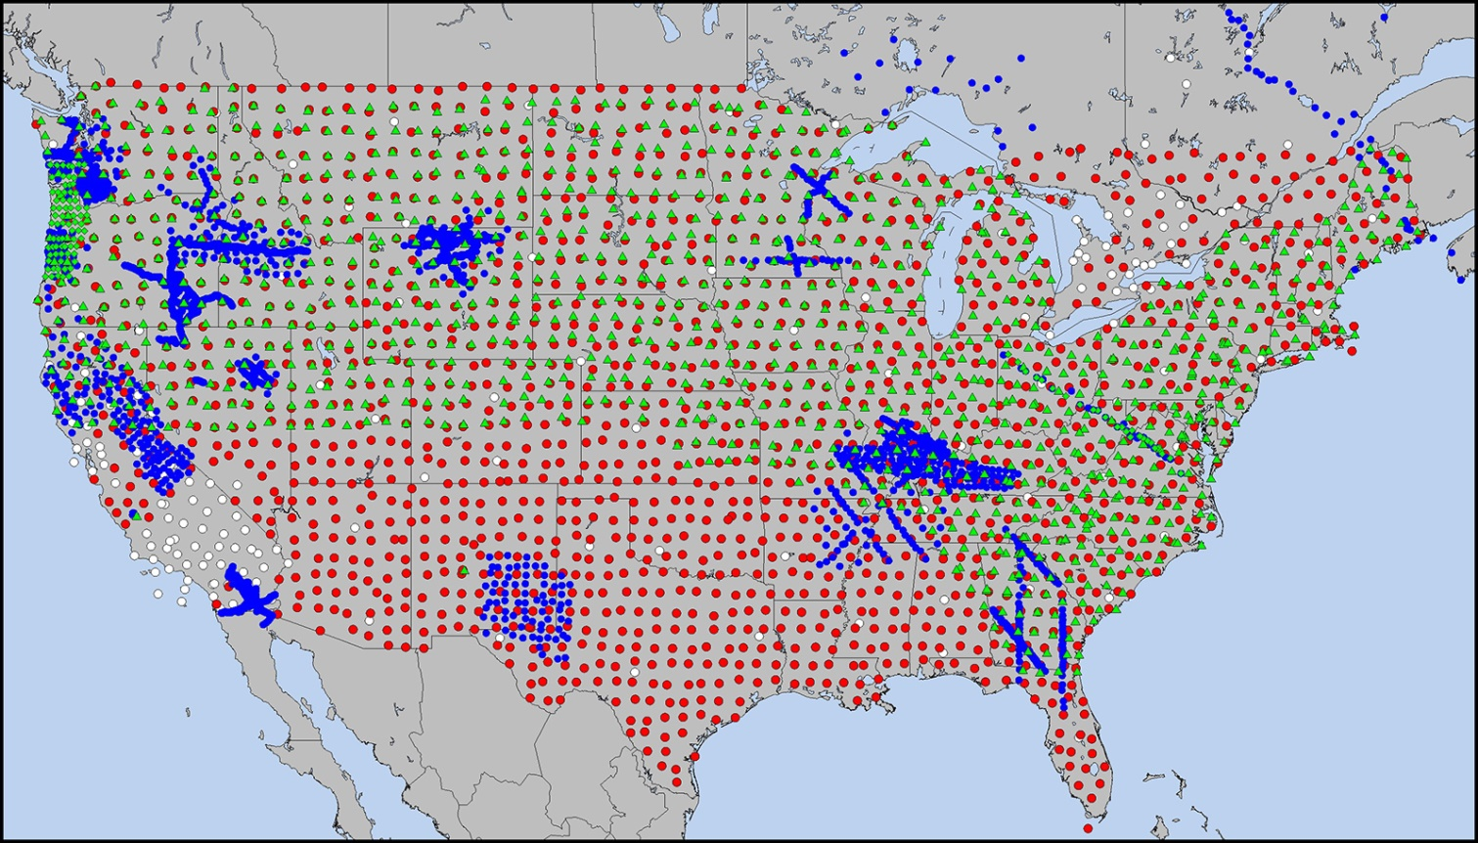
3-D Models and EarthScope
USArray in the Lower 48 U.S. and Southeastern Canada. Transportable Array (TA) stations (red), Flexible Array (FA) stations (blue), and Magnetotelluric (MT) array (green) operated at different scales from 2004–2018. MT stations are subdivided between MT-TA (green triangles) and MT-FA (tight cluster of green diamonds in the Pacific Northwest and dense line across the Mid-Atlantic). Backbone stations (white) were used as part of the TA at its outset and in Canada. Over 200 TA stations have been permanently adopted across the country, and there are active efforts across the federal government to complete the MT-TA across the southern one-third of the U.S.
Source: https://www.earthscope.org/articles/Reflections_on_USArray.html
28

Slide 30


3-D Models and EarthScope
Earthscope data is processed into magnetotelluric transfer functions that:
  Define the frequency dependent linear relationship between EM components at a single site.
(simplified for the 1D case)
Can be used to relate a magnetic field input to and electric field output at a single site
Are provided in 2x2 impedance tensors by USArray
Reference: Kelbert et al., IRIS DMC Data Services Products, 2011.
29

Slide 31
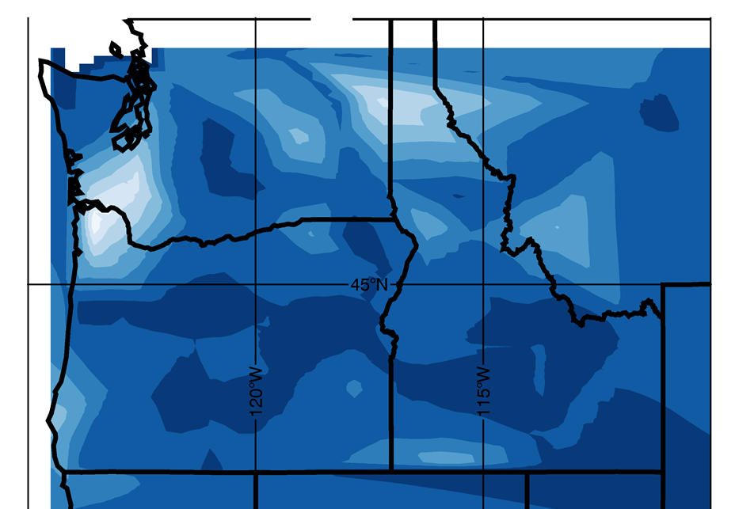
Example 3-D Earthscope Model Results
Image provides a snapshot visualization of the time-varying surface electric fields using Earthscope data
White ~ 10 V/km
Image Provided by Jenn Gannon
30

Slide 32
Input Electric Field Considerations
The current vector (I) depends upon the assumed electric field along each transmission line
With a uniform electric field determination of the transmission line’s GMD-induced voltage is path independent
  Just requires geographic knowledge of the transmission line’s terminal substations
With nonuniform fields an exact calculation would be path dependent, but just a assuming a straight line path is probably sufficient (given all the other uncertainties!)
31

Slide 33
Overview of GMD Assessments
Next we go here
32

Slide 34
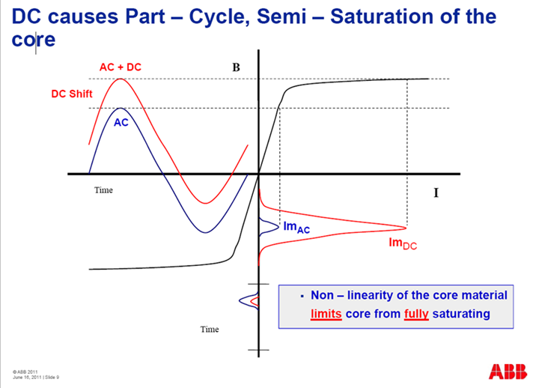
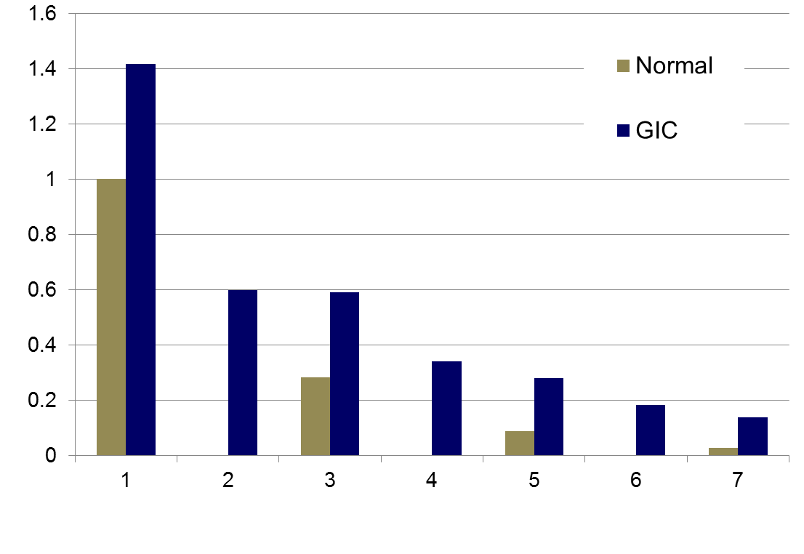
Transformer Impacts of GICs
The GICs superimpose on the ac current, causing transformers saturation for part of the ac cycle
This can cause large harmonics; in the positive sequence these harmonics can be represented by increased reactive power losses in the transformer
Harmonics
Images: Craig Stiegemeier and Ed Schweitzer, JASON Presentations,
June 2011
33

Slide 35
Relating GICs to Transformer Mvar Losses
Transformer positive sequence reactive power losses vary as a function of both the GICs in the transformer coils and the ac voltage
A common approach is to use a linear model
The I_{GIC,Eff} is an effective current that is a function of the GICs in both coils; whether auto or regular the equation is
34

Slide 36
Confusions!
I_{GIC,Eff} is a dc value, whereas Q_{loss} is the total ac losses
From a GIC perspective, the three phases are in parallel; hence there can be confusion as to whether the GICs are per phase or total (per phase is common and used in PowerWorld)
Since Q_{loss} varies linearly with voltage, the nominal high voltage of the transformer (e.g., 500 kV, 345 kV, etc.) needs to be embedded in the K
  An initial approach was to assume a K for 500 kV; the K then needed to be scaled for other voltages
35

Slide 37
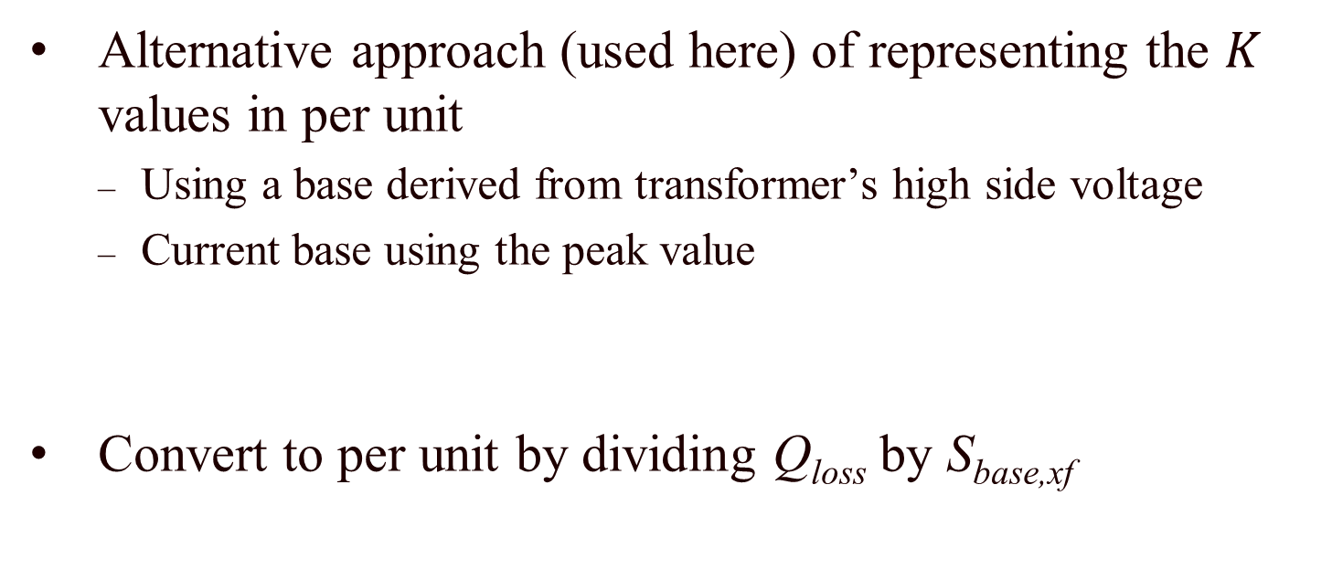
Specifying Transformer Losses Scalars in Per Unit
Alternative approach (used here) of representing the $K$ values in per unit
  Using a base derived from transformer’s high side voltage
  Current base using the peak value
Convert to per unit by dividing Q_{loss} by S_{base,xf}
Peak (or “crest” value
used since this is a dc
current base
K_{old} based on an assumed 500 kV
36

Slide 38
Overview of GMD Assessments
Now here
37

Slide 39
GMD Enhanced Power Analysis Software
By integrating GIC calculations directly within power flow and transient stability engineers can see the impact of GICs on their systems, and consider mitigation options
GIC calculations use many of the existing model parameters such as line resistance. Some non-standard values are also needed; either provided or estimated
  Substation grounding resistance
  transformer grounding configuration
  transformer coil resistance
  whether auto-transformer, three-winding transformer
38

Slide 40
Power System Restoration
Power system restoration or black start (or blackstart)
  A procedure to restore power in the event of a partial or total shutdown of the power system
  A highly complex decision problem
Object is to serve the load as soon as possible without violating operating constraints
  Actions are time critical
Primarily manual work by operators
Offline restoration planning usually based on simulations

Slide 41
Power System Restoration
Common characteristics of restoration (even though strategies are different)
  Immediate resupply of station service
  Time consuming nature of switching operation
  Start-up timings of thermal units
  Voltage rise problems of energizing unloaded transmission lines
  Frequency response of prime movers to a sudden load pickup
  Cold load inrush, power factors and coincident demand factors

Slide 42
System Restoration Efforts - IEEE
After 1977 New York City blackout, DOE required operating companies to develop a power system restoration plan, train personnel, regularly update and maintain the plan.
In response to this requirement in 1978, the Power System Operation Committee established the Power System Restoration (PSR) Task Force (TF) within the System Operation Subcommittee of the Power System Engineering Committee.
A few years later, the PSR TF was upgraded to PSR working group (WG)

Slide 43

System Restoration Efforts - IEEE
In 1993 a 110 page brochure was prepared by PSR WG and published by the IEEE PES
Includes:
  14 IEEE Committee Reports
  5 SRWG member papers in IEEE publication
  13 related IEEE transaction papers

Slide 44
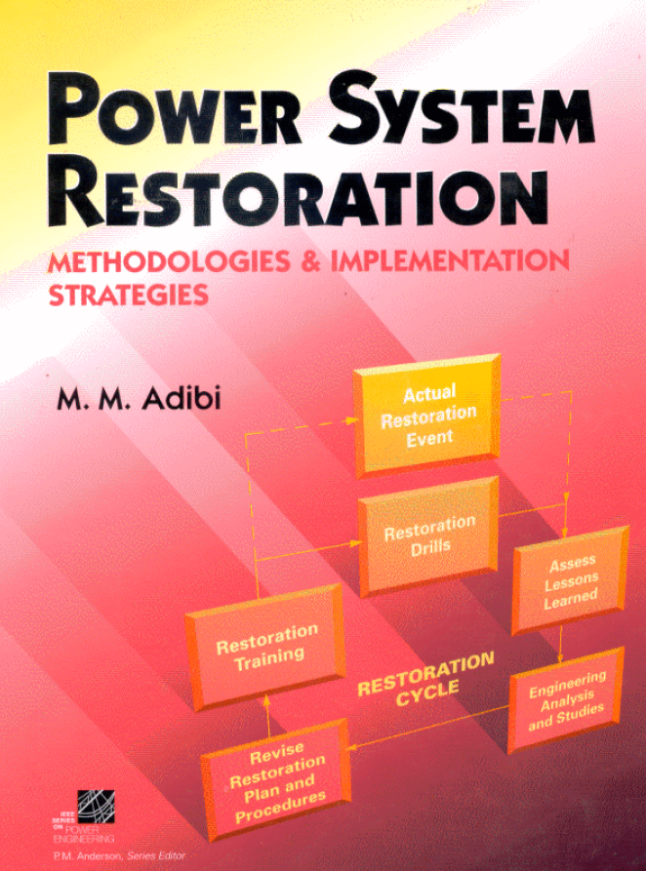
System Restoration Efforts - IEEE
In 2000 a 700 page book was prepared by PSRWG and published by Wiley-IEEE Press
Includes 87 papers including 14 papers in the original 1993 collection

Slide 45

System Restoration Efforts - IEEE
In 2014 40 IEEE papers by 110 authors including 42 panelists of Restoration Dynamics Task Force
Covers:
  Real power balance and control of frequency
  Reactive power balance and control of voltages
  Critical tasks (time sensitive functions)
  Analyses and simulations

Slide 46

Mahmood Mike Adibi (1924 – 2018)
The godfather of power system restoration
B.S.E. in 1950 from University of Birmingham, U.K.
M.S.E in 1960 from Polytech Institute of Brooklyn, NY
IEEE Life Fellow
Founder and chairman of the IEEE System Restoration Working Group in 1979
Author of the book, “Power System Restoration – Methodologies and Implementation Strategies”
  A great review book of IEEE papers between 1987 and 1999
Developed restoration plans for over a dozen utilities

Slide 47
Other Good References
PJM Manual 36: System Restoration
EPRI, “Development of Power System Restoration Tool Based on Generic Restoration Milestones,” 2010.
PSERC, “Development and Evaluation of System Restoration Strategies from a Blackout,” 2009.
IESO, “Part 7.8: Ontario Power System Restoration Plan,” 2017.
K. Sun et al., “Power System Control Under Cascading Failures: Understanding, Mitigation, and System Restoration,” Wiley-IEEE Press. 2019.
Yutian Liu, Rui Fan, and Vladimir Terzija, “Power system restoration: a literature review from 2006 to 2016,” J. Mod. Power Syst. Clean Energy, 2016, 4(3), pp. 332-341

Slide 48
NERC Standards on Restoration
NERC System Restoration and Black Start standards
  EOP-005-2 & EOP-005-3
    System Restoration from Black Start Resources
    Ensure plans, Facilities, and personnel are prepared to enable System restoration from Black Start Resources to assure reliability is maintained during restoration and priority is placed on restoring the Interconnection
  EOP-006-2 & EOP-006-3
    System Restoration Coordination
    Ensure plans are established and personnel are prepared to enable effective coordination of the System restoration process to ensure reliability is maintained during restoration and priority is placed on restoring the Interconnection.

Slide 49
Common Issues during Restoration
Active power balance and frequency control
  Need to maintain system frequency within limits by system stability and protection settings
  Can be accomplished by picking up loads in increments
Reactive power balance and overvoltage control
  Energizing few high voltage lines
  Operating generators at minimum voltage levels
  Deactivating switched shunt capacitors
  Connecting shunt reactors
  Adjusting transformer taps
  Picking up reactive loads

Slide 50
Common Issues during Restoration
Transient switching voltages
  Switching surges occur when energizing equipment
Self-excitation
  When the charging current is high relative to the size of generators
  When opening a line at the sending end but leaving the line connected to a large motor
  This causes overvoltage and damages equipment
Cold load pickup
  When load has been de-energized for several hours or more
  Inrush current can be as high as 8 – 10 times of the normal value

Slide 51
Common Issues during Restoration
System stability
  Voltage should be within limits
  Angle stability have to be maintained
  Frequency is the main issue in stability assessment
Protective systems and load control
  Continuous change in system configuration and in operating conditions may trigger undesirable operation of relays
  Load shedding can be useful in case of low frequency conditions

Slide 52
Common Issues during Restoration
Partitioning system into islands
  Necessary to speed up the process, especially for large systems
  NERC standards
    Each islands must have sufficient black start capability
    Each islands should have enough cranking paths to gens and loads
    Each islands should be able to match generation and load within prescribed frequency limits
    Each islands should have adequate voltage controls
    All tie points must be capable of synchronization with adjacent subsystems
    All islands should share information with other islands

Slide 53
Generic Restoration Steps
Preparation stage (1 – 2 hours)
  Evaluate pre- and post-disturbance conditions
  Define the target system
  Restart generators and rebuild transmission network
System restoration stage (3 – 4 hours)
  Energize transmission paths
  Restore load to stabilize generation and voltage
  Synchronize islands and reintegrate bulk power system
Load restoration stage (8 – 10 hours)
  Load restoration is the governing control objective
  Load pickup is scheduled based on generation availability
  Load restoration is effected in increasingly larger steps

Slide 54
System Restoration Tasks
Know the status of the grid
List and rank critical loads by priority
List and rank initial sources of power by availability
  Maximize generation capabilities with the available black start resources
Determine the most effective ways of brining the two together
  Schedule tasks and resources during restoration
  Establish transmission capability and paths while meeting operating constraints

Slide 55
Initial Power and Load
Initial source of power
Initial critical loads
Type | Time (min) | Success probability
Run-of-the-River Hydro | 5-10 | High
Pump-Storage Hydro | 5-10 | High
Combustion Turbine | 5-15 | Medium
Tie-line with Adjacent Systems | Short
Type | Priorities
Cranking drum-type units | High
Pipe-type cables pumping plants | High
Transmission stations | High to Medium depending on location
Distribution stations | High to Medium depending on location
Industrial loads | Medium to low

