Slide 1
ECEN 667
Power System Stability
Lecture 12: Deadbands, Governors,
PID Controllers
Prof. Tom Overbye
Dept. of Electrical and Computer Engineering
Texas A&M University
overbye@tamu.edu

Slide 2
Announcements
Read Chapter 4
Exam 1 is Thursday October 10 during class; closed book, closed notes. One 8.5 by 11 inch note sheet and calculators allowed.

Slide 3
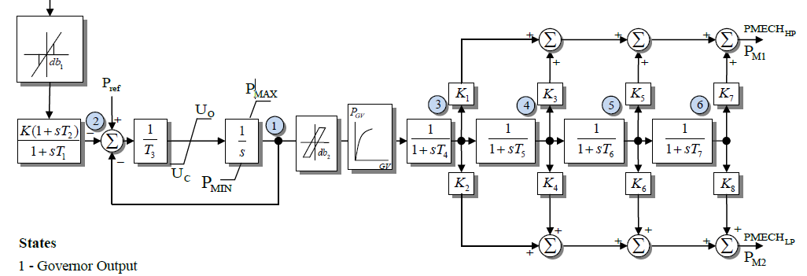
IEEEG1 Governor
A common stream turbine model, is the IEEEG1, originally introduced in the below 1973 paper
In this model K=1/R
It can be used to represent
cross-compound units, with
high and low pressure steam
U_{o} and U_{c} are rate limits
IEEE Committee Report, “Dynamic Models for Steam and Hydro Turbines in Power System Studies,” Transactions in Power Apparatus & Systems, volume 92, No. 6, Nov./Dec. 1973, pp 1904-15

Slide 4
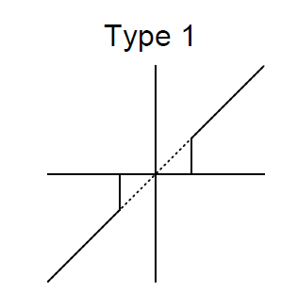
Deadbands
Before going further, it is useful to briefly consider deadbands, with two types shown with IEEEG1 and described in the 2013 IEEE PES Governor Report
The type 1 is an intentional deadband, implemented to prevent excessive response
  Until the deadband activates there is no response, then normal response after that; this can cause a potentially
  large jump in the response
  Also, once activated there is normal
  response coming back into range
  Used on input to IEEEG1

Slide 5
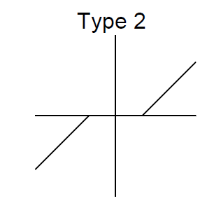
Deadbands
The type 2 is also an intentional deadband, implemented to prevent excessive response
  Difference is response does not jump, but rather only starts once outside of the range
Another type of deadband is the
unintentional, such as will occur
with loose gears
  Until deadband "engages"
  there is no response
  Once engaged there is
  a hysteresis in the
  response
When starting
simulations
deadbands
usually start at
their origin

Slide 6
Frequency Deadbands in ERCOT
In ERCOT NERC BAL-001-TRE-1 (“Primary Frequency Response in the ERCOT Region”) has the purpose “to maintain interconnection steady-state frequency within defined limits”
The deadband requirement is +/- 0.034 Hz for steam and hydro turbines with mechanical governors; +/- 0.017 Hz for all other generating units
The maximum droop setting is 5% for all units except it is 4% for combined cycle combustion turbines
Source: NERC BAL-001-TRE-1 and ERCOT, Demonstration of PFR Improvement, ERCOT Operations Planning, Sept. 2017 presentation

Slide 7
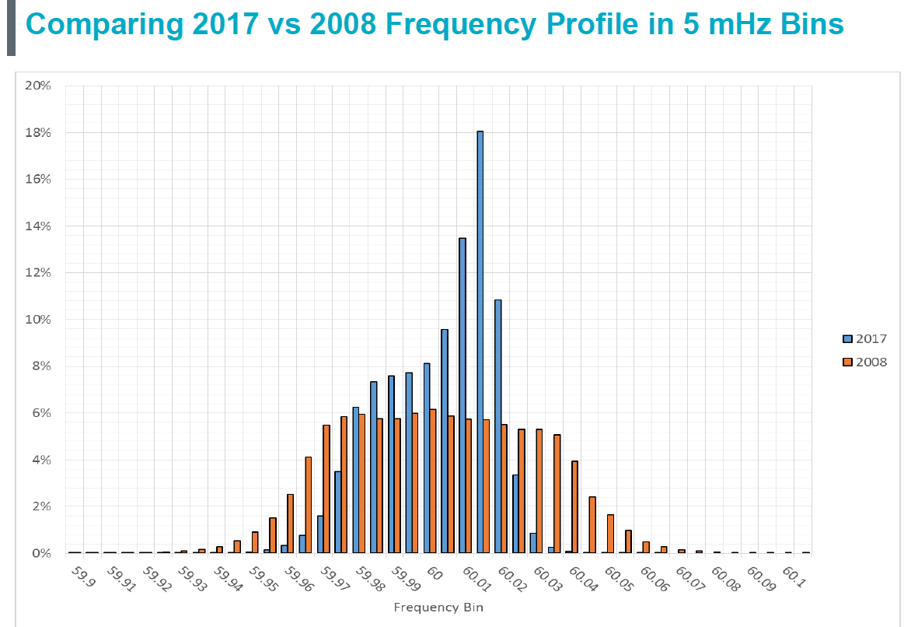
Comparing ERCOT 2017 Versus 2008 Frequency Profile (5 mHz bins)

Slide 8
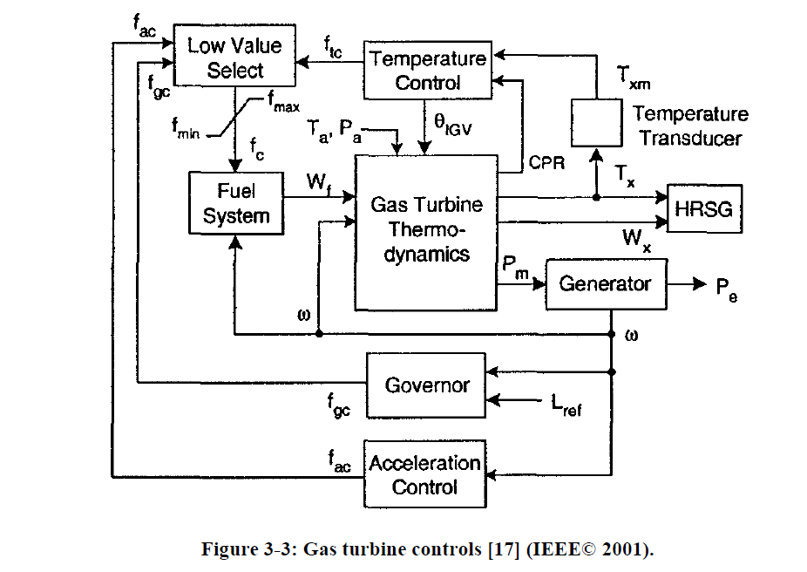
Gas Turbines
A gas turbine (usually using natural gas) has a compressor, a combustion chamber and then a turbine
The below figure gives an overview of the modeling
HRSG is
the heat
recovery
steam
generator
(if it is a
combined
cycle unit)
Image from IEEE PES, "Dynamic Models for Turbine-Governors in Power System Studies," Jan 2013

Slide 9
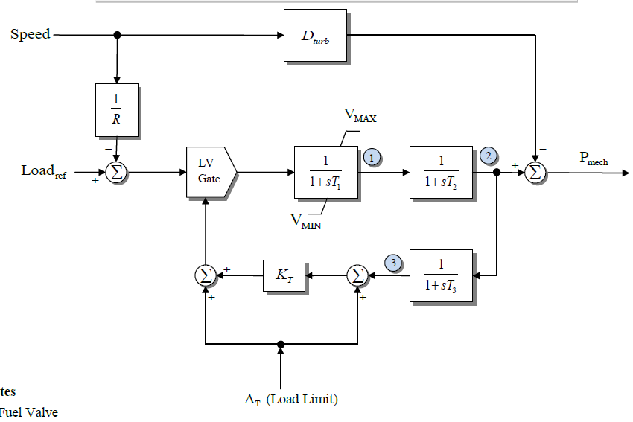
GAST Model
Quite detailed gas turbine models exist; we'll just consider the simplest, which is still used some
It is somewhat similar
to the TGOV1. T₁ is for
the fuel valve, T₂
is for the turbine, and
T₃ is for the load
limit response based
on the ambient
temperature (At);
T₃ is the delay in
measuring the exhaust
temperature
T₁ average is 0.9, T₂ is 0.6 sec

Slide 10
Play-in (Playback) Models
Often time in system simulations there is a desire to test the response of units (or larger parts of the simulation) to particular changes in voltage or frequency
  These values may come from an actual system event
"Play-in" or playback models can be used to vary an infinite bus voltage magnitude and frequency, with data specified in a file
PowerWorld allows both the use of files (for say recorded data) or auto-generated data
  Machine type GENCLS_PLAYBACK can play back a file
  Machine type InfiniteBusSignalGen can auto-generate a signal

Slide 11
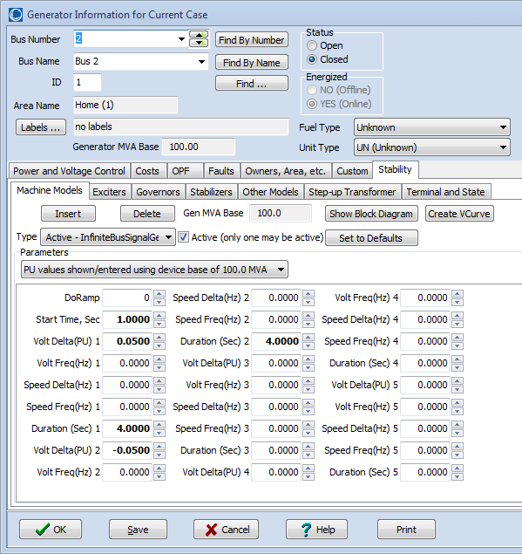
PowerWorld Infinite Bus
Signal Generation
Below dialog shows some options for auto-generation of voltage magnitude and frequency variations
Start Time tells when to start; values are then defined for up to five separate time periods
Volt Delta is the magnitude of the pu voltage deviation; Volt Freq is the frequency of the voltage deviation in Hz (zero for dc)
Speed Delta is the magnitude of the frequency deviation in Hz; Speed Freq is the frequency of the frequency deviation
Duration is the time in seconds for the time period

Slide 12
Example: Step Change in
Voltage Magnitude
Below graph shows the voltage response for the four bus system for a change in the infinite bus voltage
Case name: B4_SignalGen_Voltage

Slide 13
Example: Step Change
Frequency Response
Graph shows response in generator 4 output and speed for a 0.1% increase in system frequency
This is a
100 MVA
unit with
a per unit R
of 0.05

Slide 14
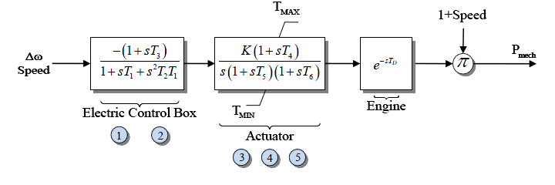
Simple Diesel Model: DEGOV
Sometimes models implement time delays (DEGOV)
  Often delay values are set to zero
Delays can be implemented either by saving the input value or by using a Pade approximation, with a 2nd order given below; a 4th order is also common

Slide 15
DEGOV Delay Approximation
With T_{D} set to 0.5 seconds (which is longer than the normal of about 0.05 seconds in order to illustrate the delay)

Slide 16
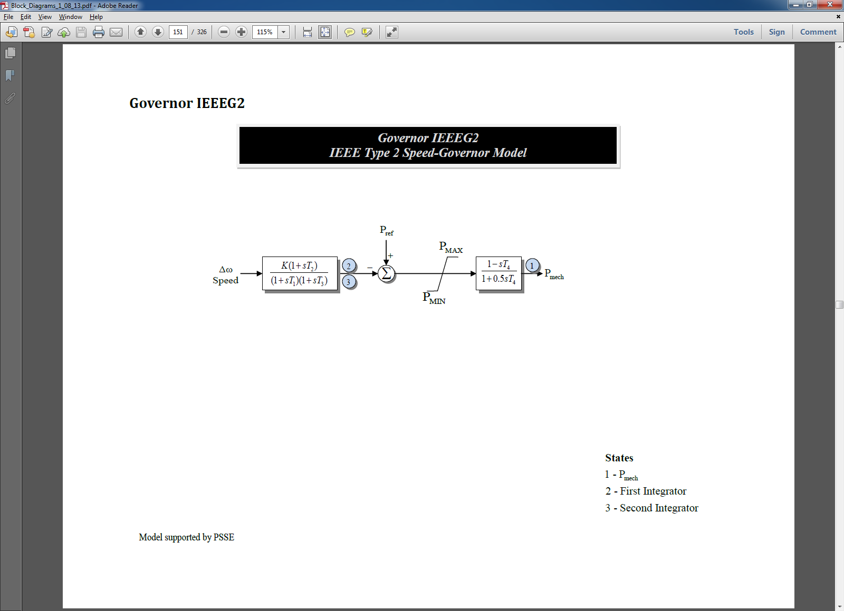
Hydro Units
Hydro units tend to respond slower than steam and gas units; since early transient stability studies focused on just a few seconds (first or second swing instability), detailed hydro units were not used
  The original IEEEG2 and IEEEG3 models just gave the linear response; now considered obsolete
Below is the IEEEG2; left side is the governor, right side is the turbine and water column
For sudden changes
there is actually an
inverse change in
the output power

Slide 17
Four Bus Example with an IEEEG2
Graph below shows the mechanical power output of gen 2 for a unit step decrease in the infinite bus frequency; note the power initially goes down!
This is caused by a
transient decrease in
the water pressure when
the valve is opened to
increase the water
flow; flows does not
change instantaneously
because of the water’s
inertia.
Case name: B4_SignalGen_IEEEG2

Slide 18
Washout Filters
A washout filter is a high pass filter that removes the steady-state response (i.e., it "washes it out") while passing the high frequency response
They are commonly used with hydro governors and (as we shall see) with power system stabilizers
With hydro turbines ballpark values for T_{w} are around one or two seconds

Slide 19
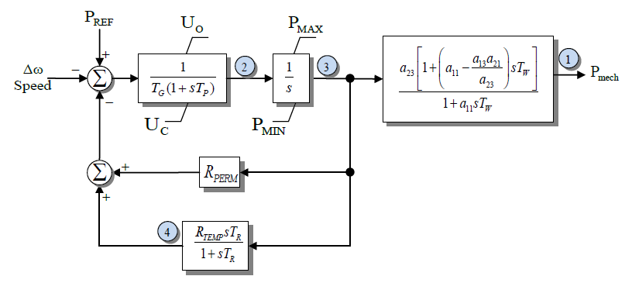
IEEEG3
This model has a more detailed governor model, but the same linearized turbine/water column model
Because of the initial inverse power change, for fast deviations the droop value is transiently set to a larger value (resulting in less of a power change)
Previously WECC had about 10% of their governors modeled with
IEEEG3s; in 2019 it is about 5%
Because of the washout filter at high frequencies R_{TEMP} dominates (on average it is 10 times greater than R_{PERM})

Slide 20
Tuning Hydro Transient Droop
As given in equations 9.41 and 9.42 from Kundar (1994) the transient droop should be tuned so
In comparing an average H is about 4 seconds, so
T_{M} is 8 seconds, an average T_{W} is about 1.3, giving
an calculated average R_{TEMP} of 0.37 and T_{R} of 6.3;
the actual averages in a WECC case are 0.46 and
6.15. So on average this is pretty good! R_{perm} is 0.05
Source: 9.2, Kundur, Power System Stability and Control, 1994

Slide 21
IEEEG3 Four Bus Frequency Change
The two graphs compare the case response for the frequency change with different R_{TEMP} values
Less variation
R_{TEMP} = 0.5, R_{PERM} = 0.05
R_{TEMP} = 0.05, R_{PERM} = 0.05
Case name: B4_SignalGen_IEEEG3

Slide 22
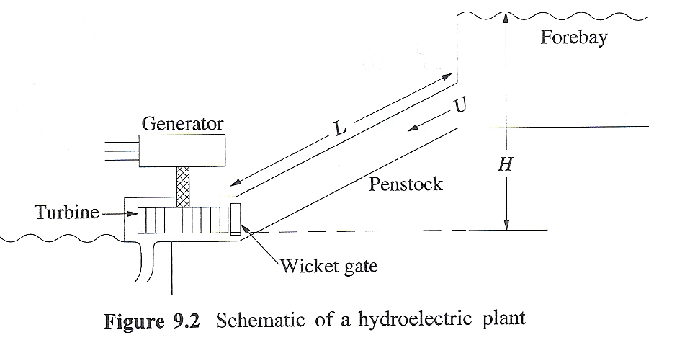
Basic Nonlinear Hydro Turbine Model
Basic hydro system is shown below
  Hydro turbines work be converting the kinetic energy in the water into mechanical energy
  assumes the water is incompressible
At the gate assume a velocity of U, a cross-sectional penstock area of A; then the
volume flow is A*U=Q;
Source: 9.2, Kundur, Power System Stability and Control, 1994

Slide 23
Basic Nonlinear Hydro Turbine Model
From Newton's second law of motion the change in the flow volume Q
As per [a] paper, this equation is normalized to
T_{W} is called the water time
constant, or water starting time
[a] "Hydraulic Turbine and Turbine Control Models for System Dynamic Studies," IEEE Trans. Power Syst., Feb, 92

Slide 24
Basic Nonlinear Hydro Turbine Model
With h_{base} the static head, q_{base} the flow when the gate is fully open, an interpretation of T_{w} is the time (in seconds) taken for the flow to go from stand-still to full flow if the total head is h_{base}
If included, the head losses, h_{loss}, vary with the square of the flow
The flow is assumed to vary as linearly with the gate position (denoted by c)

Slide 25
Basic Nonlinear Hydro Turbine Model
Power developed is proportional to flow rate times the head, with a term q_{nl} added to model the fixed turbine (no load) losses
  The term A_{t} is used to change the per unit scaling to that of the electric generator

Slide 26
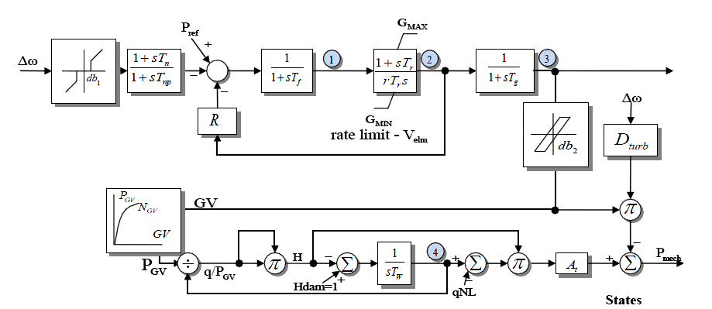
Model HYGOV
This simple model, combined with a governor, is implemented in HYGOV
About
6% of
WECC
governors
use this
model;
average
T_{W} is
2 seconds
H_{loss} is assumed small and not included
The gate position (GV) to gate power (P_{GV})
is sometimes represented with a nonlinear curve

Slide 27
Linearized Model Derivation
The previously
mentioned
linearized model
can now be
derived as

Slide 28
Four Bus Case with HYGOV
The below graph plots the gate position and the power output for the bus 2 signal generator decreasing the speed then increasing it
Note that just
like in the
linearized
model, opening
the gate initially
decreases the
power output
Case name: B4_SignalGen_HYGOV

Slide 29
PID Controllers
Governors and exciters often use proportional-integral-derivative (PID) controllers
  Developed in 1890’s for automatic ship steering by observing the behavior of experienced helmsman
PIDs combine
  Proportional gain, which produces an output value that is proportional to the current error
  Integral gain, which produces an output value that varies with the integral of the error, eventually driving the error to zero
  Derivative gain, which acts to predict the system behavior. This can enhance system stability, but it can be quite susceptible to noise

Slide 30
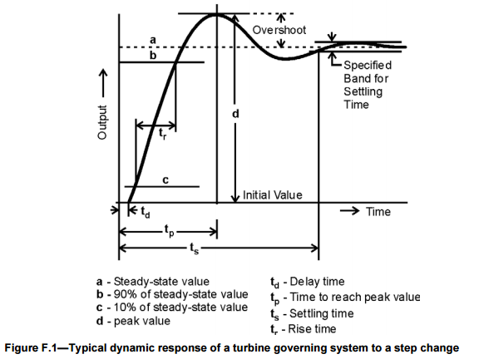
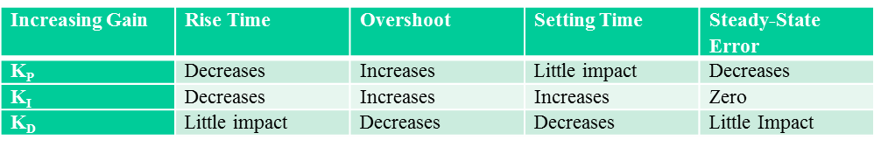
PID Controller Characteristics
Four key characteristics
of control response are
1) rise time, 2) overshoot,
3) settling time and
4) steady-state errors
Image source: Figure F.1, IEEE Std 1207-2011

Slide 31
PID Example: Car Cruise Control
Say we wish to implement cruise control on a car by controlling the throttle position
  Assume force is proportional to throttle position
  Error is difference between actual speed and desired speed
With just proportional control we would never achieve the desired speed because with zero error the throttle position would be at zero
The integral term will make sure we stay at the desired point
With derivative control we can improve control, but as noted it can be sensitive to noise

Slide 32
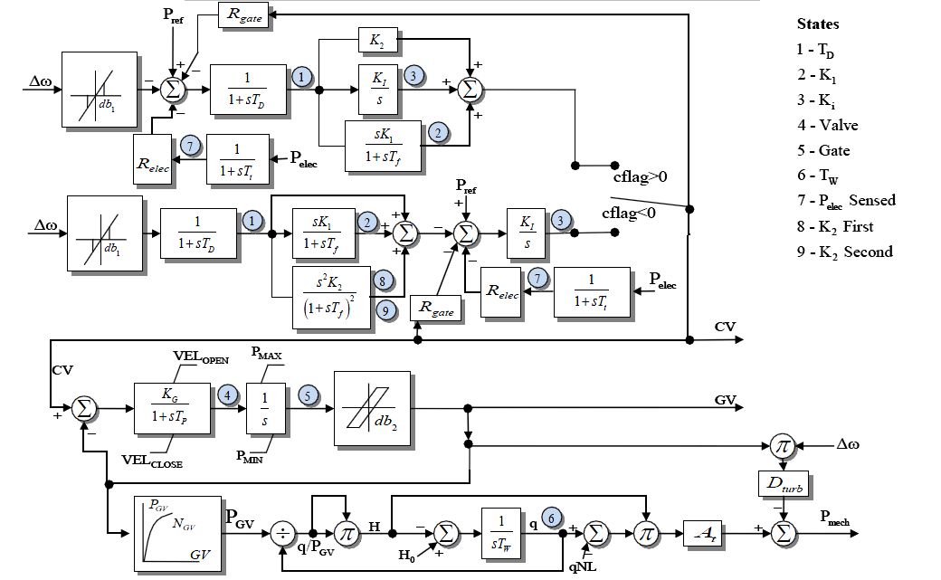
HYG3
The HYG3 models has a PID or a double derivative
Looks more
complicated
than it is
since
depending
on cflag
only one of
the upper
paths is
used
About 15% of current WECC governors at HYG3

Slide 33
Tuning PID Controllers
Tuning PID controllers can be difficult, and there is no single best method
  Conceptually simple since there are just three parameters, but there can be conflicting objectives (rise time, overshoot, setting time, error)
One common approach is the Ziegler-Nichols method
  First set K_{I} and K_{D} to zero, and increase K_{P} until the response to a unit step starts to oscillate (marginally stable); define this value as K_{u} and the oscillation period at T_{u}
  For a P controller set K_{p} = 0.5K_{u}
  For a PI set K_{P} = 0.45 K_{u} and K_{I} = 1.2* K_{p}/T_{u}
  For a PID set K_{P}=0.6 K_{u}, K_{I}=2* K_{p}/T_{u}, K_{D}=K_{p}T_{u}/8

Slide 34
Tuning PID Controller Example
Use the four bus case with infinite bus replaced by load, and gen 4 has a HYG3 governor with cflag > 0; tune K_{P}, K_{I} and K_{D} for full load to respond to a 10% drop in load (K₂, K_{I}, K₁ in the model; assume T_{f}=0.1)
Case name: B4_PIDTuning

Slide 35
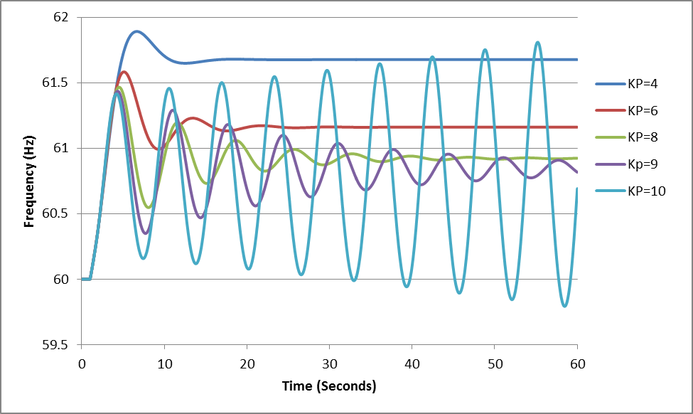
Tuning PID Controller Example
Based on testing, K_{u} is about 9.5 and T_{u} is 6.4 seconds
Using Ziegler-Nichols a good P value 4.75, is good PI values are K_{P} = 4.3 and K_{I} = 0.8, while good PID values are K_{P} = 5.7, K_{I} = 1.78, K_{D}=4.56
Further details on tuning are covered in IEEE Std. 1207-2011

Slide 36
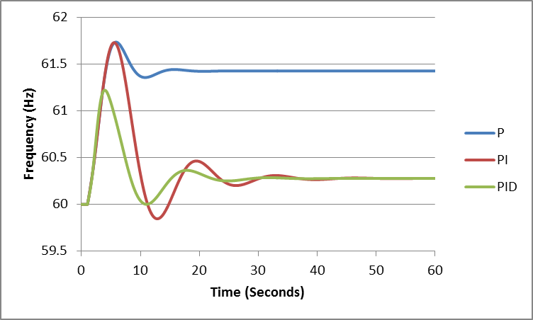
Tuning PID Controller Example
Figure shows the Ziegler-Nichols for a P, PI and PID controls. Note, this is for stand-alone, not interconnected operation

