Slide 1
ECEN 667 Power System Stability
Lecture 17: Load Models, Voltage Stability
Prof. Tom Overbye
Dept. of Electrical and Computer Engineering
Texas A&M University
overbye@tamu.edu

Slide 2
Announcements
Read Chapter 7
Homework 4 is due on Tuesday Oct 29
Book suggestion (outside of course scope): Outliers by Malcolm Gladwell (2008)
Talks about how to be extremely successful

Slide 3
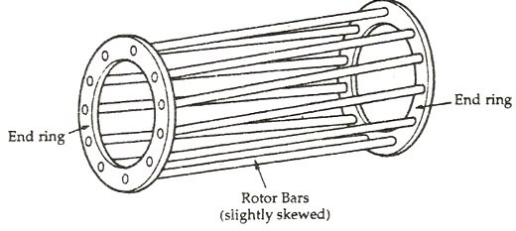
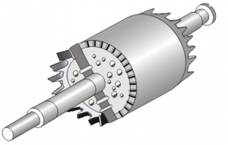
Squirrel Cage Rotor Picture
Image 1 Source: www.quora.com/What-will-happen-If-the-Squirrel-cage-motor-rotor-conductors-are-not-skewed
Embedded in laminated magnetic material
Image 2 Source: www.polytechnichub.com/squirrel-cage-rotor/

Slide 4
Specifying Induction Machine Parameters
In transient stability packages induction machine parameters are specified in per unit
If unit is modeled as a generator in the power flow (such as CIMTR1 or GENWRI) then use the generator's MVA base (as with synchronous machines)
With loads it is more complicated.
Sometimes an explicit MVA base is specified. If so, then use this value. But this can be cumbersome since often the same per unit machine values are used for many loads
The default is to use the MW value for the load, often scaled by a multiplier (say 1.25)

Slide 5
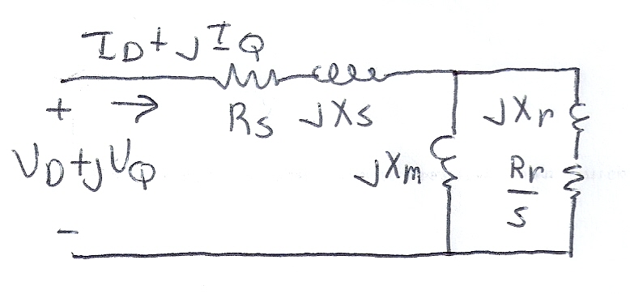
Determining the Initial Values
To determine the initial values, it is important to recognize that for a fixed terminal voltage there is only one independent value: the slip, s
For a fixed slip, the model is just a simple circuit with resistances and reactances
The initial slip is chosen to match the power flow real power value. Then to match the reactive power value (for either a load or a generator), the approach is to add a shunt capacitor in parallel with the induction machine
We'll first consider torque-speed curves, then return to determining the initial slip

Slide 6
Torque-Speed Curves
To help understand the behavior of an induction machine it is useful to plot various values as a function of speed (or equivalently, slip)
Solve the equivalent circuit for a specified terminal voltage, and varying values of slip
Plot results
Recall torque times speed = power
Here speed is the rotor speed
When using per unit, the per unit speed is just 1-s

Slide 7
Induction Motor Example
Assume the below 60 Hz system, with the entire load modeled as a single cage induction motor with per unit values on a 125 MVA base of H=1.0, R_{s}=0.01, X_{s}=0.06, X_{m}=4.0, R_{r}=0.03, X_{r}=0.04
In the CIM5 model R₁=R_{r} and X₁=X_{r}
PowerWorld case B2_IndMotor

Slide 8
Induction Motor Example
With a terminal voltage of 0.995∠0° we can solve the circuit for specified values of s
The input impedance and current are
Then with s=1 we get
Note, values are per unit on a 125 MVA base

Slide 9
Induction Motor Example
PowerWorld allows for display of the variation in various induction machine values with respect to speed
Right click on load, select Load Information Dialog, Stability
On bottom of display click Show Torque Speed Dialog
Adjust the terminal voltage and pu scalar as desired; set v=0.995 and the pu scalar to 1.0 to show values on the 125 MVA base used in the previous solution
Right click on column and select Set/Toggle/Columns, Plot Column to plot the column

Slide 10
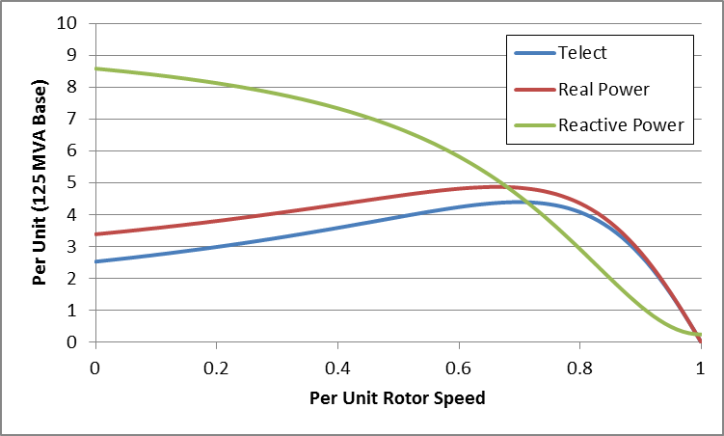
Induction Motor Example Torque-Speed Curves
The below graph shows the torque-speed curve for this induction machine; note the high reactive power consumption on starting (which is why the lights may dim when starting a cloth dryer!)
From the graph you can see with a 100 MW load
(0.8 pu on the 125 MW base), the slip is about
0.025

Slide 11
Calculating the Initial Slip
One way to calculate the initial slip is to just solve the below five equations for five unknowns (s, I_{D}, I_{Q}, E'_{D},E'_{Q}) with P_{E}, V_{D} and V_{Q} inputs
These are nonlinear equations that can have multiple solutions so use Newton's method, with an initial guess of s small (say 0.01)
Initial slip in example is 0.0251

Slide 12
Double Cage Induction Machines
In the design of induction machines, there are various tradeoffs, such as between starting torque (obviously one needs enough to start) and operating efficiency
The highest efficiency possible is 1-slip, so operating at low slip is desirable
A common way to achieve high starting torque with good operating efficiency is to use a double cage design
E.g., the rotor has two embedded squirrel cages, one with a high R and lower X for starting, and one with lower R and higher X for running
Modeled by extending our model by having two rotor circuits in parallel; add subtransient values X" and T"_{o}

Slide 13
Example Double Cage Model
Double cage rotors are modeled by adding two additional differential equations
Some models also include saturation, a topic that we will skip
PowerWorld case B2_IndMotor_DoubleCage
Image source: PSLF Manual, version 18.1_02; MotorW

Slide 14
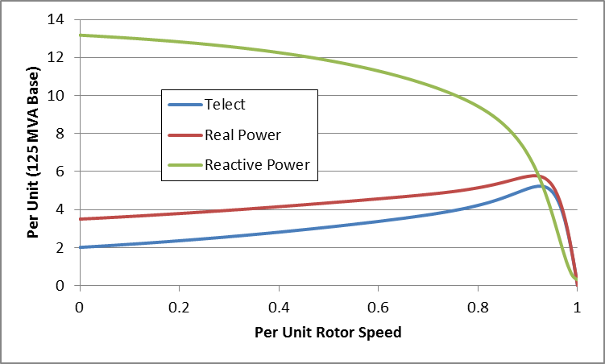
Double Cage Induction Motor Model
The previous example can be extended to model a double cage rotor by setting R₂=0.01, X₂=0.08
The below graph shows the modified curves, notice the increase in the slope by s=0, meaning it is operating with higher efficiency (s=0.0063 now!)
The additional winding does result in lower initial impedance and hence a higher starting reactive power

Slide 15
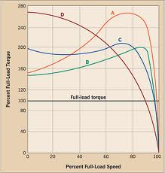
Induction Motor Classes
Four major classes of induction motors, based on application. Key values are starting torque, pull-out torque, full-load torque, and starting current
In steady-state the motor will operate on the right side of the curve at the point at which the electrical torque matches the mechanical torque
A: Fans, pumps machine tools
B: Similar to A
C: Compressors, conveyors
D: High inertia such as hoists
Image source: ecmweb.com/motors/understanding-induction-motor-nameplate-information

