Slide 1
ECEN 667
Power System Stability
Lecture 19: Voltage Stability
Prof. Tom Overbye
Dept. of Electrical and Computer Engineering
Texas A&M University
overbye@tamu.edu

Slide 2
Announcements
Read Chapter 8
Homework 5 is due on Tuesday Nov 12

Slide 3
Single Phase Induction Motor Loads
A new load model is one that explicitly represents the behavior of single phase induction motors, which are quite small and stall very quickly
  Single phase motors also start slower than an equivalent three phase machine
New single phase induction motor model (LD1PAC) is a static model (with the assumption that the dynamics are fast), that algebraically transitions between running and stalled behavior based on the magnitude of the terminal voltage

Slide 4
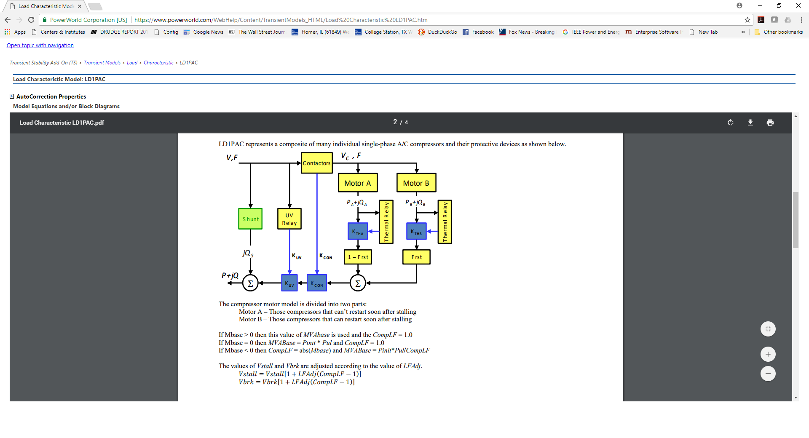
Single Phase Induction Motor Loads
Model is mostly
algebraic, but
with stalling
behavior

Slide 5
Composite Load Models
Many aggregate loads are best represented by a combination of different types of load
  Known as composite load models
  Important to keep in mind tbat the actual load is continually changing, so any aggregate load is at best an approximation
  Hard to know load behavior to extreme disturbances without actually faulting the load
Early models included a number of loads at the transmission level buses (with the step-down transformer), with later models including a simple distribution system model

Slide 6
CLOD Model
The CLOD model represents the load as a combination of large induction motors, small induction motors, constant power, discharge lighting, and other

Slide 7
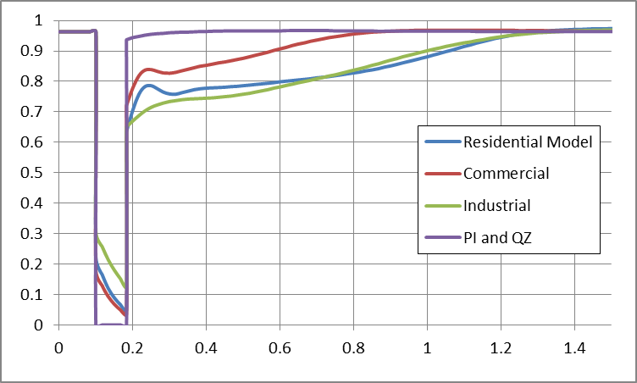
CLOD Model
Different load classes can be defined
Customer Class | Large Motor | Small Motor | Discharge Lighting | Constant Power | Remaining (PI, QZ)
Residential | 0.0 | 64.4 | 3.7 | 4.1 | 27.8
Agriculture | 10.0 | 45 | 20 | 4.5 | 19.5
Commercial | 0.0 | 46.7 | 41.5 | 4.5 | 7.3
Industrial | 65.0 | 15.0 | 10.0 | 5.0 | 4.0
Comparison of voltage recovery for different model types

Slide 8
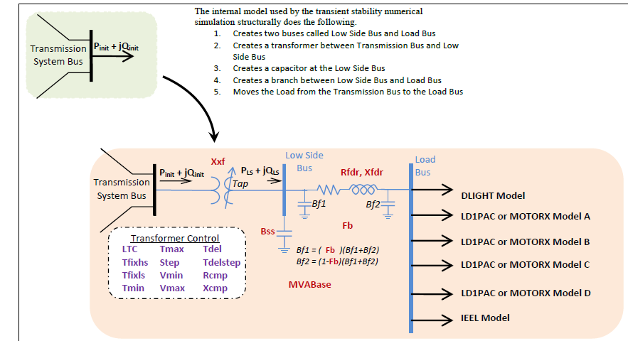
WECC Composite Load Model
Contains up to four motors or single phase induction motor models; also includes potential for solar PV

Slide 9
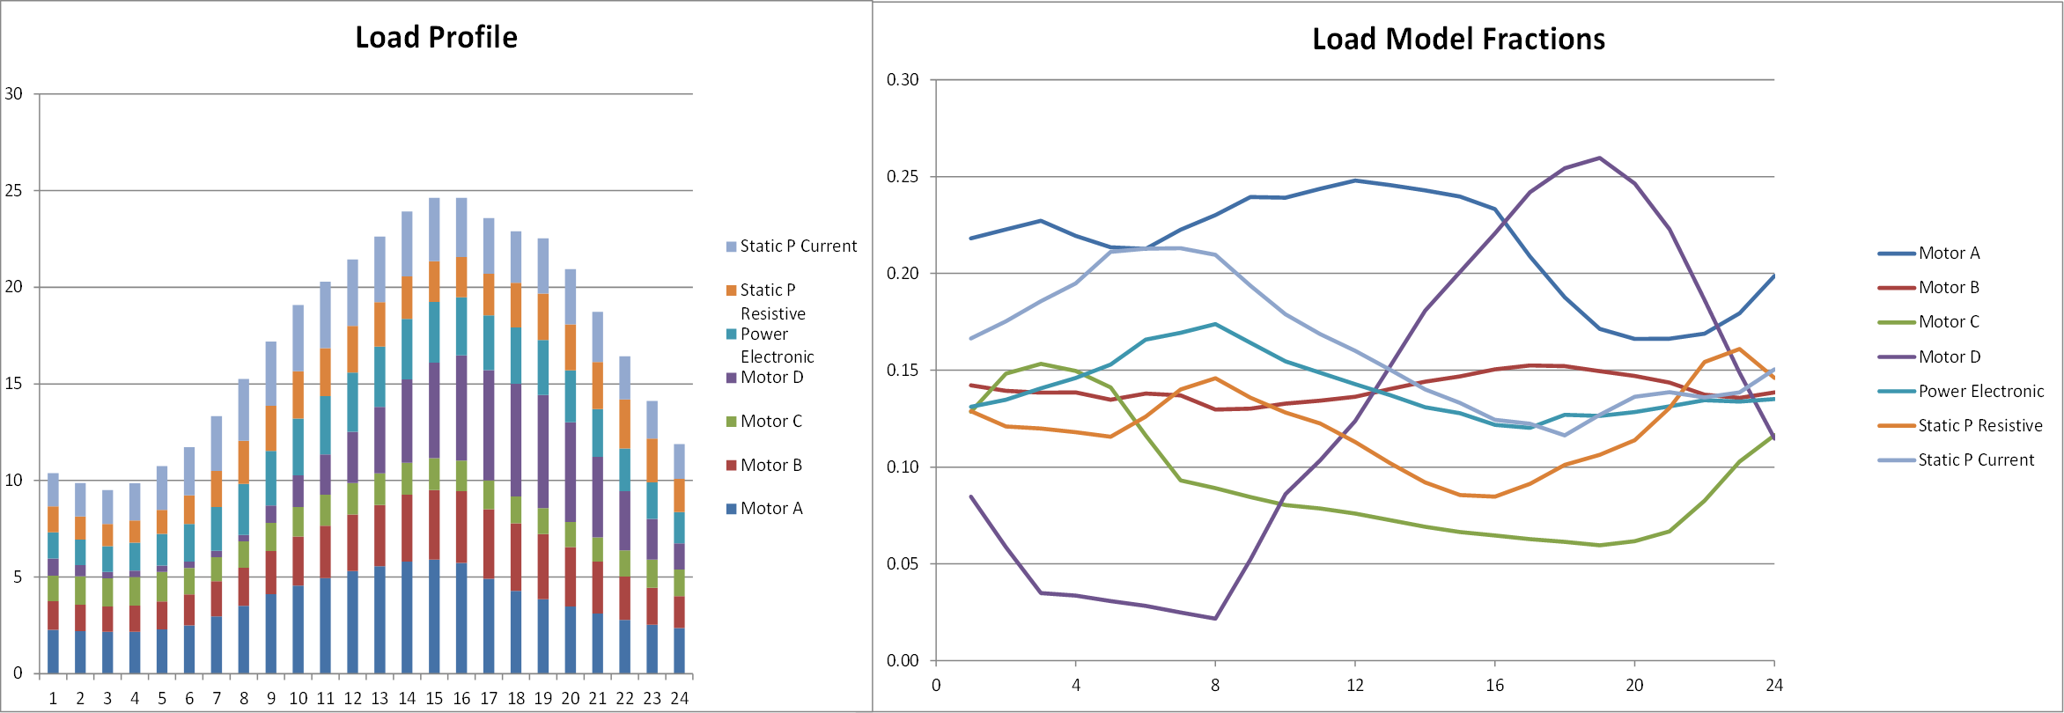
Modeling Time Variation in Load
Different time varying composite model parameters are now being used
Example of varying composite load percentages over a day

Slide 10
Current Research
Current topics for load modeling research include assessment of how much the load model maters
Another issue is how to determine the load model parameters – which ones are observable under what conditions
  For example, motor stalling can not be observed except during disturbances that actually cause the motors to stall
  Not important to precisely determine parameters that ultimately do not have much influence on the final problem solution; of course these parameters would be hard to observe
Correctly modeling embedded distribution level generation resources, such as PV, is important

Slide 11
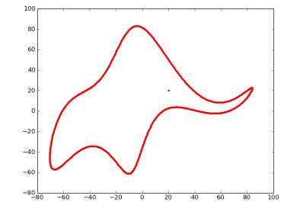
Scientific Modeling Quotes
"All models are wrong but some are useful,“
  George Box, Empirical Model-Building and Response Surfaces, (1987, p. 424)
  Box went on to say that the practical question is how wrong they have to be to not be useful
“Everything should be made as
simple as possible, but not simpler.”
  Albert Einstein [maybe]
“With four parameters I can fit an elephant, and with five I can make him wiggle his trunk”.
  John von Neumann
“Drawing an elephant with four complex parameters” by Jurgen Mayer, Khaled Khairy, and Jonathon Howard, Am. J. Phys. 78, 648 (2010), DOI:10.1119/1.3254017

Slide 12
Power System Voltage Stability
Voltage Stability: The ability to maintain system voltage so that both power and voltage are controllable. System voltage responds as expected (i.e., an increase in load causes proportional decrease in voltage).
Voltage Instability: Inability to maintain system voltage. System voltage and/or power become uncontrollable. System voltage does not respond as expected.
Voltage Collapse: Process by which voltage instability leads to unacceptably low voltages in a significant portion of the system. Typically results in loss of system load.
11

Slide 13
Voltage Stability
Two good references are
  P. Kundur, et. al., “Definitions and Classification of Power System Stability,” IEEE Trans. on Power Systems, pp. 1387-1401, August 2004.
  T. Van Cutsem, “Voltage Instability: Phenomena, Countermeasures, and Analysis Methods,” Proc. IEEE, February 2000, pp. 208-227.
Classified by either size of disturbance or duration
  Small or large disturbance: small disturbance is just perturbations about an equilibrium point (power flow)
  Short-term (several seconds) or long-term (many seconds to minutes)
12

Slide 14
Small Disturbance Voltage Stability
Small disturbance voltage stability can be assessed using a power flow (maximum loadability)
Depending on the assumed load model, the power flow can have multiple (or no solutions)
PV curve is created by plotting power versus voltage
Assume V_{slack}=1.0
Where B is the line susceptance =-10,
V∠θ is the load voltage
13

Slide 15
Small Disturbance Voltage Stability
Question: how do the power flow solutions vary as the load is changed?
A Solution: Calculate a series of power flow solutions for various load levels and see how they change
Power flow Jacobian
14

Slide 16
Maximum Loadability When Power Flow Jacobian is Singular
An important paper considering this was by Sauer and Pai from IEEE Trans. Power Systems in Nov 1990, “Power system steady-state stability and the load-flow Jacobian”
Other earlier papers were looking at the characteristics of multiple power flow solutions
Work with the power flow optimal multiplier around the same time had shown that optimal multiplier goes to zero as the power flow Jacobian becomes singular
The power flow Jacobian depends on the assumed load model (we’ll see the impact in a few slides)
15

Slide 17
Relationship Between Stability and Power Flow Jacobian
The Sauer/Pai paper related system stability to the power flow Jacobian by noting the system dynamics could be written as a set of differential algebraic equations
16

Slide 18
Relationship Between Stability and Power Flow Jacobian
Then
What Sauer and Pai show is if ∂g/ ∂ y is singular then the system is unstable; if ∂g/ ∂ y is nonsingular then the system may or may not be stable
Hence it provides an upper bound on stability
17

Slide 19
Bifurcations
In general, bifurcation is the division of something into two branches or parts
For a dynamic system, a bifurcation occurs when small changes in a parameter cause a new quality of motion of the dynamic system
Two types of bifurcation are considered for voltage stability
  Saddle node bifurcation is the disappearance of an equilibrium point for parameter variation; for voltage stability it is two power flow solutions coalescing with parameter variation
  Hopf bifurcation is cause by two eigenvalues crossing into the right-half plane
18

Slide 20
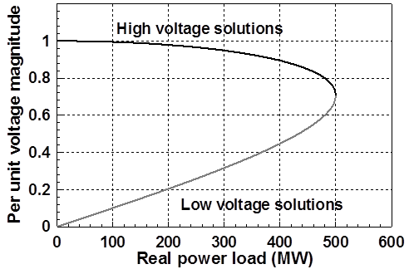
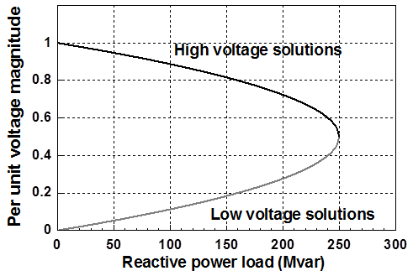
PV and QV Curves
PV curves can be traced by plotting the voltage as the real power is increased; QV curves as reactive power is increased
  At least for the upper portion of the curve
Two bus example PV and QV curves
19

Slide 21
Small Disturbance Voltage Collapse
At constant frequency (e.g., 60 Hz) the complex power transferred down a transmission line is S=VI*
  V is phasor voltage, I is phasor current
  This is the reason for using a high voltage grid
Line real power losses are given by RI² and reactive power losses by XI²
  R is the line’s resistance, and X its reactance; for a high voltage line X >> R
Increased reactive power tends to drive down the voltage, which increases the current, which further increases the reactive power losses
20

Slide 22
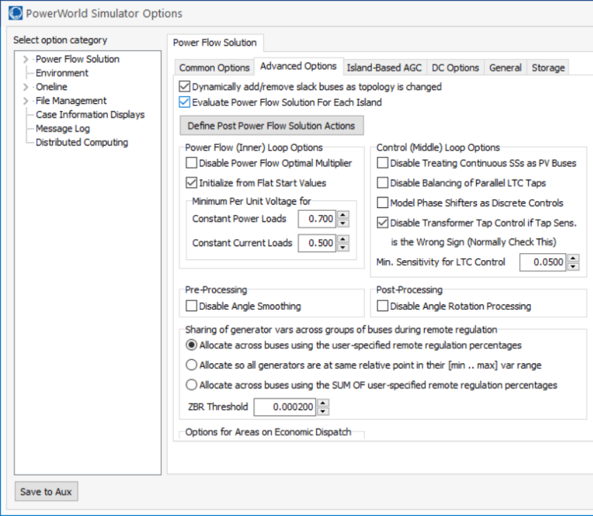
PowerWorld Two Bus Example
Commercial power flow software usually auto converts constant power loads at low voltages; set these fields to zero to disable this conversion
Case is Bus2_PV
21

Slide 23
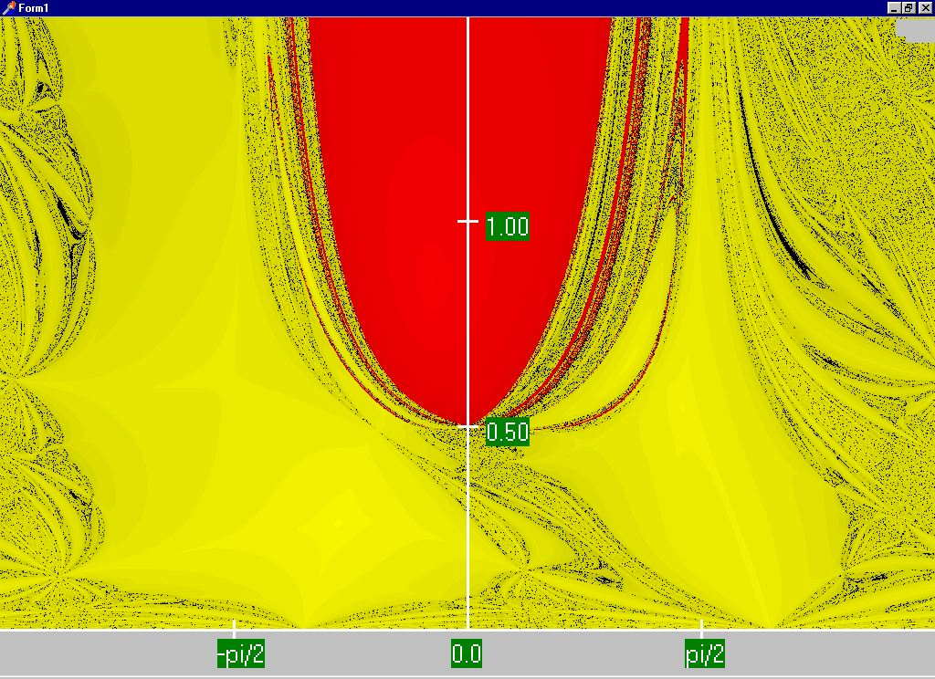
Power Flow Region of Convergence
Convergence
regions with
P=100 MW,
Q=0 Mvar
22

Slide 24
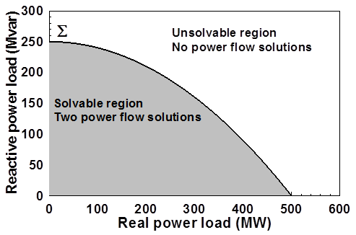
Load Parameter Space Representation
With a constant power model there is a maximum loadability surface, Σ
  Defined as point in which the power flow Jacobian is singular
  For the lossless two bus system it can be determined as
23

Slide 25
Load Model Impact
With a static load model regardless of the voltage dependency the same PV curve is traced
  But whether a point of maximum loadability exists depends on the assumed load model
    If voltage exponent is > 1 then multiple solutions do not exist (see B.C. Lesieutre, P.W. Sauer and M.A. Pai “Sufficient conditions on static load models for network solvability,”NAPS 1992, pp. 262-271)
Change load to constant impedance; hence it becomes a linear model
24

Slide 26
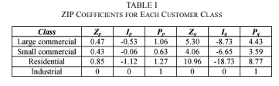
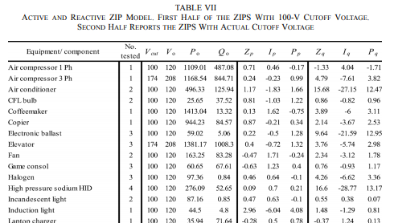
ZIP Model Coefficients
One popular static load model is the ZIP; lots of papers on the “correct” amount of each type
Table 1 from M. Diaz-Aguilo, et. al., “Field-Validated Load Model for the Analysis of CVR in Distribution Secondary Networks: Energy Conservation,” IEEE Trans. Power Delivery, Oct. 2013
Table 7 from A, Bokhari, et. al., “Experimental Determination of the ZIP Coefficients for Modern Residential, Commercial, and Industrial Loads,” IEEE Trans. Power Delivery, June. 2014
25

Slide 27
Application: Conservation Voltage Reduction (CVR)
If the “steady-state” load has a true dependence on voltage, then a change (usually a reduction) in the voltage should result in a total decrease in energy consumption
If an “optimal” voltage could be determined, then this could result in a net energy savings
Some challenges are 1) the voltage profile across a feeder is not constant, 2) the load composition is constantly changing, 3) a decrease in power consumption might result in a decrease in useable output from the load, and 4) loads are dynamic and an initial decrease might be balanced by a later increase
26

