Slide 1
ECEN 667
Power System Stability
Lecture 21: Modal Analysis
Prof. Tom Overbye
Dept. of Electrical and Computer Engineering
Texas A&M University
overbye@tamu.edu
Special Guest Lecture by TA Hanyue Li

Slide 2
Announcements
Read Chapter 8
Homework 5 is due on Tuesday Nov 12

Slide 3
Quickly Determining the b Vectors
A key insight is from an approach known as the variable projection method (from Borden, 2013) that for any signal k
Where m is the number of measurements
and n is the number of modes
A. Borden, B.C. Lesieutre, J. Gronquist, "Power System Modal Analysis Tool Developed for Industry Use," Proc. 2013 North American Power Symposium, Manhattan, KS, Sept. 2013

Slide 4
Aside: Pseudoinverse of a Matrix
The pseudoinverse of a matrix generalizes concept of a matrix inverse to an m by n matrix, in which m >= n
  Specifically this is a Moore-Penrose Matrix Inverse
Notation for the pseudoinverse of A is A⁺
Satisfies AA⁺A = A
If A is a square matrix, then A⁺ = A⁻¹
Quite useful for solving the least squares problem since the least squares solution of Ax = b is x = A⁺ b
Can be calculated using an SVD

Slide 5
Least Squares Matrix Pseudoinverse Example
Assume we wish to fix a line (mx + b = y) to three data points: (1,1), (2,4), (6,4)
Two unknowns, m and b; hence x = [m b]^{T}
Setup in form of Ax = b

Slide 6
Least Squares Matrix Pseudoinverse Example, cont.
Doing an economy SVD
Computing the pseudoinverse
In an economy SVD the Σ matrix has dimensions of
m by m if m < n or n by n if n < m

Slide 7
Least Squares Matrix Pseudoinverse Example, cont.
Computing x = [m b]^{T} gives
With the pseudoinverse approach we immediately see the sensitivity of the elements of x to the elements of b
  New values of m and b can be readily calculated if y changes
Computationally the SVD is order m²n+n³ (with n < m)

Slide 8
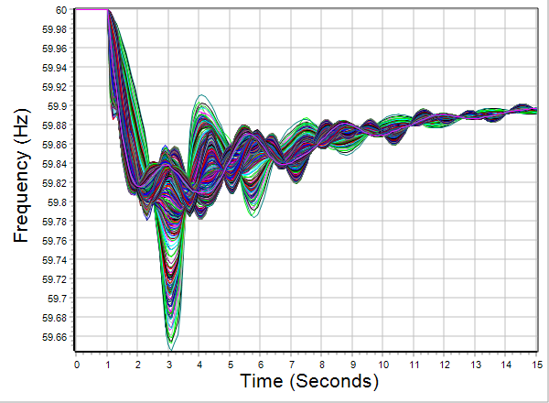
2000 Bus System Example
In PowerWorld open the case ECEN460_TSGC_GenDrop
  This is a 2000 bus synthetic electric grid on the ERCOT footprint that we use in our undergraduate and graduate classes to study larger power systems
Run the predefined transient stability contingency
  Response following the loss of two generators

Slide 9
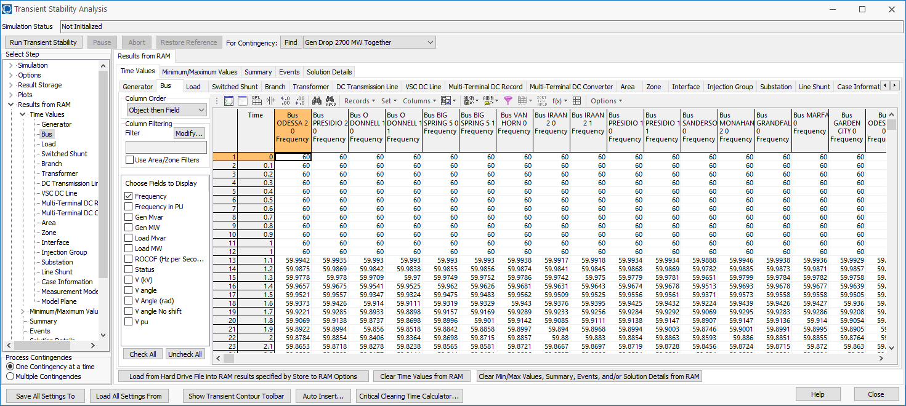
2000 Bus System Example
On the Transient Stability page select Results from RAM, view the Bus page display just the bus frequencies, right-click and select Modal Analysis All Columns
We’ll work with frequencies
in Hz rather than per unit

Slide 10
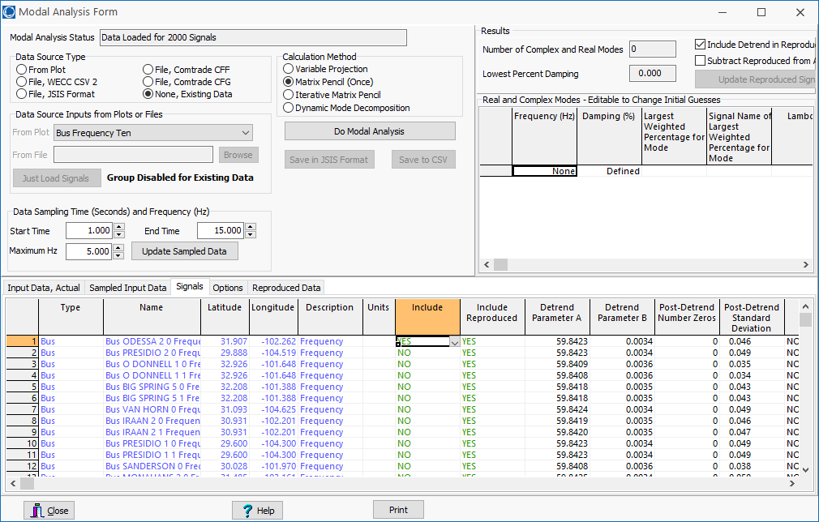
2000 Bus System Example
Initially our goal is to understand the modal frequencies and their damping
Initially we’ll consider just one of the 2000 signals
Toggle the Include to
“No” for all the 2000
signals, except set
the first one to “Yes”
Once only the first signal is selected, click the Do Modal Analysis

Slide 11
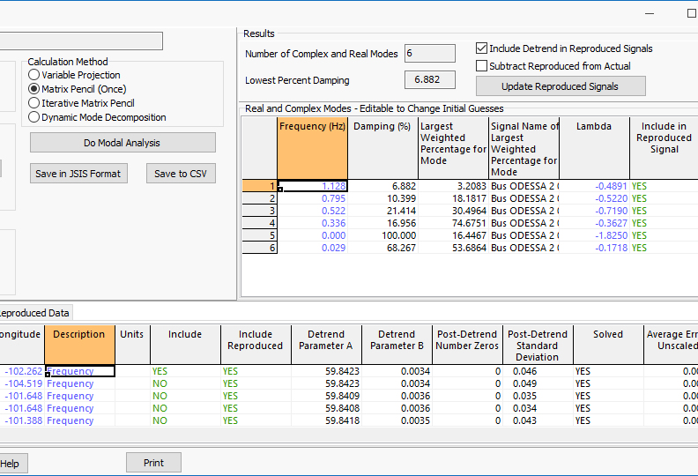
2000 Bus System Example,
One Signal
Note the modes and their damping. The signal dialog indicates that we have fairly accurately reproduced the first signal
Calculated mode information
Comparison of frequency for
the first bus

Slide 12
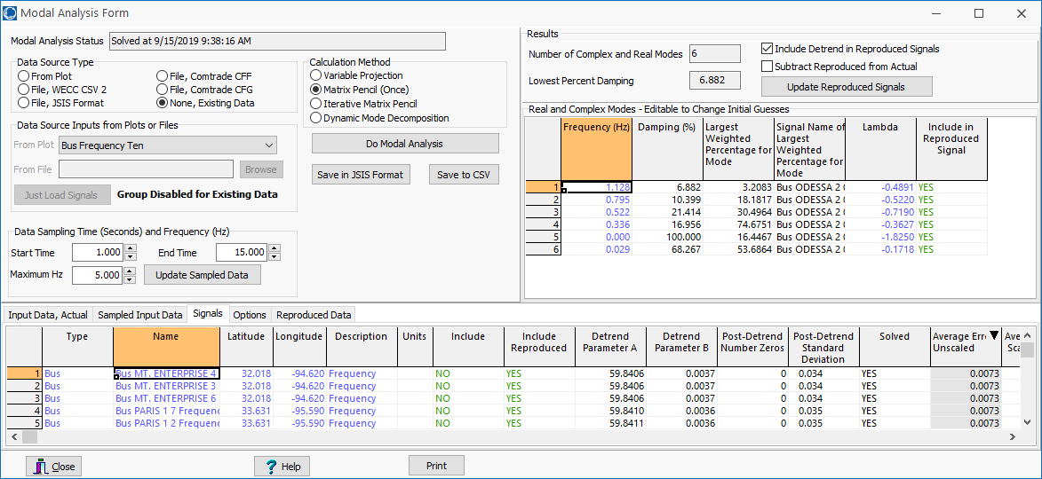
2000 Bus System Example,
Comparing the Other Signals
Sort on the cost function to see the worst match
Now we will rerun it including this bus frequency signal as well; that is, now a total of two signals
Bus 8078 has the worst match

Slide 13
2000 Bus System Example,
Now With Two Signals
The left image shows the original match for bus 8078 (when not included), and the right when included

Slide 14
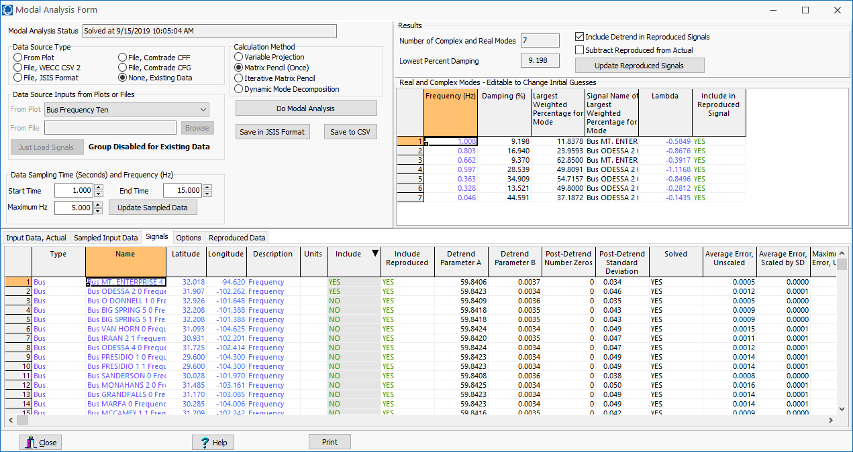
Updated Modes
The calculated modes and damping have changed slightly with the additional signal

Slide 15
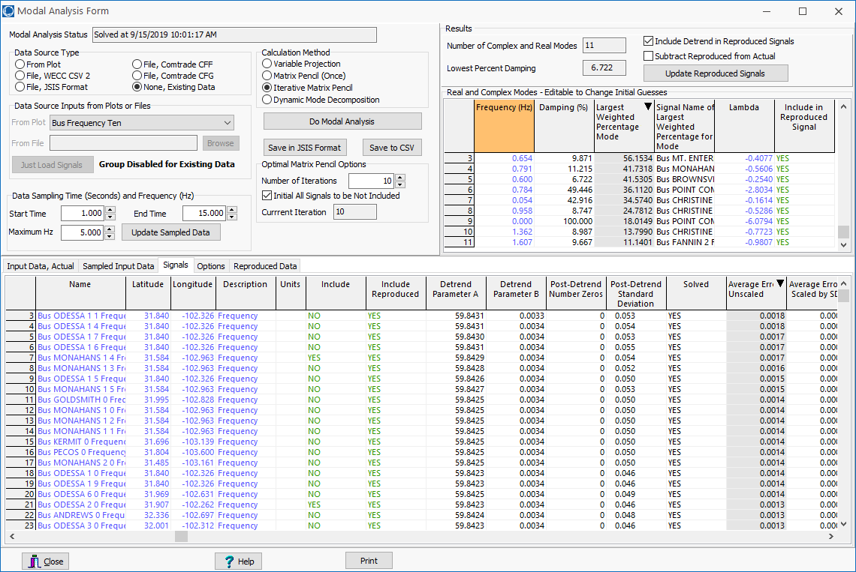
2000 Bus System Example,
Iterative Matrix Pencil
Now run the Iterative Matrix Pencil method

Slide 16
2000 Bus System Example,
Iterative Matrix Pencil
With the inclusion of just ten signals (out of 2000) quite accurate modal information is obtained for all 2000 frequency signals
This is the worst match (at bus 1072)

Slide 17
Takeaways So Far
Modal analysis can be quickly done on a large number of signals
  Computationally is an O(N³) process for one signal, where N is the number of sample points; it varies linearly with the number of included signals
  Number of sample points is automatically determined from the highest desired frequency (The Nyquist-Shannon sampling theory requires sampling at twice the highest desired frequency)
  Determining how signals are manifested in modes is fast (done when Include Reproduced is Yes)

Slide 18
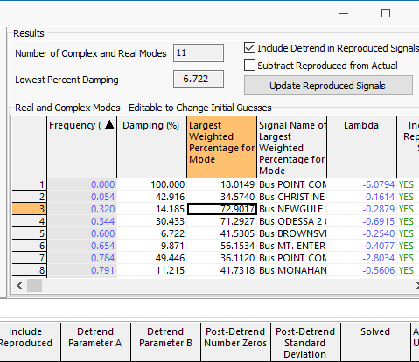
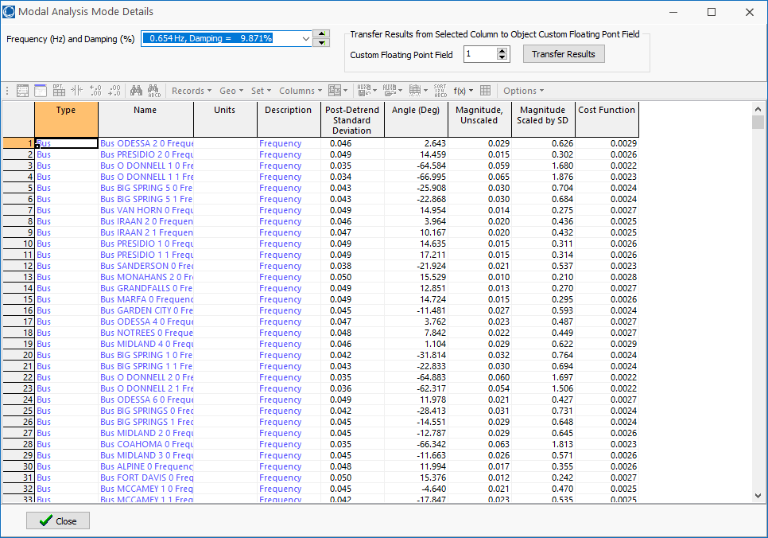
Getting Mode Details
Detailed information about each mode is available by right-clicking on mode and selecting Show Dialog

Slide 19
Quickly Visualizing Results: Geographic Data Views (GDVs)
GDVs were introduced into PowerWorld about twelve years back to provide a quick way of visualizing geographic information; they are ideally suited for modal results
To create a GDV oneline of the substations, go to Case Information, Aggregation, Substations. Then right-click in any column (Gen MW here) and select Geographic Data View, Select Column then Geographic Data View
This displays the Geographic Data View Customization Dialog

Slide 20
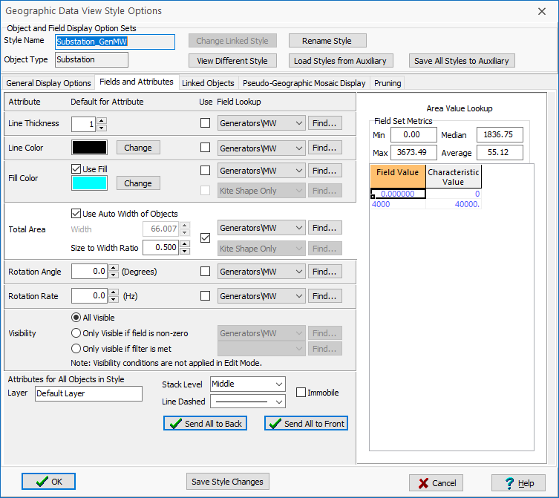
GDV Customization Dialog
Select Browse to Open an Existing Oneline and select NorthAmerica_Blank
The Fields and
Attributes page can
be used to customize
the GDV appearance
As an example of a
GDV showing the
substation gen MW,
select the Total Area field
Select Add Geographic Data View Objects…

Slide 21
GDV Display Customization
As created the GDV shows substation generation, but we will shortly modify it to show modal information
Save the display with a
different name – say
ECEN460_SubGen
To modify a GDV oneline,
just right-click on any
GDV display object and
select View Geographic
Data View Options
The GDV Styles can also be shown by selecting Onelines, List Display,
Geo Data View Styles

Slide 22
Transient Stability Toolbar
One application of GDVs is wide area visualization of time-sequenced results using the transient stability toolbar
These displays can then be made into a movie by either
  Capturing the screen as the contours are creating using screen recording software such as Camtasia
  Or having Simulator automatically store the contour images as jpegs and then creating a movie using software such as Microsoft Movie Maker

Slide 23
Transient Stability Toolbar
The toolbar uses stored transient stability results, and hence it is used only after the transient stability solution has finished
  It can be used with results that are either saved RAM or saved to the hard drive
  It has recently been updated to show PMU and modal analysis data
It requires having a oneline with objects associated with the desired results (such as buses, generators, substations, etc)
  Again these can be auto-created with GDVs

Slide 24
Showing the Toolbar
The toolbar is shown by either
  Selecting Add-ons, Stability Case Info, Show Transient Contour Toolbar
  On the Transient Stability Analysis Form select the Show Transient Contour Toolbar button at the bottom of the form
The toolbar is only fully enabled if there are results to contour
We’ll demonstrate it using the previous GDV, except changing the object size to be almost not visible
The oneline is saved as ECEN460_SubSmall

Slide 25
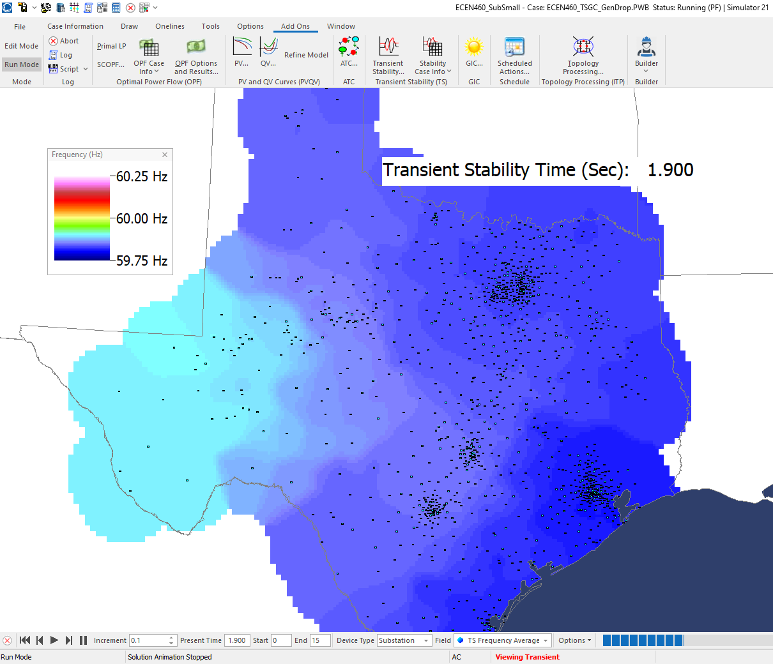
Toolbar
Use to control
time
Only objects with associated time-varying data should be selected
Use options to control the contour and the storage of images for movies

Slide 26
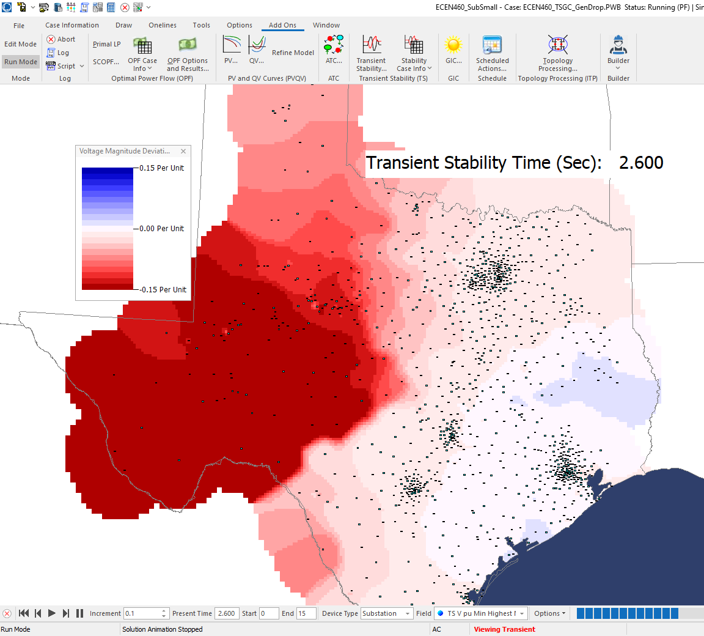
Toolbar: Voltage Deviation
Sometimes the best field to visualize is the deviation from the initial values (here the figure shows voltage magnitude deviation)
Designing synthetic grids helps to highlight the complexities in designing the actual grid!!

Slide 27
Visualizing Mode Magnitude and Angle Components
GDVs can be used to quickly visualize information about the modes
To visualize mode magnitude and angles, we’ll use the substation custom fields to store the mode values
Rerun modal analysis using the substation average frequency field. That is,
  Start from the Results From RAM, Substation display
  Show just Frequency Average field
  Right-click to select “Modal Analysis All Columns” to show the Modal Analysis Form
  Select the Iterative Matrix Pencil method and click on Do Modal Analysis; view the Mode Details dialog for 0.63 Hz

Slide 28
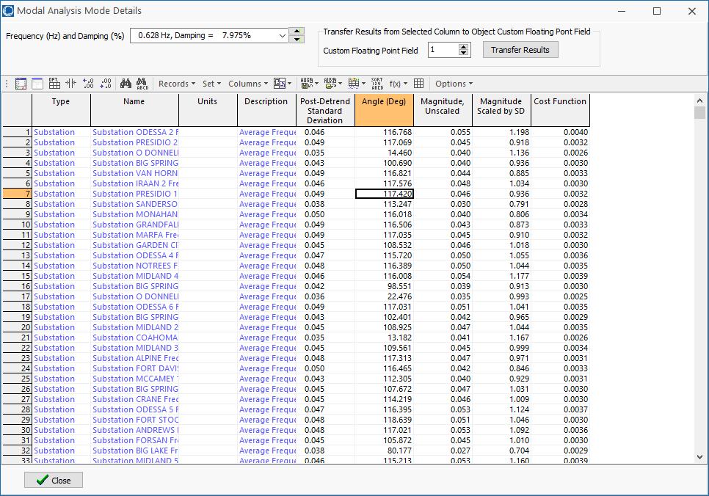
Visualizing Mode Magnitude and Angle Components
We’ll use the custom fields
to tell the substation objects
about this mode’s data
  Select the Angle field, set the
  Custom Floating Point Field to
  1; click Transfer Results
  Repeat, except click on the
  Magnitude Unscaled field and set the Custom
  Floating field to 2
Create a new GDV display using the ECEN460_SubSmall display (the customizations are on the next slide)

Slide 29
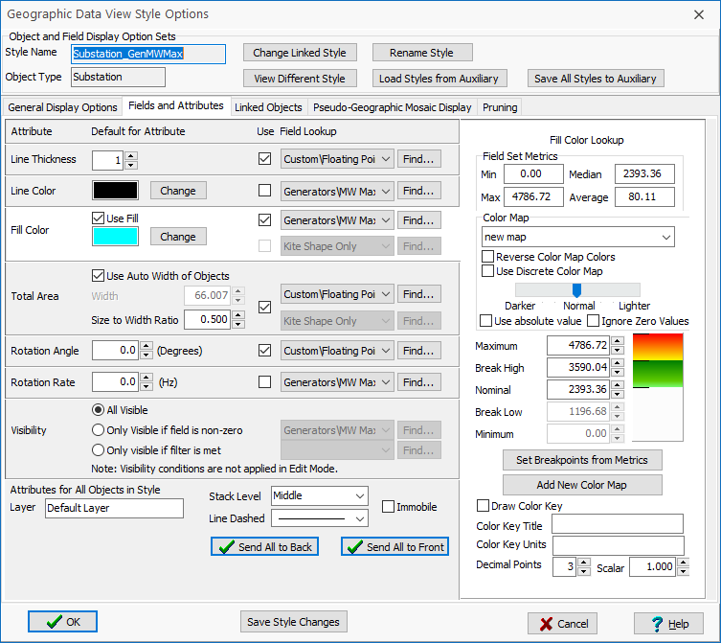
GDV Visualization of Mode Magnitude and Angle Components
Set the GDV Style as
  On the General Display Options page set the Style to Arrows and the Text to Show field to None.
  On the Fields and Attributes page
    Total Area uses the Custom Float 2 field (magnitude); a ballpark largest size should be 50000.
    Rotation Angle uses the Custom
    Float 1 field (angle)
    Line Thickness uses the Custom
    Float 2 field (magnitude)
Once a oneline has been setup,
it can be saved for repeated use
Save the oneline as
ECEN460_Modes

Slide 30
Visualization of 0.63 Hz Mode
In this display the arrows show the magnitude and angle (direction) for the mode at each substation.
However, the problem is there are too many arrows!
The solution it so dynamically prune the display using the GDV Options, Pruning command

Slide 31
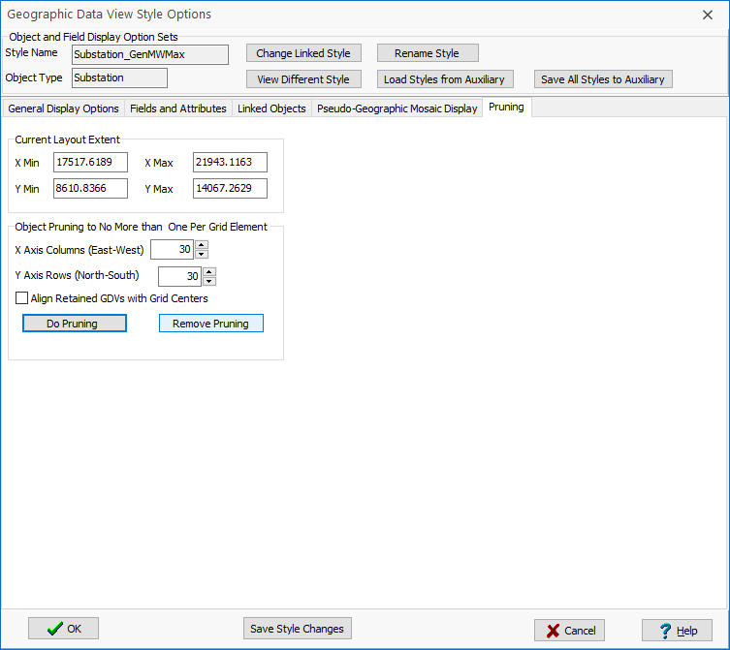
GDV Display Pruning
This page allows GDVs to
be selectively displayed
Select Do Pruning to
modify the oneline so an
invisible grid is
added to the display
and only one GDV arrow
is visible in each grid area
I also added some color, using a circular color map to highlight the angles

Slide 32
Visualization of 0.63 Hz Mode
Again save the oneline, now as
ECEN460_Modes;
it can then be
used to quickly visualize the other modes
To show other modes, just go to the Mode Details dialog for a different frequency and again transfer the angle and magnitude

Slide 33
Visualization of 0.76 Hz Mode

Slide 34
Visualizing the Source of Oscillations
For showing the source of sustained oscillations assume zero damping and recognizing that the source of the oscillation will have a leading phase angle, shift all the φ_{k,j} so it is zero at the bus with the largest A_{k,j} and set t=0. Then
Then approximate the mode j power flow on all lines between buses m and n as
The location of the oscillation has positive net power

Slide 35
Visualizing the Source of Oscillations in PowerWorld
Now done mostly automatically in PowerWorld
To apply the approach with transient stability
  Run the transient stability storing the bus angles
  Do modal analysis on the bus angles; technique is only applicable if there are lightly or negatively damped modes
  Select the desired mode to display the Mode Analysis Mode Details Dialog
  When analyzing just bus angles a Visualization
  Source of Oscillations button appears; click to
  transfer flows to line and substation custom float1

Slide 36
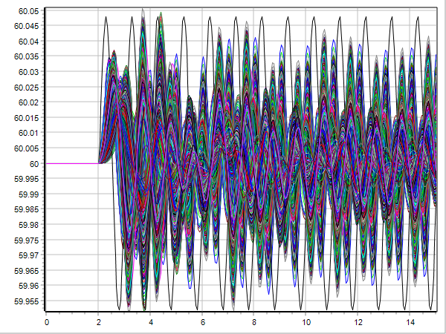
Visualizing the Source of Oscillations in PowerWorld Example
As an example, a 1Hz sustained oscillation was introduced into the 2000 bus system

Slide 37
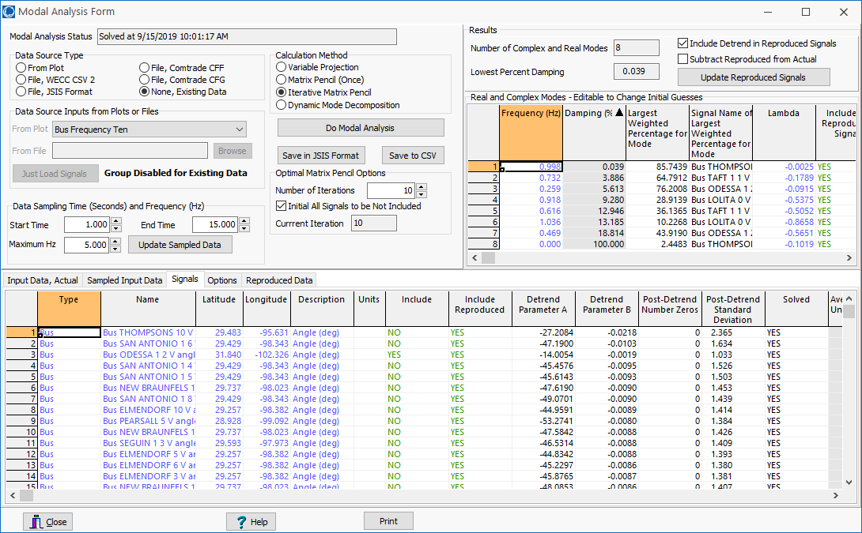
Visualizing the Source of Oscillations in PowerWorld Example

Slide 38
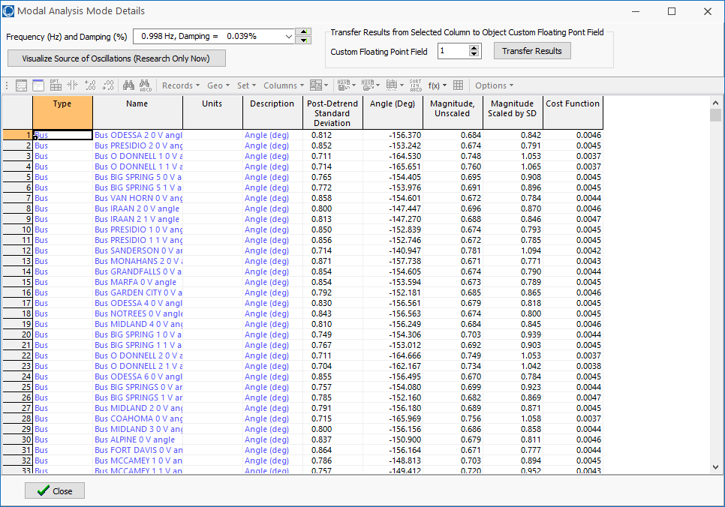
Visualizing the Source of Oscillations in PowerWorld Example
This button only appears when doing modal analysis on bus angles. Clicking on it 1) calculates the mode power flow on each line and places the value in the line’s custom float 1 field, 2) calculates the net mode power injection at each substation and stores it in the substation’s custom float 1 field.

Slide 39
Visualizing the Source of Oscillations in PowerWorld Example
This is a substation GDV, in which size of objects is proportional to the custom float 1 field; a red/blue color map shows the direction (red is the source)
The source of the
forced oscillation
is correctly identified (bus 7356) at the Thompsons substation

Slide 40
Visualizing the Source of Oscillations in PowerWorld Example
Visualizing the lines’ Custom Float1 fields shows the flow of the oscillation

