Slide 1
ECEN 667
Power System Stability
Lecture 23: Small Signal Stability, Oscillations
Prof. Tom Overbye
Dept. of Electrical and Computer Engineering
Texas A&M University
overbye@tamu.edu

Slide 2
Announcements
Read Chapter 8
Homework 5 is due Today
Homework 6 is due on Tuesday December 3
Final is at scheduled time here (December 9 from1pm to 3pm)

Slide 3
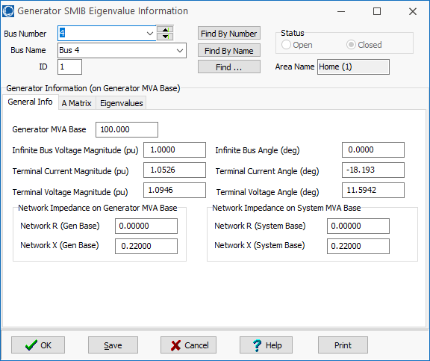
Example: Bus 4 SMIB Dialog
On the SMIB dialog, the General Information tab shows information about the two bus equivalent
PowerWorld case B4_SMIB

Slide 4
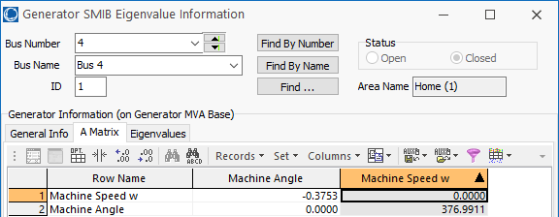
Example: Bus 4 SMIB Dialog
On the SMIB dialog, the A Matrix tab shows the A_{sys} matrix for the SMIB generator
In this example A₂₁ is showing

Slide 5
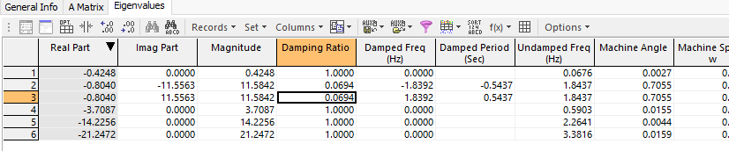
Example: Bus 4 with
GENROU Model
The eigenvalues can be calculated for any set of generator models
The example can be extended by replacing the bus 4 generator classical machine with a GENROU model
  There are now six eigenvalues, with the dominate response coming from the electro-mechanical mode with a frequency of 1.84 Hz, and damping of 6.9%
PowerWorld case B4_SMIB_GENROU

Slide 6
Relation to the Signal-Based Approaches
The results from the SMIB analysis can be compared with the signal-based approach by applying a short self-clearing fault to disturb the system
This can be done easily in PowerWorld by running the transient stability simulation, looking at the Results from RAM page, right-clicking on the desired signal(s) and selecting Modal Analysis Selected Column.
The next slide shows the results for the Bus 4 Generator rotor angle (which would not be directly observable)

Slide 7
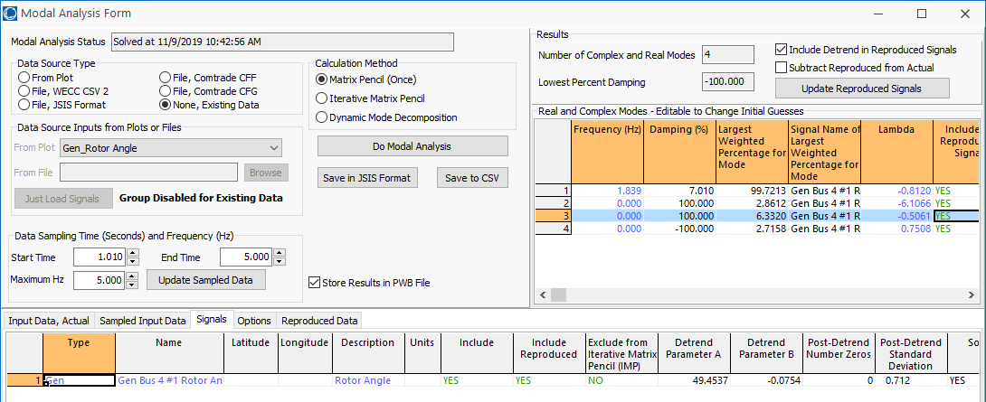
Bus 4 Generator Rotor Angle
Notice that the main mode, at 1.84 Hz with 7% damping closely matches
Not all modes will be easily observed in all signals

Slide 8
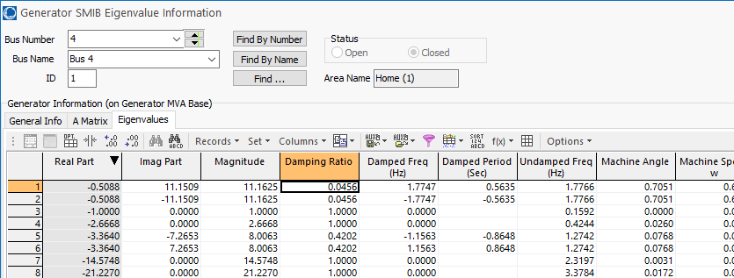
Example: Bus 4 with
GENROU Model and Exciter
Adding an relatively slow EXST1 exciter adds additional states (with K_{A}=200, T_{A}=0.2)
  As the initial reactive power output of the generator is decreased, the system becomes unstable
Case is saved as B4_GENROU_EXST1

Slide 9
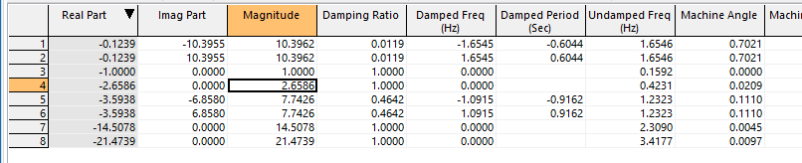
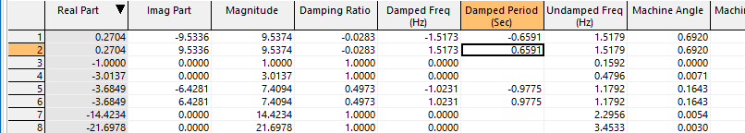
Example: Bus 4 with
GENROU Model and Exciter
With Q₄ = 25 Mvar the eigenvalues are
And with Q₄=0 Mvar the eigenvalues are

Slide 10
Example: Bus 4 with
GENROU Model and Exciter
Graph shows response following a short fault when Q4 is 0 Mvar
This motivates trying to get additional insight into how to increase system damping, which is the goal of modal analysis

Slide 11
Modal Analysis - Comments
Modal analysis (analysis of small signal stability through eigenvalue analysis) is at the core of SSA software
In Modal Analysis one looks at:
  Eigenvalues
  Eigenvectors (left or right)
  Participation factors
  Mode shape
Power System Stabilizer (PSS) design in a multi-machine context can be done using modal analysis method (we’ll see another method later)
Goal is to
determine
how the various
parameters
affect the
response of
the system

Slide 12
Eigenvalues, Right Eigenvectors
For an n by n matrix A the eigenvalues of A are the roots of the characteristic equation:
Assume λ₁…λ_{n} as distinct (no repeated eigenvalues).
For each eigenvalue λ_{i} there exists an eigenvector such that:
v_{i} is called a right eigenvector
If λ_{i} is complex, then v_{i} has complex entries

Slide 13
Left Eigenvectors
For each eigenvalue λ_{i} there exists a left eigenvector w_{i} such that:
Equivalently, the left eigenvector is the right eigenvector of A^{T}; that is,

Slide 14
Eigenvector Properties
The right and left eigenvectors are orthogonal i.e.
We can normalize the eigenvectors so that:

Slide 15
Eigenvector Example
Right Eigenvectors

Slide 16
Eigenvector Example
Left eigenvectors
We would like to make
This can be done in many ways.

Slide 17
Eigenvector Example
It can be verified that W^{T}=V⁻¹ .
The left and right eigenvectors are used in computing the participation factor matrix.

Slide 18
Modal Matrices
The deviation away from an equilibrium point can be defined as
If the initial deviation corresponds to a right eigenvector, then the subsequent response is along this eigenvector since

Slide 19
Modal Matrices
From this equation ( ) it is difficult to determine how parameters in A affect a particular x because of the variable coupling
To decouple the problem first define the matrices of the right and left eigenvectors (the modal matrices)

Slide 20
Modal Matrices
It follows that
To decouple the variables define z so
Then
Since Λ is diagonal, the equations are now uncoupled with
So

Slide 21
Example
Assume the previous system with

Slide 22
Modal Matrices
Thus the response can be written in terms of the individual eigenvalues and right eigenvectors as
Furthermore with
So z(t) can be written as using the left eigenvectors as
Note, we are
requiring that
the eigenvalues
be distinct!

Slide 23
Modal Matrices
We can then write the response x(t) in terms of the modes of the system
So c_{i} is a scalar that represents the magnitude of excitation of the i^{th} mode from the initial conditions

Slide 24
Numerical example

Slide 25
Numerical example (contd)

Slide 26
Numerical example (contd)
Because of the initial condition, the 2nd mode does not get excited

Slide 27
Mode Shape, Sensitivity and Participation Factors
So we have
x(t) are the original state variables, z(t) are the transformed variables so that each variable is associated with only one mode.
From the first equation the right eigenvector gives the “mode shape” i.e. relative activity of state variables when a particular mode is excited.
For example the degree of activity of state variable x_{k} in v_{i} mode is given by the element V_{ki} of the the right eigenvector matrix V

Slide 28
Mode Shape, Sensitivity and Participation Factors
The magnitude of elements of v_{i} give the extent of activities of n state variables in the i^{th} mode and angles of elements (if complex) give phase displacements of the state variables with regard to the mode.
The left eigenvector w_{i} identifies which combination of original state variables display only the i^{th} mode.

Slide 29
Eigenvalue Parameter Sensitivity
To derive the sensitivity of the eigenvalues to the parameters recall Av_{i} = λ_{i}v_{i}; take the partial derivative with respect to A_{kj} by using the chain rule

Slide 30
Eigenvalue Parameter Sensitivity
This is simplified by noting that
by the definition of w_{i} being a left eigenvector
Therefore
Since all elements of are zero, except the k^{th} row, j^{th} column is 1
Thus

Slide 31
Sensitivity Example
In the previous example we had
Then the sensitivity of λ₁ and λ₂ to changes in A are
For example with

Slide 32
Eigenvalue Parameter Sensitivity
This is simplified by noting that
by the definition of w_{i} being a left eigenvector
Therefore
Since all elements of are zero, except the k^{th} row, j^{th} column is 1
Thus

Slide 33
Participation Factors
The participation factors, P_{ki}, are used to determine how much the k^{th} state variable participates in the i^{th} mode
The sum of the participation factors for any mode or any variable sum to 1
The participation factors are quite useful in relating the eigenvalues to portions of a model

Slide 34
Participation Factors
For the previous example with P_{ki} = V_{ki}W_{ik} and
We get

Slide 35
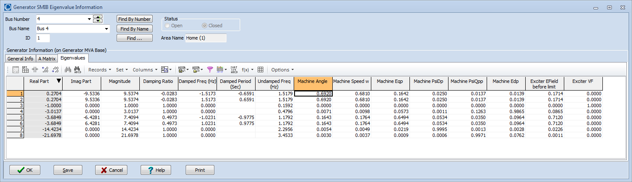
PowerWorld SMIB
Participation Factors
The magnitudes of the participation factors are shown on the PowerWorld SMIB dialog
The below values are shown for the four bus example with Q₄ = 0
Case is saved as B4_GENROU_Sat_SMIB_QZero

Slide 36
Oscillations
An oscillation is just a repetitive motion that can be either undamped, positively damped (decaying with time) or negatively damped (growing with time)
If the oscillation can be written as a sinusoid then
And the damping ratio is defined as (see Kundur 12.46)
The percent damping is just the damping ratio multiplied by 100; goal is sufficiently positive damping

Slide 37
Power System Oscillations
Power systems can experience a wide range of oscillations, ranging from highly damped and high frequency switching transients to sustained low frequency (< 2 Hz) inter-area oscillations affecting an entire interconnect
Types of oscillations include
  Transients: Usually high frequency and highly damped
  Local plant: Usually from 1 to 5 Hz
  Inter-area oscillations: From 0.15 to 1 Hz
  Slower dynamics: Such as AGC, less than 0.15 Hz
  Subsynchronous resonance: 10 to 50 Hz (less than synchronous)

Slide 38
Example Oscillations
The below graph shows an oscillation that was observed during a 1996 WECC Blackout

Slide 39
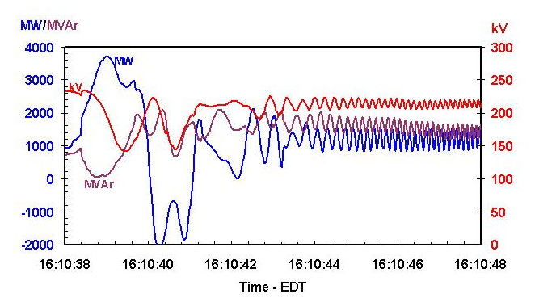
Example Oscillations
The below graph shows oscillations on the Michigan/Ontario Interface on 8/14/03

Slide 40
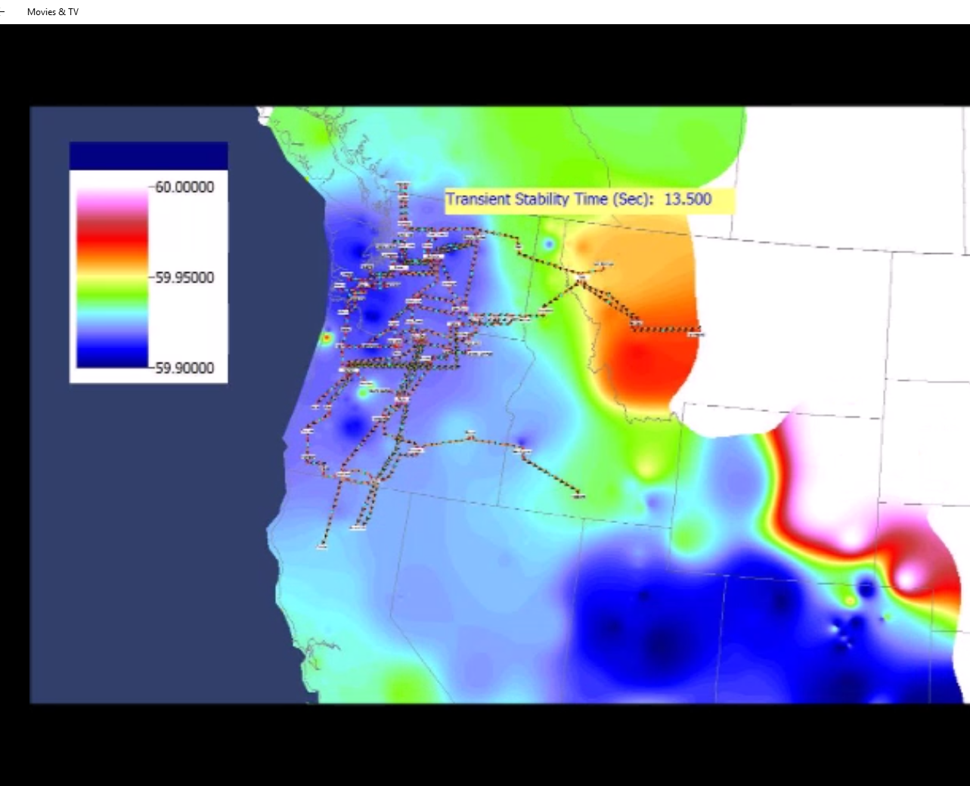
Fictitious System Oscillation
Movie shows
an example
of sustained
oscillations in
an equivalent
system

Slide 41
Forced Oscillations in WECC (from [1])
Summer 2013 24 hour data: 0.37 Hz oscillations observed for several hours. Confirmed to be forced oscillations at a hydro plant from vortex effect.
2014 data: Another 0.5 Hz oscillation also observed. Source points to hydro unit as well. And 0.7 Hz. And 1.12 Hz. And 2 Hz.
Resonance is possible when a system mode is poorly damped and close. Resonance can be observed in model simulations
1. M. Venkatasubramanian, “Oscillation Monitoring System”, June 2015
http://www.energy.gov/sites/prod/files/2015/07/f24/3.%20Mani%20Oscillation%20Monitoring.pdf

Slide 42
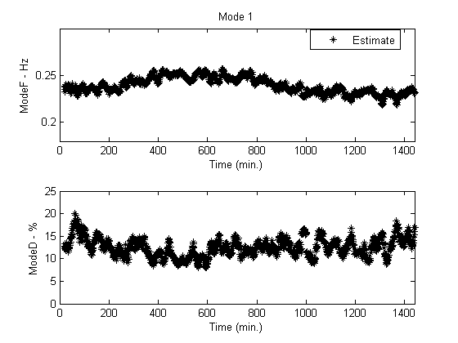
Inter-Area Modes in the WECC
The dominant inter-area modes in the WECC have been well studied
A good reference paper is D. Trudnowski, “Properties of the Dominant Inter-Area Modes in the WECC Interconnect,” 2012
  Four well known modes are
  NS Mode A (0.25 Hz),
  NS Mode B (or Alberta Mode),
  (0.4 Hz), BC Mode (0.6 Hz),
  Montana Mode (0.8 Hz)
Below figure from
paper shows NS Mode A
On May 29, 2012

