Slide 1
ECEN 667 Power System Stability
Lecture 8: Synchronous Machine Modeling
Prof. Tom Overbye
Dept. of Electrical and Computer Engineering
Texas A&M University
overbye@tamu.edu

Slide 2
Announcements
Read Chapter 5 and Appendix A
Homework 2 is due today
Homework 3 is due on Tuesday October 1
Exam 1 is Thursday October 10 during class

Slide 3
Subtransient Models
The two-axis model is a transient model
Essentially all commercial studies now use subtransient models
First models considered are GENSAL and GENROU, which require X"_{d}=X"_{q}
This allows the internal, subtransient voltage to be represented as

Slide 4
Subtransient Models
Usually represented by a Norton Injection with
May also be shown as
In steady-state ω = 1.0

Slide 5
GENSAL
The GENSAL model had been widely used to model salient pole synchronous generators
In salient pole models saturation is only assumed to affect the d-axis
In the 2010 WECC cases about 1/3 of machine models were GENSAL; in 2013 essentially none are, being replaced by GENTPF or GENTPJ
A 2014 series EI model had about 1/3 of its machines models set as GENSAL
In November 2016 NERC issued a recommendation to use GENTPJ rather than GENSAL for new models. See
www.nerc.com/comm/PC/NERCModelingNotifications/Use%20of%20GENTPJ%20Generator%20Model.pdf

Slide 6
GENSAL Block Diagram
A quadratic saturation function is used; for initialization it only impacts the E_{fd} value

Slide 7
GENSAL Example
Assume same system as before with same common generator parameters: H=3.0, D=0, R_{a} = 0, X_{d} = 2.1, X_{q} = 2.0, X'_{d} = 0.3, X"_{d}=X"_{q}=0.2, X_{l} = 0.13, T'_{do} = 7.0, T"_{do} = 0.07, T"_{qo} =0.07, S(1.0) =0, and S(1.2) = 0.
Same terminal conditions as before
Current of 1.0-j0.3286 and generator terminal voltage of 1.072+j0.22 = 1.0946 ∠11.59 °
Use same equation to get initial δ
Same delta as with the other models
Saved as case B4_GENSAL

Slide 8
GENSAL Example
Then as before and

Slide 9
GENSAL Example
Giving the initial fluxes (with ω = 1.0) of
To get the remaining variables set the differential equations equal to zero, e.g.,
Solving the d-axis requires solving two linear equations for two unknowns

Slide 10
GENSAL Example
0.4118
E_{q}’=1.1298
ψ_{d}’=0.9614
ψ_{d}”=1.031
0.5882
0.17
1.8
3.460
I_{d}=0.9909
I_{q}=0.3553
E_{fd} = 1.1298+1.8*0.991=2.912

Slide 11
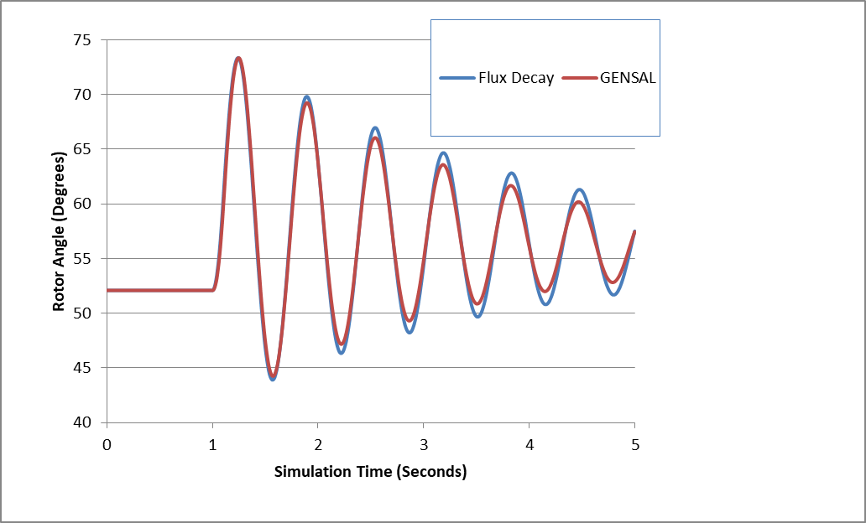
Comparison Between Gensal and Flux Decay

Slide 12
Nonlinear Magnetic Circuits
Nonlinear magnetic models are needed because magnetic materials tend to saturate; that is, increasingly large amounts of current are needed to increase the flux density
When linear λ = Li

Slide 13
Saturation

Slide 14
Relative Magnetic Strength Levels
Earth’s magnetic field is between 30 and 70 μT (0.3 to 0.7 gauss)
A refrigerator magnet might have 0.005 T
A commercial neodymium magnet might be 1 T
A magnetic resonance imaging (MRI) machine would be between 1 and 3 T
Strong lab magnets can be 10 T
Frogs can be levitated at 16 T (see www.ru.nl/hfml/research/levitation/diamagnetic
A neutron star can have 100 MT!

Slide 15
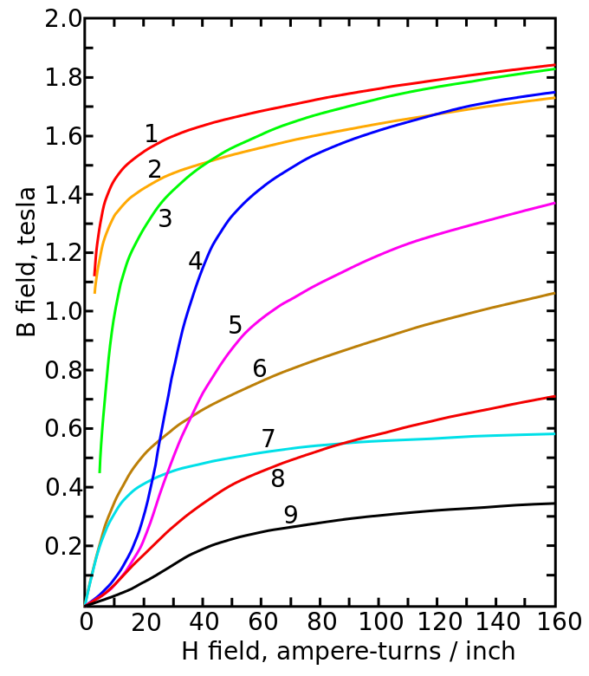
Magnetic Saturation and Hysteresis
The below image shows the saturation curves for various materials
Magnetization curves of 9 ferromagnetic materials, showing saturation. 1.Sheet steel, 2.Silicon steel, 3.Cast steel, 4.Tungsten steel, 5.Magnet steel, 6.Cast iron, 7.Nickel, 8.Cobalt, 9.Magnetite; highest saturation materials can get to around 2.2 or 2.3T
H is proportional to current
Image Source: en.wikipedia.org/wiki/Saturation_(magnetic)

Slide 16
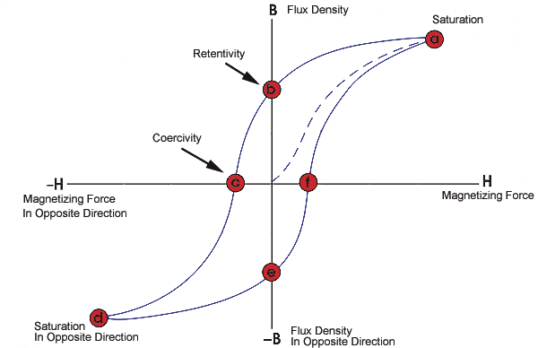
Magnetic Saturation and Hysteresis
Magnetic materials also exhibit hysteresis, so there is some residual magnetism when the current goes to zero; design goal is to reduce the area enclosed by the hysteresis loop
To minimize the amount of magnetic material, and hence cost and weight, electric machines are designed to operate close to saturation
Image source: www.nde-ed.org/EducationResources/CommunityCollege/MagParticle/Graphics/BHCurve.gif

Slide 17
Saturation Models
Many different models exist to represent saturation
There is a tradeoff between accuracy and complexity
One simple approach is to replace
with

Slide 18
Saturation Models
In steady-state this becomes
Hence saturation increases the required E_{fd} to get a desired flux
Saturation is usually modeled using a quadratic function, with the value of Se specified at two points (often at 1.0 flux and 1.2 flux)
A and B are determined from two provided data points

Slide 19
Saturation Example
If Se = 0.1 when the flux is 1.0 and 0.5 when the flux is 1.2, what are the values of A and B using the

Slide 20
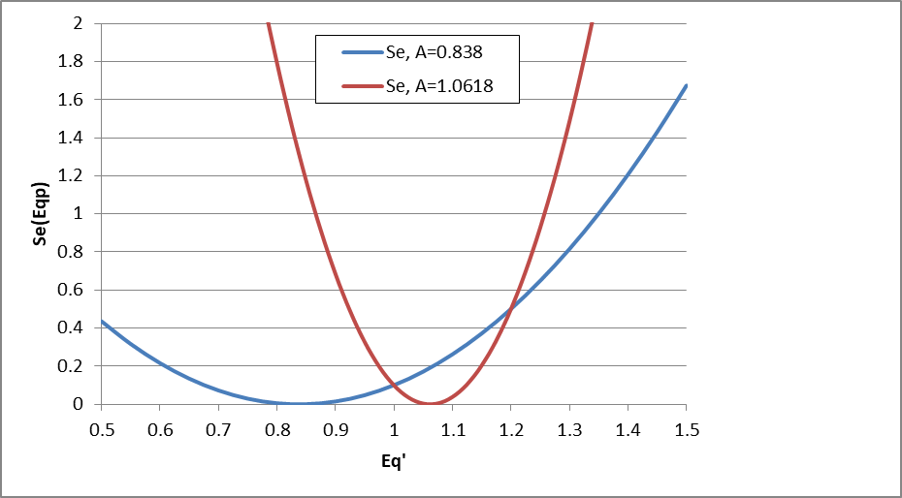
Saturation Example: Selection of A
When selecting which of the two values of A to use, we do not want the minimum to be between the two specified values. That is Se(1.0) and Se(1.2).

Slide 21
Implementing Saturation Models
When implementing saturation models in code, it is important to recognize that the function is meant to be positive, so negative values are not allowed
In large cases one is almost guaranteed to have special cases, sometimes caused by user typos
What to do if Se(1.2) < Se(1.0)?
What to do if Se(1.0) = 0 and Se(1.2) <> 0
What to do if Se(1.0) = Se(1.2) <> 0
Exponential saturation models have also been used

Slide 22
GENSAL Example with Saturation
Once E'_{q} has been determined, the initial field current (and hence field voltage) are easily determined by recognizing in steady-state the E'_{q} is zero
Saturation coefficients were determined from the two initial values
Saved as case B4_GENSAL_SAT

Slide 23
GENROU
The GENROU model has been widely used to model round rotor machines
Saturation is assumed to occur on both the d-axis and the q-axis, making initialization slightly more difficult

Slide 24
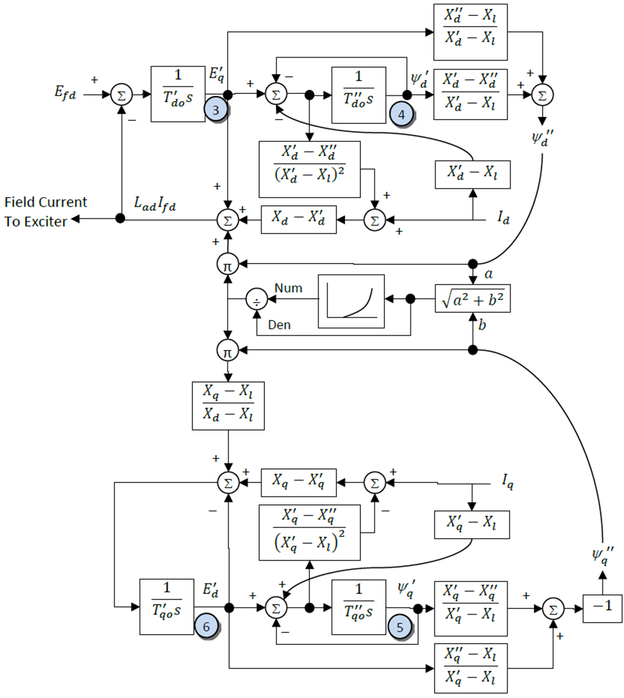
GENROU
The d-axis is similar to that of the GENSAL; the q-axis is now similar to the d-axis. Note that saturation now affects both axes.

Slide 25
GENROU Initialization
Because saturation impacts both axes, the simple approach will no longer work
Key insight for determining initial δ is that the magnitude of the saturation depends upon the magnitude of ψ", which is independent of δ
Solving for δ requires an iterative approach; first get a guess of δ using the unsaturated approach
This point is crucial!

Slide 26
GENROU Initialization
Then solve five nonlinear equations for five unknowns
The five unknowns are δ, E'_{q}, E'_{d}, ψ '_{q}, and ψ '_{d}
Five equations come from the terminal power flow constraints (which allow us to define ψ_{d} " and ψ_{q}" as a function of the power flow voltage, current and δ) and from the differential equations initially set to zero
The ψ_{d} " and ψ_{q}" block diagram constraints
Two differential equations for the q-axis, one for the d-axis (the other equation is used to set the field voltage
Values can be determined using Newton’s method, which is needed for the nonlinear case with saturation

Slide 27
GENROU Initialization
Use dq transform to express terminal current as
Get expressions for ψ "_{q} and ψ "_{d} in terms of the initial terminal voltage and δ
Use dq transform to express terminal voltage as
Then from
These values will change during the iteration as δ changes
Recall X "_{d}=X "_{q}=X" and ω=1 (in steady-state)
Expressing complex equation as two real equations

Slide 28
GENROU Initialization Example
Extend the two-axis example
For two-axis assume H = 3.0 per unit-seconds, R_{s}=0, X_{d} = 2.1, X_{q} = 2.0, X'_{d}= 0.3, X'_{q} = 0.5, T'_{do} = 7.0, T'_{qo} = 0.75 per unit using the 100 MVA base.
For subtransient fields assume X"_{d}=X"_{q}=0.28, X_{l} = 0.13, T"_{do} = 0.073, T"_{qo} =0.07
for comparison we'll initially assume no saturation
From two-axis get a guess of δ
Saved as case B4_GENROU_NoSat

Slide 29
GENROU Initialization Example
And the network current and voltage in dq reference
Which gives initial subtransient fluxes (with R_{s}=0),

Slide 30
GENROU Initialization Example
Without saturation this is the exact solution
Initial values are: δ = 52.1, E'_{q}=1.1298, E'_{d}=0.533, ψ '_{q} =0.6645, and ψ '_{d}=0.9614
E_{fd}=2.9133

Slide 31
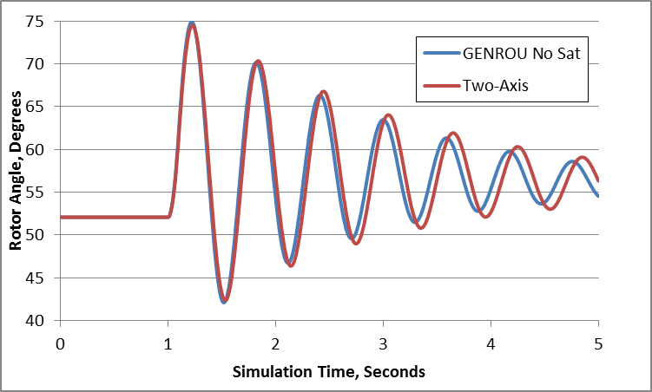
Two-Axis versus GENROU Response
Figure compares rotor angle for bus 3 fault, cleared after 0.1 seconds

Slide 32
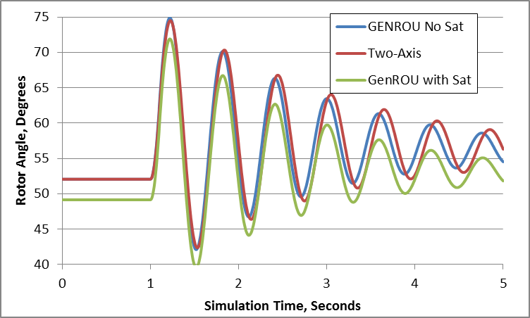
GENROU with Saturation
Nonlinear approach is needed in common situation in which there is saturation
Assume previous GENROU model with S(1.0) = 0.05, and S(1.2) = 0.2.
Initial values are: δ = 49.2, E'_{q}=1.1591, E'_{d}=0.4646, ψ '_{q} =0.6146, and ψ '_{d}=0.9940
E_{fd}=3.2186
Same fault as before
Saved as case B4_GENROU_Sat

Slide 33
GENTPF and GENTPJ Models
These models were introduced in 2009 to provide a better match between simulated and actual system results for salient pole machines
Desire was to duplicate functionality from old BPA TS code
Allows for subtransient saliency (X"_{d} <> X"_{q})
Can also be used with round rotor, replacing GENSAL and GENROU
Useful reference is available at below link; includes all the equations, and saturation details
https://www.wecc.biz/Reliability/gentpj-typej-definition.pdf

Slide 34
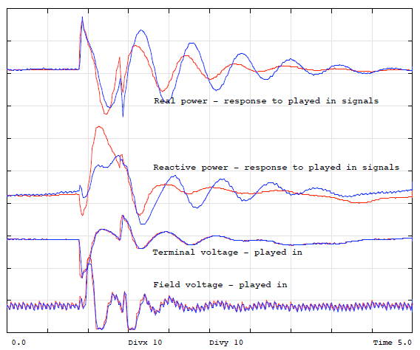
Motivation for the Change: GENSAL Actual Results
Chief Joseph
disturbance playback
GENSAL
BLUE = MODEL
RED = ACTUAL
(Chief Joseph is a 2620 MW hydro plant on the Columbia River in Washington)
Image source :https://www.wecc.biz/library/WECC%20Documents/Documents%20for %20Generators/Generator%20Testing%20Program/gentpj%20and%20gensal%20morel.pdf

Slide 35
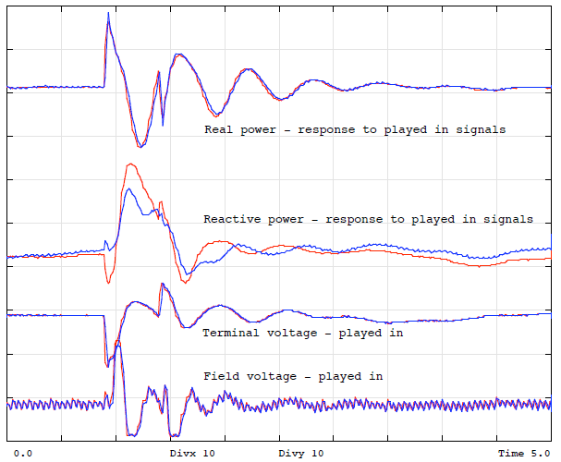
GENTPJ Results
Chief Joseph
disturbance playback
GENTPJ
BLUE = MODEL
RED = ACTUAL

Slide 36
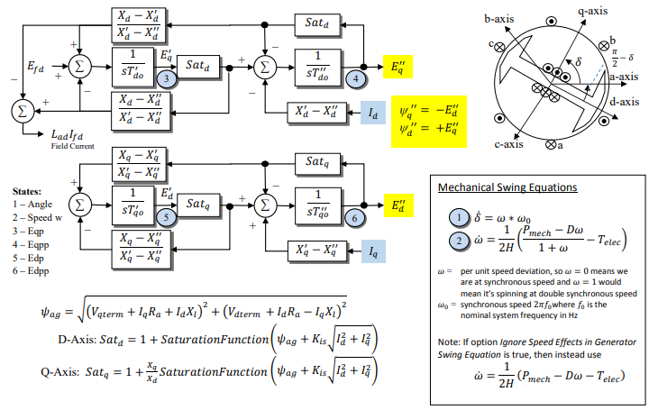
GENTPF and GENTPJ Models
Most of WECC machine models are now GENTPF or GENTPJ
If nonzero, K_{is} typically ranges from 0.02 to 0.12

Slide 37
Theoretical Justification for GENTPF and GENTPJ
In the GENROU and GENSAL models saturation shows up purely as an additive term of E'_{q}and E'_{d}
Saturation does not come into play in the network interface equations and thus with the assumption of X"_{q} = X"_{d} a simple circuit model can be used
The advantage of the GENTPF/J models is saturation really affects the entire model, and in this model it is applied to all the inductance terms simultaneously
This complicates the network boundary equations, but since these models are designed for X"_{q} ≠ X"_{d} there is no increase in complexity

Slide 38
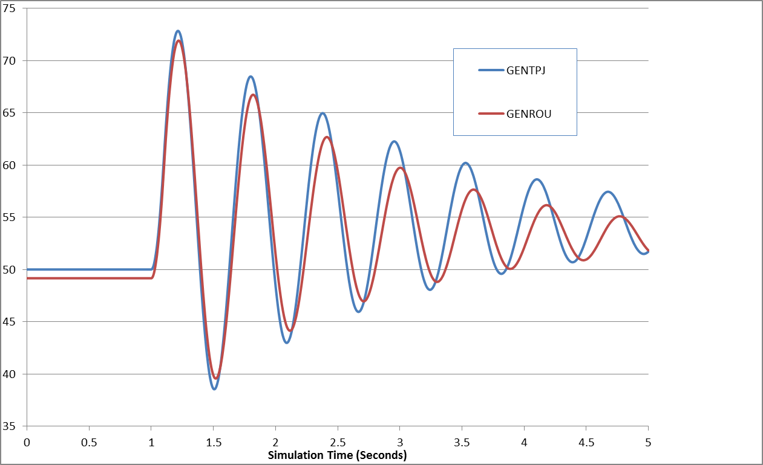
GENROU/GENTPJ Comparison
Saved as case B4_GENTPJ_Sat

Slide 39
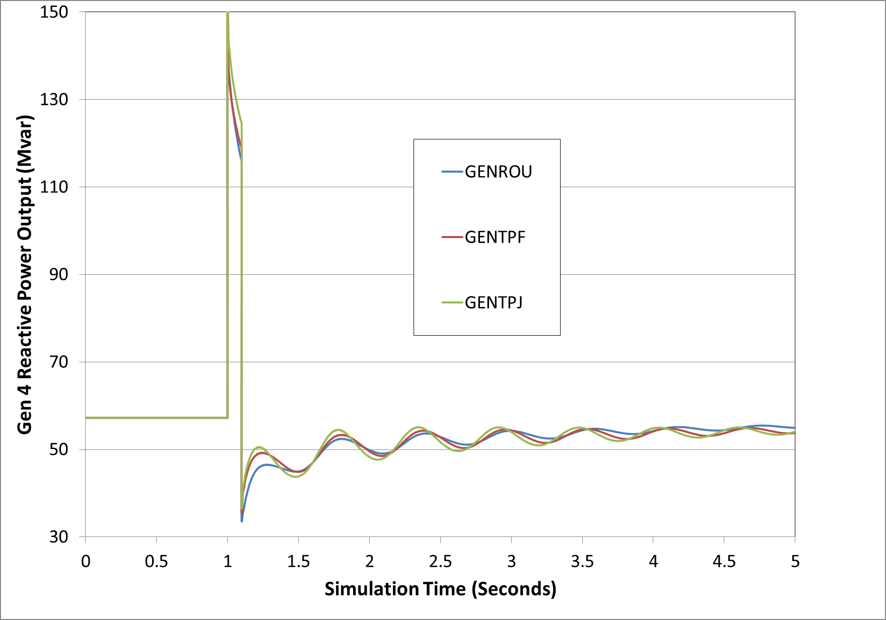
GENROU, GenTPF, GenTPJ
Figure compares gen 4 reactive power output for the 0.1 second fault

Slide 40
Why does this even matter?
GENROU and GENSAL models date from 1970, and their purpose was to replicate the dynamic response the synchronous machine
They have done a great job doing that
Weaknesses of the GENROU and GENSAL model has been found to be with matching the field current and field voltage measurements
Field Voltage/Current may have been off a little bit, but that didn’t effect dynamic response
It just shifted the values and gave them an offset
Shifted/Offset field voltage/current didn’t matter too much in the past

