Slide 1
ECEN 615 Methods of Electric Power Systems Analysis
Lecture 2: Power Systems Overview
Prof. Tom Overbye
Dept. of Electrical and Computer Engineering
Texas A&M University
overbye@tamu.edu

Slide 2
Announcements
Start reading Chapters 1 to 3 from the book (mostly background material)
We’ll be using PowerWorld Simulator fairly extensively in this class, both the educational and professional versions
Download the free 42 bus educational versions of PowerWorld Simulator at
https://www.powerworld.com/gloveroverbyesarma

Slide 3
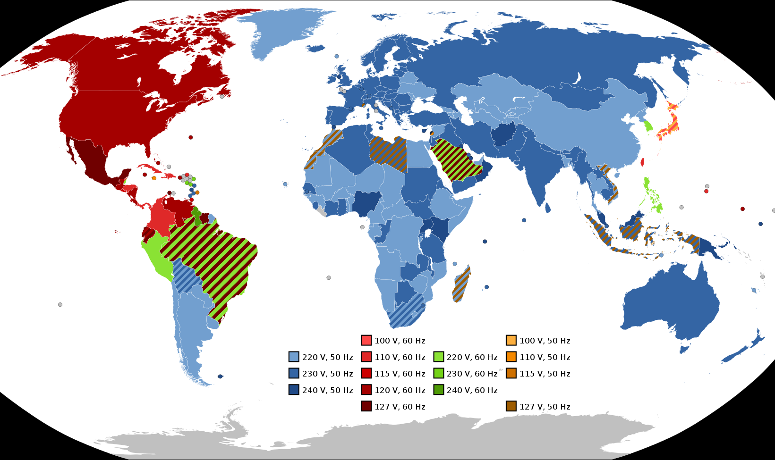
Electric Frequencies and Residential Voltages Worldwide
Image Source: en.wikipedia.org/wiki/Mains_electricity_by_country#/media/File:World_Map_of_Mains_Voltages_and_Frequencies,_Detailed.svg

Slide 4
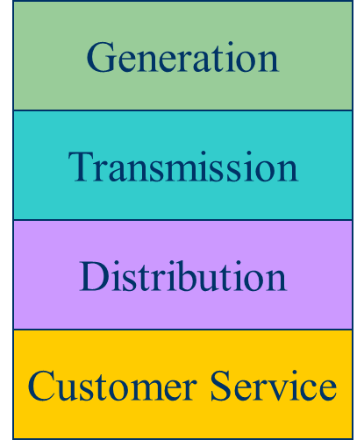
Historical Electric Utility Organization
Traditionally electric utilities were vertical monopolies; within a particular geographic market, they had an exclusive franchise
This has changed in many places around the country
In return for this exclusive franchise, the utility had the obligation to serve all
existing and future customers at rates determined jointly by utility and regulators.

Slide 5
Generation
Large plants have predominated, up to 1500 MW
Natural Gas (40%) and coal (21%) are most common sources, followed by nuclear (20%), wind (7.6%), hydro (6.6%), and solar (2.7%)
Wood is 1.0%, geothermal 0.4%
New construction mostly wind, solar and natural gas (with wind and solar energy costs now quite low)
Coal was at least 50% of the total up to 2007
Sources are by energy (not capacity), 5/2019-4/2020; source US EIA

Slide 6
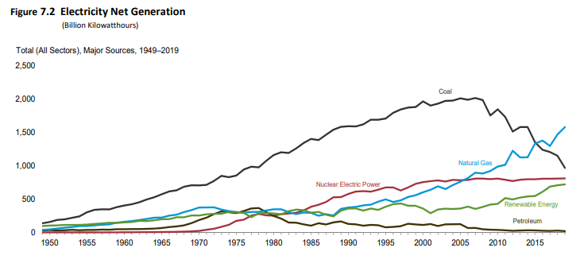
US Electricity Generation
Source: EIA Monthly Energy Review, July 2020

Slide 7
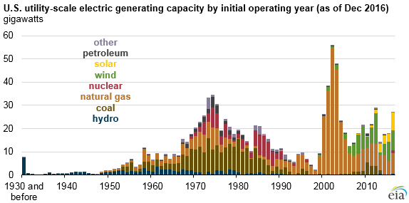
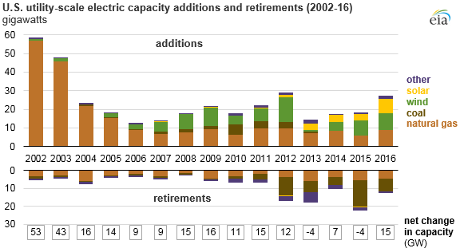
US Generator Capacity Additions
Natural gas and wind generation additions in the last decade dwarfed all other technologies, but with solar rapidly growing. The gas generation, and low natural gas prices were partially responsible for the recent decrease in carbon dioxide emissions
Sources: www.eia.gov/todayinenergy/detail.php?id=25432

Slide 8
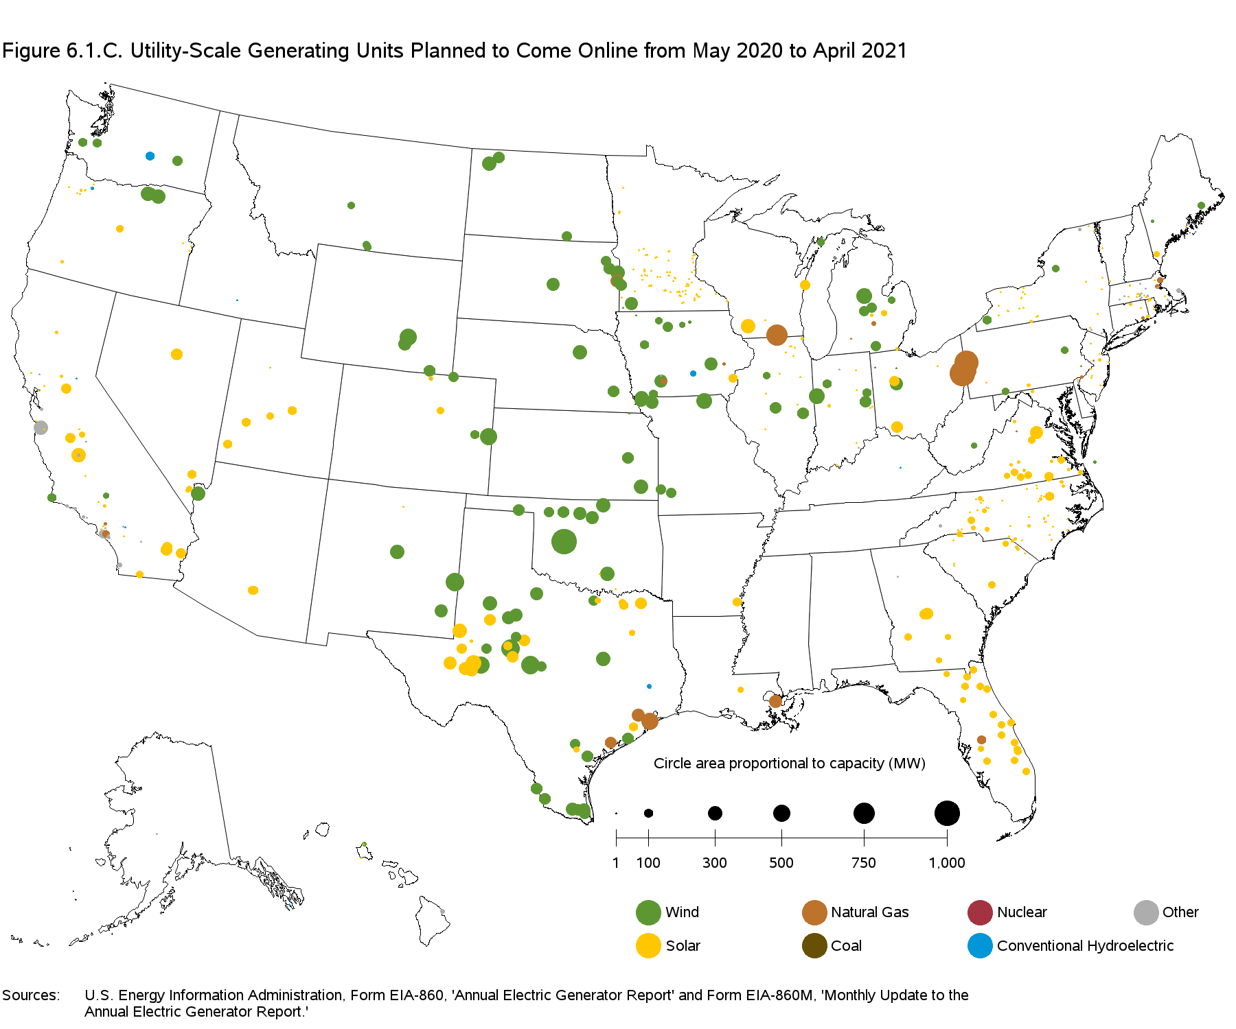
New Generation May 2020 to April 2021
Sources: EIA Electricity Monthly, May 2020

Slide 9
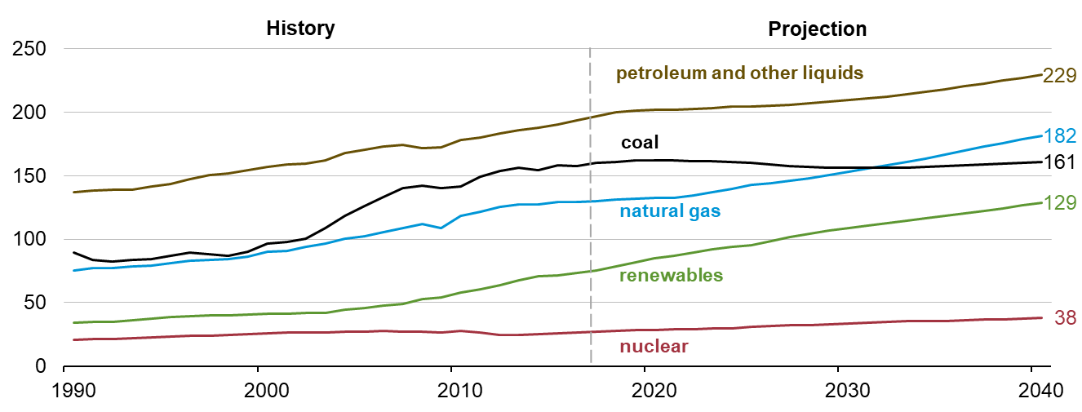
The World: Energy Consumption by Source
Source: EIA, International Energy Outlook 2018

Slide 10
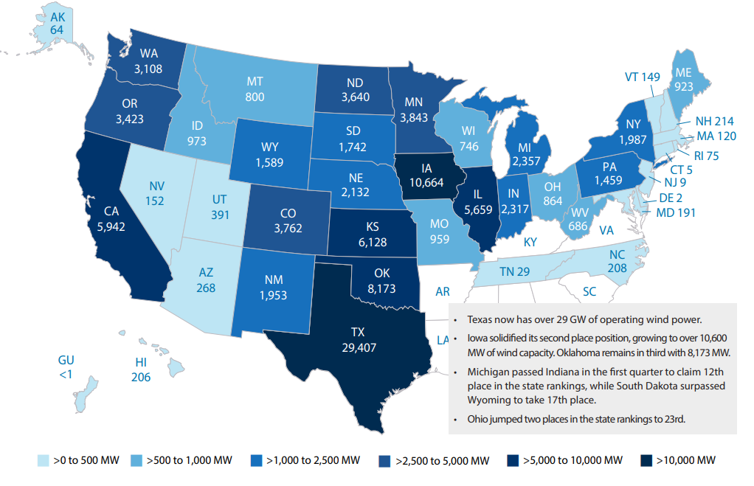
US Wind Capacity by State
Total wind capacity is now 107 GW (compared to a total US capacity of about 1000 GW)
Source: AWEA 1st Quarter 2020 Market Report

Slide 11
Texas Electricity Sources
In 2018 the Texas top five fuel sources for electricity were Natural Gas (50%), Coal (23%), Wind (15.7%), Nuclear (8.7%), Solar (0.6%), other (the rest)
Average retail price is 8.48 cents/kWh
In 2018 the California top five fuel sources for electricity were Natural Gas (46%), Solar (13.8), Hydro (13.5%), Nuclear (9.3%), Wind (7.2%), Geo (5.9%)
Average retail price is 16.58 cents/kWh
In 2018 Kentucky was 75% coal, while Washington was 69% hydro; highest retails costs are 29.1 cents/kWh in Hawaii, 19.3 in Alaska and 18.4 in Connnecticut
Source: www.eia.gov/electricity/state

Slide 12
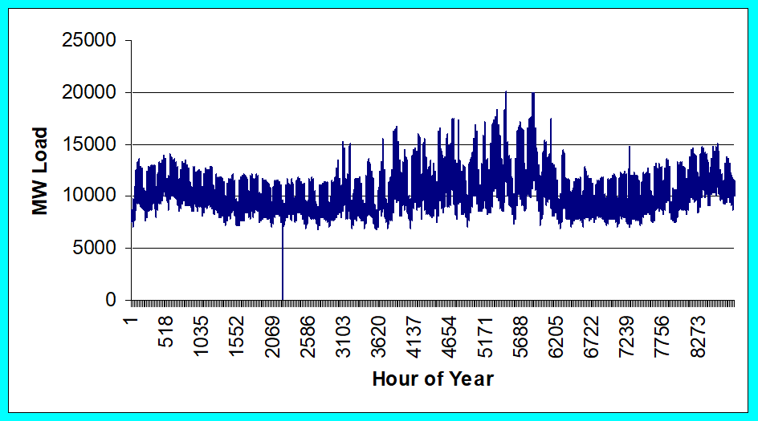
Loads
Can range in size from less than one watt to 10’s of MW.
Loads are usually aggregated.
The aggregate load changes with time, with strong daily, weekly and seasonal cycles.
ComEd Yearly Load

Slide 13
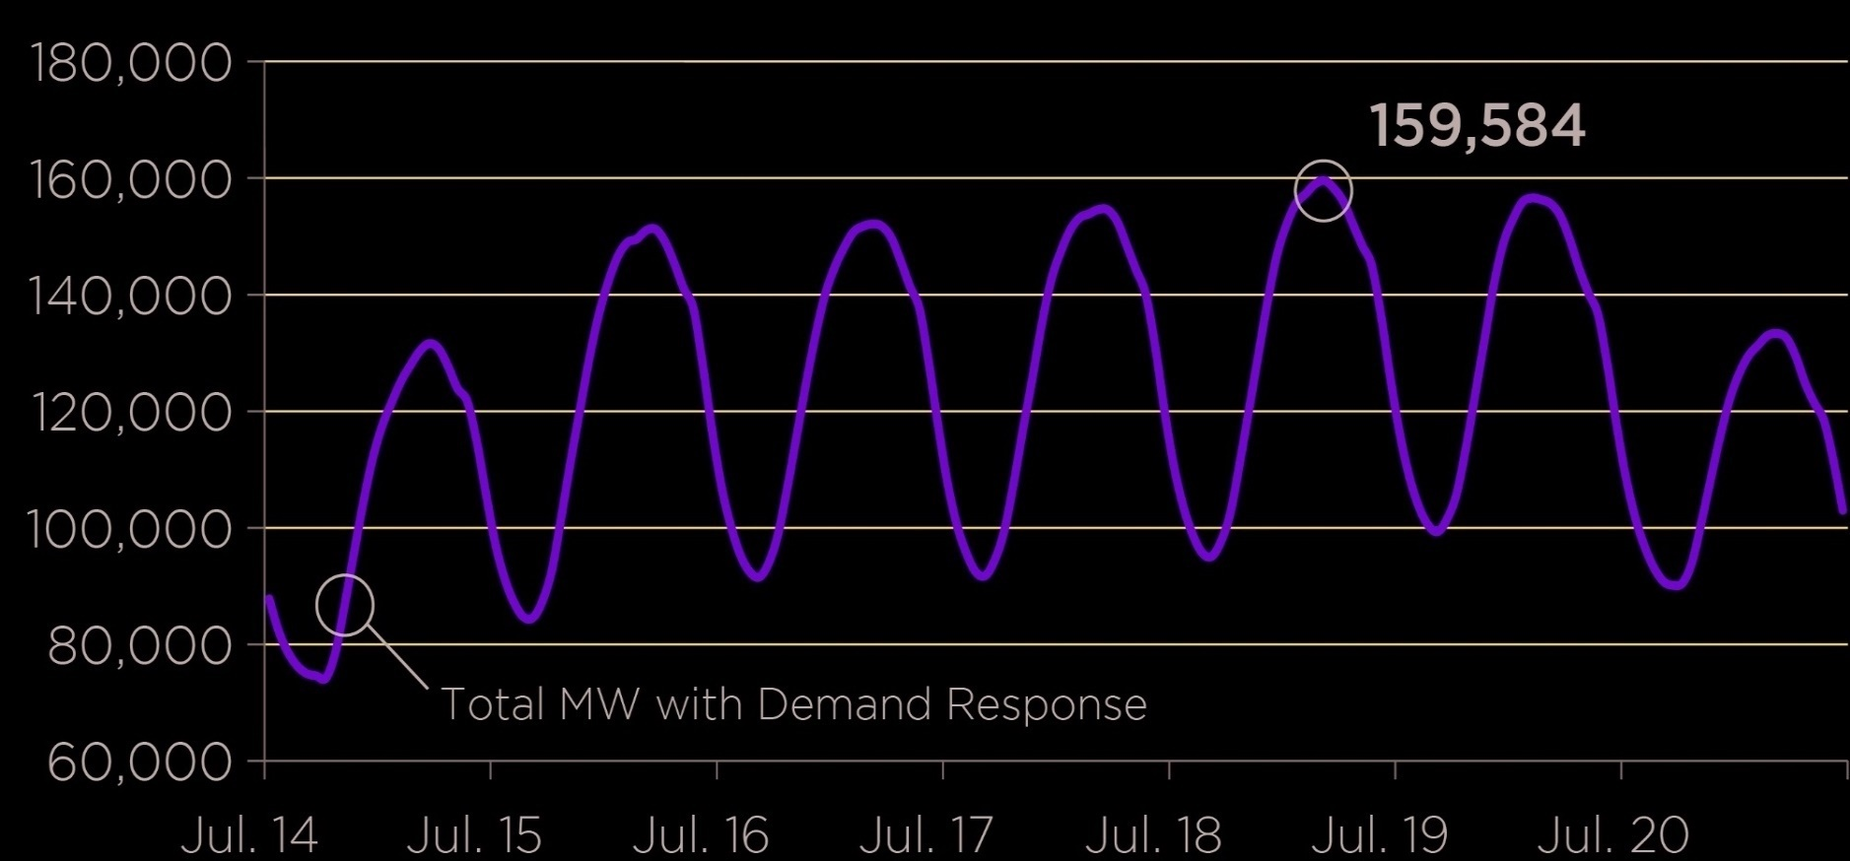
Example: PJM Weekly Summer Load Variation, July 2013

Slide 14
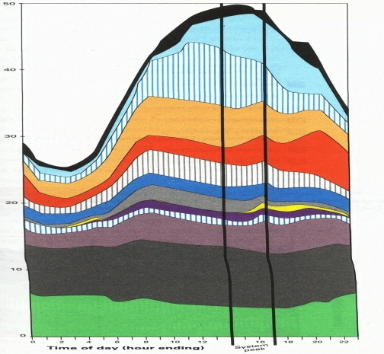
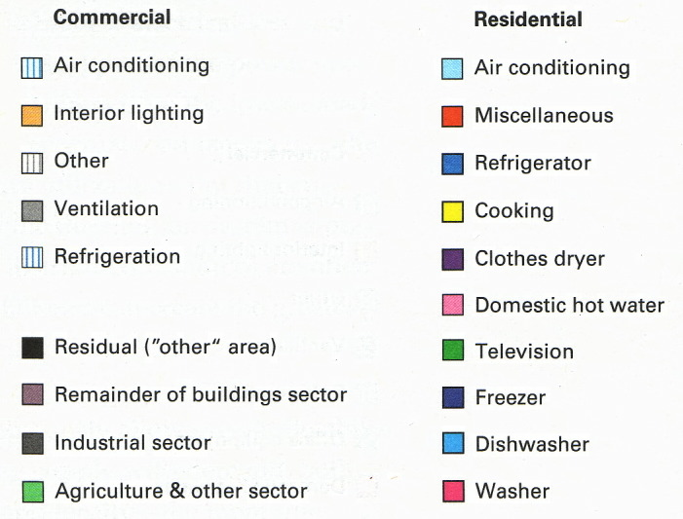
Example Daily Load Variation: Very Location Specific

Slide 15
Transmission and Distribution
Goal is to move electric power from generation to load with low losses.
Less losses at higher voltages (S=VI* and I²R losses), but more difficult to insulate.
Typical high voltage transmission voltages are 765, 500, 345, 230, 161, 138 and 69 kV.
Lower voltage lines are used for distribution (12.4 or 13.8 kV).
Typical losses are about 3 to 5% in transmission and 10 to 15% in the distribution system.

Slide 16
Transmission & Distribution
Transmission
networked connections
power can be supplied from multiple sources
typically higher voltages, above 100 kV
mostly overhead, with some underground in urban areas
Often source of large-scale blackouts
Distribution
radial connections
power moves in one direction only
typically lower voltages, below 100 kV
the source of most black-outs, but these are local
Most new construction is underground, especially in suburban and urban locations

Slide 17
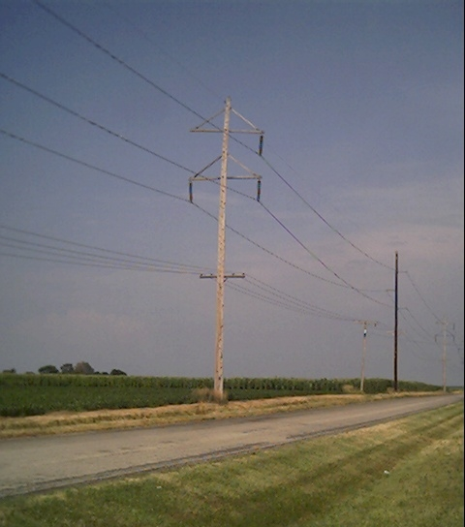
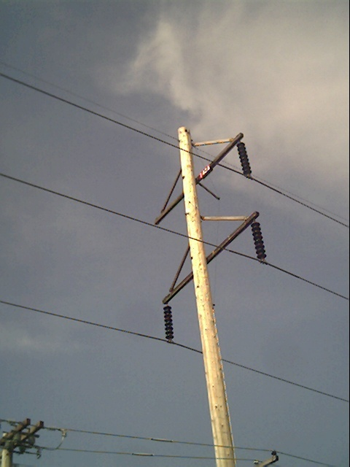
Three Phase Transmission Line

Slide 18
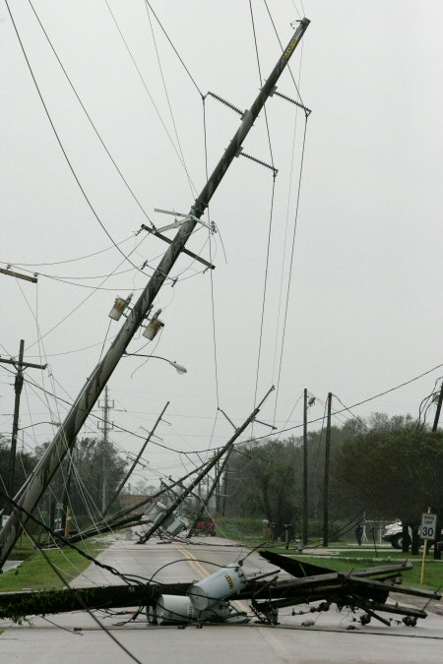
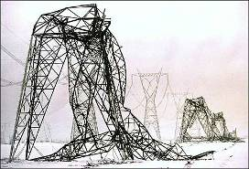
Transmission Lines and the Elements
Quebec Ice Storm
Ike in Beaumont, Tx

Slide 19
Transformers
Transformers provide an easily means for changing ac voltage levels
Power flow through transformers is bi-directional
Heating is a major concern that can quickly lead to loss of transformer life (and occasionally explosions!)
High voltage transformers (say 230 kV and up) are large, heavy, and difficult to replace

Slide 20
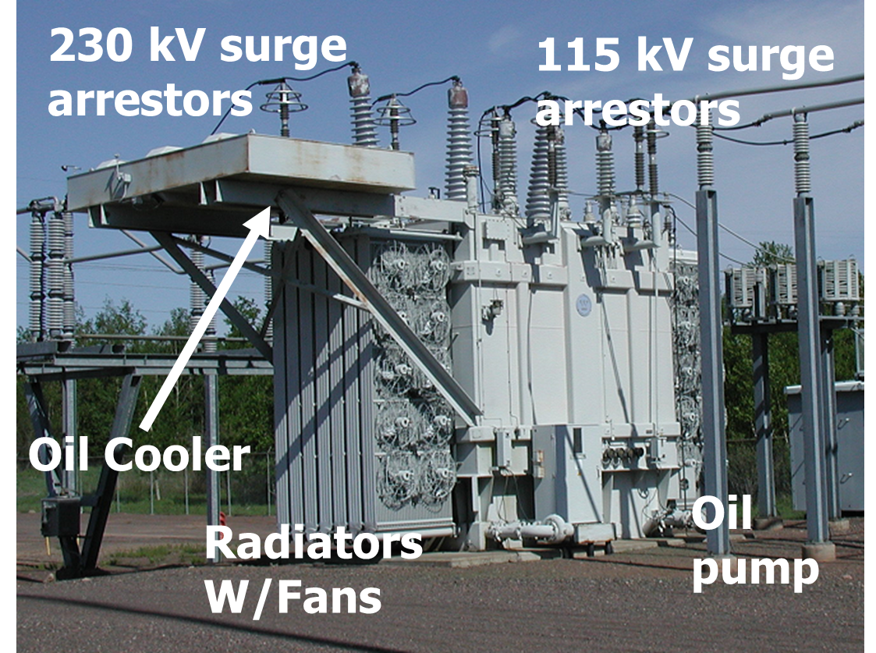
A 230/115 kV Transformer

Slide 21
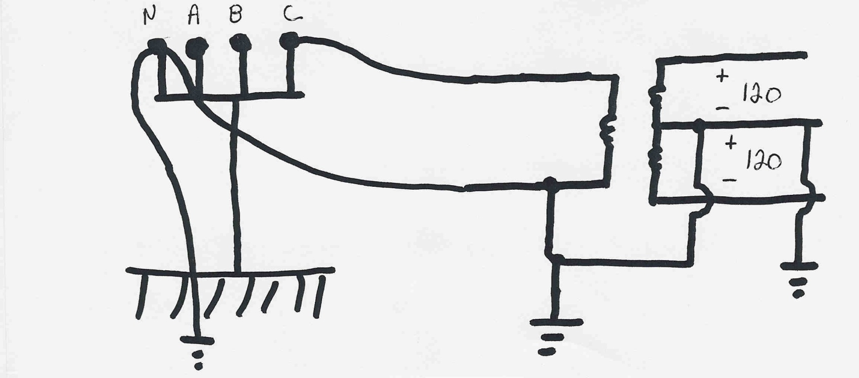
Residential Distribution Transformers
Residential single phase electric service uses a center tapped transformer to provide 240/120 volt service; a separate ground is used for safety

Slide 22
Per Unit Calculations
A key problem in analyzing power systems is the large number of transformers.
It would be very difficult to continually have to refer impedances to the different sides of the transformers
This problem is avoided by a normalization of all variables.
This normalization is known as per unit analysis

Slide 23
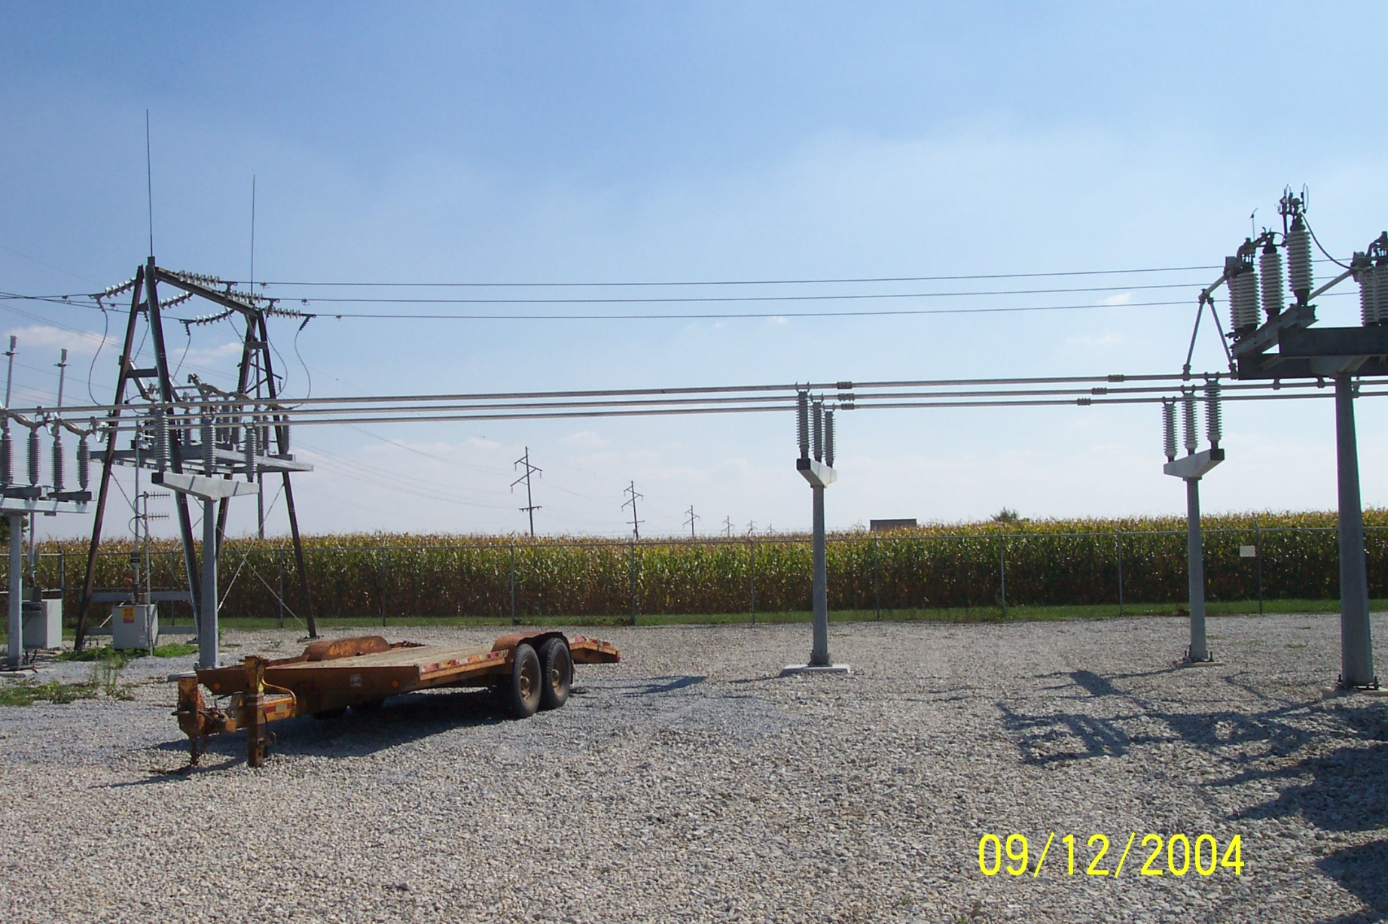
Components Join Together at a Bus

Slide 24
Energy Economics
Electric generating technologies involve a tradeoff between fixed costs (costs to build them) and operating costs
Nuclear and solar high fixed costs, but low operating costs (though cost of solar has decreased substantially recently)
Natural gas/oil have low fixed costs but can have higher operating costs (dependent upon fuel prices)
Coal, wind, hydro are in between
Also the units capacity factor is important to determining ultimate cost of electricity

Slide 25
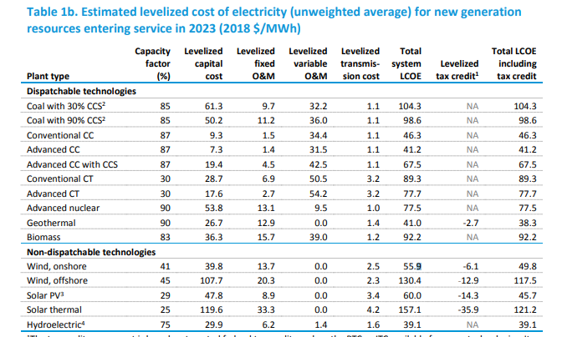
Estimated Energy Costs for New Generation, 2019 Edition
Source: www.eia.gov/outlooks/aeo/pdf/electricity_generation.pdf (February 2019)

Slide 26
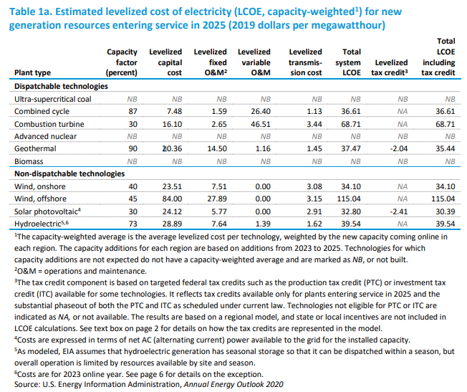
Estimated Energy Costs for New Generation, 2020 Edition

Slide 27
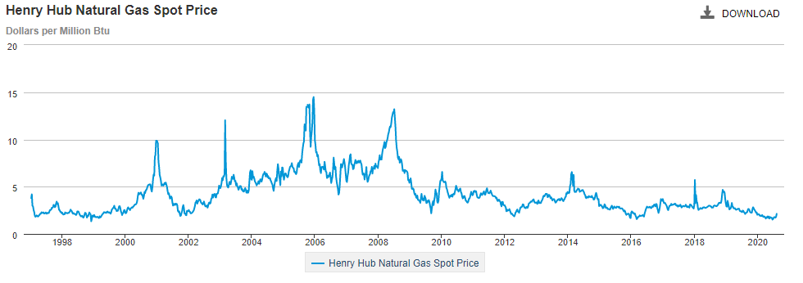
Natural Gas Prices 1997 to 2020
Marginal cost for natural gas fired electricity price
in $/MWh is about 7-10 times gas price; Henry Hub is a gas pipeline located in Erath, Louisiana.
Source: http://www.eia.gov/dnav/ng/hist/rngwhhdW.htm

Slide 28
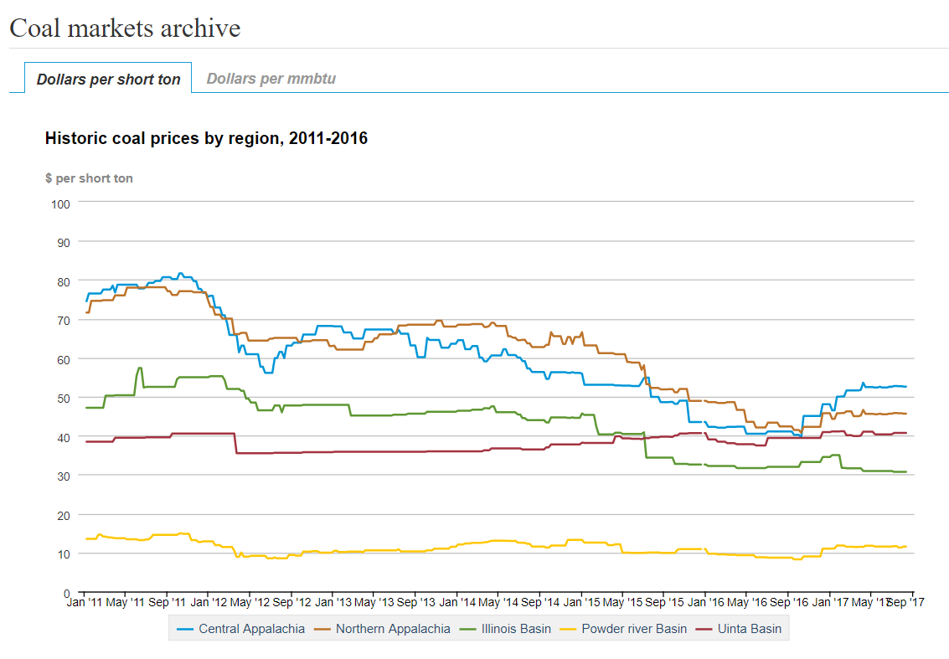
Coal Prices had Fallen But Are Now Back to Values from Five Years Ago
Current prices are about the same as in Sept. 2017
BTU content per pound varies between about 8000 and 15,000 Btu/lb, giving costs of around $1 to 2/Mbtu
Source: eia.gov/coal

Slide 29
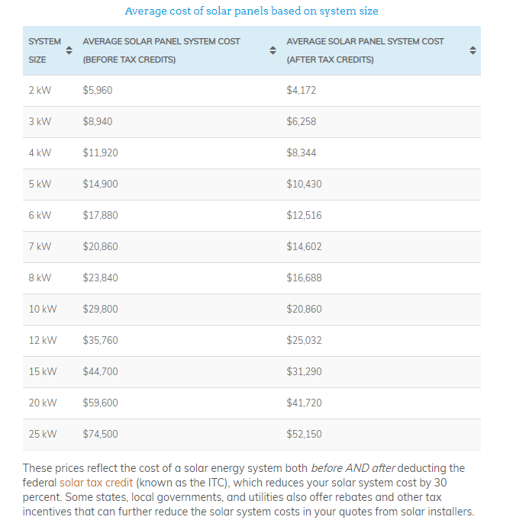
Average Cost of Solar Systems, 2019
For the cost for a 10 kW system is $2.98 per watt before the tax credit and $ 20.86 after
Source news.energysage.com/how-much-does-the-average-solar-panel-installation-cost-in-the-u-s/

Slide 30
Brief History of Electric Power
First real practical uses of electricity began with the telegraph (1860's) and then arc lighting in the 1870’s
Early 1880’s – Edison introduced Pearl Street dc system in Manhattan supplying 59 customers
1884 – Sprague produces practical dc motor
1885 – invention of transformer
Mid 1880’s – Westinghouse/Tesla introduce rival ac system
Late 1880’s – Tesla invents ac induction motor
1893 – Three-phase transmission line at 2.3 kV

Slide 31
History, cont’d
1896 – ac lines deliver electricity from hydro generation at Niagara Falls to Buffalo, 20 miles away; also 30kV line in Germany
Early 1900’s – Private utilities supply all customers in area (city); recognized as a natural monopoly; states step in to begin regulation
By 1920’s – Large interstate holding companies control most electricity systems

Slide 32
History, cont’d
1935 – Congress passes Public Utility Holding Company Act to establish national regulation, breaking up large interstate utilities (repealed 2005)
This gave rise to electric utilities that only operated in one state
1935/6 – Rural Electrification Act brought electricity to rural areas
1930’s – Electric utilities established as vertical monopolies
Frequency standardized in the 1930’s

Slide 33
Vertical Monopolies
Within a particular geographic market, the electric utility had an exclusive franchise
Generation
In return for this exclusive
franchise, the utility had the
obligation to serve all
existing and future customers
at rates determined jointly
by utility and regulators
It was a “cost plus” business
Transmission
Distribution
Customer Service

Slide 34
Vertical Monopolies
Within its service territory each utility was the only game in town
Neighboring utilities functioned more as colleagues than competitors
Utilities gradually interconnected their systems so by 1970 transmission lines crisscrossed North America, with voltages up to 765 kV
Economies of scale keep resulted in decreasing rates, so most every one was happy

Slide 35
History, cont’d -- 1970’s
1970’s brought inflation, increased fossil-fuel prices, calls for conservation and growing environmental concerns
Increasing rates replaced decreasing ones
As a result, U.S. Congress passed Public Utilities Regulator Policies Act (PURPA) in 1978, which mandated utilities must purchase power from independent generators located in their service territory (modified 2005)
PURPA introduced some competition

Slide 36
History, cont’d – 1990’s & 2000’s
Major opening of industry to competition occurred as a result of National Energy Policy Act of 1992
This act mandated that utilities provide “nondiscriminatory” access to the high voltage transmission
Goal was to set up true competition in generation
Result over the last few years has been a dramatic restructuring of electric utility industry (for better or worse!)
Energy Bill 2005 repealed PUHCA; modified PURPA

Slide 37
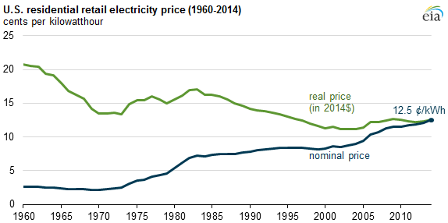
Electricity Prices, 1960-2014
Source: EIA

Slide 38
Utility Restructuring
Driven by significant regional variations in electric rates
Goal of competition is to reduce rates through the introduction of competition
Eventual goal is to allow consumers to choose their electricity supplier

Slide 39
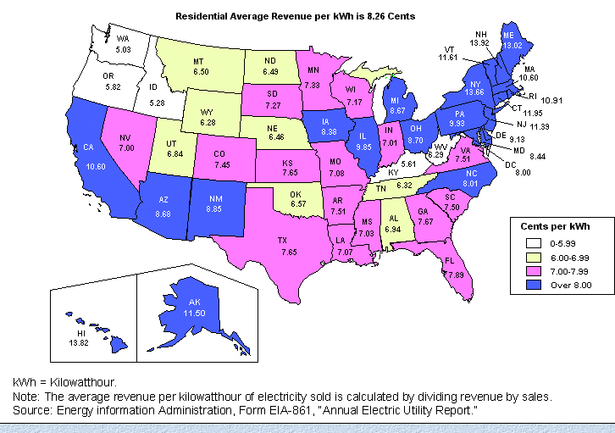
State Variation in Electric Rates

Slide 40
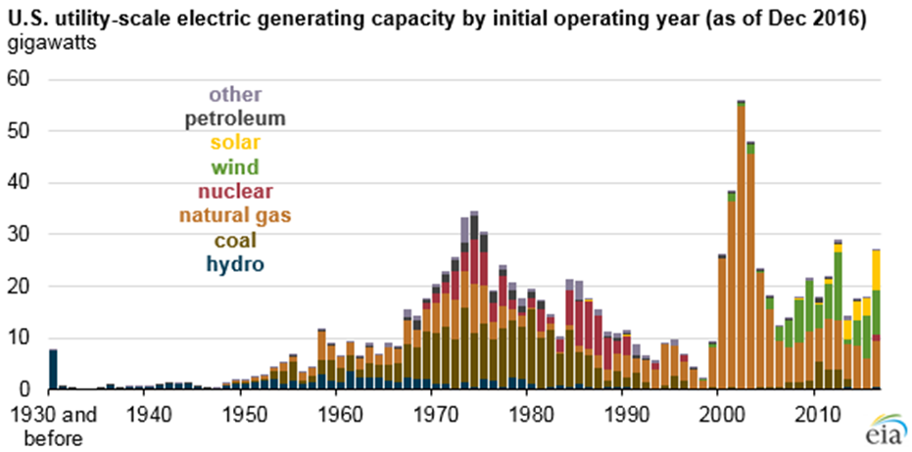
The Rise of Natural Gas Generation
Source: US EIA, 2016

Slide 41
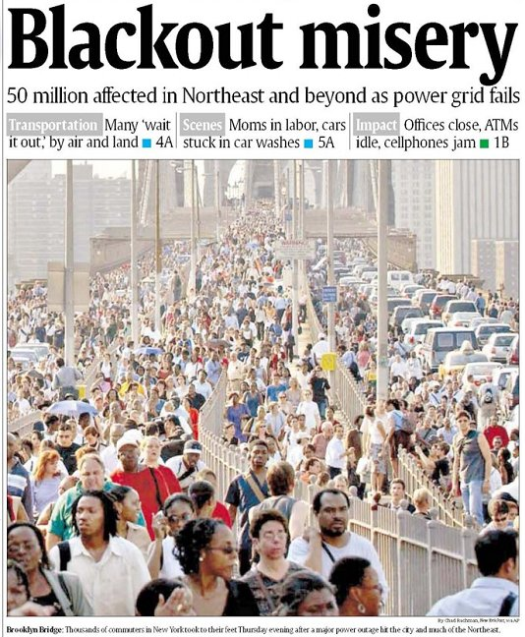
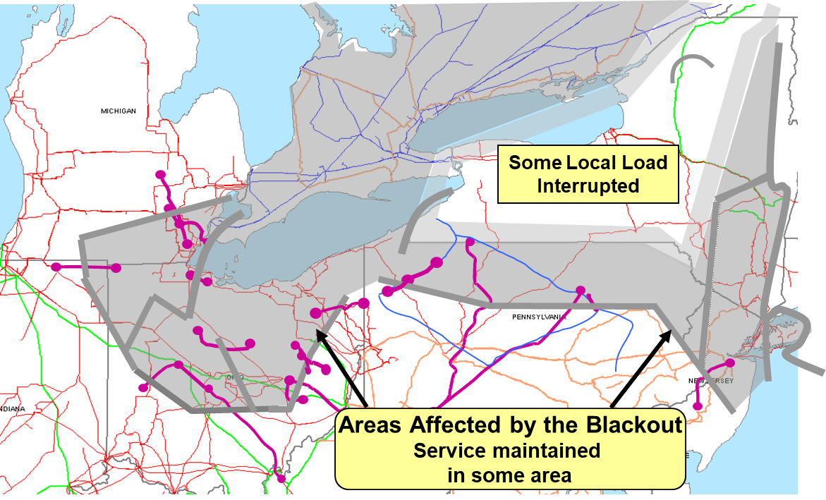
August 14th, 2003 Blackout
Above image from energy.gov, August 14, 2003 Blackout Final Report

Slide 42
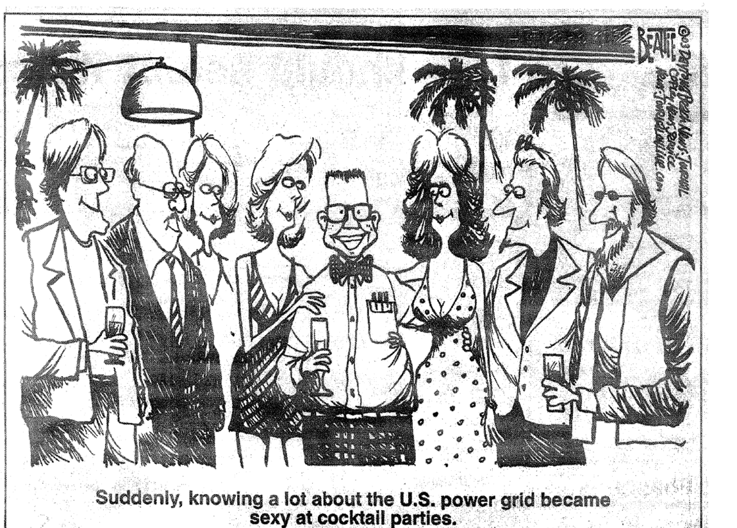
My Favorite 8/14/2003 Blackout Cartoon!

Slide 43
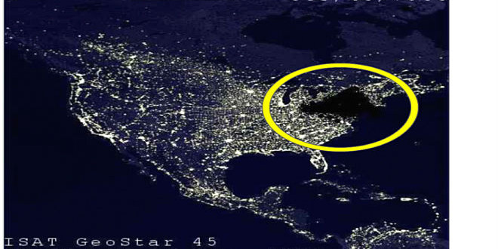
My Favorite Blackout Hoax Photo

Slide 44
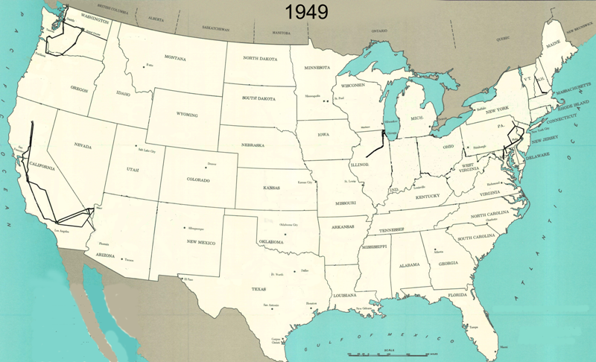
345 kV+ Transmission Growth at a Glance (From Jay Caspary)

Slide 45
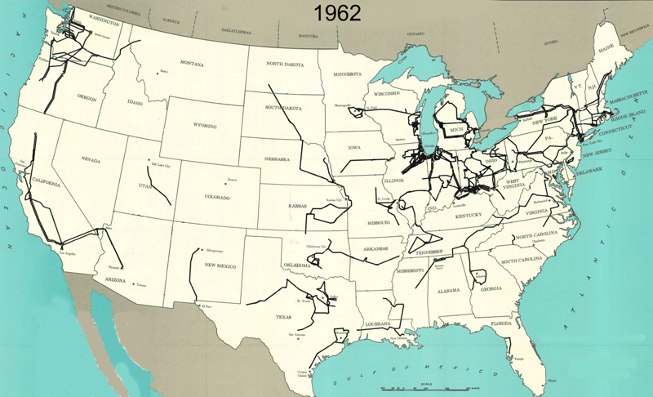
345 kV+ Transmission Growth at a Glance (From Jay Caspary)

Slide 46
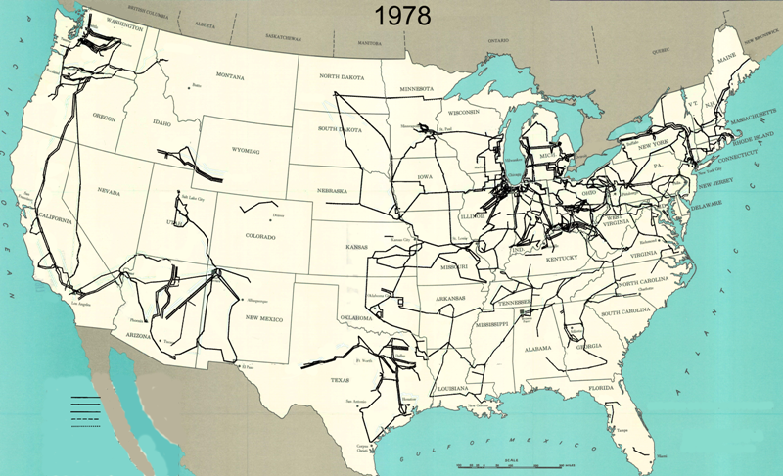
345 kV+ Transmission Growth at a Glance (From Jay Caspary)

Slide 47
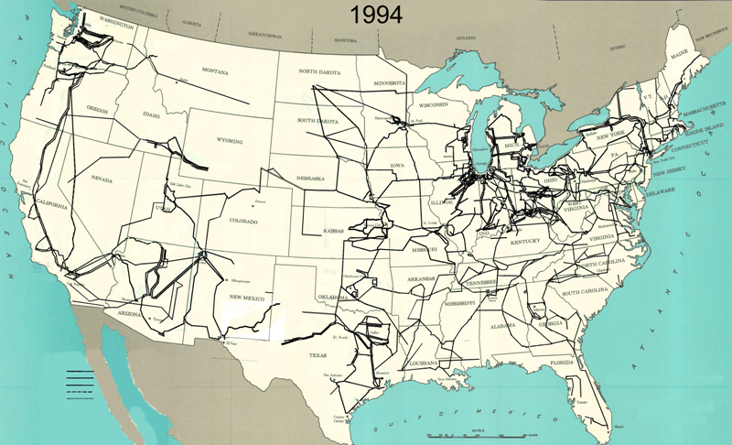
345 kV+ Transmission Growth at a Glance (From Jay Caspary)

Slide 48
The Smart Grid
The term “Smart Grid” dates officially to the 2007 “Energy Independence and Security Act”, Title 13 (“Smart Grid”)
Use of digital information and control techniques
Dynamic grid optimization with cyber-security
Deployment of distributed resources including
Customer participation and smart appliances
Integration of storage including PHEVs
Development of interoperability standards

Slide 49
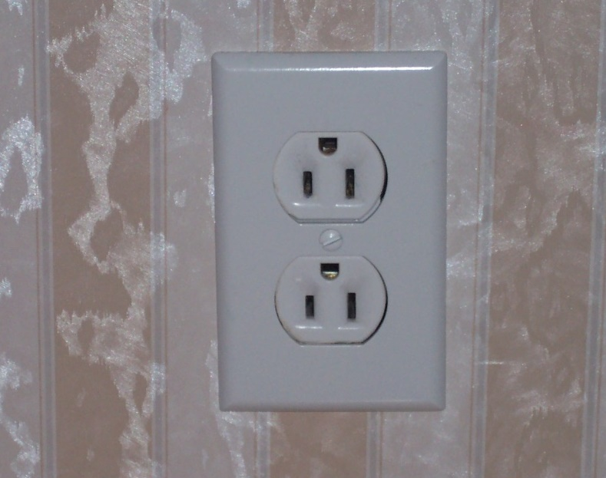
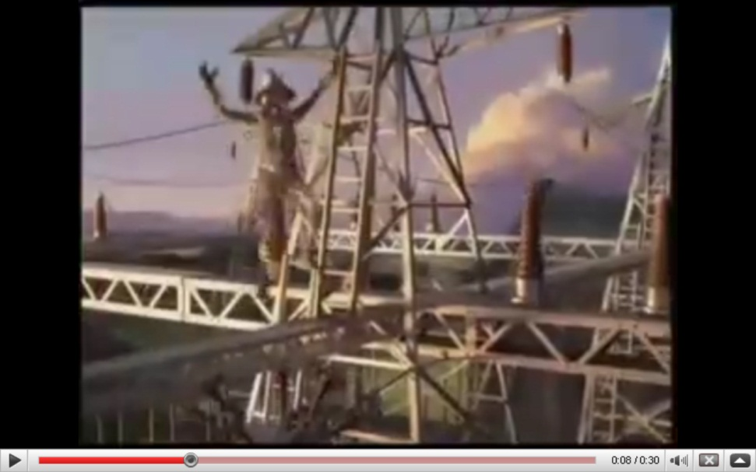
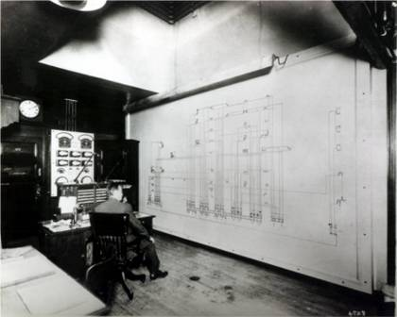
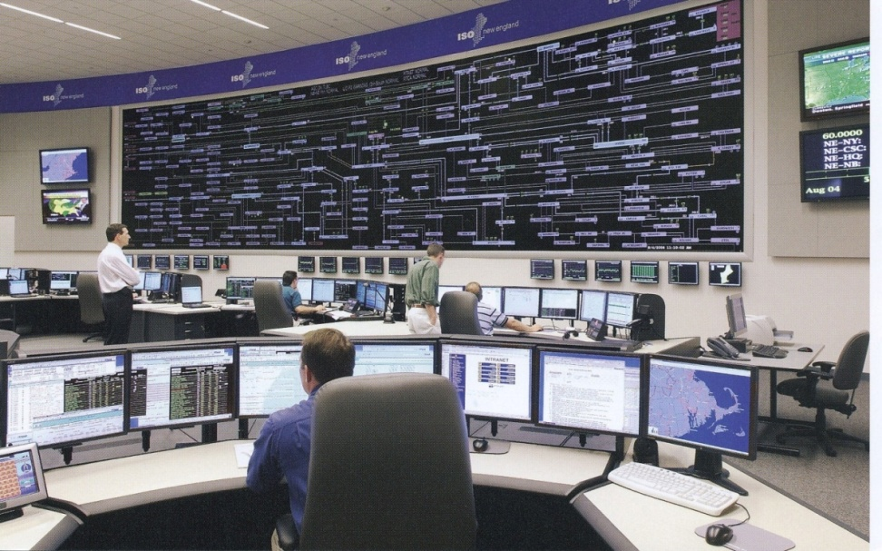
Smart Grid Perceptions (Some of Us Like the Term “Smarter”)

Slide 50
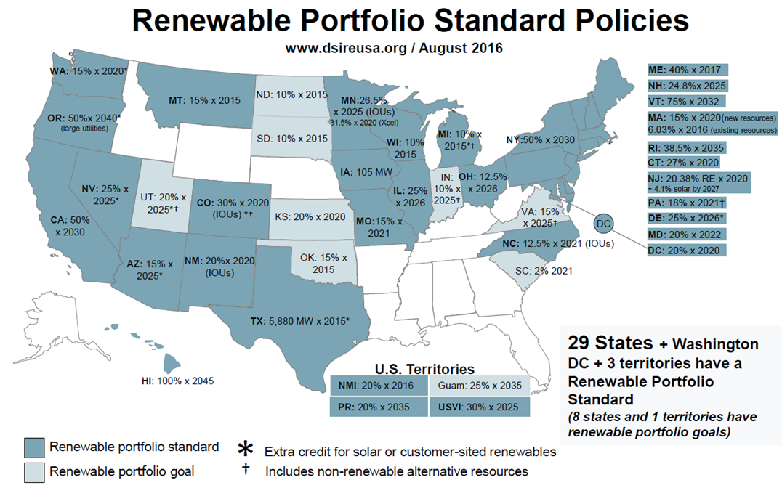
Renewable Portfolio Standards (August 2016)
TX is now 10 GW by 2025 which we’ve met (i.e., 29 GW of wind now); CA is 60% by 2030 and 100% by 2045
Image source: http://www.dsireusa.org/
See also www.ncsl.org/research/energy/renewable-portfolio-standards.aspx

Slide 51
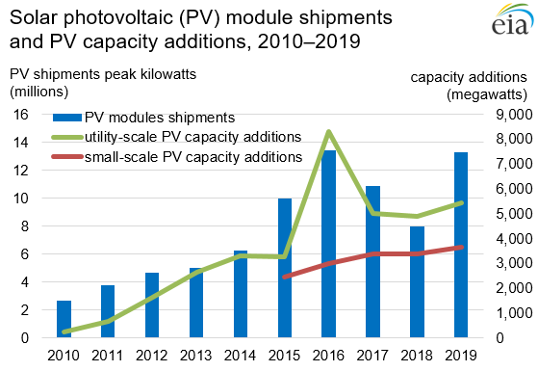
Growth in Solar PV and Wind
Source: www.eia.gov/electricity/monthly/update/

Slide 52
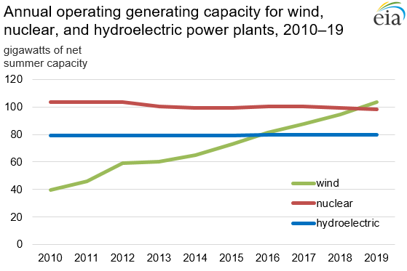
Wind now surpasses nuclear and hydro
Source: www.eia.gov/electricity/monthly/update/ (April 2020)

Slide 53
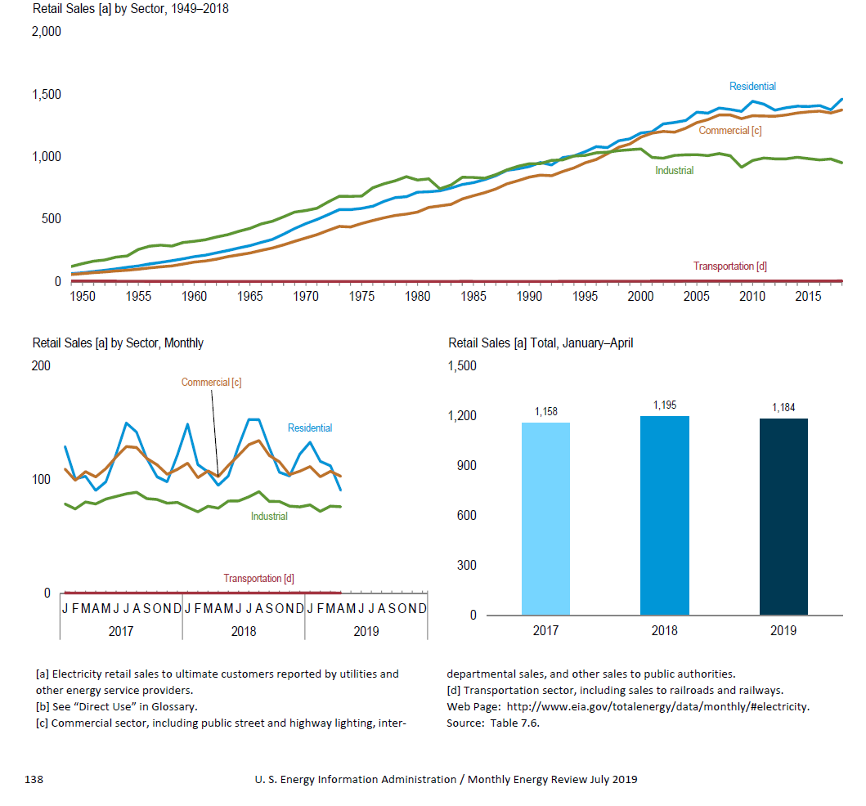
Slowing Electric Load Growth
Much of the slowing load growth is due to distributed generation, such as solar PV, which sits on the customer side of the meter
Source: EIA Monthly Energy Review, July 2019

Slide 54
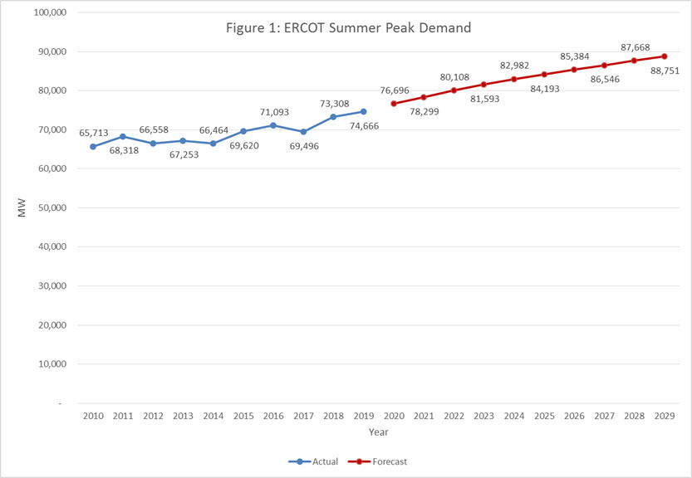
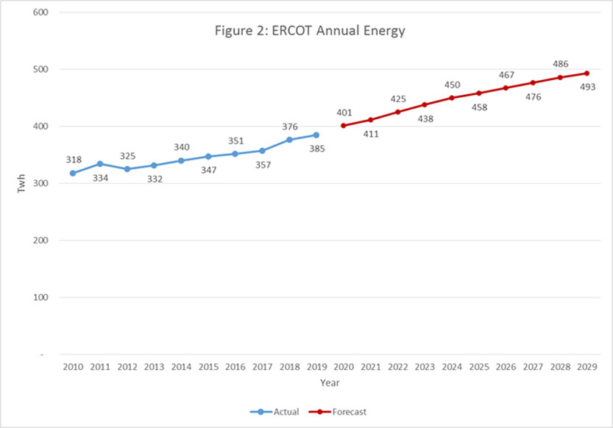
Except in Texas!
The left graph is peak demand, the right energy
ERCOT set a new peak electric load of 74.5 GW on 8/12/19, surpassing the 73.3 GW record from 2018; total energy in 2017 was 357 billion kWh
Source: www.ercot.com/gridinfo/load/forecast

Slide 55
Interconnected Power System Basic Characteristics
Three – phase AC systems:
generation and transmission equipment is usually three phase
industrial loads are three phase
residential and commercial loads are single phase and distributed equally among the phases; consequently, a balanced three – phase system results
Synchronous machines generate electricity
Exceptions: some wind is induction generators; solar PV
Interconnection transmits power over a wider region with subsystems operating at different voltage levels

