Slide 1
ECEN 615
Methods of Electric Power
Systems Analysis
Lecture 11 Sensitivity
Prof. Tom Overbye
Dept. of Electrical and Computer Engineering
Texas A&M University
overbye@tamu.edu

Slide 2
Announcements
Homework 3 should be done before the first exam but need not be turned in
Start reading Chapter 7 (the term reliability is now often used instead of security)
First exam is in class on Thursday Oct 1
  Distance learning students do not need to take the exam during the class period
  Closed book, notes. One 8.5 by 11 inch notesheet and calculators allowed
  Last’s years exam is available in Canvas with answers
  Lecture 12 will be on the August 14, 2003 Blackout
1

Slide 3
Power Flow Topology Processing
Anytime a status change occurs the power flow must perform topology processing to determine whether there are either 1) new islands or 2) islands have merged
Determination is needed to determine whether the island is “viable.” That is, could it truly function as an independent system, or should the buses just be marked as dead
  A quite common occurrence is when a single load or generator is isolated; in the case of a load it can be immediately killed; generators are more tricky
2

Slide 4
Topology Processing Algorithm
Since topology processing is performed often, it must be quick (order n ln(n))!
Simple, yet quick topology processing algoritm
  Set all buses as being in their own island (equal to bus number)
  Set ChangeInIslandStatus true
  While ChangeInIslandStatus Do
    Go through all the in-service lines, setting the islands for each of the buses to be the smaller island number; if the island numbers are different set ChangeInIslandStatus true
  Determine which islands are viable, assigning a slack bus as necessary
This algorithm does depend on the depth of the system
3

Slide 5
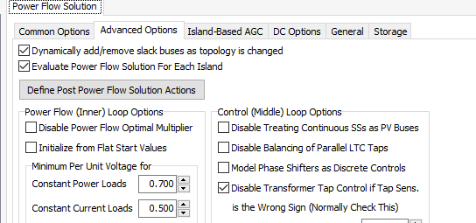
Example of Island Formation
This option allows some islands
to not have a power flow solution
Splitting large systems requires a careful consideration of the flow on the island tie-lines as they are opened
4

Slide 6
Bus Branch versus Node Breaker
Due to a variety of issues during the 1970’s and 1980’s the real-time operations and planning stages of power systems adopted different modeling approaches
Real-Time Operations
Use detailed node/breaker model
EMS system as a set of integrated applications and processes
Real-time operating system
Real-time databases
Planning
Use simplified bus/branch model
PC approach
Use of files
Stand-alone applications
  Entire data sets and software tools developed around these two distinct power system models
5

Slide 7
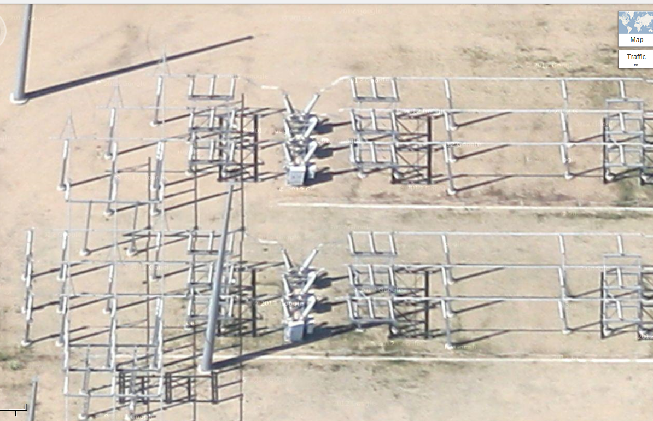
Google View of a 345 kV Substation
6

Slide 8
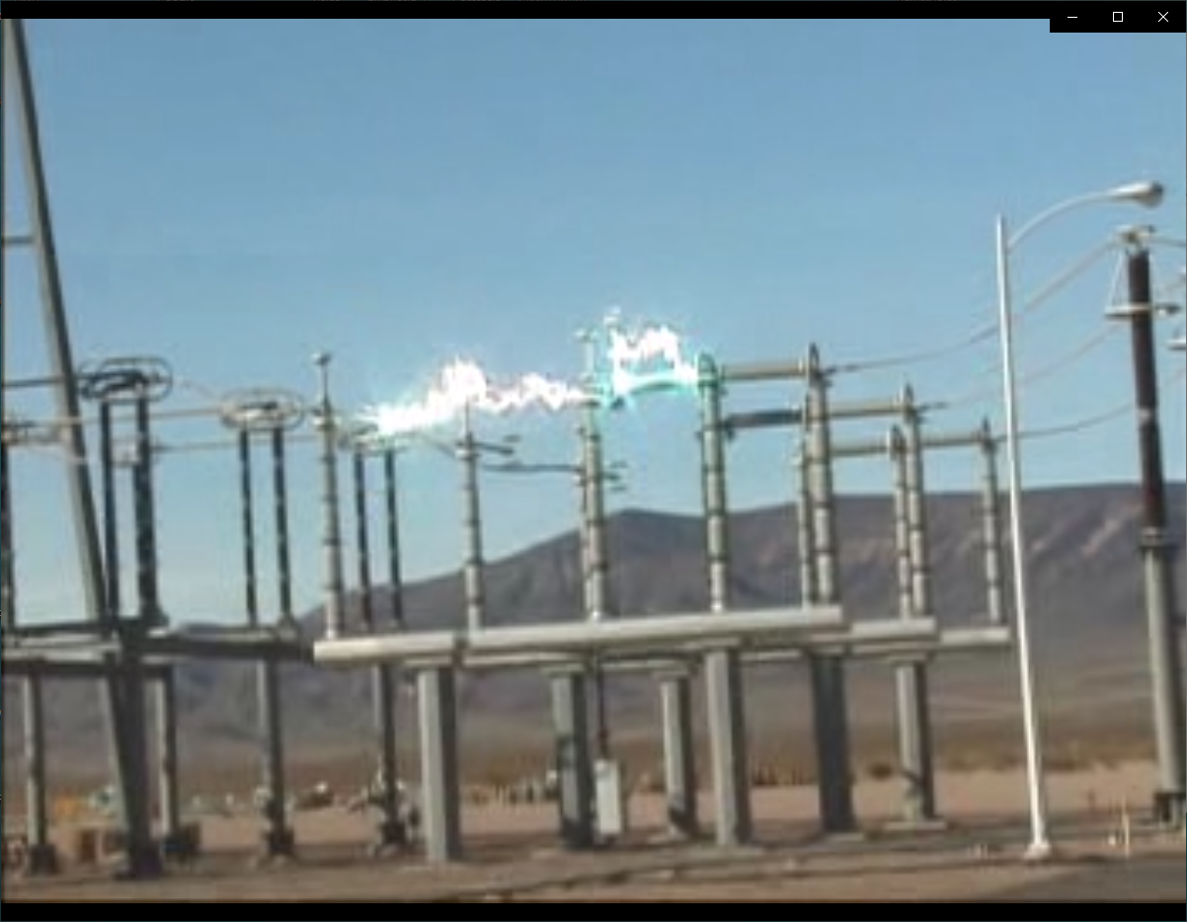
Example of Using a Disconnect to Break Load Current
7

Slide 9
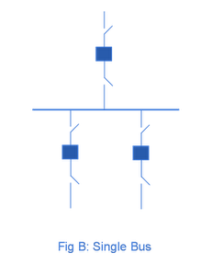
Substation Configurations
Several different substation breaker/disconnect configurations are common:
Single bus: simple but a fault
any where requires taking out the
entire substation; also doing breaker
or disconnect maintenance requires
taking out the associated line
Source: http://www.skm-eleksys.com/2011/09/substation-bus-schemes.html
8

Slide 10
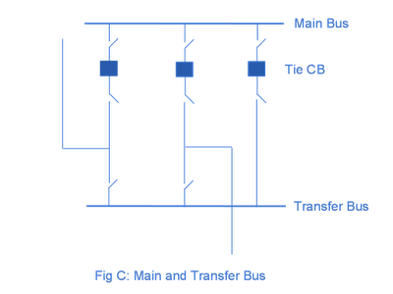
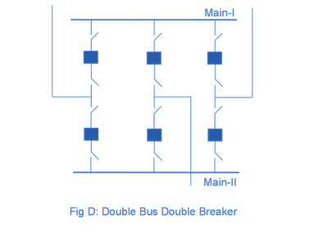
Substation Configurations, cont.
Main and Transfer Bus:
Now the breakers can be taken
out for maintenance without
taking out a line, but protection
is more difficult, and a fault
on one line will take out at least two
Double Bus Breaker:
Now each line is fully protected
when a breaker is out, so high
reliability, but more costly
Source: http://www.skm-eleksys.com/2011/09/substation-bus-schemes.html
9

Slide 11
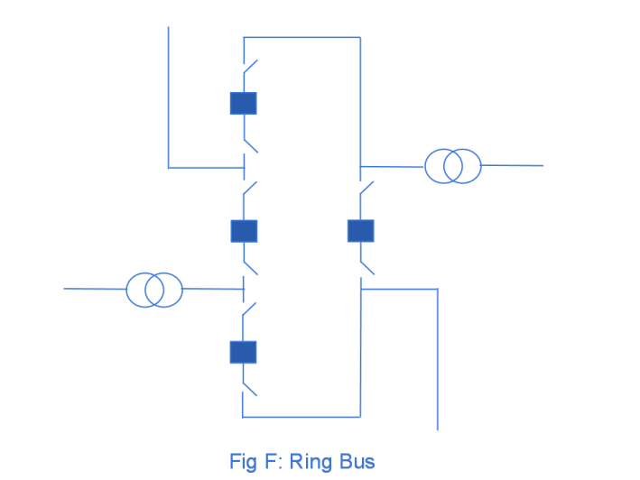
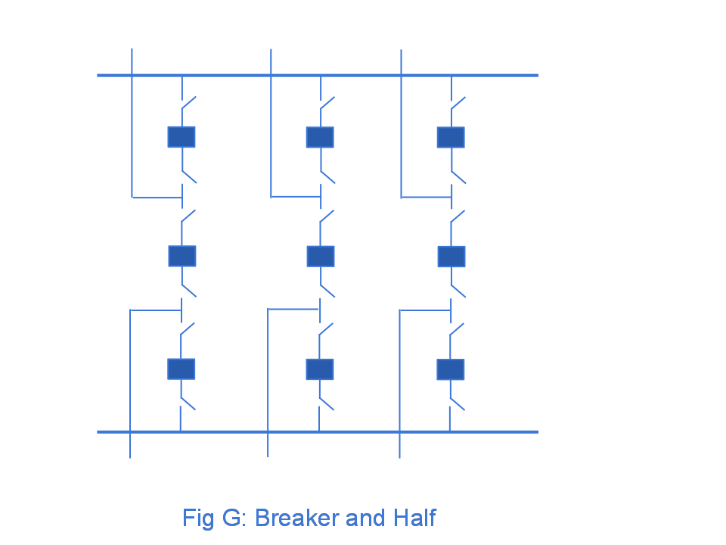
Ring Bus, Breaker and Half
As the name implies with a ring
bus the breakers form a ring;
number of breakers is same as
number of devices; any breaker can
be removed for maintenance
The breaker and half has two buses
and uses three breakers for two
devices; both breakers and buses
can be removed for maintenance
Source: http://www.skm-eleksys.com/2011/09/substation-bus-schemes.html
10

Slide 12
EMS and Planning Models
EMS Model
  Used for real-time operations
  Called full topology model
  Has node-breaker detail
Planning Model
  Used for off-line analysis
  Called consolidated model by PowerWorld
  Has bus/branch detail
-30 MW
-18 Mvar
50 MW
20 Mvar
-30 MW
-18 Mvar
10 MW
3 Mvar
10 MW
3 Mvar
-40 MW
-10 Mvar
10 MW
5 Mvar
-40 MW
-10 Mvar
10 MW
5 Mvar
11

Slide 13
Node-Breaker Consolidation
One approach to modeling systems with large numbers of ZBRs (zero branch reactances, such as from circuit breakers) is to just assume a small reactance and solve
  This results in lots of buses and branches, resulting in a much larger problem
  This can cause numerical problems in the solution
The alterative is to consolidate the nodes that are connected by ZBRs into a smaller number of buses
  After solution all nodes have the same voltage; use logic to determine the device flows
12

Slide 14
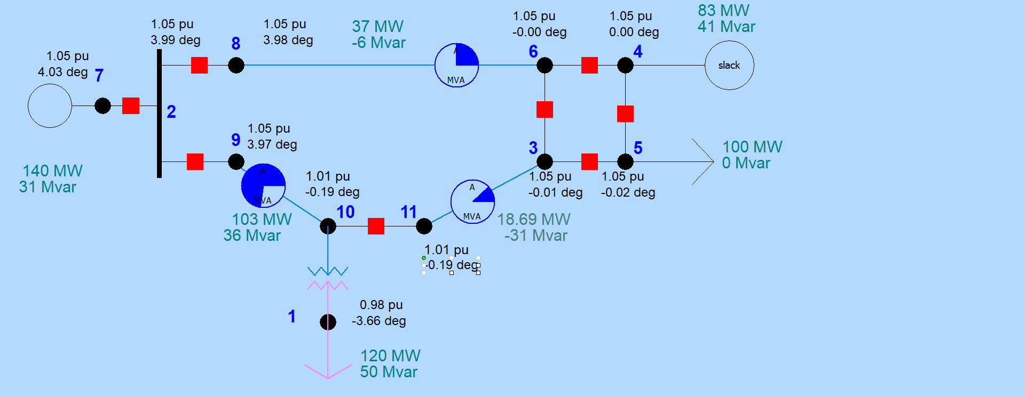
Node-Breaker Example
Case name is FT_11Node. PowerWorld consolidates nodes (buses) into super buses; available in the Model Explorer: Solution, Details, Superbuses.
13

Slide 15
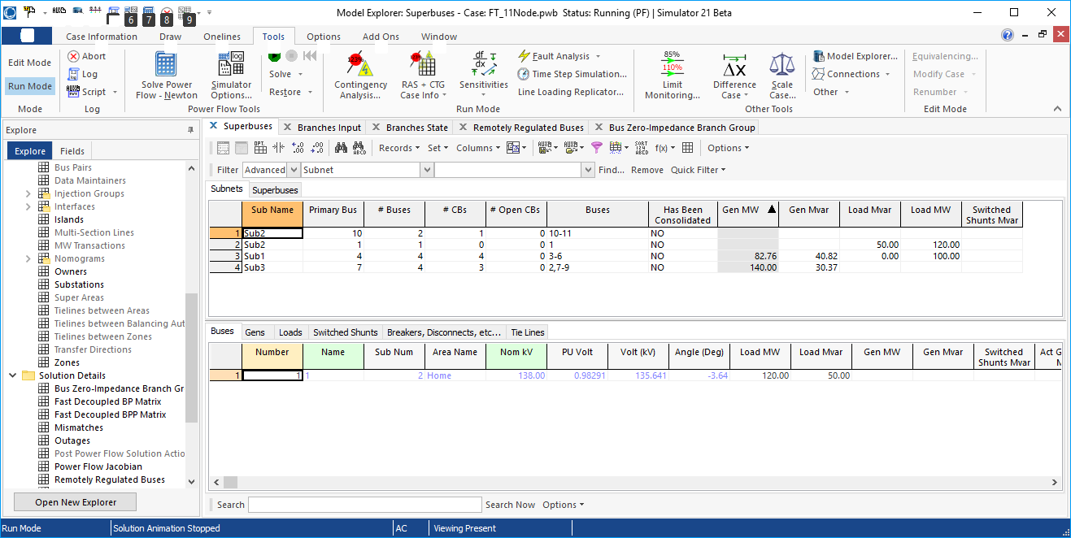
Node-Breaker Example
Note there is ambiguity on how much power is flowing in each device in the ring bus (assuming each device really has essentially no impedance)
14

Slide 16
Contingency Analysis
Contingency analysis is the process of checking the impact of statistically likely contingencies
  Example contingencies include the loss of a generator, the loss of a transmission line or the loss of all transmission lines in a common corridor
  Statistically likely contingencies can be quite involved, and might include automatic or operator actions, such as switching load
Reliable power system operation requires that the system be able to operate with no unacceptable violations even when these contingencies occur
  N-1 reliable operation considers the loss of any single element
15

Slide 17
Contingency Analysis
Of course this process can be automated with the usual approach of first defining a contingency set, and then sequentially applying the contingencies and checking for violations
  This process can naturally be done in parallel
  Contingency sets can get quite large, especially if one considers N-2 (outages of two elements) or N-1-1 (initial outage, followed by adjustment, then second outage
The assumption is usually most contingencies will not cause problems, so screening methods can be used to quickly eliminate many contingencies
  We’ll cover these later
16

Slide 18
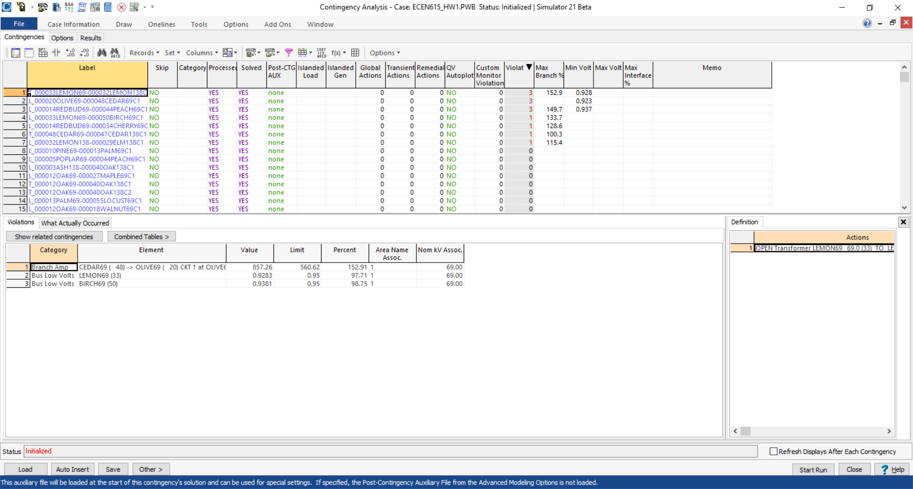
Contingency Analysis in PowerWorld
Automated using the Contingency Analysis tool
17

Slide 19
Power System Control and Sensitivities
A major issue with power system operation is the limited capacity of the transmission system
  lines/transformers have limits (usually thermal)
  no direct way of controlling flow down a transmission line (e.g., there are no valves to close to limit flow)
  open transmission system access associated with industry restructuring is stressing the system in new ways
We need to indirectly control transmission line flow by changing the generator outputs
Similar control issues with voltage
18

Slide 20
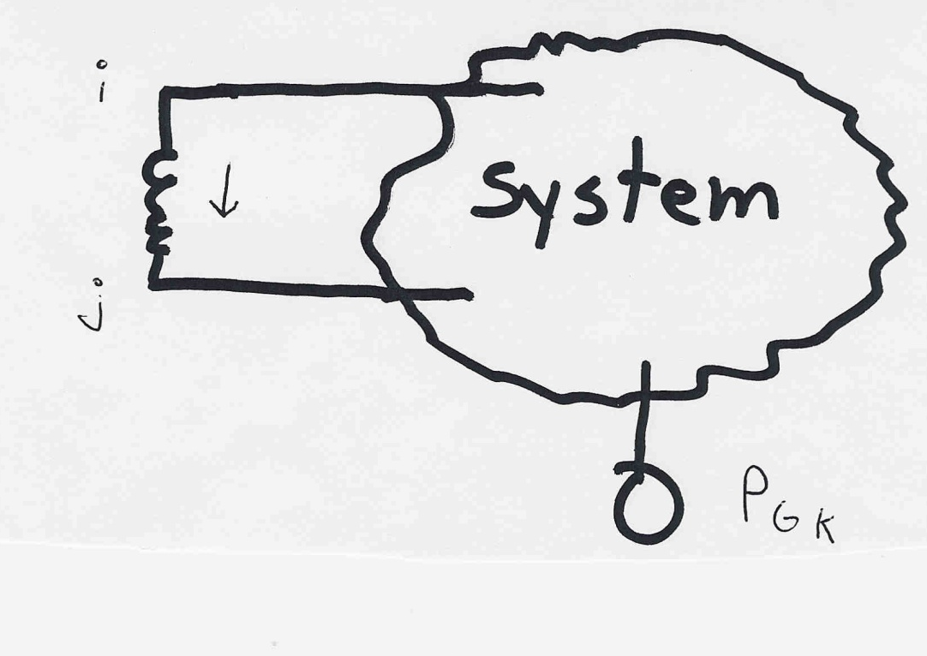
Indirect Transmission Line Control
What we would like to determine is how a change in generation at bus k affects the power flow on a line from bus i to bus j.
The assumption is
that the change
in generation is
absorbed by the
slack bus
19

Slide 21
Power Flow Simulation - Before
One way to determine the impact of a generator change is to compare a before/after power flow.
For example below is a three bus case with an overload
20

Slide 22
Power Flow Simulation - After
Increasing the generation at bus 3 by 95 MW (and hence decreasing it at bus 1 by a corresponding amount), results in a 30.3 MW drop in the MW flow on the line from bus 1 to 2, and a 64.7 MW drop
on the flow from 1 to 3.
Expressed as a
percent,
30.3/95 =32% and
64.7/95=68%
21

Slide 23
Analytic Calculation of Sensitivities
Calculating control sensitivities by repeat power flow solutions is tedious and would require many power flow solutions. An alternative approach is to analytically calculate these values
22

Slide 24
Analytic Sensitivities
23

Slide 25
Three Bus Sensitivity Example
24

Slide 26
More General Sensitivity Analysis: Notation
We consider a system with n buses and L lines given by the set given by the set
  Some authors designate the slack as bus zero; an alternative approach, that is easier to implement in cases with multiple islands and hence slacks, is to allow any bus to be the slack, and just set its associated equations to trivial equations just stating that the slack bus voltage is constant
We may denote the k^{th} transmission line or transformer in the system, _{k} , as
from node
to node
25

Slide 27
Notation, cont.
We’ll denote the real power flowing on _{k} from bus i to bus j as ƒ_{k}
The vector of real power flows on the L lines is:
which we simplify to
The bus real and reactive power injection vectors are
26

Slide 28
Notation, cont.
The series admittance of line  is g +jb and we define
We define the L×N incidence matrix
The component j of a_{i} is
nonzero whenever line _{i} is
coincident with node j. Hence
A is quite sparse, with two
nonzeros per row
27

Slide 29
Analysis Example: Available Transfer Capability
The power system available transfer capability or ATC is defined as the maximum additional MW that can be transferred between two specific areas, while meeting all the specified pre- and post-contingency system conditions
ATC impacts measurably the market outcomes and system reliability and, therefore, the ATC values impact the system and market behavior
A useful reference on ATC is Available Transfer Capability Definitions and Determination from NERC, June 1996 (available online)
28

Slide 30
ATC and Its Key Components
Total transfer capability (TTC )
  Amount of real power that can be transmitted across an interconnected transmission network in a reliable manner, including considering contingencies
Transmission reliability margin (TRM)
  Amount of TTC needed to deal with uncertainties in system conditions; typically expressed as a percent of TTC
Capacity benefit margin (CBM)
  Amount of TTC needed by load serving entities to ensure access to generation; typically expressed as a percent of TTC
29

Slide 31
ATC and Its Key Components
Uncommitted transfer capability (UTC)
UTC  TTC – existing transmission commitment
Formal definition of ATC is
ATC  UTC – CBM – TRM
We focus on determining U_{m,n}, the UTC from node m to node n
U_{m,n} is defined as the maximum additional MW that can be transferred from node m to node n without violating any limit in either the base case or in any post-contingency conditions
30

Slide 32
UTC (or TTC) Evaluation
Goal is
to load
the lines
up to
a limit
is hit
for the base case j = 0 and each contingency case
j = 1,2 … , J
31

Slide 33
Conceptual Solution Algorithm
Solve the initial power flow, corresponding to the initial system dispatch (i.e., existing commitments); set the change in transfer Δt⁽⁰⁾ = 0, k=0; set step size δ; j is used to indicate either the base case (j=0) or a contingency, j= 1,2,3…J
Compute Δt^{(k+1)} = Δt^{(k)} + δ
Solve the power flow for the new Δt^{(k+1)}
Check for limit violations: if violation is found
set U^{j}_{m,n} = Δt^{(k)} and stop; else set k=k+1, and goto 2
32

Slide 34
Conceptual Solution Algorithm, cont.
This algorithm is applied for the base case (j=0) and each specified contingency case, j=1,2,..J
The final UTC, U_{m,n} is then determined by
This algorithm can be easily performed on parallel processors since each contingency evaluation is independent of the other
33

Slide 35
Five Bus Example: Reference
PowerWorld Case: B5_DistFact
34

Slide 36
Five Bus Example: Reference
 |  |  |  |  | ( MW )
 | 1 | 2 | 0 | 6.25 | 150
 | 1 | 3 | 0 | 12.5 | 400
 | 1 | 4 | 0 | 12.5 | 150
 | 2 | 3 | 0 | 12.5 | 150
 | 3 | 4 | 0 | 12.5 | 150
 | 4 | 5 | 0 | 10 | 1,000
35

Slide 37
Five Bus Example
We evaluate U_{2,3} using the previous procedure
  Gradually increase generation at Bus 2 and load at Bus 3
We consider the base case and the single contingency with line 2 outaged (between 1 and 3): J = 1
Simulation results show for the base case that
And for the contingency that
Hence
36

Slide 38
Five Bus: Maximum Base Case Transfer
37

Slide 39
Five Bus: Maximum Contingency Transfer
38

Slide 40
Computational Considerations
Obviously such a brute force approach can run into computational issues with large systems
Consider the following situation:
  10 iterations for each case
  6,000 contingencies
  2 seconds to solve each power flow
It will take over 33 hours to compute a single UTC for the specified transfer direction from m to n.
Consequently, there is an acute need to develop fast tools that can provide satisfactory estimates
39

Slide 41
Sensitivity Problem Formulation
Denote the system state by
Denote the conditions corresponding to the existing commitment/dispatch by s⁽⁰⁾, p⁽⁰⁾ and f⁽⁰⁾ so that
the power flow equations
line real power flow vector
40

Slide 42
Sensitivity Problem Formulation
g includes the real and reactive
power balance equations
41

Slide 43
Sensitivity Problem Formulation
For a small change, Δp, that moves the injection from p⁽⁰⁾ to p⁽⁰⁾ + Δp , we have a corresponding change in the state Δx with
We then apply a first order Taylor’s series expansion
42

Slide 44
Sensitivity Problem Formulation
We consider this to be a “small signal” change, so we can neglect the higher order terms (h.o.t.) in the expansion
Hence we should still be satisfying the power balance equations with this perturbation; so
43

Slide 45
Sensitivity Problem Formulation
Also, from the power flow equations, we obtain
and then just the power flow Jacobian
44

Slide 46
Sensitivity Problem Formulation
With the standard assumption that the power flow Jacobian is nonsingular, then
We can then compute the change in the line real power flow vector
45

Slide 47
Sensitivity Comments
Sensitivities can easily be calculated even for large systems
  If Δp is sparse (just a few injections) then we can use a fast forward; if sensitivities on a subset of lines are desired we could also use a fast backward
Sensitivities are dependent upon the operating point
  They also include the impact of marginal losses
Sensitivities could easily be expanded to include additional variables in x (such as phase shifter angle), or additional equations, such as reactive power flow
46

Slide 48
Sensitivity Comments, cont.
Sensitivities are used in the optimal power flow; in that context a common application is to determine the sensitivities of an overloaded line to injections at all the buses
In the below equation, how could we quickly get these values?
  A useful reference is O. Alsac, J. Bright, M. Prais, B. Stott, “Further Developments in LP-Based Optimal Power Flow,” IEEE. Trans. on Power Systems, August 1990, pp. 697-711; especially see equation 3.
47

Slide 49
Sensitivity Example in PowerWorld
Open case B5_DistFact and then Select Tools, Sensitivities, Flow and Voltage Sensitivities
  Select Single Meter, Multiple Transfers, Buses page
  Select the Device Type (Line/XFMR), Flow Type (MW), then select the line (from Bus 2 to Bus 3)
  Click Calculate Sensitivities; this shows impact of a single injection going to the slack bus (Bus 1)
  For our example of a transfer from 2 to 3 the value is the result we get for bus 2 (0.5440) minus the result for bus 3
  (-0.1808) = 0.7248
  With a flow of 118 MW, we would hit the 150 MW limit
  with (150-118)/0.7248 =44.1MW, close to the limit we
  found of 45MW
48

Slide 50
Sensitivity Example in PowerWorld
If we change the conditions to the anticipated maximum loading (changing the load at 2 from 118 to 118+44=162 MW) and we re-evaluate the sensitivity we note it has changed little
(from -0.7248 to -0.7241)
  Hence a linear approximation (at least for this scenario) could be justified
With what we know so far, to handle the contingency situation, we would have to simulate the contingency, and reevaluate the sensitivity values
  We’ll be developing a quicker (but more approximate) approach next
49

