Slide 1
ECEN 615
Methods of Electric Power
Systems Analysis
Lecture 6: Power Operations, Power Flow
Prof. Tom Overbye
Dept. of Electrical and Computer Engineering
Texas A&M University
overbye@tamu.edu

Slide 2
Announcements
Read Chapter 6 from the book
    The book formulates the power flow using the polar form for the Y_{bus} elements
Homework 2 is due on Thursday September 17

Slide 3
Three Bus PowerWorld Simulator Case
PowerWorld Case Name: B3Slow
Load with
green
arrows
indicating
amount
of MW
flow
Note the
power
balance at
each bus
Used
to control
output of
generator
Direction of green arrow is used to indicate
direction of real power (MW) flow; the blue
arrows show the reactive power

Slide 4
Basic Power Control
Opening a circuit breaker causes the power flow to instantaneously (nearly) change.
No other way to directly control power flow in a transmission line.
By changing generation we can indirectly change this flow.
Power flow in transmission line is limited by heating considerations
Losses (I^2 R) can heat up the line, causing it to sag.

Slide 5
Transmission Line Limits
Power flow in transmission line is limited by heating considerations.
Losses (I² R) can heat up the line, causing it to sag.
Each line has a limit; many utilities use winter/summer limits.

Slide 6
Overloaded Transmission Line

Slide 7
Interconnected Operation
Balancing Authority (BA) Areas
North American Eastern and Western grids are divided into balancing authority areas (BA)
  Often just called an area
Transmission lines that join two areas are known as tie-lines.
The net power out of an area is the sum of the flow on its tie-lines.
The flow out of an area is equal to
total gen - total load - total losses = tie-flow

Slide 8
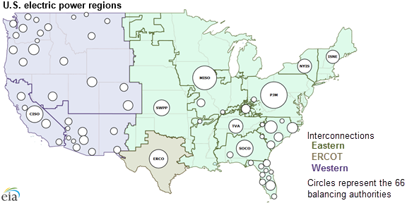
US Balancing Authorities

Slide 9
Area Control Error (ACE)
The area control error is the difference between the actual flow out of an area, and the scheduled flow
  ACE also includes a frequency component that we will probably consider later in the semester
Ideally the ACE should always be zero
Because the load is constantly changing, each utility (or ISO) must constantly change its generation to “chase” the ACE
ACE was originally computed by utilities; increasingly it is computed by larger organizations such as ISOs

Slide 10
Automatic Generation Control
Most utilities (ISOs) use automatic generation control (AGC) to automatically change their generation to keep their ACE close to zero.
Usually the control center calculates ACE based upon tie-line flows; then the AGC module sends control signals out to the generators every couple seconds.

Slide 11
Three Bus Case on AGC
Generation
is automatically
changed to match
change in load
Net tie flow is
close to zero

Slide 12
Generator Costs
There are many fixed and variable costs associated with power system operation
The major variable cost is associated with generation.
Cost to generate a MWh can vary widely
For some types of units (such as hydro and nuclear) it is difficult to quantify
More others such as wind and solar the marginal cost of energy is essentially zero (actually negative for wind!)
For thermal units it is straightforward to determine
Many markets have moved from cost-based to price-based generator costs

Slide 13
Economic Dispatch
Economic dispatch (ED) determines the least cost dispatch of generation for an area.
For a lossless system, the ED occurs when all the generators have equal marginal costs.
IC₁(P_{G,1}) = IC₂(P_{G,2}) = … = IC_{m}(P_{G,m})

Slide 14
Power Transactions
Power transactions are contracts between areas to do power transactions.
Contracts can be for any amount of time at any price for any amount of power.
Scheduled power transactions are implemented by modifying the area ACE:
ACE = P_{actual,tie-flow} - P_{sched}

Slide 15
100 MW Transaction
Net tie-line
flow is now
100 MW
Scheduled 100 MW transaction
from the Home Area to the
Other Area

Slide 16
Security Constrained ED
Transmission constraints often limit system economic operation.
Such limits required a constrained dispatch in order to maintain system security.
In the three bus case the generation at bus 3 must be constrained to avoid overloading the line from bus 2 to bus 3.

Slide 17
Security Constrained Dispatch
Dispatch is no longer optimal due to need to keep the line
from bus 2 to bus 3 from overloading

Slide 18
Multi-Area Operation
If areas have direct interconnections then they may directly transact, up to the capacity of their tie-lines.
Actual power flows through the entire network according to the impedance of the transmission lines.
Flow through other areas is known as “parallel path” or “loop flow.”

Slide 19
Seven Bus Case: One-line
System has three areas
Area Top
has five
buses
Area Left
has one
bus
Area Right has one bus
PowerWorld Case: B7Flat

Slide 20
Seven Bus Case: Area View
Actual
flow
between
areas
System has
40 MW of
“Loop Flow”
Scheduled
flow

Slide 21
Seven Bus - Loop Flow?
Transaction has actually decreased
the loop flow
Note that
Top’s
losses have
increased
from
7.1 MW to
9.6 MW
100 MW Transaction
between Left and Right

Slide 22
Pricing Electricity
Cost to supply electricity to bus is called the locational marginal price (LMP)
Presently some electric markets post LMPs on the web
In an ideal electricity market with no transmission limitations the LMPs are equal
Transmission constraints can segment a market, resulting in differing LMP
Determination of LMPs requires the solution on an Optimal Power Flow (OPF), which will be covered later in the semester

Slide 23
Three Bus LMPs – Constraints Ignored
Gen 2’s
cost
is $12
per
MWh
Gen 1’s
cost
is $10
per
MWh
Line from Bus 1 to Bus 3 is over-loaded; all buses have same marginal cost
PowerWorld Case: B3LP

Slide 24
Three Bus LMPs – Constraint Unforced
Line from 1 to 3 is no longer overloaded, but now
the marginal cost of electricity at bus 3 is $14 / MWh

Slide 25
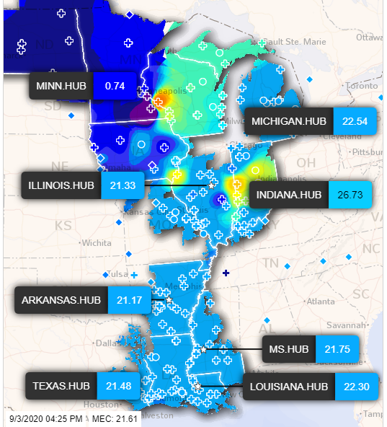
MISO LMPs on 9/3/2020, 4:30 PM
Five minute
LMPs are
posted online
for the MISO
footprint
Source: https://www.misoenergy.org/markets-and-operations/real-time--market-data/real-time-displays/

Slide 26
Advanced Power Flow
Next slides cover some more advanced power flow topics that need to be considered in many commercial power flow studies
An important consideration in the power flow is the assumed time scale of the response, and the assumed model of operator actions
  Planning power flow studies usually assume automatic modeling of operator actions and a longer time frame of response (controls have time to reach steady-state)
    For example, who is actually doing the volt/var control
  In real-time applications operator actions are usually not automated and controls may be more limited in time

Slide 27
Quasi-Newton Power Flow Methods
First we consider some modified versions of the Newton power flow (NPF)
Since most of the computation in the NPF is associated with building and factoring the Jacobian matrix, J, the focus is on trying to reduce this computation
In a pure NPF J is build and factored each iteration
Over the years pretty much every variation of the NPF has been tried; here we just touch on the most common
Whether a method is effective can be application dependent
  For example, in contingency analysis we are usually just resolving a solved case with an often small perturbation

Slide 28
Quasi-Newton Power Flow Methods
The simplest modification of the NPF results when J is kept constant for a number of iterations, say k iterations
  Sometimes known as the Dishonest Newton
The approach balances increased speed per iteration, with potentially more iterations to perform
There is also an increased possibility for divergence
Since the mismatch equations are not modified, if it converges it should converge to the same solution as the NPF
These methods are not commonly used, except in very short duration, sequential power flows with small mismatches

Slide 29
Dishonest N-R Example
We pay a price
in increased
iterations, but
with decreased
computation
per iteration; that
price is too high
in this example

Slide 30
Decoupled Power Flow
Rather than not updating the Jacobian, the decoupled power flow takes advantage of characteristics of the power grid in order to decouple the real and reactive power balance equations
  There is a strong coupling between real power and voltage angle, and reactive power and voltage magnitude
  There is a much weaker coupling between real power and voltage angle, and reactive power and voltage angle
Key reference is B. Stott, “Decoupled Newton Load Flow,” IEEE Trans. Power. App and Syst., Sept/Oct. 1972, pp. 1955-1959

Slide 31
Decoupled Power Flow Formulation

Slide 32
Decoupling Approximation

Slide 33
Off-diagonal Jacobian Terms
By assuming ½ the elements are zero, we only have to do
½ the computations

Slide 34
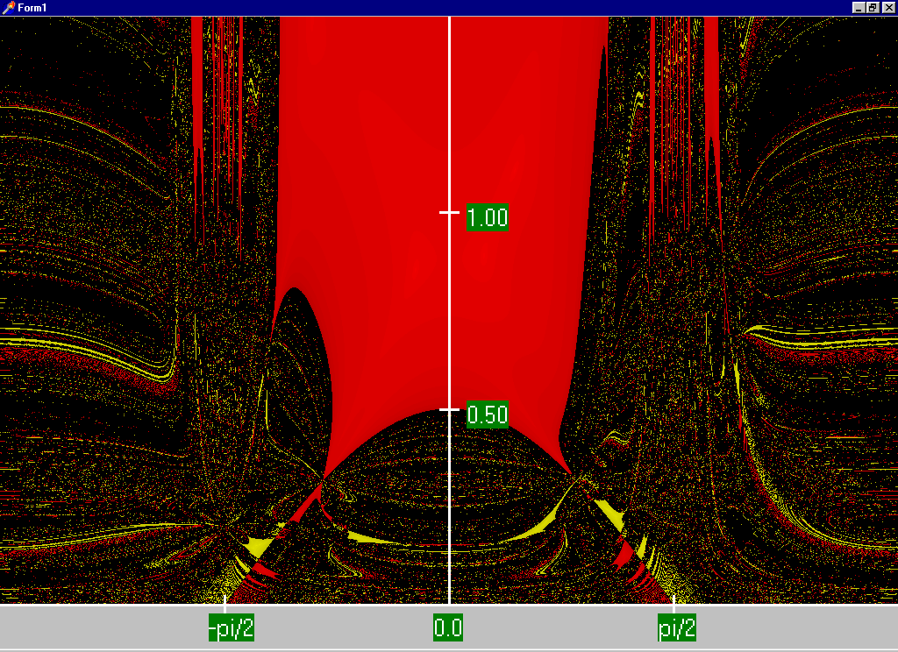
Decoupled N-R Region of Convergence
The high
solution ROC is actually
larger than with the standard
NPF. Obviously
this is not
a good a way to get the low
solution

Slide 35
Fast Decoupled Power Flow
By continuing with our Jacobian approximations we can actually obtain a reasonable approximation that is independent of the voltage magnitudes/angles.
This means the Jacobian need only be built/inverted once per power flow solution
This approach is known as the fast decoupled power flow (FDPF)

Slide 36
Fast Decoupled Power Flow, cont.
FDPF uses the same mismatch equations as standard power flow (just scaled) so it should have same solution
The FDPF is widely used, though usually only when we only need an approximate solution
Key fast decoupled power flow reference is B. Stott, O. Alsac, “Fast Decoupled Load Flow,” IEEE Trans. Power App. and Syst., May 1974, pp. 859-869
Modified versions also exist, such as D. Jajicic and A. Bose, “A Modification to the Fast Decoupled Power Flow for Networks with High R/X Ratios, “IEEE Transactions on Power Sys., May 1988, pp. 743-746

Slide 37
FDPF Approximations
To see the impact on the real power equations recall

Slide 38
FDPF Approximations
With the approximations for the diagonal term we get
Hence the Jacobian for the real equations can be approximated as –B

Slide 39
FPDF Approximations
For the reactive power equations we also scale by V_{i}
For the Jacobian off-diagonals we get

Slide 40
FDPF Approximations
And for the reactive power Jacobian diagonal we get
As derived the real and reactive equations have a constant Jacobian equal to –B
  Usually modifications are made to omit from the real power matrix elements that affect reactive flow (like shunts) and from the reactive power matrix elements that affect real power flow, like phase shifters
  We’ll call the real power matrix B’ and the reactive B”

Slide 41
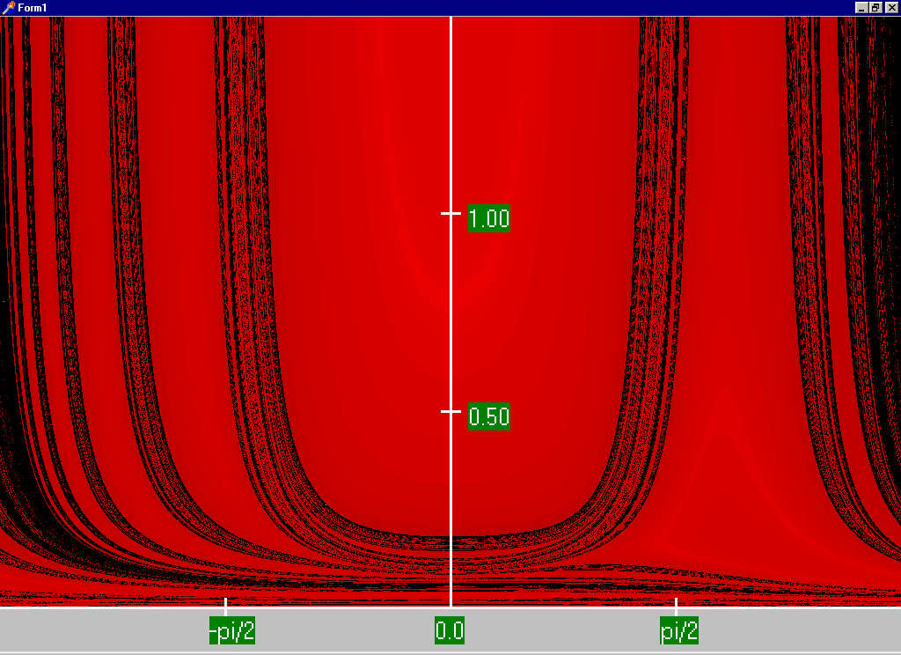
FDPF Region of Convergence

Slide 42
FDPF Cautions
The FDPF works well as long as the previous approximations hold for the entire system
With the movement towards modeling larger systems, with more of the lower voltage portions of the system represented (for which r/x ratios are higher) it is quite common for the FDPF to get stuck because small portions of the system are ill-behaved
The FDPF is commonly used to provide an initial guess of the solution or for contingency analysis

Slide 43
DC Power Flow
The “DC” power flow makes the most severe approximations:
  completely ignore reactive power, assume all the voltages are always 1.0 per unit, ignore line conductance
This makes the power flow a linear set of equations, which can be solved directly
The term dc power flow actually dates from the time of the old network analyzers (going back into the 1930’s)
Not to be confused with the inclusion of HVDC lines in the standard NPF
P sign convention is generation is positive

Slide 44
DC Power Flow References
I don’t think a classic dc power flow paper exists; a nice formulation is given in our book Power Generation and Control book by Wood, Wollenberg and Sheble
The August 2009 paper in IEEE Transactions on Power Systems, “DC Power Flow Revisited” (by Stott, Jardim and Alsac) provides good coverage
T. J. Overbye, X. Cheng, and Y. Sun, “A comparison of the AC and DC power flow models for LMP Calculations,” in Proc. 37th Hawaii Int. Conf. System Sciences, 2004, compares the accuracy of the approach

Slide 45
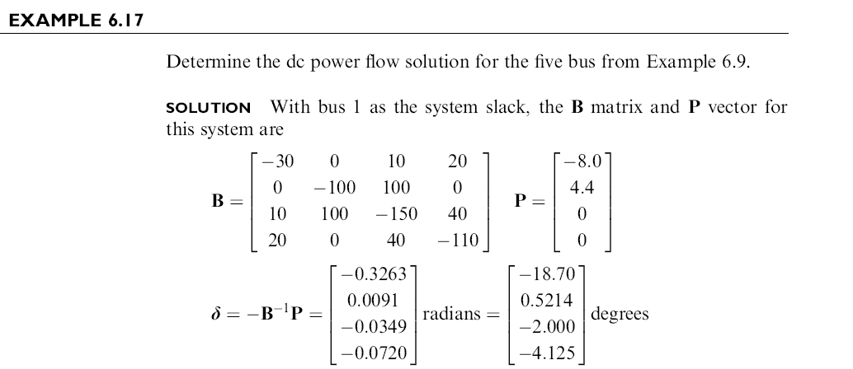
DC Power Flow Example
Example from Power System Analysis and Design, by Glover, Overbye, Sarma, 6th Edition

Slide 46
DC Power Flow in PowerWorld
PowerWorld allows for easy switching between the dc and ac power flows (case Aggieland37)
To use the
dc approach
in PowerWorld
select Tools,
Solve, DC
Power Flow
Notice there
are no
losses

Slide 47
Modeling Transformers with Off-Nominal Taps and Phase Shifts
If transformers have a turns ratio that matches the ratio of the per unit voltages than transformers are modeled in a manner similar to transmission lines.
However it is common for transformers to have a variable tap ratio; this is known as an “off-nominal” tap ratio
  The off-nominal tap is t, initially we’ll consider it a real number
  We’ll cover phase shifters shortly in which t is complex

Slide 48
Transformer Representation
The one–line diagram of a branch with a variable tap transformer
The network representation of a branch with off–nominal turns ratio transformer is
k
m
t :1
k
the tap is on
the side of bus k

Slide 49
Transformer Nodal Equations
From the network representation
Also

Slide 50
Transformer Nodal Equations
We may rewrite these two equations as
Y_{bus} is still symmetric
here (though this will
change with phase
shifters)
This approach was first presented in F.L. Alvarado, “Formation of Y-Node using the Primitive Y-Node Concept,” IEEE Trans. Power App. and Syst., December 1982

Slide 51
The π-Equivalent Circuit for a Transformer Branch
k
m

Slide 52
Variable Tap Voltage Control
A transformer with a variable tap, i.e., the variable t is not constant, may be used to control the voltage at either the bus on the side of the tap or at the bus on the side away from the tap
This constitutes an example of single criterion control since we adjust a single control variable (i.e., the transformer tap t) to achieve a specified criterion: the maintenance of a constant voltage at a designated bus
Names for this type of control are on-load tap changer (LTC) transformer or tap changing under load (TCUL)
Usually on low side; there may also be taps on high side that can be adjusted when it is de-energized

Slide 53
Variable Tap Voltage Control
An LTC is a discrete control, often with 32 incremental steps of 0.625% each, giving an automatic range of ± 10%
It follows from the π – equivalent model for the transformer that the transfer admittance between the buses of the transformer branch and the contribution to the self admittance at the bus away from the tap explicitly depend on t
However, the tap changes in discrete steps; there is also a built in time delay in how fast they respond
Voltage regulators are devices with a unity nominal ratio, and then a similar tap range

Slide 54
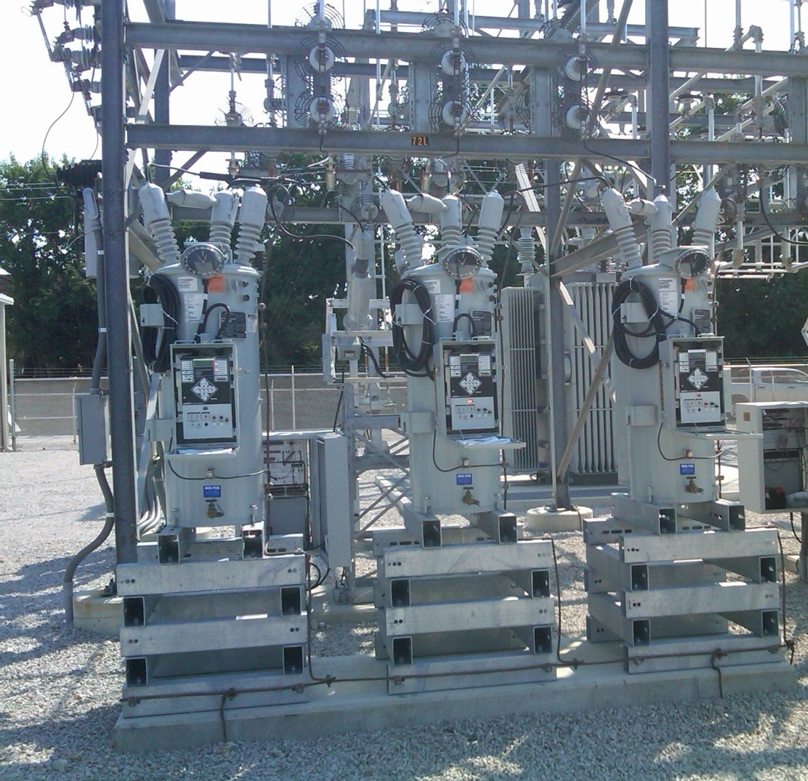
Ameren Champaign (IL) Test Facility Voltage Regulators
These are connected
on the low side of a
69/12.4 kV
transformer; each
phase can be
regulated separately

