Slide 1
ECEN 615
Methods of Electric Power
Systems Analysis
Lecture 17:EMSs, SVD, Pseudo Inverse, Equivalents
Prof. Tom Overbye
Dept. of Electrical and Computer Engineering
Texas A&M University
overbye@tamu.edu

Slide 2
Announcements
Skim Chapters 3, 4 and 5
Starting reading Chapter 8
Homework 5 is due on Thursday Oct 29
1

Slide 3
Energy Management Systems (EMSs)
EMSs are now used to control most large scale electric grids
EMSs developed in the 1970’s and 1980’s out of SCADA systems
  An EMS usually includes a SCADA system; sometimes called a SCADA/EMS
Having a SE is almost the definition of an EMS. The SE then feeds data to the more advanced functions
EMSs have evolved as the industry as evolved as the industry has evolved, with functionality customized for the application (e.g., a reliability coordinator or a vertically integrated utility)
2

Slide 4
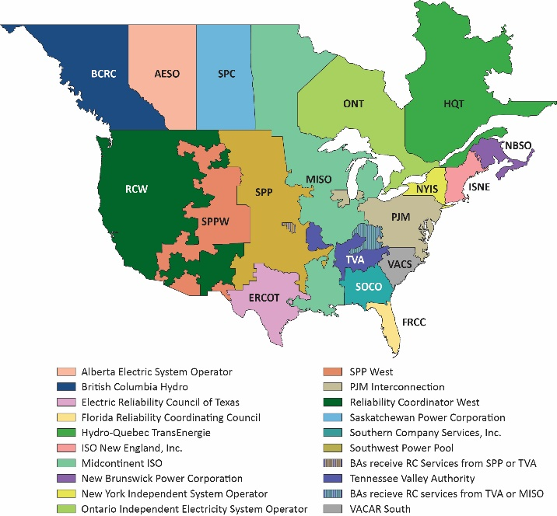
NERC Reliability Coordinators
Source: www.nerc.com/pa/rrm/TLR/Pages/Reliability-Coordinators.aspx
3

Slide 5

EEI Member Companies
4

Slide 6
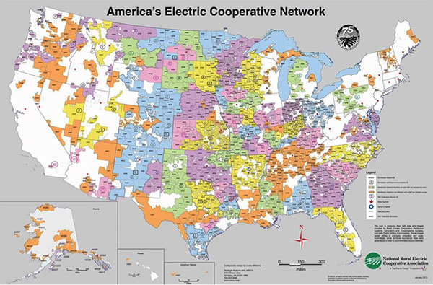
Electric Coops
5

Slide 7

Texas Electric Coops
6

Slide 8

ERCOT Control Center with EMS
7
Source: www.texastribune.org/2016/05/17/texas-market-forces-driving-shift-coal-study-says/

Slide 9
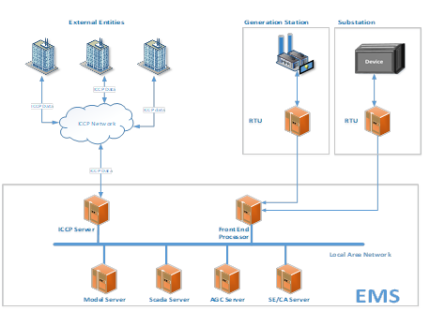
ERCOT EMS
Slide source: ERCOT, D. Penney, J. Mandavilli, M. Henry, “Loss of SCADA, EMS or LCC”
8

Slide 10
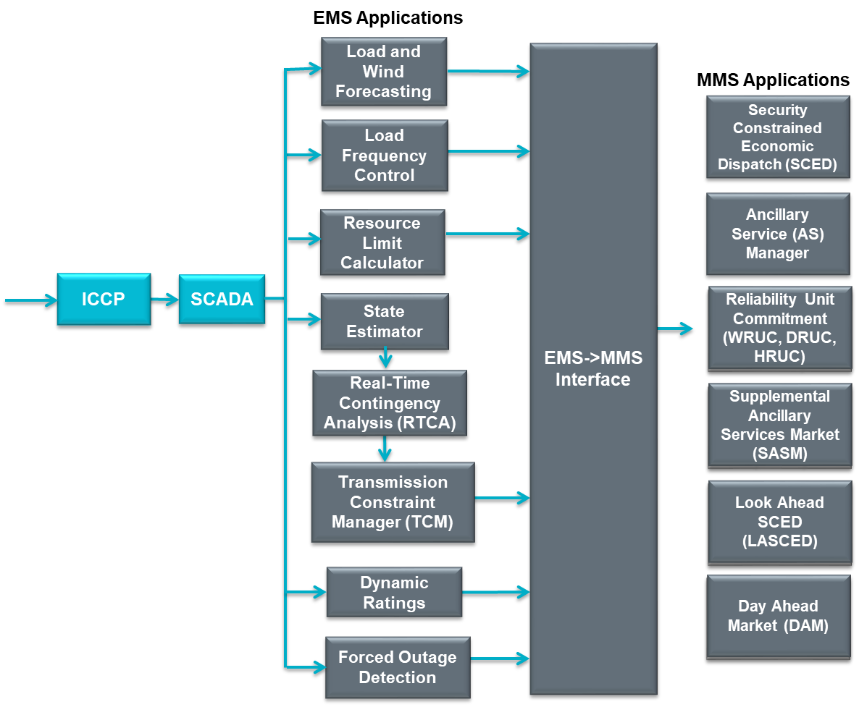
ERCOT EMS
9

Slide 11
Aside: Singular Value Decomposition
Traditionally power system analysis has mostly been focused on the sparse matrices associated with the electric grid; there was not much signal analysis
This is rapidly changing as the power industry get more signals and need to extract information from them, with PMUs one example
This data is often presented in the form of a matrix, for example with the rows being sample points
A key technique for extracting information from matrices is known as the singular value decomposition
10

Slide 12
Aside: Matrix Singular Value Decomposition (SVD)
The SVD is a factorization of a matrix that generalizes the eigendecomposition to any m by n matrix to produce
where S is a diagonal matrix of the singular values, and U and V are orthogonal matrices
The singular values are non-negative real numbers that can be used to indicate the major components of a matrix (the gist is they provide a way to decrease the rank of a matrix
A key application is image compression
The original concept is more than
100 years old, but has founds lots
of recent applications
11

Slide 13
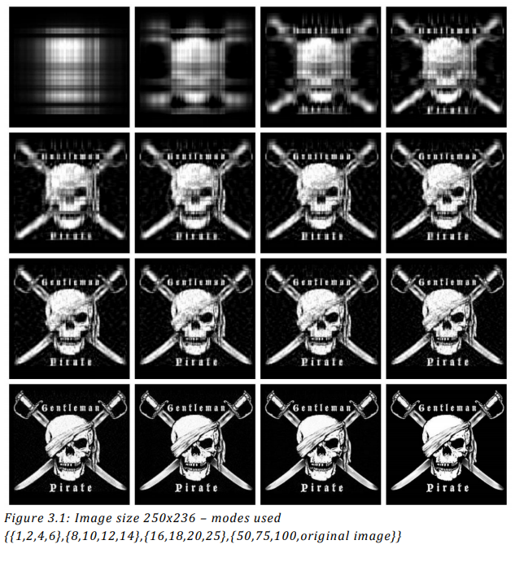
Aside: SVD Image Compression Example
Images can be
represented with
matrices. When
an SVD is applied
and only the
largest singular
values are retained
the image is
compressed.
12
Image Source: www.math.utah.edu/~goller/F15_M2270/BradyMathews_SVDImage.pdf

Slide 14
Aside: SVD and Principle Component Analysis (PCA)
The previous image compression example demonstrates PCA, which reduces dimensionality
  Extracting the principle components
The principle components are associated with the largest singular values
  This helps to extract the key features of the data and removes redundancy
PCA can be used to do facial recognition
PCA is starting to be more widely used in power system analysis, particularly when doing signal analysis
13

Slide 15
Aside: An SVD Application, the Pseudoinverse of a Matrix
The pseudoinverse of a matrix generalizes concept of a matrix inverse to an m by n matrix, m >= n
  Specifically this is a Moore-Penrose Matrix Inverse
Notation for the pseudoinverse of A is A⁺
Satisfies AA⁺A = A
If A is a square matrix, then A⁺ = A⁻¹
Quite useful for solving the least squares problem since the least squares solution of Ax = b is
x = A⁺ b
Can be calculated using an SVD
14

Slide 16
Aside: Pseudoinverse Least Squares Matrix Example
Assume we wish to fit a line (mx + b = y) to three data points: (1,1), (2,4), (6,4)
Two unknowns, m and b; hence x = [m b]^{T}
Setup in form of Ax = b
15

Slide 17
Aside: Pseudoinverse Least Squares Matrix Example
Doing an economy SVD
Computing the pseudoinverse
In an economy SVD the Σ matrix has dimensions of
m by m if m < n or n by n if n < m
16

Slide 18
Least Squares Matrix Pseudoinverse Example, cont.
Computing x = [m b]^{T} gives
With the pseudoinverse approach we immediately see the sensitivity of the elements of x to the elements of b
  New values of m and b can be readily calculated if y changes
Computationally the SVD is order mn²+n³
(with n < m)
17

Slide 19
Power System Equivalents
No electric grid model is ever going to completely represent a real electric grid
  “All models are wrong but some models are useful”
A key modeling consideration is how much of the electric grid to represent
  For large-scale systems the distribution system is usually equivalenced at some point; this has few system level ramifications if it is radial; if it is networked then there are potential issues
  At the transmission level either the full interconnect is represented or it is equivalenced
  In an SE model in large grids (like the Eastern Interconnect) it is always an electrical equivalent
18

Slide 20
Kron Reduction, Ward Equivalents
For decades power system network models have been equivalenced using the approach originally presented by J.B. Ward in 1949 AIEE paper “Equivalent Circuits for Power-Flow Studies”
  Paper’s single reference is to 1939 book by Gabriel Kron, so this is also known as Kron’s reduction or a Ward equivalent
System buses are partitioned into a study system (s) to be retained and an external system (e) to be eliminated; buses in study system that connect to the external are known as boundary buses
19

Slide 21
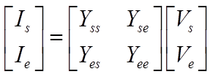

Ward Equivalents
The Ward approach is based on the below relationship
No impact on study, non-boundary buses
Equivalent is created by doing a partial factorization of the Y_{bus}
  Computationally efficient
20

Slide 22
Other Types of Equivalents
There are many different methods available for creating power system equivalents
  A classic paper is by S. Deckmann, et. al., “Studies on Power System Load Flow Equivalencing,” IEEE Transactions Power App. And Syst., Nov/Dec 1980
  Companion paper covers numerical testing of equivalents
The major equivalencing types are
  Ward-Type Equivalence: this is what we’ll be covering, with the major differences associated with how the generator buses and equivalent loads are represented
  REI Equivalents: All boundary buses connect to one “REI” bus
  Linearized Methods: Linearize about an operating point
  Others: PTDF-based, backbone type
21

Slide 23
Equivalent System Properties
An equivalent is usually created from a larger model
  In the Eastern Interconnect there are full grid models that are used for wide-area planning, these are equivalenced for real-time usage or more specialized studies
The equivalent is usually smaller and less detailed
  Solves quicker
  Requires less storage
  Requires less up-to-date data
Equivalences contain fictitious elements
  This can make modeling/updating more difficult
The equivalent only approximates the behavior of the original
22

Slide 24
Study vs External System
The key decision in creating an equivalent is to divide the system into a study portion that is represented in detail, and an external portion that is represented by the equivalent
The two systems are joined at boundary buses, which are part of the study subsystem
How this is done is application specific; for example:
  for real-time use it does not make sense to retain significant portions of the grid for which there is no real-time information
  for contingency analysis the impact of the contingency is localized
  for planning the new system additions have localized impacts
23

Slide 25
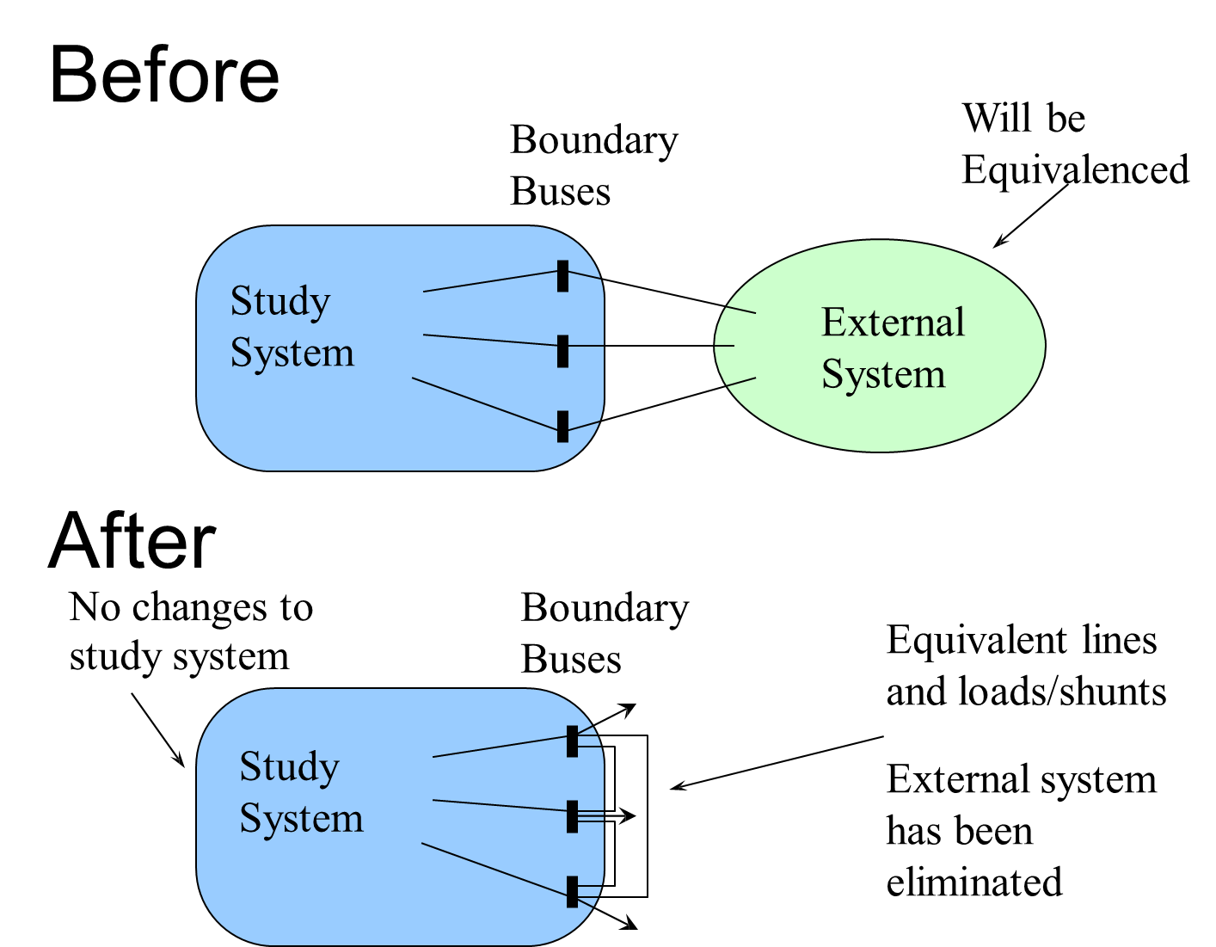
Ward Type Equivalencing
24

Slide 26
Ward Type Equivalencing Considerations
The Ward equivalent is calculated by doing a partial factorization of the Y_{bus}
  The equivalent buses are numbered before the study buses
  As the equivalent buses are eliminated their first neighbors are joined together
  At the end, many of the boundary buses are connected
  This can GREATLY decrease the sparsity of the system
  Buses with different voltages can be directly connected
25

Slide 27
Ward Type Equivalencing Considerations
At the end of the Ward process often many of the new equivalent lines have high impedances
  Often there is an impedance threshold, and lines with impedances above this value are eliminated
The equivalent lines may have unusual values, including negative resistances
Load and generation is represented as equivalent current injections or shunts; sometimes these values are converted back to constant power
Consideration needs to be given to loss of reactive support; the equivalent embeds the present load and generation values
26

Slide 28
B7Flat_Eqv Example
In this example the B7Flat_Eqv case is reduced, eliminating buses 1, 3 and 4. The study system is then 2, 5, 6, 7, with buses 2 and 5 the boundary buses
For ease of
comparison
system is
modeled
unloaded
27

Slide 29
B7Flat_Eqv Example
Original Y_{bus}
28

Slide 30
B7Flat_Eqv Example
Note Y_{es}=Y_{se}'
if no phase
shifters
29

Slide 31
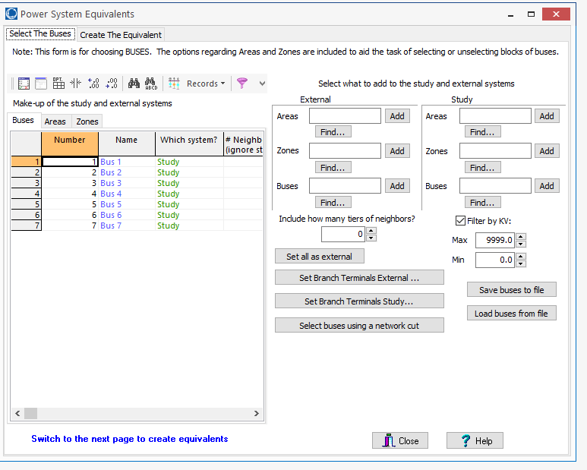
Equivalencing in PowerWorld
Open a case and solve it; then select Edit Mode, Tools, Equivalencing; this displays the Power System Equivalents Form
Next step is then to
divide the buses into
the study system and
the external system;
buses can be loaded
from a text file as
well
30

Slide 32
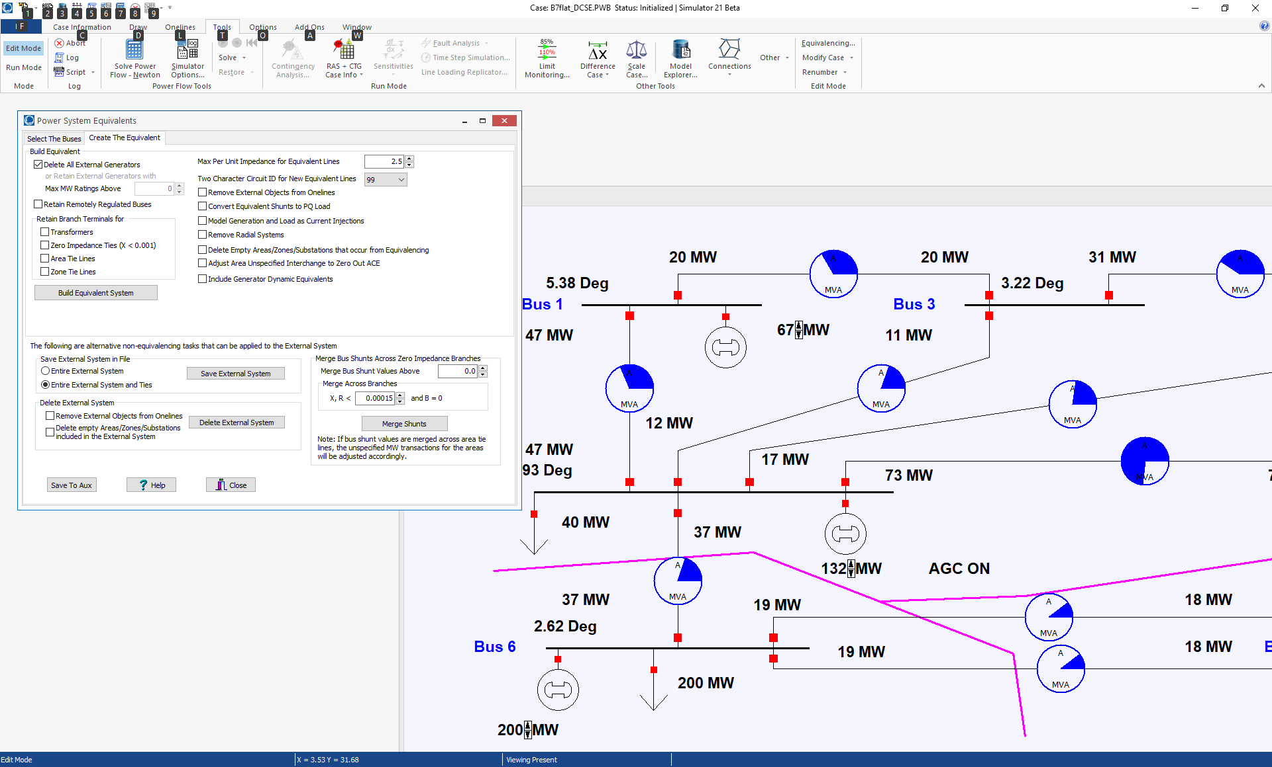
Equivalencing in PowerWorld
Then go to the Create The Equivalent page, select the desired options and select Build Equivalent System
Maximum
impedance
lines to retain
’99’ or ‘EQ’
are common
circuit values
for equivalent
lines
Click to create the equivalent
Removes equivalenced objects from the oneline
31

Slide 33
Small System Equivalent Example
Example shows the creation of an equivalent for Aggieland37 example
First example is
simple, just removing
WHITE138 (bus 3);
note TEXAS138 is
now directly joined to
RELLIS138..
Case is Aggieland37_HW5
32

Slide 34
Small System Equivalent Example
Only bus 3 was removed; the new equivalent line was auto-inserted.
Don’t save the
equivalent with the
same name as the
original, unless you
want to lose the
original
33

Slide 35
Small System Equivalent Example
Now remove buses at WHITE138 and TEXAS and RELLIS (1, 3, 12, 40, 41, 44); set Max Per Unit Impedance for
Equivalent
Lines to
99 (per unit)
to retain all
lines. Again
to an auto-
insert to show
the equivalent
lines.
34

Slide 36
Small System Equivalent Example
Now set the Max Per Unit Impedance for Equivalent Lines to 2.5.
35

Slide 37
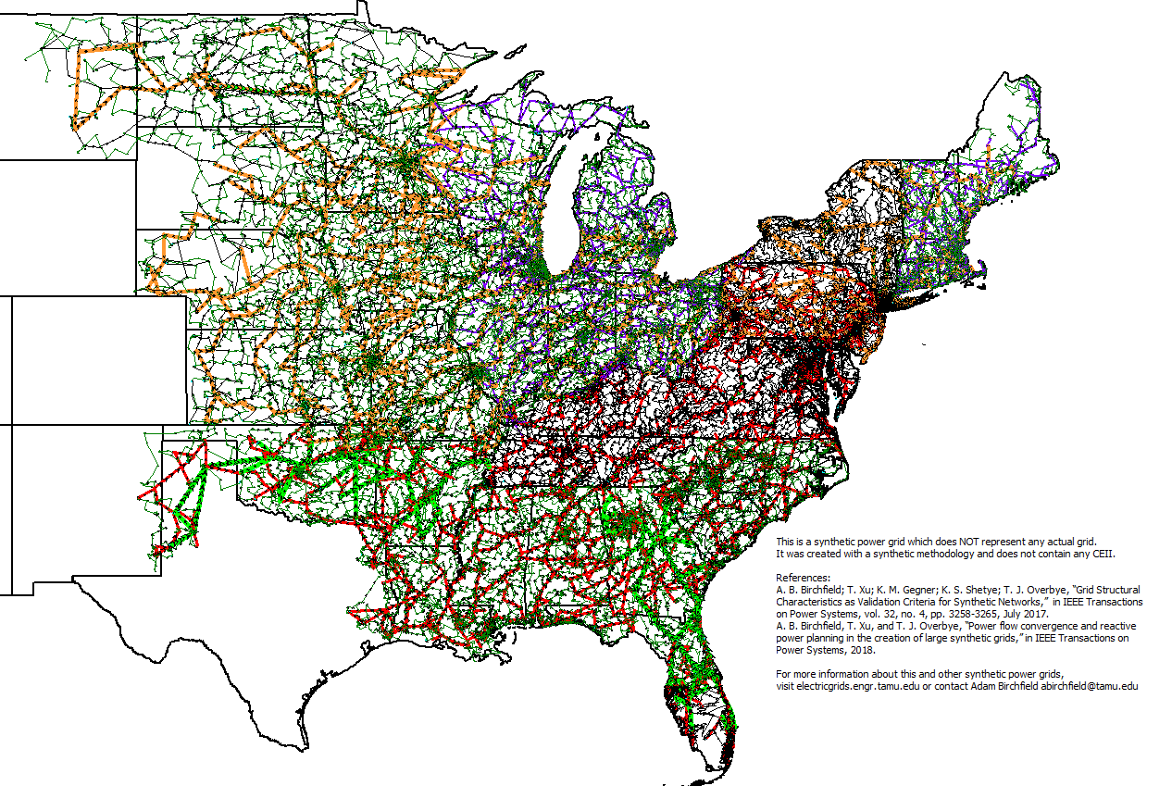
Large System Example: 70K Case
Original System has 70,000 buses and 71,343 lines
36

Slide 38
Large System Example: 70K Case
Just retain the Oklahoma Area; now 1591 buses and 1745 lines (deleting ones above 2.5 pu impedance)
37

Slide 39
Grid Equivalent Examples
A 2016 EI case had about 350 lines with a circuit ID of ’99’ and about 60 with ‘EQ’ (out of a total of 102,000)
  Both WECC and the EI use ’99’ or ‘EQ’ circuit IDs to indicate equivalent lines
  One would expect few equivalent lines in interconnect wide models
A ten year old EI case had about 1633 lines with a circuit ID of ’99’ and 400 with ‘EQ’ (out of a total of 65673)
A ten year old case with about 5000 buses and 5000 lines had 600 equivalent lines
38

Slide 40

Example: PJM EMS Equivalent
PJM provides information about their EMS model in
  www.pjm.com/-/media/documents/manuals/m03a.ashx
Data here is from the December 2019 (Rev 18) document
39

