Slide 1
ECEN 615
Methods of Electric Power
Systems Analysis
Lecture 19: Voltage Stability, Economic Dispatch, Optimal Power Flow
Prof. Tom Overbye
Dept. of Electrical and Computer Engineering
Texas A&M University
overbye@tamu.edu

Slide 2
Announcements
Read Chapter 8
Homework 5 is due on Thursday Oct 29
1

Slide 3
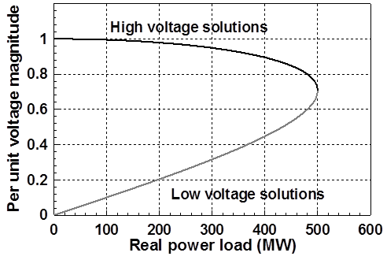
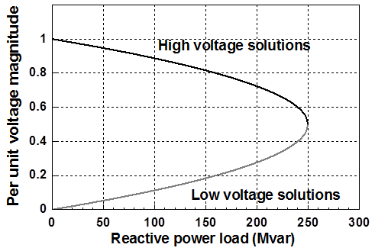
PV and QV Curves
PV curves can be traced by plotting the voltage as the real power is increased; QV curves as reactive power is increased
  At least for the upper portion of the curve
Two bus example PV and QV curves
2

Slide 4
Small Disturbance Voltage Collapse
At constant frequency (e.g., 60 Hz) the complex power transferred down a transmission line is S=VI*
  V is phasor voltage, I is phasor current
  This is the reason for using a high voltage grid
Line real power losses are given by RI² and reactive power losses by XI²
  R is the line’s resistance, and X its reactance; for a high voltage line X >> R
Increased reactive power tends to drive down the voltage, which increases the current, which further increases the reactive power losses
3

Slide 5
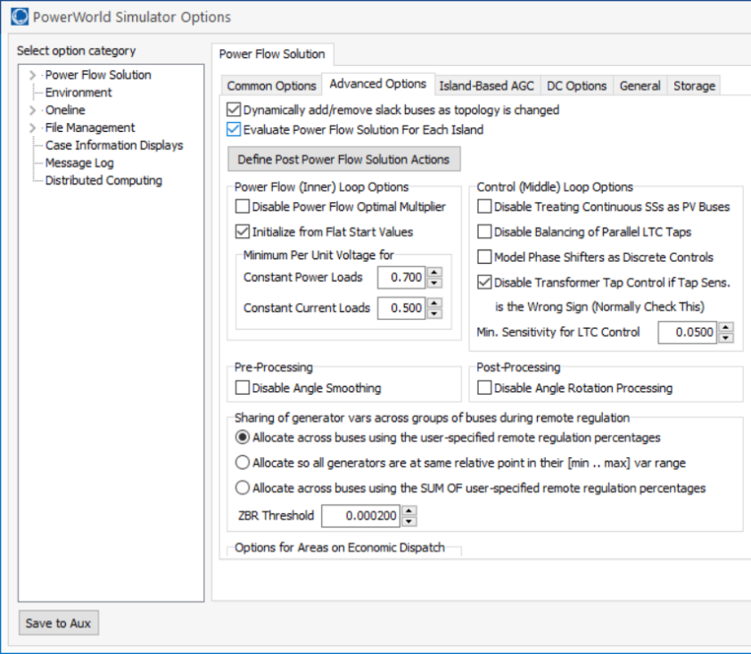
PowerWorld Two Bus Example
Commercial power flow software usually auto converts constant power loads at low voltages; set these fields to zero to disable this conversion
4

Slide 6
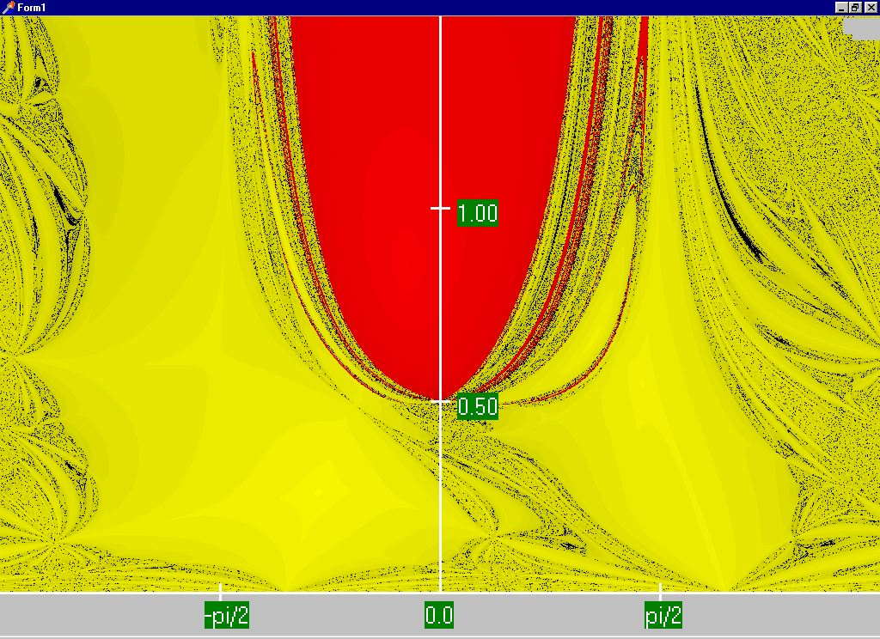
Power Flow Region of Convergence
Convergence
regions with
P=100 MW,
Q=0 Mvar
5

Slide 7
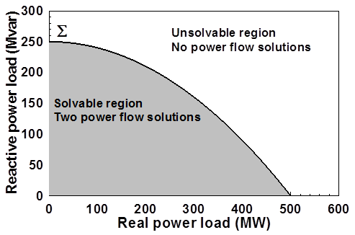
Load Parameter Space Representation
With a constant power model there is a maximum loadability surface, Σ
  Defined as point in which the power flow Jacobian is singular
  For the lossless two bus system it can be determined as
6

Slide 8
Load Model Impact
With a static load model regardless of the voltage dependency the same PV curve is traced
  But whether a point of maximum loadability exists depends on the assumed load model
    If voltage exponent is > 1 then multiple solutions do not exist (see B.C. Lesieutre, P.W. Sauer and M.A. Pai “Sufficient conditions on static load models for network solvability,”NAPS 1992, pp. 262-271)
Change load to constant impedance; hence it becomes a linear model
7

Slide 9
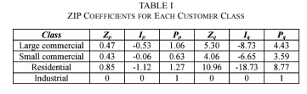
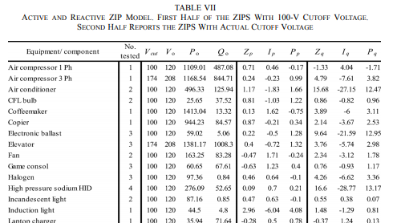
ZIP Model Coefficients
One popular static load model is the ZIP; lots of papers on the “correct” amount of each type
Table 1 from M. Diaz-Aguilo, et. al., “Field-Validated Load Model for the Analysis of CVR in Distribution Secondary Networks: Energy Conservation,” IEEE Trans. Power Delivery, Oct. 2013
Table 7 from A, Bokhari, et. al., “Experimental Determination of the ZIP Coefficients for Modern Residential, Commercial, and Industrial Loads,” IEEE Trans. Power Delivery, June. 2014
8

Slide 10
Application: Conservation Voltage Reduction (CVR)
If the “steady-state” load has a true dependence on voltage, then a change (usually a reduction) in the voltage should result in a total decrease in energy consumption
If an “optimal” voltage could be determined, then this could result in a net energy savings
Some challenges are 1) the voltage profile across a feeder is not constant, 2) the load composition is constantly changing, 3) a decrease in power consumption might result in a decrease in useable output from the load, and 4) loads are dynamic and an initial decrease might be balanced by a later increase
9

Slide 11
Determining a Metric to Voltage Collapse
The goal of much of the voltage stability work was to determine an easy to calculate metric (or metrics) of the current operating point to voltage collapse
  PV and QV curves (or some combination) can determine such a metric along a particular path
  Goal was to have a path independent metric. The closest boundary point was considered,
  but this could be quite misleading
  if the system was not going to
  move in that direction
  Any linearization about the current operating point (i.e., the Jacobian) does not consider important nonlinearities like generators hitting their reactive power limits
10

Slide 12
Determining a Metric to Voltage Collapse
A paper by Dobson in 1992 (see below) noted that at a saddle node bifurcation, in which the power flow Jacobian is singular, that
  The right eigenvector associated with the Jacobian zero eigenvalue tells the direction in state space of the voltage collapse
  The left eigenvector associated with the Jacobian zero eigenvalue gives the normal in parameter space to the boundary Σ. This can then be used to estimate the minimum distance in parameter space to bifurcation.
I. Dobson, “Observations on the Geometry of Saddle Node Bifurcation and Voltage Collapse in Electrical Power
Systems,” IEEE Trans. Circuits and Systems, March 1992
11

Slide 13
Determining a Metric to Voltage Collapse Example
For the previous two bus example we had
12

Slide 14
Determining a Metric to Voltage Collapse Example
Calculating the right and left eigenvectors associated with the zero eigenvalue we get
13

Slide 15
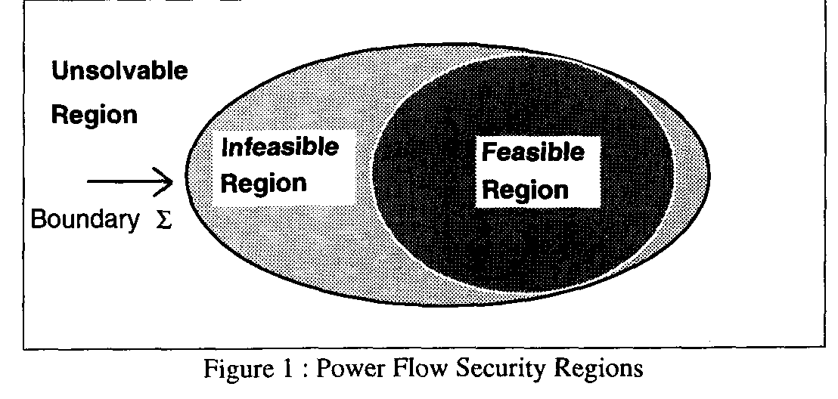
Quantifying Power Flow Unsolvability
Since lack of power flow convergence can be a major problem, it would be nice to have a measure to quantify the degree of unsolvability of a power flow
  And then figure out the best way to restore solvabiblity
T.J. Overbye, “A Power Flow Measure for Unsolvable Cases,” IEEE Trans. Power Systems, August 1994
14

Slide 16
Quantifying Power Flow Unsolvability
To setup the problem, first consider the power flow iteration without and with the optimal multiplier
15

Slide 17
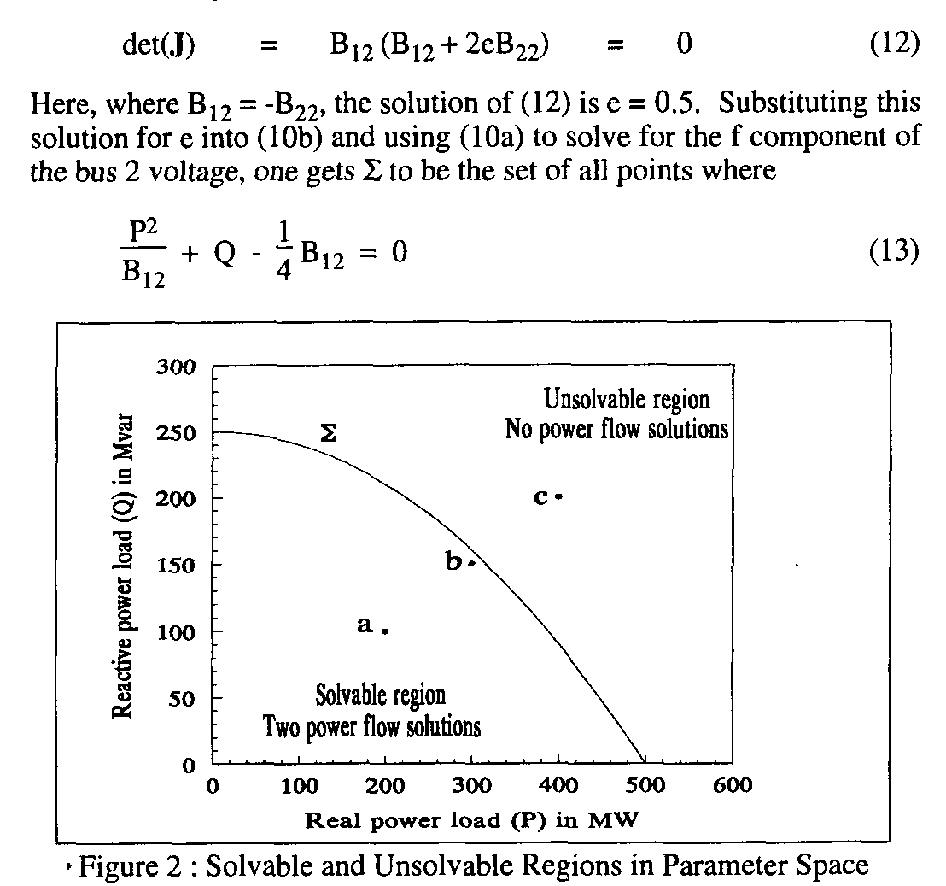
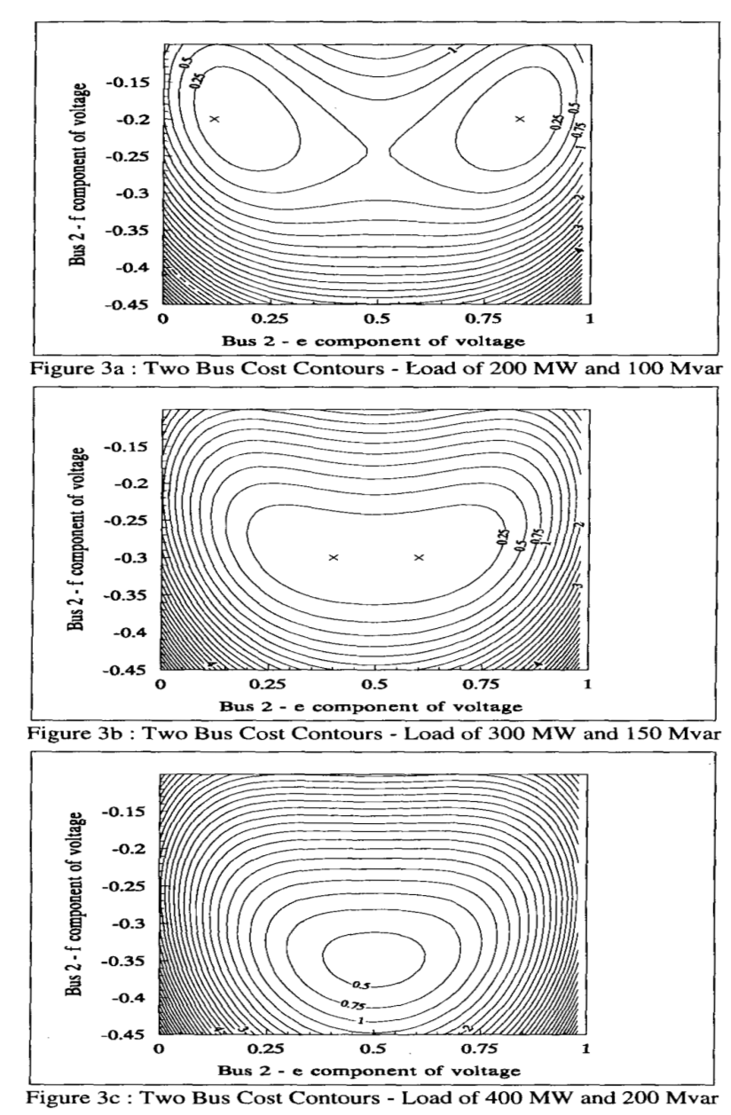
Quantifying Power Flow Unsolvability
16

Slide 18
Quantifying Power Flow Unsolvability
However, when there is no solution the standard power flow would diverge. But the approach with the optimal multiplier tends to point in the direction of minimizing F(x^{k+1}). That is,
17

Slide 19
Quantifying Power Flow Unsolvability
The only way we cannot reduce the cost function some would be if the two directions were perpendicular, hence with a zero dot product. So
18

Slide 20
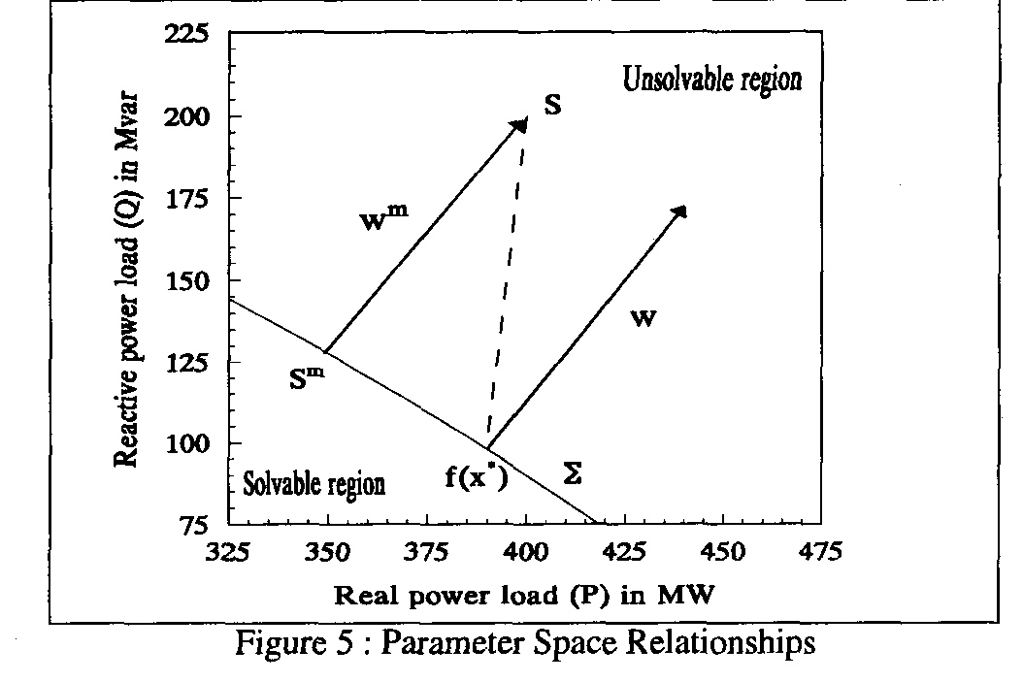
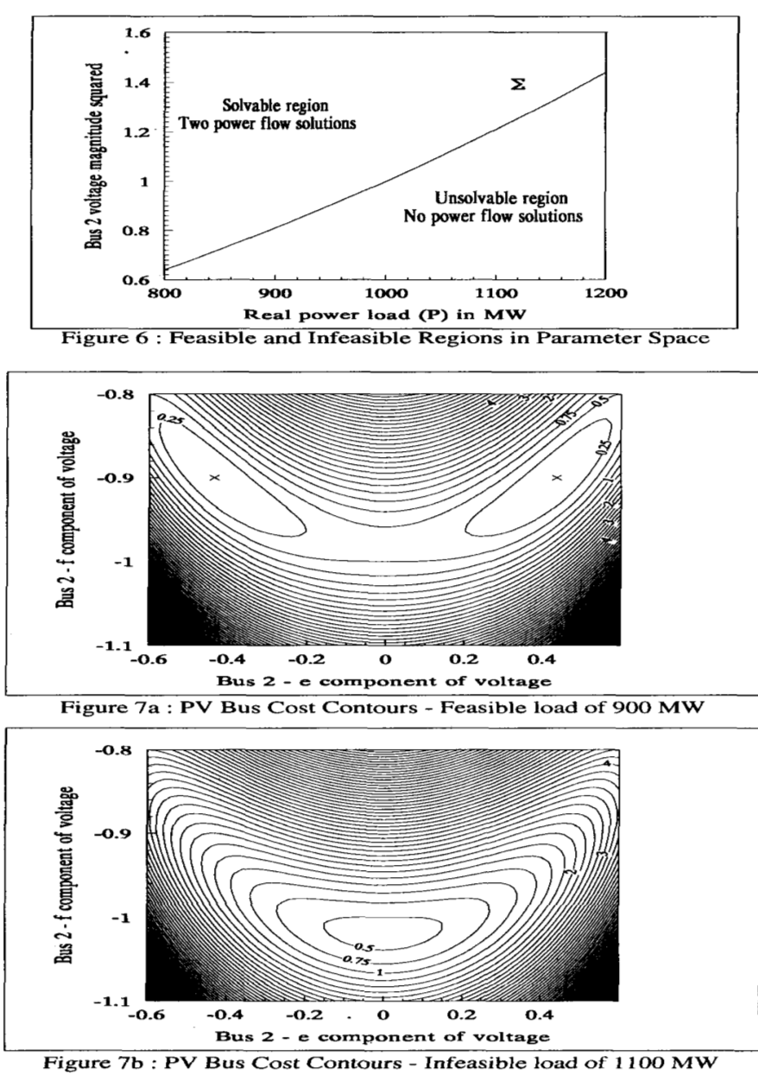
Quantifying Power Flow Unsolvability
If Σ were flat then w is parallel to w^{m}
19

Slide 21
Quantifying Power Flow Unsolvability
The left eigenvector associated with the zero eigenvalue of the Jacobian (defined as w^{i*}) is perpendicular to Σ (as noted in the early 1992 Dobson paper)
We can get the closest point on the Σ just by iterating, updating the S Vector as
(here S is the initial power injection, x^{i*} a boundary solution)
Converges when
20

Slide 22
Challenges
The key issues is actual power systems are quite complex, with many nonlinearities. For example, generators hitting reactive power limits, switched shunts, LTCs, phase shifters, etc.
Practically people would like to know how far some system parameters can be changed before running into some sort of limit violation, or maximum loadability.
  The system is changing in a particular direction, such as a power transfer; this often includes contingency analysis
Line limits and voltage magnitudes are considered
  Lower voltage lines tend to be thermally constrained
Solution is to just to trace out the PV or QV curves
21

Slide 23
PV and QV Analysis in PowerWorld
Requires setting up what is known in PowerWorld as an injection group
  An injection group specifies a set of objects, such as generators and loads, that can inject or absorb power
  Injection groups can be defined by selecting Case Information, Aggregation, Injection Groups
The PV and/or QV analysis then varies the injections in the injection group, tracing out the PV curve
This allows optional consideration of contingencies
The PV tool can be displayed by selecting Add-Ons, PV
22

Slide 24
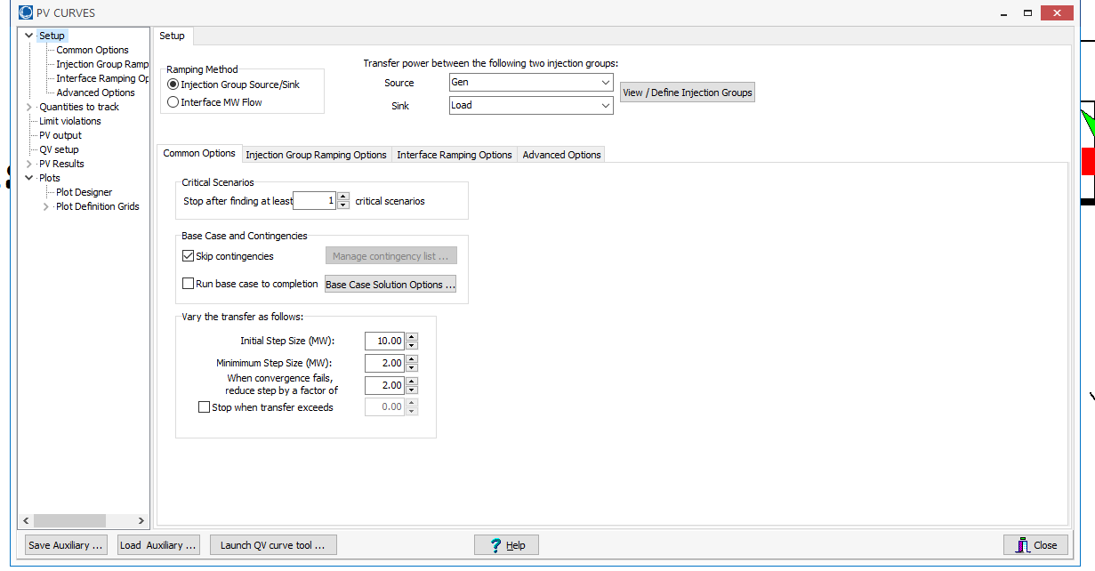
PV and QV Analysis in PowerWorld: Two Bus Example
Setup page defines the source and sink and step size
23

Slide 25
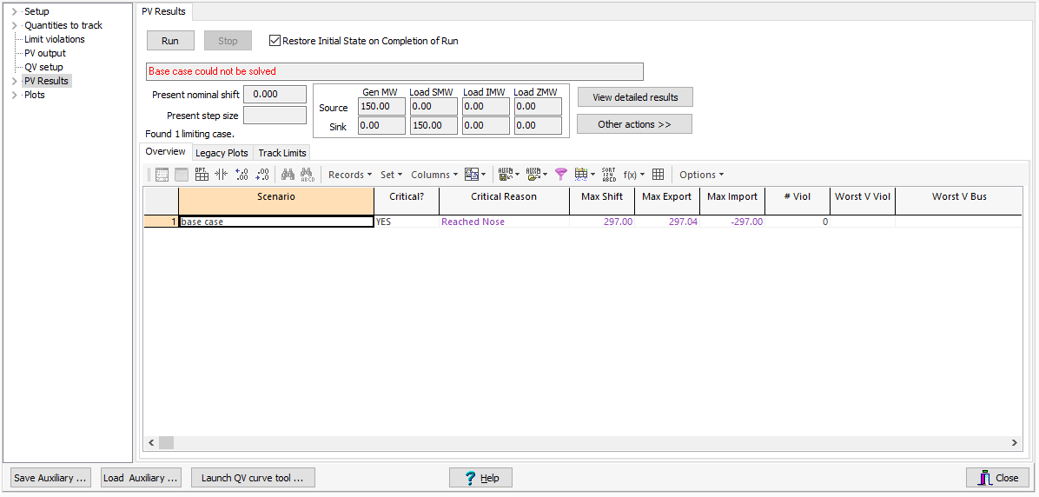
PV and QV Analysis in PowerWorld: Two Bus Example
The PV Results Page does the actual solution
  Plots can be defined to show the results
  Other Actions, Restore initial state restores the pre-study state
Click the Run button
to run the PV analysis;
Check the Restore
Initial State on
Completion of Run to
restore the pre-PV
state (by default it is
not restored)
24

Slide 26
PV and QV Analysis in PowerWorld: Two Bus Example
25

Slide 27
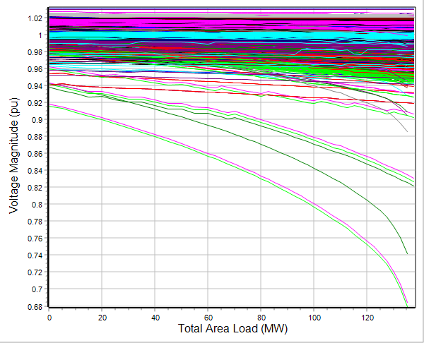
PV and QV Analysis in PowerWorld: 37 Bus Example
Usually other limits also need to be considered in
doing a realistic PV analysis
26

Slide 28
Power System Economic Dispatch
Generators can have vastly different incremental operational costs
  Some are essentially free or low cost (wind, solar, hydro, nuclear)
  Because of the large amount of natural gas generation, electricity prices are very dependent on natural gas prices
Economic dispatch is concerned with determining the best dispatch for generators without changing their commitment
Unit commitment focuses on optimization over several days. It is discussed in Chapter 4 of the book, but will not be not covered here in-depth
27

Slide 29
Power System Economic Dispatch
Economic dispatch is formulated as a constrained minimization
  The cost function is often total generation cost in an area
  Single equality constraint is the real power balance equation
Solved by setting up the Lagrangian (with P_{D} the load and P_{L} the losses, which are a function the generation)
A necessary condition for a minimum is that the gradient is zero. Without losses this occurs when all generators are dispatched at the same marginal cost (except when they hit a limit)
28

Slide 30
Power System Economic Dispatch
If losses are neglected then there is a single marginal cost (lambda); if losses are included then each bus could have a different marginal cost
29

Slide 31
Economic Dispatch Penalty Factors
The penalty factor
at the slack bus is
always unity!
30

Slide 32
Economic Dispatch Example
Case is GOS_Example6_22; use Power Flow Solution
Options, Advanced Options to set Penalty Factors
31

Slide 33
Optimal Power Flow (OPF)
OPF functionally combines the power flow with economic dispatch
SCOPF adds in contingency analysis
Goal of OPF and SCOPF is to minimize a cost function, such as operating cost, taking into account realistic equality and inequality constraints
Equality constraints
  bus real and reactive power balance
  generator voltage setpoints
  area MW interchange
32

Slide 34
OPF, cont.
Inequality constraints
  transmission line/transformer/interface flow limits
  generator MW limits
  generator reactive power capability curves
  bus voltage magnitudes (not yet implemented in Simulator OPF)
Available Controls
  generator MW outputs
  transformer taps and phase angles
  reactive power controls
33

Slide 35
Two Example OPF Solution Methods
Non-linear approach using Newton’s method
  handles marginal losses well, but is relatively slow and has problems determining binding constraints
  Generation costs (and other costs) represented by quadratic or cubic functions
Linear Programming
  fast and efficient in determining binding constraints, but can have difficulty with marginal losses.
  used in PowerWorld Simulator
  generation costs (and other costs) represented by piecewise linear functions
Both can be implemented using an ac or dc power flow

Slide 36
OPF and SCOPF Current Status
OPF (really SCOPF) is currently an area of active research, with ARPA-E having an SCOPF competition and recently awarding about $5 million for improved algorithms (see gocompetition.energy.gov)
A 2016 National Academies Press report, titled “Analytic Research Founds for the Next-Generation Electric Grid,” recommended improved AC OPF models
  I would recommend reading this report; it provides good background on power systems include OPF
  It is available for free at www.nap.edu/catalog/21919/analytic-research-foundations-for-the-next-generation-electric-grid
35

Slide 37
OPF and SCOPF History
A nice OPF history from Dec 2012 is provided by the below link, and briefly summarized here
Prior to digital computers economic dispatch was solved by hand and the power flow with network analyzers
Digital power flow developed in late 50’s to early 60’s
First OPF formulations in the 1960’s
  J. Carpienterm, “Contribution e l’étude do Dispatching Economique,” Bulletin Society Francaise Electriciens, 1962
  H.W. Dommel, W.F. Tinney, “Optimal power flow solutions,” IEEE Trans. Power App. and Systems, Oct. 1968
    “Only a small extension of the power flow program is required”
www.ferc.gov/industries/electric/indus-act/market-planning/opf-papers/acopf-1-history-formulation-testing.pdf (by M Cain, R. O’Neill, A. Castillo)
36

Slide 38
OPF and SCOPF History
A linear programming (LP) approach was presented by Stott and Hobson in 1978
  B. Stott, E. Hobson, “Power System Security Control Calculations using Linear Programming,” (Parts 1 and 2) IEEE Trans. Power App and Syst., Sept/Oct 1978
Optimal Power Flow By Newton’s Method
  D.I. Sun, B. Ashley, B. Brewer, B.A. Hughes, and W.F. Tinney, "Optimal Power Flow by Newton Approach", IEEE Trans. Power App and Syst., October 1984
Follow-up LP OPF paper in 1990
  O. Alsac, J. Bright, M. Prais, B. Stott, “Further Developments in LP-based Optimal Power Flow,” IEEE Trans. Power Systems, August 1990
37

Slide 39
OPF and SCOPF History
Critique of OPF Algorithms
  W.F. Tinney, J.M. Bright, K.D. Demaree, B.A. Hughes, “Some Deficiencies in Optimal Power Flow,” IEEE Trans. Power Systems, May 1988
Hundreds of other papers on OPF
Comparison of ac and dc optimal power flow methods
  T.J. Overbye, X. Cheng, Y. San, “A Comparison of the AC and DC Power Flow Models for LMP Calculations,” Proc. 37th Hawaii International Conf. on System Sciences, 2004
38

Slide 40
Key SCOPF Application: Locational Marginal Prices (LMPs)
The locational marginal price (LMP) tells the cost of providing electricity to a given location (bus) in the system
Concept introduced by Schweppe in 1985
  F.C. Schweppe, M. Caramanis, R. Tabors, “Evaluation of Spot Price Based Electricity Rates,” IEEE Trans. Power App and Syst., July 1985
LMPs are a direct result of an SCOPF, and are widely used in many electricity markets worldwide
39

Slide 41
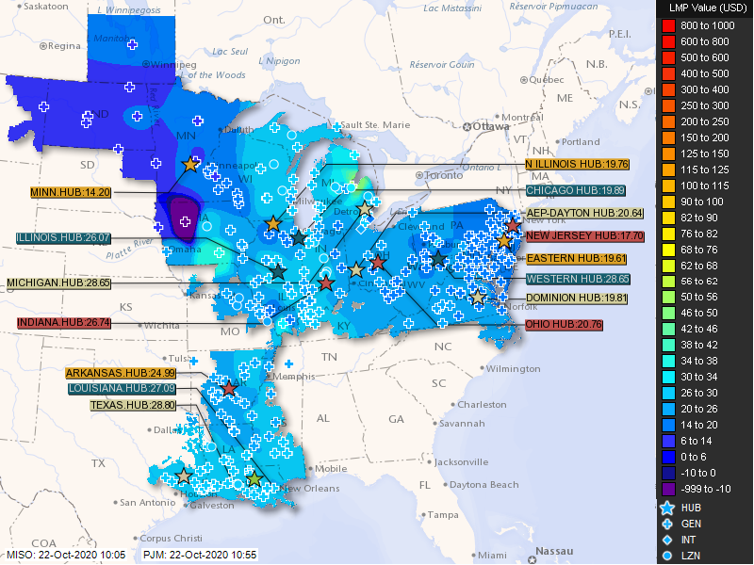
Example LMP Contour, 10/22/2020
LMPs are now
widely
visualized
using color
contours; the
first use of
LMP color
contours was
presented in [1]
https://www.miso-pjm.com/markets/contour-map.aspx
[1] T.J. Overbye, R.P. Klump, J.D. Weber, “A Virtual Environment for Interactive Visualization of Power System Economic and Security Information,” IEEE PES 1999 Summer Meeting, Edmonton, AB, Canada, July 1999
40

Slide 42
OPF Problem Formulation
The OPF is usually formulated as a minimization with equality and inequality constraints
where x is a vector of dependent variables (such as the bus voltage magnitudes and angles), u is a vector of the control variables, F(x,u) is the scalar objective function, g is a set of equality constraints (e.g., the power balance equations) and h is a set of inequality
constraints (such as line flows)
41

Slide 43
LP OPF Solution Method
Solution iterates between
  solving a full ac or dc power flow solution
    enforces real/reactive power balance at each bus
    enforces generator reactive limits
    system controls are assumed fixed
    takes into account non-linearities
  solving a primal LP
    changes system controls to enforce linearized constraints while minimizing cost
42

Slide 44
Two Bus with Unconstrained Line
With no overloads the
OPF matches
the economic
dispatch
Transmission line is not overloaded
Marginal cost of supplying
power to each bus (locational marginal costs)
43

Slide 45
Two Bus with Constrained Line
With the line loaded to its limit, additional load at Bus A must be supplied locally, causing the marginal costs to diverge.
44

Slide 46
Three Bus (B3) Example
Consider a three bus case (Bus 1 is system slack), with all buses connected through 0.1 pu reactance lines, each with a 100 MVA limit
Let the generator marginal costs be
  Bus 1: 10 $ / MWhr; Range = 0 to 400 MW
  Bus 2: 12 $ / MWhr; Range = 0 to 400 MW
  Bus 3: 20 $ / MWhr; Range = 0 to 400 MW
Assume a single 180 MW load at bus 2
45

Slide 47
B3 with Line Limits NOT Enforced
Line between
Bus 1and Bus 3
is over-loaded;
all buses have
the same
marginal cost
46

Slide 48
B3 with Line Limits Enforced
LP OPF changes
generation to
remove violation.
Bus marginal
costs are now
different.
47

Slide 49
Verify Bus 3 Marginal Cost
One additional MW
of load at bus 3
raised total cost by
14 $/hr, as G2 went
up by 2 MW and G1
went down by 1MW
48

Slide 50
Why is bus 3 LMP = $14 /MWh
All lines have equal impedance. Power flow in a simple network distributes inversely to impedance of path.
  For bus 1 to supply 1 MW to bus 3, 2/3 MW would take direct path from 1 to 3, while 1/3 MW would “loop around” from 1 to 2 to 3.
  Likewise, for bus 2 to supply 1 MW to bus 3, 2/3MW would go from 2 to 3, while 1/3 MW would go from 2 to 1to 3.
49

Slide 51
Why is bus 3 LMP $ 14 / MWh, cont’d
With the line from 1 to 3 limited, no additional power flows are allowed on it.
To supply 1 more MW to bus 3 we need
  ΔP_{G1} + ΔP_{G2} = 1 MW
  2/3 Δ P_{G1} + 1/3 Δ P_{G2} = 0; (no more flow on 1-3)
Solving requires we up P_{G2} by 2 MW and drop P_{G1} by 1 MW -- a net increase of $24 – $10 = $14.
50

Slide 52
Both lines into Bus 3 Congested
For bus 3 loads
above 200 MW,
the load must be
supplied locally.
Then what if the
bus 3 generator
opens?
51

Slide 53
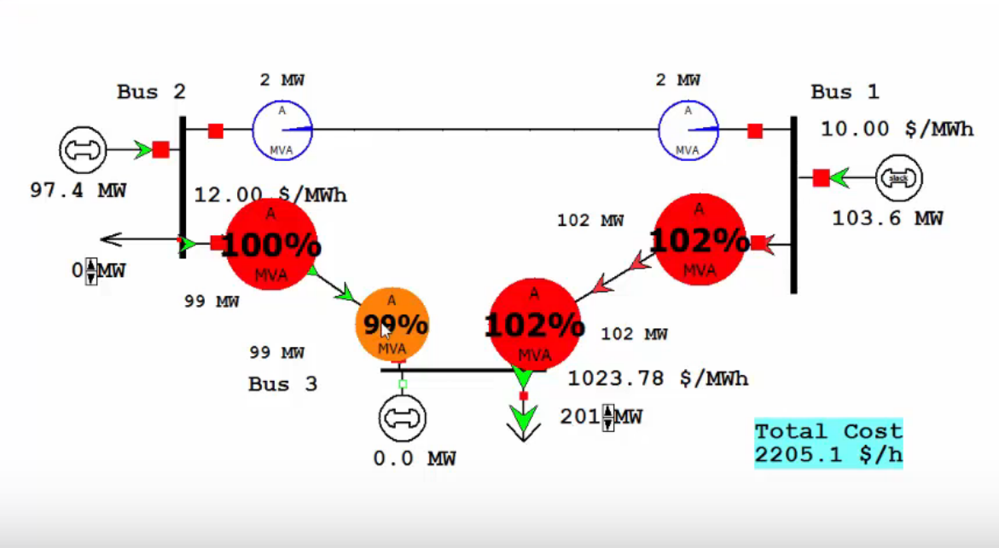
Both lines into Bus 3 Congested
51

