Slide 1
ECEN 615
Methods of Electric Power
Systems Analysis
Lecture 23: Electricity Markets
Prof. Tom Overbye
Dept. of Electrical and Computer Engineering
Texas A&M University
overbye@tamu.edu

Slide 2
Announcements
Read Chapter 8 and Appendices 3B and 3E of Chapter 3
Homeworks 6 and 7 are assigned today, with Homework 6 due on Nov 12 and Homework 7 by Nov 24
The second exam will be in class on Nov 17
  Distance learners will be able to take the exam from Nov 16 to Nov 18
Associated with Homework 7 will be student presentations; these will be about 15 minutes during class on Nov 19 or Nov 24
  Other times can be arranged for the distance learners
1

Slide 3
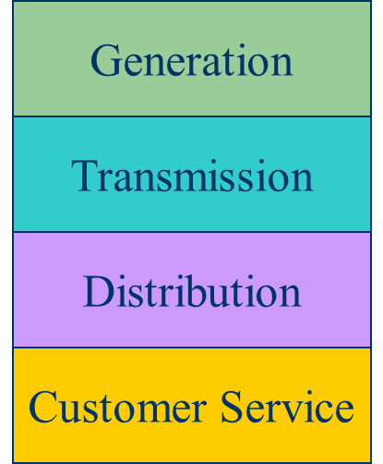
Electricity Markets History
For decades electric utilities operated as vertical monopolies, with their rates set
by state regulators
Utilities had an obligation to serve
and customers had no choice
  There was little third party generation
Major change in US occurred in 1992
with the National Energy Policy Act
that mandated utilities provide
“nondiscriminatory” access to the high voltage grid
Goal was to setup true competition in generation

Slide 4
Markets Versus Centralized Planning
With the vertically integrated utility, a small number of entities (typically utilities) did most of the planning
  For example, which new generators and/or lines to build
  Planning was coordinated and governed by regulators
  Regulators needed to know the utilities actual costs so they could provide them with a fixed rate of return
With markets the larger number of participants often make individual decisions in reaction to prices
  For example, whether to build new generation
  Generator owners in general to not need to reveal their true costs; rather they make offers into the market

Slide 5
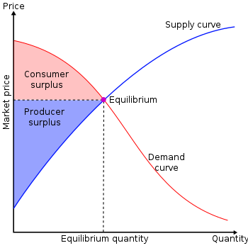
Overall Goal
Goal is to maximize the economic surplus (or total welfare), which is the sum of the consumer surplus and the producer surplus (i.e., their profit)
Generation owners have to
decide their offer prices
If their price is too high, they
are not selected to generate
At the wholesale level, the
consumers often just see a
price, though there can be price
responsive load bids
Image Source: en.wikipedia.org/wiki/Economic_surplus#/media/File:Economic-surpluses.svg

Slide 6
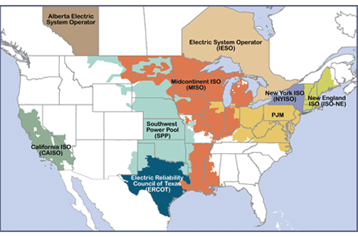
Electricity Markets Today
Starting in about 1995 electricity markets gradually started to develop, both in the US and elsewhere
In North America
more than 60% of the
load is supplied via
wholesale electricity
markets; markets differ
but they all have certain
common features
  The terms regional transmission organizations (RTOs) and independent system operators (ISOs) are used (RTOs are more functionality and most are actually RTOs
Image source: www.ferc.gov/industries-data/electric/power-sales-and-markets/rtos-and-isos

Slide 7
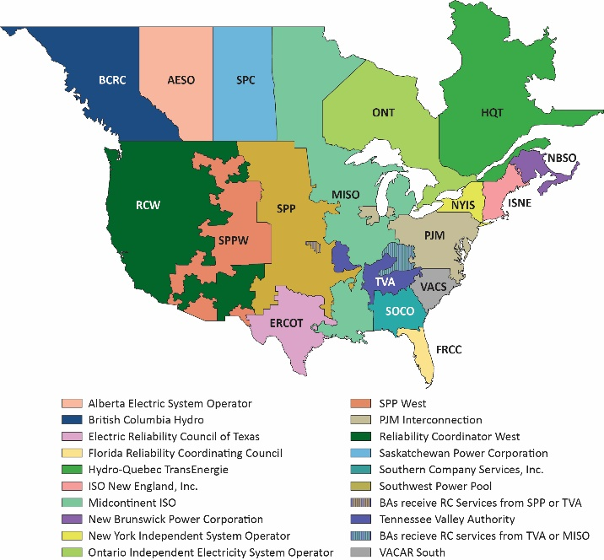
Aside: NERC Reliability Coordinators (RCs)
As noted in NERC
IRO-001-1, “Reliability Coordinators must have the authority, plans and agreements in place to immediately direct reliability entities within the Reliability Coordinator Areas to re-dispatch generation, reconfigure transmission, or reduce load to mitigate critical conditions to return the system to a reliable state.”

Slide 8
Electricity Markets Common Features
Day ahead market – this is needed because time is required to make decisions about committing generators
  Generation owners submit offers for how much generation they can supply and at what price; accepted offers are binding
Real-time energy market – needed because day ahead forecasts are never perfect, and unexpected events can occur
Co-optimization with other “ancillary services” such as reserves
The source for much of this material “Analytic Research Foundations for the Next-Generation Electric
Grid” (Chapter 2), The National Academies Press, 2016 (free download available)

Slide 9
Electricity Markets Common Features
Pricing is done using locational marginal prices, determined by an SCOPF
  Most markets include a marginal losses component
LMP markets are designed to send transparent price signals so people can make short and long-term decisions
  Generators are free to offer their electricity at whatever price they desire; they do not have to reveal their “true” costs
  Most of the times markets work as planned (competitive prices)
  During times of shortages (scarcity) there are limits on LMPs; ERCOT’s is $9000/MWh
  Markets are run by independent system operators (ISOs)

Slide 10
LMP Energy Markets
In an LMP energy market the generation is paid the LMP at the bus, and the loads pay the LMP at the bus
  This is done in both the day ahead market and in the real-time market (which makes up the differences between actual and the day ahead)
The generator surplus (profit) is the difference between the LMP and the actual cost of generation
Generators that offer too high are not selected to run, and hence make no profit
A key decision for the generation owners is what values to offer

Slide 11
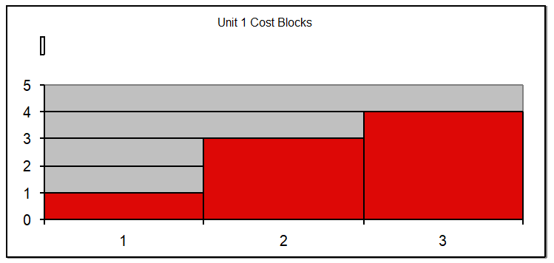
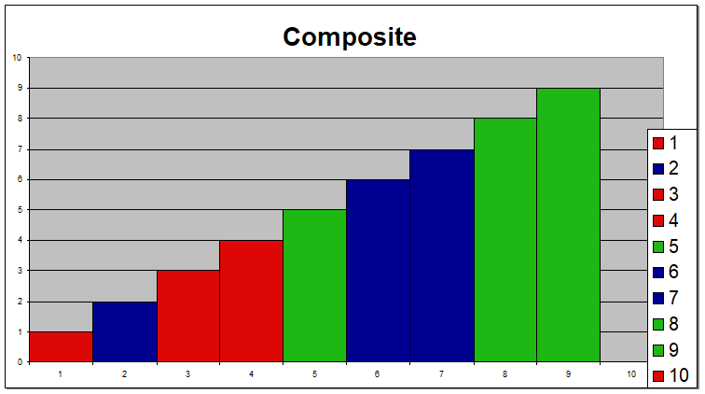
Generator Offers
Generator offers are given in piecewise linear curves; that is, a fixed $/MWh for so much power for a time period
In the absence of constraints (congestion) the ISO would just select the lowest offers to meet the anticipated load
Actual dispatch is determined using an SCOPF

Slide 12
General Guidelines
Generators with high fixed costs and low operating costs (e.g., wind, solar, nuclear) benefit from running many hours
  Usually they should submit offers close to their marginal costs
  Wind (and some others) receive a production tax credit for their first ten years of operation
    $23/MWh for systems starting construction before 1/1/2017
    $18/MWh 2017, $14/MWh in 2018, $10/MWh in 2019
    It was suppose to end in 2019, but was extended in 12/2019 through 2020 at $15MWh (stay tuned for future changes!)
Generators with low fixed costs and high operating cost can do fine operating fewer hours (at higher prices)

Slide 13
Auctions
In its simplest form, an auction is a mechanism of allocating scarce goods based upon competition
  a seller wishes to obtain as much money as possible, and a buyer wants to pay as little as necessary.
An auction is usually considered efficient if resources accrue to those who value them most highly
Auctions can be either one-sided with a single monopolist seller/buyer or a double auction with multiple parties in each category
  bid to buy, offer to sell
Most people’s experience is with one-side auctions with one seller and multiple buyers

Slide 14
Auctions, cont.
Electricity markets can be one-sided, with the ISO functioning as a monopolist buyer, while multiple generating companies make offers to sell their generation, or two-sided with load participation
Auctions provide mechanisms for participants to reveal their true costs while satisfying their desires to buy low and/or sell high.
Auctions differ on the price participants receive and the information they see along the way

Slide 15
Types of Single-Sided Auctions with Multiple Buyers, One Seller
Simultaneous auctions
  English (ascending price to buy)
  Dutch (descending price to buy)
Sealed-bid auctions (all participants submit offers simultaneously)
  First price sealed bid (pay highest price if one, discriminatory prices if multiple)
  Vickrey (uniform second price) (pay the second highest price if one, all pay highest losing price if many); this approach gives people incentive to bid their true value

Slide 16
Uniform Price Auctions: Multiple Sellers, One Buyer
Uniform price auctions are sealed offer auctions in which sellers make simultaneous decisions (done when submitting offers).
Generators are paid the last accepted offer
Provides incentive to offer at marginal cost since higher values cause offers to be rejected
  reigning price should match marginal cost
Price caps are needed to prevent prices from rising up to infinity during shortages
Some generators offering above their marginal costs are needed to cover their fixed costs

Slide 17
What to Offer Example
Below example shows 3 generator case, in which the bus 2 generator can vary its offer to maximize profit
Note, this example makes the unrealistic assumption that the other generators do not vary their offers in response

Slide 18
Horizontal Market Power
One issue is whether a particular group of generators has market power
Market power is the antithesis of competition
    It is the ability of a particular group of sellers to maintain prices above competitive levels, usually by withholding supply
  The extreme case is a single supplier of a product (i.e., a monopoly)
  In the short run what a monopolistic producer can charge depends upon the price elasticity of the demand
  Sometimes market power can result in decreased prices in the long-term by quickening the entry of new players or new innovation

Slide 19
Market Power and Scarcity Rents
A generator owner exercises market power when it is unwilling to make energy available at a price that is equal to that unit’s variable cost of production, even thought there is currently unloaded generation capacity (i.e., there is no scarcity).
Scarcity rents occur when the level of electric demand is such that there is little, if any, unused capacity
Scarcity rents are used to recover fixed costs

