Slide 1
ECEN 460
Power System Operation and Control
Lecture 10: Synchronous Machine Modeling
Prof. Tom Overbye
Dept. of Electrical and Computer Engineering
Texas A&M University
overbye@tamu.edu

Slide 2
Announcements
After the test read Chapter 6.7 to 6.11
HW 4 is 6.9, 6.12, 6.18, 6.25
  It should be done before the first exam, but need not be turned in.
Lowest two homework scores will be dropped
First exam is Thursday Oct 5 in class; one of my old exams is posted for reference; closed book, closed notes, one 8.5 by 11 inch note sheet allowed; calculators allowed
  Exam covers up to Sept 28 lecture, except not the synchronous machine material

Slide 3
Rotation Speed and Two Main Types of Synchronous Machines
Machines may have multiple pole pairs to spin at speeds slower than the electrical frequency
Round Rotor
  Air-gap is constant, used with higher speed machines
Salient Rotor (often called Salient Pole)
  Air-gap varies circumferentially
  Used with many pole, slower machines such as hydro

Slide 4
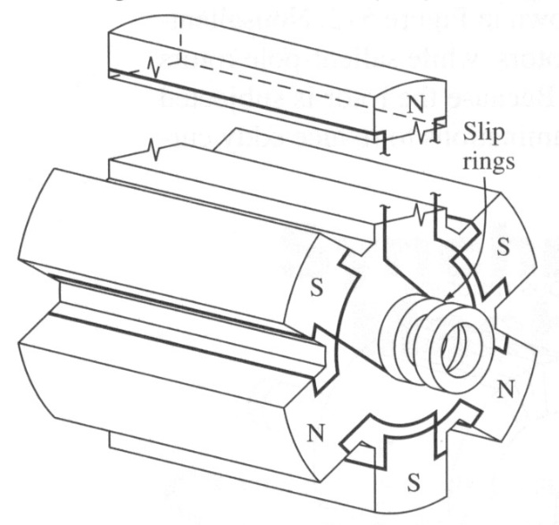
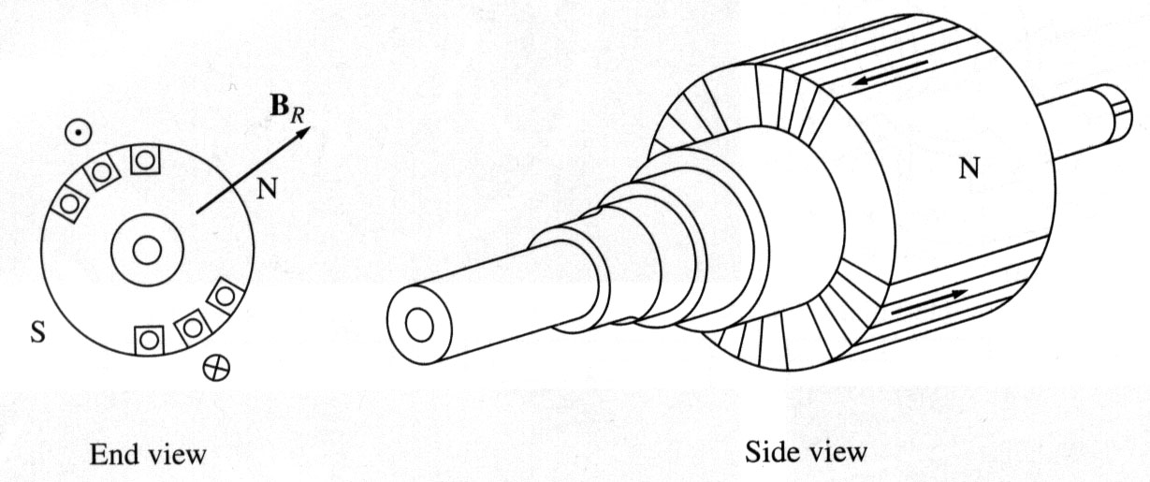
Synchronous Machine Rotors
Rotors are essentially electromagnets
Two pole (P)
round rotor
Six pole salient
rotor
Image Source: Dr. Gleb Tcheslavski, ee.lamar.edu/gleb/teaching.htm

Slide 5
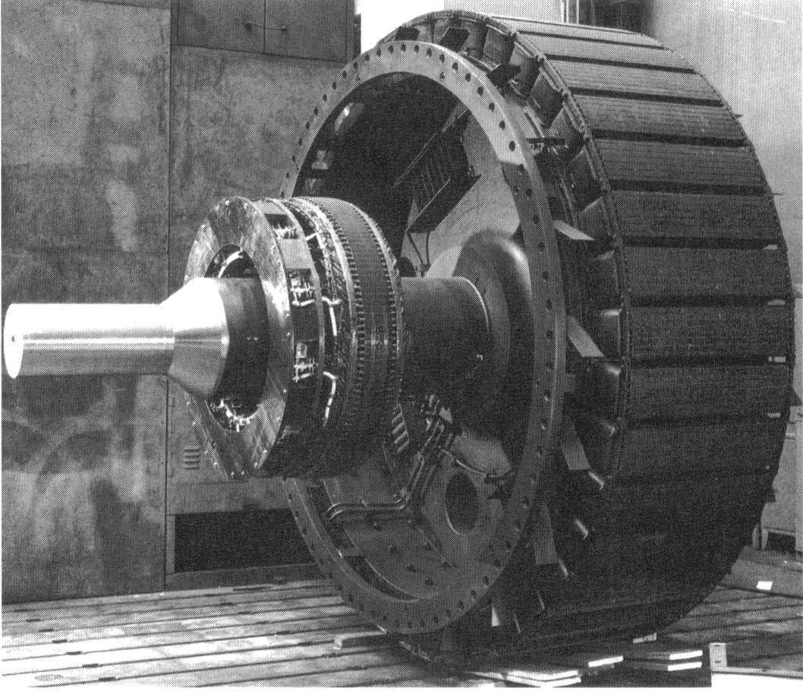
Synchronous Machine Rotors
High pole
salient
rotor
Shaft
Part of exciter,
which is used
to control the
field current
Image Source: Dr. Gleb Tcheslavski, ee.lamar.edu/gleb/teaching.htm

Slide 6
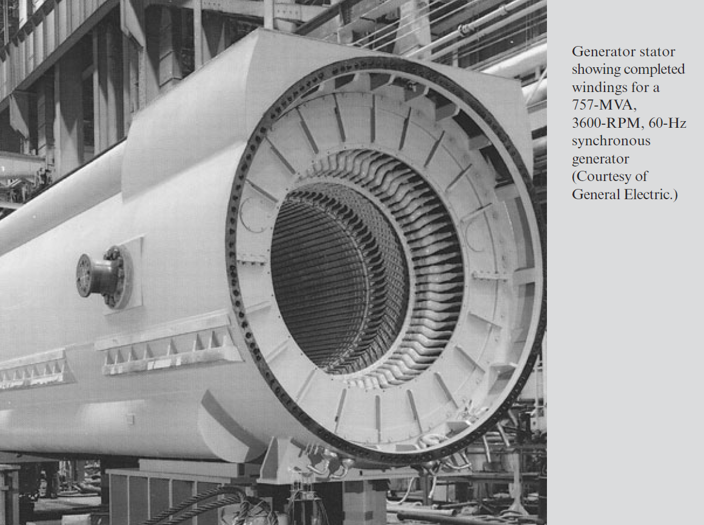
Synchronous Machine Stators
Image Source: Book, Beginning of Chapter 8 Photo

Slide 7
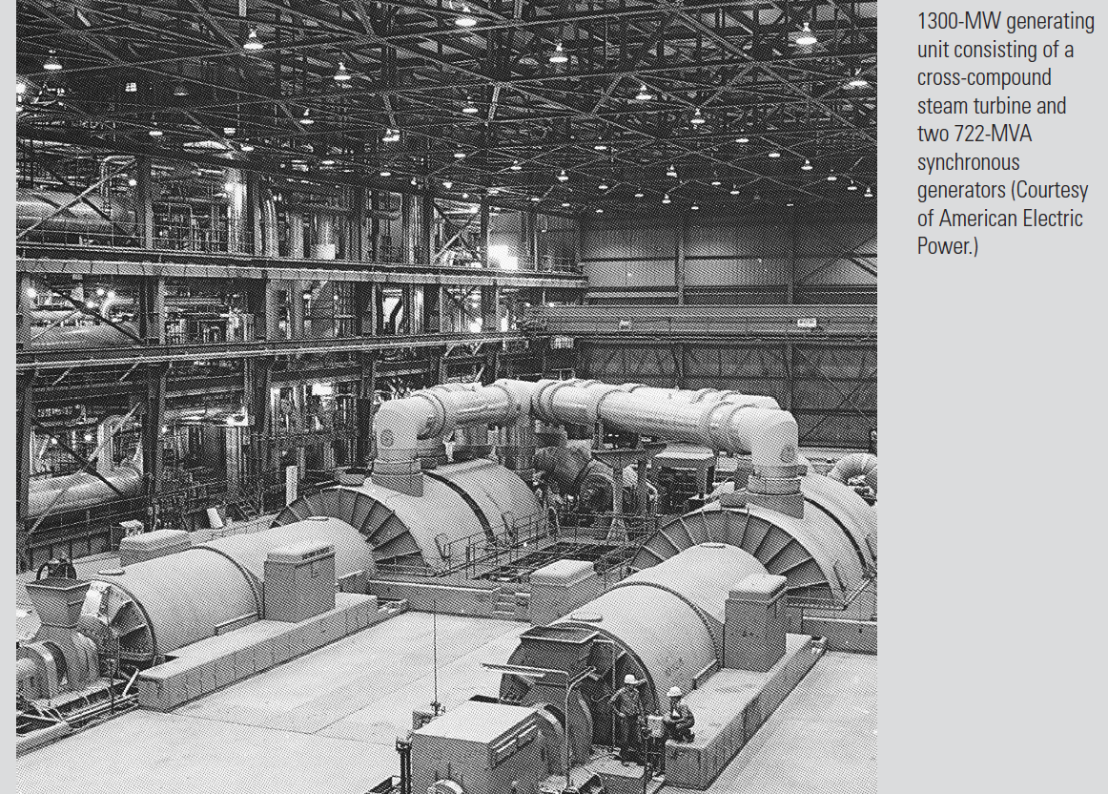
Synchronous Generators
Image Source: Book, Beginning of Chapter 11 Photo

Slide 8
Brief Coverage of Magnetics
Ampere’s circuital law:

Slide 9
Magnetic Flux Density
Magnetic fields are usually measured in terms of flux density
Notes:
8

Slide 10
Magnetic Flux
Notes:
9

Slide 11
Relative Flux Density Values
Earth’s magnetic field is between 30 and 70 μT (0.3 to 0.7 gauss)
A refrigerator magnet might have 0.005 T
A commercial neodymium magnet might be 1 T
A magnetic resonance imaging (MRI) machine would be between 1 and 3 T
Strong lab magnets can be 10 T
Frogs can be levitated at 16 T (see www.ru.nl/hfml/research/levitation/diamagnetic)

Slide 12
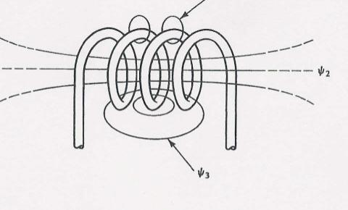
Flux linkages and Faraday’s law
Notes:
11

Slide 13
Inductance
For a linear magnetic system, that is one where
B = μ H
we can define the inductance, L, to be
the constant relating the current and the flux
linkage
λ = L i
where L has units of Henrys (H)
Notes:
12

Slide 14
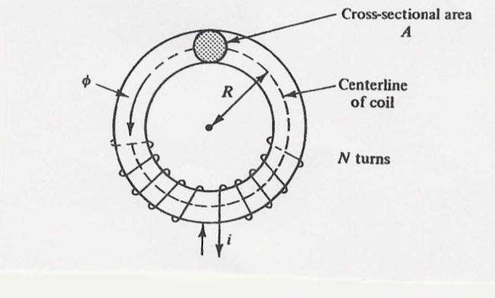
Inductance Example
Calculate the inductance of an N turn coil wound tightly on a torodial iron core that has a radius of R and a cross-sectional area of A. Assume
  all flux is within the coil
  all flux links each turn

Slide 15
Inductance Example, cont’d
Let N=100, A=
0.0006 m², R=0.03 m,
μ_{r}=1000; then L is
0.04 H;

Slide 16
Creating a Voltage in an Open-Circuited Generator
With zero stator current, the only flux is due to the field current
When the generator is at standstill, the flux linking each coil depends on its angle relative to the rotor’s position (and hence the field winding)
  The three phases are physically shifted by 120 degrees from each other
The maximum
flux depends on the field current

Slide 17
Creating a Voltage in an Open-Circuited Generator
No voltage is generated at standstill
Now assume the rotor is spinning at a uniform rate, ω = 2πf, so

Slide 18
Creating a Voltage in an Open-Circuited Generator
Then by Faraday’s law a voltage is induced

Slide 19
Creating a Voltage in an Open-Circuited Generator
For a linear magnetic circuit we can also write this as proportional to field current
The negative sign
could be removed
with a change in
the assumed
polarity

Slide 20
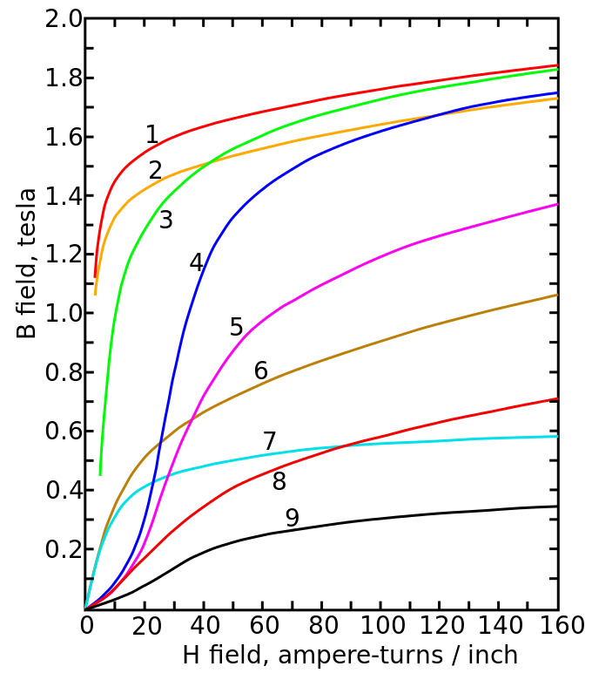
Magnetic Saturation and Hysteresis
A linear magnetic circuit assumes the flux density B is always proportional to current, but real magnetic materials saturate
Magnetization curves of 9 ferromagnetic materials, showing saturation. 1.Sheet steel, 2.Silicon steel, 3.Cast steel, 4.Tungsten steel, 5.Magnet steel, 6.Cast iron, 7.Nickel, 8.Cobalt, 9.Magnetite; highest saturation materials can get to around 2.2 or 2.3T
H is proportional to current
Image Source: en.wikipedia.org/wiki/Saturation_(magnetic)

Slide 21
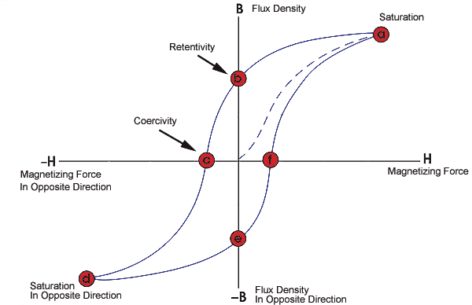
Magnetic Saturation and Hysteresis
Magnetic materials also exhibit hysteresis, so there is some residual magnetism when the current goes to zero; design goal is to reduce the area enclosed by the hysteresis loop
To minimize the amount
of magnetic material,
and hence cost and
weight, electric machines
are designed to operate
close to saturation
Image source: www.nde-ed.org/EducationResources/CommunityCollege/MagParticle/Graphics/BHCurve.gif

Slide 22
Frequency Impacts
Assuming no saturation, the generated voltage is then proportional to frequency
To create the same voltage with less flux, we just need to increase the frequency; this is why aircraft operate at a higher frequency (e.g., 400 Hz)
When controlling motors with variable frequency, common control is to use constant volt/Hz, preventing saturation

Slide 23
Synchronous Machines with Output Current
When operating with an output current, the terminal voltage is not equal to the internally generated voltage
This is due to several factors
  Resistance in the stator windings
  Self-inductance in the stator windings
  Distortion of the air-gap magnetic field due to the stator current; that is, the stator current induces a magnetic field
  Salient pole characteristics of the machine
The stator reactance is called the synchronous reactance, X_{S}, and is sometimes broken into two parts
X_{l} is due to the winding
self inductance

Slide 24
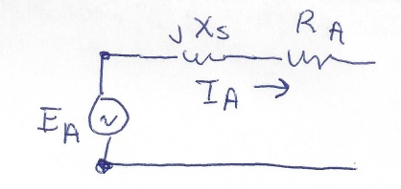
A Synchronous Machine Model
This gives us the following per phase model, which can be helpful in considering how the steady-state real and reactive output of the machine changes with changes in the field current
This model is not particularly good for saturation and understanding the generator’s dynamic response, something we’ll revisit in Chapter 11

Slide 25
Synchronous Machine Testing to Determine Its Parameters
These synchronous machine parameters can be determined from two tests (which we’ll do in Lab 4)
  Open-circuit test: measure the machine’s response when there is no load, and the field current is gradually changed
  Short-circuit test: measure the machine’s response when it is operated at rated speed and its terminals are short-circuited

Slide 26
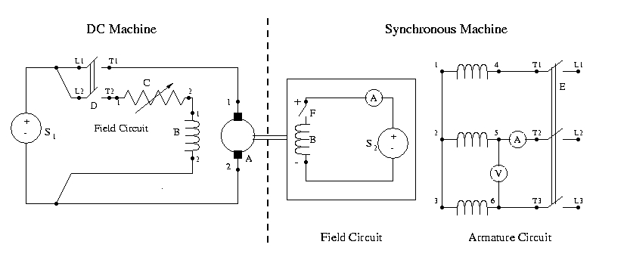
Lab 4 and 5 Setup
We’ll be using a dc machine (which is speed controllable) to drive a synchronous generator. In lab 4 we’ll be doing open-circuit and short-circuit tests to determine its parameters
In the experiment you’ll be measuring line-to-line values,
which are sqrt(3) times the line-to-neutral values

Slide 27
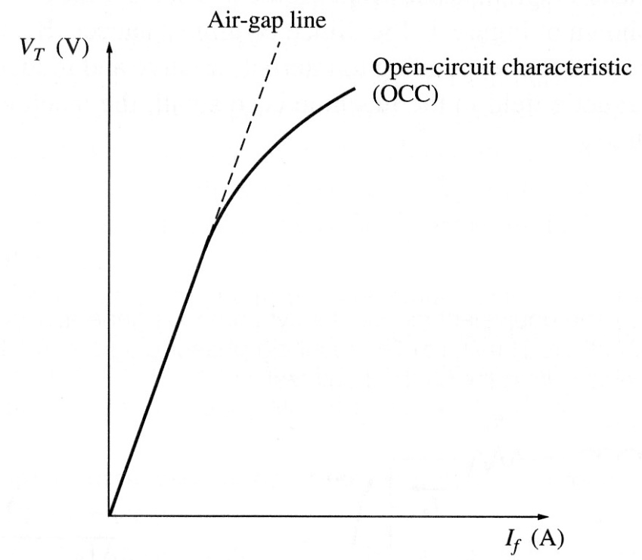
Open-Circuit Characteristic (OCC)
The open-circuit characteristic (OCC) can be derived by gradually
changing the field current
when operating at a fixed
frequency (e.g., synchronous
speed)
  Hysteresis needs to be
  considered when making
  field current adjustments
Because there is no stator current, the internal voltage can be directly measured at the terminals
We’ll be using phasor values here

Slide 28
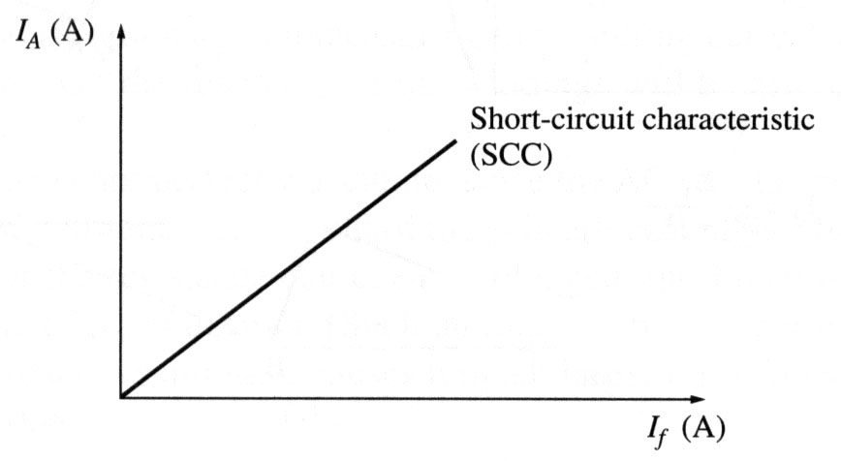
Short-Circuit Test
The short-circuit characteristic measures the relationship between the field current and the terminal current
With the model we get
Since usually X_{S} >> R_{A}, so
This curve is almost
linear since there is little
saturation because the
fluxes in the machine
tend to cancel.

Slide 29
Short-Circuit Test, cont.
However, in doing this test we cannot directly measure E_{A} and of course the terminal voltage is now zero during the short-circuit.
One approach is to approximate it as

Slide 30
Short-Circuit Test, cont.
This approach is accurate up to the point of saturation. An alternative approach is to substitute the equivalent air-gap voltage instead of the V_{OCC} value.
  This is commonly called the unsaturated synchronous reactance, X_{u}
The amount of saturation depends
on loading; in
large generators
saturation is explicitly modeled

Slide 31
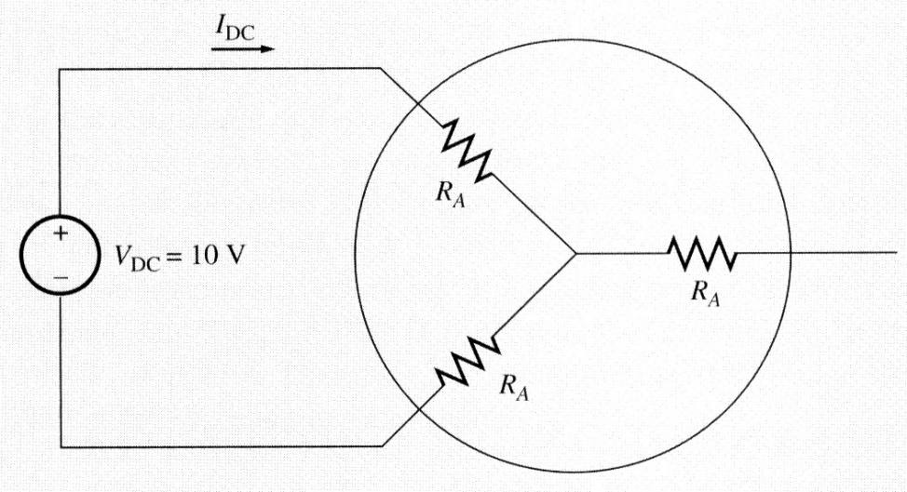
Measuring R_{A}
The winding resistance can be calculated at standstill by applying a small dc voltage to two of the terminals, and then measuring the dc current
Or one could just use an
ohmmeter

Slide 32
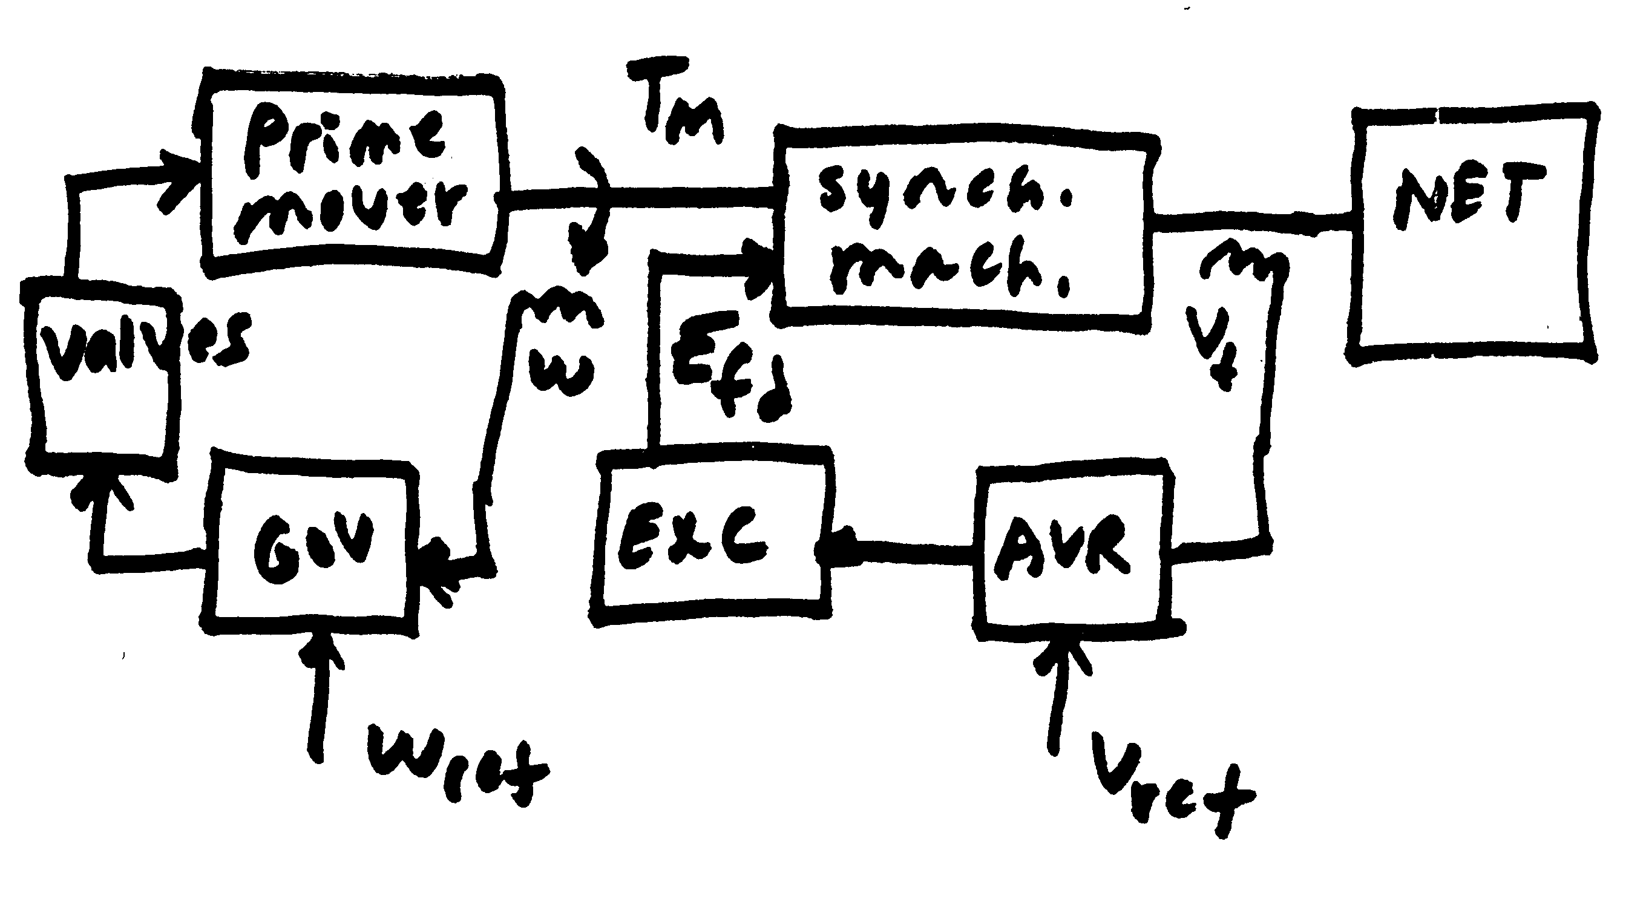
Operating Synchronous Machines Under Load
We’ve seen that the terminal voltage of a synchronous machine can be controlled by adjusting its field voltage (and hence field current)
Large generators have a number of automatic control systems, including one called an exciter to keep the terminal voltage or other
voltage at a specified
value
Small machines might
operate with a constant
field current

Slide 33
Operating Synchronous Machines Under Load with a Constant Field
If the field voltage and hence field current are assumed constant, and the speed is assumed constant (which in practice would be controlled by a governor, which we’ll address in Chapter 12), then the internal voltage can be assumed to be constant
  This is what we’ll be assuming in Experiment 5
How the voltage varies with loading is then given by

Slide 34
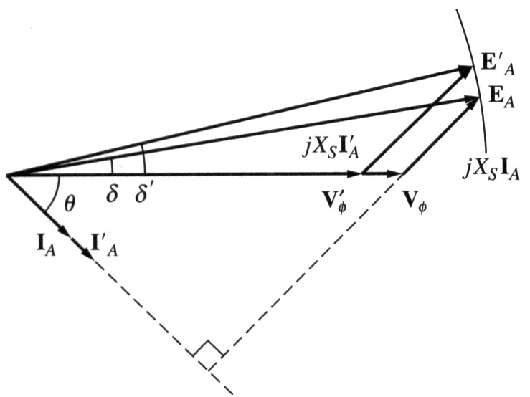
Operating Synchronous Machines Under Load with a Constant Field
To help gain insight, we’ll neglect the usually small R_{A} so then
  Arbitrarily we can set the angle of V_{T} to zero
If the load has a lagging power
factor then internal voltage
magnitude is higher
If leading pf then internal voltage
is lower than the terminal voltage

Slide 35
Operating Synchronous Machines Under Load with a Constant Field
With R_{A} neglected, the power out of the machine is given by
δ is called the torque angle; in general it is the angle difference
between the internal voltage angle and the
terminal voltage angle

Slide 36
Example
A 200 kVA, 480 V (line-to-line), 60 Hz, Y-connected generator with a rated field voltage of 5A was tested with the following results
  V_{T,LL} = 540 V at rated field current
  I_{A,SC} = 300 A at rated field current
  When disconnected, a dc voltage of 10 V is applied to two of the terminals, giving a current of 25 A
  Find the model

Slide 37
Example, cont.
The internal, per phase voltage is
The synchronous reactance at the rated field current is
If we wished to include the impact of R_{A} it would be

Slide 38
Example, cont.
Now assume a three-phase, wye-connected load is attached to its terminal with Z = 4∠20° Ω. The field current is adjusted so the line-to-line terminal voltage is 480 V and the generator is operated at 60 Hz. What is the internal voltage, and what is the total power delivered to the load? Use X_{S} = 1.04 Ω. Then repeat with Z = 4∠-20° Ω.

Slide 39
Example, cont.
With Z = 4∠20° Ω
With Z = 4∠-20° Ω

Slide 40
Quick Coverage of DC Machines
Prior to widespread use of machine drives, dc motors had a important advantage of easy speed control
  Example is a model railroad
On the stator a dc machine has either a permanent magnet or a single concentrated winding
  With winding field voltage is V_{f} and field current is I_{f}
Rotor (armature) currents are supplied through brushes and commutator

Slide 41
Types of DC Machines
If there is a field winding (i.e., not a permanent magnet machine) then the machine could be connected in the following ways
  Separately-excited: Field and armature windings are connected to separate power sources
    For an exciter, control is provided by varying the field current (which is stationary), which changes the armature voltage
  Series-excited: Field and armature windings are in series
  Shunt-excited: Field and armature windings are in parallel

Slide 42
Quick Coverage of DC Machines
In a machine with a field winding the equations are
In steady-state these can be simplified to
In a shunt-connected machine, V_{T} = V_{F} so
G is a machine constant,
ω_{m} is its speed

