Slide 1
ECEN 460
Power System Operation and Control
Lecture 11: Power Flow
Prof. Tom Overbye
Dept. of Electrical and Computer Engineering
Texas A&M University
overbye@tamu.edu

Slide 2
Announcements
Read Chapter 6.7 to 6.11
Exam 1 Results: Avg: 78.8
  96-100: 1
  92-95: 1
  88-91: 6
  84-87: 11
  80-83: 14
  76-79: 14
  72-75: 8
  68-71: 7
  67 or less: 6

Slide 3
Problem 6.25
Use Newton-Raphson to solve

Slide 4
At the End of Lecture 9 We Had

Slide 5
NR Application to Power Flow

Slide 6
Real Power Balance Equations

Slide 7
Newton-Raphson Power Flow

Slide 8
Power Flow Variables

Slide 9
N-R Power Flow Solution

Slide 10
Power Flow Jacobian Matrix

Slide 11
Power Flow Jacobian Matrix, cont’d

Slide 12
Two Bus Newton-Raphson Example
For the two bus power system shown below, use the
Newton-Raphson power flow to determine the
voltage magnitude and angle at bus two. Assume
that bus one is the slack and S_{Base} = 100 MVA.

Slide 13
Two Bus Example, cont’d

Slide 14
Two Bus Example, cont’d

Slide 15
Two Bus Example, First Iteration

Slide 16
Two Bus Example, Next Iterations

Slide 17
Two Bus Solved Values
Once the voltage angle and magnitude at bus 2 are
known we can calculate all the other system values,
such as the line flows and the generator reactive
power output

Slide 18
Two Bus Case Low Voltage Solution

Slide 19
Low Voltage Solution, cont'd
Low voltage solution

Slide 20
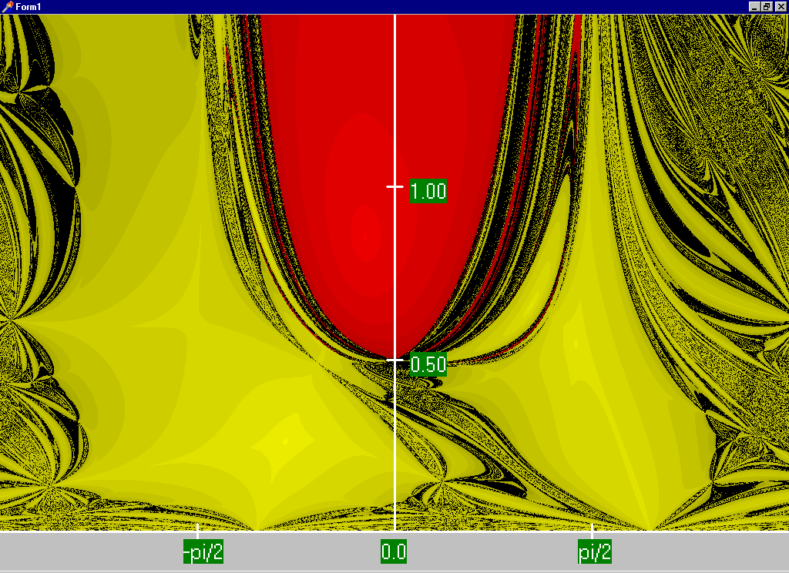
Two Bus Region of Convergence
Slide shows the region of convergence for different initial
guesses of bus 2 angle (x-axis) and magnitude (y-axis)
Red region
converges
to the high
voltage
solution,
while the
yellow region
converges
to the low
voltage
solution

Slide 21
August 14, 2003 Day Ahead Power Flow Low Voltage Solution Contour
The day
ahead
model had
65
energized
115,138,
or 230 kV
buses
with
voltages
below
0.90 pu
The lowest 138 kV voltage was 0.836 pu; lowest 34.5 kV was 0.621 pu;
case contained 42,766 buses; case had been used daily all summer

Slide 22
PV Buses
Since the voltage magnitude at PV buses is fixed there is no need to explicitly include these voltages in x or write the reactive power balance equations
  the reactive power output of the generator varies to maintain the fixed terminal voltage (within limits)
  optionally these variations/equations can be included by just writing the explicit voltage constraint for the generator bus
  |V_{i} | – V_{i setpoint} = 0

Slide 23
Three Bus PV Case Example

Slide 24
Generator Reactive Power Limits
The reactive power output of generators varies to maintain the terminal voltage; on a real generator this is done by the exciter
To maintain higher voltages requires more reactive power
Generators have reactive power limits, which are dependent upon the generator's MW output
These limits must be considered during the power flow solution
These limits will be discussed further with the Newton-Raphson algorithm

Slide 25
Generator Reactive Limits, cont'd
During power flow once a solution is obtained check to make generator reactive power output is within its limits
If the reactive power is outside of the limits, fix Q at the max or min value, and resolve treating the generator as a PQ bus
  this is know as "type-switching"
  also need to check if a PQ generator can again regulate
Rule of thumb: to raise system voltage we need to supply more vars

Slide 26
The N-R Power Flow: 5-bus Example
T2
800 MVA
345/15 kV
1
T1
5
4
3
520 MVA
Line 3 345 kV
50 mi
400 MVA
15 kV
800 MVA
15 kV
400 MVA
15/345 kV
345 kV 100 mi
345 kV 200 mi
40 Mvar
80 MW
Line 2
Line 1
2
280 Mvar
800 MW
Single-line diagram
25

Slide 27
The N-R Power Flow: 5-bus Example
Bus | Type | V per unit | δ degrees | P_{G} per unit | Q_{G} per unit | P_{L} per unit | Q_{L} per unit | Q_{Gmax} per unit | Q_{Gmin} per unit
1 | Swing | 1.0 | 0 | ⎯ | ⎯ | 0 | 0 | ⎯ | ⎯
2 | Load | ⎯ | ⎯ | 0 | 0 | 8.0 | 2.8 | ⎯ | ⎯
3 | Constant voltage | 1.05 | ⎯ | 5.2 | ⎯ | 0.8 | 0.4 | 4.0 | -2.8
4 | Load | ⎯ | ⎯ | 0 | 0 | 0 | 0 | ⎯ | ⎯
5 | Load | ⎯ | ⎯ | 0 | 0 | 0 | 0 | ⎯ | ⎯
Table 1.
Bus input
data
Bus-to-Bus | R’ per unit | X’ per unit | G’ per unit | B’ per unit | Maximum MVA per unit
2-4 | 0.0090 | 0.100 | 0 | 1.72 | 12.0
2-5 | 0.0045 | 0.050 | 0 | 0.88 | 12.0
4-5 | 0.00225 | 0.025 | 0 | 0.44 | 12.0
Table 2.
Line input data
26
Notes:
26

Slide 28
The N-R Power Flow: 5-bus Example
Bus-to-Bus | R per unit | X per unit | G_{c} per unit | B_{m} per unit | Maximum MVA per unit | Maximum TAP Setting per unit
1-5 | 0.00150 | 0.02 | 0 | 0 | 6.0 | —
3-4 | 0.00075 | 0.01 | 0 | 0 | 10.0 | —
Table 3.
Transformer
input data
Bus | Input Data | Unknowns
1 | V₁ = 1.0, δ₁ = 0 | P₁, Q₁
2 | P₂ = P_{G2}-P_{L2} = -8 Q₂ = Q_{G2}-Q_{L2} = -2.8 | V₂, δ₂
3 | V₃ = 1.05 P₃ = P_{G3}-P_{L3} = 4.4 | Q₃, δ₃
4 | P₄ = 0, Q₄ = 0 | V₄, δ₄
5 | P₅ = 0, Q₅ = 0 | V₅, δ₅
Table 4. Input data
and unknowns
27
Notes:
27

Slide 29
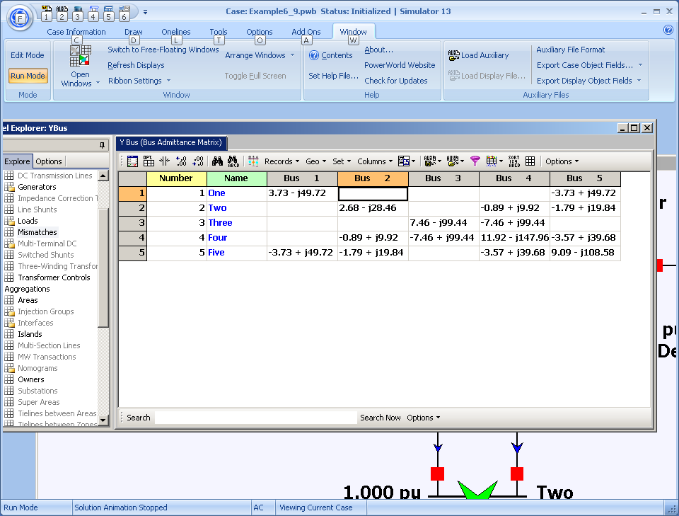
Time to Close the Hood: Let the Computer Do the Math! (Ybus Shown)
28
Notes:
28

