Slide 1
ECEN 460
Power System Operation and Control
Lecture 15: Economic Dispatch
Prof. Tom Overbye
Dept. of Electrical and Computer Engineering
Texas A&M University
overbye@tamu.edu

Slide 2
Announcements
Finish reading Chapter 6
Homework 5 is due Tuesday Oct 24
Homework 6 is 6.58, 6.59, 6.60, 6.62, 6.63; it is due on Tuesday Oct 31
The TAs will have office hours in WEB 115 to help you finish the lab

Slide 3
Generation Dispatch
Since the load is variable and there must be enough generation to meet the load, almost always there is more generation capacity available than load
Optimally determining which generators to use can be a complicated task due to many different constraints
  For generators with low or no cost fuel (e.g., wind and solar PV) it is “use it or lose it”
  For others like hydro there may be limited energy for the year
  Some fossil has shut down and start times of many hours
Economic dispatch looks at the best way to instantaneously dispatch the generation
2

Slide 4
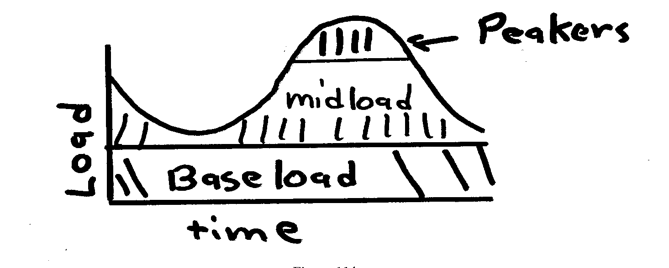
Generator types
Traditionally utilities have had three broad groups of generators
  baseload units: large coal/nuclear; always on at max.
  midload units: smaller coal that cycle on/off daily
  peaker units: combustion turbines used only for several hours during periods of high demand
Wind and solar
PV can be
quite variable;
usually they are
operated at max.
available power
3

Slide 5
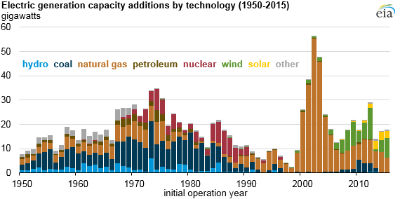
Utility Scale Generator Capacity Additions in the US
4

Slide 6
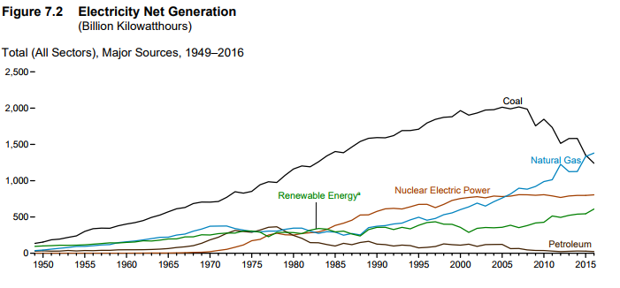
US Electricity Generation by Fuel Type
In first half of 2017, wind was 7.2% and solar was 1.3%
Source: www.eia.gov/totalenergy/data/monthly/pdf/sec7_4.pdf

Slide 7
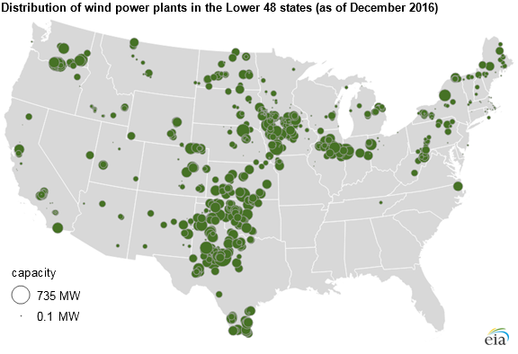
Distribution of Wind Power Plants
6

Slide 8
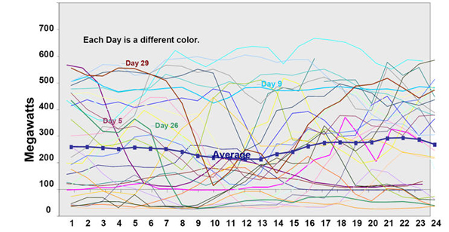
The Challenge of Wind Dispatch
Image shows wind output for a month in California
by hour and day
Source: www.megawattsf.com/gridstorage/gridstorage.htm

Slide 9
Thermal versus Hydro Generation
The two main types of generating units are thermal and hydro, with wind rapidly growing
For hydro the fuel (water) is free but there may be many constraints on operation
  fixed amounts of water available
  reservoir levels must be managed and coordinated
  downstream flow rates for fish and navigation
Hydro optimization is typically longer term (many months or years)
In 460 we will concentrate on thermal units and some wind, looking at short-term optimization
8

Slide 10
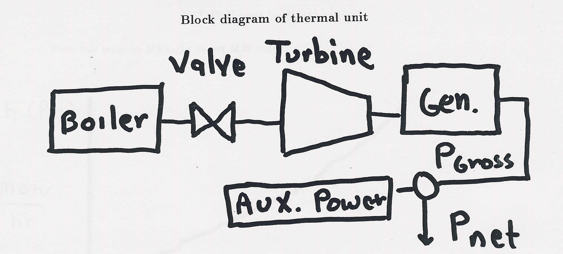
Block Diagram of Thermal Unit
To optimize generation costs we need to develop
cost relationships between net power out and operating
costs. Between 2-6% of power is used within the
generating plant; this is known as the auxiliary power
9

Slide 11
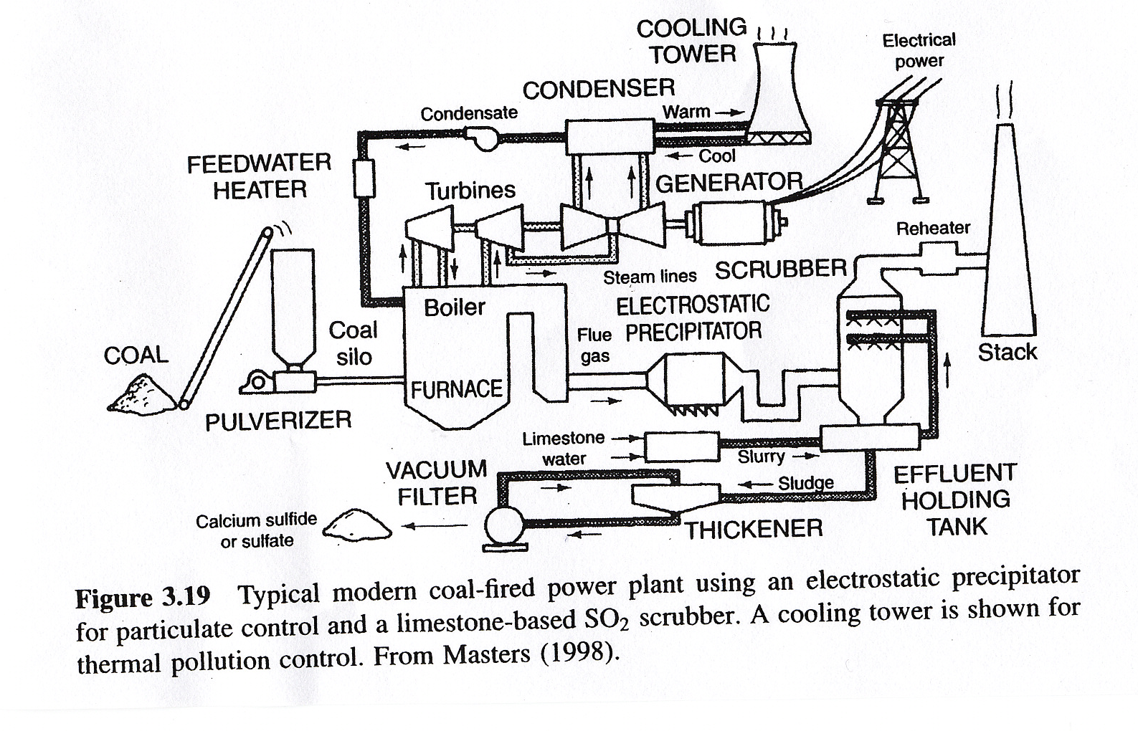
Modern Coal Plant
Source: Masters, Renewable and Efficient Electric Power Systems, 2004
10

Slide 12
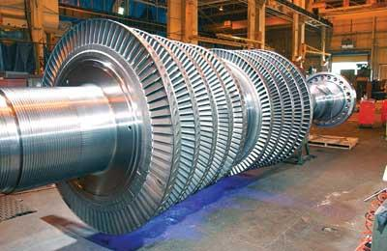
Turbine for Nuclear Power Plant
Source: http://images.pennnet.com/articles/pe/cap/cap_gephoto.jpg
11

Slide 13
Basic Gas Turbine
Most common fuel is natural gas
Typical efficiency is around 30 to 35%
12

Slide 14
Combined Cycle Power Plant
Efficiencies of up to 60% can be achieved, with even higher
values when the steam is used for heating. Fuel is usually natural gas
13

Slide 15
Generator Cost Curves
Generator costs are typically represented by up to four different curves
  input/output (I/O) curve
  fuel-cost curve
  heat-rate curve
  incremental cost curve
For reference
  1 Btu (British thermal unit) = 1054 J
  1 MBtu = 1x10⁶ Btu
  1 MBtu = 0.293 MWh
  3.41 Mbtu = 1 MWh
14

Slide 16
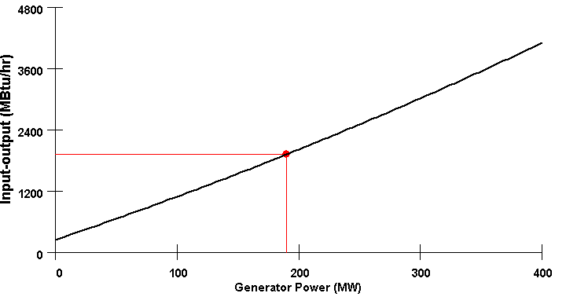
I/O Curve
The IO curve plots fuel input (in MBtu/hr) versus net MW output.
15

Slide 17
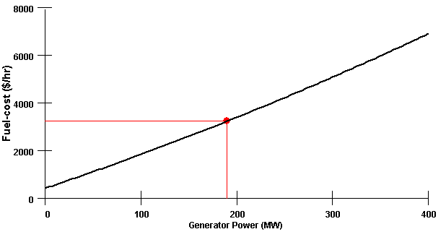
Fuel-cost Curve
The fuel-cost curve is the I/O curve scaled by fuel cost. A typical cost for coal is $ 1.70/Mbtu.
16

Slide 18
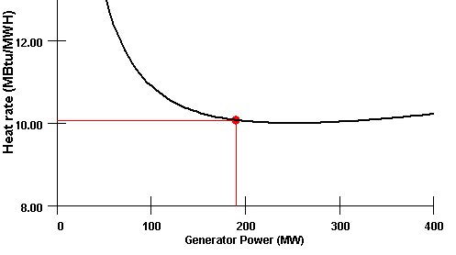
Heat-rate Curve
Plots the average number of MBtu/hr of fuel input needed per MW of output.
Heat-rate curve is the I/O curve scaled by MW
Best for most efficient units are
around 9.0
17

Slide 19
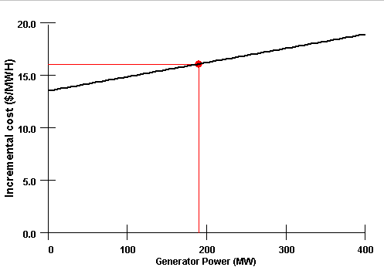
Incremental (Marginal) cost Curve
Plots the incremental $/MWh as a function of MW.
Found by differentiating the cost curve
18

Slide 20
Mathematical Formulation of Costs
Generator cost curves are usually not smooth. However the curves can usually be adequately approximated using piece-wise smooth, functions.
Two representations predominate
  quadratic or cubic functions
  piecewise linear functions
In 460 we'll assume a quadratic presentation
19

Slide 21
Coal Usage Example 1
A 500 MW (net) generator is 35% efficient. It is being supplied with Western grade coal, which costs $1.70 per MBtu and has 9000 Btu per pound. What is the coal usage in lbs/hr? What is the cost?
20

Slide 22
Coal Usage Example 2
Assume a 100W lamp is left on by mistake for 8 hours, and that the electricity is supplied by the previous coal plant and that transmission and distribution losses are 20%. How coal has been used?
21

Slide 23
Incremental Cost Example
22

Slide 24
Incremental Cost Example, cont'd
23

Slide 25
Economic Dispatch: Formulation
The goal of economic dispatch is to determine the generation dispatch that minimizes the instantaneous operating cost, subject to the constraint that total generation = total load + losses
Initially we'll
ignore generator
limits and the
losses
24

Slide 26
Unconstrained Minimization
This is a minimization problem with a single equality constraint
For an unconstrained minimization a necessary (but not sufficient) condition for a minimum is the gradient of the function must be zero,
The gradient generalizes the first derivative for multi-variable problems:
25

Slide 27
Minimization with Equality Constraint
When the minimization is constrained with an equality constraint we can solve the problem using the method of Lagrange Multipliers
Key idea is to modify a constrained minimization problem to be an unconstrained problem
26

Slide 28
Economic Dispatch Lagrangian
27

Slide 29
Economic Dispatch Example
28

Slide 30
Economic Dispatch Example, cont’d
29

Slide 31
Lambda-Iteration Solution Method
The direct solution only works well if the incremental cost curves are linear and no generators are at their limits
A more general method is known as the lambda-iteration
  the method requires that there be a unique mapping between a value of lambda and each generator’s MW output
  the method then starts with values of lambda below and above the optimal value, and then iteratively brackets the optimal value
30

Slide 32
Lambda-Iteration Algorithm
31

Slide 33
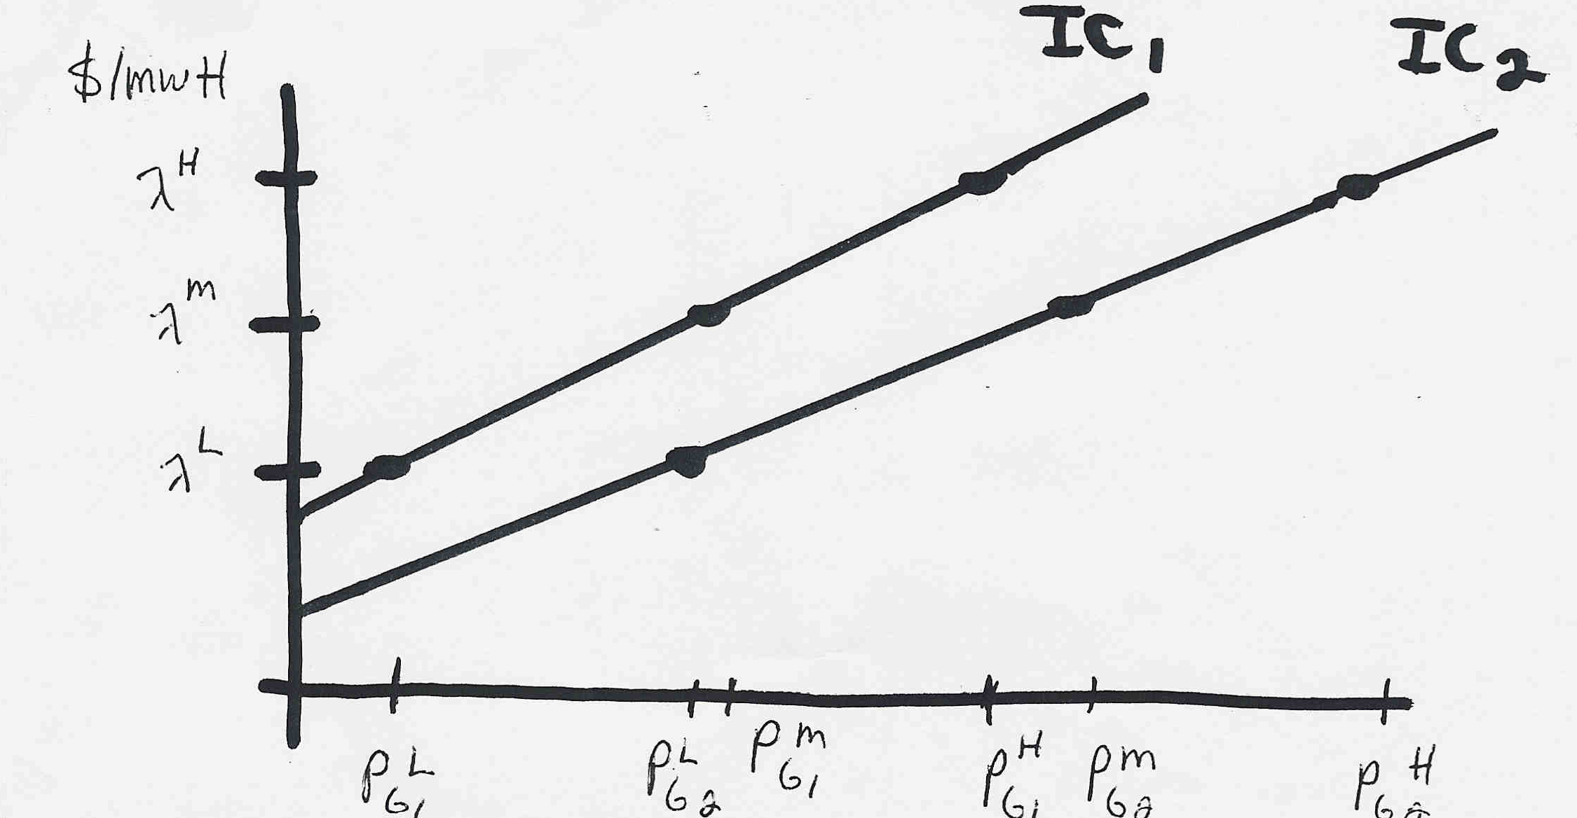
Lambda-Iteration: Graphical View
In the graph shown below for each value of lambda
there is a unique P_{Gi} for each generator. This
relationship is the P_{Gi}(λ) function.
32

Slide 34
Lambda-Iteration Example
33

Slide 35
Lambda-Iteration Example, cont’d
34

Slide 36
Lambda-Iteration Example, cont’d
35

Slide 37
Lambda-Iteration Example, cont’d
36

Slide 38
Generator MW Limits
Generators have limits on the minimum and maximum amount of power they can produce
Often times the minimum limit is not zero. This represents a limit on the generator’s operation with the desired fuel type
Because of varying system economics usually many generators in a system are operated at their maximum MW limits.
37

Slide 39
Lambda-Iteration with Gen Limits
38

