Slide 1
ECEN 460
Power System Operation and Control
Lecture 16: Economic Dispatch, Optimal Power Flow
Prof. Tom Overbye
Dept. of Electrical and Computer Engineering
Texas A&M University
overbye@tamu.edu

Slide 2
Announcements
Finish reading Chapter 6
Homework 6 is 6.58, 6.59, 6.60, 6.62, 6.63; it is due on Tuesday Oct 31

Slide 3
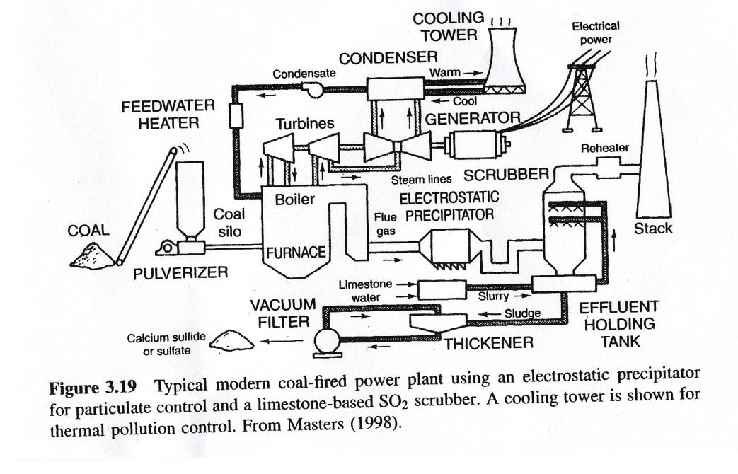
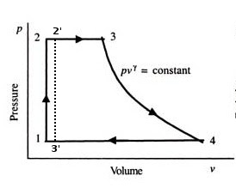
Coal Plant: Need for Condenser
Rankine cycle uses a fluid that is evaporated and condensed; Brayton cycle when just a gas
Work output is the integral of the P-V diagram; we require a change in pressure and volume
Plants are more efficient when there is a greater temperature difference

Slide 4
Generator MW Limits
Generators have limits on the minimum and maximum amount of power they can produce
Often times the minimum limit is not zero. This represents a limit on the generator’s operation with the desired fuel type
Because of varying system economics usually many generators in a system are operated at their maximum MW limits.
3

Slide 5
Lambda-Iteration with Gen Limits
4

Slide 6
Lambda-Iteration Gen Limit Example
5

Slide 7
Lambda-Iteration Limit Example,cont’d
6

Slide 8
Back of Envelope Values
Often times incremental costs can be approximated by a constant value:
  $/MWhr = fuelcost * heatrate + variable O&M
  Typical heatrate for a coal plant is 10, modern combustion turbine is 10, combined cycle plant is 7 to 8, older combustion turbine 15.
  Fuel costs ($/MBtu) are quite variable, with current values around 1.5 for coal, 3 for natural gas, 0.5 for nuclear, probably 10 for fuel oil.
  Hydro, solar and wind costs tend to be quite low, but for this sources the fuel is free but limited
7

Slide 9
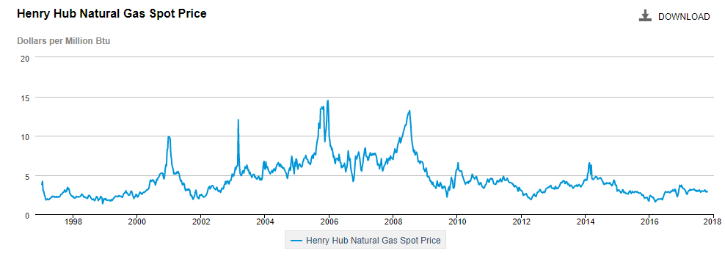
Natural Gas Prices 1997 to 2017
Marginal cost for natural gas fired electricity price
in $/MWh is about 7-10 times gas price; Oct 2017 price
is $2.84/MBtu
Source: http://www.eia.gov/dnav/ng/hist/rngwhhdW.htm
8

Slide 10
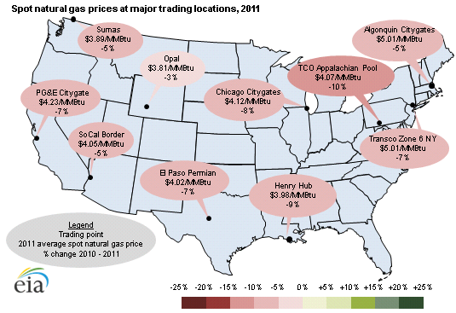
Geographic Variation in Natural Gas Prices
9

Slide 11
Inclusion of Transmission Losses
The losses on the transmission system are a function of the generation dispatch. In general, using generators closer to the load results in lower losses
This impact on losses should be included when doing the economic dispatch
Losses can be included by slightly rewriting the Lagrangian:
10

Slide 12
Impact of Transmission Losses
11

Slide 13
Impact of Transmission Losses
The penalty factor
at the slack bus is
always unity!
12

Slide 14
Impact of Transmission Losses
13

Slide 15
Calculation of Penalty Factors
14

Slide 16
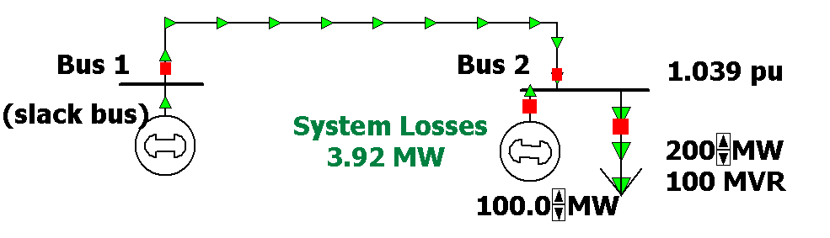
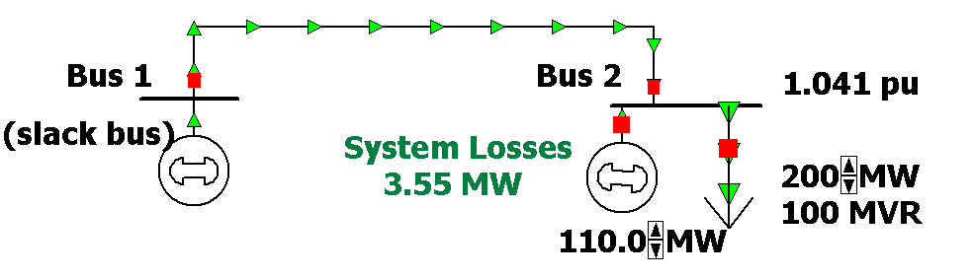
Two Bus Penalty Factor Example
15

Slide 17
Example 6.22
16

Slide 18
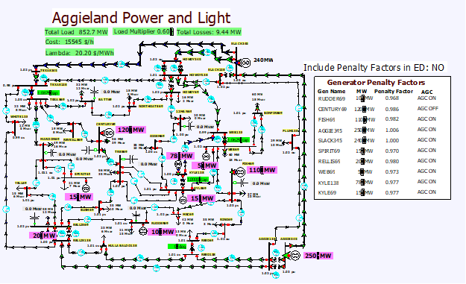
Lab Seven Introduction: 37 Bus
Lab seven covers economic dispatch and contingency analysis for the two systems from lab six
17

Slide 19
Lab Seven Introduction: 37 Bus
Lab considers the system economic dispatch under varying load conditions, using a uniform load scalar
In first part of lab you’ll observe how values change without consideration of losses
Second part is a repeat considering the impact of marginal losses
Third part looks at contingency analysis, with the goal to fix voltage and flow violations
Last part looks at loss minimization
18

Slide 20
Contingency Analysis and the Reference Case
Contingency analysis works by first storing a reference case, then sequentially applying each contingency to the reference case, reloading the reference case between contingencies
In PowerWorld the reference case can be changed by either closing and reopening the contingency analysis form, or using an option on the form
This allows you to easily look at of individual contingency cases
  Right click on the contingencies and select Contingency Records, Solve Selected Contingency
19

Slide 21
Lab Seven Introduction: 2000 Bus Case, Operating North Central Texas
The North
Central Texas
Area has 483
Buses
Case for lab is
setup with just
77 500 kV line
contingencies
20

Slide 22
Lab Seven Introduction: 2000 Bus Case: Initial Voltage Contour
21

Slide 23
Optimal Power Flow (OPF)
Next we’ll consider OPF and SCOPF
OPF functionally combines the power flow with economic dispatch
SCOPF adds in contingency analysis
In both minimize a cost function, such as operating cost, taking into account realistic equality and inequality constraints
Equality constraints
  bus real and reactive power balance
  generator voltage setpoints
  area MW interchange
22

Slide 24
OPF, cont’d
Inequality constraints
  transmission line/transformer/interface flow limits
  generator MW limits
  generator reactive power capability curves
  bus voltage magnitudes (not yet implemented in Simulator OPF)
Available Controls
  generator MW outputs
  transformer taps and phase angles
23

Slide 25
Two Example OPF Solution Methods
Non-linear approach using Newton’s method
  handles marginal losses well, but is relatively slow and has problems determining binding constraints
Linear Programming
  fast and efficient in determining binding constraints, but can have difficulty with marginal losses.
  used in PowerWorld Simulator
24

