Slide 1
ECEN 460
Power System Operation and Control
Lecture 20: Transient Stability
Prof. Tom Overbye
Dept. of Electrical and Computer Engineering
Texas A&M University
overbye@tamu.edu

Slide 2
Announcements
Begin reading Chapter 11
Design project is due on Dec 5; details on the website
Homework 7 is 6.65, 6.69, 6.72, 11.4, 11.7; it should be done before second exam but need not be turned in
No lab week of Nov 13; lab 9 is on Nov 20/21 and lab 10 is on Nov 27/28; no lab week of Dec 4
Exam 2 is during class on November 14
  My UIUC ECE 476 exam 2 is posted, but the 476 content is slightly different from 460
  Closed booked, closed notes, two note sheets and calculators
  Email me question suggestions before COB on Thursday

Slide 3
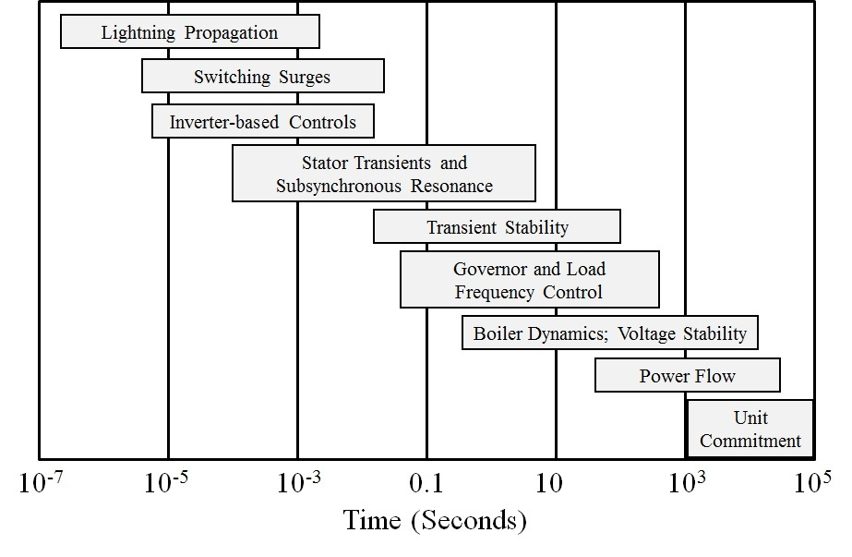
Power System Time Scales and Transient Stability
Image source: P.W. Sauer, M.A. Pai, Power System Dynamics and Stability, 1997, Fig 1.2, modified
2

Slide 4
Power System Stability Terms
Terms continue to evolve, but a good reference is [1]; image shows Figure 1 from this reference
[1] IEEE/CIGRE Joint Task Force on Stability Terms and Definitions, “Definitions and Classification of Power System Stability,” IEEE Transactions Power Systems, May 2004, pp. 1387-1401
3

Slide 5
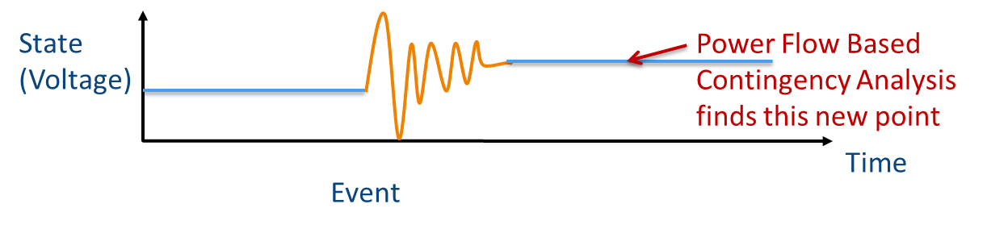
Recap: Power Flow
The power flow is used to determine a quasi steady-state operating condition for a power system
  Goal is to solve a set of algebraic equations
    g(y) = 0 [y variables are bus voltage and angle]
  Models employed reflect the steady-state assumption
  Using a power flow, after a contingency occurs (such as opening a line), the algebraic equations are solved to determine a new equilibrium
4

Slide 6
Power Flow vs. Dynamics
Dynamics simulations is used to determine whether following a contingency the power system returns to a steady-state operating point
  Goal is to solve a set of differential and algebraic equations,
    dx/dt = f(x,y) [y variables are bus voltage and angle]
    g(x,y) = 0 [x variables are dynamic state variables]
  Starts in steady-state, and hopefully returns to a usually new steady-state value
  Models reflect the transient stability time frame (up to dozens of seconds)
    Slow Values → Treat as constants
    Ultra Fast States → Treat as algebraic relationships
5

Slide 7
Power System Transient Stability
In order to operate as an interconnected system all of the generators (and other synchronous machines) must remain in synchronism with one another
  synchronism requires that (for two pole machines) the rotors turn at exactly the same speed
Loss of synchronism results in a condition in which no net power can be transferred between the machines
A system is said to be transiently unstable if following a disturbance one or more of the generators lose synchronism
6

Slide 8
Generator Transient Stability Models
In order to study the transient response of a power system we need to develop models for the generator valid during the transient time frame of several seconds following a system disturbance
We need to develop both electrical and mechanical models for the generators
7

Slide 9
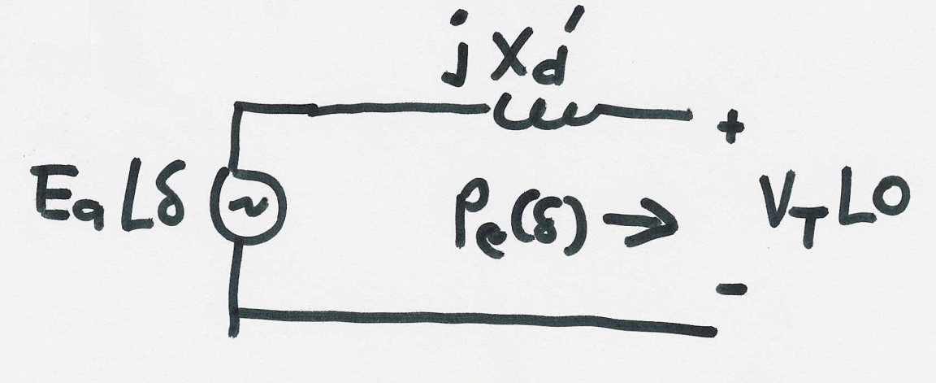
Generator Electrical Model
The simplest generator model, known as the classical model, treats the generator as a voltage source behind the direct-axis transient reactance; the voltage magnitude is fixed, but its angle changes according to the mechanical dynamics
8

Slide 10
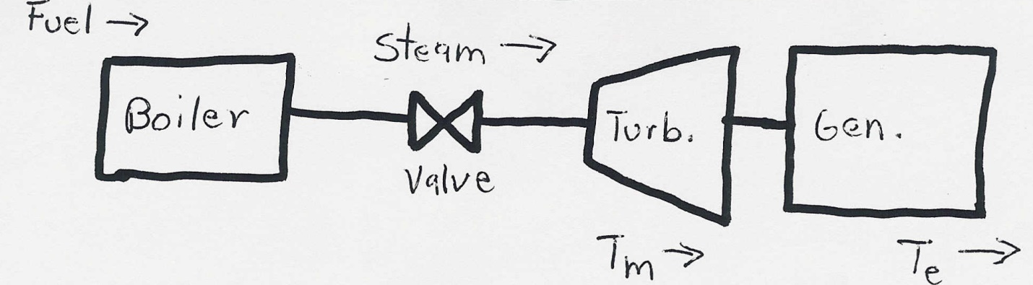
Generator Mechanical Model
Generator Mechanical Block Diagram
9

Slide 11
Generator Mechanical Model, cont’d
10

Slide 12
Generator Mechanical Model, cont’d
11

Slide 13
Generator Mechanical Model, cont’d
12

Slide 14
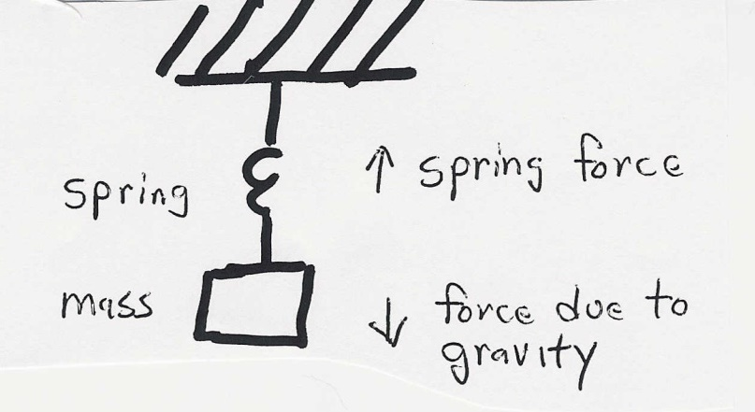
Generator Swing Equation
13

Slide 15
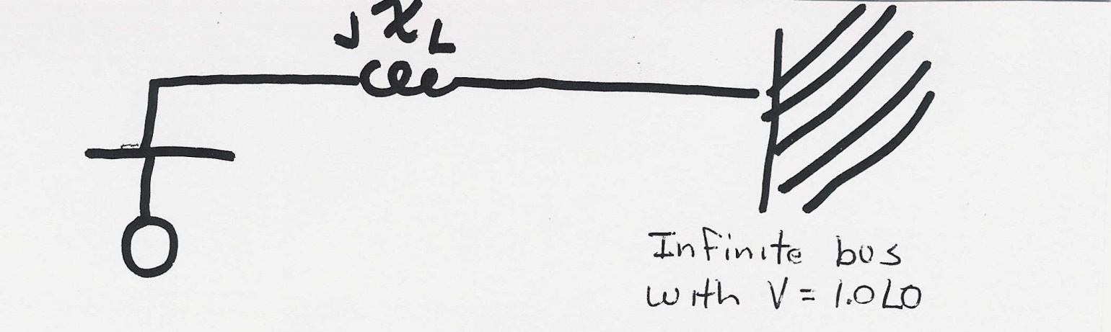
Single Machine Infinite Bus (SMIB)
To understand the transient stability problem we’ll first consider the case of a single machine (generator) connected to a power system bus with a fixed voltage magnitude and angle (known as an infinite bus) through a transmission line with impedance jX_{L}
14

Slide 16
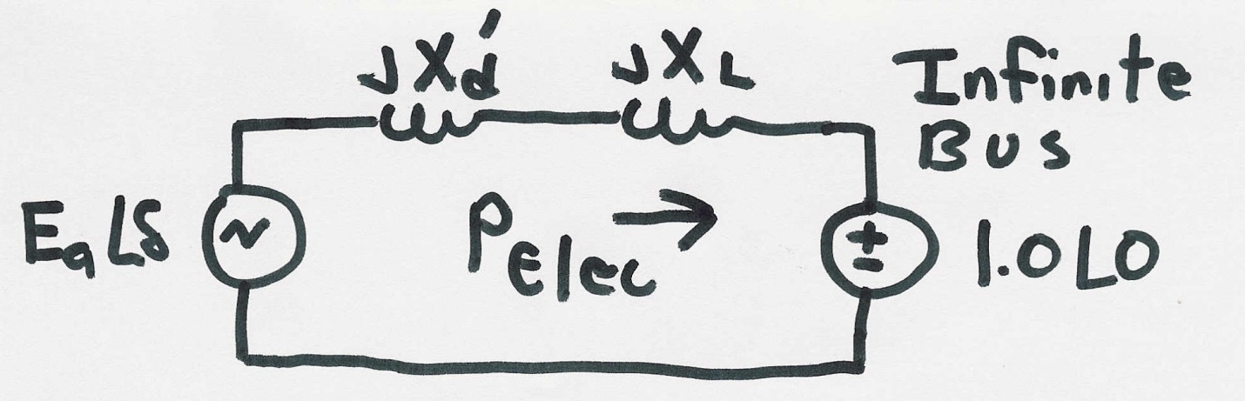
SMIB, cont’d
15

Slide 17
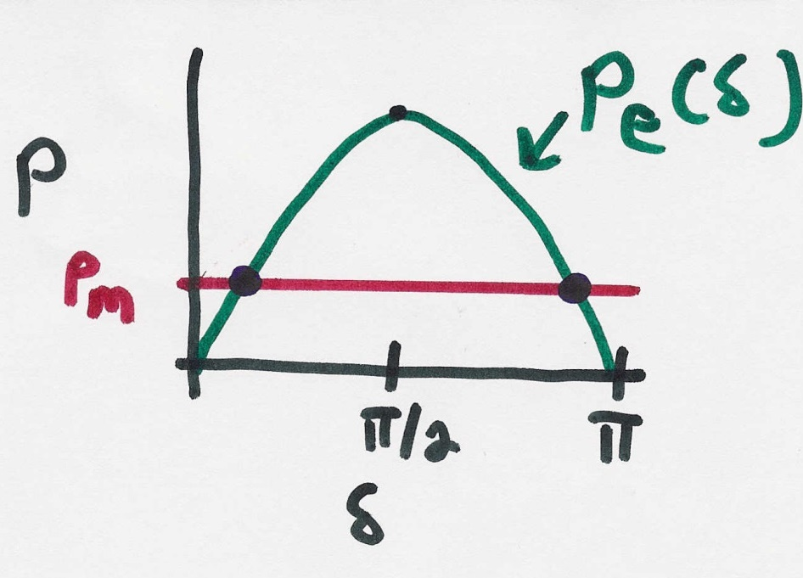
SMIB Equilibrium Points
16

Slide 18
Transient Stability Analysis
For transient stability analysis we need to consider three systems
  Prefault - before the fault occurs the system is assumed to be at an equilibrium point
  Faulted - the fault changes the system equations, moving the system away from its equilibrium point
  Postfault - after fault is cleared the system hopefully returns to a new operating point
Actual transient stability studies can have
multiple events
17

Slide 19
Transient Stability Solution Methods
There are two methods for solving the transient stability problem
  Numerical integration
    this is by far the most common technique, particularly for large systems; during the fault and after the fault the power system differential equations are solved using numerical methods
  Direct or energy methods; for a two bus system this method is known as the equal area criteria
    mostly used to provide an intuitive insight into the transient stability problem
18

Slide 20
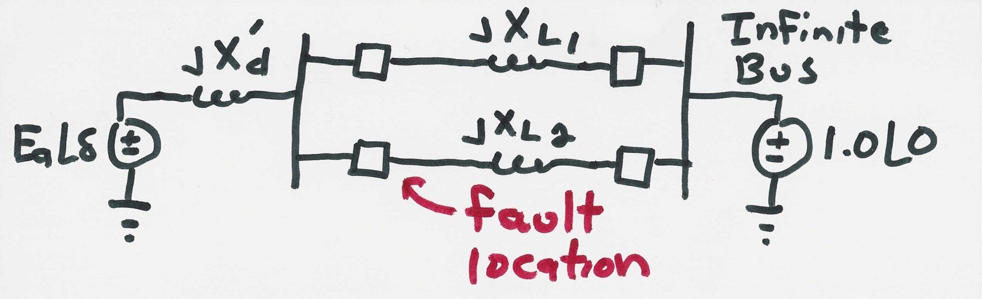
SMIB Example
Assume a generator is supplying power to an infinite bus through two parallel transmission lines. Then a balanced three phase fault occurs at the terminal of one of the lines. The fault is cleared by the opening of this line’s circuit breakers.
19

Slide 21
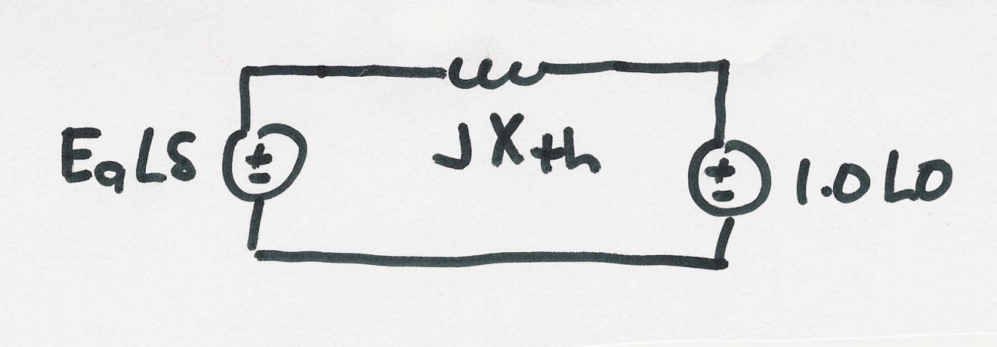
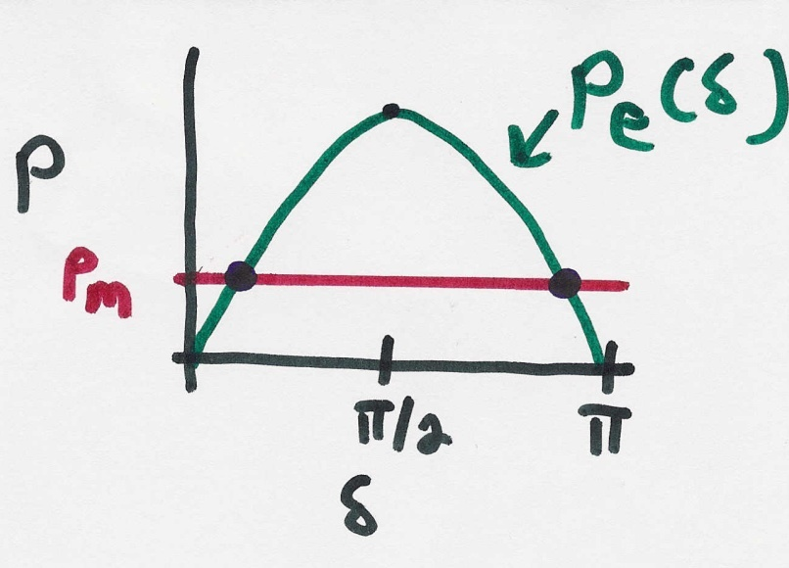
SMIB Example, cont’d
Simplified prefault system
20

Slide 22
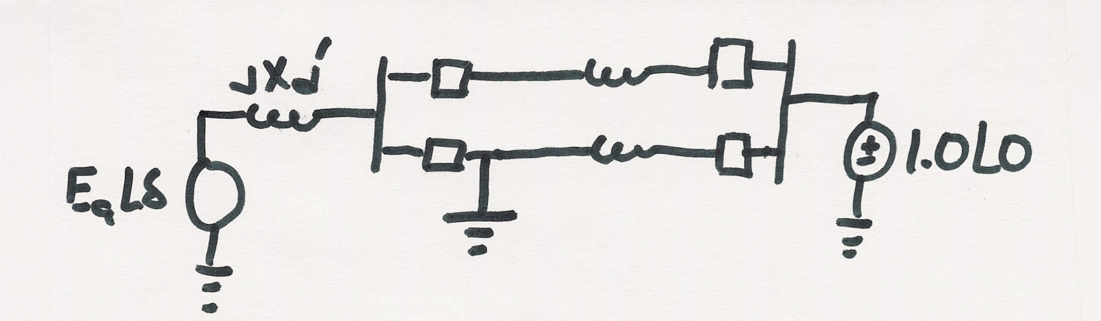
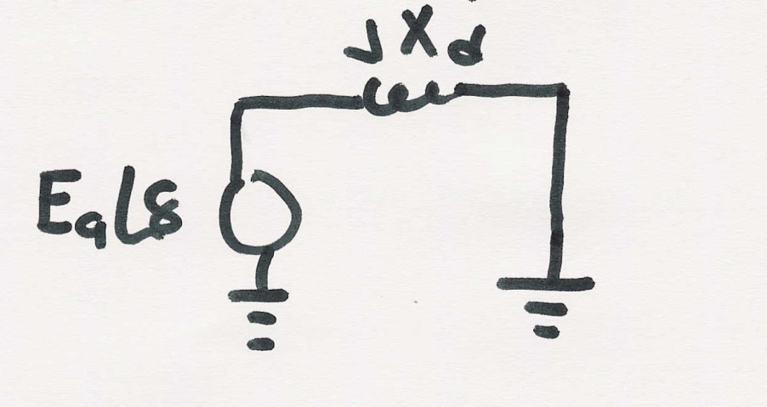
SMIB Example, Faulted System
During the fault the system changes
The equivalent system during the fault is then
During this fault no
power can be transferred
from the generator to
the system
21

Slide 23
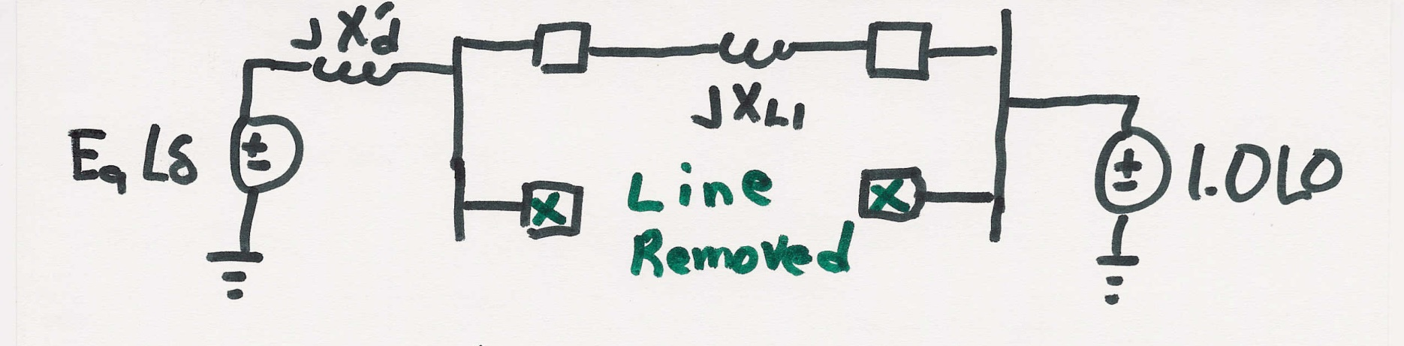
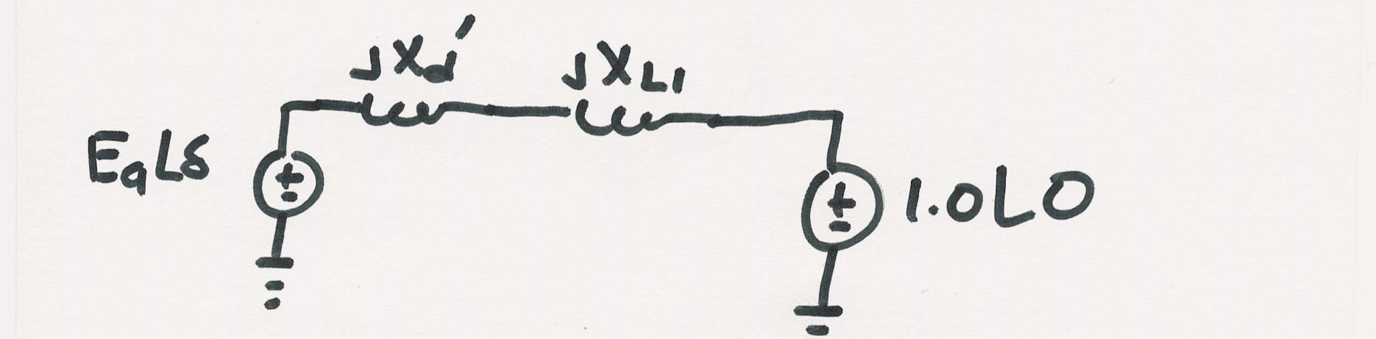
SMIB Example, Post Fault System
After the fault the system again changes
The equivalent system after the fault is then
22

Slide 24
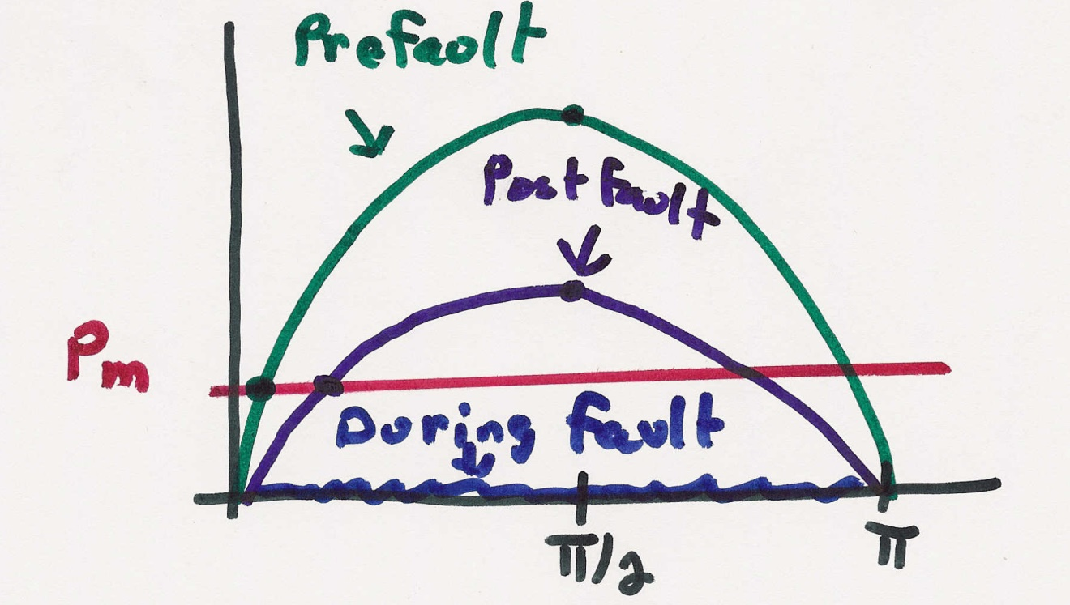
SMIB Example, Dynamics
23

Slide 25
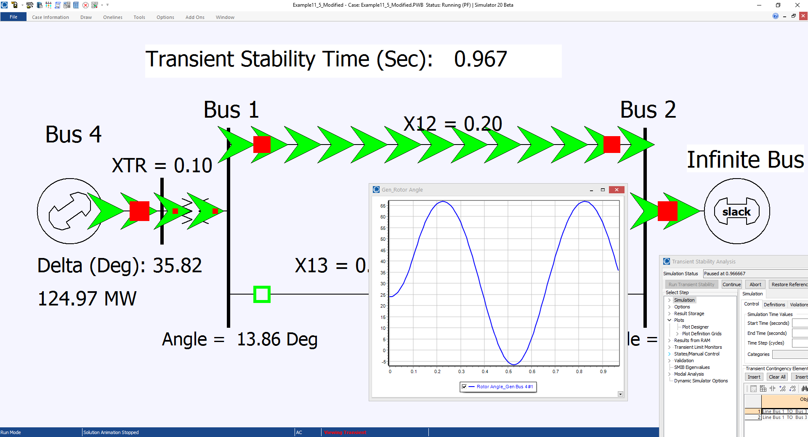
Modified Example 11.5

