Slide 1
ECEN 460 Power System Operation and Control
Lecture 3: Power Grid History, Three-Phase
Prof. Tom Overbye
Dept. of Electrical and Computer Engineering
Texas A&M University
overbye@tamu.edu

Slide 2
Announcements
Please read Chapters 1, 2, 4.1-4.6
HW 1 is 2.9, 22, 28, 43, 48; due Thursday 9/14
Regular problems (not multiple choice)
Labs will start next week (Sept 11)

Slide 3
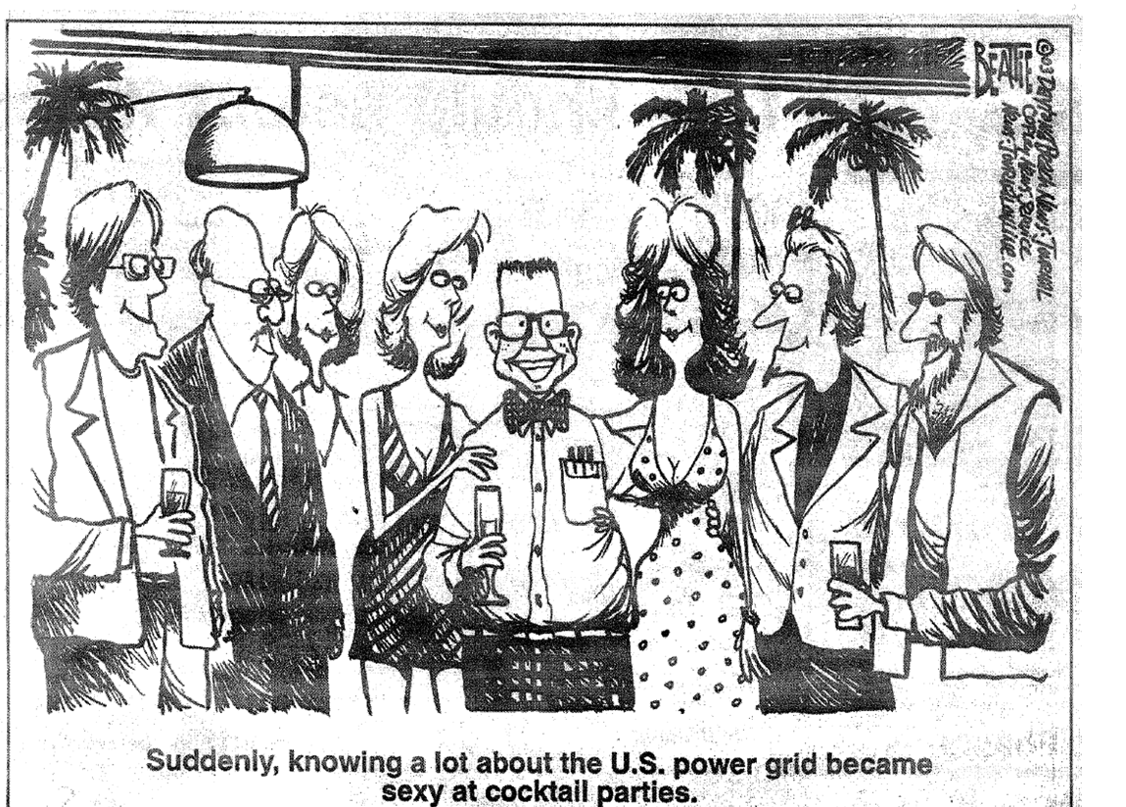
My Favorite 8/14/2003 Blackout Cartoon!

Slide 4
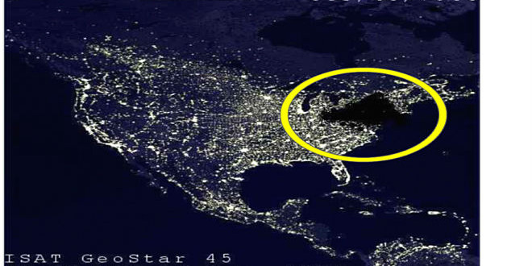
My Favorite Blackout Hoax Photo

Slide 5
The Smart Grid
The term “Smart Grid” dates officially to the 2007 “Energy Independence and Security Act”, Title 13 (“Smart Grid”)
Use of digital information and control techniques
Dynamic grid optimization with cyber-security
Deployment of distributed resources including
Customer participation and smart appliances
Integration of storage including PHEVs
Development of interoperability standards

Slide 6
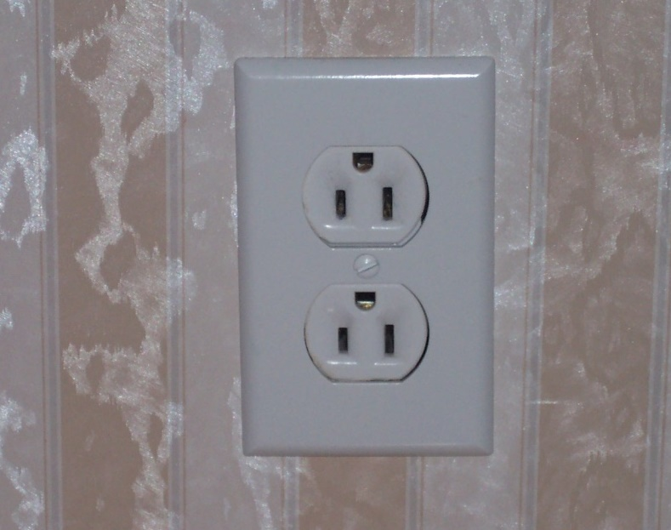
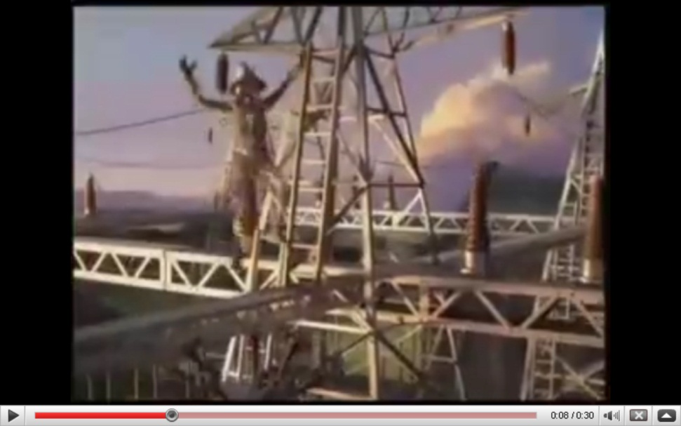
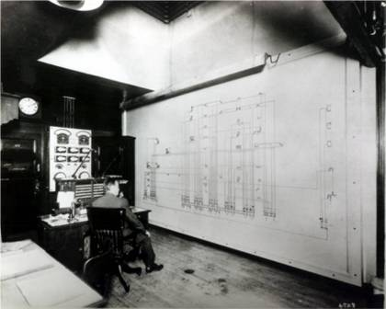
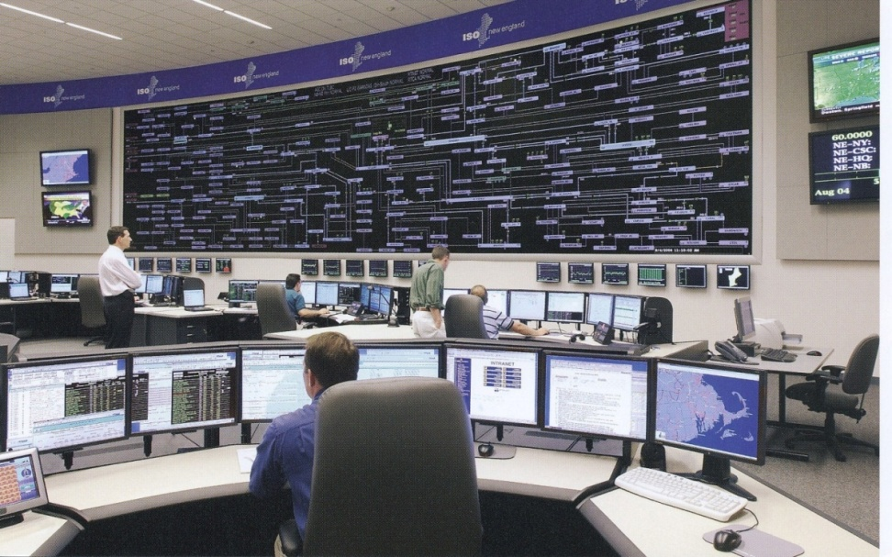
Smart Grid Perceptions (Some of Us Like the Term “Smarter”)

Slide 7
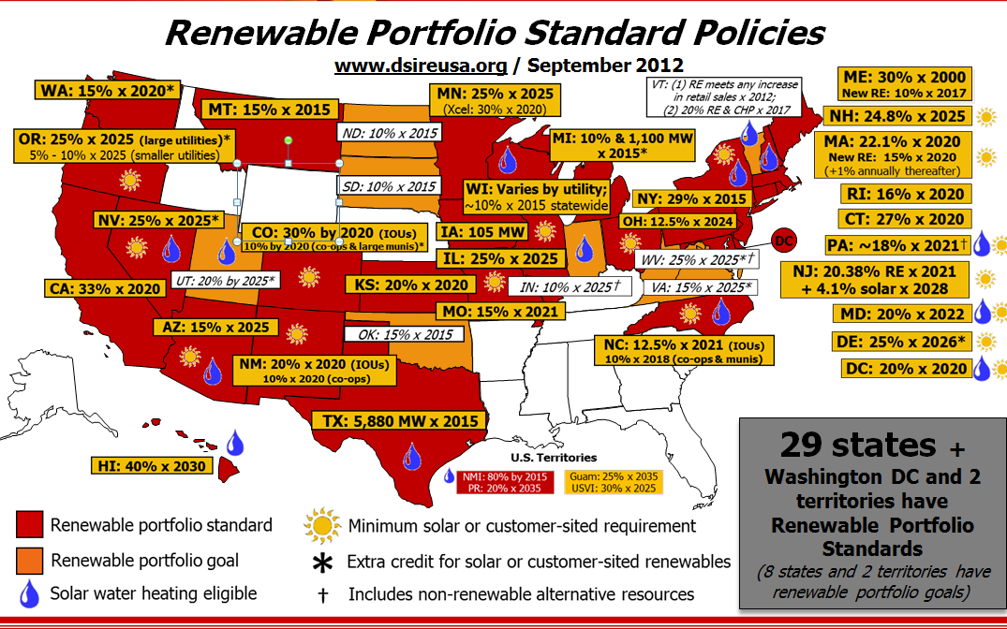
Renewable Portfolio Standards (September 2012)
Source: http://www.dsireusa.org/

Slide 8
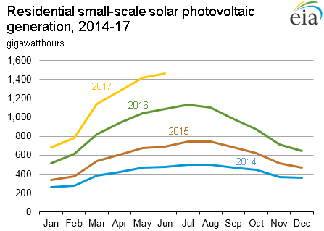
Growth in Solar PV
We already covered the growth in wind
Source: www.eia.gov/electricity/monthly/update/

Slide 9
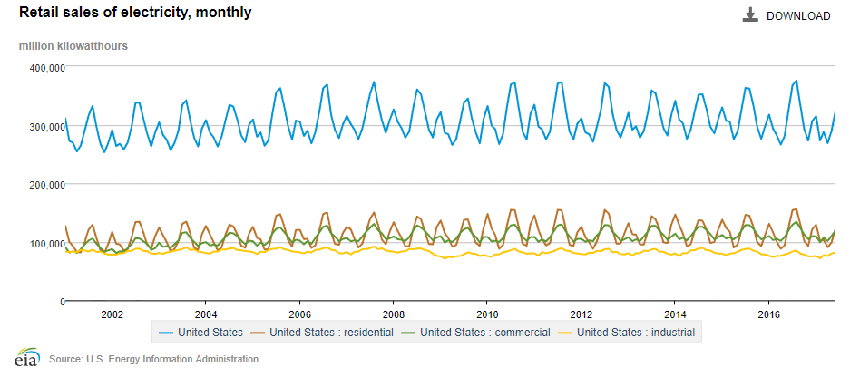
Slowing Electric Load Growth
The total retail electric sales in 2013 were higher than in 2016
Source: EIA electric power monthly, August 2017

Slide 10
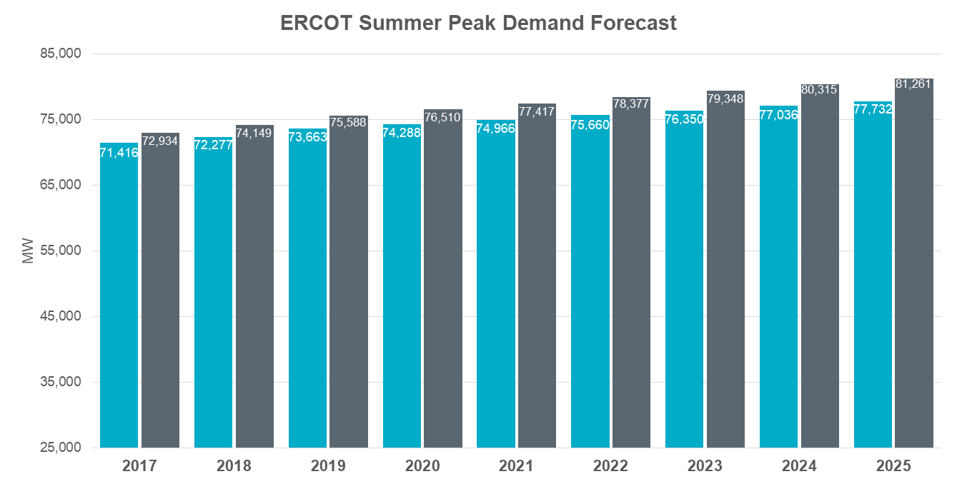
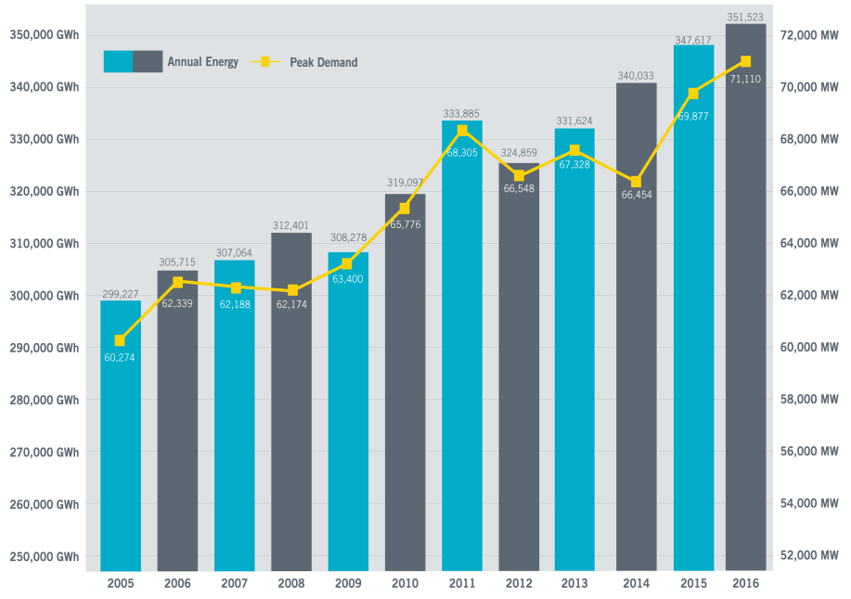
Except in Texas!
Image source: CEO Perspectives, Bill Magness, ERCOT, May 2017

Slide 11
In the News: Symantec Reports Hackers Have Access to US Grid
Electric companies have been targeted by hackers for many years. However, a new attack, by a group Symantec calls Dragonfly, seems to indicate some have possibly gained more operational access to grid systems in the US and Europe
They seek to get access to utility employee credentials through malicious emails and watering hole attacks (compromising websites used by power engineers)
Others cast doubt indicating hackers are far from being able to turn off the lights
Sources: www.businessinsider.com/symantec-hackers-sabotage-power-grid-2017-9, www.symantec.com/connect/blogs/dragonfly-western-energy-sector-targeted-sophisticated-attack-group

Slide 12
Modeling Cautions!
"All models are wrong but some are useful," George Box, Empirical Model-Building and Response Surfaces, (1987, p. 424)
Models are an approximation to reality, not reality, so they always have some degree of approximation
Box went on to say that the practical question is how wrong to they have to be to not be useful
A good part of engineering is deciding what is the appropriate level of modeling, and knowing under what conditions the model will fail
Always keep in mind what problem you are trying to solve!

Slide 13
Balanced Three-Phase (φ) Systems
A balanced three-phase (φ) system has
three voltage sources with equal magnitude, but with an angle shift of 120°
equal loads on each phase
equal impedance on the lines connecting the generators to the loads
Bulk power systems are almost exclusively 3φ
Single-phase is used primarily only in low voltage, low power settings, such as residential and some commercial

Slide 14
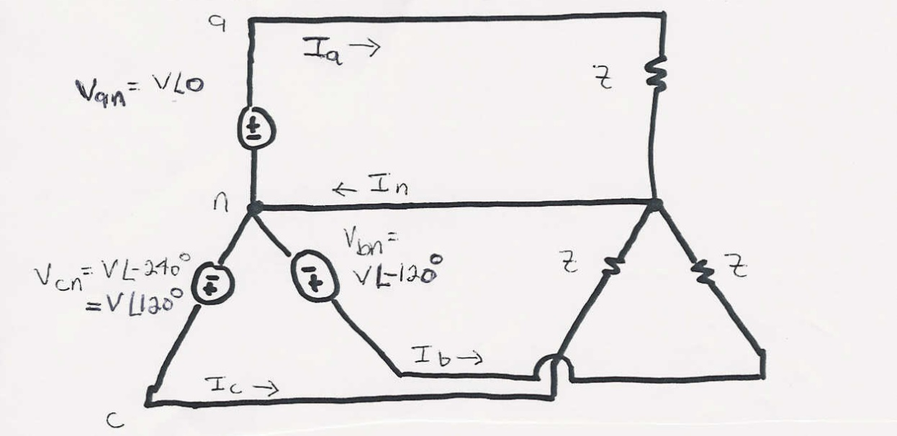
Balanced 3φ -- No Neutral Current

Slide 15
Advantages of Three-Phase Power
Can transmit more power for same amount of wire (twice as much as single phase)
Torque produced by three-phase machines is constant
Three-phase machines use less material for same power rating
Three-phase machines start more easily than single-phase machines

Slide 16
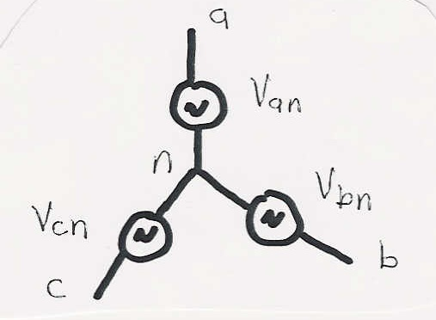
Three-Phase Wye Connection
There are two ways to connect 3φ systems
Wye (Y)
Delta (Δ)

Slide 17
Wye Connection Line Voltages
V_{cn}
V_{ab}
V_{ca}
-V_{bn}
V_{an}
V_{bn}
(α = 0 in this case)
V_{bc}
Line to line
voltages are
also balanced

Slide 18
Wye Connection, cont’d
Define voltage/current across/through device to be phase voltage/current
Define voltage/current across/through lines to be line voltage/current

Slide 19
Delta Connection
I_{ca}
I_{c}
I_{b}
I_{ab}
I_{bc}
I_{a}

Slide 20
Three-Phase Example
Assume a Δ-connected load is supplied from a 3φ 13.8 kV (L-L) source with Z = 100∠20°Ω

Slide 21
Three-Phase Example, cont’d

Slide 22
Delta-Wye Transformation

Slide 23
Delta-Wye Transformation Proof

Slide 24
Delta-Wye Transformation, cont’d

Slide 25
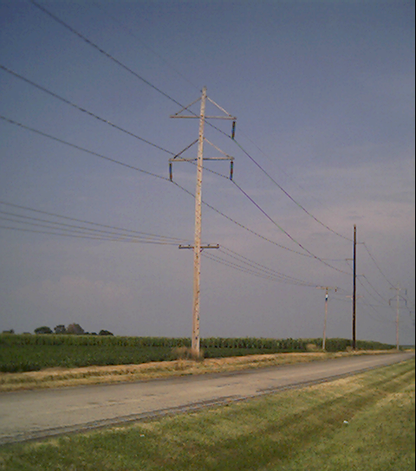
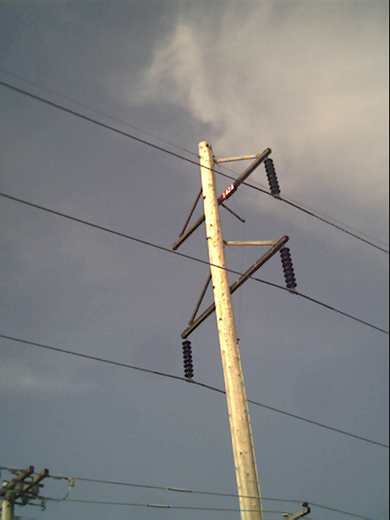
Three-Phase Transmission Line

Slide 26
Per Phase Analysis
Per phase analysis allows analysis of balanced 3φ systems with the same effort as for a single phase system
Balanced 3φ Theorem: For a balanced 3φ system with
All loads and sources Y connected
No mutual Inductance between phases

Slide 27
Per Phase Analysis, cont’d
Then
All neutrals are at the same potential
All phases are COMPLETELY decoupled
All system values are the same sequence as sources. The sequence order we’ve been using (phase b lags phase a and phase c lags phase a) is known as “positive” sequence (negative and zero sequence systems are mostly covered in ECEN 459)

Slide 28
Per Phase Analysis Procedure
To do per phase analysis
Convert all Δ load/sources to equivalent Y’s
Solve phase “a” independent of the other phases
Total system power S = 3 V_{a} I_{a}*
If desired, phase “b” and “c” values can be determined by inspection (i.e., ±120° degree phase shifts)
If necessary, go back to original circuit to determine line-line values or internal Δ values.

Slide 29
Per Phase Example
Assume a 3φ, Y-connected generator with V_{an} = 1∠0° volts supplies a Δ-connected load with Z_{Δ} = -jΩ through a transmission line with impedance of j0.1Ω per phase. The load is also connected to a Δ-connected generator with V_{a”b”} = 1∠0° through a second transmission line which also has an impedance of j0.1Ω per phase.
Find
1. The load voltage V_{a’b’}
2. The total power supplied by each generator, S_{Y} and S_{Δ}

Slide 30
Per Phase Example, cont’d

Slide 31
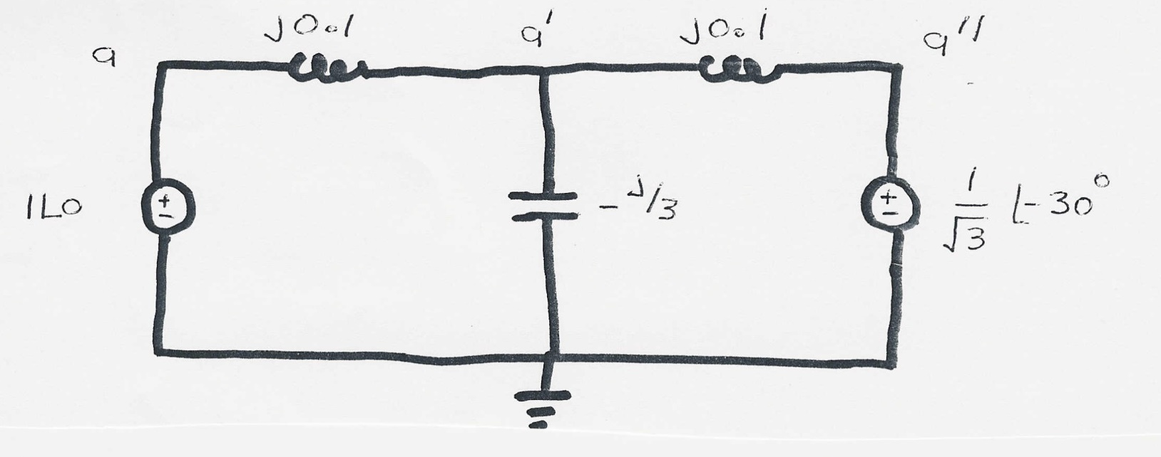
Per Phase Example, cont’d

Slide 32
Per Phase Example, cont’d

Slide 33
Per Phase Example, cont’d

Slide 34
Power System Operations Overview
Goal is to provide an intuitive feel for power system operation
Emphasis will be on the impact of the transmission system
Introduce basic power flow concepts through small system examples

Slide 35
Power System Operations Overview
Goal is to provide an intuitive feel for power system operation
Emphasis will be on the impact of the transmission system
Introduce basic power flow concepts through small system examples

Slide 36
Power System Basics

Slide 37
Electric Loads
Can range in size from less than one watt to 10’s of MW
Load are usually aggregated.
The aggregate load changes with time, with strong daily, weekly and seasonal cycles.

Slide 38
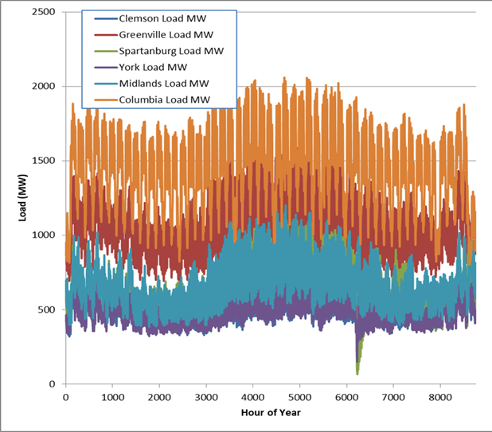
Electric Load Yearly Variation
Data source: FERC 714 filings, 2004

Slide 39
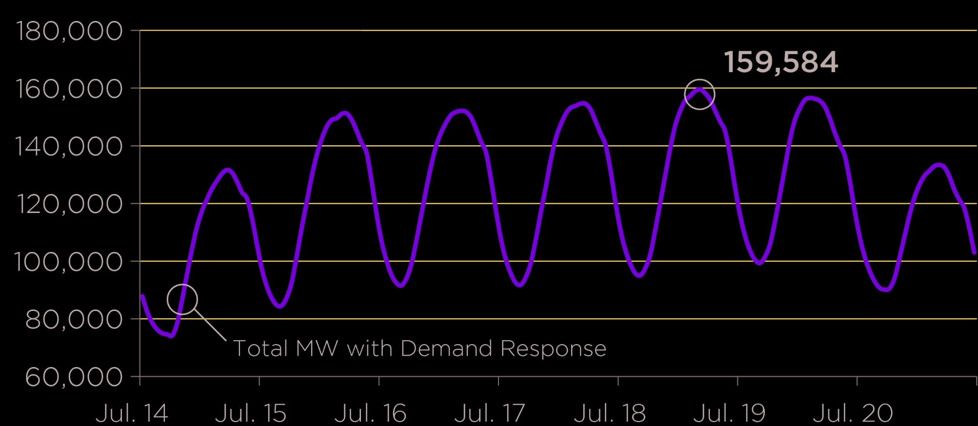
Example: PJM Weekly Summer Load Variation, July 2013

Slide 40
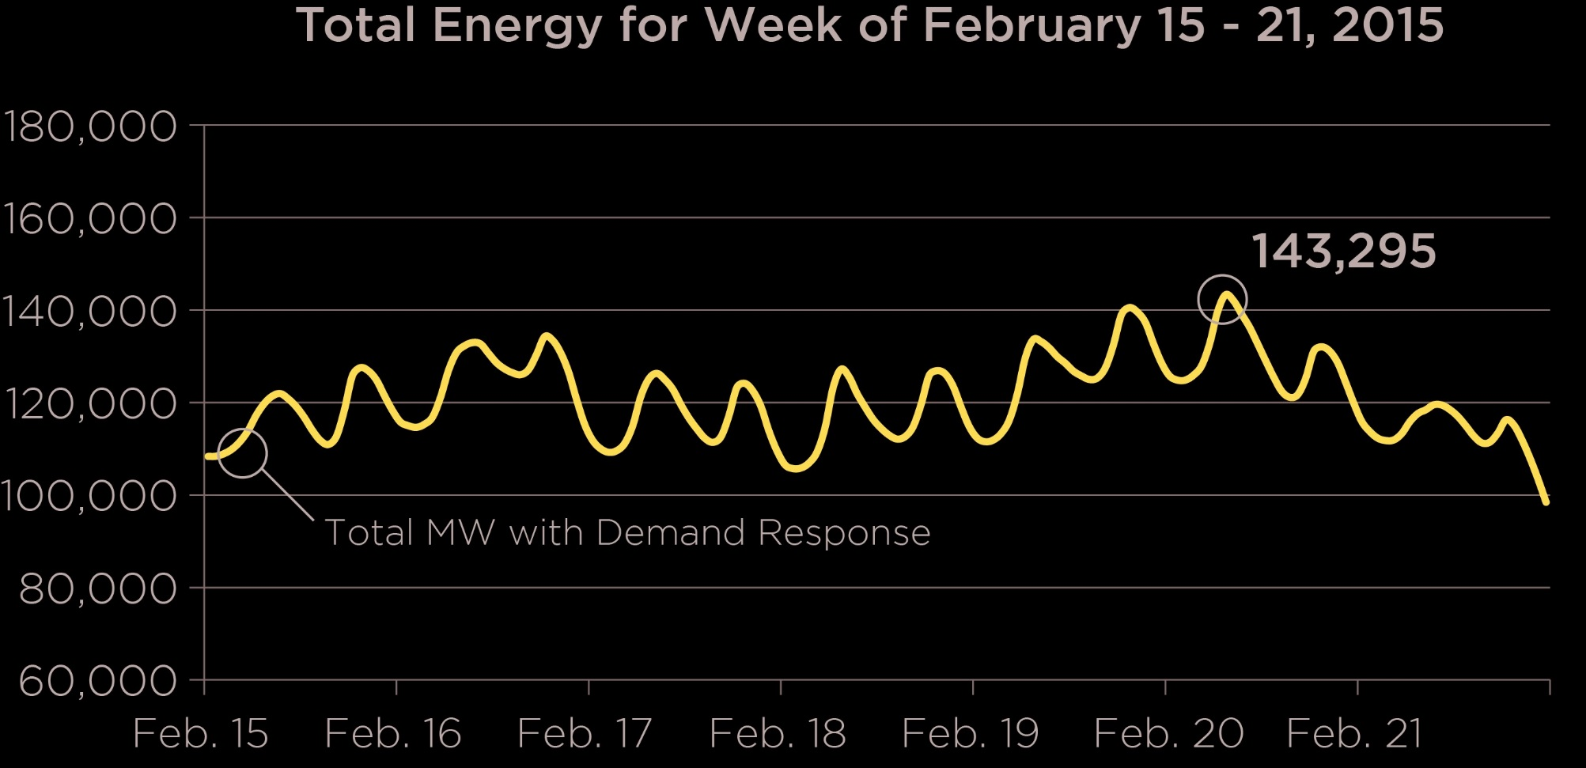
Example: PJM Weekly Winter Load Variation, February 2015

Slide 41
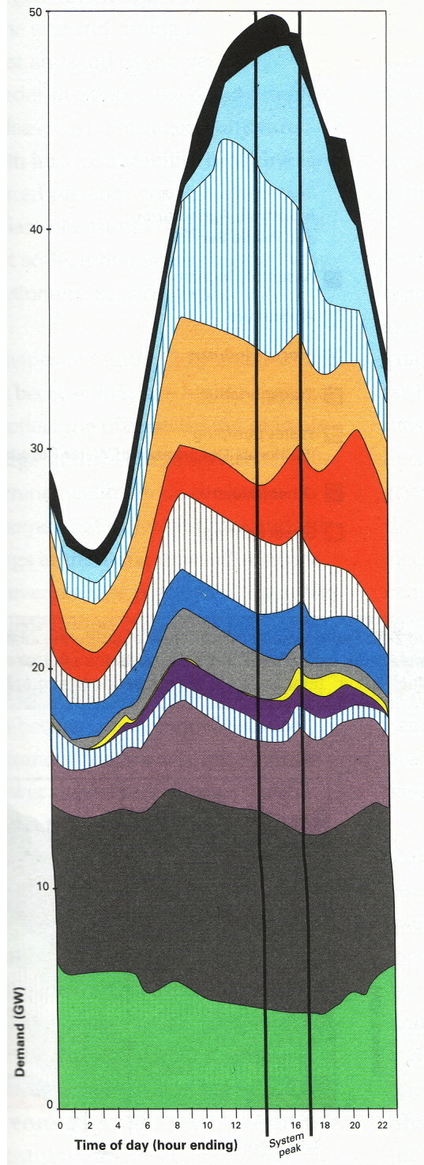
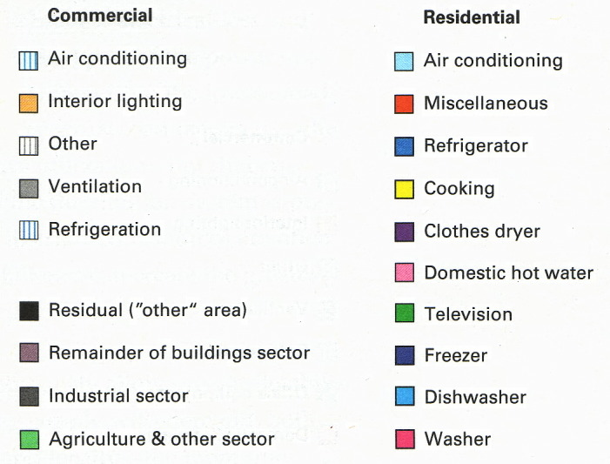
Example: Daily Variation for CA

