Slide 1
ECEN 460
Power System Operation and Control
Lecture 4: Power Grid Operations
Prof. Tom Overbye
Dept. of Electrical and Computer Engineering
Texas A&M University
overbye@tamu.edu

Slide 2
Announcements
Please read book 4.1-4.6
HW 1 is 2.9, 22, 28, 43, 48; due Thursday 9/14
Optional reading from the US National Academies
  “Enhancing the Resilience of the Nation’s Electricity System”
    www.nap.edu/catalog/24836/enhancing-the-resilience-of-the-nations-electricity-system
  “Analytic Research Foundations for the Next-Generation Electric Grid
    www.nap.edu/catalog/21919/analytic-research-foundations-for-the-next-generation-electric-grid

Slide 3
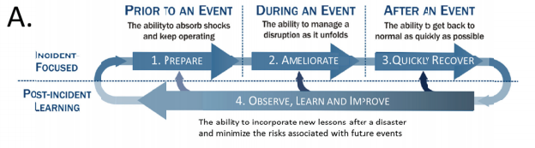
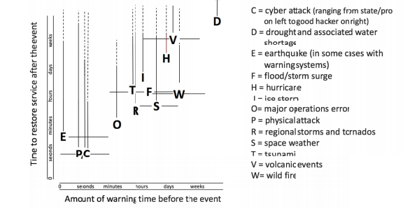
Enhancing the Resilience of the Nation’s Electricity System
About 300,000
customers lost
electric service
due to Harvey,
and perhaps 7
million with
Irma
Source: NAS Electric Grid Resilience Report Figures 1.2a, 3.1

Slide 4
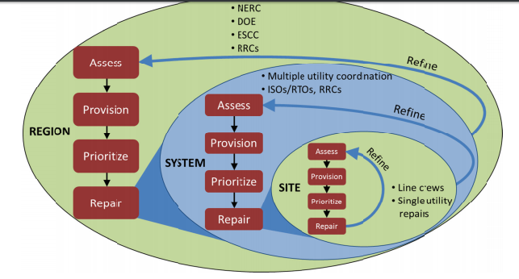
General Restoration Process
Source: NAS Electric Grid Resilience Report Figure 6.1

Slide 5
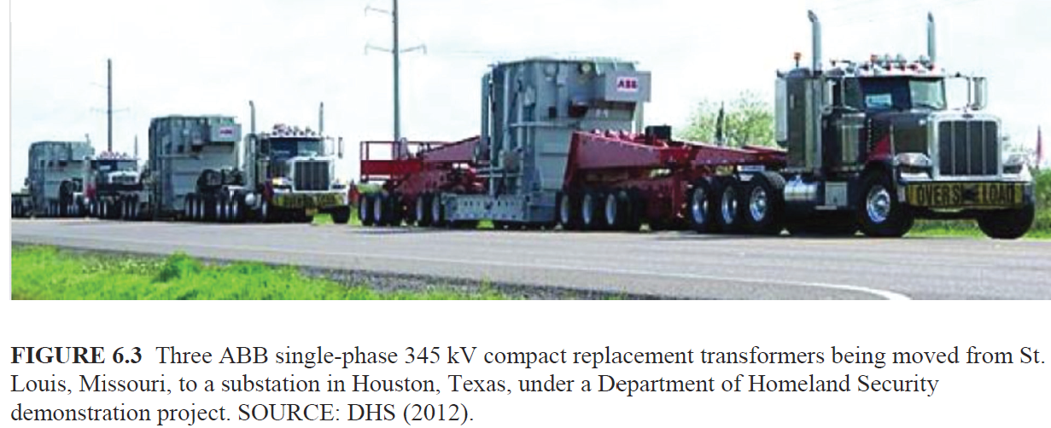
Restoration
Restoration depends on the type of damage. Crews can quickly replace downed lines and repair or replace low and medium voltage transformers
  Water in damage slows recovery
  Damage to high voltage transformers is a particular problem
Source: NAS Electric Grid Resilience Report Figure 6.3

Slide 6
Power System Basics
All power systems have three major components: Generation, Load and Transmission/Distribution.
Generation: Creates electric power.
Load: Consumes electric power.
Transmission/Distribution: Transmits electric power from generation to load.
  Lines/transformers operating at voltages above 100 kV are usually called the transmission system. The transmission system is usually networked.
  Lines/transformers operating at voltages below 100 kV are usually called the distribution system (radial).

Slide 7
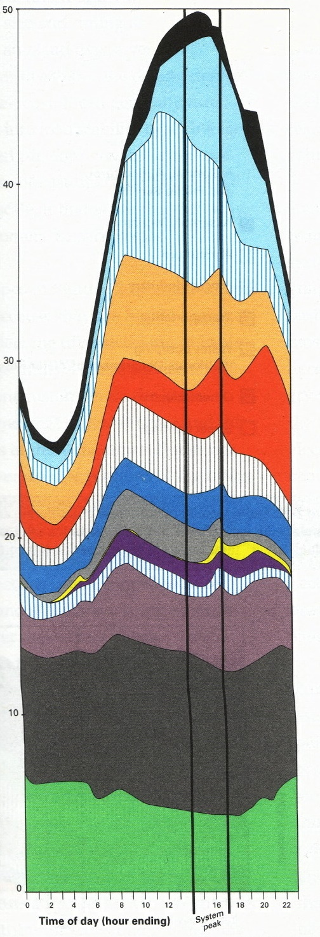
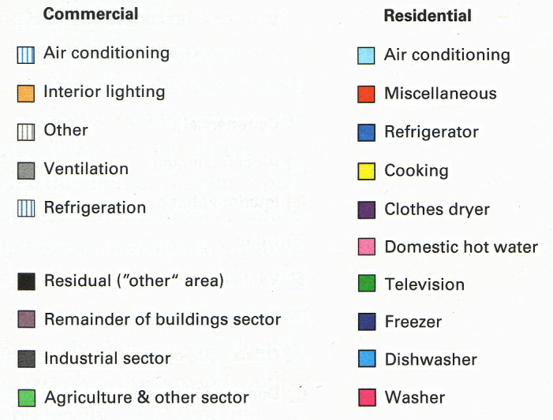
Example: Daily Variation for CA

Slide 8
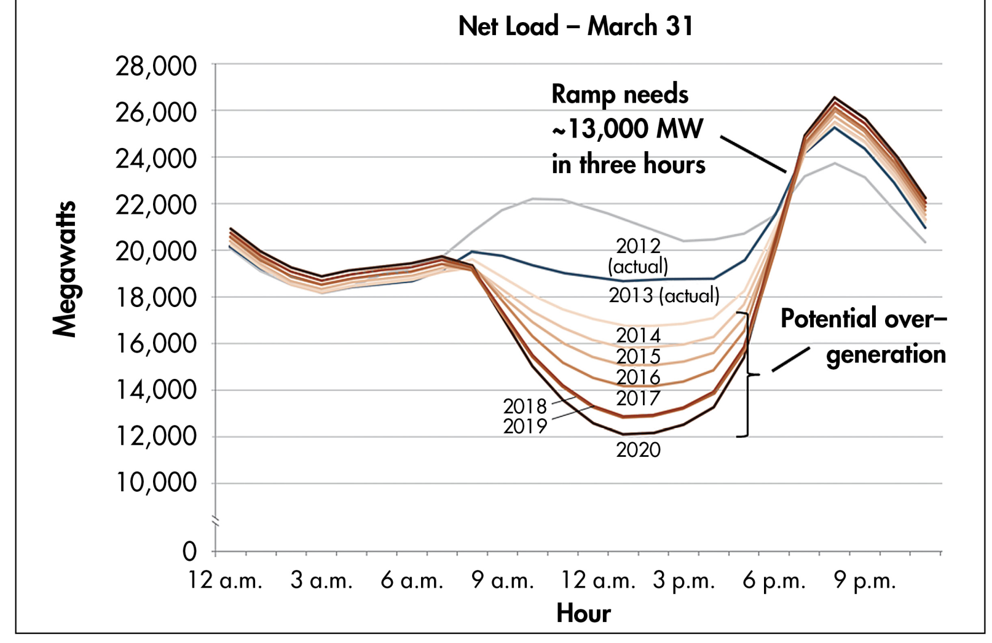
The “Duck Curve”

Slide 9
Per Unit Introduction
A key problem in analyzing power systems is the large number of transformers
  It would be very difficult to continually have to refer impedances to the different sides of the transformers
This problem is avoided by a normalization of all variables known as per unit analysis

Slide 10
Per Unit Introduction, cont.
Different base voltages are used for the different voltage levels, separated by the transformer turns ratios
Per unit can be used with either single-phase or three-phase systems
Example: Assume a per unit base voltage of 138 kV. Then a voltage that is 140.5∠10° kV becomes
Operators tend to give voltages in kV, whereas
engineers use per unit; we’ll cover this more
in a few lectures

Slide 11
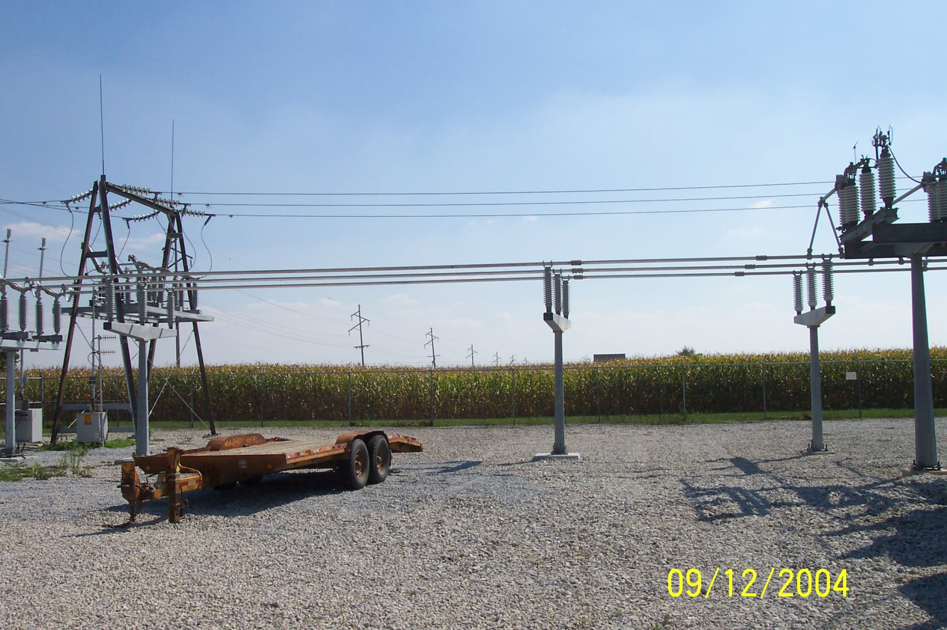
A Substation “Bus”

Slide 12
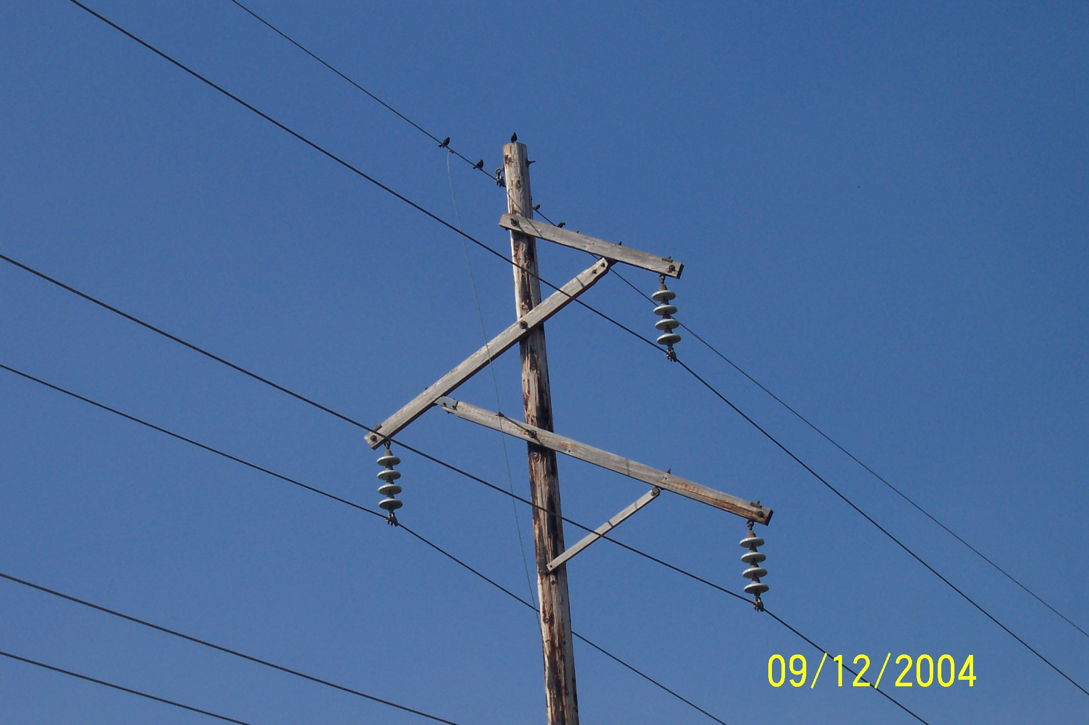
Birds Do Not Sit on High Voltage Lines

Slide 13

High Voltage Transmission Line Worker
Source: www.youtube.com/watch?v=LIjC7DjoVe8

Slide 14
Simulation of the
Eastern Interconnect

Slide 15
Three Bus PowerWorld Simulator Case
Load with
green
arrows
indicating
amount
of MW
flow
Note the
power
balance at
each bus
Used
to control
output of
generator
Direction of green arrow is used to indicate
direction of real power (MW) flow; the blue
arrows show the reacti

Slide 16
Power Balance Constraints
Power flow refers to how the power is moving through the system.
At all times in the simulation the total power flowing into any bus MUST be zero!
This is know as Kirchhoff’s law. And it can not be repealed or modified.
Power is lost in the transmission system.

Slide 17
Basic Power Control
Opening or closing a circuit breaker causes the power flow to instantaneously(nearly) change.
No other way to directly control power flow in a transmission line.
By changing generation or load, or by switching other lines, we can indirectly change this flow.

Slide 18
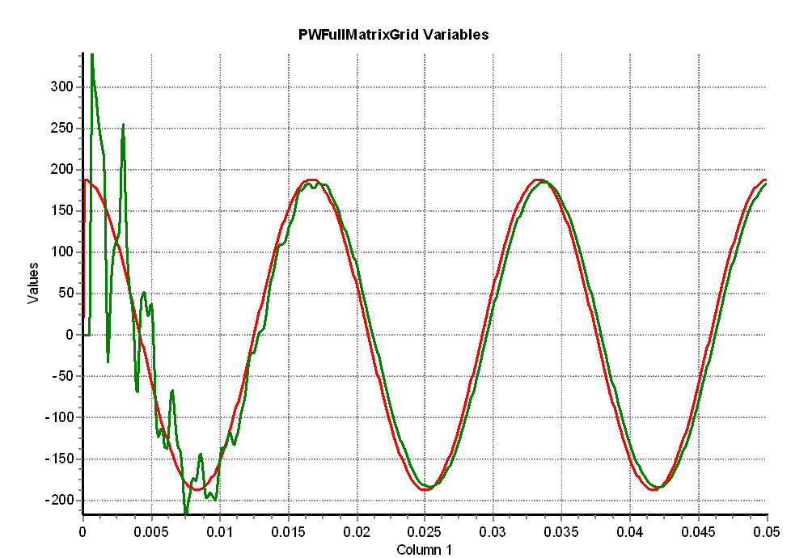
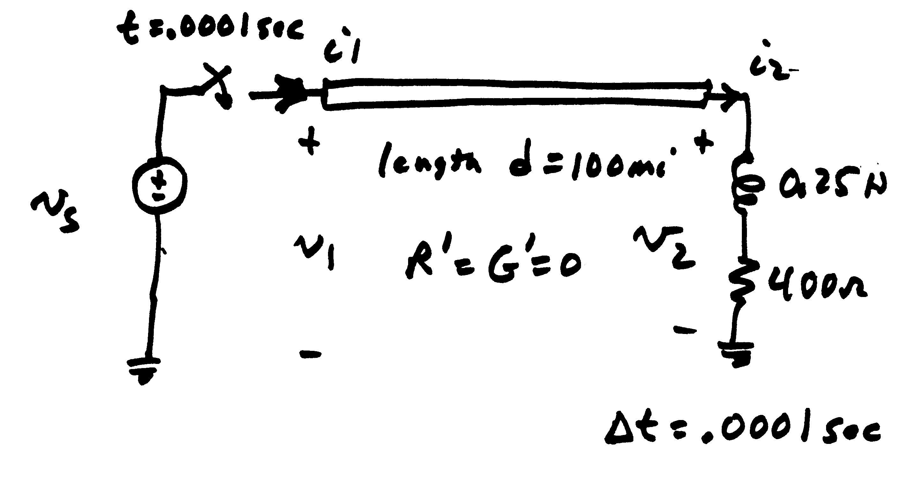
Modeling Consideration – Change is Not Really Instantaneous!
The change isn’t really instantaneous because of propagation delays, which are near the speed of light; there also wave reflection issues
  This is covered in chapters 5 and 13
Red is the v_{s} end, green the v₂ end

Slide 19
Transmission Line Limits
Power flow in transmission line is limited by heating considerations.
Losses (I² R) can heat up the line, causing it to sag.
Each line has a limit; Simulator does not allow you to continually exceed this limit. Many utilities use winter/summer limits.

Slide 20
Overloaded Transmission Line

Slide 21
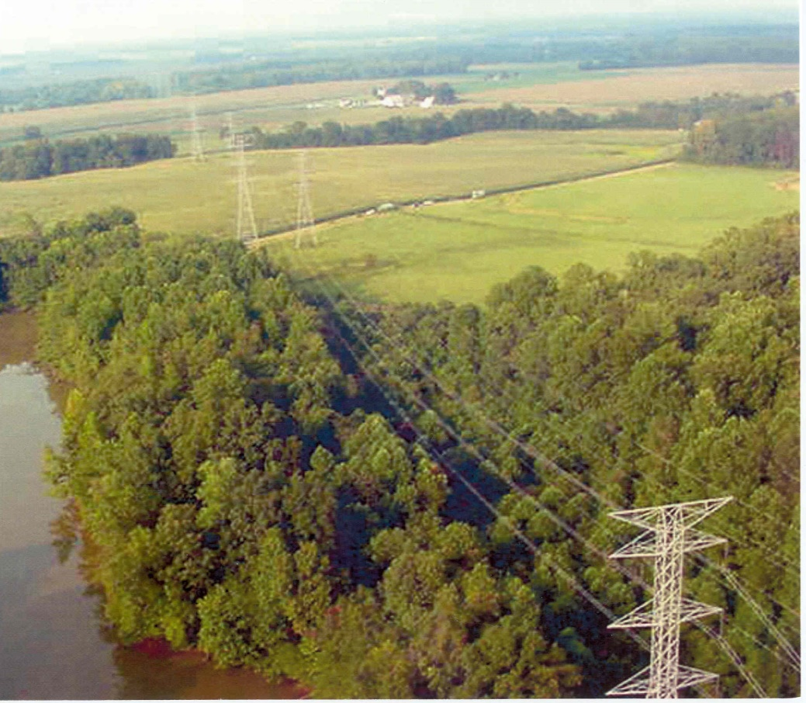
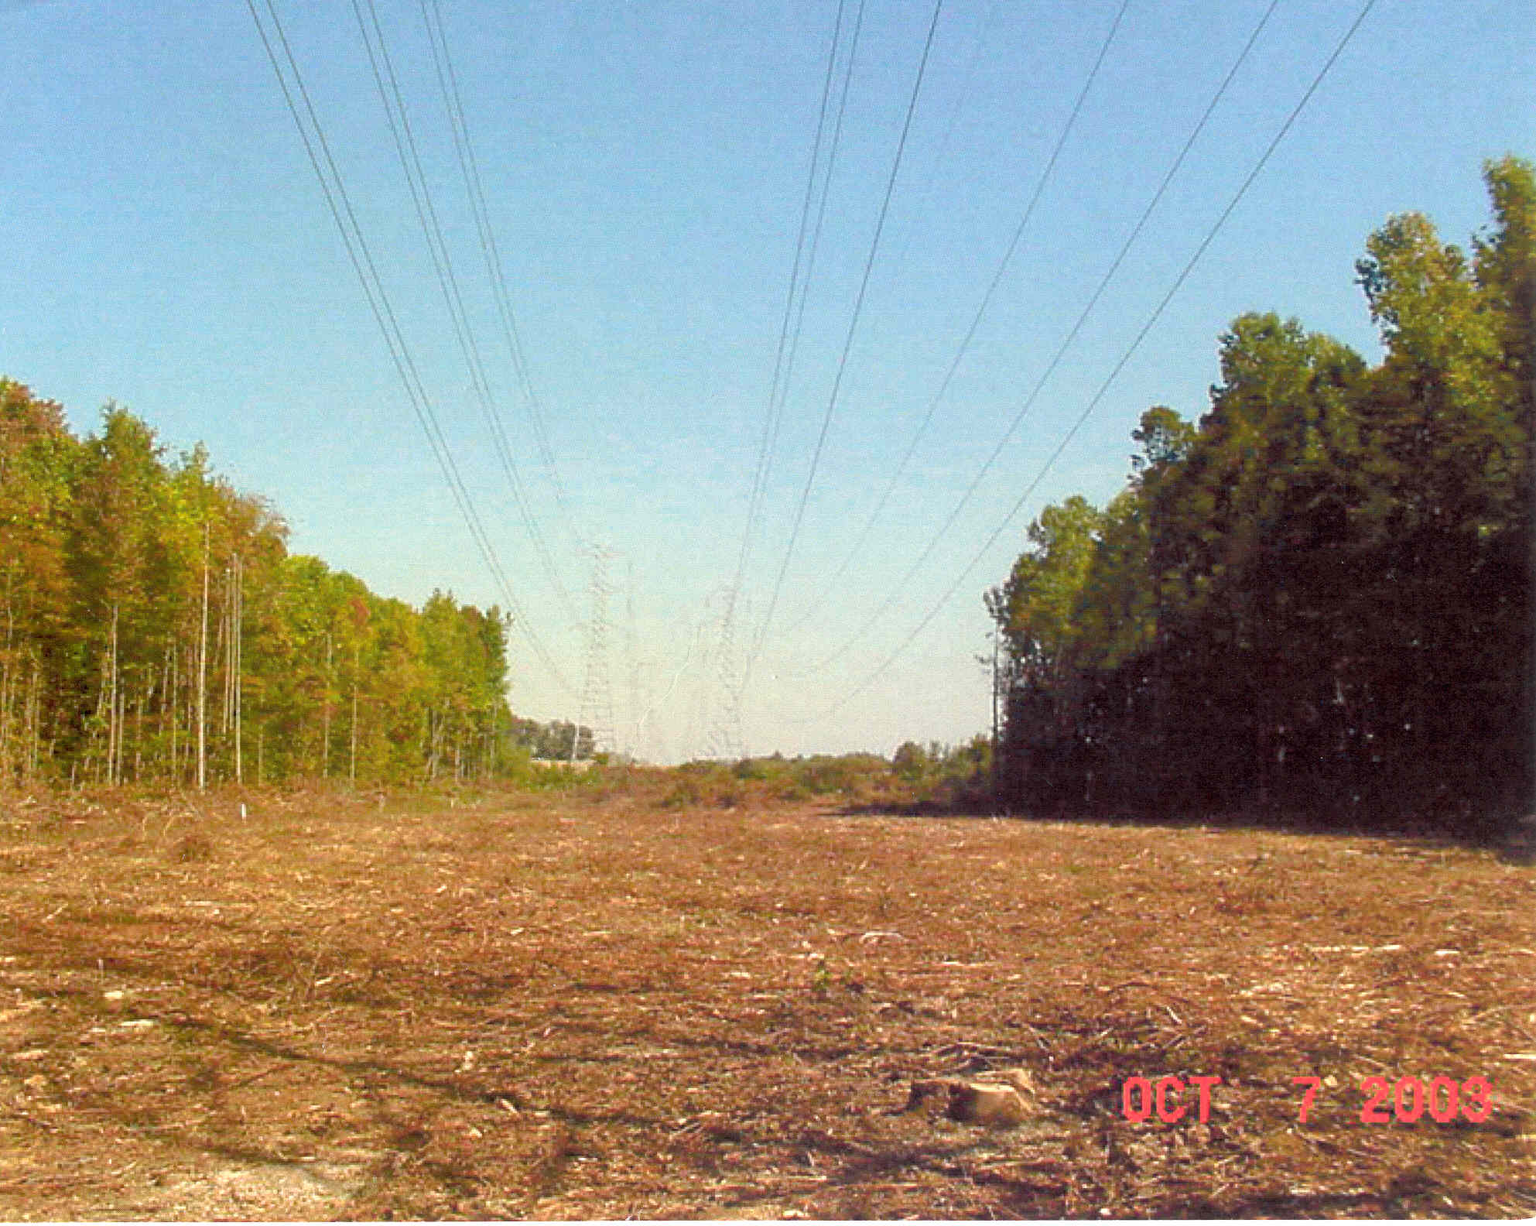
Transmission Lines and Trees
We like trees, and they grow; but when trees get close to lines bad things can occur
Before “Trimming”
After “Trimming”

Slide 22
Interconnected Operation
Power systems are interconnected across large distances. For example most of North America east of the Rockies is one system, with most of Texas and Quebec being major exceptions
Individual utilities only own and operate a small portion of the system, which is referred to an operating area (or an area).

Slide 23
Balancing Authority Areas
Transmission lines that join two areas are known as tie-lines.
The net power out of an area is the sum of the flow on its tie-lines.
The flow out of an area is equal to
total gen - total load - total losses = tie-flow
Trend is towards larger balancing authority areas
  ERCOT combined all their balancing authority areas in 2001

Slide 24
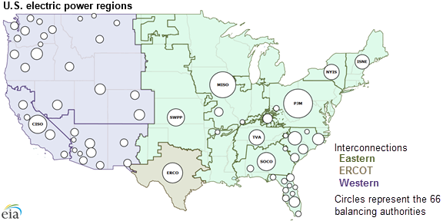
Contiguous US Balancing Authority Areas
Image Source: www.eia.gov/todayinenergy/detail.php?id=27152

Slide 25
Area Control Error (ACE)
The area control error is the difference between the actual flow out of an area, and the scheduled flow.
  There is also a frequency dependent component that we’ll address in Chapter 12
Ideally the ACE should always be zero.
Because the load is constantly changing, each utility must constantly change its generation to “chase” the ACE.

Slide 26
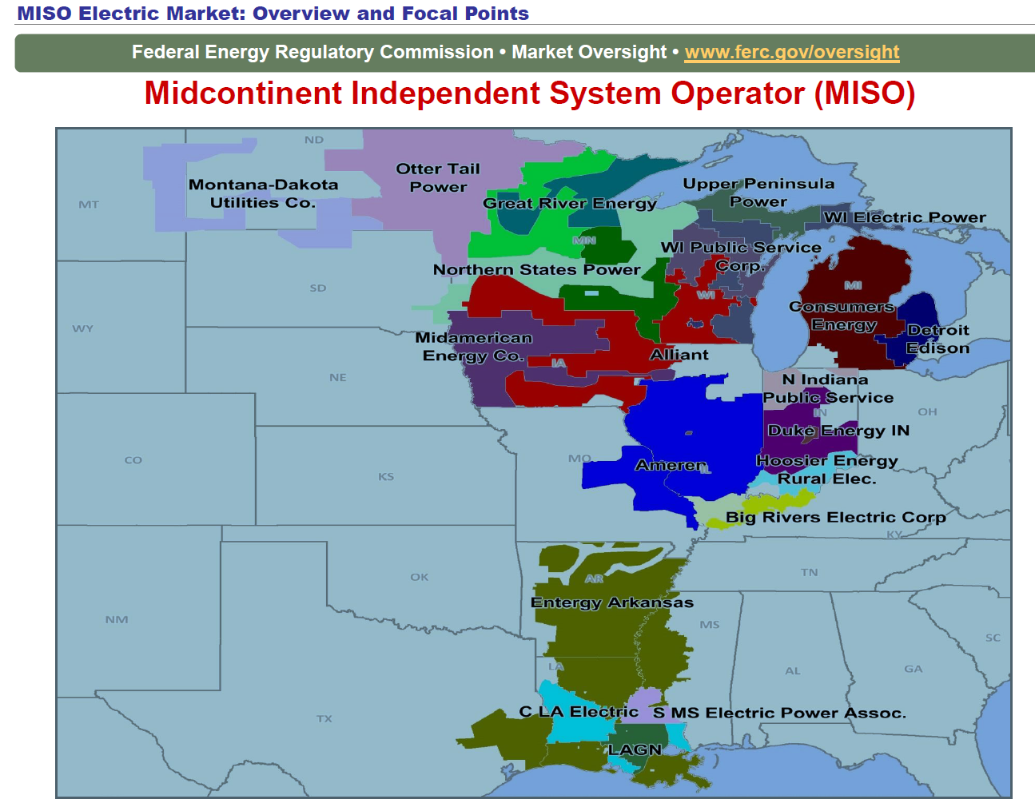
MISO Real-Time ACE (US Members)
Previously
many MISO
utilities did
their own
ACE
calculations;
now they are
part of MISO,
which does
one for the
region
https://www.misoenergy.org/MARKETSOPERATIONS/REALTIMEMARKETDATA/Pages/ACEChart.aspx

Slide 27
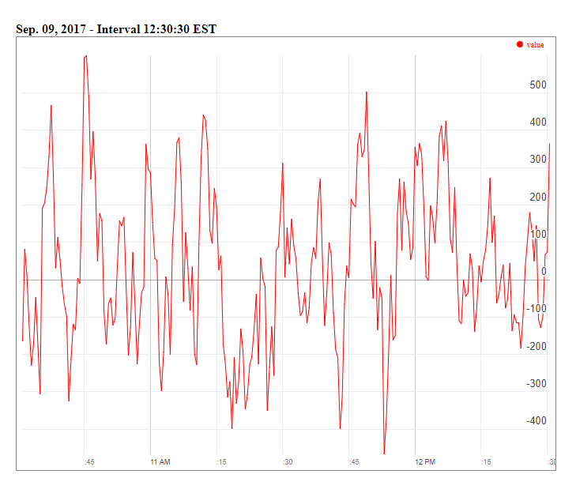
MISO Real-Time ACE, 9/9/17
MISO's real-time ACE is available online (along with lots of other data)
https://www.misoenergy.org/MARKETSOPERATIONS/REALTIMEMARKETDATA/Pages/ACEChart.aspx

Slide 28
Automatic Generation Control
Most utilities use automatic generation control (AGC) to automatically change their generation to keep their ACE close to zero
Usually the utility control center calculates ACE based upon tie-line flows; then the AGC module sends control signals out to the generators every couple seconds.

Slide 29
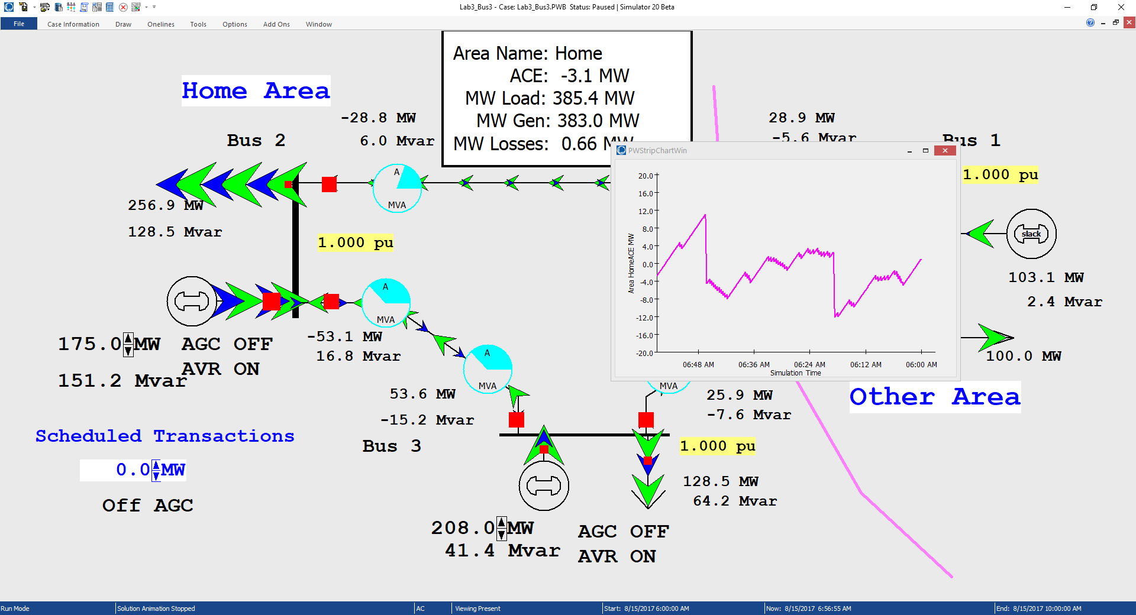
Three Bus Case with Manual ACE Control
Generation is manually
changed to match
change in load, keep
ACE close to zero

Slide 30
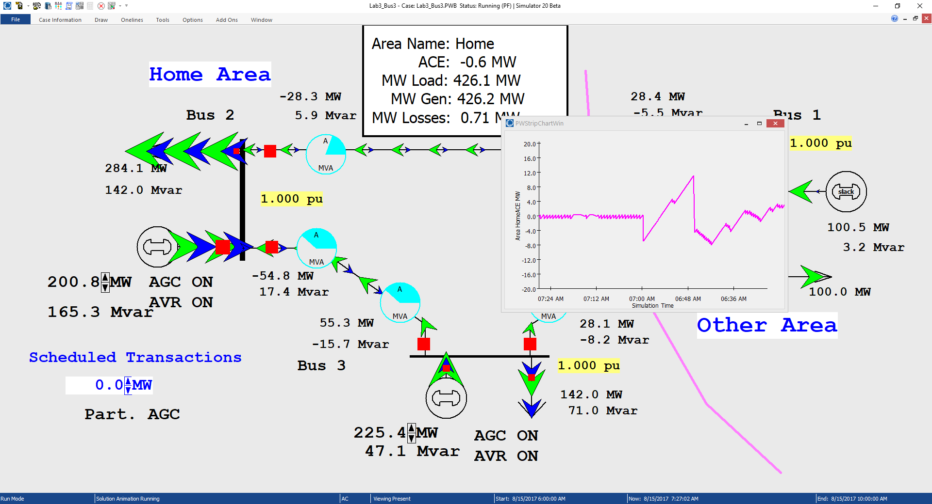
Three Bus Case with AGC
Ripple is due to the deadband, used to prevent excessive change in the generation
Generation real power is now being automatically controlled

