Slide 1
ECEN 460
Power System Operation and Control
Lecture 9: Power Flow,
Synchronous Machine Modeling
Prof. Tom Overbye
Dept. of Electrical and Computer Engineering
Texas A&M University
overbye@tamu.edu

Slide 2
Announcements
Please read Chapter 2.4, and 6.1 to 6.6
HW 4 is 6.9, 6.12, 6.18, 6.25 (on 6.25 just know how to do one iteration)
  It should be done before the first exam, but need not be turned in.
Lowest two homework scores will be dropped
First exam is Thursday Oct 5 in class; one of my old exams is posted for reference; closed book, closed notes, one 8.5 by 11 inch note sheet allowed; calculators allowed

Slide 3
Stopping Criteria

Slide 4
Gauss Power Flow

Slide 5
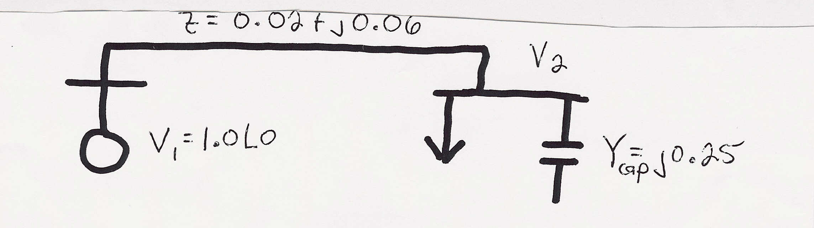
Gauss Two Bus Power Flow Example
A 100 MW, 50 Mvar load is connected to a generator
through a line with z = 0.02 + j0.06 p.u. and line charging of 5 Mvar on each end (100 MVA base). Also, there is a 25 Mvar capacitor at bus 2. If the generator voltage is 1.0 p.u., what is V₂?
S_{Load} = 1.0 + j0.5 p.u.

Slide 6
Gauss Two Bus Example, cont’d

Slide 7
Gauss Two Bus Example, cont’d

Slide 8
Gauss Two Bus Example, cont’d

Slide 9
Slack Bus
In previous example we specified S₂ and V₁ and then solved for S₁ and V₂.
We can not arbitrarily specify S at all buses because total generation must equal total load + total losses
We also need an angle reference bus.
To solve these problems we define one bus as the "slack" bus. This bus has a fixed voltage magnitude and angle, and a varying real/reactive power injection.

Slide 10
Stated Another Way
From exam problem 4.c we had
This Y_{bus} is actually singular!
So we cannot solve
This means (as you might expect), we cannot independently specify all the current injections I

Slide 11
Gauss with Many Bus Systems

Slide 12
Gauss-Seidel Iteration

Slide 13
Three Types of Power Flow Buses
There are three main types of power flow buses
  Load (PQ) at which P/Q are fixed; iteration solves for voltage magnitude and angle.
  Slack at which the voltage magnitude and angle are fixed; iteration solves for P/Q injections
  Generator (PV) at which P and |V| are fixed; iteration solves for voltage angle and Q injection
    special coding is needed to include PV buses in the Gauss-Seidel iteration (covered in book, but not in slides since Gauss-Seidel is no longer commonly used)

Slide 14
Accelerated G-S Convergence

Slide 15
Accelerated Convergence, cont’d

Slide 16
Gauss-Seidel Advantages/Disadvantages
Advantages
  Each iteration is relatively fast (computational order is proportional to number of branches + number of buses in the system
  Relatively easy to program
Disadvantages
  Tends to converge relatively slowly, although this can be improved with acceleration
  Has tendency to miss solutions, particularly on large systems
  Tends to diverge on cases with negative branch reactances (common with compensated lines)
  Need to program using complex numbers

Slide 17
Newton-Raphson Algorithm
The second major power flow solution method is the Newton-Raphson algorithm
Key idea behind Newton-Raphson is to use sequential linearization

Slide 18
Newton-Raphson Method (scalar)

Slide 19
Newton-Raphson Method, cont’d

Slide 20
Newton-Raphson Example

Slide 21
Newton-Raphson Example, cont’d

Slide 22
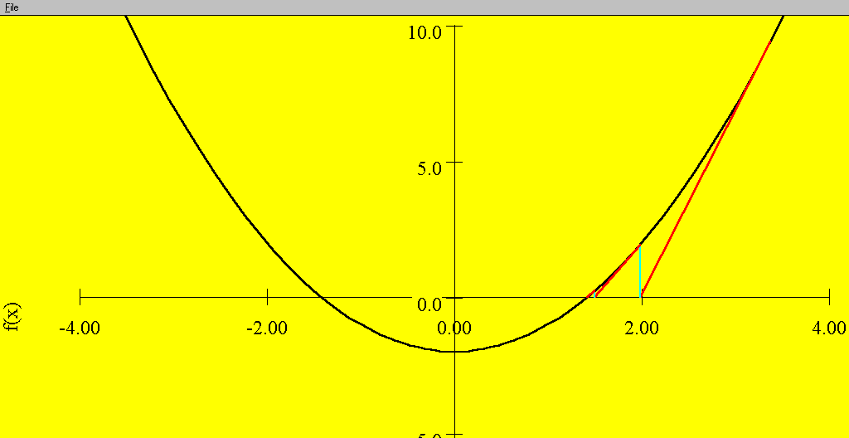
Sequential Linear Approximations
At each
iteration the
N-R method
uses a linear
approximation
to determine
the next value
for x
Function is f(x) = x² - 2 = 0.
Solutions are points where
f(x) intersects f(x) = 0 axis

Slide 23
Newton-Raphson Comments
When close to the solution the error decreases quite quickly -- method has quadratic convergence
f(x^{(v)}) is known as the mismatch, which we would like to drive to zero
Stopping criteria is when ⏐f(x^{(v)}) ⏐ < ε
Results are dependent upon the initial guess. What if we had guessed x⁽⁰⁾ = 0, or x ⁽⁰⁾ = -1?
A solution’s region of attraction (ROA) is the set of initial guesses that converge to the particular solution. The ROA is often hard to determine

Slide 24
Multi-Variable Newton-Raphson

Slide 25
Multi-Variable Case, cont’d

Slide 26
Multi-Variable Case, cont’d

Slide 27
Jacobian Matrix

Slide 28
Multi-Variable Example

Slide 29
Multi-variable Example, cont’d

Slide 30
Multi-variable Example, cont’d

Slide 31
Synchronous Machine Modeling
Electric machines are used to convert mechanical energy into electrical energy (generators) and from electrical energy into mechanical energy (motors)
  Many devices can operate in either mode, but are usually customized for one or the other
Vast majority of electricity is generated using synchronous generators and some is consumed using synchronous motors
Much literature on subject, and sometimes overly confusing with the use of different conventions and nomenclature

Slide 32
Synchronous Machine Basics
Two basic parts
  Stator (or armature) is the stationary outside of the machine
  Rotor is the internal part that rotates
  Stator and rotor are separated by an airgap, which is needed to allow the rotor to spin
Synchronous machines are named because in steady state the rotor spins at a speed proportional to the electrical frequency (i.e., it stays in synch with the electrical frequency)
Can be either three-phase or single-phase; we’ll just consider three-phase machines

Slide 33
Synchronous Machine Basics
The rotor has a dc field current that is used to produce a magnetic field
  There needs to be some electrical connection between the spinning rotor and stationary stator to provide this current
  Occasionally the rotor is a permanent magnetic, but this limits control of the machine
The three stator windings have a three-phase, voltage. In a motor or interconnected generator this voltage is supplied. In a stand along generator it is induced.
The electric currents in the stator create a rotating magnetic field; rotor runs “in synch” with this field

Slide 34
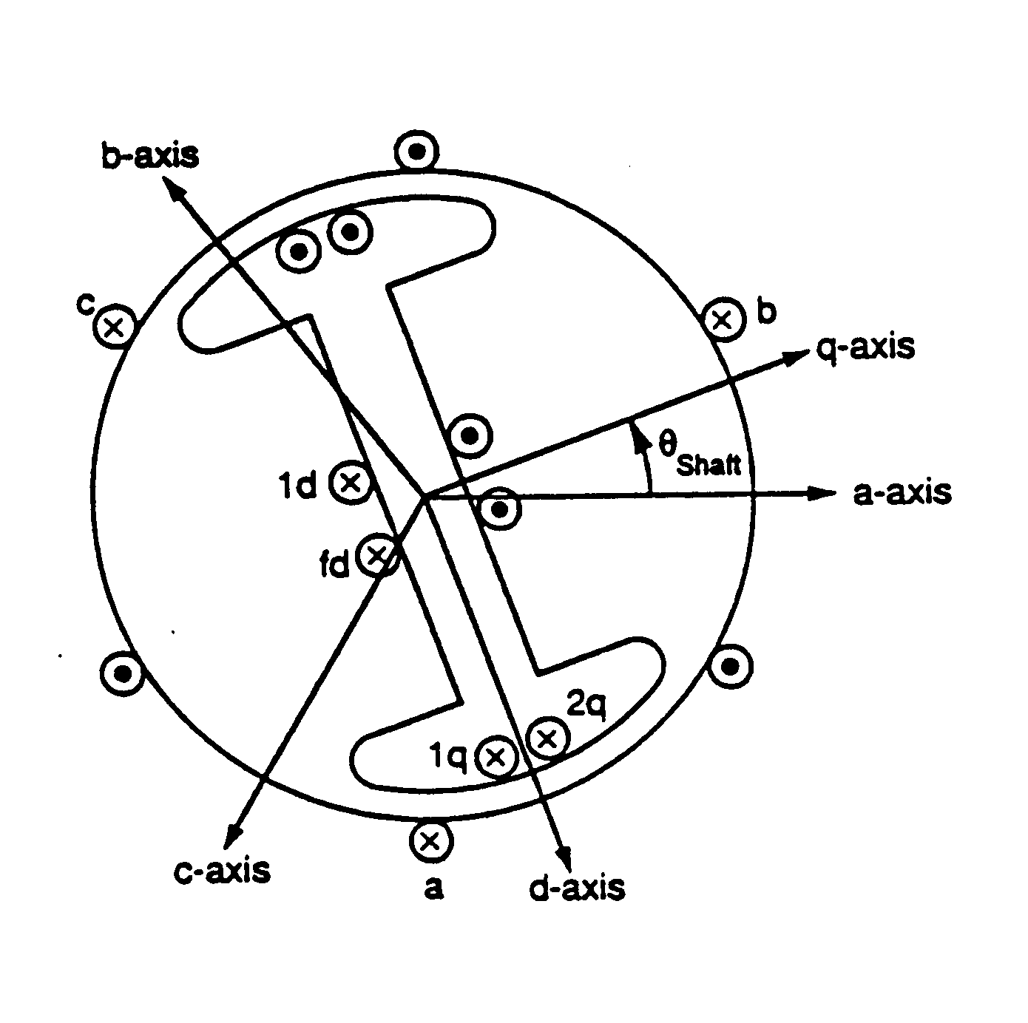
Synchronous Machine Modeling
3φ bal. windings (a,b,c) – stator
Field winding (fd) on rotor
Damper in “d” axis
(1d) on rotor
2 dampers in “q” axis
(1q, 2q) on rotor

Slide 35
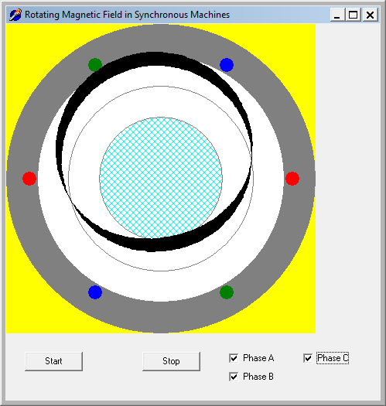
Rotating Magnetic Field Demo

Slide 36
Rotation Speed and Two Main Types of Synchronous Machines
Machines may have multiple pole pairs to spin at speeds slower than the electrical frequency
Round Rotor
  Air-gap is constant, used with higher speed machines
Salient Rotor (often called Salient Pole)
  Air-gap varies circumferentially
  Used with many pole, slower machines such as hydro

Slide 37
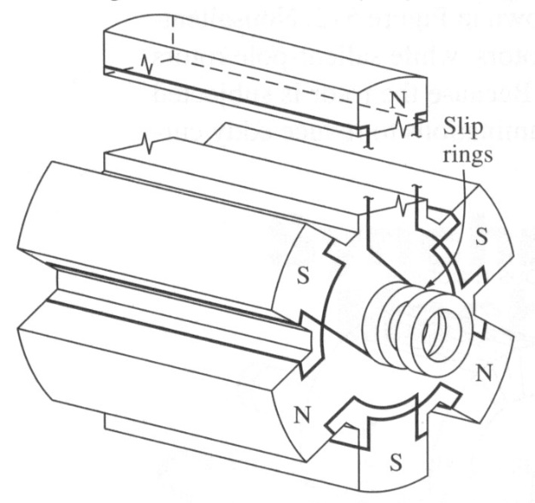
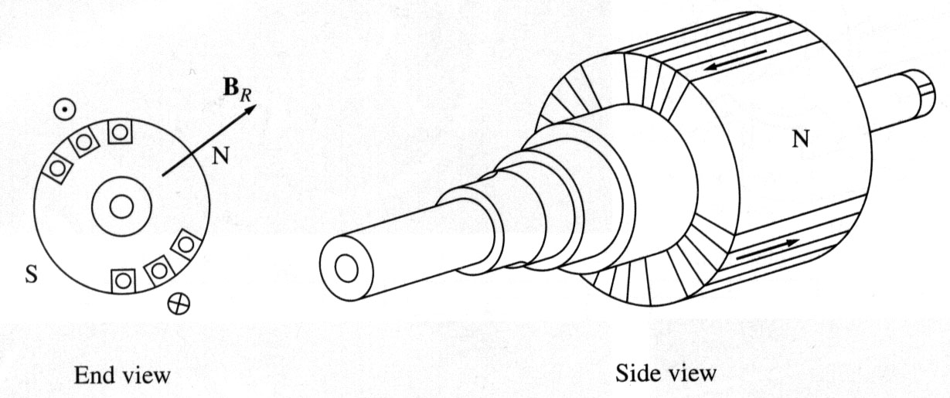
Synchronous Machine Rotors
Rotors are essentially electromagnets
Two pole (P)
round rotor
Six pole salient
rotor
Image Source: Dr. Gleb Tcheslavski, ee.lamar.edu/gleb/teaching.htm

Slide 38
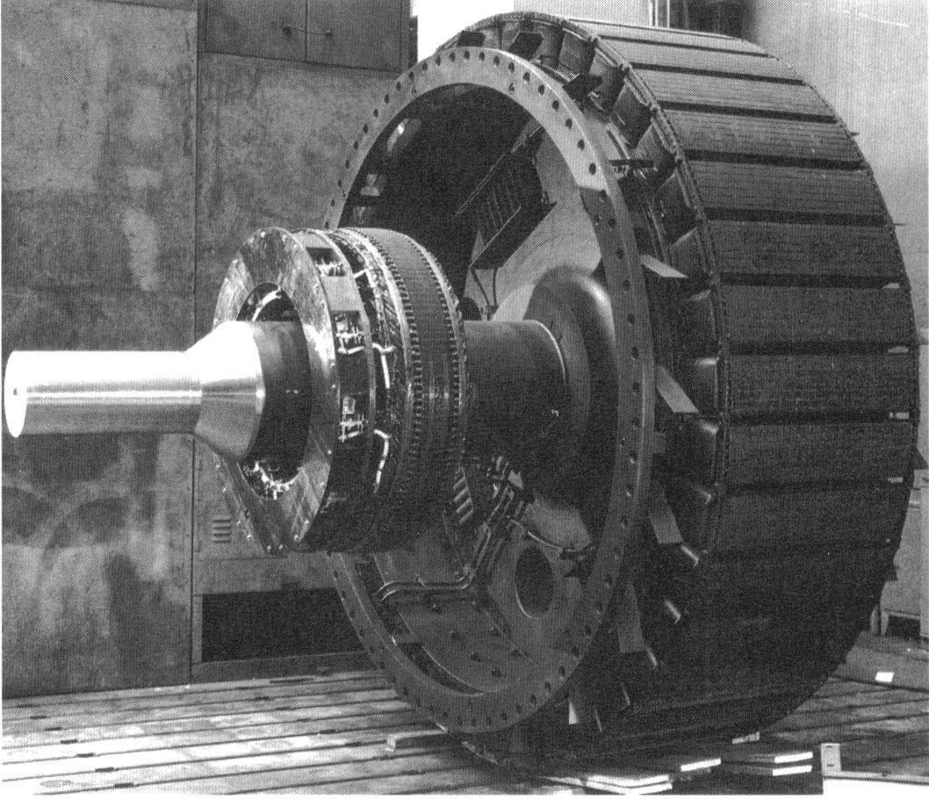
Synchronous Machine Rotors
High pole
salient
rotor
Shaft
Part of exciter,
which is used
to control the
field current
Image Source: Dr. Gleb Tcheslavski, ee.lamar.edu/gleb/teaching.htm

Slide 39
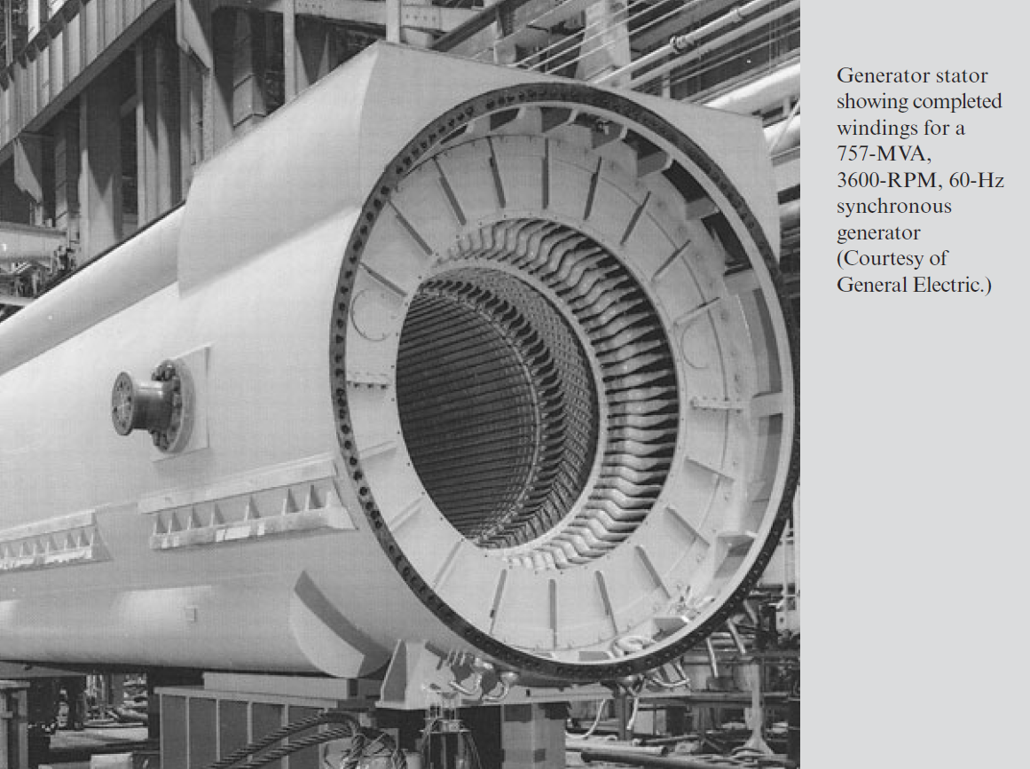
Synchronous Machine Stators
Image Source: Book, Beginning of Chapter 8 Photo

Slide 40
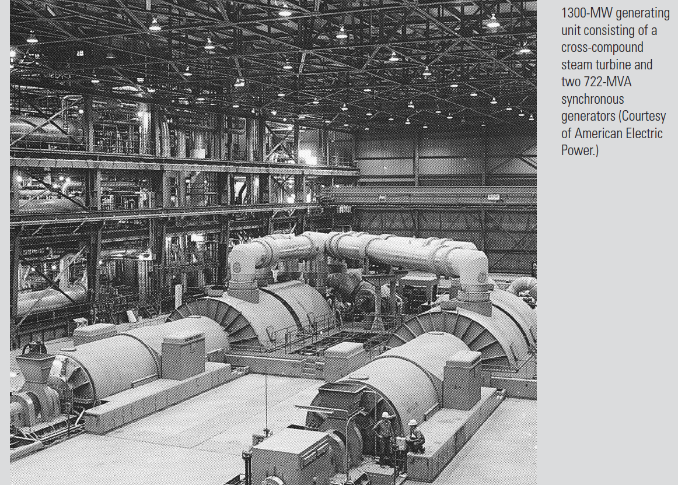
Synchronous Generators
Image Source: Book, Beginning of Chapter 11 Photo

Slide 41
Brief Coverage of Magnetics
Ampere’s circuital law:

Slide 42
Magnetic Flux Density
Magnetic fields are usually measured in terms of flux density
Notes:
41

Slide 43
Magnetic Flux
Notes:
42

Slide 44
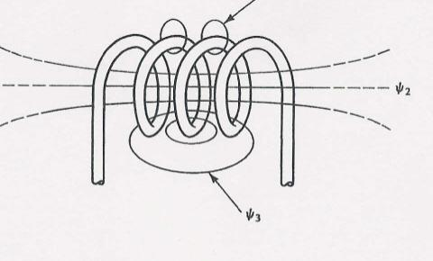
Flux linkages and Faraday’s law
Notes:
43

Slide 45
Inductance
For a linear magnetic system, that is one where
B = μ H
we can define the inductance, L, to be
the constant relating the current and the flux
linkage
λ = L i
where L has units of Henrys (H)
Notes:
44

Slide 46
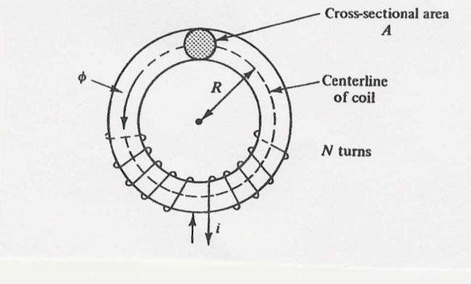
Inductance Example
Calculate the inductance of an N turn coil wound tightly on a torodial iron core that has a radius of R and a cross-sectional area of A. Assume
  all flux is within the coil
  all flux links each turn

Slide 47
Inductance Example, cont’d
Let N=100, A=
0.0006 m², R=0.03 m,
μ_{r}=1000; then L is
0.04 H;

