Slide 1
ECEN 615 Methods of Electric Power Systems Analysis
Lecture 1: Power Systems Overview
Prof. Tom Overbye
Dept. of Electrical and Computer Engineering
Texas A&M University
overbye@tamu.edu

Slide 2
Course Mechanics
In Fall 2022 ECEN 615 is offered both live on campus in ETB 1003 on Tuesdays and Thursdays from 8 to 9:15 am (central) and via distance learning (DE)
The recorded lectures are available to both on campus and DE students
All students are welcome to attend the live lectures and on campus students should
The course has a public website as well as a private Canvas website
We’ll post all material on Canvas; all should be able to login to Canvas at canvas.tamu.edu (also from lms.tamu.edu)
Slides will be available on Canvas before each lecture, with often updated slides posted after the lecture
Much of the material will be on the public website, included the ppts of the lectures, but not the recordings

Slide 3
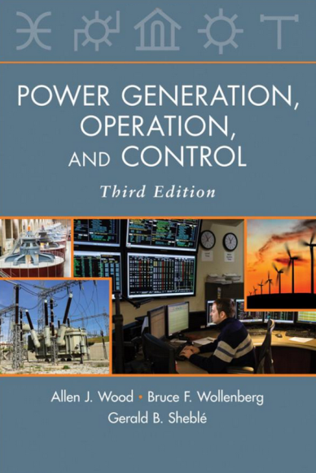
Syllabus Material
The syllabus is posted in several locations
The public website is
overbye.engr.tamu.edu/ecen-615-fall-2022/
Assumed background is an undergrad power class
The course will have homework and probably a project, as well as two in class exams
The final grade is 35% for the first exam, 35% for the second exam, and 30% for the homework and project
The almost required book is A. J. Wood, B. F.Wollenberg, G. B. Sheble, Power Generation, Operation and Control, Third Edition, Wiley, 2013, ISBN-13: 978-0471790556

Slide 4
About Me: Professional
Received BSEE, MSEE, and Ph.D. from UW-Madison
Worked for eight years as engineer for Madison Gas & Electric
Was at UIUC from 1991 to 2016, doing teaching and doing research in the area of electric power systems
Joined TAMU in January 2017; Taught many power systems classes over last 29 years
Developed commercial power system analysis package, known now as PowerWorld Simulator. This package has been sold to about 1000 different corporate entities worldwide
DOE investigator for 8/14/2003 blackout
Member US National Academy of Engineering

Slide 5
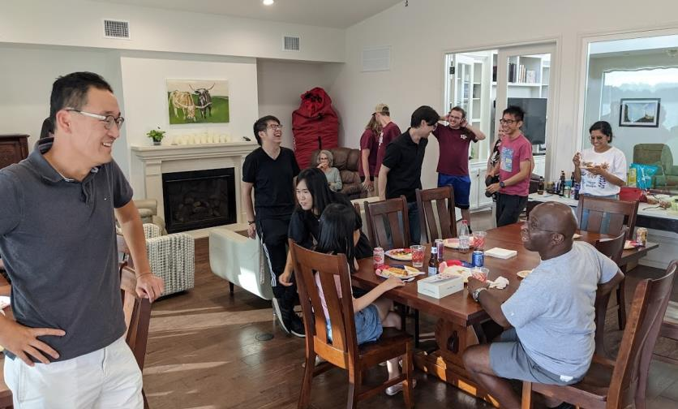
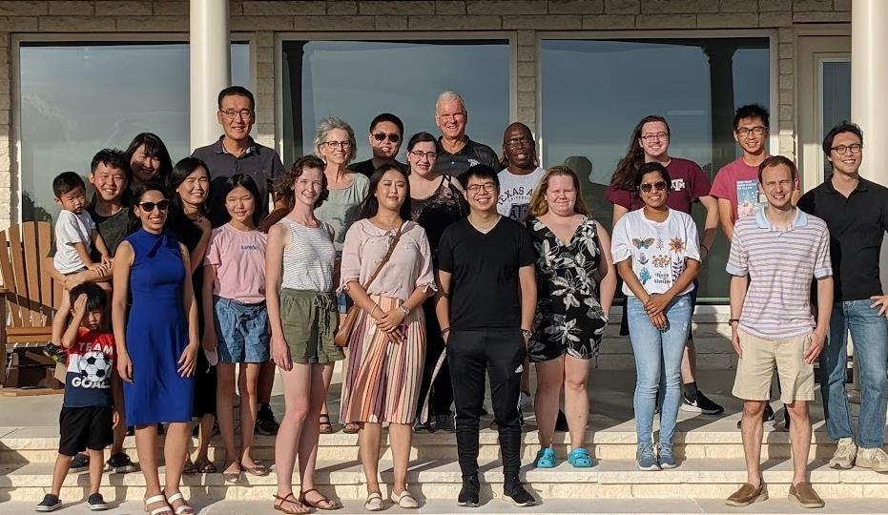
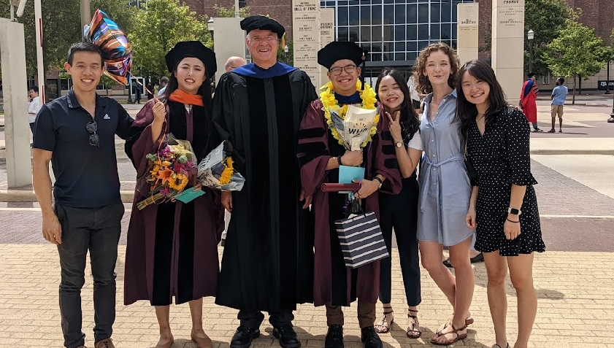
About Me: TAMU Research Group, Summer 2022

Slide 6
TAMU Energy and Power Group (EPG) Spring 2022 Dinner
All 615 students are invited to our fall event, which will be at Prof. Davis’s house on Saturday October 1 (more details will be given soon)

Slide 7
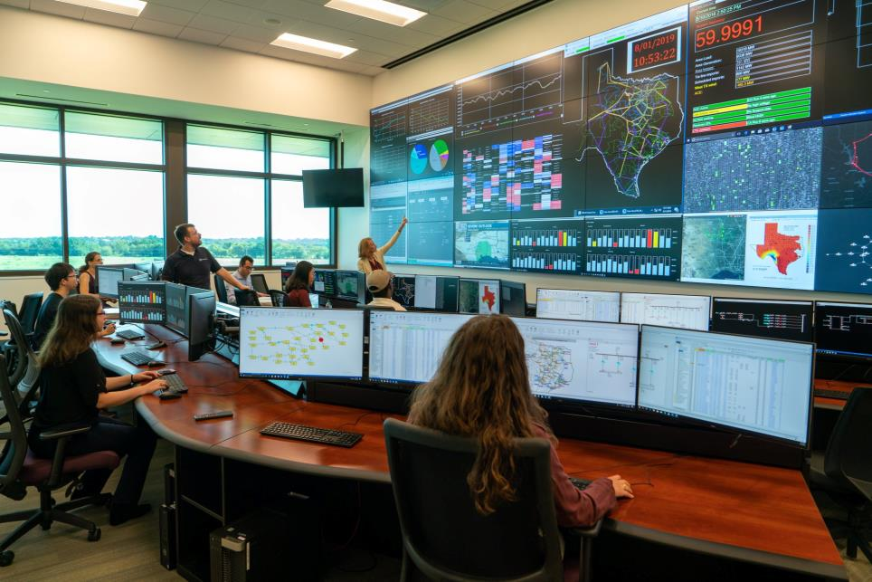
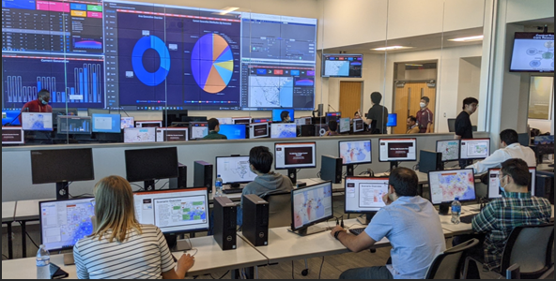
Electric Grid Control Room at CIR

Slide 8
About Me: Nonprofessional
Married to Jo; and have three children: Tim, Hannah and Amanda
We homeschooled our kids with Tim now a PhD student at TAMU, Hannah is doing a PhD at UCSB in communications (and recently got married) and Amanda just graduated from Belmont in environmental sciences
Jo is a counselor (LPC), we attend Grace Bible Church in College Station and teach 4th graders class (Creekside)
I am the faculty advisor for Christian Engineering Leaders; I also like swimming, watching football (Aggies and Packers!)

Slide 9
About TA Sanjana Kunkolienkar
Second year graduate student at TAMU
B.Tech. (Electrical Engineering, University
of Mumbai (India))
Worked at Siemens, India
Research Interests
Everything Power Systems!
Advisor: Prof. Tom Overbye
Hobbies & Interests: Reading, Writing,
Trekking and Painting
Logistics Chair, Texas Power and Energy Conference 2023 (TPEC 2023)
(contact me for volunteer opportunities or if you want to know
more about the conference!)
Austin, Texas
Some of my paintings

Slide 10
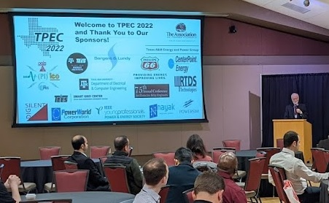
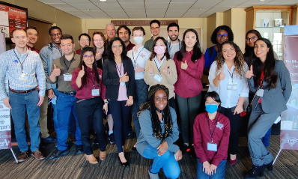
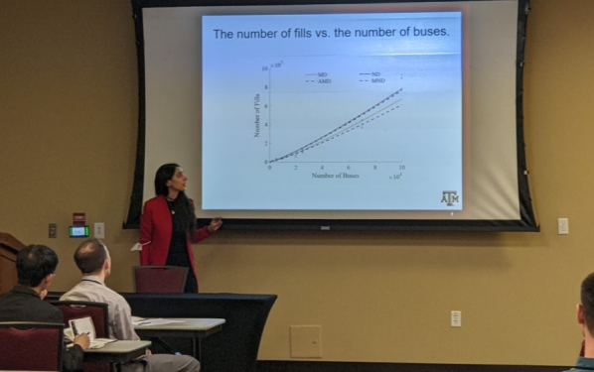
Texas Power and Energy Conference (TPEC)
Starting in 2017 we have been hosting the Texas Power and Energy Conference on campus in either February or March
TPEC 2022 was held Feb 28 to March 1 at the TAMU Memorial Student Center, with many students presenting papers
Technically co-sponsored with IEEE so papers appear in IEEE Xplore
Student run so there are LOTs of volunteer activities; tpec.engr.tamu.eud

Slide 11
Announcements
Start reading Chapters 1 to 3 from the book (mostly background material)
We’ll be using PowerWorld Simulator fairly extensively in this class, both the educational and professional versions
For now if you don’t have a version, just download the free 42 bus educational versions of PowerWorld Simulator at
https://www.powerworld.com/gloveroverbyesarma
(be sure to get version 22; we might transition to version 23 if it comes out during the semester)

Slide 12
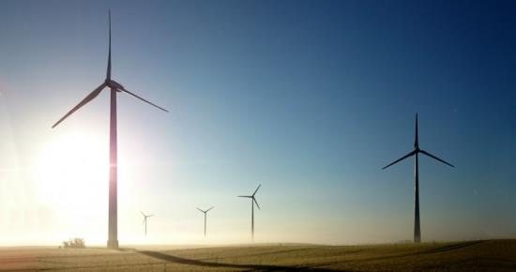
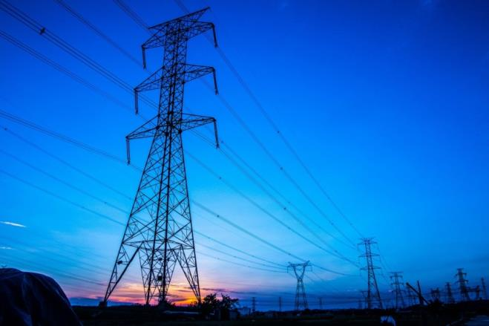
Course Topics
Introduction to Power Systems
Overview of Power System Modeling and Operation
Power Flow
Sparse Matrices in Power System Analysis
Sensitivity Analysis and Equivalents
Power System Data Analytics and Visualization
Optimal Power Flow and Power Markets
Power System State Estimation
High Impact, Low Frequency Events

Slide 13
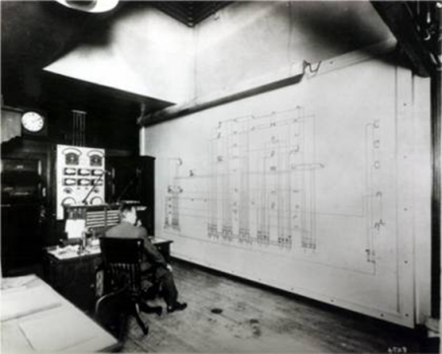
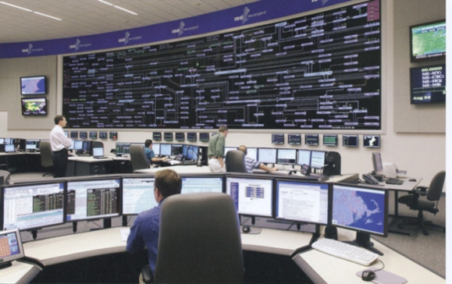
ECEN 615 Motivation: A Vision for a Long-Term Sustainable Electric Future
In 2000 the US National Academy of Engineering (NAE) named Electrification (the vast networks of electricity that power the developed world) as the top engineering technology of the 20th century
Beating automobiles (2), airplanes (3), water (4), electronics (5)
Electricity has changed the world!
For the 21th century the winner could be “Development of a sustainable and resilient electric infrastructure for the entire world”

Slide 14
Power System Examples
Electric utility: can range from quite small, such as an island, to one covering half the continent
there are four major interconnected ac power systems in North American, each operating at 60 Hz ac; 50 Hz is used in some other countries.
Microgrids can power smaller areas (like a campus) and can be optionally connected to the main grid
Airplanes and Spaceships: reduction in weight is primary consideration; frequency is 400 Hz.
Ships and submarines
Automobiles: dc 12 V standard; 360-376 V for electric
Battery operated portable systems

Slide 15
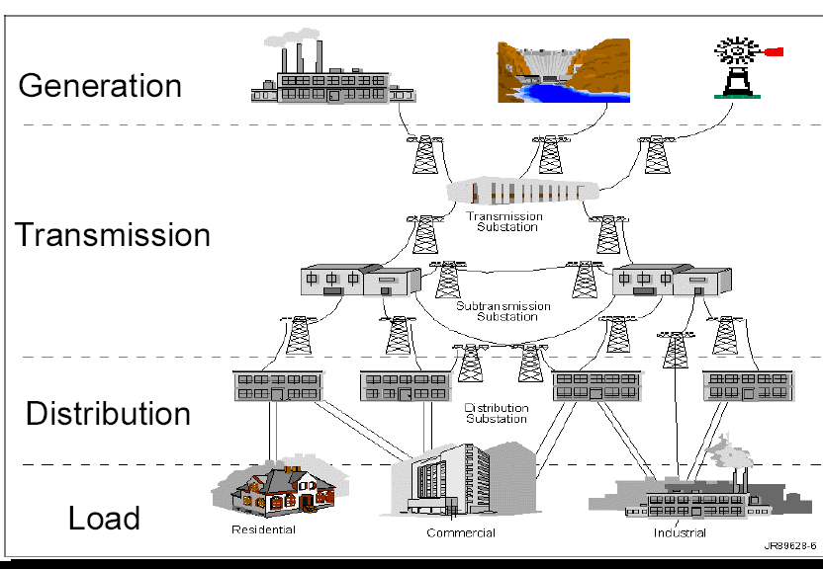
Electric Grid Overview
Generation – source of electric energy
Coal had provided over half of the U.S. electric energy, but now natural gas leads, with renewable sources rapidly growing
Load – consumes electric energy
Consumers are in complete control of the switch; utilities must supply enough power to meet load
Transmission and Distribution – the wires that carry the power from generation to load
Operating at voltages up to 765 kV (kilovolt), with 500 kV, 345 kV, 230 kV 161 kV and 138 kV common

Slide 16
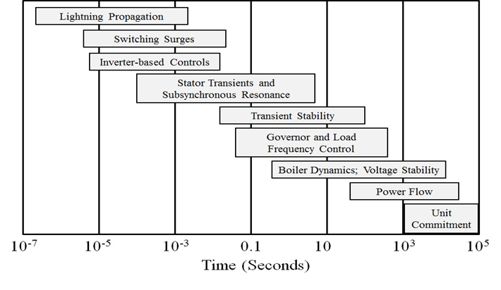
Electric Grid Time Frames
Image: Sauer, P.W., M. A. Pai, Power System Dynamics and Stability, Stripes Publishing, 2007

Slide 17
Power and Energy
Power is the instantaneous transfer of energy; expressed in watts (W), kW, MW, GW
US installed generation capacity is about 1000 GW
Energy is the integration of power over time; expressed in units of joules (J = 1 W-sec), kWh (3.6 x 10⁶ J), or btu (1055 J; 1 MBtu=0.292 MWh)
U.S. electric energy consumption is about 4100 billion kWh (about 12,500 kWh per person; 1.4 kW continuous per person on average)

Slide 18
AC System Analysis
The power grid is an ac system, operating at close to 60 Hz in North America, 50 Hz in many other places
Constant frequency ac systems are analyzed using phasor analysis, which expresses a time varying value, such as a voltage or current, as a magnitude and phase angle
v(t) = V_{max} cos(ωt + θ_{v}) → V_{rms}∠ θ_{v}
Phase angle is always with respect to an arbitrary reference angle
In 615 we’ll almost always be talking about ac systems and looking at the average power over a cycle

Slide 19
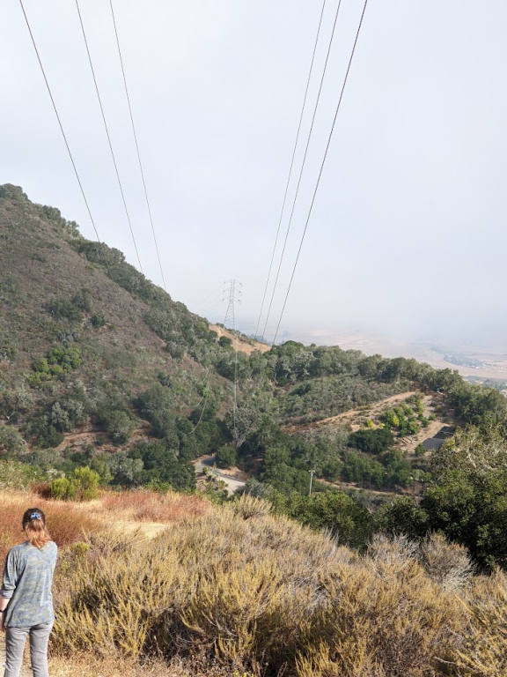
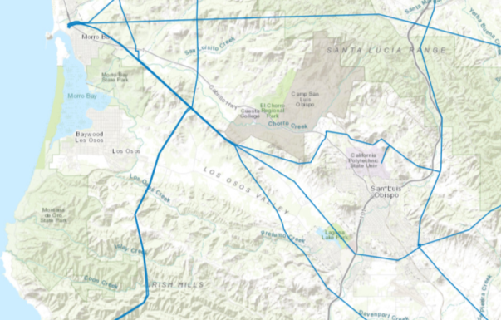
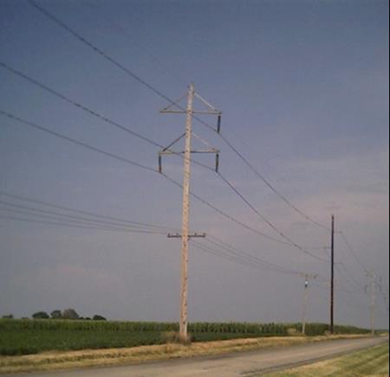
Three-Phase Systems
Essentially all large-scale electric grids are three-phase
Three wires, with the same voltage magnitude and a phase shift of 120 degrees
Usually the high voltage electric grid is “balanced,”
This means that it can be very well modeled as an equivalent single-phase system
The three-phase lines are often shown with a single line, what is known as a oneline
230 kV dual circuit
138 kV

Slide 20
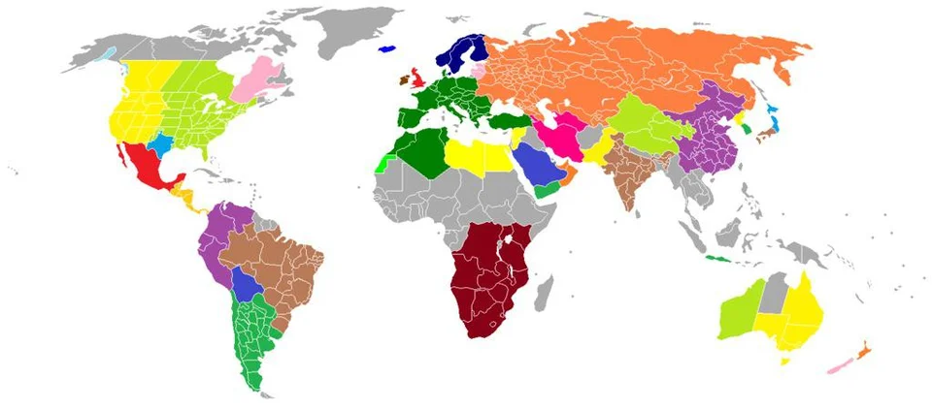
Synchronous Electric Grids
Much of the electricity in the developed world is supplied by large-scale, 60 or 50 Hz synchronous electric grids
Such grids can provide improved reliability, larger electricity markets and often economics of scale
However, they add planning complexities
Power can be transferred between synchronous grids by first converting it to dc, with HVDC lines one example
Islands, and other parts of the world are supplied by smaller electric grids
Large-Scale Electric Grid Interconnections
Image Source: i.redd.it/krkhdfslrjh61.jpg

Slide 21
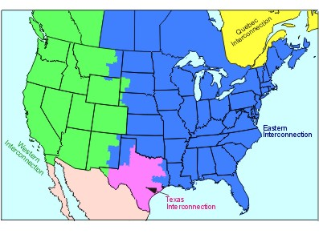
North America Interconnections

Slide 22
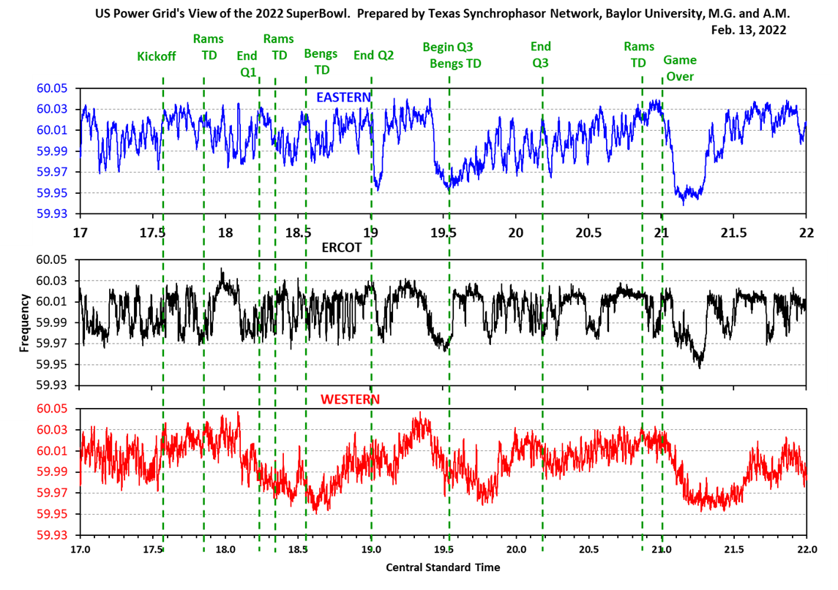
All Three US Grids Are 60 Hz, But Are Not Usually At the Same Value
Images show the frequency during the 2022 Super Bowl (2/13/22)
Image from Prof. Mack Grady of Baylor University

Slide 23
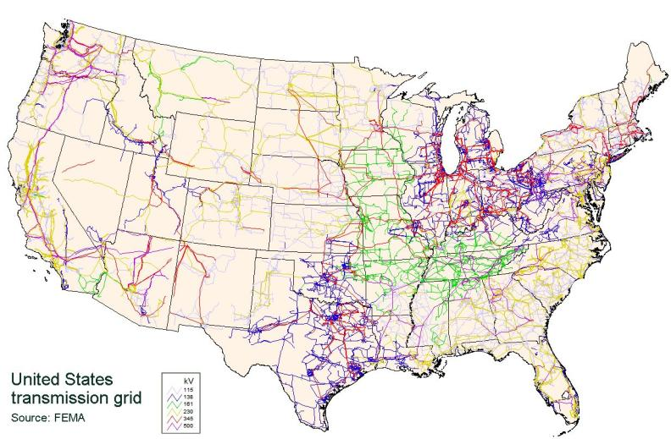
Continental US Transmission Grid
The Continental US Grid is interconnected with Canada and parts of Mexico

Slide 24
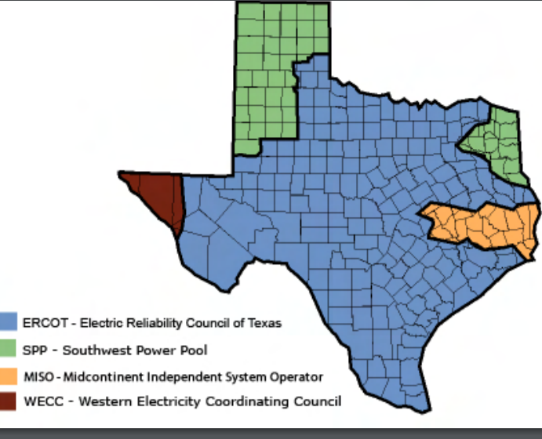
Electric Interconnections in Texas
El Paso is in the Western Interconnect (WECC) and parts of North and East Texas are in the Eastern Interconnect (EI) (with the boundaries in the image just approximate)
Lubbock Power and Light customers joined ERCOT in May 2021
Source: www.puc.texas.gov/industry/maps/maps/ERCOT.pdf

